Slide 1
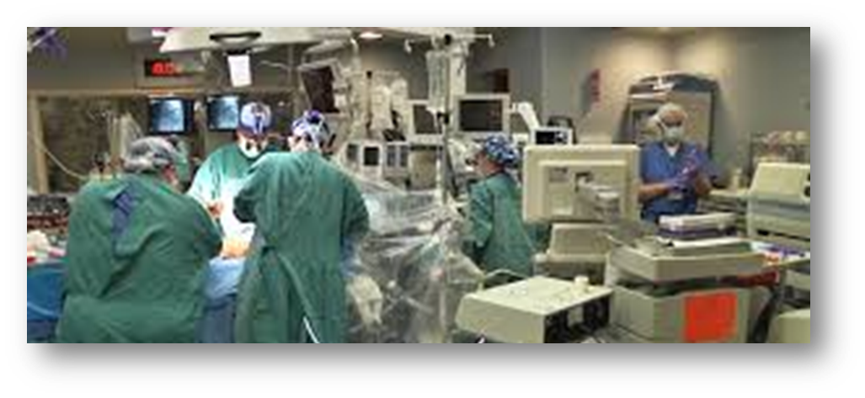
VAD Awareness In The
OR
Christyna Justice, RN BSN
VAD COORDINATOR
On-call VAD Coordinator

Slide 2
Objectives
List indications for Mechanical Circulatory Support
Identify types and function of Mechanical Circulatory Support
VAD Management in the OR setting
Understand common complications
Discuss safety checks and monitoring of patients with Mechanical Circulatory Support in procedural settings.

Slide 3
Who has Heart Failure?
Approximately 5.7 million persons in the United States have HF with the numbers increasing.
In the U.S., >650,000 new HF cases are diagnosed annually.
The lifetime risk of developing HF is 20% for Americans ≥40 years of age.
HF incidence increases with age:
  20 per 1,000 individuals 65 to 69 years of age
  >80 per 1,000 individuals >85 years of age
2013 ACCF/AHA Guideline for the Management of Heart Failure : A Report of the American College of Cardiology Foundation/American Heart Association of Practice Guidelines http://circ.ahajournals.org/content/early/2013/06/03/CIR.0b013e31829e8776.citation
Notes:
One in 5 Americans will be >65 years of age by 2050. Because HF prevalence is highest in this group, the number of Americans with HF is expected to significantly worsen in the future. Disparities in the epidemiology of HF have been identified.

Slide 4
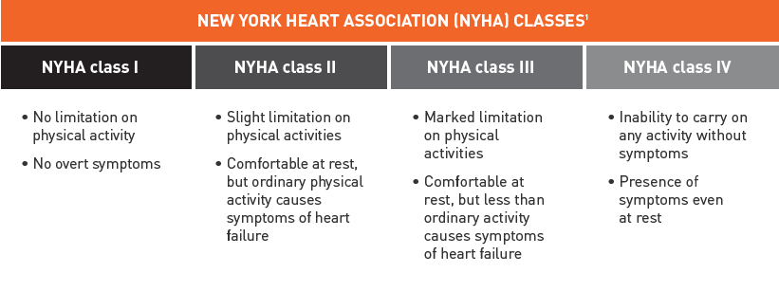

Slide 5
Indications for Use
Bridge to Transplant
  Patient is eligible & actively awaiting organ
Destination Therapy
  Unable to receive organ transplant
  Plan for life long support
Bridge to Recovery
  Reversible cardiomyopathy: acute myocarditis
  Intraoperative MI
  Failure to wean from CPB
  Goal = heart recovery and removal of mechanical support

Slide 6
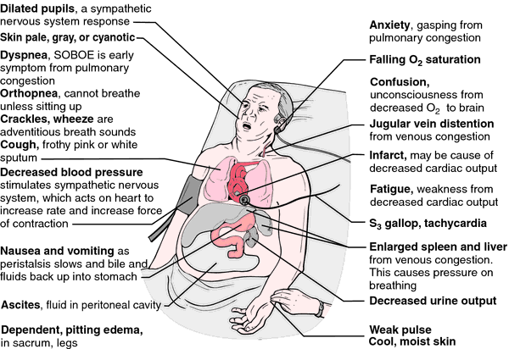
Heart Failure symptoms
http://medical-dictionary.thefreedictionary.com/heart+failure

Slide 7
Triggers for VAD Implantation
Low Cardiac Output (CI <2)
High filling pressures
Maximal inotropic support with or without IABP support
Declining renal and/or hepatic function
O Blood type or body size that predicts a long wait time for transplant
Intractable arrhythmias

Slide 8
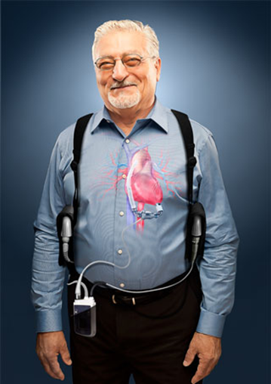
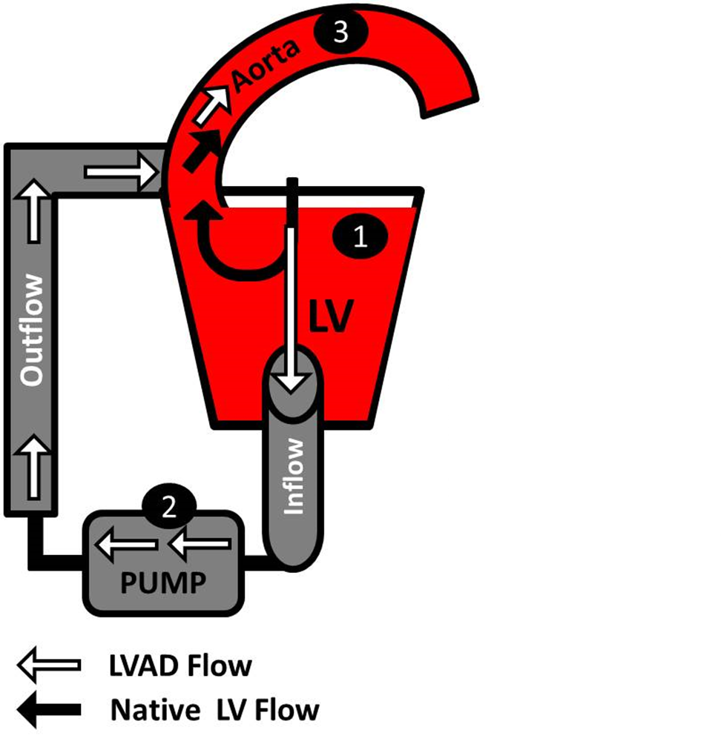
What is a VAD?
Ventricular assist device (VAD) is a continuous flow mechanical pump.
When one of the heart’s natural pumps (a ventricle) does not perform well, a VAD is used to increase the amount of blood that flows through the body.
Having a VAD implant allows most people with advanced heart failure to return to a fuller life.
Notes:
The HVAD Pump is surgically implanted in the chest, in a sac around the heart known as the pericardial space. The small size of the pump allows it to be implanted using a smaller incision than required with older VAD technologies.
The HVAD Pump is connected directly to your heart at the bottom of the left ventricle, where it draws oxygen-rich blood through the pump and pushes it into your aorta. Once blood reaches the aorta, it can flow to the rest of the body.
Despite the compact size of the HVAD Pump, it can pump enough blood every minute to decrease heart failure symptoms. Your doctor will program the HVAD Pump so it delivers the right amount of flow for your body’s needs.
The driveline is connected to the pump. The driveline exits the body through a small incision in the skin, and connects to the controller.

Slide 9
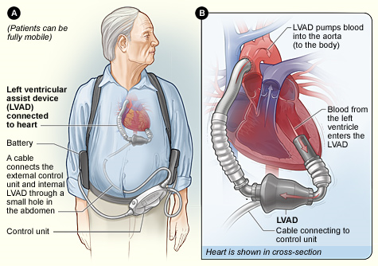
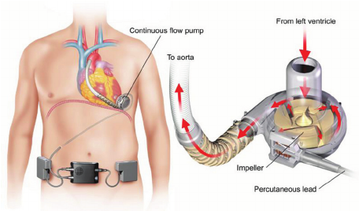
How a VAD works

Slide 10
Assessment Changes
Patient may NOT have a palpable pulse.
Patient may not have a “normal” blood pressure.
  Obtain with Doppler.
Patient still has native heart…will have EKG rhythm.

Slide 11
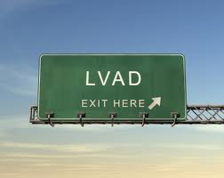
Why not directly transplant
Long wait
Increased demand
Limited donor hearts
Or patient NOT a transplant candidate.

Slide 12
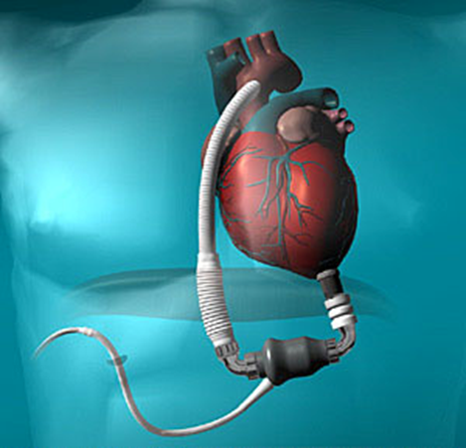
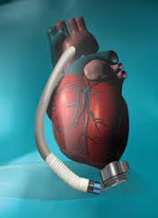
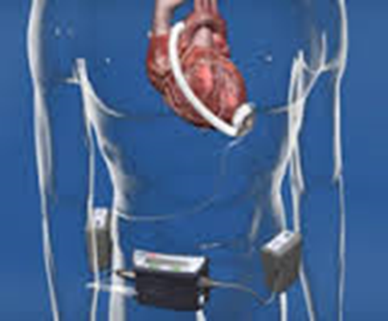
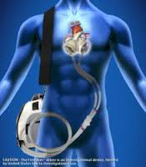
Devices available at VCU Medical Center
HMII
HMIII
HVAD
TAH

Slide 13
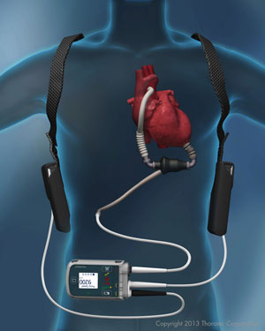
Why a Heartmate ii?
Class IV Heart Failure
Left Ventricular Failure
In need of a Heart Transplant or for Destination Therapy
HeartMate II was FDA approved in 2008 as a bridge to transplant and 2010 as destination therapy.

Slide 14

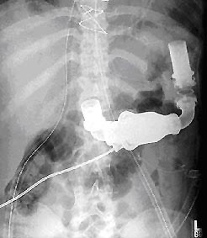
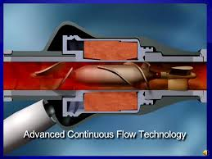
Heartmate II https://www.youtube.com/watch?v=YBxDhUzSrsk

Slide 15
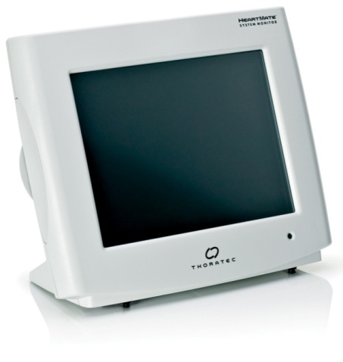
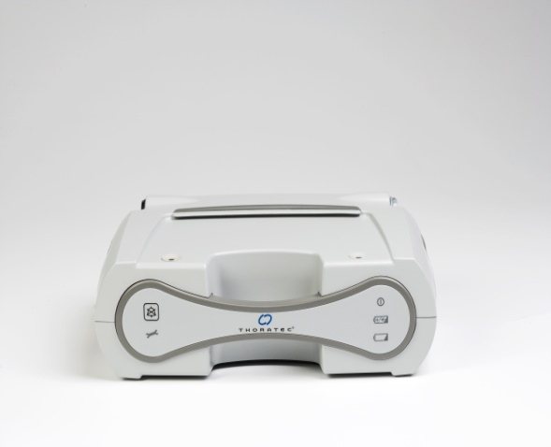
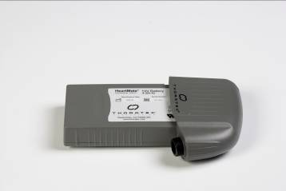
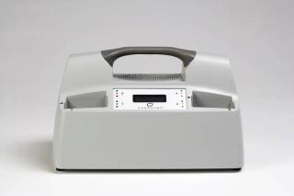
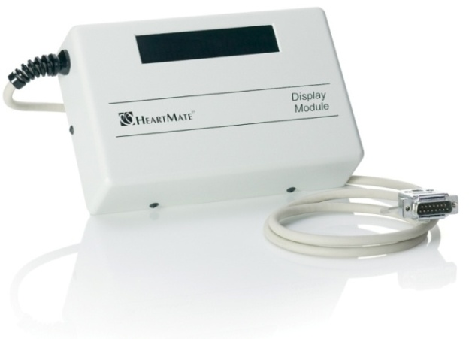
Components
Power Module
Patient Cable
Battery Charger
Batteries and clips
System Monitor (inpatient use)
Display Module (home with the patient if using EPC controller)

Slide 16
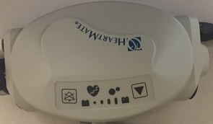
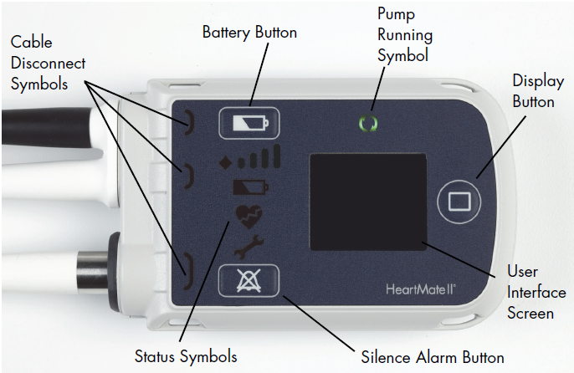
Controllers
HMII EPC System Controller
(‘old’ controller)
HMII Pocket controller

Slide 17
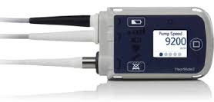
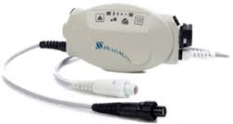
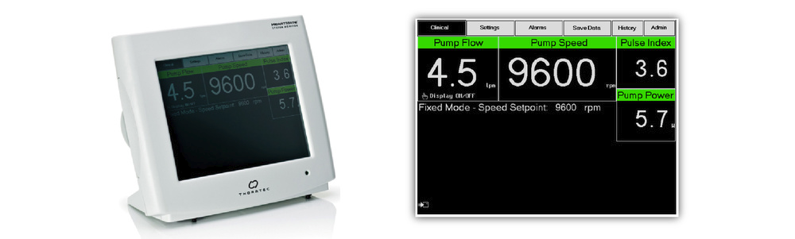
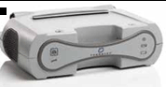
Viewing VAD parameters - HeartMate II/III
Display button
- Continue to press this button to scroll through 5 screens to acquire parameters for HM
1. Speed (rpm)
2. Flow (L/min)
3. PI (Pulse Index)
4. Power (W)
5. Last screen will state “backup battery charged”
Important: there are NOT ‘normal values’ for these parameters… trend the patient’s ‘normal’ values.
If there is a deviation +/- 2.0 for power or flow, CALL the Attending provider.

Slide 18
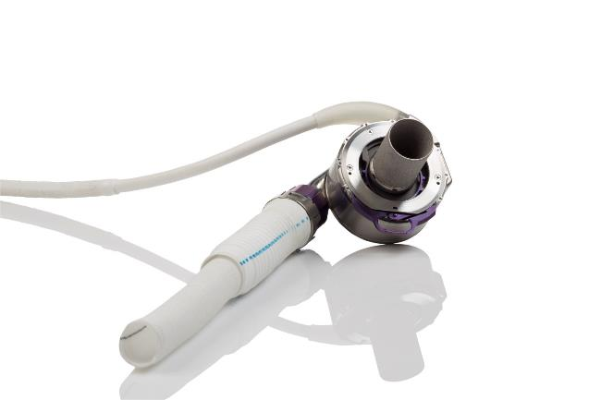
Why Heartmate III
Class IV Heart Failure
Left Ventricular Failure
In need of a Heart Transplant or for Destination Therapy
Now approved for short and long term use

Slide 19
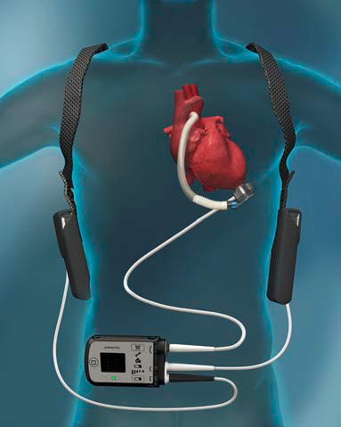
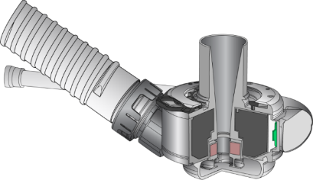
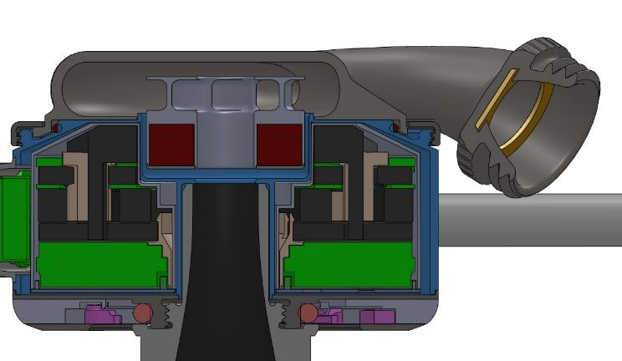
Heartmate III
Shroud Recirculation
Main
Flow
Inlet Recirculation

Slide 20
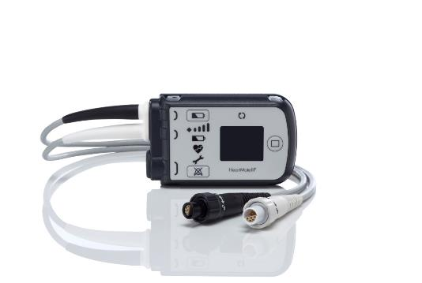
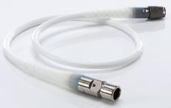
Controller

Slide 21



Lights and alarms
Green
Yellow
Red
Each Alarm indicated by:
    Visual Light
    Audible Alarm
    Display Message
Do not ignore Alarms
The issue that caused the alarm must be immediately addressed

Slide 22
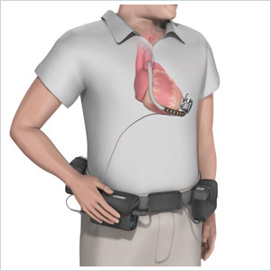
Why a HVAD?
Class IV Heart Failure
Left Ventricular Failure
In need of a Heart Transplant
HeartWare was FDA approved in 2012 as a bridge to transplant and approval in 2017 as destination therapy.

Slide 23
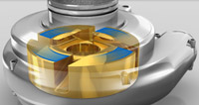
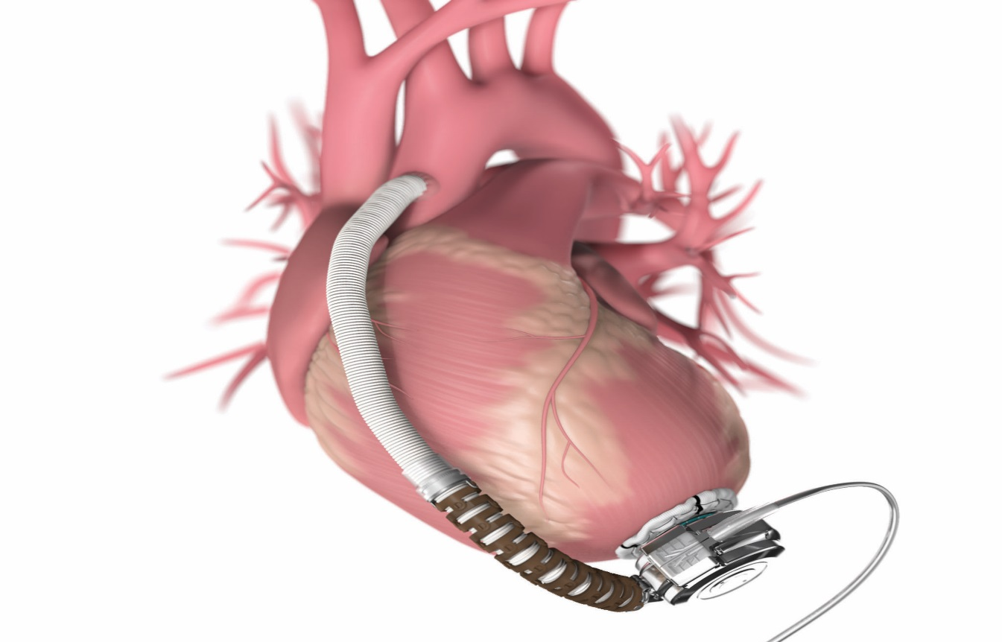
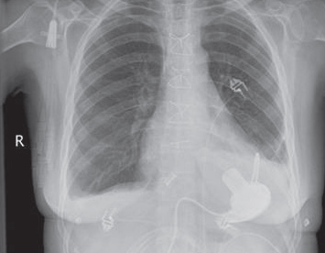
HVAD
https://www.youtube.com/watch?v=v8aIeoHXTMw

Slide 24
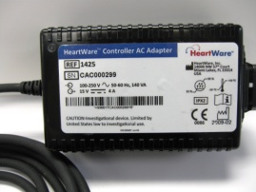
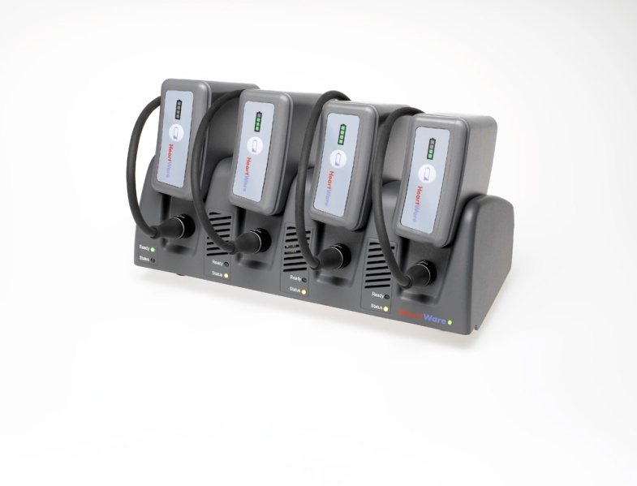
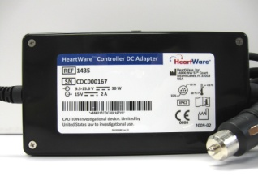

Components
HeartWare® Controller
AC Adapter
HeartWare® Battery Charger
and Batteries
HeartWare® Controller
DC Adapter

Slide 25
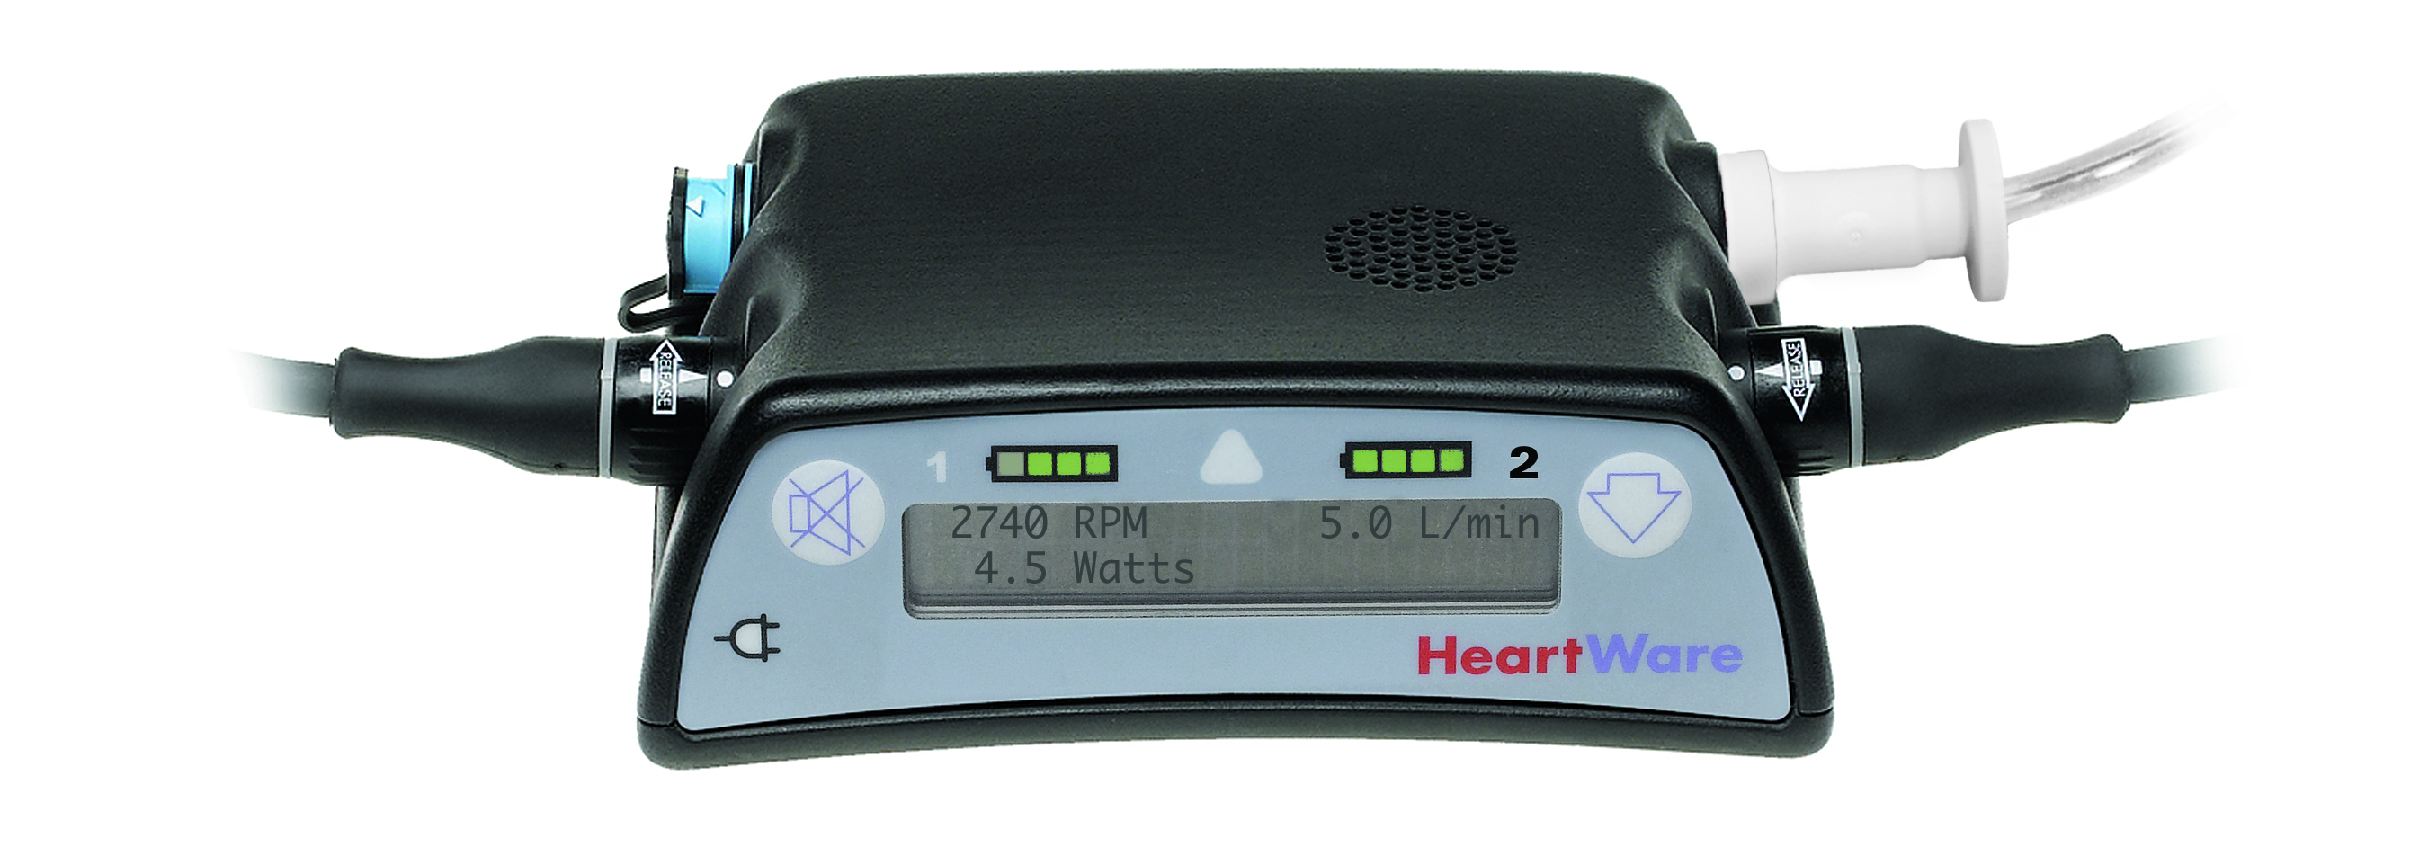

Controller
Battery Indicator 2
Battery Indicator 1
Alarm Indicator
Power Source 2
Power Source 1
Alarm
Mute Button
Controller Display
AC/DC Indicator
Scroll Button

Slide 26

Viewing VAD parameters – HeartWare VAD
Flow (L/min):
calculated using VAD power, speed parameters, and hematocrit setting.
Will change with hemodynamic changes
Speed (RPM):
Set revolutions per minute, should not fluctuate.
(If change is noted, contact provider)
Power (watts):
- Amount of power consumption of the pump to push blood flow through pump.
What to Chart/trend:
Speed
Flow
Power
Important to monitor the patient for clinical changes:
BP
Cardiac arrhythmias
Bleeding
Important: there are NOT ‘normal values’ for these parameters… trend the patient’s ‘normal’ values.
If there is a deviation +/- 2.0 for power or flow, CALL the Attending provider.

Slide 27
Lights and alarms
Green
Yellow
Red
Each Alarm indicated by:
    Visual Light
    Audible Alarm
    Display Message
Do not ignore Alarms
The issue that caused the alarm must be immediately addressed

Slide 28
Assessment & Management in the OR

Slide 29
Assessment for LVADs
  Vitals: All VAD patients should have a doppler and dynamap blood pressure (at least attempted)
  Driveline
    Site should be CDI. Dressing needs to be intact.
    Should not be any tears or kinks in the driveline or cords
  Cardiovascular focused: remembering these patients still have Heart Failure
  May or may not have a palpable pulse
  Monitor for alarms/alerts
  Should hear the hum of the LVAD if you listen to the patient’s chest
    Should not be any high pitched sounds or grinding sounds- ALL 3 VADs sound different.

Slide 30
Monitoring/Assessment of VAD patients
Vitals:
  Patients may NOT have a palpable pulse
  SpO2 can be acquired but may be difficult
  Can acquire HR by listening to apical pulse or EKG.
  BP obtained with Doppler (see video) – normal = 60-90
Be aware of driveline site (with dressing) and equipment connections – ensure nothing is pulled
Assessment – Cardiovascular focused, patients do have Heart Failure.
  Can listen to chest – will hear the hum of the VAD
EKG can be obtained
  (may show artifact related to VAD interference)
Can follow ACLS protocol
  DO NOT detach any equipment.
  CAN perform Chest compressions
  CAN give drugs
  CAN defibrillate if patient unstable,
  sedate prior to defibrillation if patient is stable and talking
  CAN intubate

Slide 31
Assessment Considerations
Because the pump is continuous flow, it may be difficult to detect pulsatility in the extremities.
What does this mean to us?
  Pulse may not be palpable
  Blood pressure may not be measurable by usual means, electronic cuff
  Pulse oximeter may not read accurately
  Pulse and blood pressure can be measured using doppler
  Doppler BP is similar to mean BP, goal 70-90
  These patients have narrow pulse pressure,
  doppler BP cuff/ ALIne best measurement

Slide 32
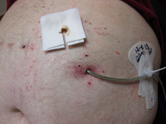
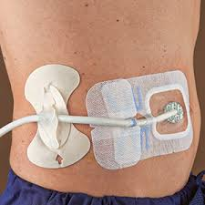
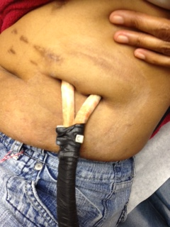
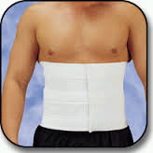
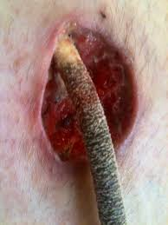
driveline

Slide 33
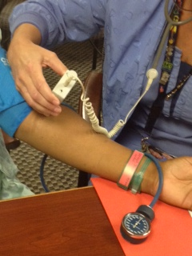
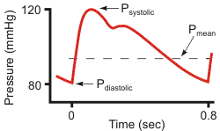
Doppler Blood pressure
This is not a MAP
Checked with a manual cuff and Doppler
Normal is 70-90
MAP= DP + 1/3 (SP- DP)
MAP is the average BP during a single cardiac cycle
MAP > 60 needed to perfuse major organs
Notes:
HeartWare >85
Greator than 110 stop PT

Slide 34
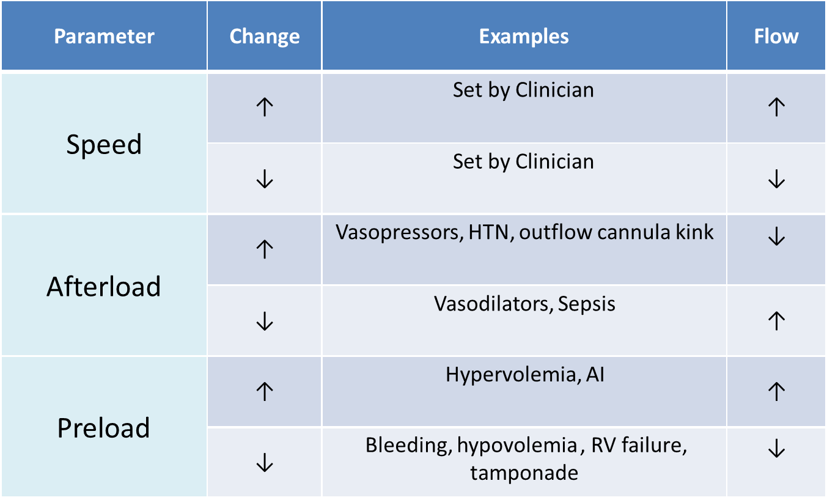
Physiological changes to affect FLOW

Slide 35
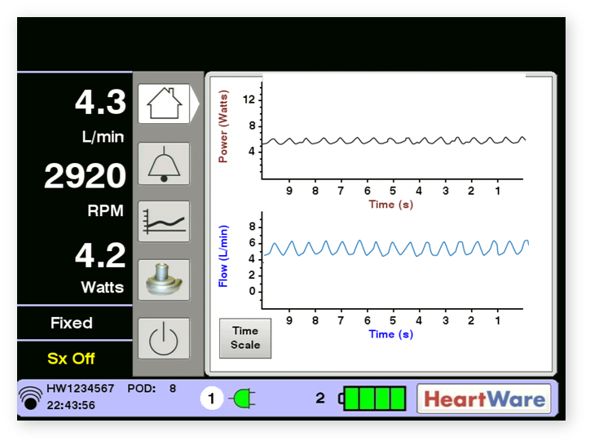
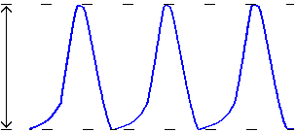
Pulsatility
– represents cardiac pulsatility – related to the amount of assistance provided by the pump.
  Higher values = more ventricular filling (i.e. pump providing less support to LV)
  Lower values = less ventricular filling
Heartmate pulsatility = PI (on controller or monitor)
Heartware pulsatility can only be obtained on Clinical monitor
Heart rate
Beginning of diastole
Pulsatility
Waveform Trough
Beginning of systole

Slide 36

Physiological changes to effect Pulsatility

Slide 37

VAD ASSESSMENT
•S sepsis or sedation
•H hypertension
•A arrhythmias
•B bleeding
•D dehydration
•O overdrive, occlusion
•R right heart failure
•C clot

Slide 38

Clinical Screen

Slide 39


Slide 40




Slide 41


Mechanical Circulatory Support Devices
 | HeartMate II / HeartWare (HVAD) | Freedom Driver Total Artificial Heart
Native Heart in place | Yes | No – fully mechanical
Heart rhythm | Yes | No
Perform EKG | Yes | No
Blood Pressure | May or may not have BP using automated or manual cuff. Use Doppler to obtain Doppler BP (similar to MAP but without invasive monitoring) HeartMate II goal 70-90 Heart Ware goal 70-85 | Yes Goal: systolic <130 mmHg Pts have protocol for PRN home use of Nitroglycerin SL or hydralazine by mouth at home for elevated SBP
Pulse | May NOT have a pulse due to continuous flow device | Yes – rate usually 120-130 bpm Can view rate on device
Sounds | Can hear pump hum with stethoscope | Can hear mechanical heart valves click externally
CPR Code Drugs | Yes - including chest compressions May defibrillate/cardiovert with device in place Yes | No No – May worsen condition
Batteries | Pair lasts 10-12 hours / Lasts 4-6 hours Rechargeable Rechargeable | Pair lasts 2 hours Rechargeable
VAD coordinator 804-828-0951 Pager #9058

Slide 42
Common Complications

Slide 43
GI Bleeding

Slide 44









Slide 45



Pump Thrombosis

Slide 46



INFECTION
Driveline May 2012
Driveline June 2012
1 week post driveline revision

Slide 47

Questions?
Thank you!

