Slide 1
John C Lundell, MD
Anesthesiologist and Expert Witness
US Anesthesia Partners
Clinical Associate Professor of Anesthesiology
UT Southwestern Medical Center

Slide 2
Background
1994 Yale University School of Medicine, MD
1998 Wake Forest University, Anesthesia Residency
1999 Wake Forest Univ, Cardiac Anesthesia Fellowship
1999-2004 US Air Force Service
2004-2005UCSD Assoc Clinical Prof Anesthesiology
2005 Arrive in Dallas!

Slide 3
They don’t pay us to put people to sleep, they pay us to wake them up again!
--P. J. McElhone, MD

Slide 4
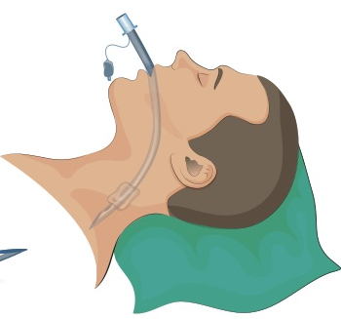
Anesthetic Emergence

Slide 5
Anesthetic Emergence
Learning Objectives
Hypothermia & Shivering—Causes and Treatment
Muscle Relaxation & Reversal—Incomplete Reversal
Stages of Anesthesia—Timing of Extubation
Analgesia & Emergence—The 3 Kinds of Wake Up
Special Precautions with Emergence & Extubation

Slide 6
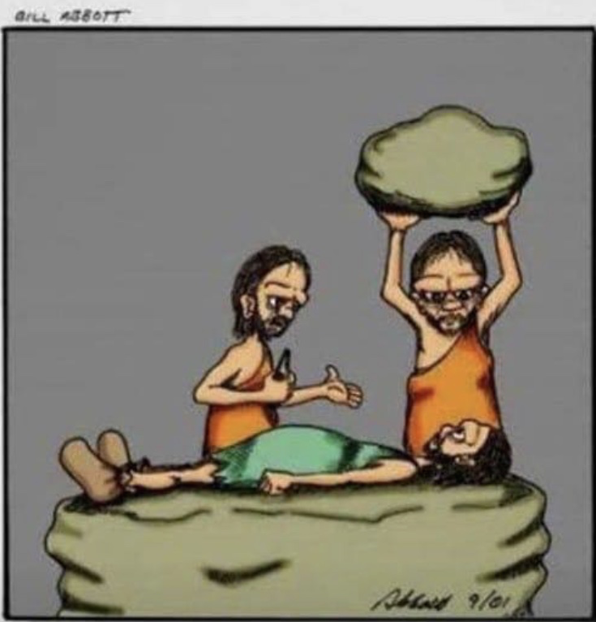
your anesthesiologist.
…and this
is Ralph,

Slide 7
Where Does Emergence Occur?
OR
ICU
PACU

Slide 8
Emergence in PACU
OMG the patient is still intubated!
Keep Calm and Breathe
  Some PACUs hyperventilate if I bring an intubated pt
  To be fair, it can be a staffing issue if left intubated
Breathe for the patient (if needed)
No Big Deal
ICU extubation—meet criteria
OR extubation—simplified criteria

Slide 9
Simple Extubation Criteria
Warm enough to not shiver
Strong enough to maintain their airway
Awake enough to protect their airway
Comfortable enough to cooperate
Prepped enough to succeed

Slide 10
Simple Extubation Criteria
Warm
Strong
Awake
Comfortable
Prepped

Slide 11
Simple Extubation Criteria
Warm
Strong
Awake
Comfortable
Prepped

Slide 12
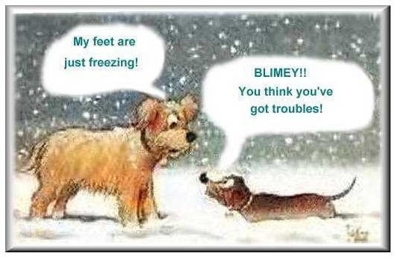

Slide 13
Warm Enough not to shiver
Shivering = Hypothermia
  Generates heat by making muscles work
Hypothermia is bad
  More prone to wound infection
  Slows drug metabolism
    Longer post anesthetic recovery
  More post op shivering
    Cardiac events (myocardial O2 demand)--MI

Slide 14
Warm Enough not to shiver
Prevention is Better than Treatment
  OR temperature
    Warm until draping
    Warm when undraping
  Bair Huggers
    Claim your territory
    Upper Bair warms patients
    Lower Bair warms leg squeezers
    Lower Bair past umbilicus works

Slide 15
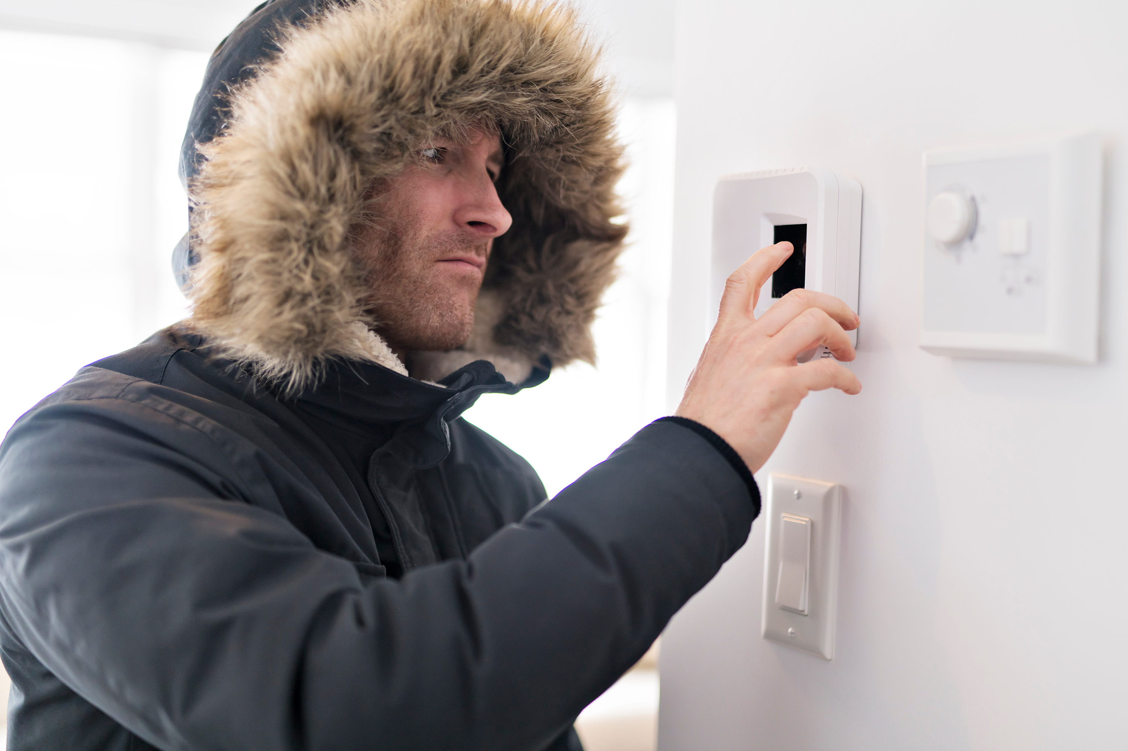
Stealthily Adjust Thermostat

Slide 16
Hypothermia Mechanism
Vasodilation + Cold Environment = Hypothermia
  Vasodilation
    Caused by general or spinal anesthesia
    Shifts warm blood from core → periphery
  Cold Environment
    Cools the warm blood arriving to periphery
    Sends cooled blood to hypothalamus, triggers shivering

Slide 17
Shivering Treatment
Patients may not complain of being cold
  Skin may feel subjectively warmer
  Cold core blood is registered by hypothalamus
Warm the patient with a Bair Hugger
Reset hypothalamic thermostat
Rx: Ketamine, Tramadol, Zofran, Precedex,
Demerol

Slide 18
Simple Extubation Criteria
Warm
Strong
Awake
Comfortable
Prepped

Slide 19
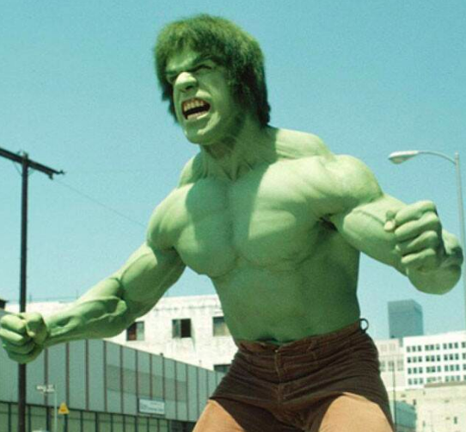

Slide 20

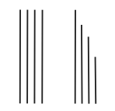
Strong Enough
Rocuronium T ½ = 60-70 min. > 3 hr no reversal.
Reverse If < 2 hr (must have ≥ 2 twitches to reverse).
2-3 hours check for 5 second sustained tetany
Train of Four (TOF)
Sustained Tetany
T4/T1 = 1 T4/T1 = 0.5
Contraction Fades

Slide 21
Double Burst Stimulation
Hard to compare small decreases in T4 vs. T1
Small decreases TOF can still mean weak patients
Tetany is very painful unless patient very asleep
Two 50 Hz bursts
Separated by 0.75 sec
Easier to compare than TOF
More accurate and sensitive than TOF
Less painful than Tetany

Slide 22
Why 2 Twitches to Reverse?
Reversal depends on Competitive Inhibition:
Rocuronium (Roc) vs. Acetylcholine (ACh)
Compete to bind Neuromuscular Junction
Like team musical chairs
  If Roc gets almost all chairs, patient is profoundly weak
  If Ach gets almost all chairs, patient is strong
  Anywhere in between, patient is not Strong Enough
Reversal only adds ACh, does not remove Roc

Slide 23
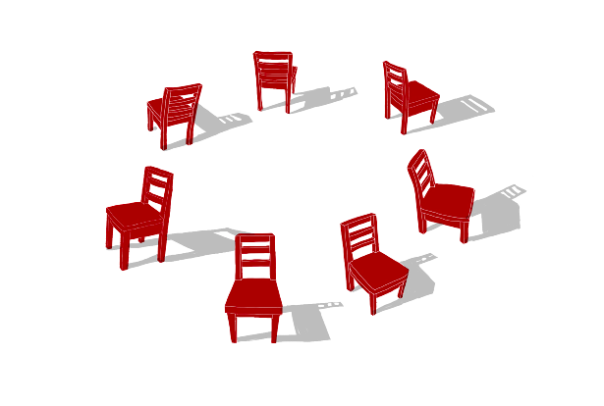
Team Musical Chairs
Profound Blockade
7 Chairs
= Rocuronium (8)
= Acetylcholine (2)

Slide 24
Team Musical Chairs
Moderate Blockade
7 Chairs
= Rocuronium (5)
= Acetylcholine (15)

Slide 25
Team Musical Chairs
Fully Reversed
= Rocuronium (5)
= Acetylcholine (52)

Slide 26
Strong Enough to maintain their airway
First muscle to recover from Roc is the Diaphragm
Patient may start breathing
Patient may even breathe adequately
But airway muscles are weak--like sleep apnea
Extubation in this state → “Fish out of water”

Slide 27
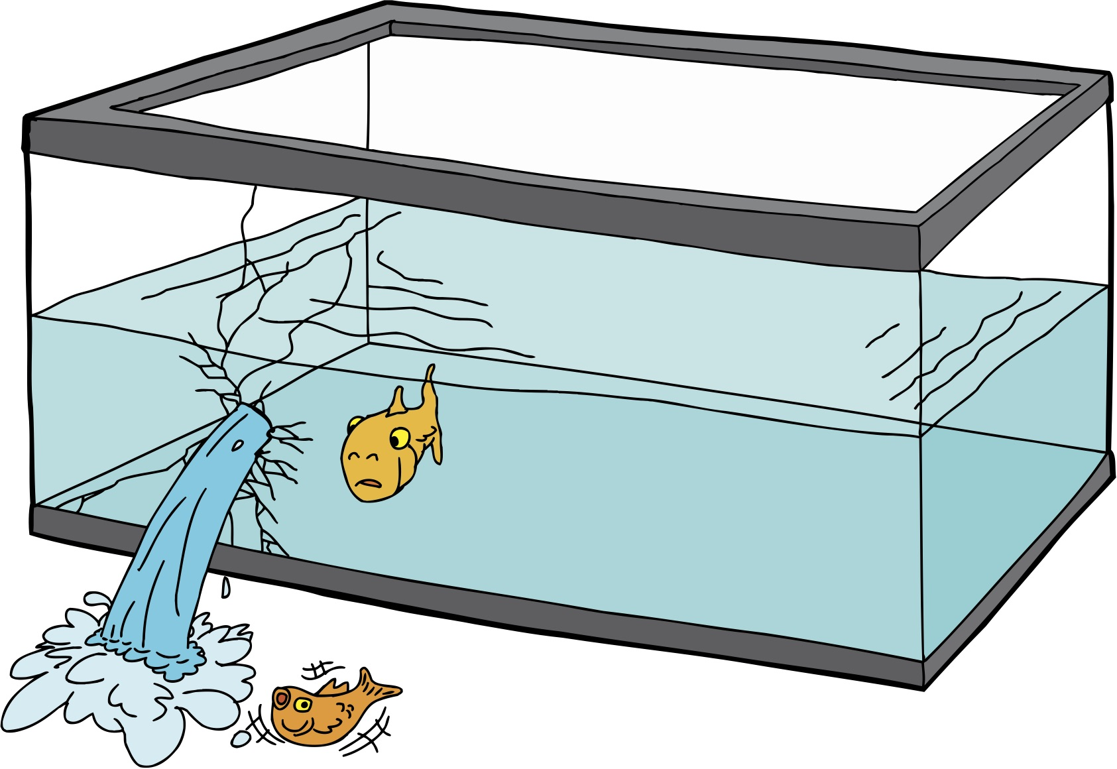
Residual Paralytic:
Fish Out of Water

Slide 28
Residual Paralytic
Diaphragm moves well, Airway muscles are weak
ETT stents airway open
Without ETT airway collapses
Patients struggle to breathe just like:
A FISH OUT OF WATER
Assist Ventilation, Give reversal
Verify Reversal—5 sec tetany (ouch!) or 5 sec head lift

Slide 29
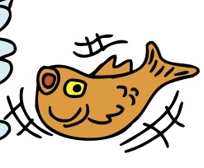
Obese patient with Sleep Apnea
3 of 4 Twitches
Reversed, Extubated
SpO2 not maintained
BiPAP but looked weak
Failed head lift
Infiltrated IV
New IV, Reversal given—much better
“Trust, but verify”

Slide 30
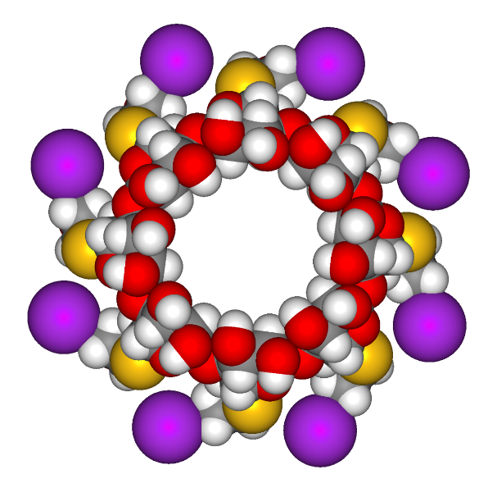
Sugammadex
ϒ-Cyclodextrin
Lipophilic Core
Hydrophilic Periphery
Binds ROC and VEC
Roc

Slide 31
Sugammadex
Does not increase ACh, removes Roc
Can reverse Roc almost immediately instead of waiting to get to 2-3 twitches
Can replace traditional (Neostigmine) reversal
Can supplement inadequate or premature reversal
Works like magic even on profound blockade
$$$, but fewer side effects (bradycardia)

Slide 32
Simple Extubation Criteria
Warm
Strong
Awake
Comfortable
Prepped

Slide 33
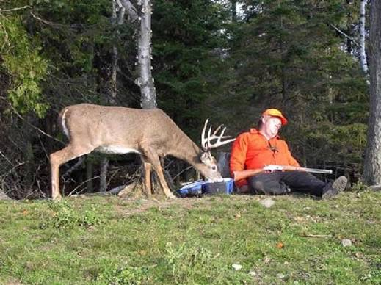

Slide 34
Awake Enough to protect their airway
Stages of General Anesthesia (or Alcohol)
Originally seen Ether Inhalational Induction
  1-Analgesia Not seen with IV induction
  2-Excitement Not seen with IV induction
  3-Surgical Anesthesia Goal for Anesthesia
  4-Respiratory Arrest Anesthesia s vigilance = DOA

Slide 35

Stage 1 Anesthesia (ETOH):
Analgesia “Feeling no Pain”
Seen after premedication
Goal of Sedation
Patient can cooperate but probably rather just sleep
Patients can protect airway
Not seen with IV induction (too fleeting)
Safe to extubate, or to just chill in PACU

Slide 36
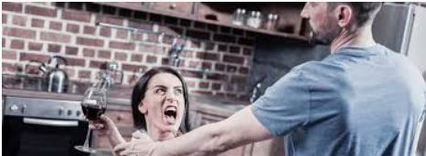
Stage 2: Excited/Aggressive
“10 feet tall and bulletproof”
Seen with emergence, but not IV induction—too fleeting
“Conscious sedation”→Awaken or General Anesthesia
Dangerous: airway reflexes dysfunctional, aspiration risk
Laryngospasm risk → severe desaturation

Slide 37
Stage 3: Surgical Anesthesia
“Out Cold”
IV induction goes from awake to stage 3
Lid Lash reflex disappears
Airway reflexes disappear
Safe for LMA insertion
Still will cough with intubation
Still Breathing

Slide 38
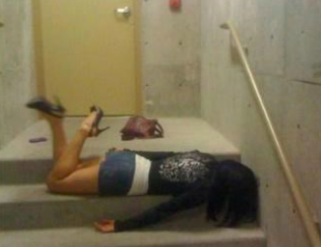
Stage 3: Out Cold

Slide 39
Recognizing Stage 2 during emergence
Swallowing or “Tonguing” the ETT
Disconjugate gaze
Irregular respirations
Cough/breath hold easily
Unresponsive to gentle tap on forehead
How to proceed? Wait. (See “Three Wake Ups”)

Slide 40
Simple Extubation Criteria
Warm
Strong
Awake
Comfortable
Prepped

Slide 41
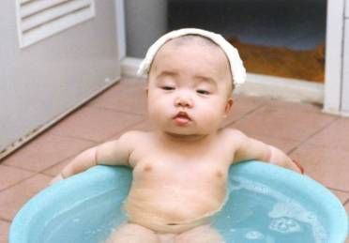

Slide 42
Comfortable Enough to cooperate
Uncomfortable = uncooperative
  Rule out hypoxia
  Consider full bladder, pain, nausea
Comfortable emergence: GETA plus block
  TAP, Interscalene, Adductor Canal, etc.
General plus multimodal analgesia
  Tylenol, NSAIDS, Ketamine, Precedex, Gabapentin
Three Wake Ups—Find the Smooth Wake Up

Slide 43
The Three Wake Ups
The Smoker Wake Up
  Cough, breath hold, wheeze, desaturate
    LTA, IV Lidocaine, Deep Extubation
The Teenage Wake Up
  Sudden, violent, disoriented, strong
    Ready for quick extubation or resedation
The Narcotic Wake Up
  Gentle tap → open eyes, extubate

Slide 44
The Narcotic Wake Up
Get patient reversed, breathing near end of case
Titrate narcotic to respiratory rate around 12
  As Sevoflurane wanes, more analgesia needed
Gently tap forehead and say patient’s first name
  Do not otherwise stimulate
If they open their eyes, say “Open your mouth”
  Suction and extubate simultaneously
Wait 1 minute, try again.
Repeat until successful

Slide 45
Simple Extubation Criteria
Warm
Strong
Awake
Comfortable
Prepped

Slide 46


Slide 47
Prepped Enough to succeed
Special Considerations
  Bad Teeth—soft bite block, AWAKE extubation
  Swollen airway—Leak test
  OSA/Obesity –Sitting, CPAP ready
  Difficult intubation—Extubation Plan
    The more difficult to intubate, the more important the plan.
    Have equipment ready, backup plan ready
    Extubate tomorrow
  Asthma—LTA on intubation, IV Lidocaine at end, bronchodilator in OR, Nebs in PACU, Deep extubation

Slide 48
Deep Extubation
Used for severe asthma or to avoid coughing
Backwards—extubation, then emergence
Steps
  Reverse, get patient breathing spontaneously
  Increase Sevoflurane deeper than for surgery
  Test for readiness—Jiggle ETT
    If no coughing/breath holding = ready
  Oral/Nasal airway, Suction, Extubate
  Don’t stimulate them after extubation
    Still have to go through stage 2

Slide 49
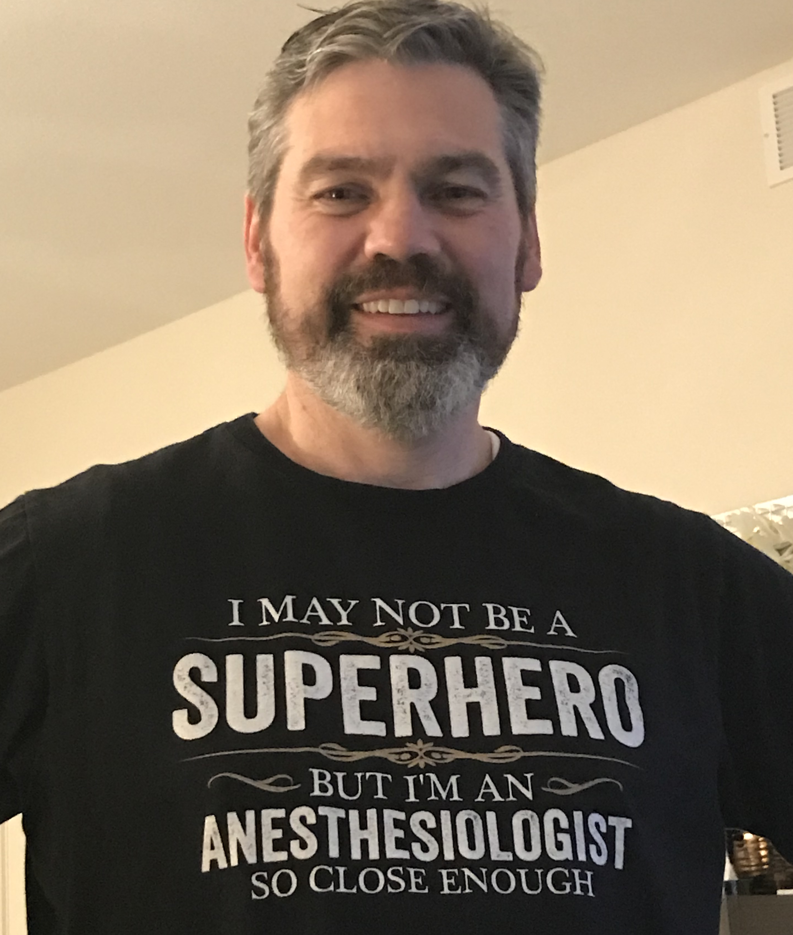

Slide 50

Questions?

Slide 51
If you liked the lecture, look for the book it came from:
Anesthesia Basics for Perioperative Nurses by John C. Lundell, MD
Available for pre order on Amazon as paperback and eBook

