Slide 1


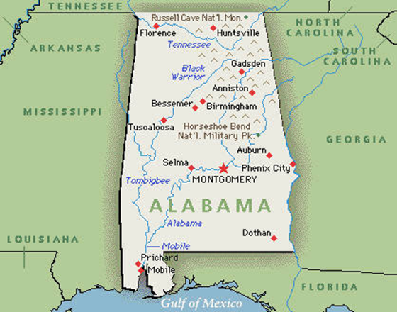

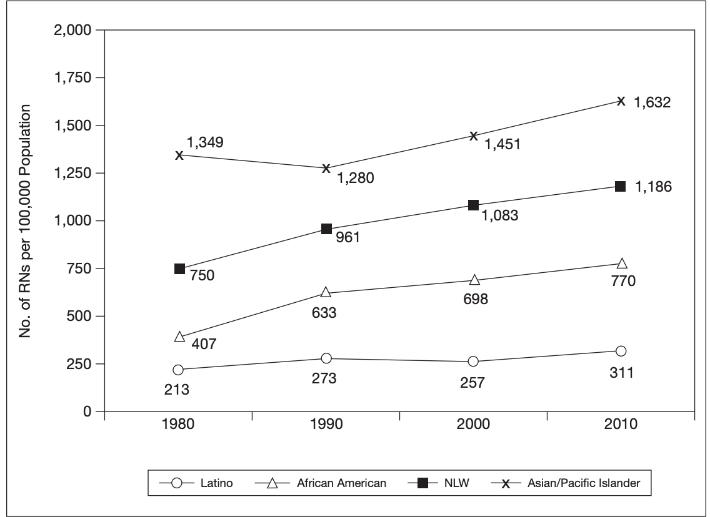
TITLE
Author
University of Alabama at Birmingham School of Nursing
Mission and Goals
Alabama Chapter
Nationally Ranking Health Issues
How Does Alabama Compare?
NAHN is committed to advancing the health in Hispanic communities and to lead, promote and advocate the educational, professional, and leadership opportunities for Hispanic nurses.
Hypertension 41.9%
Obesity 36.3%
Physical Inactivity 32.0%
Diabetes Mellitus 14.1%
alabamapublichealth.gov (2018)
Alabama Registered Nurse
Population
30 Year Trend of Minority
Nurse Growth
Registered Nurses in Alabama: 83,354
(As of Aug. 1st 2019)
Alabama Population
Hispanic Registered Nurses: 1,214
(As of last licensing renewal period. Dec 2016)
4,887,900 (2018)
195,500 Hispanics
US Census estimate of projected residential population for 2018
https://www.census.gov/topics/population.html
http://www.abn.alabama.gov/
@ Alabama National Association of Hispanic Nurses Home Page- https://alnahn.nursingnetwork.com/
Ruggles S, et al. (2010)

