Slide 1

TB Testing for Health
Care Personnel
A Modern Approach to TB Screening
Pat Iyer, MSN, RN, BC
Massachusetts Department of Public Health
September 2019

Slide 2
Faculty Disclosure
I wish to acknowledge that I have no commercial or vested interests or relationships to report.
September 2019

Slide 3
Objectives
Describe the updated recommendations for TB Testing for Health Care Personnel
Discuss strategies for facilities to develop best practices as part of a TB Infection Control Plan
Notes:
3

Slide 4
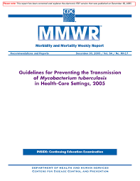
CDC Guidelines for Preventing TB Transmission in Health Care Settings – 2005
Health Care Personnel (HCP) Screening
Risk for health care associated transmission
TB Infection Control
Relevance for BT Preparedness
Recommendations for Preventing Transmission in Health Care Settings (Risk based)

Slide 5
Why the changes?
Expansive systematic review of data and literature
Relatively low proportion of US HCP tested positive at baseline
<1% of US HCP previously testing negative convert during serial testing
Nearly 50% of US HCP previously testing positive revert to a negative test result during serial testing
Insufficient evidence to assess incidence and transmission of TB disease among HCP
No case of TB disease reported among the 64,000 USP HCP included in the reviewed studies *
  → All this effort was costly and ineffective in preventing TB among HCP
  *Tuberculosis Screening, Testing, and Treatment of U.S. Health Care Personnel: Recommendations from the National Tuberculosis Controllers Association and CDC, 2019. MMWR May 17, 2019

Slide 6
2019 Recommendations
TB Screening with an individual TB risk assessment and symptom evaluation at baseline (preplacement) – (new)
TB testing with an interferon-gamma release assay (IGRA) or tuberculin skin test (TST) for persons without documented prior TB disease or latent TB infection (LTBI)
No routine serial TB testing at any interval after baseline in the absence of a known exposure or ongoing transmission (new)

Slide 7
2019 Recommendations continued
Encouragement for all HCP with untreated LTBI, unless treatment is contraindicated (new)
Annual symptom and risk screening for HCP with untreated LTBI (new)
Annual TB education for all HCP (new emphasis)

Slide 8
What hasn’t changed
Other related components of the 2005 MMWR
TB exposure control plan – Contact Investigations
Facility Risk Classification
Fundamentals of TB Infection Control
Managing persons with suspected or confirmed TB disease
Environmental Controls
Respiratory Protection
Cleaning, disinfecting, and sterilizing patient care equipment

Slide 9
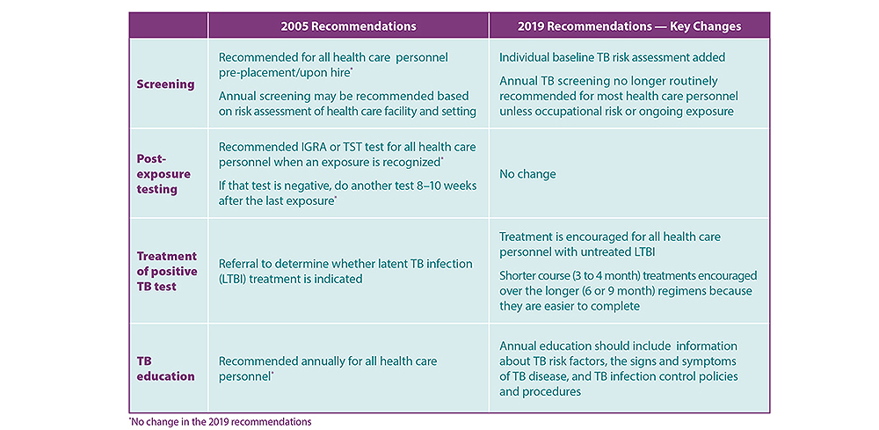
Key Changes

Slide 10
Closing Points
CDC and the National TB Controllers Association released updated recommendations for TB screening, testing, and treatment of HCP on May 17, 2019
Insufficient evidence to assess incidence and transmission of TB disease among HCP
All U.S. HCP should be screened for TB upon hire (i.e., preplacement).
Additional evaluation for TB disease as needed.
Annual TB testing of HCP is not recommended unless there is a known exposure or ongoing transmission at a healthcare facility.
Annual TB education for all HCP
These updated recommendations are part of the Guidelines for Preventing the Transmission of Mycobacterium tuberculosis in Health-Care Settings, 2005

Slide 11


Slide 12
Resources
www.mass.gov/tuberculosis
https://www.cdc.gov/tb/topic/testing/healthcareworkers.htm?s_cid=fb-cdctb-00067
https://www.cdc.gov/mmwr/preview/mmwrhtml/rr5417a1.htm?s_cid=rr5417a1_e
https://www.cdc.gov/tb/topic/infectioncontrol/healthcarepersonnel-faq.htm
Massachusetts Department of Public Health TB Program 617-983-6970

Slide 13


