Slide 1
THE ROLE OF A NURSE EXPERT
Dr. Mary A. Taschner, DNP, ANP-BC
Massachusetts Association of Occupational Health Nurses
Fall Conference September 21, 2019

Slide 2
What is a nurse expert
You are the nurse expert for the nurse in question and her/his legal team-
  Your education, background and expertise provide the basis for you to discern whether the standard of care has been met.
  Provide an objective description of what occurred and a professional opinion based on standards.
You provide an objective opinion-you are not an advocate
  To a reasonable degree of medical certainty, has the nursing care provided to the patient, met the standard of care of the average nurse, at the time and under the circumstances?
Notes:
Nurse is the only one competent to testify as to the standard of nursing practice.
Witness has first hand knowledge/NEW has NO direct knowledge but insight based on experience, expertise.

Slide 3
RESPONSIBILITIES
Educate the legal team and the jury
Medical and relevant record review
Peer reviewed publication review for standard of care
Review policies, procedures, protocols from health care system, state, federal government, and professional organization
Provide verbal and/or written opinion
Deposition testimony
Trial testimony
Accompany patient to IME appointment
Notes:
MRR: consistency, gaps, errors
Record review-objective assessment of care delivered; assessment completed; plan of care developed and implemented; documentation of the plan of care followed, evaluated, modified; were institutional standards of care followed; if not, why not?
Record review may include-current and past medical record (inpatient, outpatient, home care, LTC, prior hospitalizations), EMS run reports, autopsy, death certificate, depositions, etc…
Provide verbal and/or written opinion
Deposition testimony
Trial testimony
Accompany patient to medical appointment
Record review may include-current and past medical record (inpatient, outpatient, home care, LTC, prior hospitalizations), EMS run reports, autopsy, death certificate, depositions, etc…

Slide 4

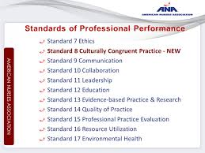


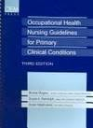
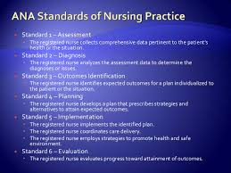
RESOURCES

Slide 5
CREDENTIALS and hiring process
Credentials
  Nursing Education
  Nursing Experience
  Prior work as nurse expert
How Hired
  Agreement with attorney-terms
  Known as nurse expert
  Plaintiff vs. Defense
Understand what is being asked of you

Slide 6
POSITIVE AND NEGATIVE ASPECTS
POSITIVES
  Challenge
  Interesting work
  Expands professional nursing role
  Pays well
NEGATIVES
  Adversarial process
  Long term time commitment and flexibility
  Requires attention to detail

Slide 7
Go for it!!
Need for nurse experts
Contribute to our evolving nursing practice
Help define nursing care meeting the standard of care
Important for nurses to do this work; that it does not defer to physicians or other providers to set the standard

