Slide 1
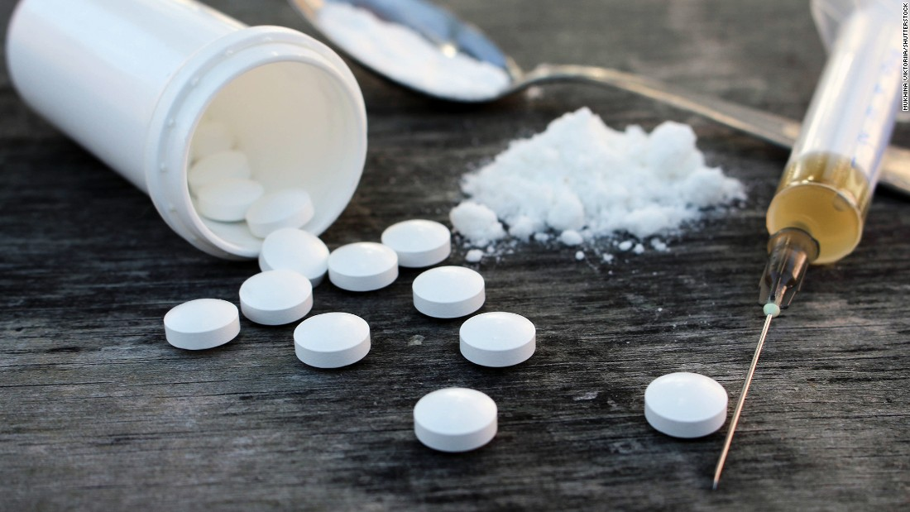
Narcan and Overdoses
By: Teri Clover, EMT

Slide 2
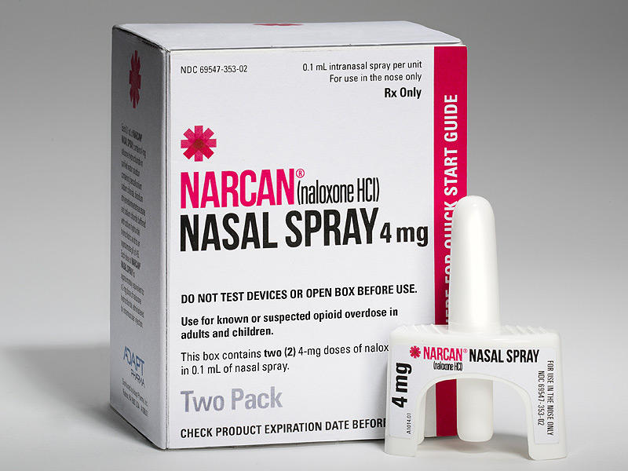
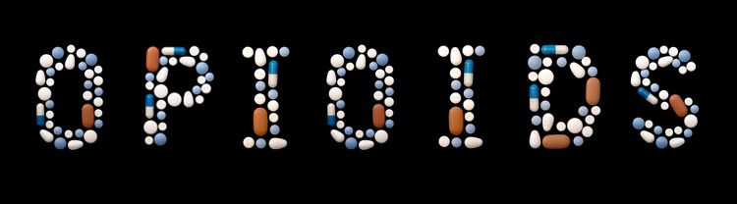
Goals:
Learn what makes opioids unique.
Be able to identify an overdose.
Be able to administer Narcan.
Learn about the new threats.

Slide 3
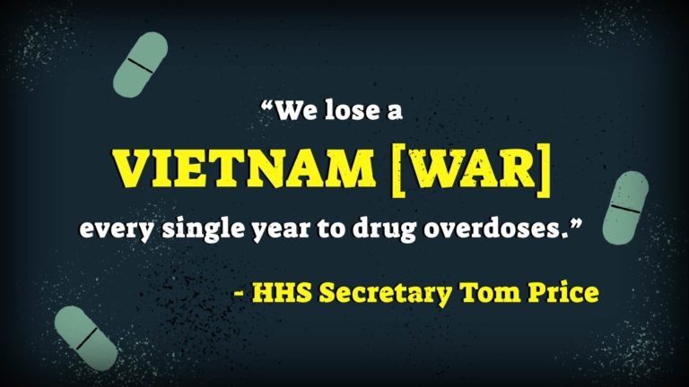
Notes:
Vietnam War – Approximately 58,000 American deaths from the war.
Opioids – 63,000 Americans died just 2016.

Slide 4
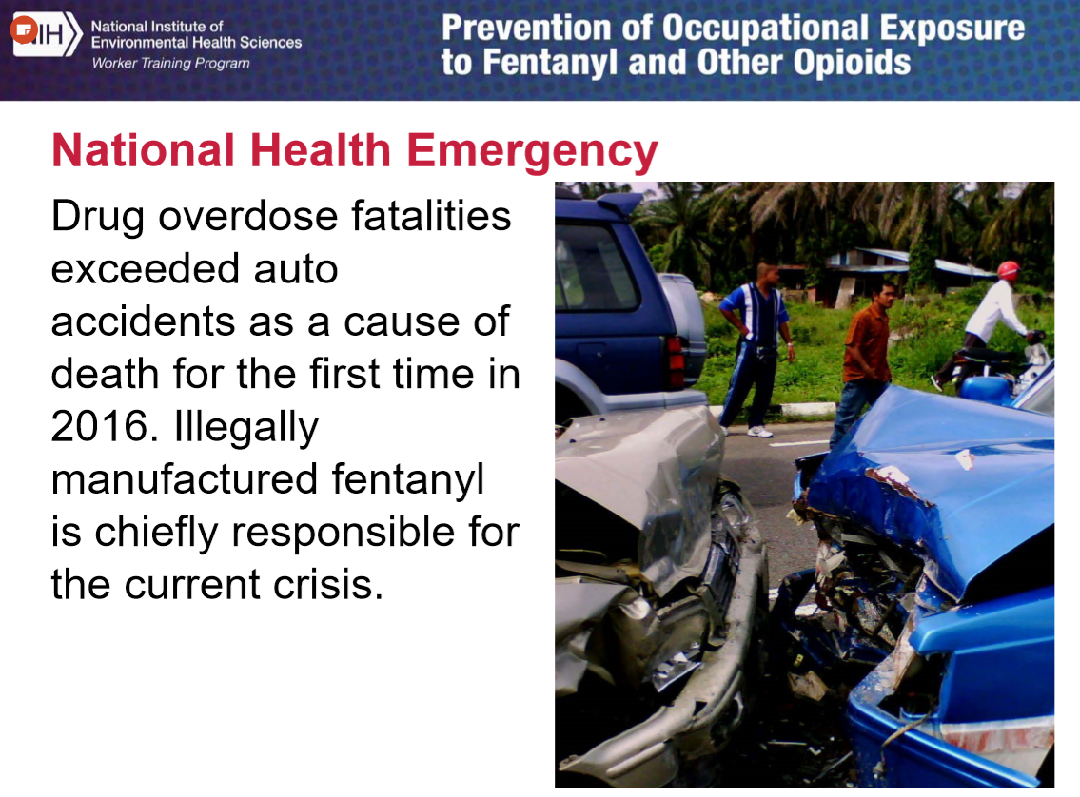

Slide 5
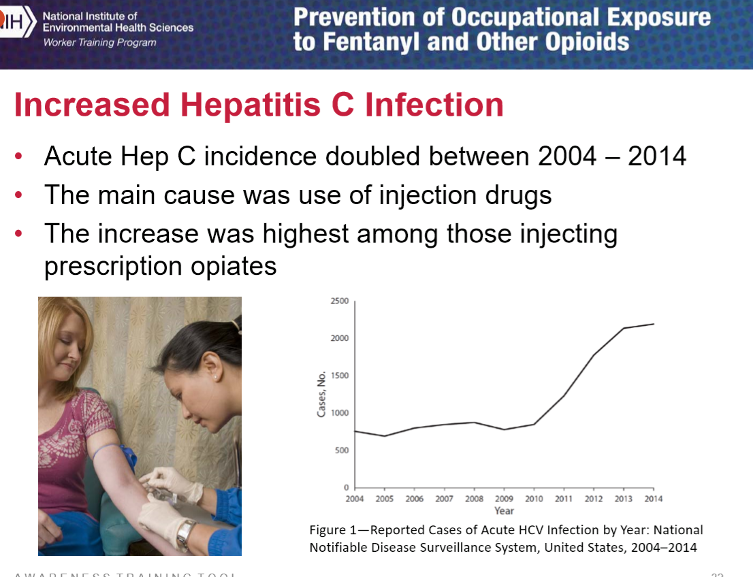

Slide 6
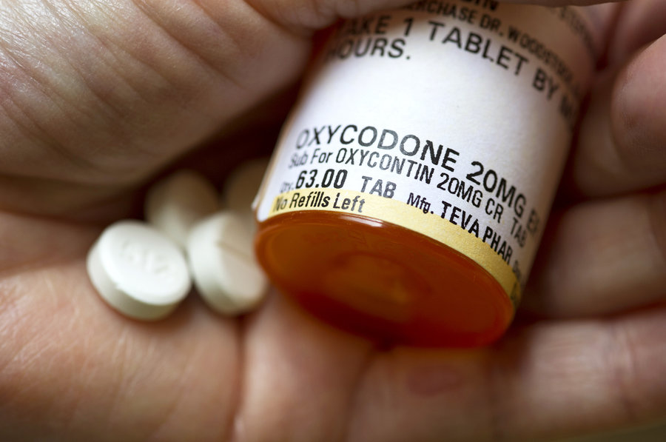
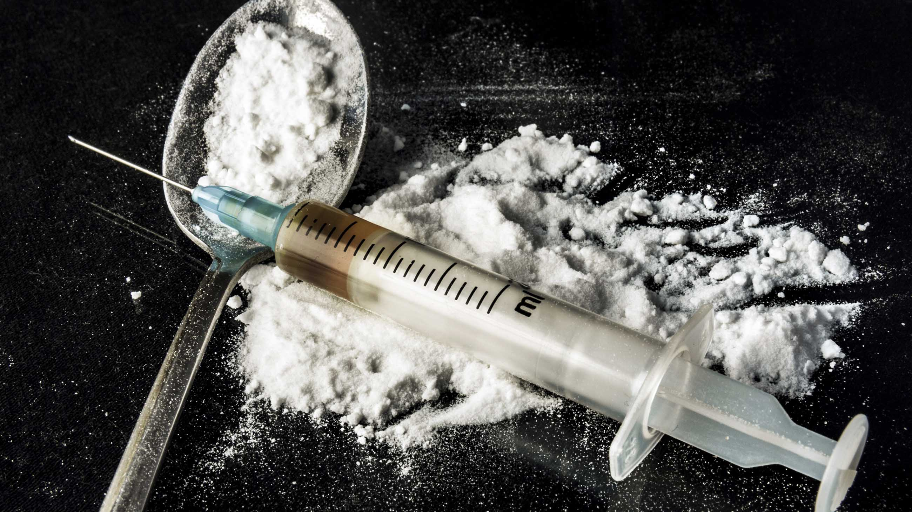
What are Opioids?
Powerful pain relievers that block the reuptake of serotonin.
They are classified as a depressant drug.
Can be synthetic/manmade (ex. heroine or fentanyl).
Can be natural (ex. morphine or oxycodone).
Notes:
Unlike Stimulants, Opioids and Depressants slow down all your vital signs (breathing and pulse) and depress your breathing.
Stimulants such as Cocaine on the other hand don’t really lead over overdosing but what we call overramping. This is because stimulants don’t cause depressed breathing but uneffective breathing as all your vitals signs go up (breathing and heart rate).

Slide 7
What are the Signs and Symptoms of an Opioid Overdose?

Slide 8

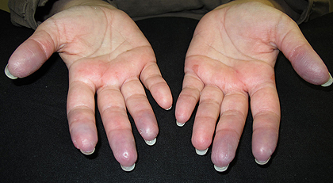
Warning Signs
Drug paraphernalia.
Slurred or confused speech.
Unresponsive.
Depressed breathing or no breathing at all.
Gurgling sounds or snoring respirations (agonal/apnea).
Constricted pupils (pin-point).
Cold and clammy.
Pale or gray skin.
Blue skin around the extremities, mouth, or both (cyanosis).

Slide 9
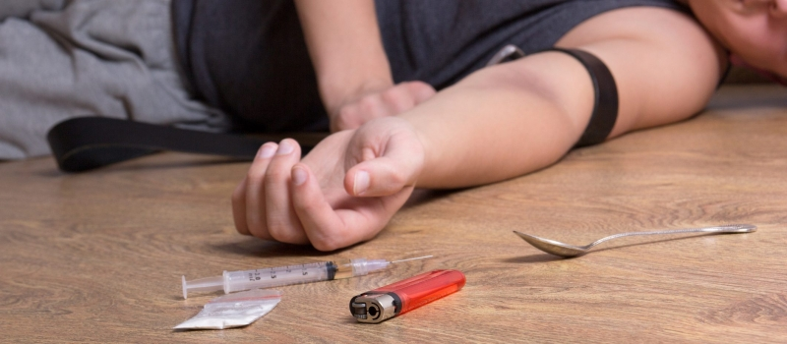
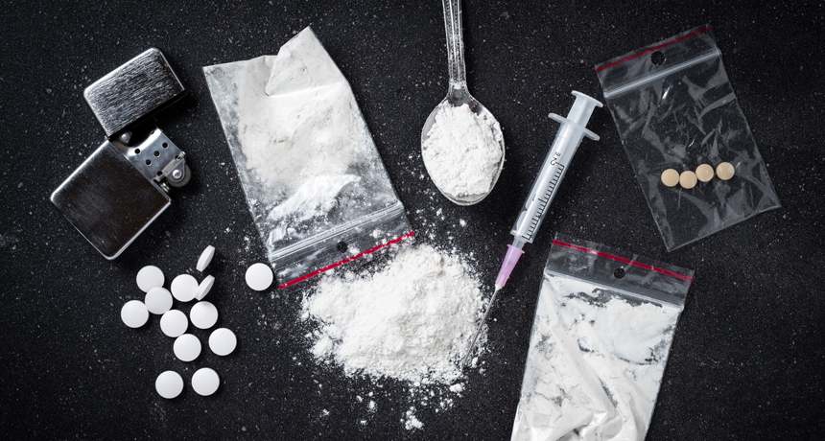
Drug Paraphernalia

Slide 10
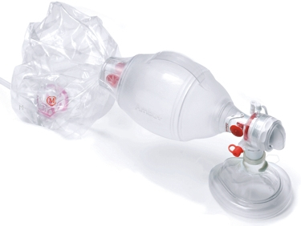
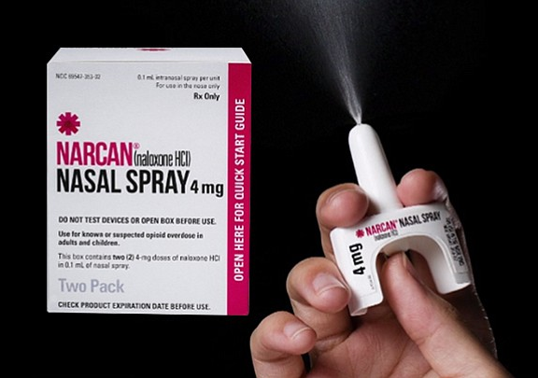
How Can We Help?
Scene safety/BSI!
Call 911.
Maintain an open airway.
Recovery position (left lateral recumbent).
Maintain pt’s breathing.
Administer Narcan.

Slide 11
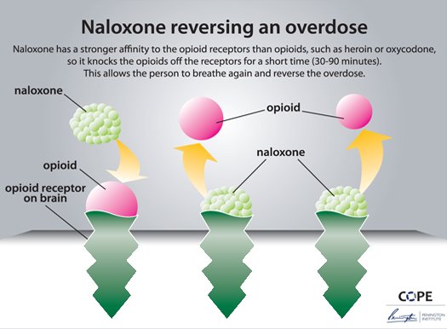
How Does Narcan Work?
Blocks the effects of opioids and allows the brain to reabsorb serotonin.
Narcan has a stronger attraction to brain receptors than opioids.
Patient will begin breathing again and no longer feel high.

Slide 12
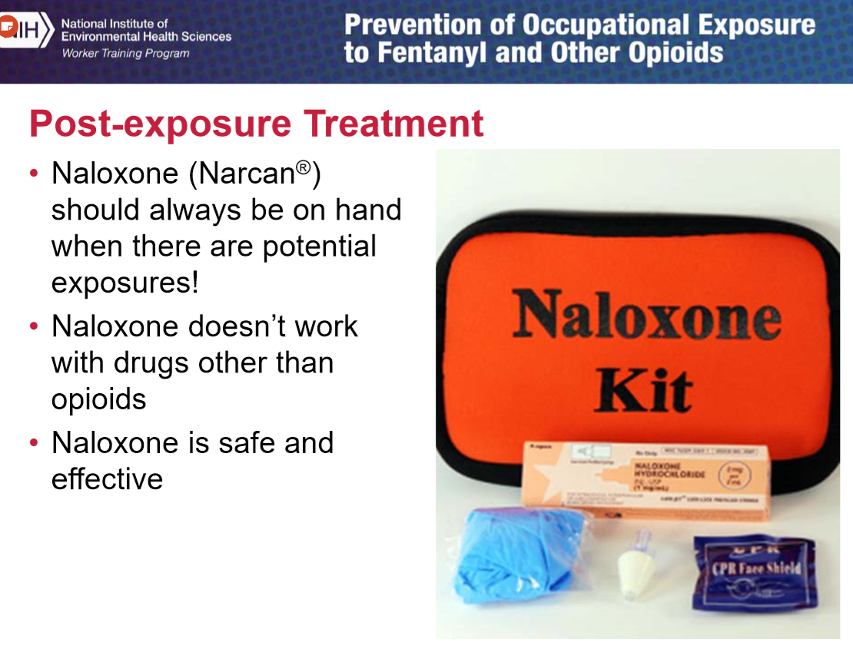

Slide 13
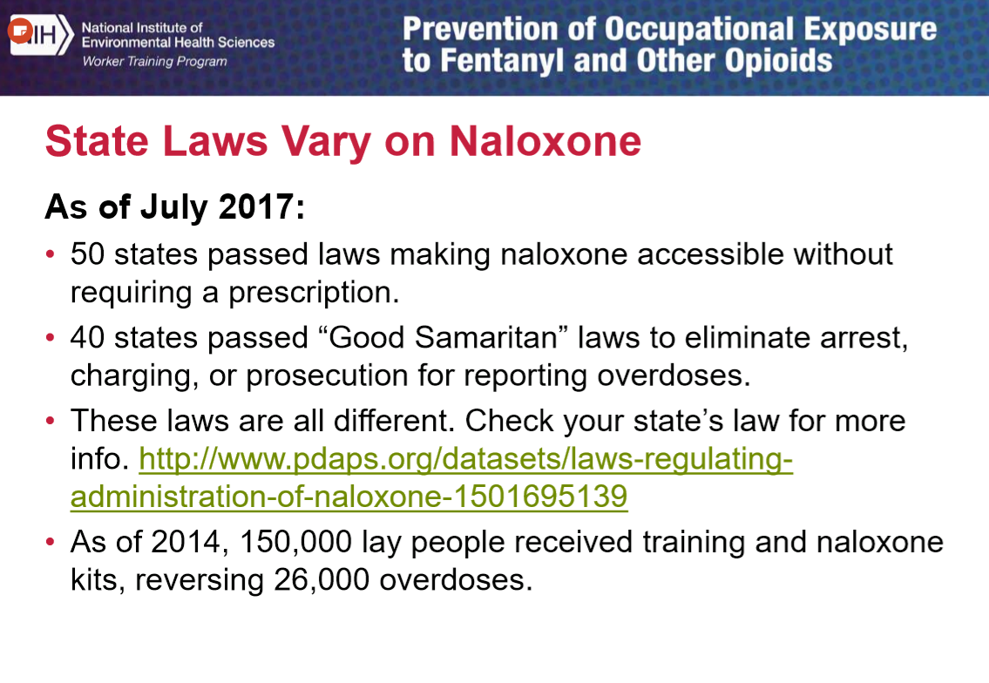
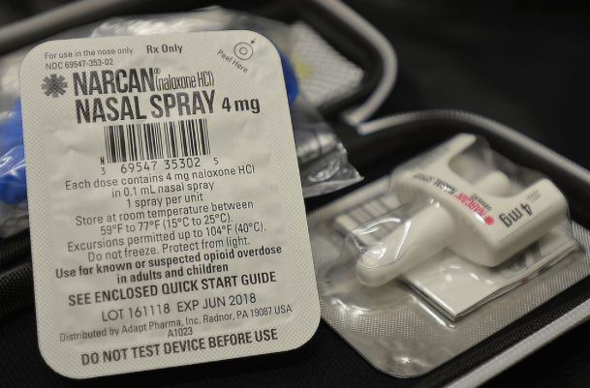

Slide 14
How to Administer Narcan?

Slide 15
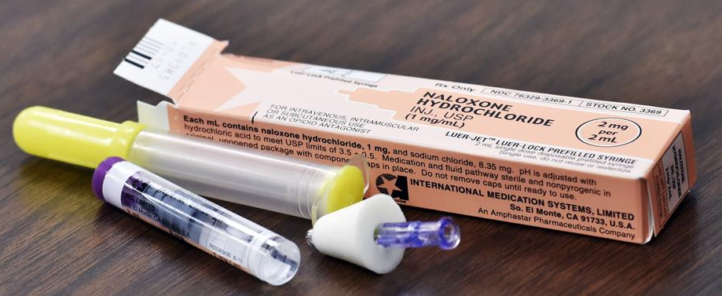
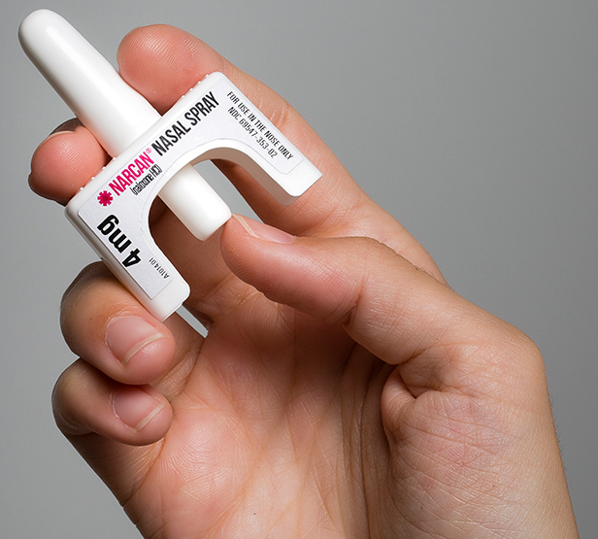
After Narcan
Pt’s go into immediate withdrawal.
This is unpleasant for the pt, but opioid withdrawal is not deadly.
Pt’s will no longer feel high.
Pt may be confused.
Pt may be hostile. Protect yourself and remember your scene safety.
Vomiting is common and normal, protect your pt’s airway!

Slide 16
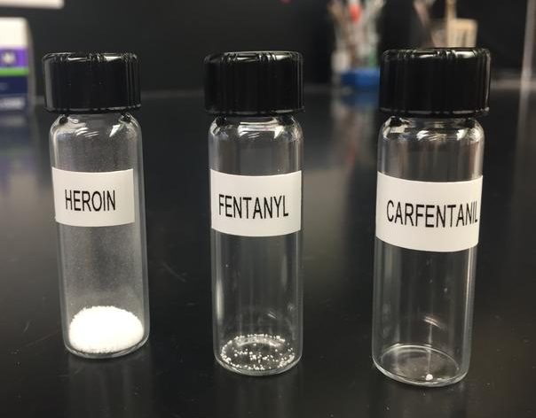
Emerging Threats
Fentanyl is 50 to 100 times more potent than Morphine.
Used to treat cancer and hospice patients for pain management.
Carfentanil is 10,000 times more potent than Morphine.
Used as an elephant tranquilizer; never intended for human use.

Slide 17
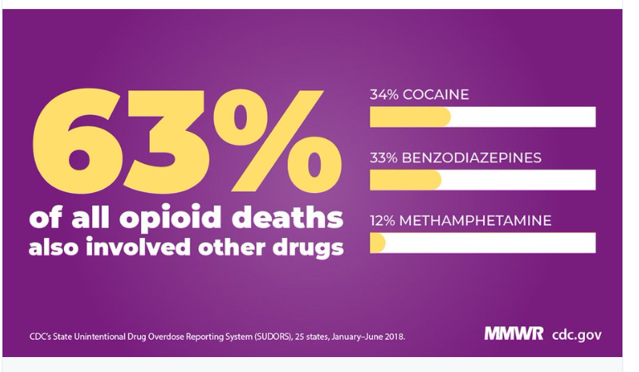
There is No Quality Control With Street Drugs

Slide 18
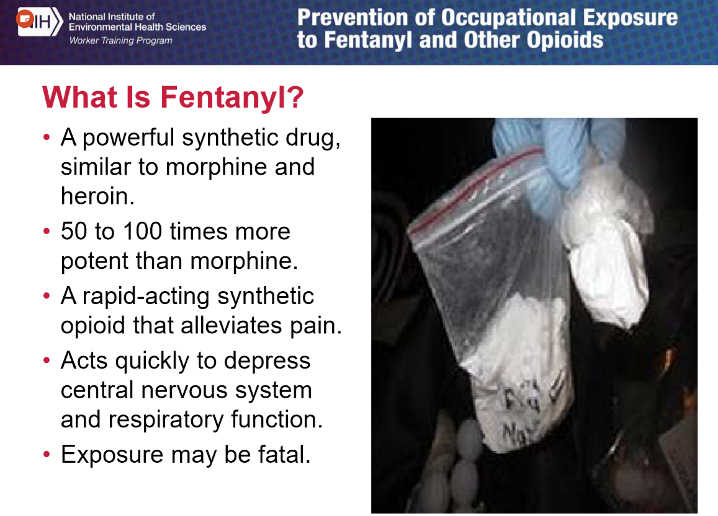
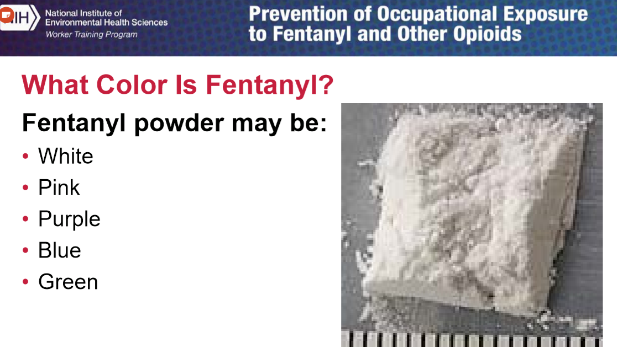

Slide 19
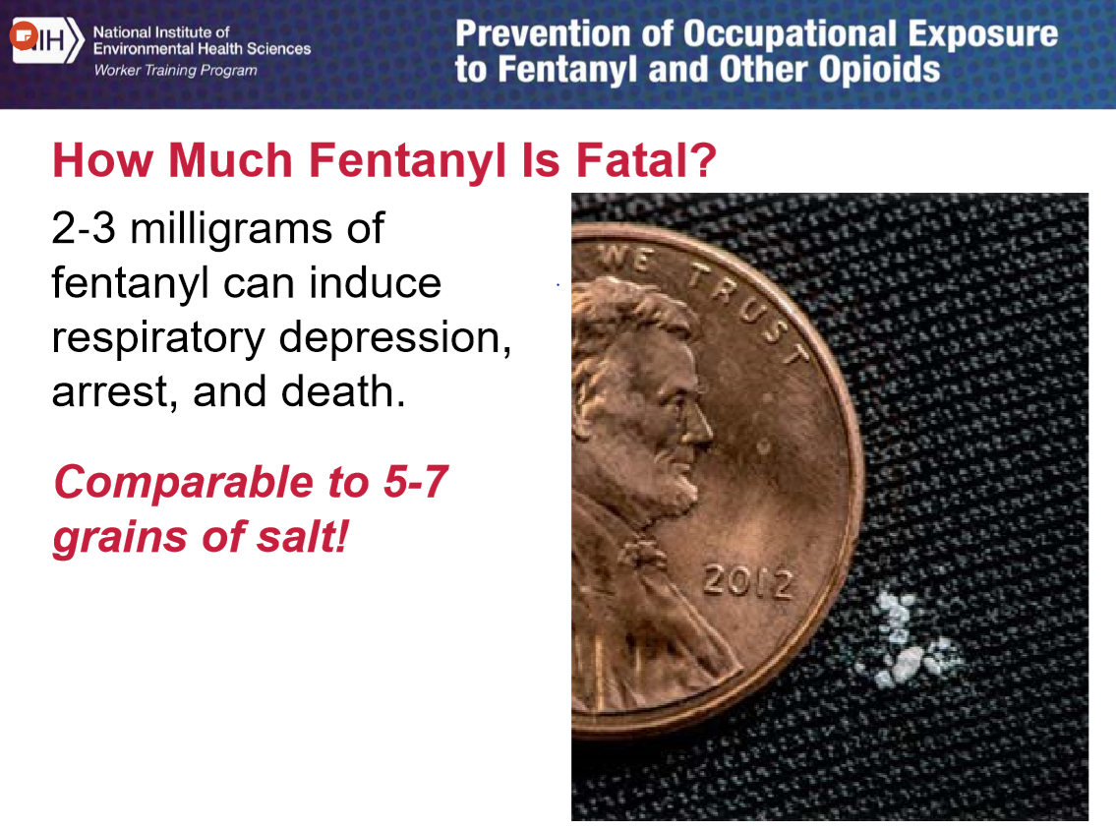

Slide 20
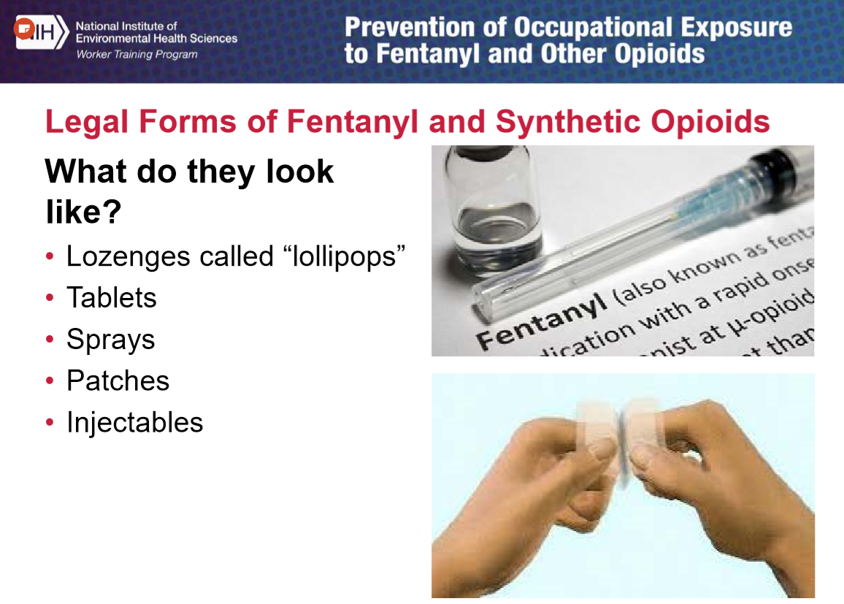

Slide 21
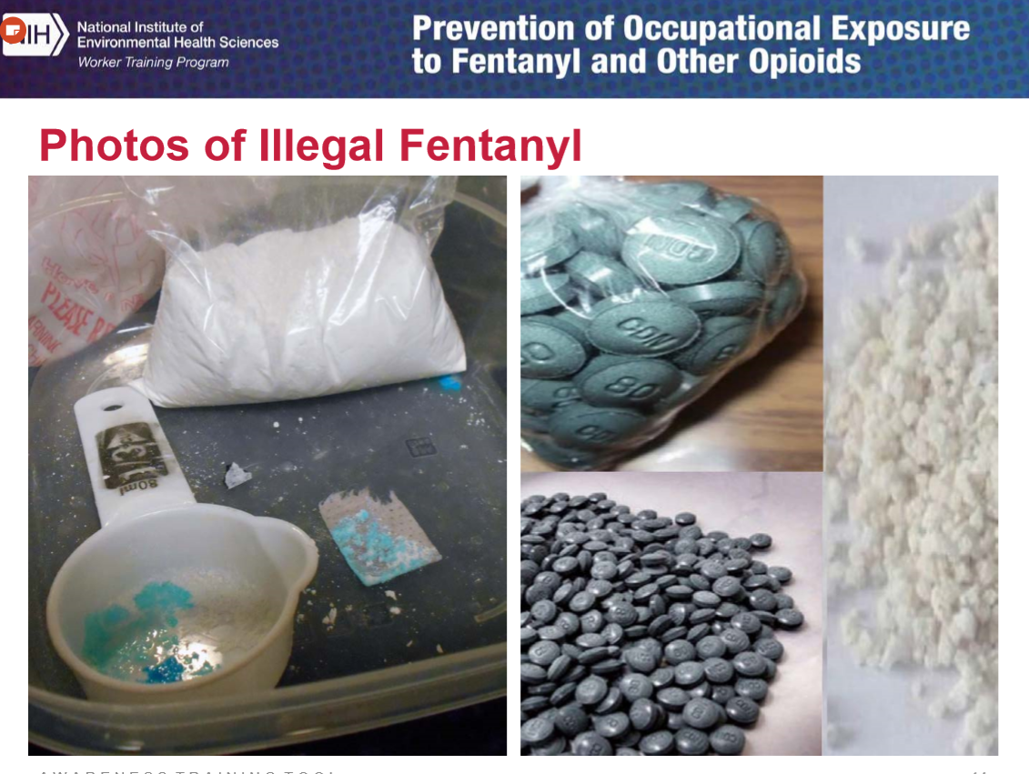

Slide 22
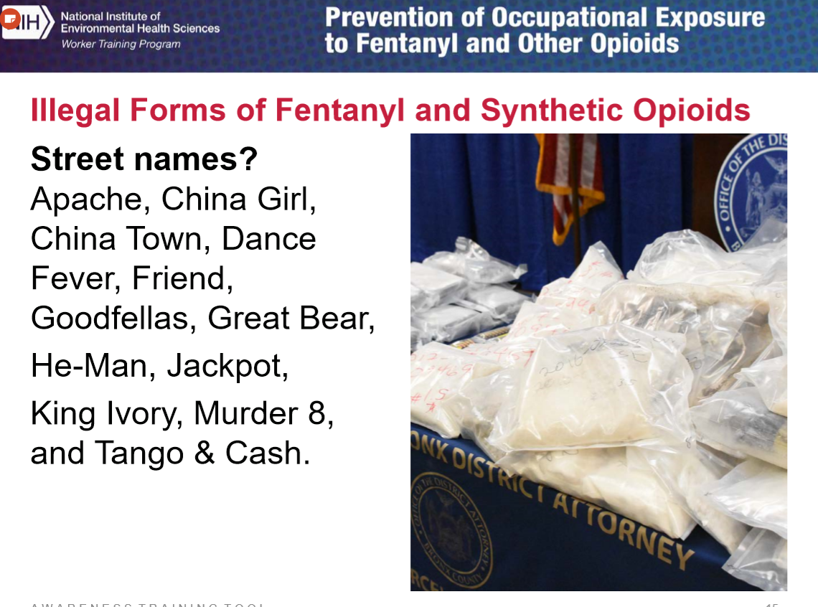

Slide 23
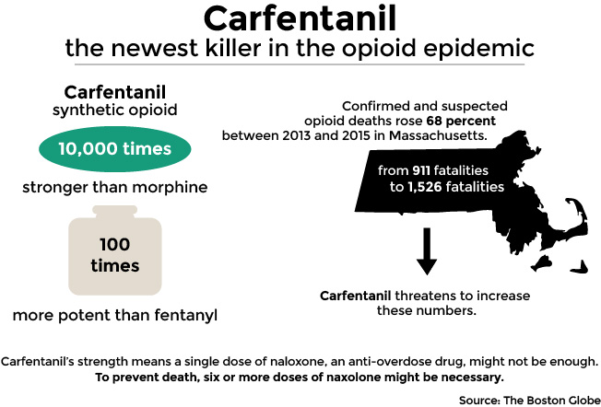
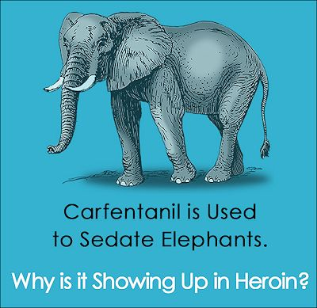
Carfentanil

Slide 24
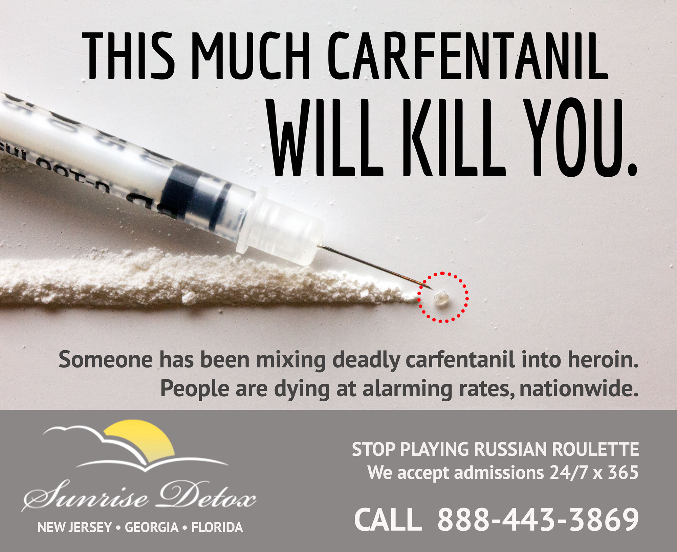
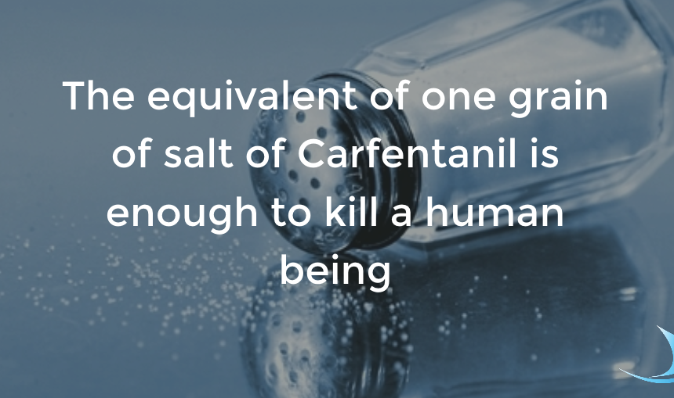

Slide 25
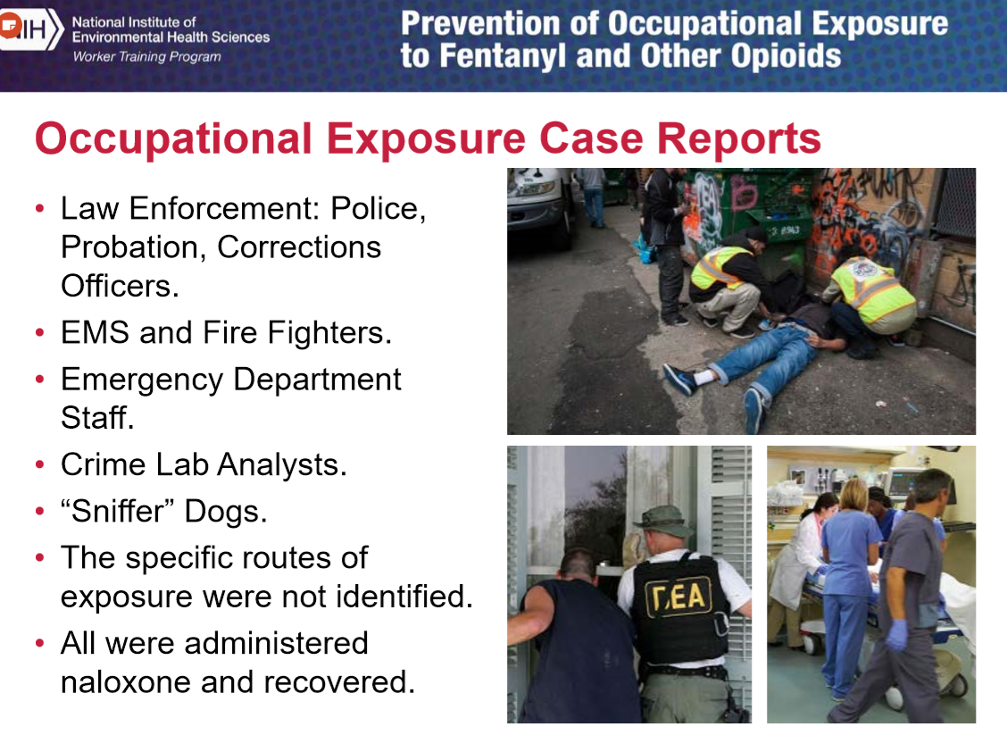

Slide 26
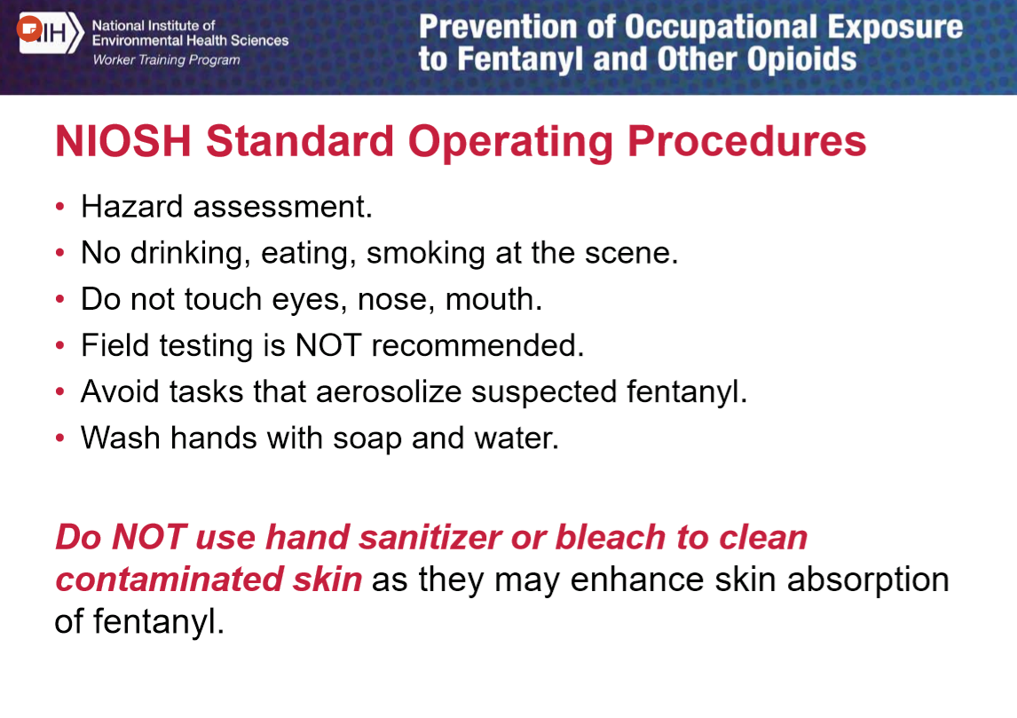

Slide 27
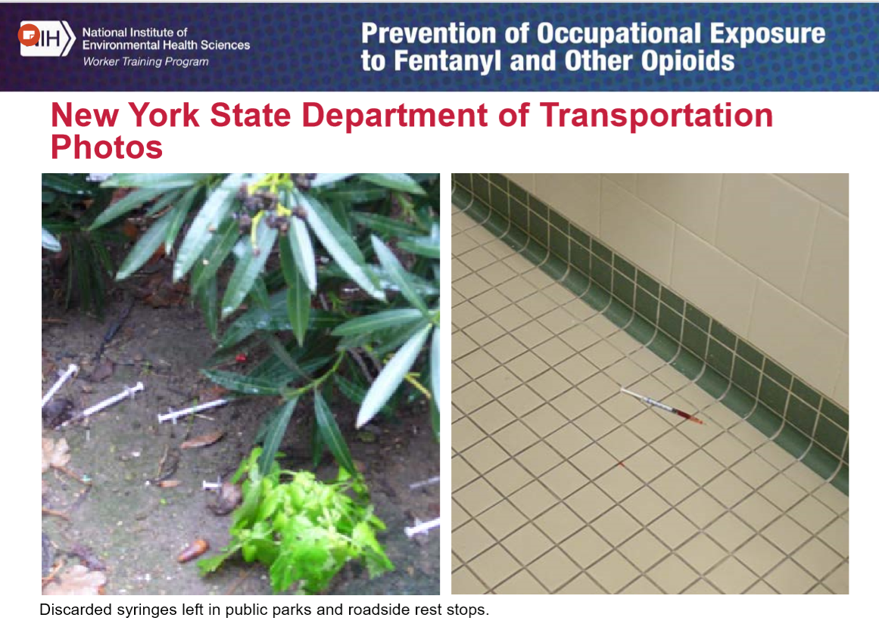

Slide 28
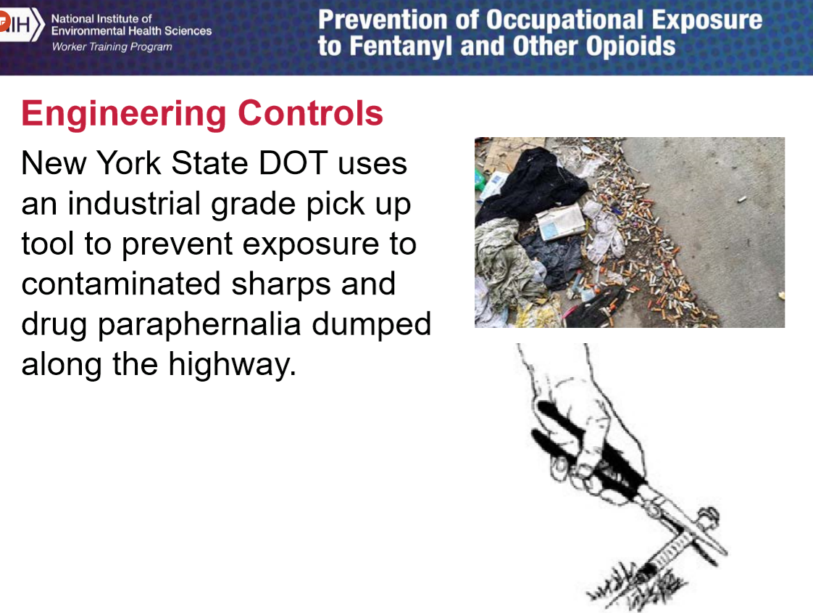
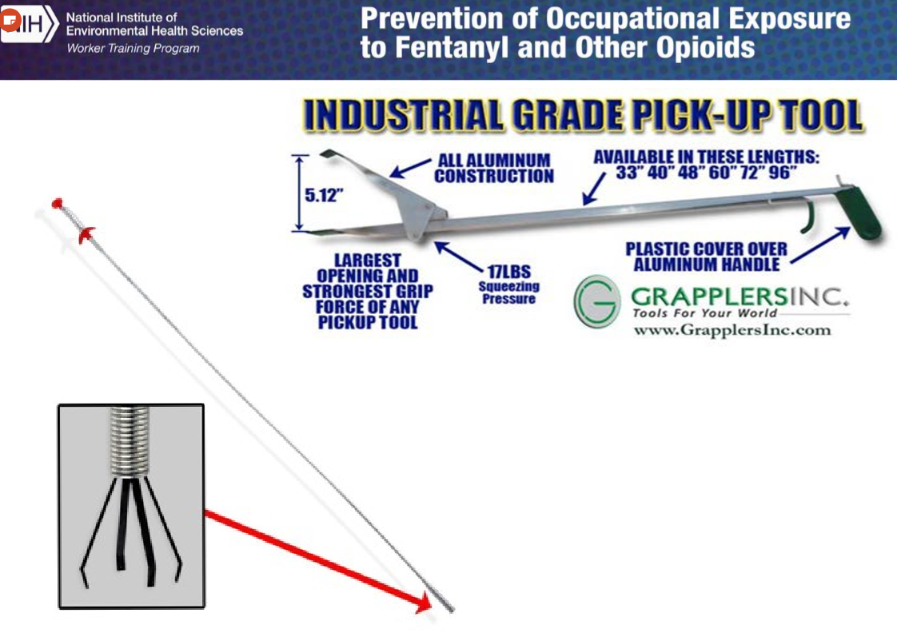

Slide 29
Naloxone in the Workplace
Using Naloxone to Reverse Opioid Overdose in the Workplace: Information for Employers and Workers.
Information on establishing a program at work
The National Institute for Occupational Safety and Health (NIOSH), part of the Centers for Disease Control and Prevention (CDC), developed this information to help employers and workers understand the risk of opioid overdose and help them decide if they should establish a workplace naloxone availability and use program.
https://www.cdc.gov/niosh/docs/2019-101/default.html

Slide 30
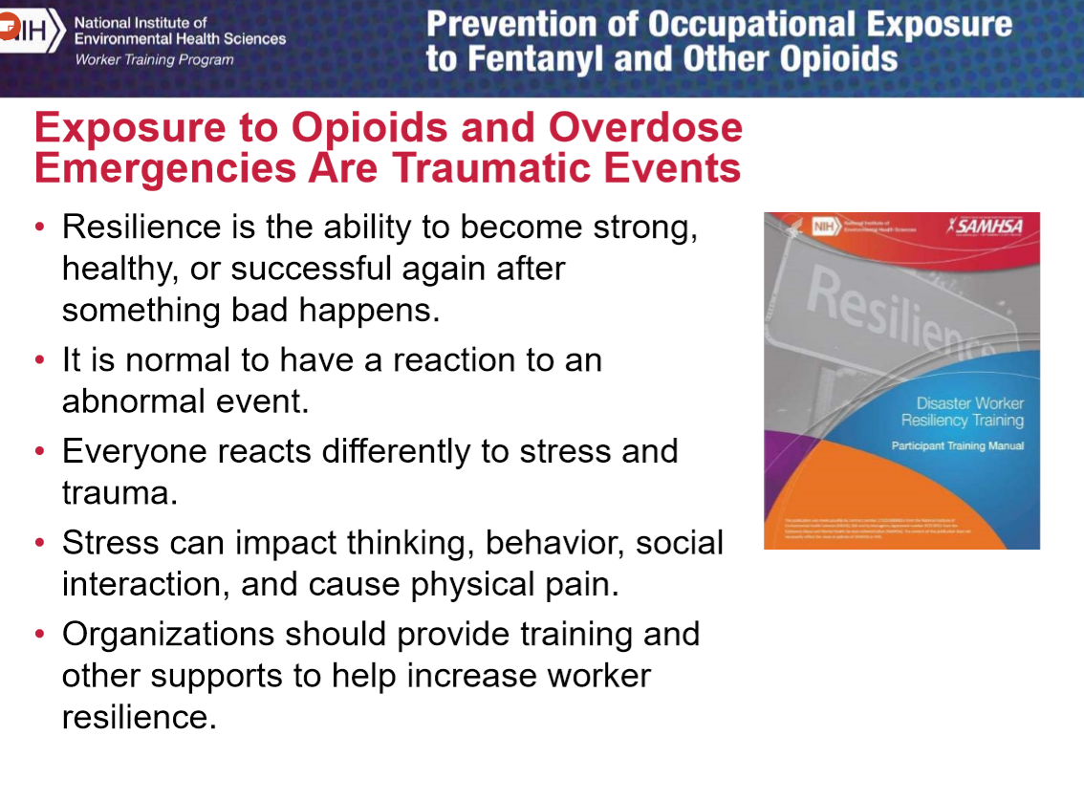

Slide 31
Questions?

