Slide 1
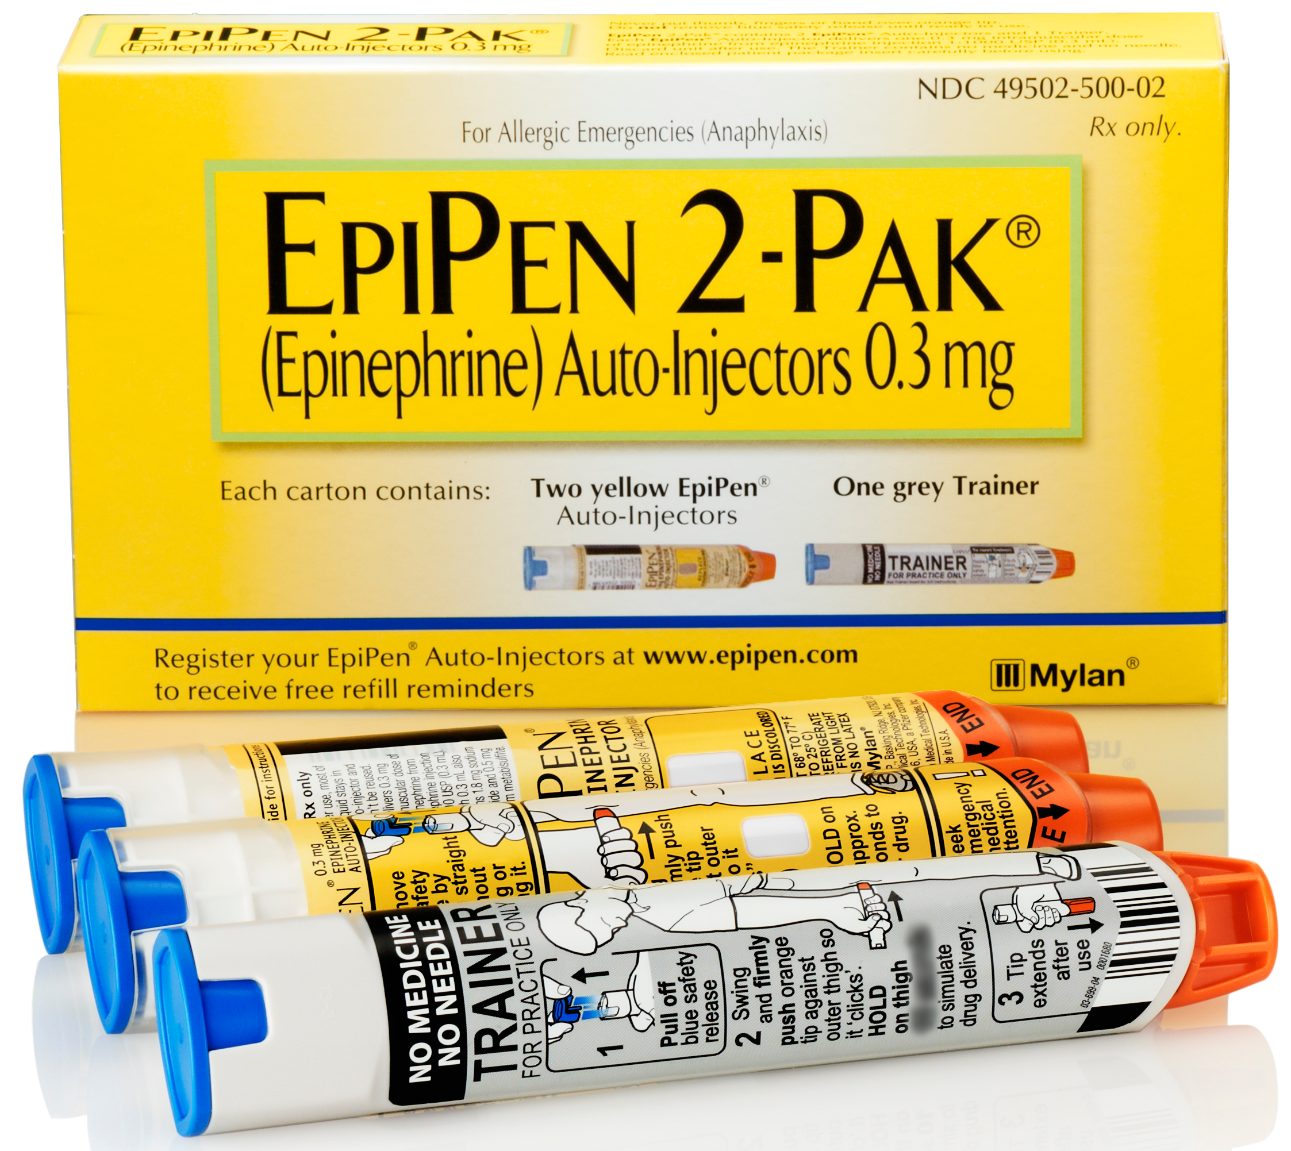
Epi-Pen
By: Teri Clover

Slide 2
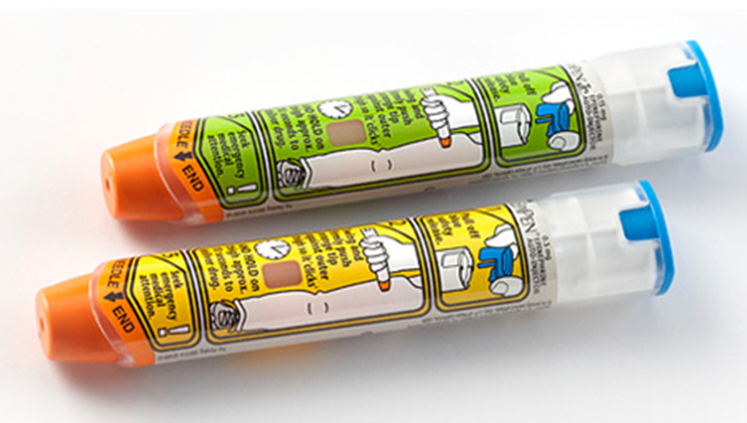
Goals:
Gain an understand of anaphylaxis.
Be able to recognize the signs and symptoms of an allergic reaction.
Be able to help with the administration of epinephrine and an anaphylactic emergency.

Slide 3


Signs and Symptoms of Anaphylaxis
Hives (red patches on skin, usually located on chest and neck).
Strider (high pitched wheezing on inspiration).
Difficulty breathing.
Difficulty swallowing, speaking, or drooling.
Increased heart rate.
Low blood pressure.
Swelling (particularly at site of infection or of the throat or tongue if ingested).
Later signs: nausea and vomiting.

Slide 4
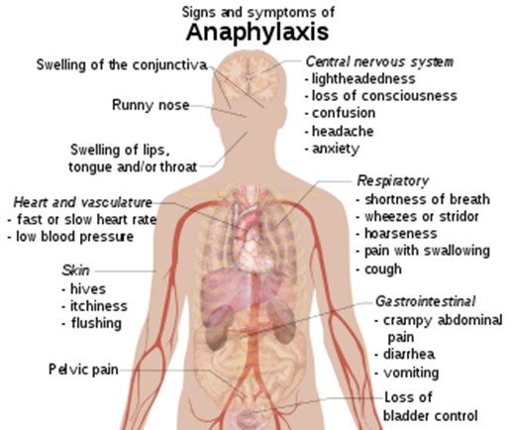

Slide 5



Common Allergies
To Food:
  Peanuts, shellfish, and milk.
To Stings:
  Bees.
To Medication:
  Penicillin.

Slide 6

What to Do:
Call 911.
If patient is prescribed an epi-pen, find it and administer.
Calm patient and stay with them.

Slide 7
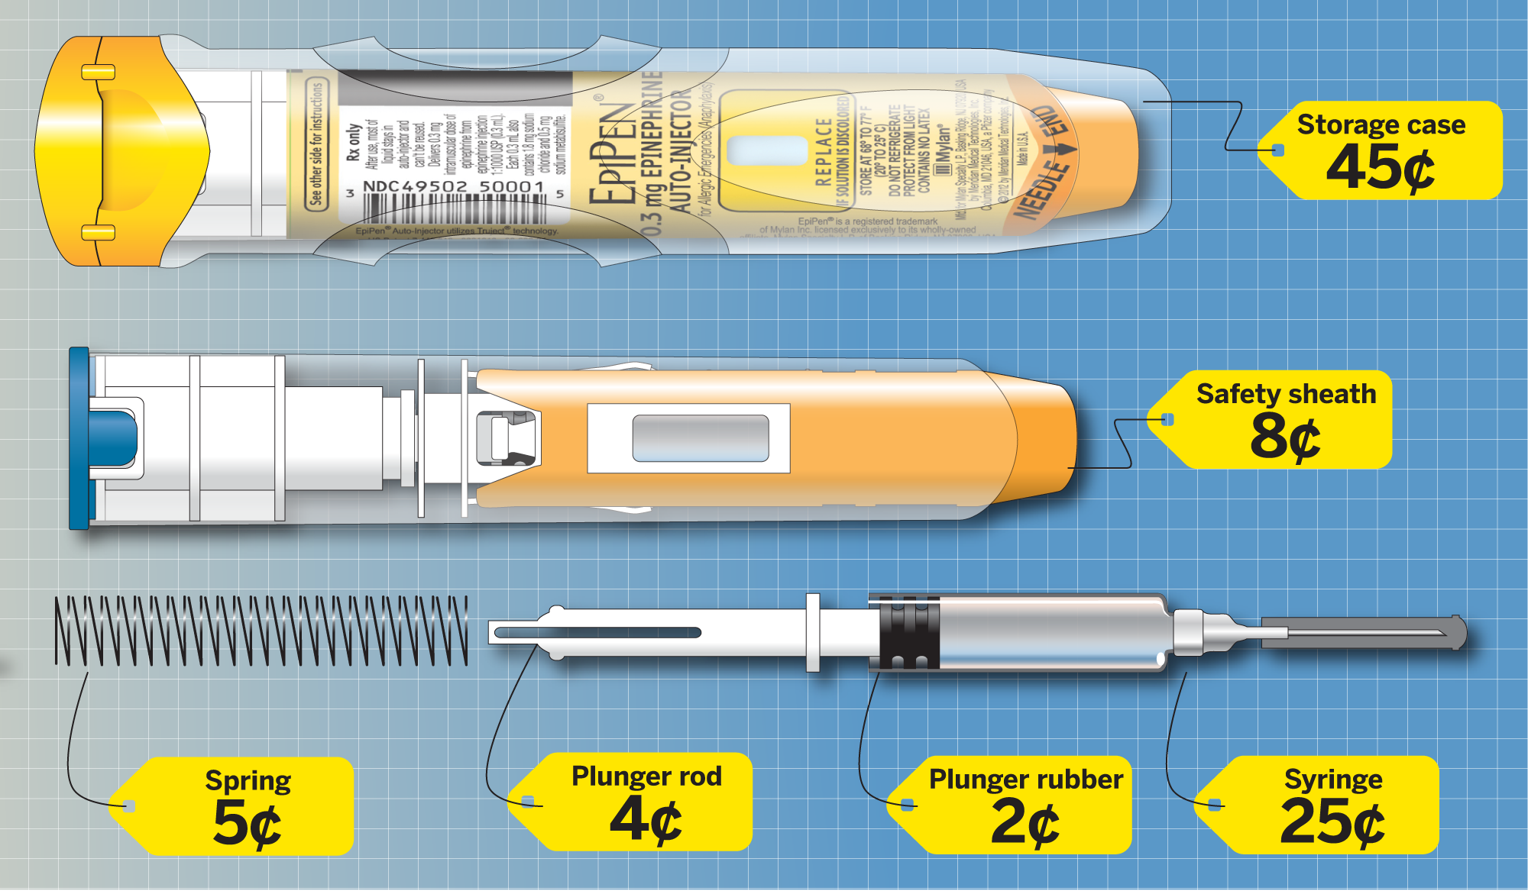
What is an Epi-Pen?
An epinephrine auto-injector.
Injects epinephrine, which is adrenalin.
It’s a vasoconstrictor (constricts cells to reduce swelling).
Injected intra-muscular (into the muscles).
Dosage is based on weight:
For adults: 0.3 mg
For children: 0.15 mg

Slide 8
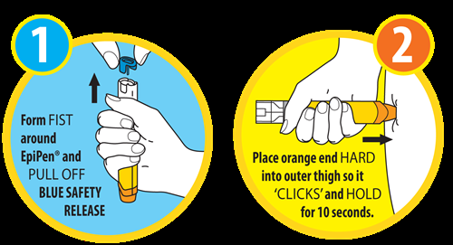
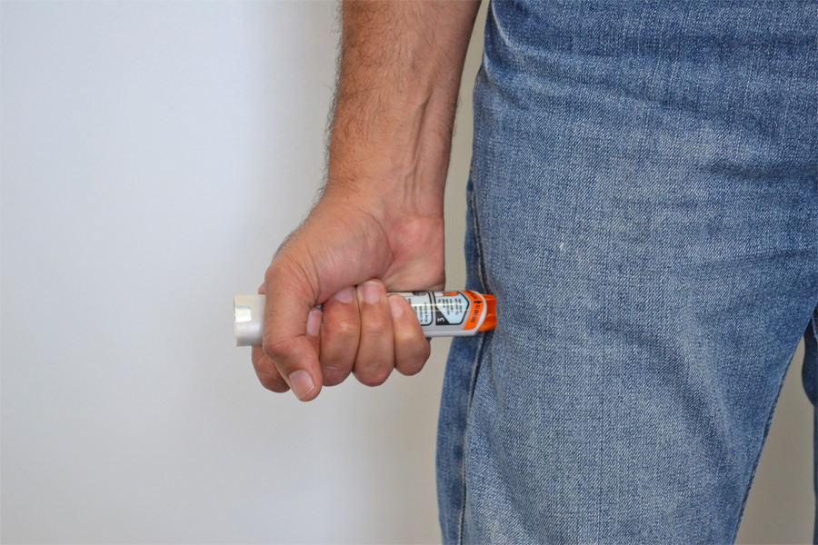
How to Administer an Epi-Pen:
Blue to the sky, orange to the thigh.
Take off blue safety cap.
Press needle to the left lateral thigh, hard enough to hear a click.
Hold for 10 seconds to allow medication to disperse intramuscular.
Rub outer thigh to disperse medication.
Have patient sit down.
Administer second dose if ambulance has not arrived or patient does not improve within 15 minutes.

Slide 9
Questions?

