Slide 1
Perioperative glucose management
Kelli Williams, FNP-BC, APRN-Rx, CDE
Notes:
Intro:
Good afternoon, my name is Kelli Williams. I am a nurse practitioner with the Inpatient diabetes team at the Queen’s Medical Center and I have the pleasure of spending a little time with you to discuss Perioperative glucose management.
Slide 1:
The management of patients with and without diabetes and those with undiagnosed diabetes pose many challenges when undergoing surgery.
Literature demonstrates a clear association between perioperative hyperglycemia and adverse clinical outcomes. However, studies and protocols are still lacking specific details on how to accomplish this task.

Slide 2
Objectives
Describe the prevalence of diabetes, undiagnosed diabetes and hyperglycemia in the perioperative period
Describe the glycemic targets for the perioperative period
Discuss the impact of hyperglycemia on surgical outcomes
Discuss pre-operative, intra-operative and post-operative glycemic management
Discuss outcomes from a PI project on Perioperative Glucose Management in elective total joints at the Queen’s Medical Center
Notes:
Slide 2:
This presentation will discuss the:
Prevalence of diabetes, undiagnosed diabetes and hyperglycemia in the perioperative period, the glycemic targets for the perioperative period, the impact of hyperglycemia on surgical outcomes, pre, intra, and postoperative glycemic management and special considerations and lastly, I will share outcomes from a PI project on perioperative glucose management in elective total joints at the Queen’s Medical Center.

Slide 3
Prevalence of hyperglycemia and diabetes in surgical patients
Diabetes affects > 9% of the U.S. population
Increased incidence of cardiovascular disease
33-50%of patients undergoing surgery do not know they have diabetes at the time of surgery
20-40% of patients undergoing general surgery have perioperative hyperglycemia
  “stress hyperglycemia”
  Impaired glucose tolerance
Occurs in approx. 80% of patients after cardiac surgery
Notes:
Slide 3:
In 2015, it has been reported that diabetes affects >9% of the U.S. population. Undiagnosed diabetes accounts for 23.8 %.
Patients with diabetes have an increased incidence of cardiovascular disease. This combined with microvascular diseases oven translate into more surgical procedures.
1/3- ½ of patients with type 2 DM do not know they have diabetes at the time of surgery
20-40% of patients undergoing general surgery experience hyperglycemia
And it occurs in approximately 80% of cardiac surgery patients
12-30% of patients who experience perioperative hyperglycemia do not have a hx of diabetes before surgery
Stress hyperglycemia typically resolves after the acute illness or surgical stress resolves.
However, studies show that 60% of patients admitted with new hyperglycemia had confirmed diabetes at 1 yr.

Slide 4
Metabolic consequences of surgical stress and anesthesia
Neuroendocrine stress response with release of counterregulatory hormones
  Catecholamines, cortisol, glucagon, growth hormone -> insulin resistance
Cortisol increases
  hepatic glucose production, stimulates protein catabolism, increases gluconeogenesis -> hyperglycemia
General anesthesia lead to larger metabolic abnormalities
More extensive surgeries result in a higher degree of insulin resistance
Effects are most pronounced on the first post operative day
  May persist for 9-21 days after surgery
Notes:
The stress of surgery and anesthesia alters the finely regulated balance between glucose production and glucose utilization
This causes a neuroendocrine stress response with release of counterregulatory hormones, such as catecholamines, cortisol, glucagon and growth hormones.
The increased secretion of these hormones cause insulin resistance
Cortisol increases hepatic glucose production, stimulates protein catabolism and promotes gluconeogenesis resulting in elevated blood glucose levels
The magnitude of counterregulatory hormone release varies per individual and is influenced by the type of anesthesia
General is associated with larger metabolic abnormalities vs. epidural anesthesia
Additionally, more complex and extensive surgeries lead to a higher degree of insulin resistance
It is noted that patients without a diagnosis of diabetes had a more pronounced steep rise in hyperglycemia compared to those diagnosed with diabetes
This relative state of insulin resistance is most pronounced on the first post operative day and may persist for 9-21 days after surgery

Slide 5
What organs are affected by diabetes?
Notes:
Word cloud: Text KELLIWILLIAM891 to 22333

Slide 6
Multiorgan system effects of diabetes
Coronary heart disease
  Independent risk factor with 2x increased risk of cardiac death
Cerebrovascular disease
  Independent risk factor with 2x increased risk of ischemic stroke
Neuropathy
  Increased nerve stimulation threshold
  Increased sensitivity to local anesthetics
  Cardiovascular instability due to cardiovascular autonomic neuropathy (CAN)
  Delayed gastric emptying
  Obstructive sleep apnea
Nephropathy
  Avoidance of nephrotoxins (NSAIDS)
Retinopathy
  Increased risk for postoperative visual loss
Notes:
Diabetes is a multiorgan disease associated with multiple conditions that may affect anesthetic care and perioperative risk
Diabetes is a risk factor for macrovascular disease- which are coronary heart disease, cerebrovascular disease and
Microvascular disease which are neuropathy, nephropathy and retinopathy
Type 2 diabetes is an independent risk factor for CHD with an overall risk of CHD and cardiac death twice that of patients without diabetes.
CVD is also an independent risk factor with twice the risk of ischemic stroke compared with patients without diabetes
Diabetic neuropathy leads to abnormal nerve conduction
The nerve abnormalities may cause increased nerve stimulation threshold.
Thus, ultrasound guidance is preferred for most nerve blocks as the electrical stimulation is markedly increased and unpredictable which may lead to nerve injury.
There is also increased sensitivity to local anesthetics putting patients at risk for nerve damage with regional anesthesia and duration of peripheral nerve block may be prolonged
Cardiovascular autonomic neuropathy can result in hypotension on induction of anesthesia or with changes in position (ie. Reverse Trendelenberg)
Diabetic autonomic neuropathy of the GI tract results in GERD and/or delayed gastric emptying which can increase the risk of aspiration during induction of anesthesia
Diabetic autonomic neuropathy is also associated with an increased risk of obstructive sleep apnea and /or central sleep apnea.
Thus, identification and management in the perioperative period is imperative to minimize postoperative morbidity and mortality.
Avoidance of perioperative kidney injury include maintenance of renal perfusion pressure and avoidance of nephrotoxins.
Nonsteroidal anti-inflammatory drugs are commonly administered as part of multimodal postoperative analgesia, but should be used cautiously or avoided in patients with diabetic nephropathy
Diabetic retinopathy is a leading cause of blindness worldwide
Thus, patients are at increased risk for postoperative visual loss in prolonged procedures in the head down position

Slide 7
Preoperative evaluation
History and physical examination
  Type of diabetes
  Level of blood glucose control
  Long term complications of diabetes
  Frequency of blood glucose monitoring
  Frequency of hypoglycemia
  Pharmacotherapy
Laboratory assessment
Characteristics of surgery
Notes:
The preoperative evaluation of any patient, including those with diabetes, focuses on cardiopulmonary risk assessment.
Patients with diabetes have an increased risk of silent ischemia then the general population
Some of the key elements of the initial history and physical examination are:
Determination of the type of diabetes, since Type 1 diabetes patients have a higher risk of developing diabetes ketoacidosis and must have basal insulin at all times
Assessment of baseline glycemic control, including frequency of glucose monitoring, range of blood glucose levels and hemoglobin A1c results
A1c levels
Assessment of long term complications of diabetes, including coronary heart disease, cerebrovascular disease, autonomic neuropathy, nephropathy and retinopathy
Assessment of hypoglycemia, including frequency, timing, awareness and severity
Detailed history of diabetes therapy, including type of insulin, injectables, oral medication dose and timing should be assessed and appropriate adjustments should be made
Baseline complete metabolic profile, EKG, hemoglobin A1c to evaluate kidney function, electrolytes and glucose control
Characteristics of surgery, including when the patient must stop eating prior to surgery, type of surgery, timing of the operative procedure and duration of the procedure should be discussed

Slide 8
Hyperglycemia without the diagnosis of diabetes
Retrospective studies
  7,300 cardiac surgical patients with preoperative hyperglycemia
    Increased risk of prolonged mechanical ventilation, reintubation, increased need for resuscitation and mortality vs. patients with diabetes and patients without preoperative hyperglycemia
  61,500 non-cardiac patients associated with higher one-year-mortality than the same level of hyperglycemia in patients with diabetes
Notes:
Patients with hyperglycemia without a known diagnosis of diabetes may be at greater risk for perioperative morbidity and mortality than patients with known diabetes.
The patients without a known history of diabetes present for surgery with varying degrees of hyperglycemia without prior optimization
Thus, they may have both macro and microvascular complications that have not been optimized

Slide 9
Preoperative medication management
Type 1 diabetes
  Do not hold basal insulin
  Interruption in basal insulin delivery may lead to the occurrence of diabetic ketoacidosis
  No dose adjustments for long acting insulin are required if current dose is correctly calculated
  Hold rapid acting insulin while patient is NPO
Type 2 diabetes
  Administer half the dose of basal or intermediate acting insulin the morning of surgery
  Hold short or rapid acting insulin while patient is NPO
  Continue oral hypoglycemic or non-insulin injectables until the morning of surgery
  Hold oral hypoglycemic or non-insulin injectables on the morning of surgery
Notes:
During the preoperative evaluation of patients with diabetes, it is important to review current glycemic control and pharmacotherapy and provide patients with written instructions on how to adjust medications the day before and the morning of surgery.
In patients with Type 1 diabetes, it is important to not hold or interrupt basal insulin delivery to prevent the occurrence of diabetic ketoacidosis.
No adjustments in the dose of long acting insulin are required if its current dose is appropriate with no history of hypoglycemia with prolonged fasting
If there is a history of hypoglycemia, it is reasonable to reduce the basal rate by 10-20% on the night before surgery
Omit any short or rapid acting insulin on the morning of surgery while patient is NPO
In patients with Type 2 diabetes, it is reasonable to administer half the dose of basal or intermediate acting insulin the morning of surgery
Omit any short or rapid acting insulin on the morning of surgery while patient is NPO
Continuation of oral hypoglycemic or non-insulin injectables as usual until the morning of surgery
On the morning of surgery, hold all oral hypoglycemic and non-insulin injectable medication

Slide 10
Postponing elective surgical procedures
Hyperglycemia associated with poor outcomes
Inconsistent data to support a specific A1c goal and duration to maintain
Australian Diabetes Association- delay surgery for A1c > 9%
Association of Anaesthetists of Great Britain and Ireland- delay for A1c > 8.5%
Joint British Societies recommend referral to a specialist if A1c > 8.5%
Individualize the decision to delay surgery
Patient considerations
Diabetic ketoacidosis or Hyperglycemic hyperosmolar state
Notes:
The association of hyperglycemia with poor outcomes has been established, however, interventions aimed at hyperglycemia management to improve outcomes have not been clearly demonstrated .
There is inconsistent data to suggest that achieving and maintaining a specific A1c, fasting blood glucose level, or preoperative blood glucose level in the preoperative period will improve postoperative outcomes.
Different societal guidelines recommend various A1c thresholds for delaying elective surgery. The American Diabetes Association does not make specific recommendations for delaying surgery.
Whereas the Australian Diabetes Association guidelines recommend delaying surgery for A1c > 9%, the Association of Anaesthetists of Great Britian and Irelnad recommends delay of elective surgery
For a preoperative A1c > 8.5%.
The Joint British Societies guidelines recommend referral to a specialist for evaluation preoperatively if A1c is > 8.5%, but say the decision to delay surgery must be individualized.
One must consider that when patients are scheduled for surgery, they have planned their lives (and their loved ones lives) ,took time away for work or responsibilities, and prepared psychologically to have surgery.
Thus, cancelling surgery would constitute a major inconvenience with potential hardships.
However, given these types of scenarios, it would be prudent to postpone surgery when blood glucose levels are >350 mg/dL and/or if diabetes ketoacidosis or hyperglycemic hyperosmolar state occurs.

Slide 11
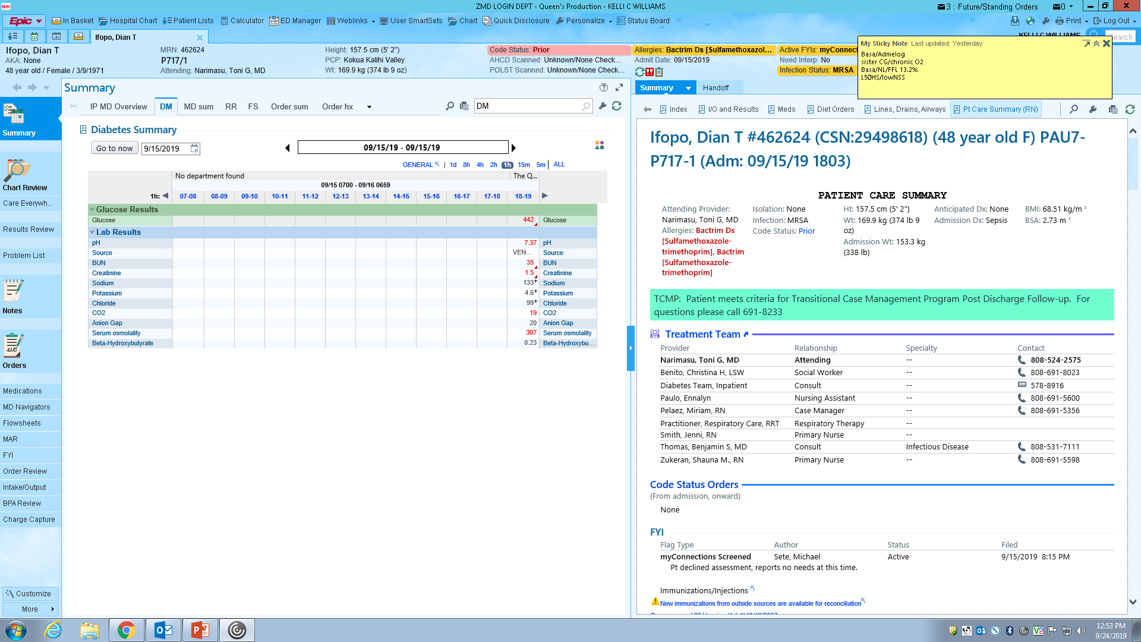
Case scenario #1 Total knee arthroplasty
57 yr old female with a hx of T2DM, HTN, HLD, OSA, osteoarthritis to left knee
Scheduled for an elective total left knee arthroplasty
Home medication: Lantus 28 units SQ HS, Metformin XR 1gm po w/ dinner, Lisinopril 20mg po daily, Atorvastatin 40mg po daily, ASA 325mg po daily
Labs in pre-op holding
What factors within the case scenario would prompt you to cancel or postpone the elective procedure?

Slide 12
Perioperative glucose goals
Avoid severe hyperglycemia
Avoid hypoglycemia
Prevent ketoacidosis/hyperosmolar states
Maintain fluid and electrolyte balance
Notes:
The goal for perioperative management is to avoid severe hyperglycemia, hypoglycemia, prevent ketoacidosis/hyperosmolar states, and maintain fluid and electrolyte balance

Slide 13
Perioperative glycemic targets
Initiate insulin therapy starting at a threshold BG > 180 mg/dL
Once insulin therapy is started, target glucose is 140-180 mg/dL
More stringent goals, <140 mg/dL
  Patients with no hx of DM
  Tightly controlled patients prior to surgery
Notes:
Per the American Diabetes Association a recent randomized controlled study in surgical patients reported that targeting blood glucose levels to <180 mg/dL is associated with lower
Rates of mortality and stroke compared with a target blood glucose <200mg/dL
Insulin therapy should be initiated for treatment of blood glucoses > 180mg/dL
Once insulin therapy is started, a target glucose range of 140-180 is recommended for the majority of patients
However, tighter targets extending to less than 140 can be used and are beneficial to certain patients such as
Patients with no prior hx of DM and those who are tightly controlled prior to surgery
Thus, it is important to determine and individualize the preoperative average and range of blood glucose levels for patients

Slide 14
NICE-SUGAR study
Normoglycemia in Intensive Care Evaluation- Survival Using Glucose Algorithm Regulation (NICE-SUGAR) trial
  Randomly assigned 6104 medical and surgical ICU patients to
    Intensive insulin therapy (target blood glucose level of 81 to 108 mg/dL)
    conventional glucose control (target blood glucose of <180 mg/dL
  Increased the incidence of severe hypoglycemia
  Either increased mortality or had no effect on mortality, when compared to the more permissive blood glucose ranges of 140 to 180 mg/dL and 180 to 200 mg/dL
  Recommend a blood glucose target of 140 to 180 mg/dL in most critically ill adult patients
Notes:
In 2009, The largest trial was the multicenter Normoglycemia in Intensive Care Evaluation Survival Using Glucose Algorithm Regulation (NICE-SUGAR) trial, which randomly assigned 6104 medical and surgical ICU patients to either IIT (target blood glucose level of 81 to 108 mg/dL) or conventional glucose control (target blood glucose of <180 mg/dL) .
Compared to the conventional glucose control group:
●The IIT group had a significantly lower time-weighted blood glucose (115 versus 144 mg/dL [6.2 versus 7.9 mmol/L])
●The IIT group had a significantly higher 90 day mortality (27.5 versus 24.9 percent, odds ratio 1.14, 95% CI 1.02-1.28)
●The IIT group had a significantly higher incidence of severe hypoglycemia (6.8 versus 0.5 percent), defined as a blood glucose <40 mg/dL
In the subgroup of 2232 operative patients, those who received IIT had a significantly higher mortality than those who received conventional glycemic control
Thus, the recommendation is a blood glucose target of 140 to 180 mg/dL in most critically ill adult patients

Slide 15
Pre-operative glycemic management
Check blood glucose levels preoperatively
Hypoglycemia treatment for blood glucose < 70 mg/dL
For long surgeries (>2 hours) or complex surgeries (CABG) check blood glucose more frequently
Hyperglycemia or blood glucose > 180 mg/dL
  Supplemental correction dose of short or rapid acting insulin recommended
  Intravenous insulin infusion for certain conditions
  Standard protocol for subcutaneous correction or intravenous insulin recommended
Notes:
When patients report for surgery in the morning, their blood glucose and time and dose of last diabetes medication should be recorded
Hypoglycemia or glucose <70 should be treated accordingly either with glucose gel, tablets, D50 per your facilities policy
If blood glucose is > 180 mg/dL, a supplemental correction dose of short or rapid acting insulin is recommended
Intravenous insulin infusion may need to be initiated in some conditions such as severe hyperglycemia, Type 1 diabetes, prolonged surgeries
A standard protocol for subcutaneous supplemental correction insulin dose and also for intravenous insulin infusion rates should be adopted

Slide 16
Intra-operative glucose management
Blood glucose monitoring frequency is dependent on
  Duration, complexity and timing of surgery
  Preoperative blood glucose level
  Preoperative diabetes pharmacotherapy
  Intraoperative pharmacotherapy
  Type of anesthesia
Route of insulin administration
  Subcutaneous rapid acting insulin
    minimally invasive
    easy to administer
    low rate of hypoglycemia
    Effective in correcting hyperglycemia
  Intravenous insulin infusion
    Longer, complex cases
    Hemodynamically unstable
Notes:
Intraoperative management is aimed at treating hyperglycemia and avoiding hypoglycemia
The frequency of blood glucose monitoring during anesthesia depends on the duration, complexity, invasiveness and timing of surgery,
Preoperative blood glucose level <100 should be rechecked intraoperatively
Preoperative diabetes medication such as long acting insulin or sulfonylurea may increase the risk for hypoglycemia while the patient is NPO
Intraoperative pharmacotherapy utilized such as steroids may cause hyperglycemia
Sedation and/or general anesthesia may mask the signs and symptoms of hypoglycemia and hyperglycemia
Thus, frequent blood glucose monitoring is recommended and
Medications necessary to treat hypoglycemia, including 50% dextrose and glucagon should be readily available
Patients undergoing surgery of short durations are often appropriate candidates for subcutaneous insulin treatment
Subcutaneous rapid acting insulin analogs are minimally invasive, easy to administer, have a low rate of hypoglycemia and is effective in correcting hyperglycemia
IV insulin infusion is recommended in patients undergoing procedures with anticipated hemodynamic changes, significant fluid shifts, expected changes in temperature
Or lengthy operative times. These variable alter subcutaneous insulin absorption and distribution
Unreliable pharmacokinetics may result in persistent hyperglycemia or sudden hypoglycemia.
Blood glucose testing should occur hourly when using an IV insulin infusion

Slide 17
Post-operative glucose management
Non-critically ill, non-ICU patients may be managed with subcutaneous insulin
Blood glucose checks need to continue at least every 2 hours in patients with diabetes and for patients who received insulin in the OR
Correctional subcutaneous rapid-acting insulin doses are provided for blood glucose levels > 180 mg/dL
Continuation of blood glucose monitoring should be continued upon transition to surgical unit
Determination of diabetes medication treatment
  patient’s level of consciousness, recovery condition, ability to swallow and oral status
Sliding scale insulin alone is not recommended
Notes:
In the post anesthesia recovery unit, Glucose control in non critically ill, non-ICU patients may be managed with subcutaneous insulin
While the patient is in the post anesthesia recovery unit, blood glucose checks need to continue at least every 2 hours for all patients with diabetes
And for patients without diabetes who received insulin in the operating room
Correctional subcutaneous rapid-acting insulin doses are provided for blood glucose levels > 180 mg/dL
When patients transition out of the PACU on to the surgical units, continuation of blood glucose, monitoring should be continued
Assessment of the patient’s level of consciousness, recovery condition, ability to swallow and oral status will determine which diabetes medication treatment will be appropriate
However, sliding scale insulin alone is not recommended as the single regimen as it may result in hypoglycemia and/or hyperglycemia

Slide 18
What are the signs and symptoms of hypoglycemia?
Notes:
Word cloud: Text KELLIWILLIAM891 to 22333

Slide 19
Safety of glycemic control and risks of Hypoglycemia
Hypoglycemia is blood glucose < 70 mg/dL
Poor clinical outcomes, increased mortality and morbidity and may result in increased neurological damage
Increased risk for hypoglycemia
  tight glycemic control, labile blood glucose levels, history of frequent hypoglycemia, glycemic goals are too aggressive
Masked by general anesthesia and sedation
Prevention of hypoglycemia
  monitor blood glucose levels, communicate medications that were taken preoperatively, hypoglycemia treatment protocol, resume oral intake as soon as patients are able to swallow safely
Notes:
Hypoglycemia or blood glucose <70 mg/dL is the most common event associated with patients taking insulin or insulin secretagogues and prolonged NPO status
It is associated with poor clinical outcomes, increased mortality and morbidity and may result in increased neurological damage
Patients who are at increased risk for perioperative hypoglycemia include patients with tight glycemic control, labile blood glucose levels, history of frequent hypoglycemia and when glycemic goals are too aggressive
Hypoglycemia symptoms are masked by general anesthesia and sedation
Therefore, care must be provided to appropriately monitor blood glucose levels for dangerous drops, communicate medications that were taken preoperatively, utilize a hypoglycemia treatment protocol and resuming oral intake as soon as patients are able to swallow safely

Slide 20
What are the adverse effects of hyperglycemia?
Notes:
Word cloud: Text KELLIWILLIAM891 to 22333

Slide 21
Impact of hyperglycemia on surgical outcomes
Ramos study: Postoperative hyperglycemia increased the risk of postoperative infections irrespective of diabetic status
Pro-inflammatory effects that contribute to postoperative capillary leak syndrome, platelet dysfunction and altered immune response
Firsch study: Hyperglycemia had worse outcomes with postoperative infections, acute renal failure, acute myocardial infarction, 30-day mortality, longer ICU and hospital stays.
Goal: avoid hyperglycemia
Notes:
A retrospective study of 995 patients by Ramos, found that postoperative hyperglycemia increased the risk of postoperative infections irrespective of diabetic status.
Hyperglycemia has pro-inflammatory effects that contribute to postoperative capillary leak syndrome, platelet dysfunction and altered immune response
Frisch and colleagues retrospective study of over 3000 non-cardiac surgery patients showed that patients with hyperglycemia had worse outcomes with postoperative infections, acute renal failure, acute myocardial infarction, and 30-day mortality, as well as longer ICU and hospital stays.
Thus, avoiding hyperglycemia is recommended

Slide 22
Perioperative Glucose Management for Joint Replacement at QMC Punchbowl
Notes:
A perioperative glucose management project started as part of an Advanced Quality Training Program at QMC which consisted of small teams that looked at individual problems. Through the course it taught me how to perform a test of change to tackle one aspect of a problem, implement an intervention, collect data, analyze the data, then standardize the process to ultimately improve patient safety and as wall as provide quality and financial outcomes.

Slide 23
General Mission Statement
Improve perioperative glycemic control to improve safety for surgical patients by reducing the risk of complication, infection, and unnecessary hospitalization days.
Notes:
I wanted to tackle a problem that I was passionate about and improve the process to provide all patients who undergo surgery with optimal glucose management . Thus, the general mission statement which started this project was to improve perioperative glycemic control to improve safety for surgical patients by reducing the risk of complication, infection, and unnecessary hospitalization days.

Slide 24
Aim Statement
To increase the proportion of patients receiving perioperative blood glucose monitoring (pre-op, OR, PACU) to 85% by June 2019
To increase the proportion of patients who experience a hyperglycemic event (BG >200) to use a blood glucose management protocol to 85% by June 2019
To decrease the length of stay by 10% for every 500 patients who received perioperative glucose management by June 2019
Notes:
Therefore, the aim statement had 3 goals.
First, to increase the proportion of patients receiving perioperative blood glucose monitoring to 85% by June 2019.
Second, to increase the proportion of patients who experience a hyperglycemic event which is a blood glucose > 200 to use a blood glucose management protocol to 85% by June 2019.
Lastly, to decrease the length of stay by 10% for every 500 patients who received perioperative glucose management by June 2019.

Slide 25
Cohort definition and intervention period
Elective knee and hip replacement surgeries done in MOR at Punchbowl
December 10, 2018- June 30, 2019
Notes:
The intervention period started on December 10, 2018 through June 30, 2019 on elective knee and hip replacement surgery patients performed in the Main OR at QMC PB campus.

Slide 26
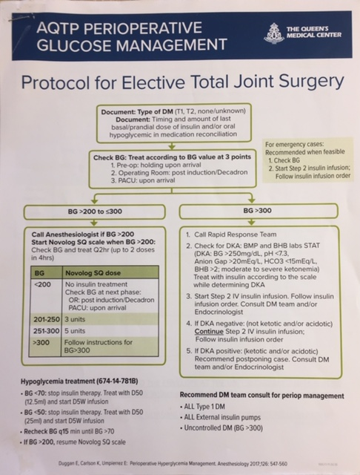

Slide 27
Increased Intraoperative Glucose monitoring to 95.7%
Goal 1: To increase the proportion of orthopedic surgery patients receiving perioperative blood glucose monitoring
 | Baseline (Discharges in Jan 2017-Jan 2018) |  |  | Intervention (Surgery Date >= 12/10/18 and discharges thru 6/30/2019)
 | #Surgeries | #BG Monitoring | %BG Monitoring | #Surgeries | #BG Monitoring | %BG Monitoring
Holding area | 845 | 822 | 97.3% | 397 | 386 | 97.2%
Intra-op | 845 | 127 | 15.0% | 397 | 380 | 95.7%
PACU | 845 | 771 | 91.2% | 397 | 394 | 99.2%
Overall in any of the three periop areas | 845 | 840 | 99.4% | 397 | 397 | 100.0%
Notes:
The next several slides will be discussing the results of this pilot project.
Goal #1 was to increase the proportion of Orthopedic surgery patients receiving perioperative blood glucose monitoring.
On the left side of the screen shows the baseline data of blood glucose monitoring from January 2017- January 2018, broken down into the 3 phases of care- pre-op holding, intra-op and post anesthesia recovery unit
There were 845 cases with blood glucose monitoring in each phase of surgery. The overall blood glucose monitoring was 99.4%. However, the intraoperative monitoring stood out at only 15% compared to the other areas.
On the right side of the screen shows the intervention data from December 10, 2018 through June 30, 2019.
There were 397 cases with blood glucose monitoring in each phase of surgery. The overall blood glucose monitoring increased to 100%.
With the intraoperative monitoring significantly improving to 95.7%.

Slide 28
Intra-op blood glucose monitoring significantly increased after intervention
Notes:
This slide displays a the p-chart of the intraoperative glucose monitoring
On the left side of the screen the Y-axis shows us the percent of glucose monitoring. The higher the better.
On the bottom of the screen the X-axis shows us the occurrence of monthly monitoring.
The solid green line is the mean.
During the baseline the mean was 14.8%.
The dotted red lines are the upper and lower limits.
I had an initial perioperative glucose monitoring pilot from March to May 2018. Thus, an uptick in glucose monitoring occurred.
As you can see, when the pilot ended, the glucose monitoring did not sustain intraoperatively.
Thanks to the UHA grant, I was able to restart the perioperative glucose monitoring
And the intraoperative glucose monitoring significantly increased during the intervention period with a mean of 95.5%
The variations are within the limits which shows good control.

Slide 29
93% Overall increased use of protocol
Goal 2: To increase the proportion of orthopedic surgery patients who experience a hyperglycemic event (BG >200) to use a blood glucose management protocol
 | Baseline (Discharges in Jan 2017-Jan 2018) |  |  | Intervention (Surgery Date >= 12/10/18 and discharges thru 6/30/2019)
 | #Surgeries with BG >200 | #Treated | %Treated | #Surgeries with BG >200 | #Treated | %Treated
Overall in any of the three periop areas | 39 | 18 | 46.2% | 18 | 16 | 88.9%
Notes:
Goal #2 was to increase the proportion of Orthopedic surgery patients who experience a hyperglycemic event or blood glucose > 200mg/dL to use a blood glucose management protocol to treat hyperglycemia.
On the left side of the screen we have the baseline data.
There were 39 surgeries with patients blood glucose >200. 18 events were treated which was 46.2%.
On the right side of the screen we have the intervention data.
There were 18 surgeries with patients blood glucose >200. 16 events were treated per protocol which was 88.9%
Thus, overall increased use of the protocol was 93%

Slide 30
Decreased mean inpatient hospital length of stay by 23%
Goal 3: To decrease the length of stay (LOS) by 10% for every 500 patients who received perioperative glucose management by June 2019
 | Baseline (Discharges in Jan 2017- Jan 2018) | Intervention (Surgery Date >= 12/10/18 and discharges thru 6/30/2019)
#Discharges | 845 | 397
LOS Mean | 2.62 | 2.03
LOS SD (Standard Deviation) | 2.28 | 1.31
30-day Readmission counts | 28 | 8
30-day Readmission% | 3.3% | 2.0%
Notes:
Goal #3 was to decrease the length of stay by 10% for every 500 patients who received perioperative glucose management
On the left side of the screen we have the # of discharges, mean length of stay and the standard deviation of the length of stay
Below , the 30 day readmission counts and percentage
In the middle column, there were 845 discharges with a mean length of stay of 2.62 days, 28 readmissions which was 3.3% of readmissions in this population
On the right side of the screen, during the intervention period, there were 397 discharges with a decreased mean length of stay of 2.03 days, 8 readmissions which was 2.0% of this population.
Thus, the mean inpatient hospital length of stay decreased by 23%
30-day Readmission counts treated recent discharges in Jun eligible for denominator as it was refreshed on 8/14/19.
Not significant different.

Slide 31
Notes:
After the data was collected and analyzed as seen in the previous screens.
The process was adjusted and a perioperative hyperglycemia Orderset 640 was created to standardize the orders necessary to treat hyperglycemia.
The orderset applies to all surgical admits and hospitalized patients.
It includes: BG checks in pre-op holding and PACU, Novolog correction scales, consultation orders for the inpatient DM team or Endocrinologist at PB and WO.
Or the Admitting MD at NHCH.
And the pre/post op hand off report for nurses, now includes documentation of the Novolog dose and time given, as it applies, and the blood glucose result

Slide 32
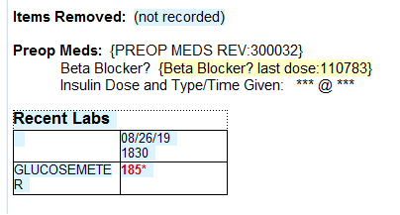
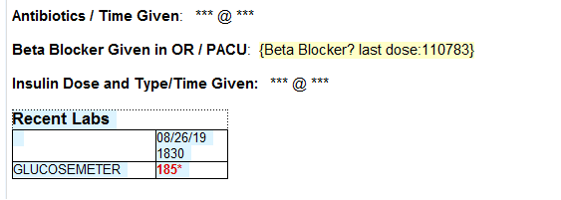
Pre-op hand off report:
Post-op hand off report:
Notes:
The intervention period started on December 10, 2018 through June 30, 2019 on elective knee and hip replacement surgery patients performed in the Main OR at QMC PB campus.

Slide 33
Summary of PI project
The proportion of patients receiving perioperative blood glucose monitoring increased to 100%
  Largest increase seen intraoperatively
The proportion of patients who experience a hyperglycemic event (BG >200) to use a blood glucose management protocol increased to 93%
The length of stay decreased by 23% in patients who received perioperative glucose management
Comprehensive nursing education completed at QMC PB and WO
A standardized Perioperative Hyperglcyemia orderset created and in production at QMC PB and WO
  NHCH to go live on October 1, 2019
Notes:
In closing, I want to thank UHA again for giving Queen’s Medical Center this grant to fund some of the projects that were started in the Advanced Quality Training Program.
It truly helped to fulfill what we learned. To tackle a specific problem, collect data , perform an intervention, evaluate the outcomes and ultimately, standardize the high quality care we provide to patients based on evidence based practices.
I’m happy to say the proportion of patients receiving perioperative blood glucose monitoring increased to 100%.
The treatment of hyperglycemic events or blood glucose >200 increased to 93% and
The hospital length of stay in patients who received perioperative blood glucose monitoring decreased by 23%.
Thus, through this collaborative effort between UHA and QMC, a standardized Queen’s Health Systems perioperative hyperglycemia orderset was created and put into production at PB and WO on September 5, 2019, and will go live for NHCH on October 1, 2019.
Thank you.

Slide 34
Summary
Hyperglycemia represents a significant risk to surgical patients
  perioperative complications in both patients with and without diabetes
Insulin administration intra and postoperatively have been shown to improve clinical outcomes
Treat blood glucose values >180 with insulin
Target range for the perioperative period is 140-180 mg/dL
A perioperative glucose management strategy should be implemented for hyperglycemic patients regardless of their diabetic status
Notes:
In closing,
Hyperglycemia represents a significant risk to surgical patients and a large population are hyperglycemic and many have undiagnosed diabetes.
Current studies demonstrate an association between hyperglycemia and risk of perioperative complications in both patients with and without diabetes
Insulin administration intra and postoperatively have been shown to improve clinical outcomes
It is recommended to treat blood glucose values >180 with insulin
Target range for the perioperative period is 140-180 mg/dL
Lastly, a perioperative glucose management strategy should be implemented for hyperglycemic patients regardless of their diabetic status

Slide 35
Mahalo!

