Slide 1
Postoperative Care for
Liver and Kidney Transplant Patients
Makoto Ogihara, MD
Transplant Surgeon
HIPAN 2019 Annual Conference
September 30, 2019

Slide 2
Who Needs Kidney Transplant?
700,000 patients on dialysis in US
4,000 patients on dialysis in HI
90,000 patients on waitlist in US
300 patients on waitlist in HI
Average waiting time in HI: 4 years
90% on hemodialysis (HD)
10% on peritoneal dialysis (PD)
Causes of renal failure: diabetes, hypertension (75%)

Slide 3
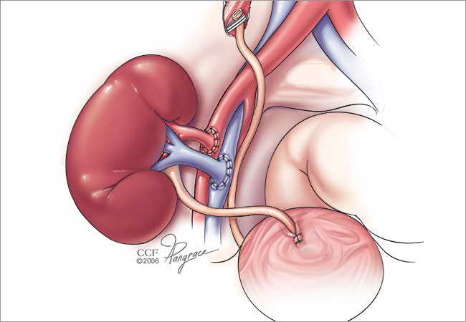
How Kidney Transplant is Done in OR

Slide 4
Case Study 1
65 y/o Vietnamese male retired taxi driver
HD since 2012 due to lupus nephritis
S/p CABG
Deceased kidney transplant in May 2019

Slide 5
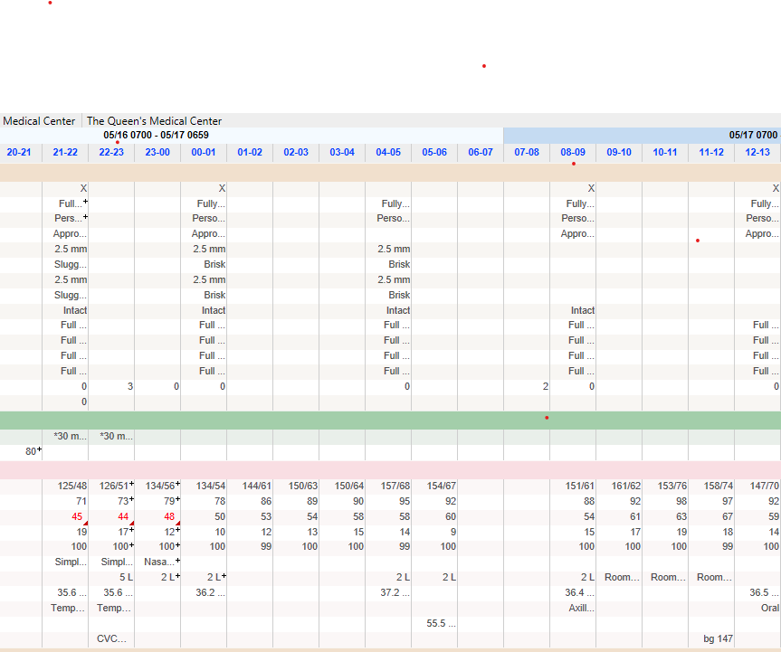
Case Study 1, Vitals

Slide 6
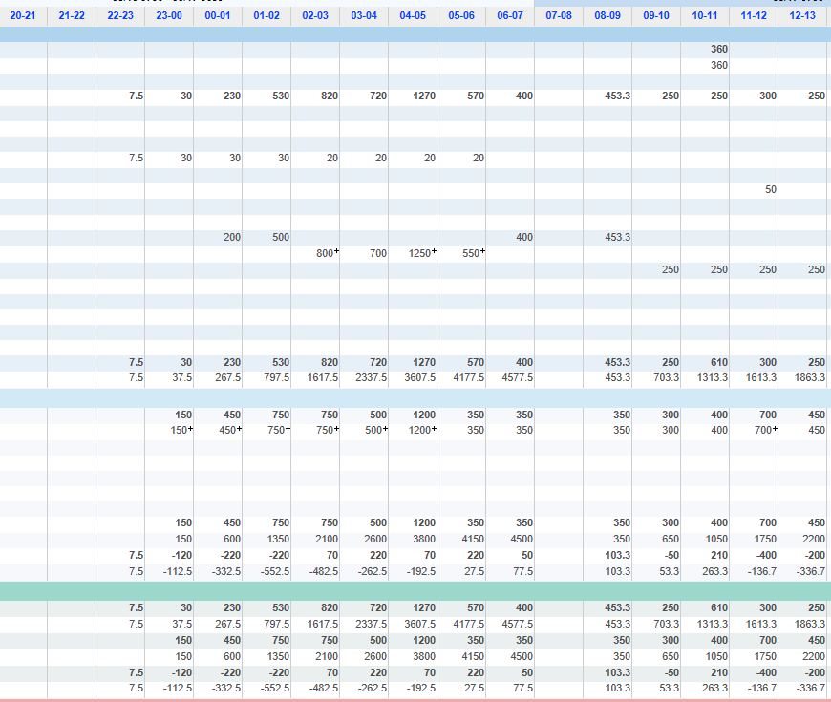
Case Study 1, I/O

Slide 7
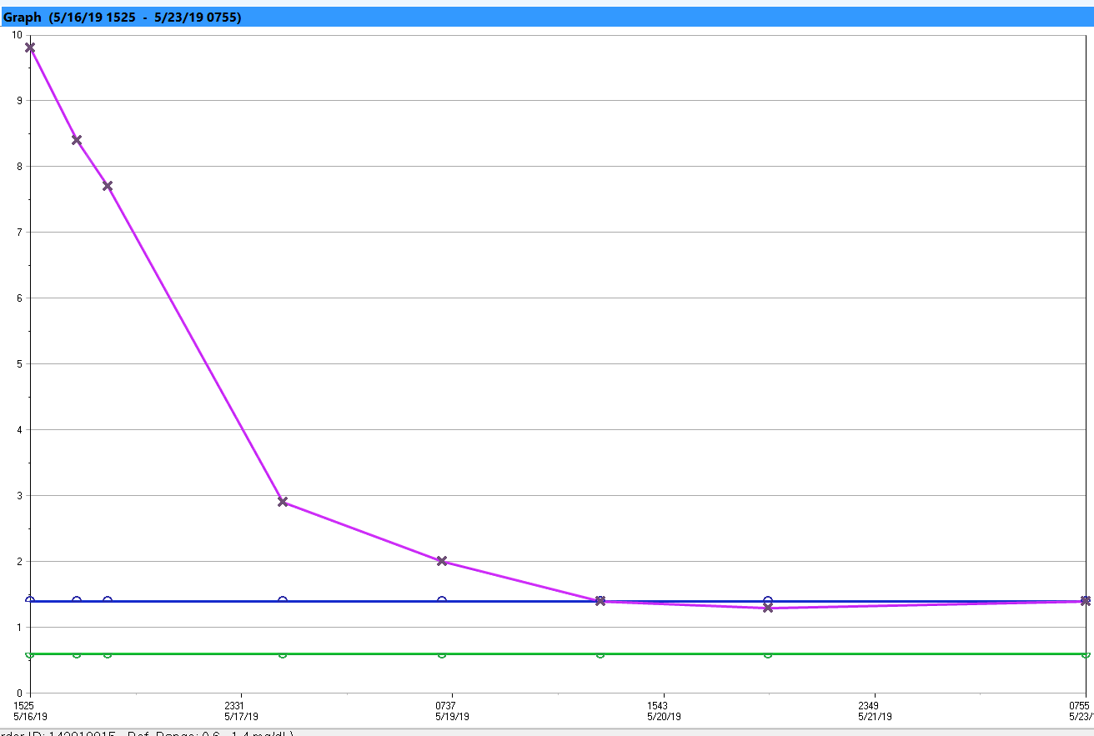
Case Study 1, Creatinine Trend

Slide 8
Unique Postop Course of Kidney Transplant
Unpredictable urine output
Replace UO with IVF
Avoid over or under-resuscitation
Transplant kidney depends on perfusion pressure
Maintain MAP
Watch for hyperkalemia
Anemia (drop of Hb) is very common
Recipient generally feels great with only mild discomfort

Slide 9
Unusual Serious Complications
Postop hemorrhage: drain output, hypotension, swelling
Acute thrombosis of transplant renal artery: sudden cessation of brisk urine output
Acute thrombosis of transplant renal vein: hematuria, decrease in urine output
Ischemia of lower extremity of transplant kidney side

Slide 10
Common Transplant Medications
Immunosuppressants
Tacrolimus (Prograf)
Mycophenolate (Cellcept)
Steroid (Solumedrol)
Infection prophylaxis
Valganciclovir (Valcyte)
Sulfamethoxazole/TMP (Bactrim)

Slide 11
Who Needs Liver Transplant
17,000 patients on waitlist in US
30 patients on waitlist in HI
Timing of liver transplant depends not on waiting time but on MELD score
MELD score ranges 6-40 (based on INR, Cr, Bil)
Causes of liver failure: alcohol, hepatitis B/C, NASH

Slide 12
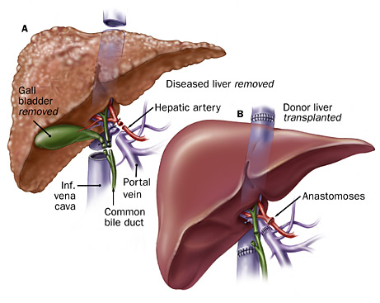
How Liver Transplant is Done in OR

Slide 13
Case Study 2
48 y/o part Hawaiian male disabled plumber
Heavy alcohol use and morbid obesity
Large-volume ascites
Encephalopathy
Listed for liver transplant with MELD 32
Admitted from a nursing home to QMC for spontaneous bacterial peritonitis
Complicated by hepatorenal syndrome, started on CRRT in ICU

Slide 14
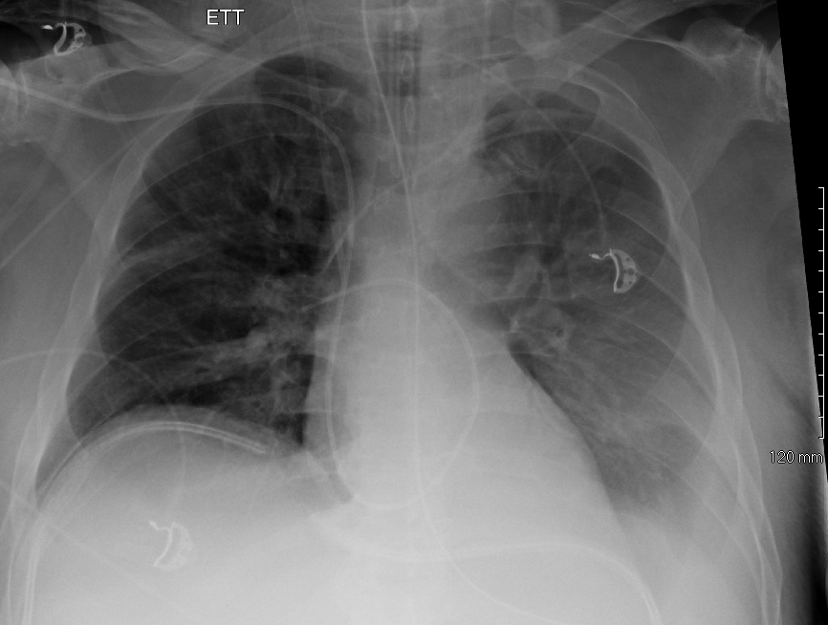
Case Study 2, Chest X-ray

Slide 15
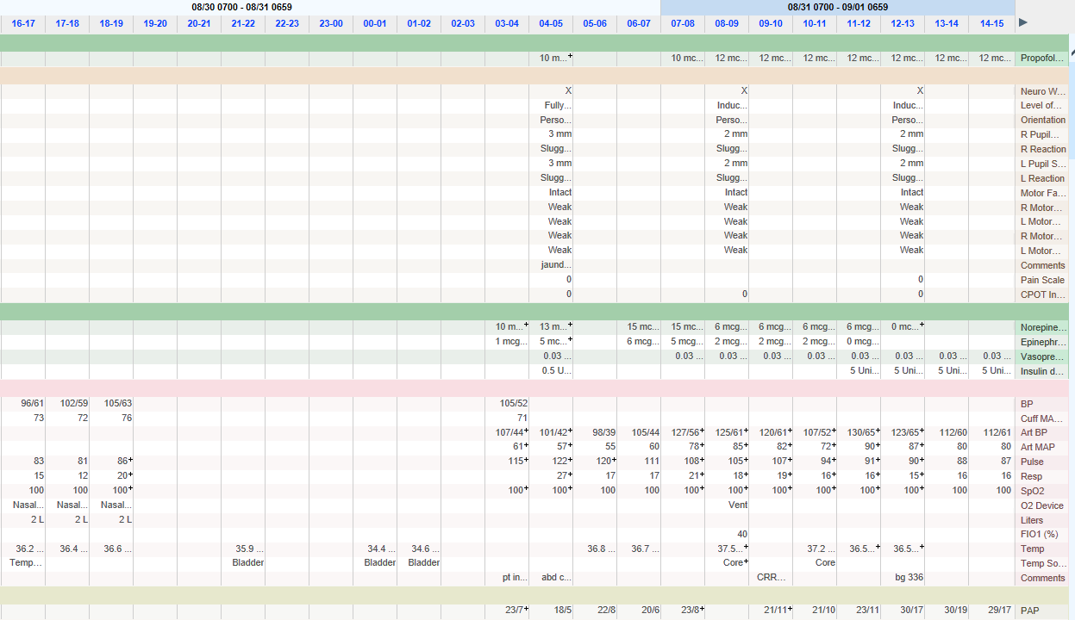
Case Study 2, Vitals

Slide 16
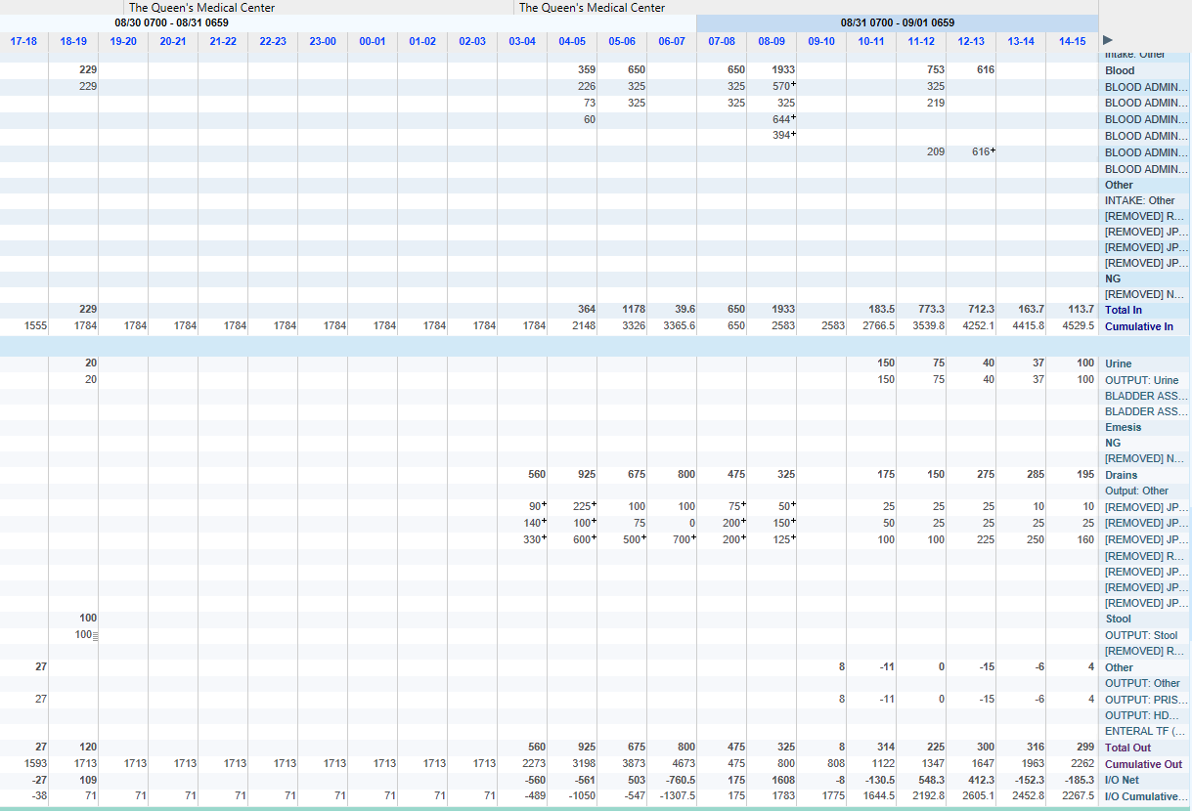
Case Study 2, I/O

Slide 17
Unique Postop Course of Liver Transplant
With improving transplant liver function
Mental status improves
Normotension
Normothermia
Bleeding decreases/stops
Stable urine output
Hb/lactic acid/INR

Slide 18
Serious Complications
Immediate postop
Hemorrhage requiring re-exploration (10-15%)
Intermediate postop
Vascular thrombosis, most commonly hepatic artery (5-10%)
Late postop
Bile leak
Abscess, peritonitis

Slide 19
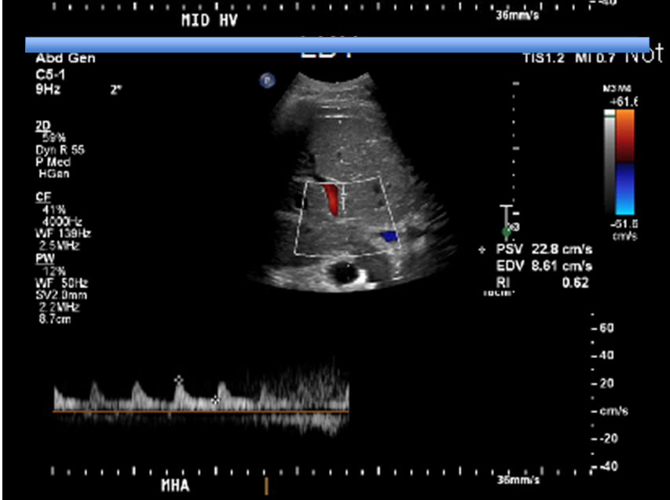
Case Study 2, Doppler US

Slide 20
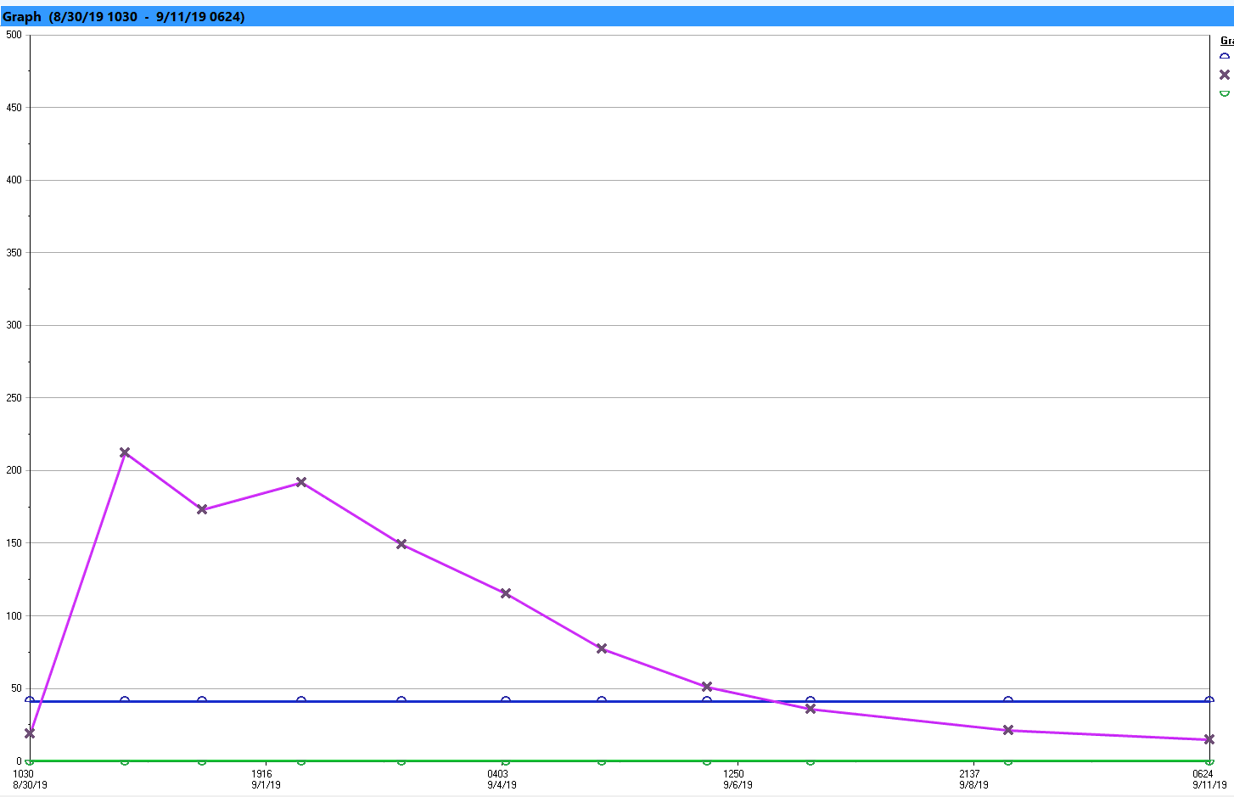
Case Study 2, ALT Trend

Slide 21
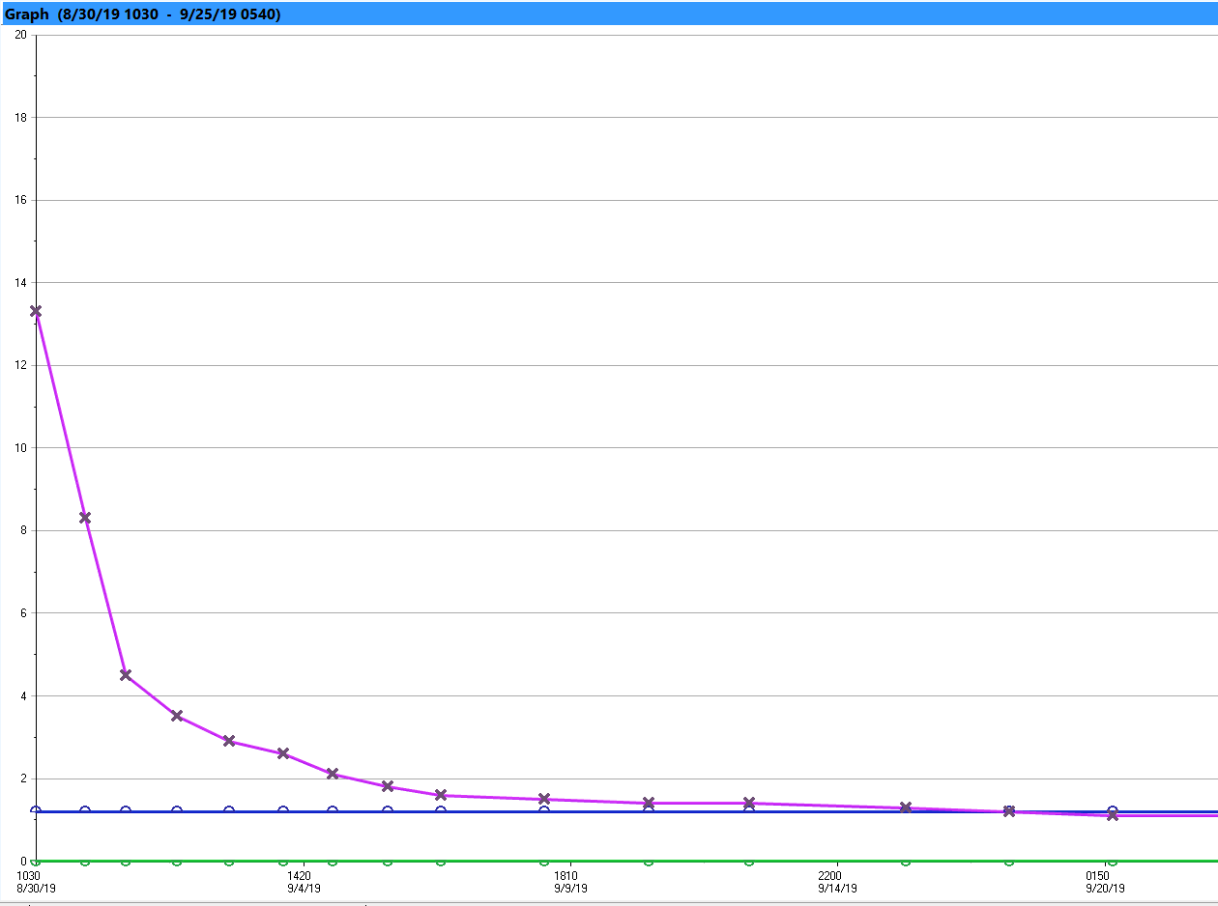
Case Study 2, Bilirubin Trend

Slide 22
Common Transplant Medications
Immunosuppressants
Tacrolimus (Prograf)
Mycophenolate (Cellcept)
Steroid (Solumedrol)
Infection prophylaxis
Valganciclovir (Valcyte)
Sulfamethoxazole/TMP (Bactrim)
Nystatin

Slide 23
Take Home Points
Kidney Transplant
Usually hemodynamically stable
Hourly urine output, watch for sudden change
Comorbidity (DM, HT, CAD)
Behaves as medical ICU patient
Liver Transplant
Hemorrhage is more common
Drain output and hypotension
Behaves as surgical ICU patient

Slide 24
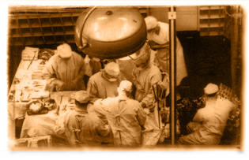
First Kidney Transplant in 1954

Slide 25
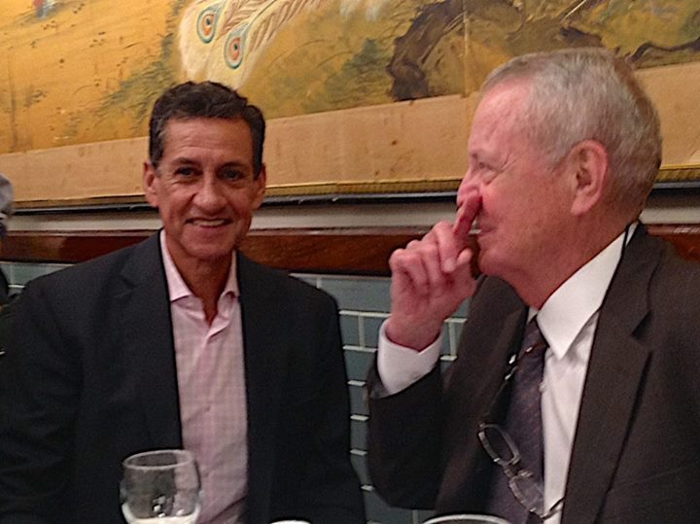
Liver Transplant Pioneers

Slide 26
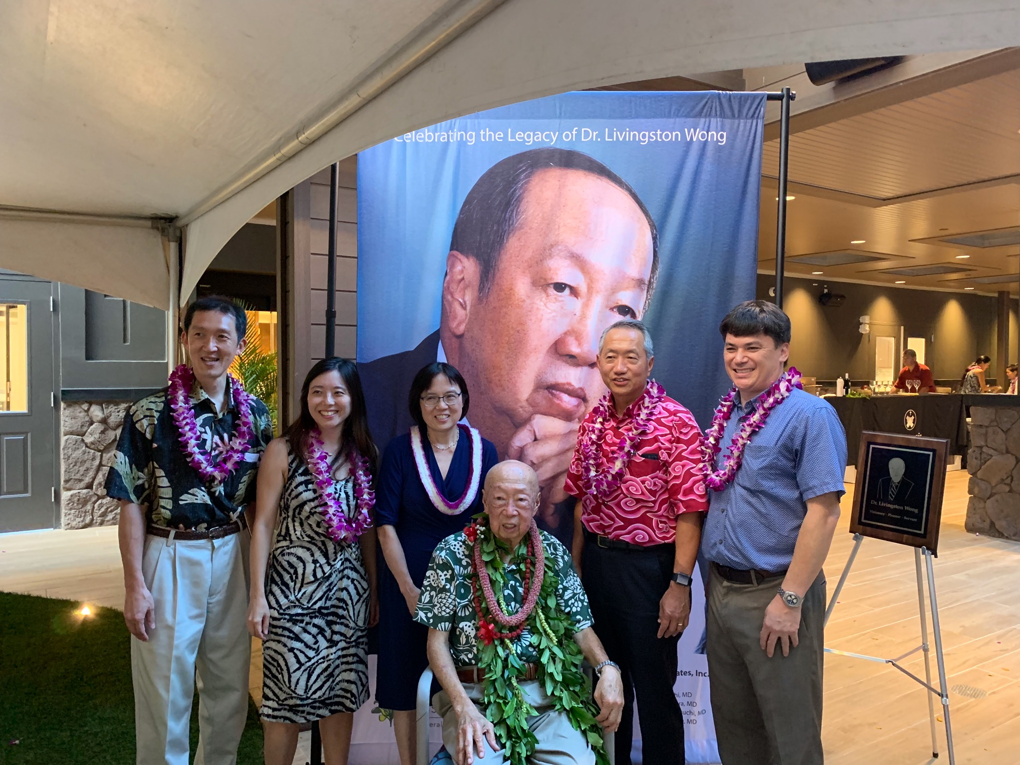
Transplant Surgeons in Hawaii

