Slide 1

The Science of Compassion
Anna DeLong, LCSW, CEAP, Mindfulness Teacher
Faculty and Employee Assistance program; Honorary Appointment School of Nursing;
Compassionate Care Initiative Ambassador
acb2f@virginia.edu; 434-924-8140

Slide 2

Notes:
Compassion interrupts fear circuitry – many or most of you don’t know me and even if you do know me perhaps you don’t know that I’m very afraid of giving talks to large groups of people in public and have considered whether or not I should have an emesis basin hidden somewhere easily accessible.
Thank goodness – compassion interrupts the fear circuitry in my brain
– AND INTERRUPT THE FEAR CIRCUITRY.
My respect for (health care providers) is both personal and profession. Professionally I have been involved on health care teams for more than 30 years now. I’ve noticed the way you care, how hard you work, the sacrifices you make, I’ve heard so often from nurses who say they deliberately don’t drink water during a shift, so they won’t have to stop and pee.
When I focus on my deep respect for your profession. I’m not afraid to be here with you today. Instead, my desire to share this empowering information with you in support of your own sustainable health – and to increase the potential that you will be nourished by your work rather than drained. My desire to support you so you can continue to do your very important work in a sustainable healthy way – that brings meaning and even joy in caring - overrides my fear. Is so much more important than my fear. So here I stand – emesis basin less and very honored to be in the presence of so many important valued necessary team members. May I begin with a heartfelt THANK you for all the important work that you do.

Slide 3
INTENTION
May you be well
May you live and work with ease
May you attend to your own needs kindly every day
May you respond to your own limitations with compassion just as you care for others
May you remember and honor your own innate goodness
May you remember and be guided by what you find most meaningful
May you be nourished by your meaningful work

Slide 4
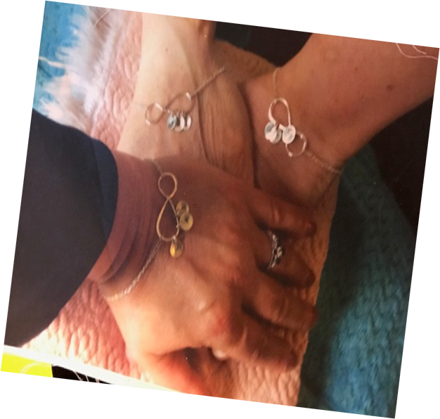
Compassion is Transformative

Slide 5
COMPASSION AGENDA
Science of compassion
Difference between compassion and empathy
Benefits of compassion
Cultivating compassion
Sustaining compassion
For more info…

Slide 6
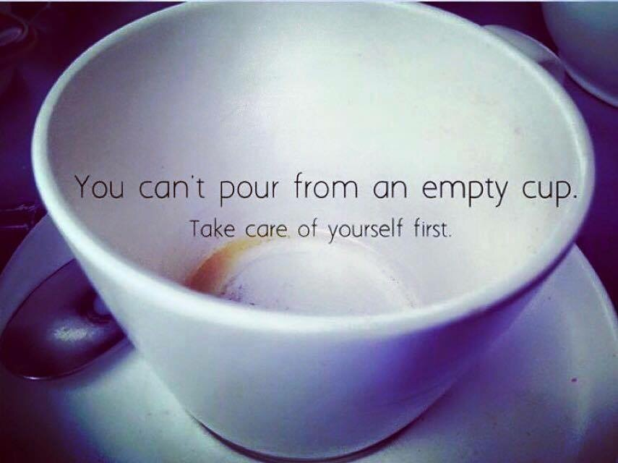

Slide 7

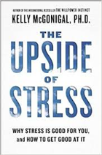

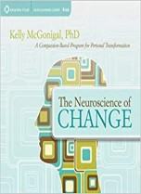
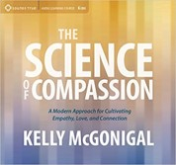
The Best Way to Improve, grow, etc…
“….is to have really great strategies to nourish the most exhausted version of ourselves rather than just keep expecting our best self to show up.”
K. McGonical, PhD

Slide 8

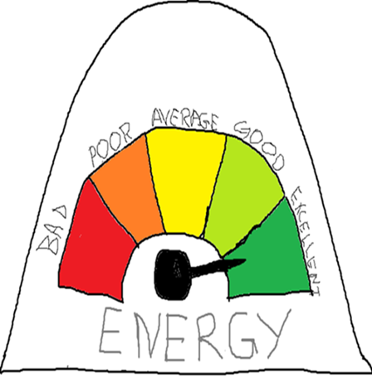
SELF AWARE - SELF CARE
Pay attention to your own energy needs
Ensure your self-care plan is strong enough to balance the stress of emotional impact of suffering you experience and/or witness.
This is NOT a luxury,
IT IS A NECESSITY!

Slide 9

Definition of Resiliency
An INTELLIGENT deployment
of limited resources
Most of us have wasted too much time and prescious resources trying to solve problems over which we have no control.
Dean Becker, PhD
On the other hand we have also found ourselves disengaging and giving up prematurely so that we miss opportunities to solve the problems that come our way.

Slide 10
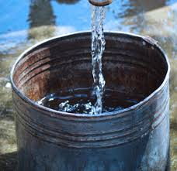
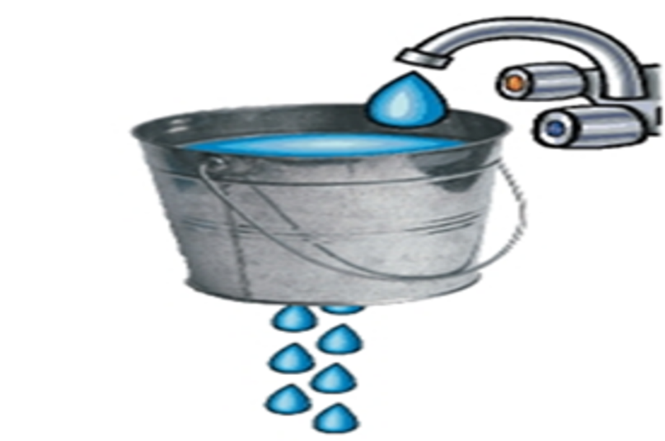
WISE DEPLOYMENT
UNWISE DEPLOYMENT
What’s within your control
AND
In keeping with your goal
Allowing thoughts, efforts and energy to ruminate on that which is outside of control AND/OR not in keeping with the goal.

Slide 11
Compassion is a natural basic instinct
Like language
Born with potential - Needs to be nourished
Competes with other conflicting instincts
Avoid and escape suffering
When we experience suffering deeply, can trigger a desire to escalate suffering rather than relieve suffering (revenge/punishment)

Slide 12

benefits of choosing to cultivate compassion
resilience to stress
happiness
gratitude
physical health and well being (live longer)
promotes social connections
powerful antidote to feelings of loneliness or social anxiety and separation
Key source of meaning and hope
K. McGonical, PhD

Slide 13



Immune boost
5 min compassion meditation
(Focus on your heart, then think of someone you love)
Boost in SIgA
as much as 240%
Lasted up to 5 hours

Slide 14
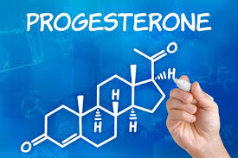

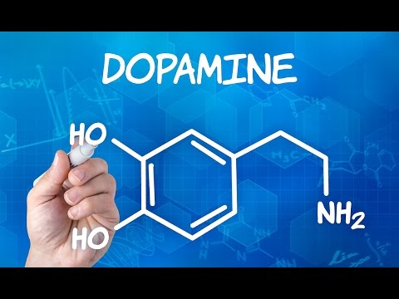
Biology of compassion promotes Wellbeing and social Engagement
Linked to recovery from stress
Helps immune, cardiovascular systems
Sets stage to be strengthened by stress
Improves empathic accuracy
Boosts positive sensations from social engagement
Molecule of courage – inhibits fear circuitry
Anti-inflammatory, anti oxidant, helps cells regenerate
Feel good hormone
Associated with things we find pleasurable
Important hormone which motivates action
Biology of hope in the brain
Notes:
Promotes Wellbeing and social engagement:
Helps recover from stress
Combo of oxytocin and dopamine – desire to connect and dampened fear Reduces implicit bias
Increases potential for meaningful experiences

Slide 15

Compassion definition
Compassion is a multidimensional process
An awareness of suffering (cognitive/empathic awareness)
Sympathetic concern related to being emotionally moved by suffering (affective component)
A wish to see the relief of that suffering (intention)
A responsiveness or readiness to help relieve that suffering (motivational)
Hooria Jazaieri, LMFT
Stanford University School of Medicine
Notes:
Compassion is an unfolding process in our minds and in our bodies that is in response to pain or suffering. Compassion begins when we become aware of suffering (either another person’s or our own suffering.
As compassion unfolds, we have a sense of sharing in or being affected in some ways by the suffering – may feel a sense of distress.
After the distress we feel a growing sense of connection, care, love or kindness toward the one who is suffering – so that we will stay, (rather than run away) and a desire to relieve the suffering and a wish that the person who is suffering could know peace, courage, hope, connection support.
A willingness to respond so that we might relieve the suffering.

Slide 16
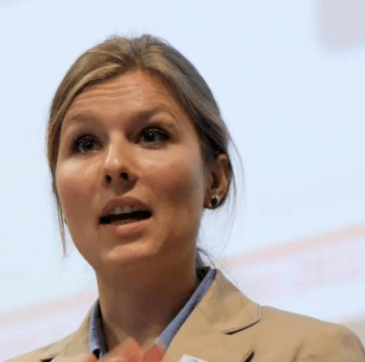

Neuroscientists – Compassion Experts Olga Klimecki, PhD; Tania Singer, PhD
“Empathy is really important for understanding other’s emotions…but there is a downside of empathy…..When we share in the suffering of others too much, our negative emotions increase and this carries the danger of an emotional burnout……vicarious pain”
Research suggests deliberate cultivation of compassion offers new coping strategies that fosters positive affect even when confronted with distress of others.
Prior to the compassion training, participants in the study showed brain activity in an empathic network associated with pain perception and unpleasantness; after the training, brain activity shifted to a compassionate network that has been associated with positive emotions and physiological responses.

Slide 17
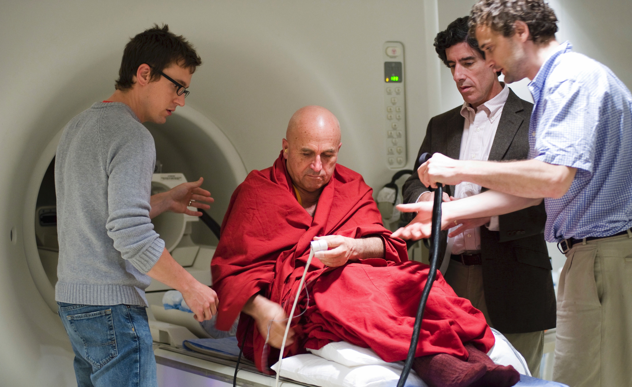
DIFFERENCE BETWEEN COMPASSION & EMPATHY
Research compared:
Compassion state with default resting state
Compassion and Empathy
Expert meditators (compassion) with non-expert meditators
Lutz et al. 2008; 2009 University of Wisconsin

Slide 18
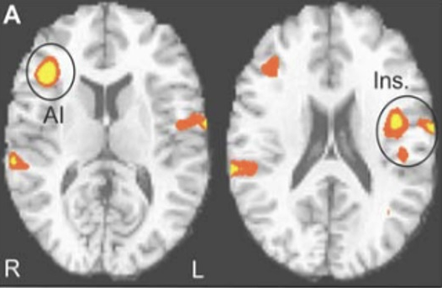
compassion and empathy begin with activation of alarm system
Lutz et al. 2008; 2009
University of Wisconsin

Slide 19
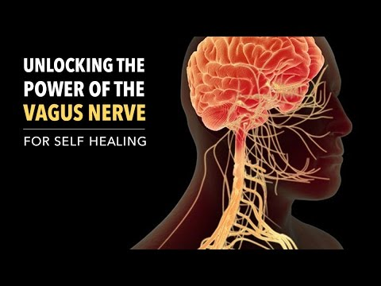
Second phase of compassion
people often report feeling more grounded & centered
Everything slows down, (speech, actions, heart rate, respiratory rate)
Even impacts vocal chords

Slide 20
BALANCING ACTIVATION WITH CALM
VAGUS NERVE
(stabilizing)
HEART RATE
ACCELERATION
(ENERGIZING)
A physiology that supports social engagement

Slide 21

SIGNATURE OF COMPASSION
Nervous Systems:
activated/ready
AND
grounded, centered, slowed
Higher heart/rate variability
Respiratory/heart rate in sync
BALANCE Of
OPPOSITES

Slide 22
Results of compassion training
“Although the negative emotions did not disappear after the compassion training; participants appeared better able to stay in touch with negative emotions from a calmer mindset (more associated with pause and plan mode of the brain rather than the alarm system.”
Tania. Singer, PhD

Slide 23




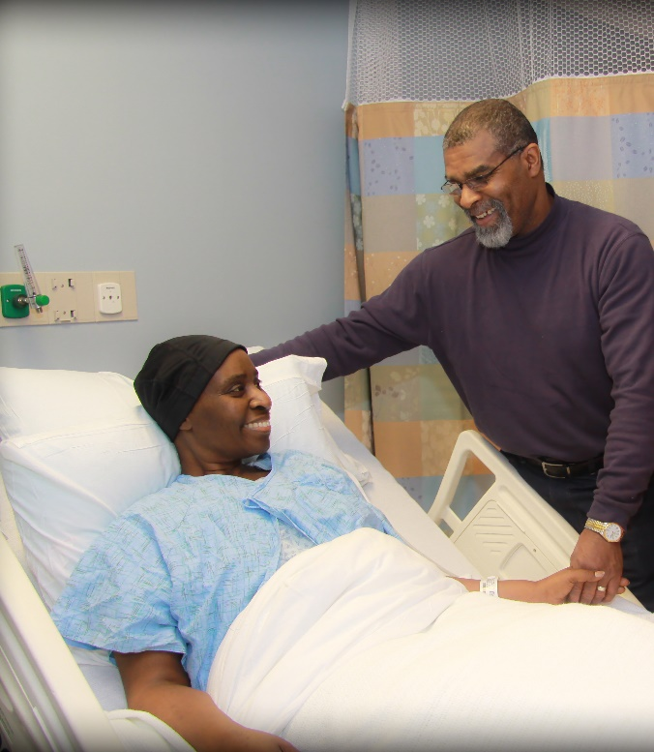

Slide 24

Genuine intention initiates compassion process
Point to your goal!
“A response to suffering that is rooted in genuine caring is most effective.”
K. McGonical
Even an amazing athletic move
is ineffective if not aimed at the goal.

Slide 25
Strong Back + Soft Front EQUINAMITY COMPASSION = Wise, meaningful, healthy
Strong Back
AND
Strong Front
= Cold, Aloof Response
Soft Front
AND
Soft Back
= Vulnerable Response

Slide 26
I care about your pain
and
I cannot control it
I wish you happiness and peace
and
I cannot make your choices for you.

Slide 27


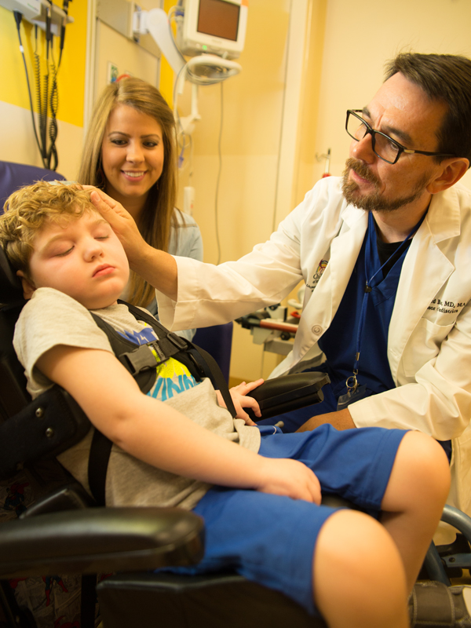
DOES COMPASSIONATE PRESENCE REALLY HELP?
COMPASSIONATE INTERACTION WITH HEALTH CARE PROVIDER:
FOLLOWING OUTCOMES REPORTED:
Faster healing of wounds
Reduced pain
Reduced anxiety
Reduced blood pressure
Shorter hospital stays
Greater sense of trust in care giver
CCARE, Stanford

Slide 28
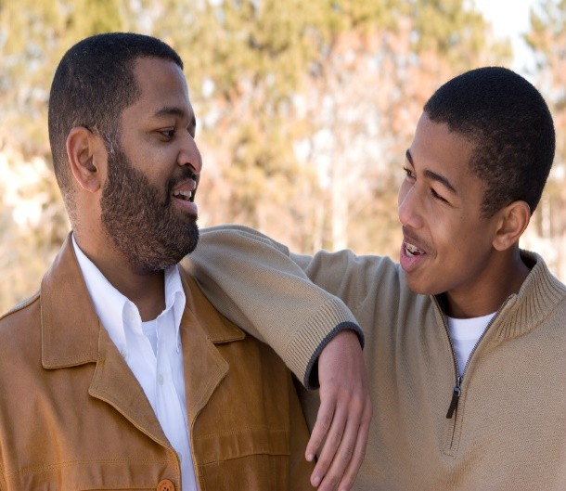

COMPASSION IS CONTAGIOUS MEANINGFUL CONNECTIONS

Slide 29
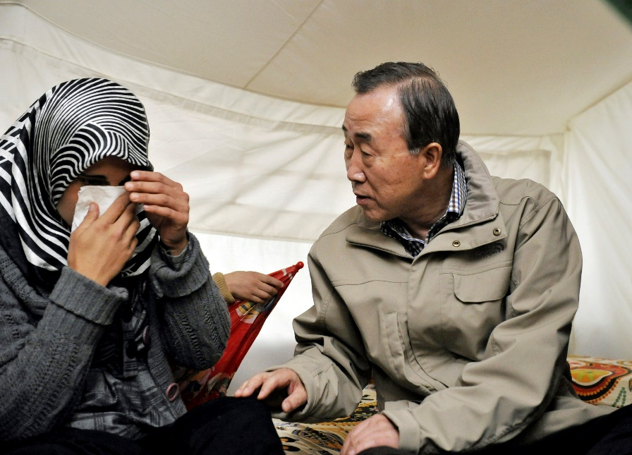

Rated high in compassion University of California, Berkley
More open body language
Comfortable Eye contact
Minimal encouragers
Listening without interrupting
Turn our attention to the one who is suffering,
(body language, eye contact, focus, even hands)

Slide 30




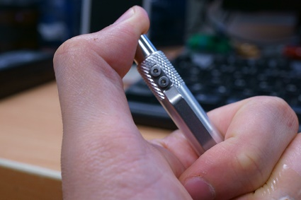
Rated low in compassion
Closed body language
Little eye contact
Glancing at watch or phone
Pity face
Presence of phone
“object manipulation”
Cell phone in view = people report feeling less connected.

Slide 31


Slide 32
Sustaining compassion
Shrink your attention to what is possible in the moment
Set fair and realistic expectations
Remember small seeds grow into giant trees (little steps matter)
Practice compassion satisfaction
Allow for vicarious resilience
Cultivate self compassion
Self aware – self care
Train in compassion, (meditations, perception training, Affect endurance, etc.)

Slide 33
COMPASSION TRAINING
SHORT compassion meditations
Day long training/practice in compassion meditation
6 week program (UVA)
8 week program (Stanford)
Year long program (Germany)
All showing positive results
LONGER TRAININGS BLEND:
Awareness/Mindfulness
Metacognition – perception
Constructive meditation -affect

Slide 34


4 steps to awareness
Choose INTENTION of your ATTENTION
MONITOR how you are doing
When you NOTICE you’ve DRIFTED, GENTLY RETURN
Cultivate a KIND, ENCOURAGING TONE

Slide 35

Exercise to cultivate self compassion

Slide 36


Slide 37
resources
https://cci.nursing.virginia.edu/
UVA Compassionate Care Initiative
http://greatergood.berkeley.edu/
Greater Good Center, University of California, Berkeley
http://ccare.stanford.edu/ Center for Compassion and Altruism Research and Education, Stanford
https://www.cogneurosociety.org/empathy_pain/ “Feeling others’ Pain: Transforming Empathy into Compassion” (CNS 2013)
http://news.wisc.edu/study-shows-compassion-meditation-changes-the-brain/ “Study Shows compassion meditation changes the brain” University of Wisconsin
To learn more about compassion and available resources:
Anna DeLong, LCSW
Uvafeap.com
434-243-2643
Let us know if you would be interested in further compassion training!
https://med.virginia.edu/mindfulness-center/ UVA Mindfulness Ctr.
https://insighttimer.com/ Free popular smart phone app with 1000’s of guided meditations

