Slide 1
Enhanced Recovery After Surgery (ERAS) at UVA Medical Center:
Virginia Society for PeriAnesthesia Nursing
Bethany Sarosiek, RN, MSN, MPH, CNL
September 7, 2019

Slide 2
Objectives
Provide background and rationale behind ERAS implementation at UVA medical center
Share outcomes and experiences in program implementation
Describe the key steps for implementation
Review barriers to implementation and suggestions for overcoming

Slide 3
“If we don’t change our direction, we’re likely to end up where we’re headed.”
Notes:
Chinese Proverb

Slide 4


Dr. Bob Thiele Dr. Traci Hedrick

Slide 5
What is Enhanced Recovery After Surgery (ERAS)?
A multimodal approach to perioperative care designed to decrease the time required to recover from surgery and improve perioperative outcomes
  Major components include:
    Not starving patients before surgery
    Intraoperative “goal-directed therapy” (GDT) – using advanced hemodynamic monitors to only give IV fluids when they are needed
    Adequate pain control with minimal opioid use
    Early ambulation
    Patients take ownership of their care

Slide 6
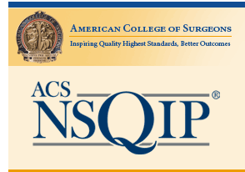
Why ERAS in Colorectal Surgery?
2012 NSQIP data revealed discouraging trends starting in 2008 when outcomes at UVA were better than average:
  Morbidity: 1.35 (from 0.99)
  LOS: 0.79 (from 0.99)
  UTI: 1.95 (not tracked in 2008)
  SSI: 1.37 (from 0.99)

Slide 7
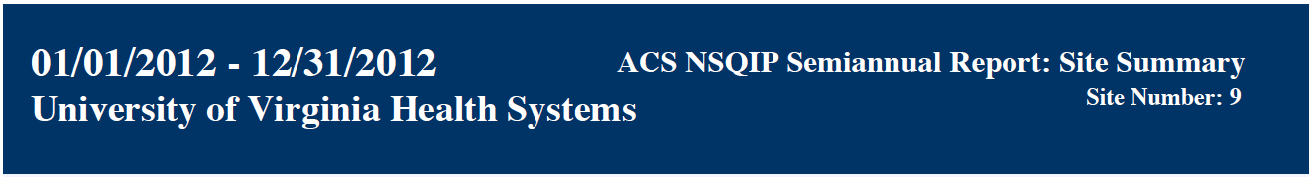
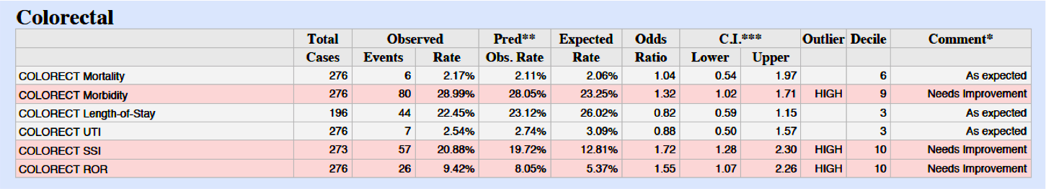
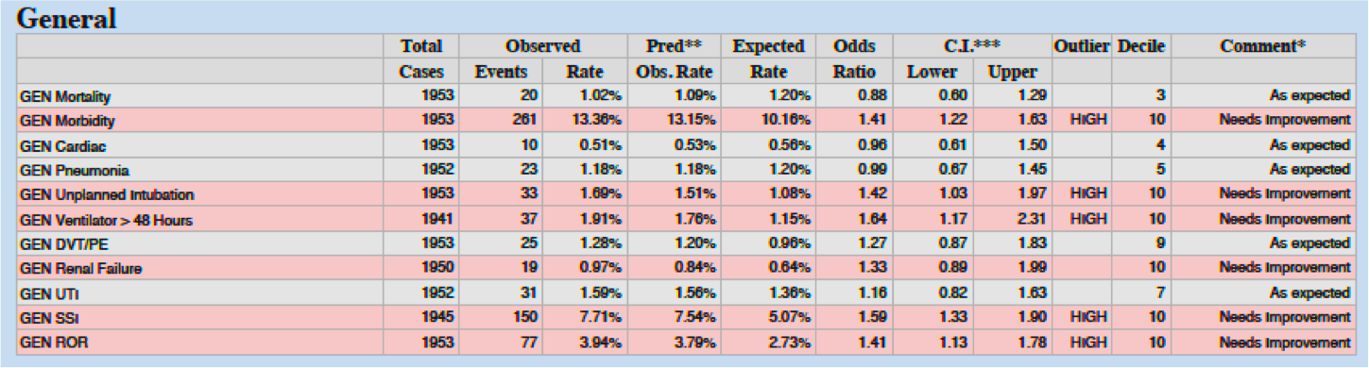

Slide 8
Our Objective
Recognizing the need for improvement, we implemented an Enhanced Recovery After Surgery (ERAS) protocol for all patients undergoing elective colorectal surgery at an academic institution.
Provide quality care at reduced costs while ensuring standardization

Slide 9
Colorectal Implementation
Began - August 1, 2013
  All patients undergoing elective abdominal surgery on colorectal service enrolled in protocol regardless of procedure or medical comorbidities
Compared pre/post data
  - pre ERAS (08/2012 – 02/2013)
  - post ERAS (08/2013 – 12/2014)

Slide 10
Notes:
2 day reduction in LOS
4L reduction in overall fluid balance AND
98% red in intraoperative and 77% red in postop morphine equivalent use

Slide 11



Notes:
40% reduction in readmissions
60% reduction in SSI

Slide 12
Colorectal LOS Relative to Medical Center

Slide 13
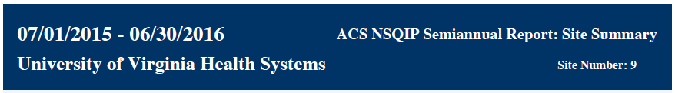
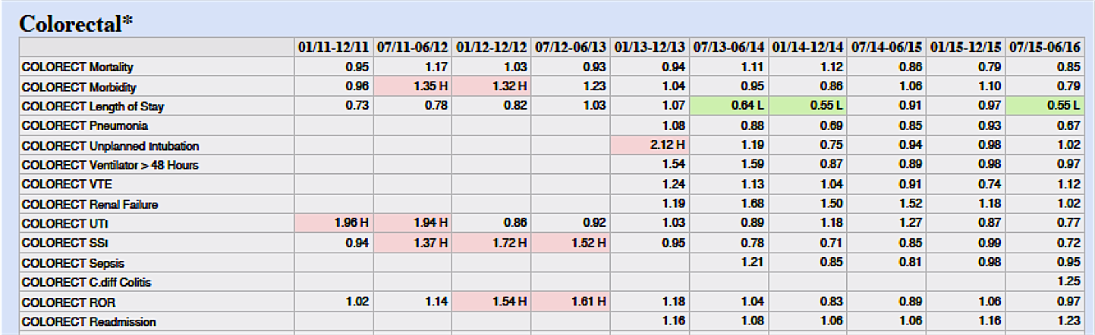


Slide 14
So what did we do?

Slide 15
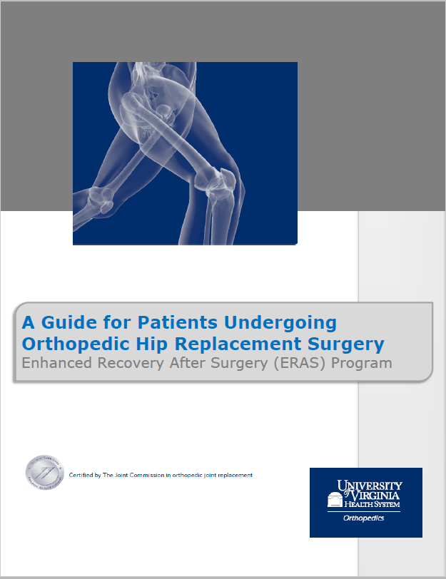
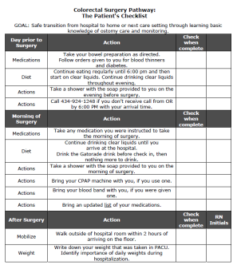

1. Patient owns their care
Surgery Handbooks
Patient Checklists
UVA ERAS App

Slide 16

2. Fluid Management
Hydration before surgery
Preventing tissue catabolism and dehydration
Decreasing the stress response
Decreasing patient anxiety

Slide 17
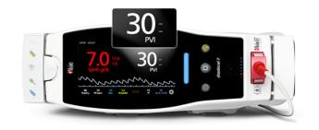
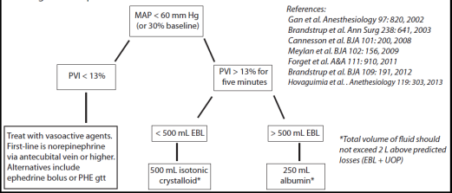
2. Fluid Management
Goal directed fluid therapy
What?
Preoperative IV in SAS – saline locked
Intraoperative fluid algorithm
Vasopressors for hypotension
Why?
Traditional strategies fail
Prevent fluid overload

Slide 18
3. Multimodal Analgesia
Preoperative:
  PO multimodal cocktail
  Intrathecal spinal – Duramorph or Hyperbaric Bupivacaine
Intraoperative:
  ketamine & lidocaine
  Surgeon- or anesthesia-administered liposomal bupivacaine
Postoperative:
  IV acetaminophen, lidocaine and ketamine
  PO acetaminophen, celecoxib, and gabapentin
  PR options

Slide 19

4. Early Ambulation
Encourage bowel motility
Reduce postoperative respiratory and other complications
Early removal of tubes and drains to encourage

Slide 20

5. Early Feeding
Stimulates intestinal motility
Encourages hydration
Eliminates need for IV fluids

Slide 21
So is it applicable outside of colorectal surgery?

Slide 22
ERAS Expansion Timeline to Date
Thoracic
&
Obstetrics
Mar 2016
Cardiac Oct 2018
Colorectal Aug 2013
Ortho Joints Oct 2017
Bariatric June 2019
2013
2014
2015
2016
2017
2018
2019
All HPB May 2019
Whipple Dec 2016
All GYN Mar 2015
Donor Nephrectomy TXP Apr 2018

Slide 23

Thoracic ERAS - Pain Management
and Opioid Use

Slide 24
Ortho ERAS - Length of Stay

Slide 25
Whipple ERAS - Pain Management

Slide 26
Cardiac ERAS - Prehabilitation
 | Pts with walk test Q1-2 2018 | Pts seen by PT Q1 2019
n | 146 | 96
LOS Surgery to D/C | 7.4 days | 8.1 days
D/C to Extended care | 22% | 11%
Readmitted | 13% | 4%
Mortality | 2% | 2%

Slide 27
So how did we do it at UVA?

Slide 28

Create the conditions for change
Introduce new practices and engage and enable the organization
Implement and sustain change
Notes:
Those of you familiar with change mgmt may be familiar with the work of John COTTTTTER
Internationally renowned as foremost speaker on organization change and leadership
In his book, outlines organizational change into an 8 step change model

Slide 29
KOTTER’S CHANGE THEORY
Create the conditions for change
Enable and Engage
Make it Stick

Slide 30
Create Urgency and Build Coalitions
What are we currently doing?
What’s the point: data and goals
Asking Three Questions
What are we currently doing?
What should we be doing?
What are we currently doing?
What should we be doing?
What do we want to be doing?
Notes:
Sense of purpose – GOAL oriented
What are we currently doing?
What should we be doing?
What do we want to be doing?

Slide 31
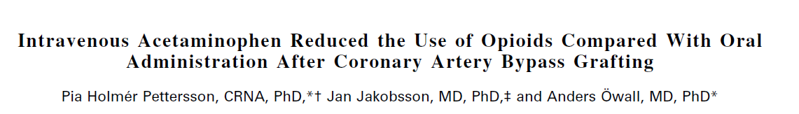
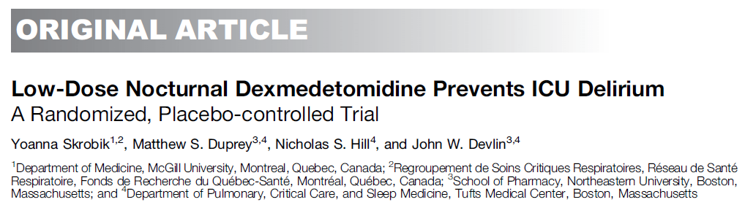
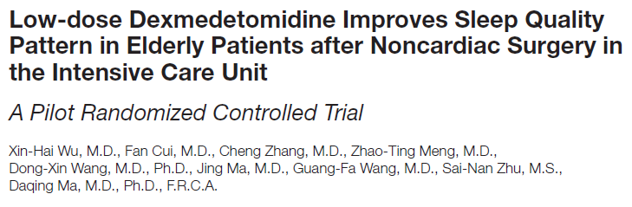
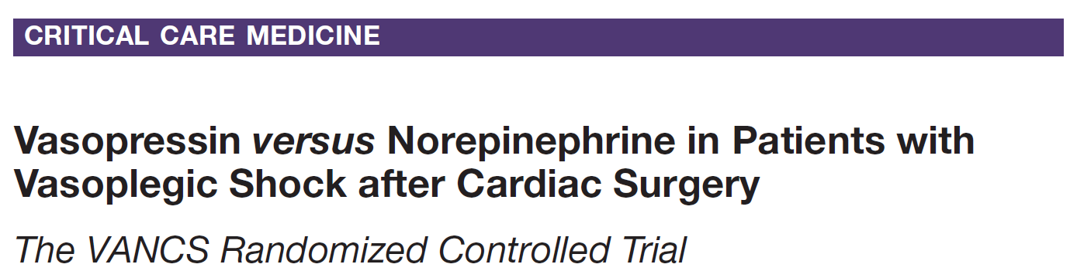
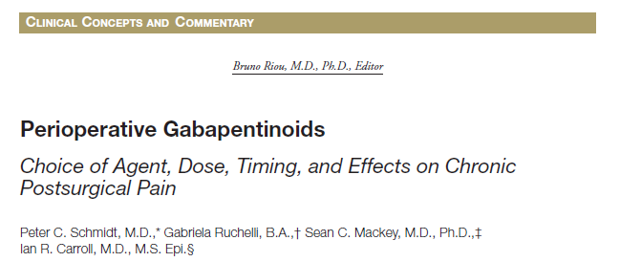
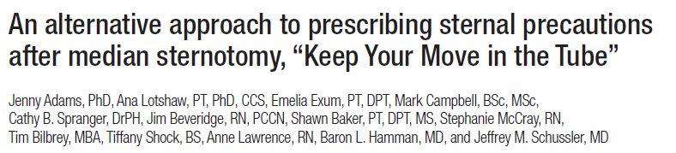

Slide 32
Build Interdisciplinary Partnerships
  Drive buy-in through hands-on participation
  Core Team Champions
    Surgeon
    Anesthesia
    Nursing
  Partners
    Pharmacy
    Pain management
    Participating staff from clinic, preop, OR, PACU, postop floors
    Nursing and pharmacy informaticists
    Registered Dieticians
    PT, OT, and other support staff
    Managers/administrators from all involved units

Slide 33
Define the Vision
Leverage unit-based talent
Provide the WHY behind the WHAT
Don’t rush progress but don’t let it halt success

Slide 34
KOTTER’S CHANGE THEORY
Create the conditions for change
Enable and Engage
Make it Stick

Slide 35
Make it as easy as possible to do the right thing!
Communicate the Vision
  Core team Champions
  Structured education sessions
  Computer-based learning
  Emails, team huddles and staff meetings
  Resource notebooks
  EMR support

Slide 36
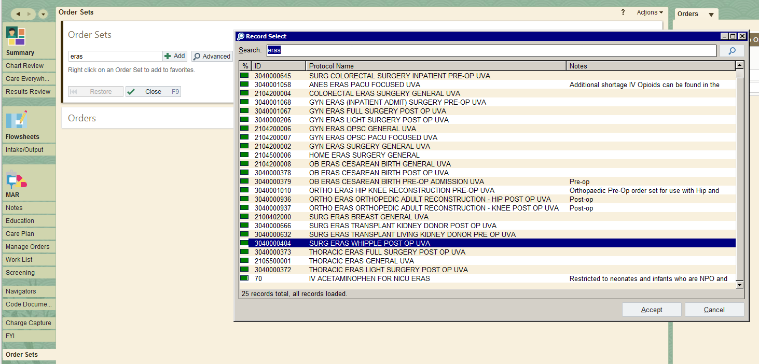
Standard Postop Orders
For postop orders, all ERAS order sets are searchable by “ERAS”

Slide 37
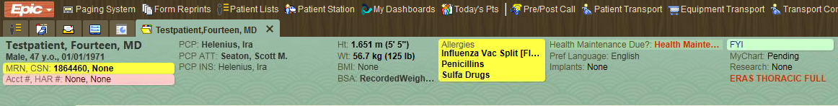
Enable Action
  Visual cues in patient charts
  Equipment and orders available and ready for use
  Hands-on coaching - BE (personally) AVAILABLE
  Remove barriers – process should be ongoing and iterative

Slide 38

Celebrate small wins
Updates on patient progress
Widely share!
SMALL gains translate to LARGE successes

Slide 39
KOTTER’S CHANGE THEORY
Create the conditions for change
Enable and Engage
Make it Stick

Slide 40
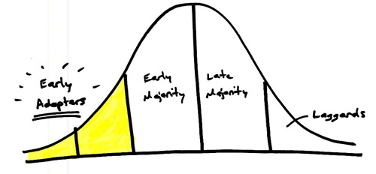
Ensure Sustainability
EASY AS POSSIBLE TO DO THE RIGHT THING!
Recognize success with daily feedback
Ongoing data review
POSITIVE and constructive reinforcement
Focus on LATE adopters

Slide 41
Ongoing compliance monitoring
Report ERAS outcomes
Determine needs for program expansion
Request additional resources as needed
Additional ERAS service line expansion
ERAS
Program Expansion

Slide 42
Organizational Expansion
ERAS Program Lead
Nursing
ERAS Nurse Coordinator (3)
ERAS Pain Nurse Practitioner
Data & Technology
Data Analyst
Perioperative Service Line

Slide 43
4313 patients enrolled
3,872 hospital days saved
potential capacity for 704 additional admissions
$7.7M opportunistic revenue
(with)
(equals)
(equals)

Slide 44
What Does Implementation Require?
1. Interdisciplinary effort
2. Buy-in from everyone to standardize care
3. Strict monitoring of compliance
4. Constant feedback and review
5. Specialty champions
6. A dedicated team to pull it all together

Slide 45
Thank you!
Email: ERASRN@Virginia.edu

