Slide 1
Comfortably Numb? Update on Regional Anesthesia
Aric Elmer M.D.
VSPAN MEETING
September 7, 2019

Slide 2
Disclosures
I have no financial disclosures
This talk covers various updates in regional anesthesia
This is in no way comprehensive

Slide 3
Outline
Regional Anesthesia Historical Perspective
Benefits and Risks of Regional Anesthesia
Liposomal Bupivacaine (Exparel®)
Review of Truncal Blocks: What’s New?
LAST
Q & A

Slide 4
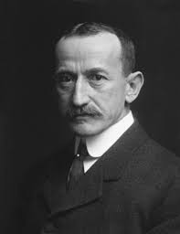


History…
Carl Koller MD (1857-1944; Austrian ophthalmologist) demonstrated cocaine as an anesthetic for eye procedures 1884

Slide 5
History…
William Mayo MD and Charles Mayo MD (founders Mayo Clinic)
utilized cocaine anesthetic infiltration techniques in their surgeries beginning in 1889
William Halsted MD (1852-1922, Chair of Surgery Johns-Hopkins)
cocaine infiltration for dissection followed by injection around major nerve trunks under direct visualization
Became addicted to cocaine performing “self blocks”
13 fatalities over first 7 yrs of cocaine administration

Slide 6
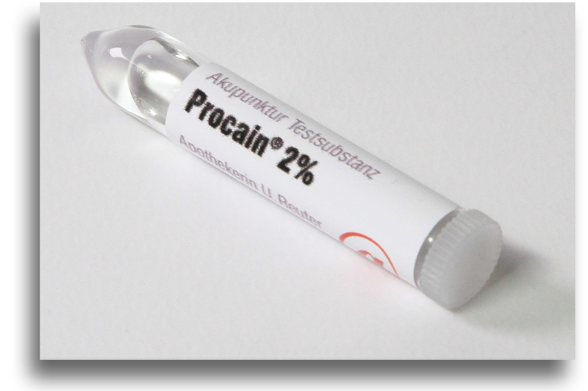
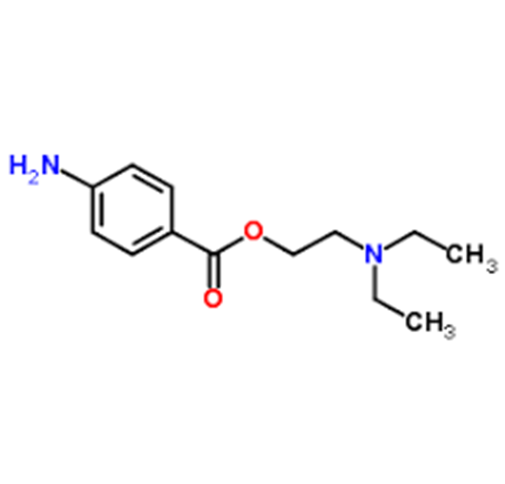
History…
Alfred Einhorn (1856-1917; German chemist) synthesizes Procaine 1905
Safer and more reliable alternative to cocaine

Slide 7
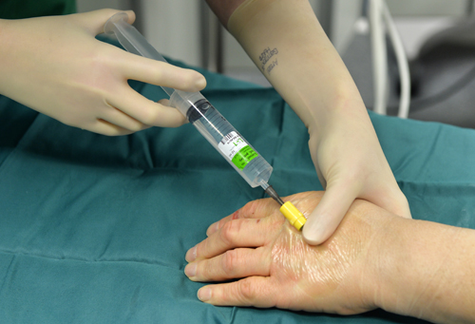
History…
Bier Block
August Bier MD (1861-19490; German surgeon and Father of spinal anesthesia) introduced IV local anesthetic block “Bier block” in 1908

Slide 8
History…
Diedrich Kulenkampff MD (German surgeon) uses surface anatomy and paresthesia technique to perform first supraclavicular block in 1911
Karl Mulley MD uses same technique for first interscalene block 1919
Gaston Labat MD (1876-1934) writes the first regional anesthesia text book becoming the “father of regional anesthesia”

Slide 9
History…
Paresthesia Technique c. 1911 to 1980
Nerve Stimulation replaces Paresthesia in 1980s
US guidance as early as 1989
US guidance now nearly universal & is standard of care

Slide 10
What Blocks What?
Brachial Plexus: Upper extremity
Interscalene (shoulders)
Supraclavicular/Infraclavicular/Axillary (arm & hand)
Forearm (wrist & hand)
Sciatic: posterior thigh and lower leg
Multiple approaches for desired effect
Femoral: anterior thigh and knee
Adductor canal block: saphenous nerve block
Sensory only (versatile for knee & lower anterior leg)
Abdomen
TAP, rectus sheath & Ilioingunial/Iliohypogastric (IIN/IHN)
Quadratus lumborum (QL)
Chest
Paravertebral block (TPVB)
Pecs and Serratus blocks
Erector spinae block (ESB)

Slide 11
Risks
General
Block failure/need to convert to GA (<1%)
Infection (rare; more common w/ catheter)
Bleeding (rare; higher risk w/ anticoagulation)
Serious
Nerve injury (2.4 per 10,000; Auroy et al 2002)
LAST (incidence 0.4-21 per 10,000; Barrington et al 2013, Liu et al 2016)
Seizure (1.2 per 10,000)
Respiratory failure (0.4 per 10,000; lumbar plexus block)
Cardiac arrest (0.2 per 10,000; lumbar plexus block)
Death (0.2 per 10,000; lumbar plexus block)

Slide 12
Benefits
Faster return of GI function (Steinbrook 1998)
Better pain control (Rigg et al 2002, Park et al 2001)
Less PONV (Chan et al 2001)
Improved exercise tolerance/rehabilitative efforts (Carli et al 2002
Less respiratory complication (Ballantyne et al 2002)
Faster emergence/recovery/discharge (McCartney et al 2004)
Extended benefit of CPNB catheters (Richman et al 2006)
Extended benefit with Exparel®?

Slide 13
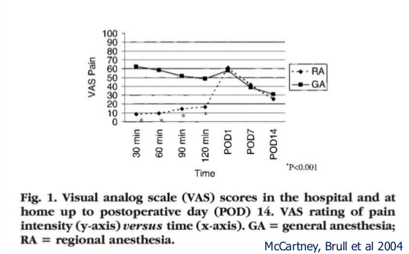

Slide 14
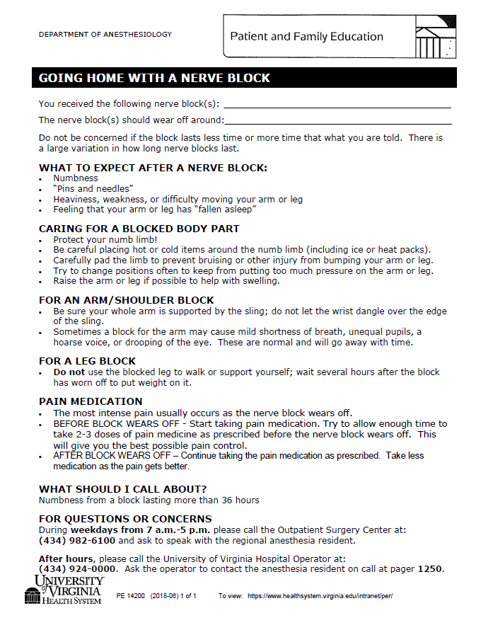
*Special thanks to Debbie Topping for putting this together

Slide 15
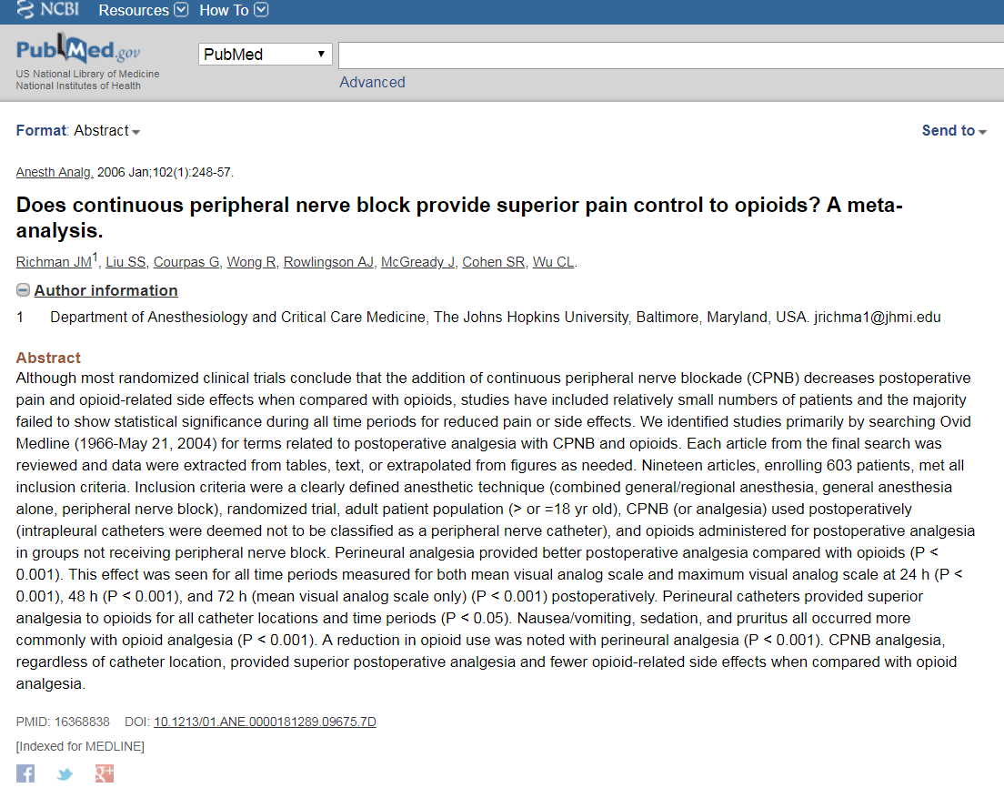

Slide 16
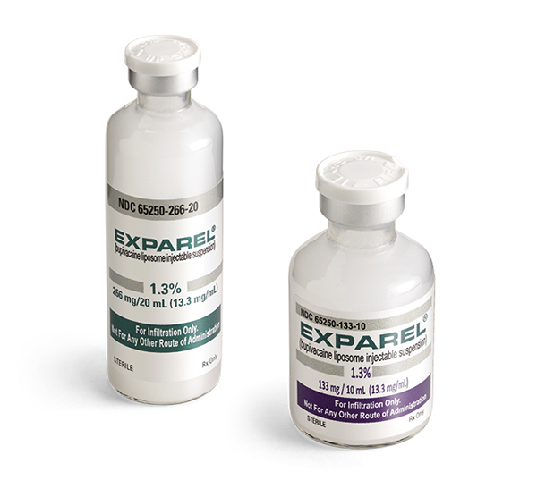
Exparel®
Bupivacaine liposome injectable suspension
FDA approved Oct. 28, 2011
Local injections
TAP blocks
Interscalene PB nerve blocks

Slide 17
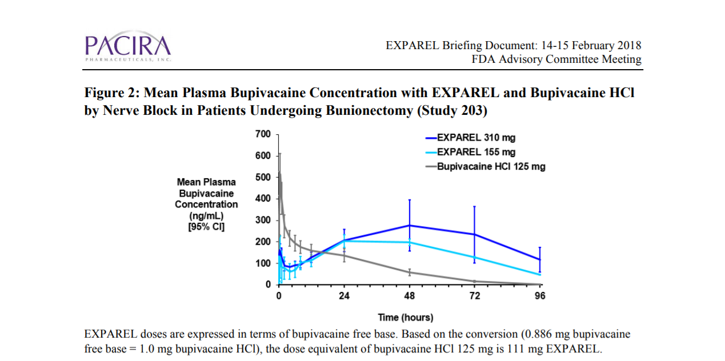
Exparel®

Slide 18
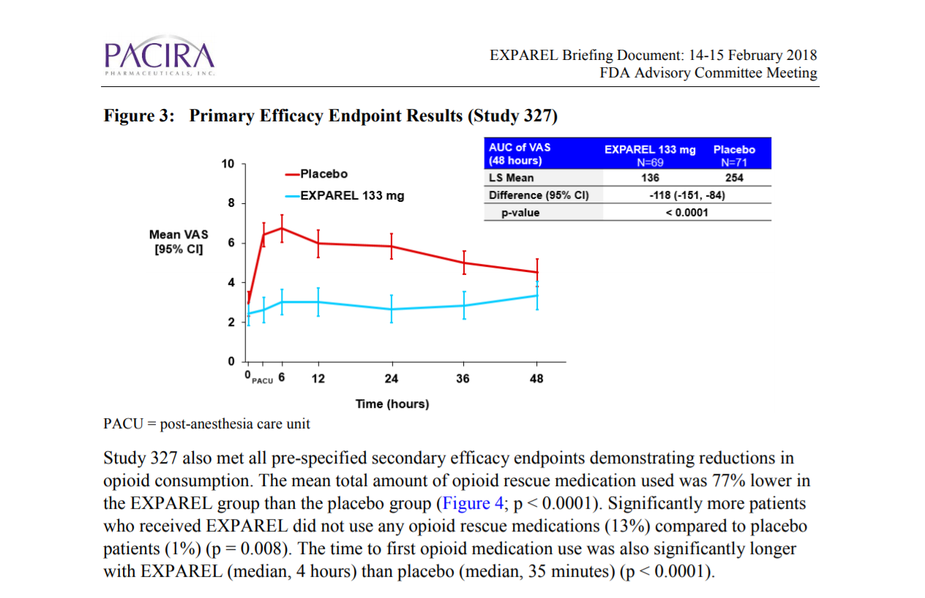
Exparel®

Slide 19
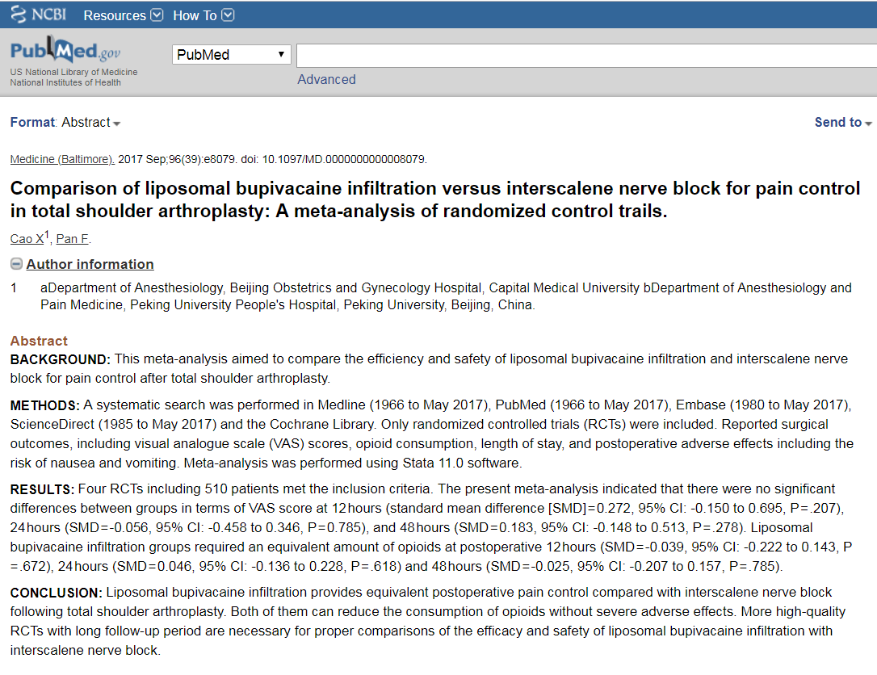
Exparel®

Slide 20
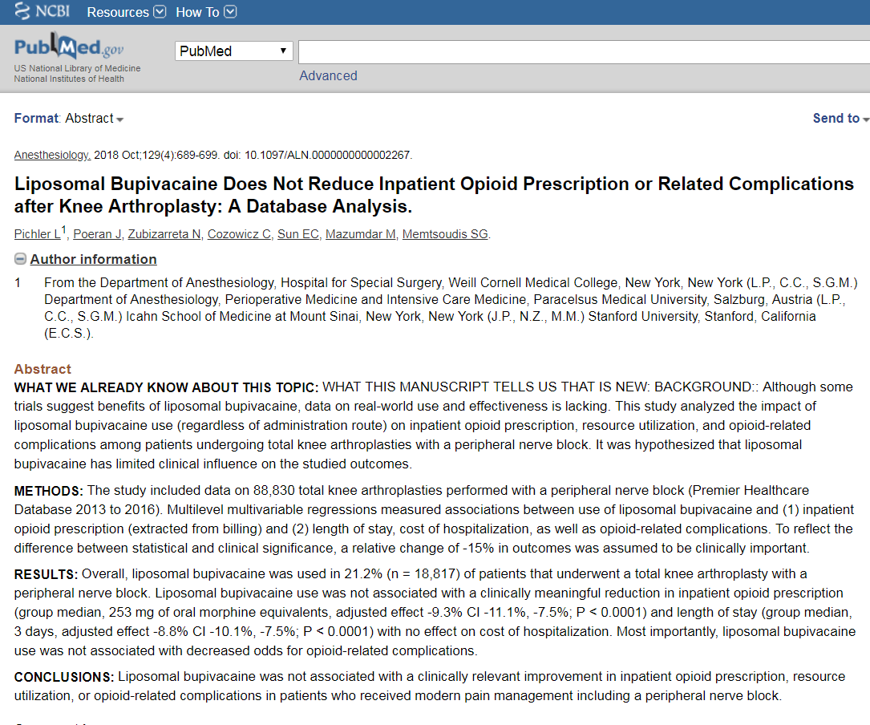
Exparel®

Slide 21
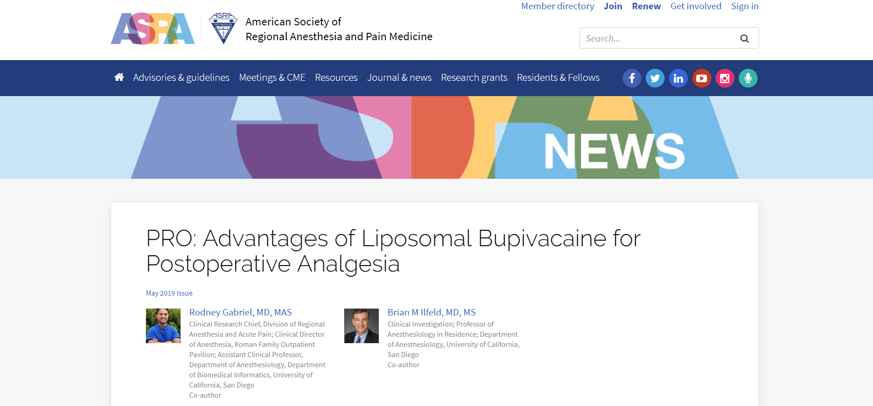
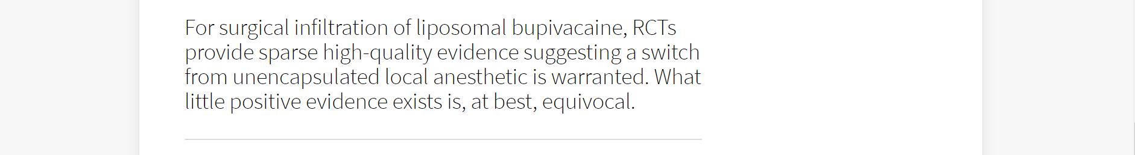
Exparel®

Slide 22
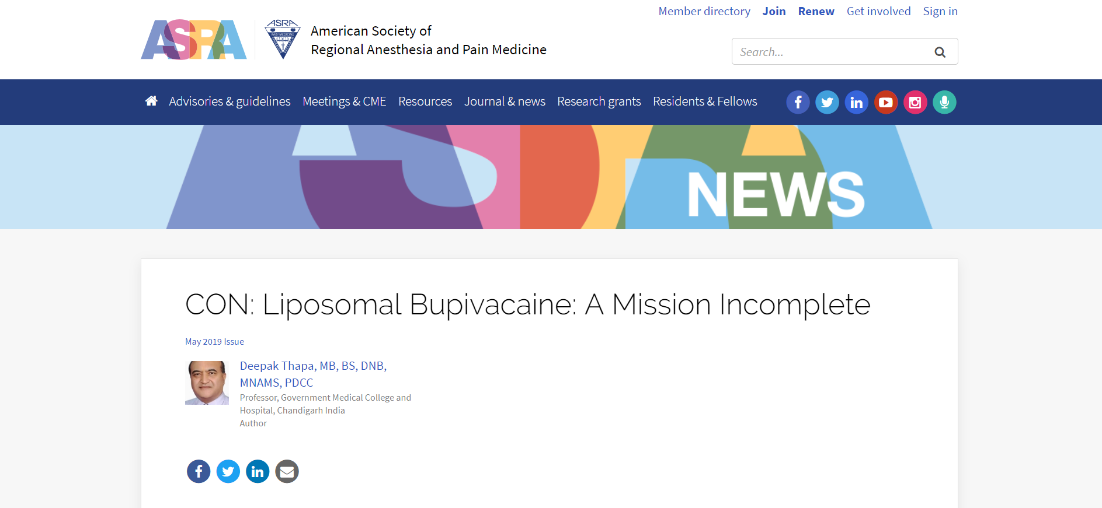
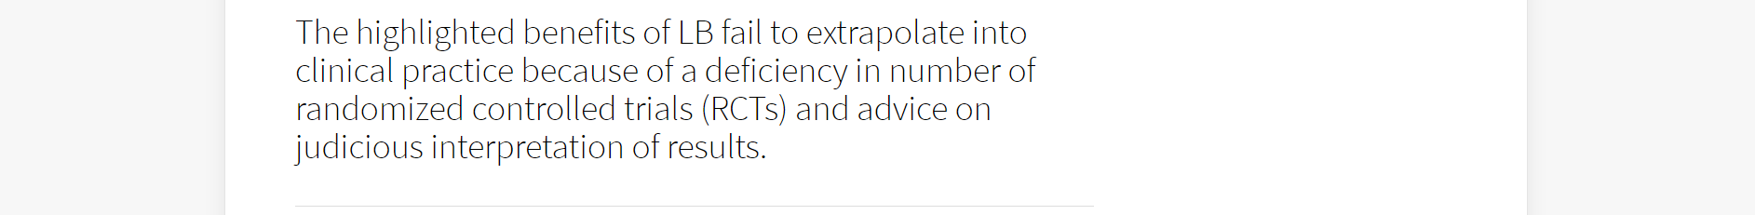
Exparel®

Slide 23
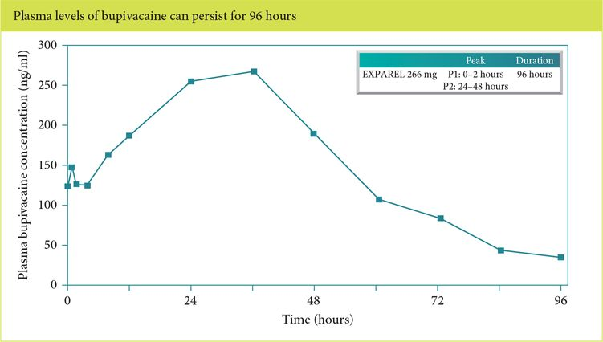
Exparel®

Slide 24
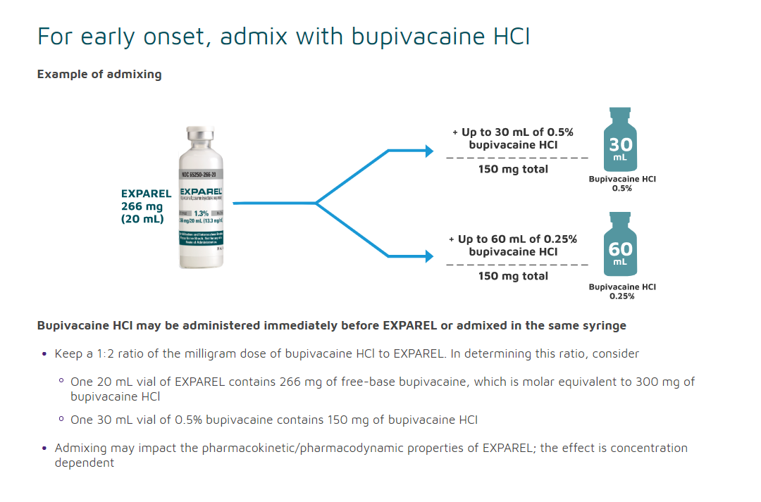
Exparel®

Slide 25
Truncal Blocks
Abdomen
TAP, rectus sheath & Ilioingunial/Iliohypogastric (IIN/IHN)
Quadratus lumborum (QL)
Chest
Paravertebral block (TPVB)
Pecs and Serratus blocks
Erector spinae block (ESP)

Slide 26
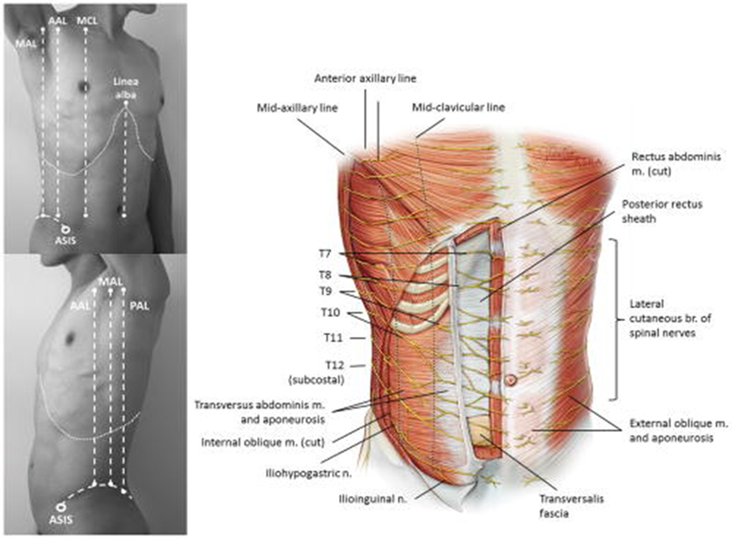
Abdominal Wall
Thoracolumbar spinal nerves
T6-T11
Subcostal nerve T12
Ilioinguinal/iliohypogastric L1

Slide 27
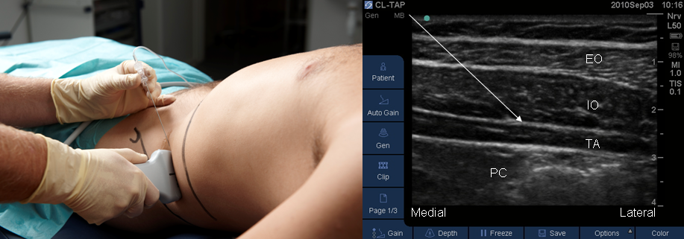
TAP Blocks
Classic TAP
Targets T10 to T12-L1 nerves
Umbilicus and lower abdomen
Useful in lower abdominal surgery
Borglum and Jensen 2012

Slide 28
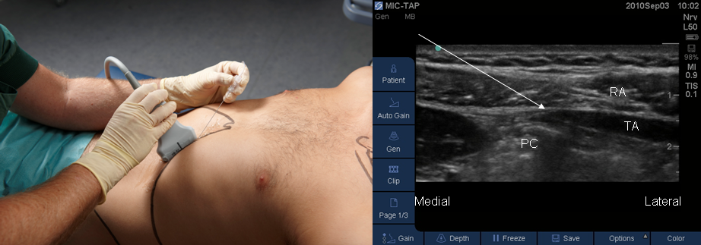

TAP Blocks
Subcostal TAP
Targets T6 to T9 nerves
Xiphoid process to above umbilicus
Useful in upper abdominal incisions

Slide 29
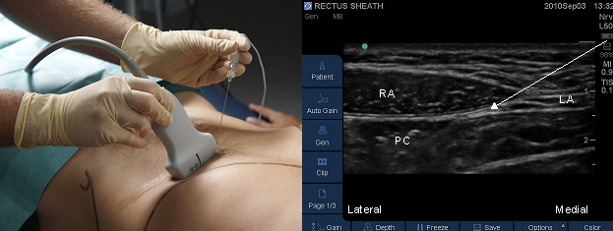
Rectus Sheath
Ventral branches of thoracoabdominal nerves
Targets T6 to T11 nerves
Useful for midline incisions, umbilical hernia

Slide 30
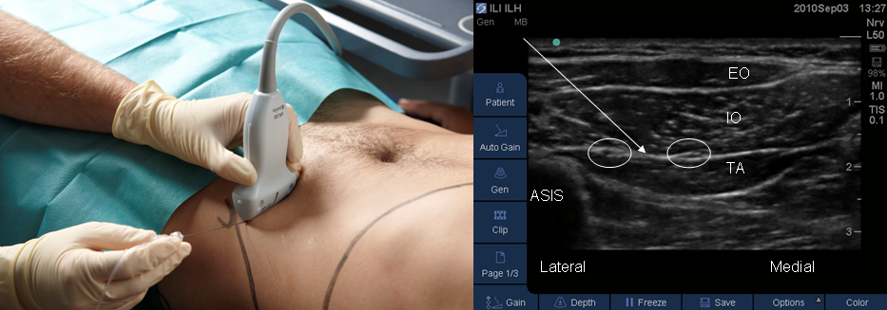
IIN & IHN Blocks
Ilioinguinal & Iliohypogastric nerves
Targets nerves specifically
Useful in inguinal hernia surgery

Slide 31
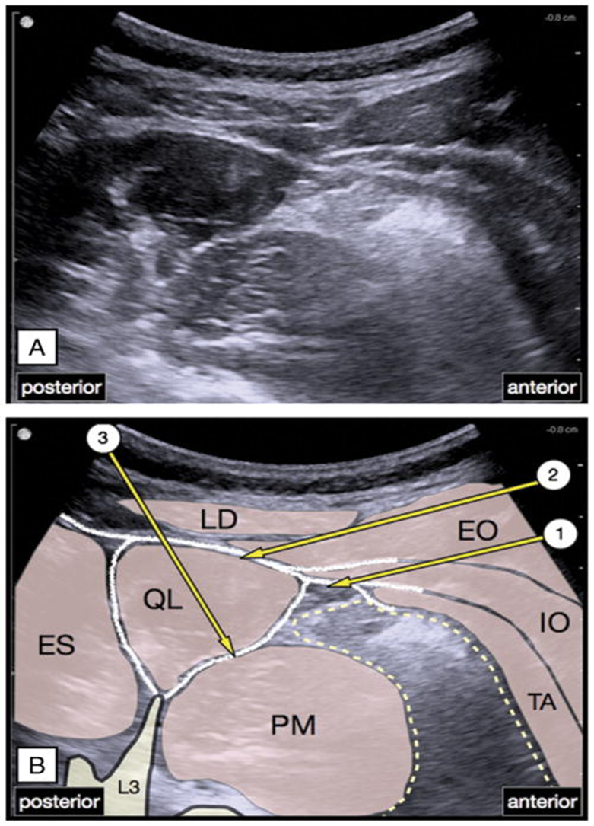
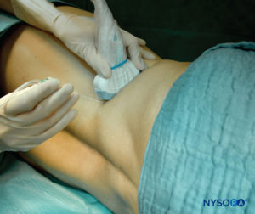
QL Block
Quadratus Lumborum
Targets T6-L1
Useful broadly
Spread to PV space?
Visceral coverage?

Slide 32
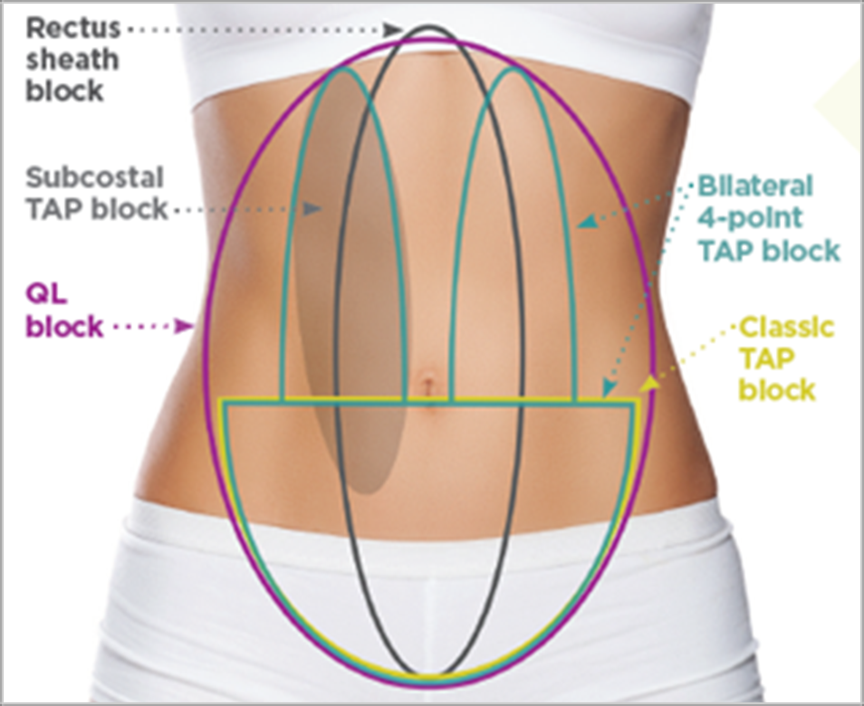
Abdominal Blocks

Slide 33
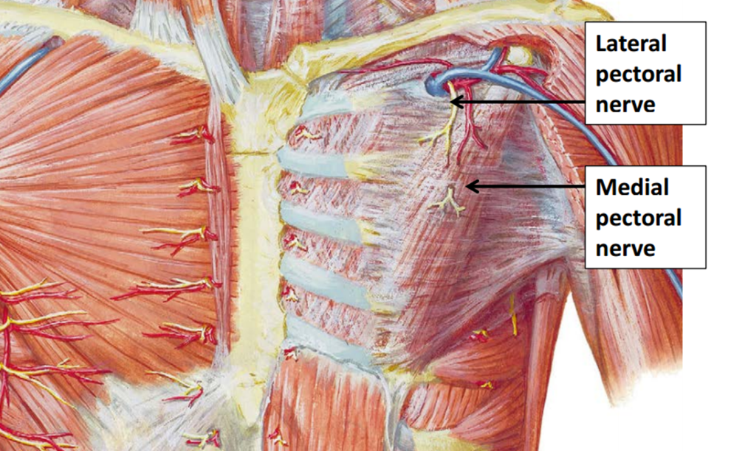
Chest Wall Blocks
Thoracic Spinal Nerves
T2-T6 intercostals
Medial & Lateral Pec nerves

Slide 34
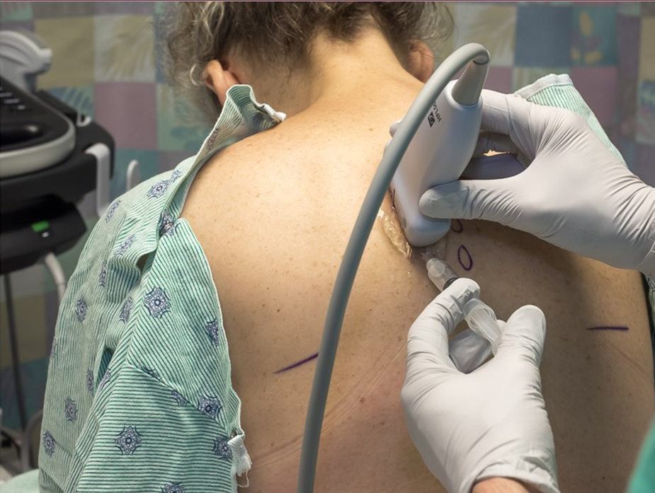
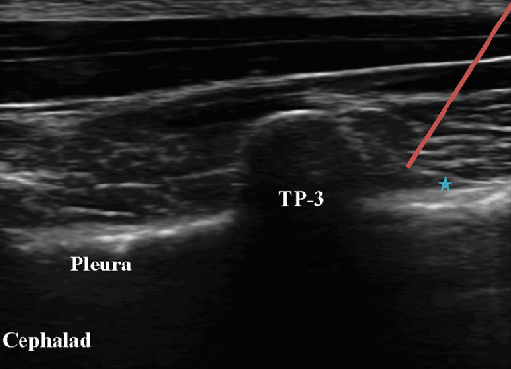
TPVB
Thoracic Spinal Nerves (Selheim, 1905)
T2-T6 intercostals, lateral & medial branches
Useful in breast & thoracic, rib fractures
Risk for PTX, technically challenging, painful

Slide 35
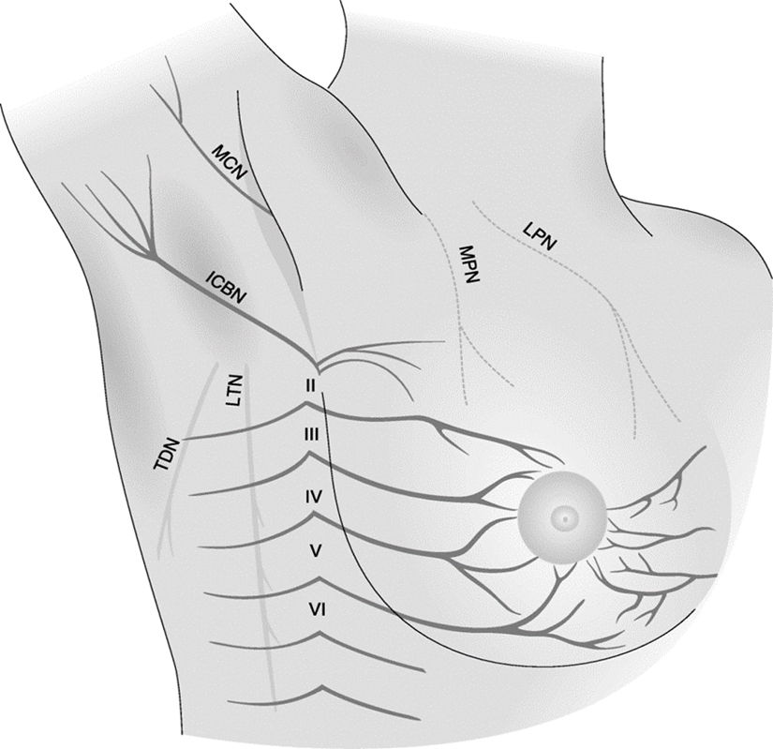




TPVB
No Coverage
Paravertebral blocks (TPVB)

Slide 36
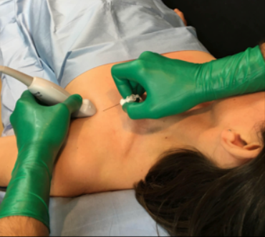
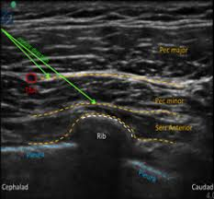
Pecs Blocks
Thoracic Spinal Nerves & Pec nerves (Blanco, 2011)
Pec I: pec nerves
Pec II: T2-T6 intercostals
Useful in breast surgery & axillary coverage
Decreased risk for PTX over TPVB

Slide 37
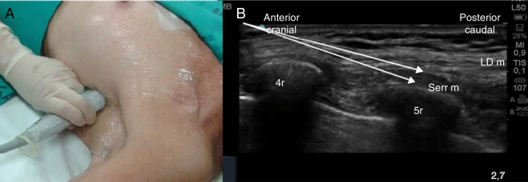
Serratus Block
Thoracic Spinal Nerves, LTN & TDN (Blanco, 2013)
T2-T6 intercostals lateral only
Useful in breast surgery, lat flap recon & axillary coverage
Decreased risk for PTX over TPVB

Slide 38

Pecs Blocks
Pecs I (superficial)
Pecs II (deep) & Serratus
No analgesia

Slide 39
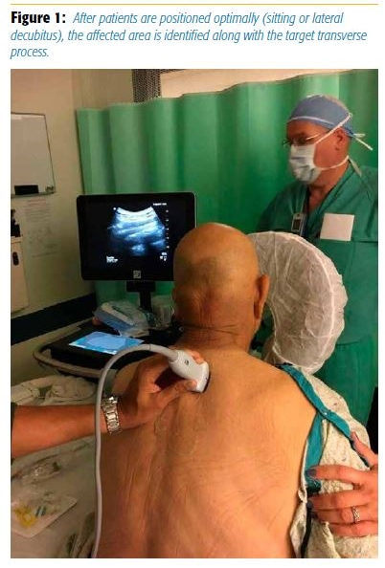
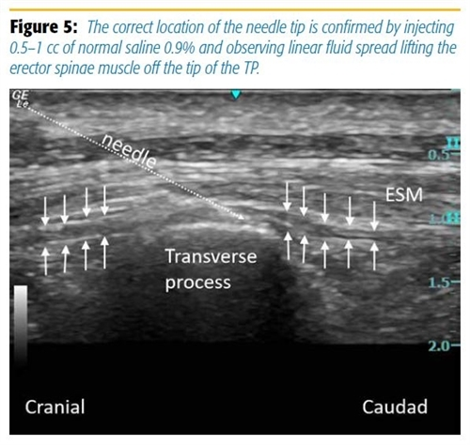
ESP Block
Thoracic Spinal Nerves (Ferero, 2016)
T2-T6 intercostals, lateral & anterior?
Useful in breast surgery, rib fractures
Decreased risk for PTX over TPVB

Slide 40


TPVB
No Coverage
Possible coverage
Paravertebral blocks (TPVB)

Slide 41
Etiology
LAST
Unintended intravascular injection of LA
Systemic absorption of LA
LA exert effect at and block transmission of Na+ channels
Organs that rely on Na+ channels are affected (e.g.- CNS and Heart)

Slide 42
Incidence
LAST
Database study: Total Joints w/PNB 2006-14
238,437 patients
Incidence 1.8:1000
Database study: Total Joints w/PNB 1998-2013
710,327 patients
Incidence 1.04:1000 (decreasing 10% per yr)
AURORA database study 2008-12
25,300 PNB
Incidence 0.87:1000
USG:0.36:1000 both minor and major events
ASRA notes that the rates have decreased.
1.6-2 per 1000 in 1990s to
0.08 – 0.98 per 1000 from 2003-2013

Slide 43
Risk factors
LAST
Extremes of age (i.e., <4 months or >79 years)
Cardiac conduction disease
Ischemic heart disease
Renal dysfunction
Hepatic dysfunction
Pregnancy
Carnitine deficiency
Highly vascular block site

Slide 44
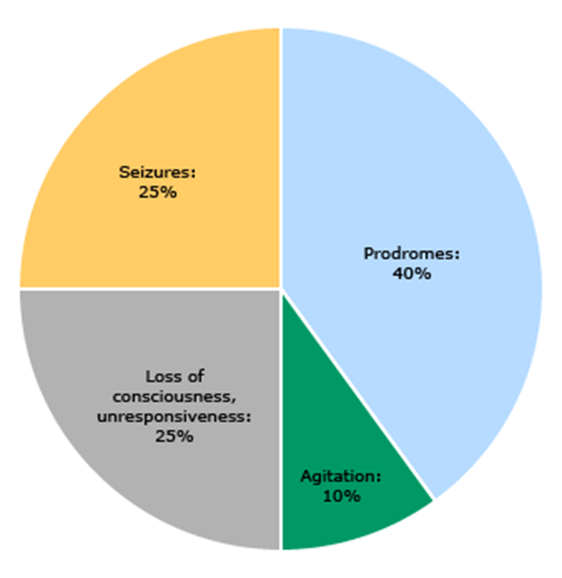
Signs and Symptoms
LAST
CNS:
Prodrome
Tinnitus
Circumoral numbness
Metallic taste
Dysarthria
Agitation
Seizures
Loss of consciousness
Respiratory arrest

Slide 45
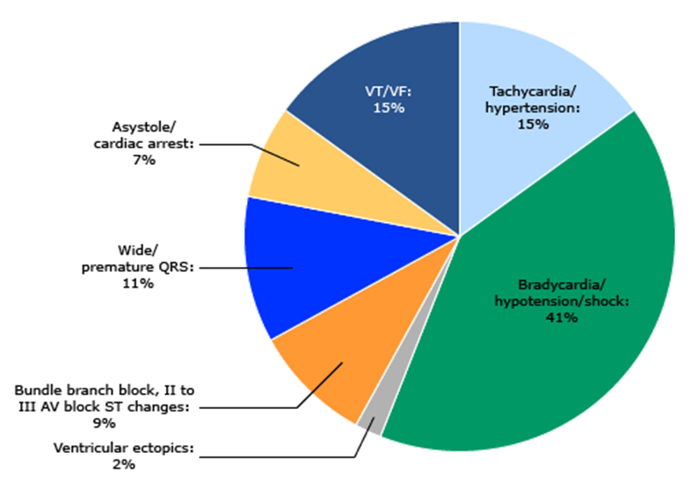
Signs and Symptoms
LAST
Cardiovascular:
HTN and Tachyarrythmias leading to…
Hypotension and Bradycardia
Ventricular arrhythmias
Cardiovascular collapse

Slide 46
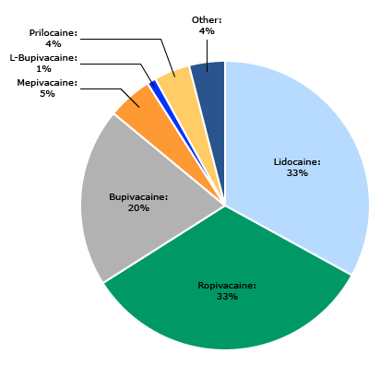
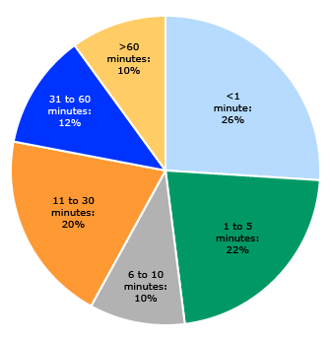
LAST

Slide 47
Prevention
LAST
Maintain high degree of suspicion
Monitor BP, ECG and pulse ox
Communicate w/ patient when feasible
Be conservative w/ LA, especially elderly, small BMI, poor cardiac function and conduction abnormalities
Aspirate every 3-5 mL
Inject slowly and avoid high pressure
Stock 20% lipid emulsion close to LA
US guidance
Be prepared: Have a plan to treat and low threshold

Slide 48
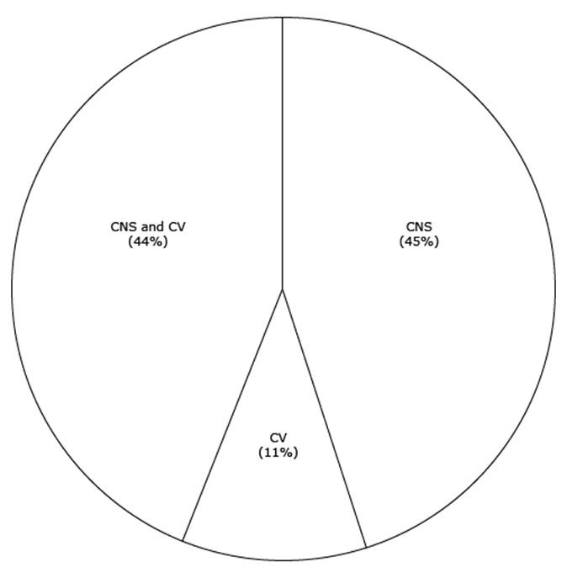
Detection
LAST
Maintain high degree of suspicion
Single most important step is considering LAST as the diagnosis
CNS symptoms are often subtle/absent
Cardiovascular signs may be the first sign
Be prepared: Have a plan to treat and low threshold

Slide 49
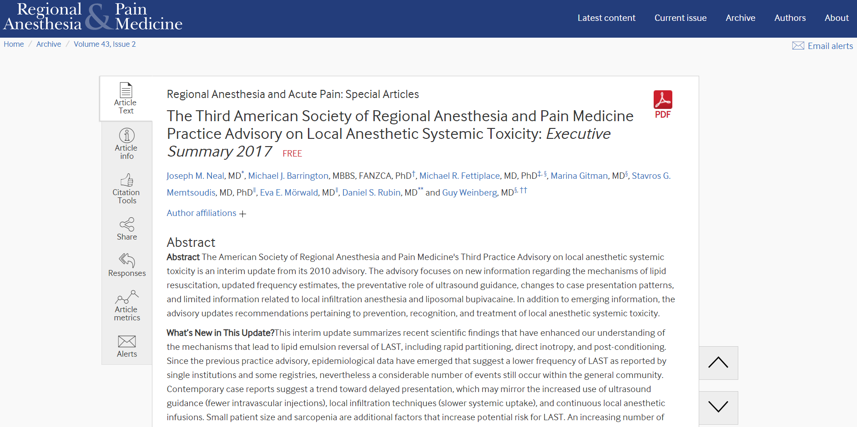
LAST
Recommendations

Slide 50
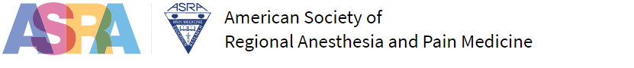
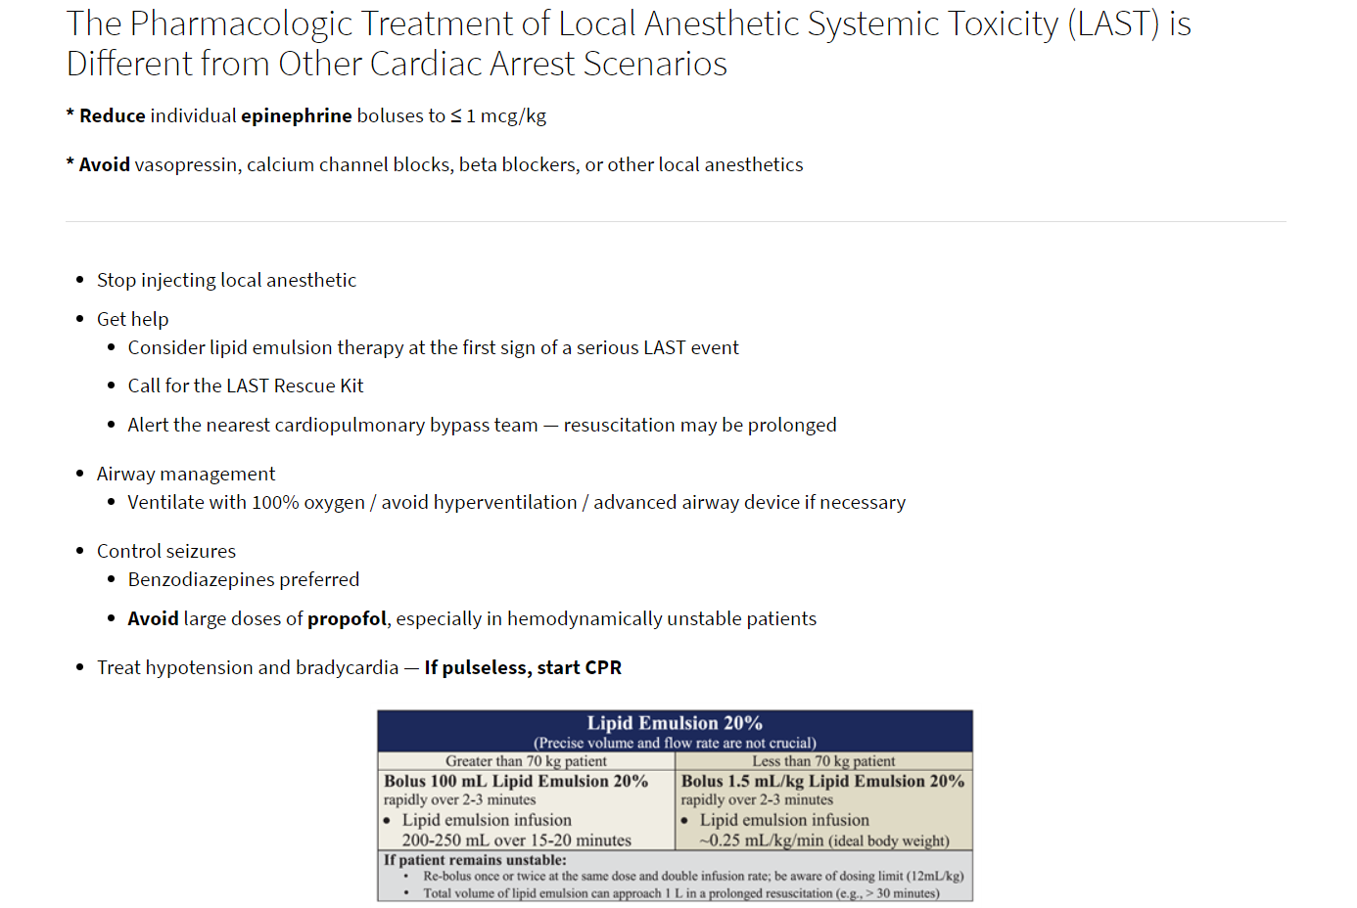
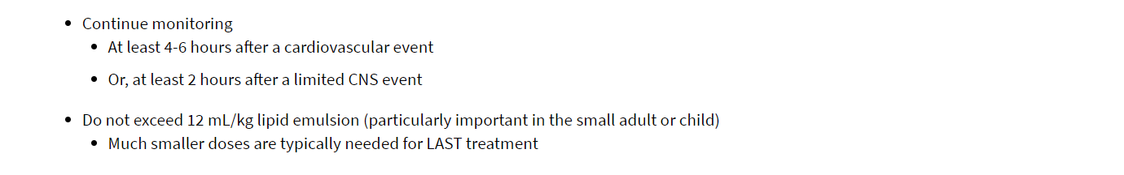
LAST

Slide 51
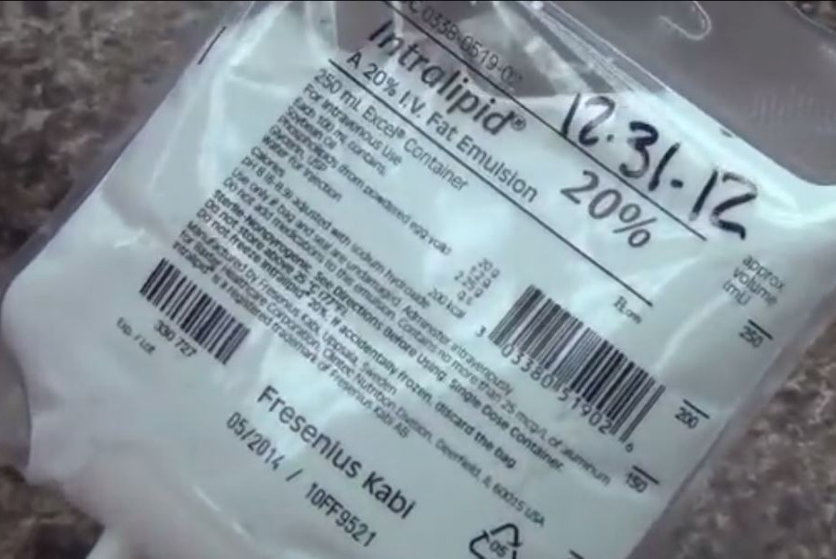
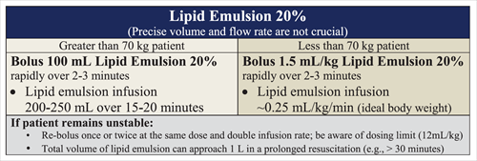
LAST

Slide 52
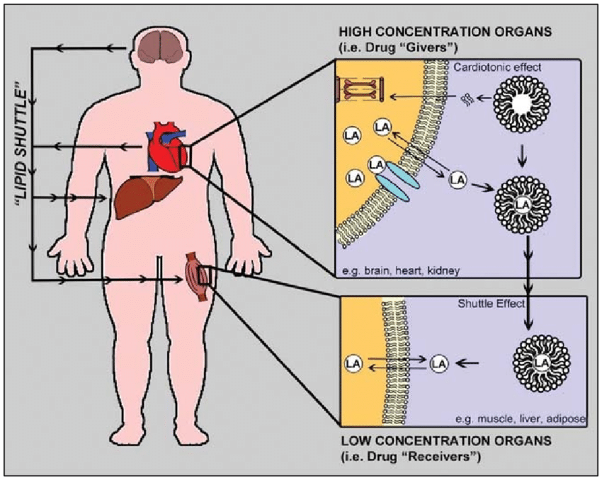
LAST
Intralipid mechanism
Shuttling Effect
Dynamic lipid sink
Shuttles LA away from CNS and Heart for detoxification
Cardiotonic Effects
Increased contractility/CO
Enhances shuttling
Postconditioning Effects
Activates cardioprotective pathways

Slide 53
LAST
Be Prepared
Checklist
ASRA
Algorithm/Cognitive aid
NYSORA (and others)
Prepare
Simulation training

Slide 54
References
Auroy Y, Benhamou D, Bargues L, Ecoffey C, Falissard B, Mercier F, et al. Major complications of regional anesthesia in France: the SOS Regional Hotline Service. Anesthesiology, 2002 Nov;97(5):1274-80.
Liu SS, Ortolan S, Sandoval MV, et al. Cardiac arrest and seizures due to local anesthetic systemic toxicity after peripheral nerve blocks: should we still fear the reaper? Reg Anesth Pain Med 2016;41:5–21.
Barrington MJ, Kluger R. Ultrasound guidance reduces the risk of local anesthetic systemic toxicity following peripheral nerve blockade. Reg Anesth Pain Med 2013;38:289–297.
Jens Børglum and Kenneth Jensen (August 14th 2012). Abdominal Surgery: Advances in the Use of Ultrasound-Guided Truncal Blocks for Perioperative Pain Management, Abdominal Surgery, Fethi Derbel, IntechOpen, DOI: 10.5772/48255. Available from: https://www.intechopen.com/books/abdominal-surgery/abdominal-surgery-advances-in-the-use-of-ultrasound-guided-truncal-blocks-for-perioperative-pain-man.
Mörwald EE, Zubizarreta N, Cozowicz C, Poeran J, Memtsoudis SG. Incidence of Local Anesthetic Systemic Toxicity in Orthopedic Patients Receiving Peripheral Nerve Blocks. Reg Anesth Pain Med. 2017;42(4):442.
Chin KJ1, McDonnell JG, Carvalho B, Sharkey A, Pawa A, Gadsden J. Essentials of Our Current Understanding: Abdominal Wall Blocks. Reg Anesth Pain Med. 2017 Mar/Apr;42(2):133-183.
Woodworth GE, Ivie RMJ, Nelson SM, Walker CM, Maniker RB. Perioperative Breast Analgesia: A Qualitative Review of Anatomy and Regional Techniques. Reg Anesth Pain Med. 2017 Sep/Oct;42(5):609-631.​
Forero M, Adhikary SD, Lopez H, et al. The erector spinae plane block: a novel analgesic technique in thoracic neuropathic pain. Reg Anesth Pain Med. 2016;41(5):621–627.
Rubin DS, Matsumoto MM, Weinberg G, Roth S. Local Anesthetic Systemic Toxicity in Total Joint Arthroplasty: Incidence and Risk Factors in the United States From the National Inpatient Sample 1998-2013. Reg Anesth Pain Med. 2018;43(2):131.
Barrington MJ, Kluger R. Ultrasound guidance reduces the risk of local anesthetic systemic toxicity following peripheral nerve blockade. Reg Anesth Pain Med. 2013;38(4):289.
Vasques F, Behr AU, Weinberg G, et al. A review of local anesthetic systemic toxicity cases since publication of the American Society of Regional Anesthesia recommendations: To whom it may concern. Reg Anesth Pain Med 2015; 40:698.
Di Gregorio G, Neal JM, Rosenquist RW, Weinberg GL. Clinical presentation of local anesthetic systemic toxicity: A review of published cases, 1979 to 2009. Reg Anesth Pain Med 2010; 35:181.
Neal JM, Barrington MJ, Fettiplace MR, et al. The Third American Society of Regional Anesthesia and Pain Medicine Practice Advisory on Local Anesthetic Systemic Toxicity: Executive Summary 2017. Regional Anesthesia & Pain Medicine 2018;43:113-123.

