Slide 1

Validation of Pediatric Obstructive Sleep Apnea Assessment Tools in the Peri-Anesthesia Setting
Leilani M Jankus MSN, RN, CCRN-K, CPAN Clinical Director OR Specialty: Pediatric Surgery and Sedation.
  Mary Ann Friesen, PhD, RN, CPHQ Nursing Research and Evidence Based Practice Coordinator, Professional Practice, Inova System Office
  Martha Schneider, DNP, RN, NEA-BC, Magnet Program Director, Nursing Administration Inova Fairfax Medical Campus
  Jacqueline Tibbetts, MSN, RN, CPAN, Registered Nurse 3 Pediatric Surgery Peri-Anesthesia Care Unit
  Miriam Faunda, MSN, RN, CAPA, Program Director Children’s Surgery Verification
  Scott D. Barnett PhD, MSPH, Manager Biostatistics and Epidemiology, Inova Heart and Vascular Institute
  Carol Swamidoss Douglas, PhD, RNC Clinical Educator for Nursing Research and Evidence Based Practice, Inova Fairfax Medical Campus

Slide 2


Slide 3

Identifying Knowledge or Clinical Practice Gaps: Analyzing Forms of Nursing Inquiry
Jacqueline Tibbetts MSN, RN, CPAN
VSPAN Annual conference 2019
Notes:
I would to share a brief overview of the research process, discuss the three different forms of inquiry, Research, Evidence-based Practice and Quality Improvement and the role of the nurse in working towards 90% of clinical decisions being based on research evidence by 2020 (IOM, 2009).

Slide 4

Significance and Scope of the Problem
Increase PeriAnesthesia risk Extend hospital stay:
Increase cost
Decrease patient satisfaction
Effect hospital reimbursement
Death
osa or SDB In Ped Patients
Notes:
So how do we start? G.K Chesterton an English poet and writer suggested, it is not that we can’t see the solution, sometimes we cannot see the problem.
In our case, the organization had recently introduced an adult screening tool for diagnosing potential Obstructive Sleep Apnea (OSA) patients. However, as is often the case when we looked for research in the pediatric population there was a paucity of research data.
The Pediatric Surgery Center team believed the significance and scope of the problem extended beyond our patients to all pediatric populations requiring OSA or Sleep Disorder Breathing (SDB) screening prior to anesthesia.
Significance may be briefly described as to the effects on patients, which potentially increases cost due to unexpected events and unplanned hospital admission, potentially effecting hospital reimbursement.
Patient/family satisfaction may be affected by increased discomfort and anxiety for patients and families. Death is a potential concern in this vulnerable population. The scope of the problem goes beyond our pediatric unit, this is a global concern.
There are multiple resources, guidelines and tools for the nurses. Joanna Briggs library access provided free by ASPAN. John’s Hopkins EBP Tool

Slide 5
Forms of Inquiry: Similarities
Quality Improvement
Research
Evidence-based Practice
Teamwork
Critical thinking
Commitment to Improve
Notes:
I have found there are often misconceptions when differentiating between the differences of the three forms of inquiry. Before we address the differences we should look at the similarities of the three forms of inquiry. Quality Improvement (QI), Research and Evidence-based practice (EBP).
The similarities include a need for teamwork, critical thinking and a commitment to improve whatever the problem is perceived to be (Dang & Dearholt, 2018). I believe Quality Improvement (QI), Research and Evidence-based practice (EBP) are inextricably connected as they relate to the continuum of clinical scholarship (Carter, et al., 2017).

Slide 6
Forms of Inquiry: Aims-identifying gaps
Quality Improvement
Research
Evidence-based Practice
Knowledge, evidence
Knowledge of best evidence available
Performance; process, practice, system
Notes:
All three forms of inquiry aim to identify gaps:
The gap in Quality Improvement (QI), may be in performance, either the process, system or practice.
The gap in Research is available knowledge evidence, and last but not least
The gap in Evidence-based practice (EBP) identifies a gap in knowledge of the best evidence that is available from current research (Carter, et al., 2017).

Slide 7
Forms of Inquiry: Methods
Quality Improvement
Research
Evidence-based Practice
Plan, Do, Study, Act (PDSA)
Rigorous Scientific Process
Practice question, evidence, Translate(PET)
Notes:
As with most processes there are frameworks to guide us. There are several available methods for three different forms of inquiry.
For QI I identified Planning, doing, studying and acting (PDSA) (Dang & Dearholt, 2018).
For Research, a scientific process similar to the Evidence-based practice (EBP) model; the Johns Hopkins Evidence-Based Nursing Practice practice question, evidence and translation method or (PET) (Dang & Dearholt, 2018). We had permission to use the tool through our organization.

Slide 8
Johns Hopkins Nursing Evidence-based Practice Model and Guidelines: PET
Practice:1-6 team identify stakeholders, develop PICO(T) question, identify leader and schedule time frame
Evidence: 7-11research for evidence, appraise and synthesize best evidence available. Make practice change recommendations based on evidence
Translation:12-19 translation. Is the proposed change feasible, is it a good fit for the chosen area? Are resources available?
Notes:
There are multiple resources, guidelines and tools for the nurses. Joanna Briggs library access provided free by ASPAN. John’s Hopkins EBP Tool. The tool has 19 steps to follow
Page 46.
Steps 1-6 are related to forming the team of stakeholders, who are invested in addressing the practice concern, and have expertise in the topic, and developing a searchable question.
Steps 7-11 looking for evidence in online libraries, government resources and other reputable online sources. Peer reviewed journals, recent five years is best practice, unless seminal source. Text books and Wiki no recommended.
Steps 12-19 is the proposed feasible, will it translate from the research environment to ours? Do we have the financial, personnel and physical resources? The team creates an action plan, implements and evaluates the change. The results are then disseminated, just as we are doing to you.

Slide 9
Forms of Inquiry: Outcomes
Quality Improvement
Research
Evidence-based Practice
Produces
Synthesizes
Generates
Notes:
I believe the outcomes of two of the three different forms of inquiry may be similar: Quality Improvement (QI), produces evidence for application at a local level, whether it be on a unit, facility or an organization either involving the process, system or practice, and Evidence-based practice (EBP) synthesizes best evidence that is already available from current research to translate in clinical practice.
Whereas, Research generates new knowledge systematically following a rigorous protocol for a much broader application (Dang & Dearholt, 2017). All forms of inquiry are critical.

Slide 10
Conclusion: Impact of research evidence on clinical practice
Generates further inquiry
Collaboration and teamwork
Translational science
Recommendation for practice change
Nursing practice informs research
Evaluate clinical practice
Notes:
As nurses about to celebrate the 200th anniversary of the birth of Florence Nightingale, we must have lofty goals. We need to be in line with the, former IOM now, The Health and Medicine Division (HMD)’s The National Academies of Sciences, Engineering and Medicine recommendations to help facilitate a spirit of inquiry and aim for all clinical practice be based on evidence by 2020 (IOM, 2009). We need to have an understanding of the similarities and differences of Research, QI and EBP.
Although, as nurses, we may not perform research, we must be able to discern research that has a robust and systematic process, furthermore, that is credible, valid and transferable.
We must help transition research that is already available into clinical practice, to insure the most up-to-date clinical practice is cognizant of patient preferences and values as well as listening to clinical experts.
Many of us here are affiliated with a Magnet organization; the overseeing of continuous QI measures and projects will insure quality patient outcomes. I hope you now have an increased awareness of the three forms of inquiry, whose definitive lines often seem blurred, and this new or refreshed understanding affords optimal outcomes for any future research to clinical practice projects.

Slide 11
References
Carter, E. J., Mastro, K., Vose, C., Rivera, R., & Larson, E. L. (2017). Clarifying the conundrum: Evidence-Based Practice, Quality Improvement, or Research?: The clinical scholarship continuum. The Journal of Nursing Administration, 47(5), 266–270. do:10.1097/NNA.0000000000000477
Combs, D. G. (2015). Modified STOP-BANG Tool for Stratifying Obstructive Sleep Apnea in Adolescent Children. Plos One.
Dang, D., & Dearholt, S. (2018). Johns Hopkins nursing evidence-based practice: Model and guidelines. Indianapolis, IN: Sigma Theta Tau International.
Institute of Medicine[IOM] (2003). Health professions education: A bridge to quality. Washington, DC: National Academic Press.
Tait AR, V.-L. T. (2013). The STBUR questionnaire for predicting perioperative respiratory adverse events in. Paediatric Anaesthesia, 510-516.

Slide 12


Background
  In 2015, The Joint Commission had 61 Sentinel Events in Patients with undiagnosed Obstructive Sleep Apnea [OSA] and Sleep Disordered Breathing [SDB]

Slide 13

Background
In 2018, We implemented evidence-based protocols for monitoring and intervention in patients at risk for OSA or SDB.
STOP-BangTM questionnaire in regular use.
STOP-BangTM is not appropriate for use in Pediatric patients.

Slide 14

STOP-Bang Assessment tool
S = Do you Snore when
sleeping?
T = Do you have daytime Tiredness?
O = Has anyone Observed
you stop breathing
during your sleep?
P = Do you have or are you
taking medication for
high blood Pressure?
B = BMI > 35
A = AGE > 50 years
N = Neck circumference
  Women > 16 inches
  Men > 17 inches
  G = Gender/ MALE
  * High Risk = > 5*

Slide 15
The Problem
We needed to find a tool that would be:
  applicable to a general population of pediatric patients ages 6 months to 17 years.
  helpful in screening patients at risk for complications of OSA and SDB post-anesthesia.
  Easy to use in a busy pre-operative setting
  Easy to elicit answers from parents/caregivers

Slide 16

Research Questions
  What tool, of those available, will be valid and reliable in predicting perioperative respiratory adverse events in pediatric patients?
  What tool will be quick and easy to use in the pediatric pre-operative setting?

Slide 17

Literature Review
  Sleep apnea presents differently in children (S. Verhulst, 2011).
  Sleep apnea screening not done as a routine examination for pediatric patients in primary care offices (Erichsen, 2012) .
  Pediatric responses to opioid administration more variable (S. Verhulst, 2011).
  Most Pediatric tools available tested on homogeneous populations (dental, adolescents, sleep study patients).

Slide 18
Literature Review
STBUR tool (Tait, 2013)- similar population to ours.
Pediatric S(T1)OP BANG (Cronly, 2015)- pediatric dental sedation
Pediatric Sleep Questionnaire (PSQ) validated for pediatrics-22 questions long, sleep study patients.
3 question (Schnoor, 2018)-smaller study but correlated to patients undergoing sleep studies.
STBUR tool gaining use (Odom-Forren, 2017; ASPAN, 2016).

Slide 19
The Research Study
To determine which tool would be most efficacious in predicting perioperative respiratory adverse events at our facility.
Chose to compare the STOP-BANG proposed by Cronly (2015) and the STBUR tool proposed by Tait, (2014).

Slide 20

The Research Study
Additionally, we wanted to know which tool
-was easy for the staff to use.
-was quick to complete in the pre-op.
-was simple for the parents to understand.
We asked nurses who were using the tools to complete a survey.

Slide 21
Ethical Considerations
Prior to beginning the study the assessment form was approved by medical records as a pilot and a permanent part of the health record.
The research study (18-3052)was presented to the Institutional Review Board [IRB]on April 30, 2018
Notes:
During the IRB approval process, we realized that the assessment was required of us, whether we were doing a study or not. By making our assessment tools a permanent part of the record and not collecting any identifying data, we would not be required to obtain consent.

Slide 22
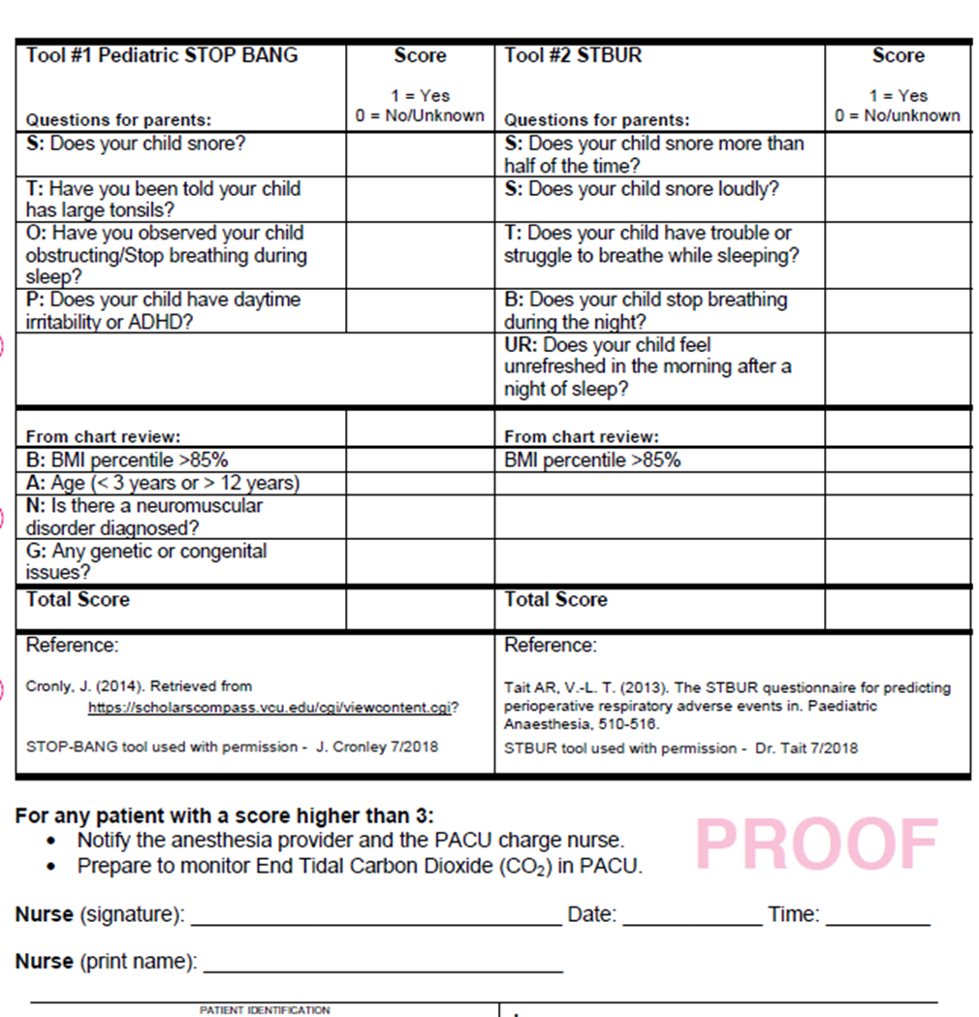

Slide 23
Methods
Scores of >3 were reported to anesthesia and charge nurses.
We completed a retrospective review and completed a case report form for each case.

Slide 24
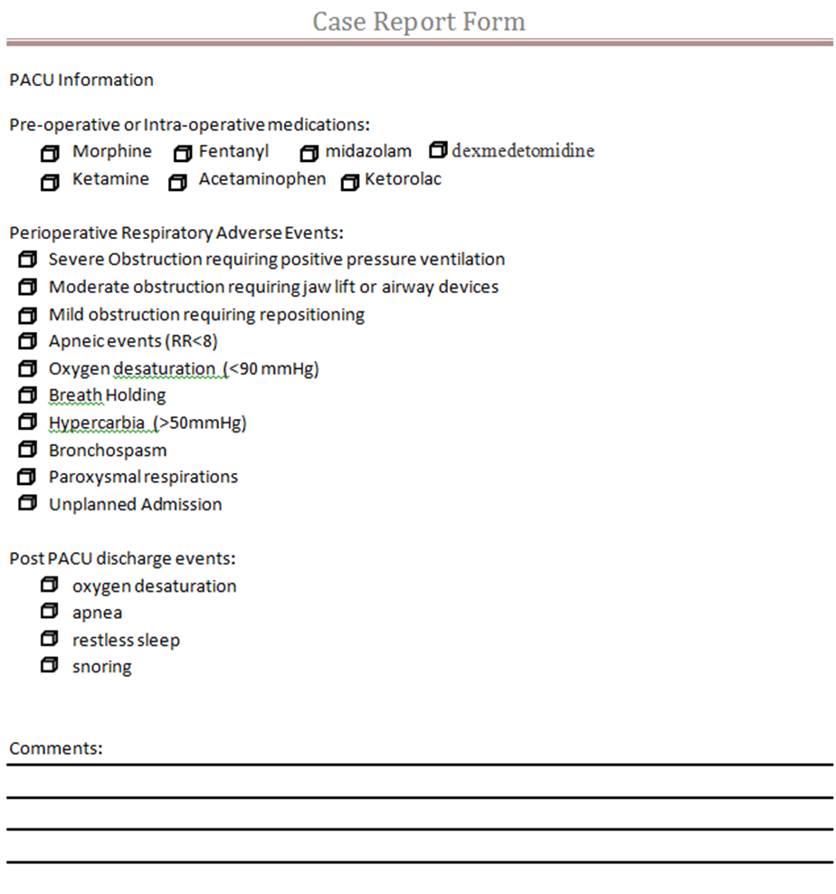

Slide 25

Methods-Nursing
We surveyed the nursing staff at 1 week of use and again at 14 weeks of use.

Slide 26
How easy was the pediatric STBUR tool to complete ?
1 2 3 4 5 Very easy easy not easy or hard hard very hard
On average, how long did it take you to complete the STBUR assessment?
2 to 3 minutes 4 to 5 minutes 6 to 7 minutes 8 to 9 minutes 10 minutes or longer
Do you have any other comments or insights about the tool? _______________________________________________________________________________________________________________________________________________________________________________________________________________________________________________________________

Slide 27
We assessed 300 patients with both tools in the pediatric pre-operative setting.
During chart reviews we had to remove 28 patients due to exclusion criteria.
  Under 6 months
  Already had diagnosed OSA or SDB

Slide 28
Results
Both tools were excellent at screening OUT OSA and SDB.
The pediatric S(T1)OP-BANG tool predicted Perioperative Respiratory Adverse Events 22.7% of the time.
The STBUR tool predicted Perioperative Respiratory Adverse Events 37.5% of the time.

Slide 29
Score Results-percentage of patients

Slide 30
Results
Nursing Surveys at 1 week and 14 weeks suggested that tools were equal but parents had better understanding of the STBUR tool.
 | Ease of Use
 | STOP Bang |  | STBUR
 | week 1 | week 14 | week 1 | week 14
very easy | 1 (16.7) | 1 (16.7) | 3 (50.0) | 2 (33.3)
easy | 4 (66.7) | 1 (16.7) | 2 (33.3) | 2 (33.3)
not easy | 1 (16.7) | 4 (66.7) | 1 (16.7) | 2 (33.3)
total | 6 | 6 | 6 | 6
 | Fisher's E | 0.0541 |  | 0.1948
 | Time to Complete
 | STOP Bang |  | STBUR
 | week 1 | week 14 | week 1 | week 14
2-3 min | 3 (50.0) | 5 (83.3) | 3 (50.0) | 6 (100)
4-5 min | 3 (50.0) | 1 (16.7) | 3 (50.0) | 0 (0.0)
total | 6 | 6 | 6 | 6
 | Fisher's E | 0.2424 |  | 0.0909
There was only an N of six nurses
that completed the survey, so it is
difficult to extrapolate the data to
a more generalized group

Slide 31
Results-comments
STOP-BANG comments
STBUR comments
will be faster once it is in EPIC, includes those we already monitor closely
The questions related to Neuromuscular and genetic/congenital conditions are vague.
The BMI for <2 years was challenging until we got access; Sometimes parents aren't sure of an answer; when asking about genetic issues: is it only something that relates to face, neck and jaw?
questions are very vague; parents ask clarification of many questions; also no option if the tonsils WERE large but have since been removed.
Will only trigger a blue bracelet for those we wouldn’t otherwise suspect; this scale will find them
I think that its strange that there's no option for just snoring. Either snores loudly or snores more than 1/2 the time. Maybe combine them somehow
less questions; I feel that a mixture of both tools could be developed by us with an addition of a question about sleep studies and pre-op sats.
questions are straightforward and rarely require clarification.

Slide 32
Patient Care Outcomes
STBUR tool has been selected as our assessment for Pediatric OSA and SDB.
The assessment tool is being amended to only have the STBUR tool on it, along with documentation of diagnosed sleep apnea.
Education of pre-operative staff to complete the assessment in pediatric patients-across the system.
STBUR tool to be included in the EMR.

Slide 33
Nursing Care Process Improvements
Patients assessed at 3 or more are considered higher risk. The greater the score, the greater the risk.
All patients assessed at higher risk are given a blue band, that designates their high risk level.
Anesthesia is made aware of risk level.
Changes to anesthesia technique and medications.
Nursing adjusts staffing based on risk level.
Patients are placed on ETCO2 monitoring until awake in PACU and admitted for overnight monitoring.

Slide 34



Slide 35
American Society of PeriAnesthesia Nurses (ASPAN). Competency Based Orientation and Credentialing Program for the Registered Nurse Caring for the Pediatric Patient in the PeriAnesthesia Setting. (2016 ed.) pp.193-198.
The Joint Commission. (2015). Joint Commission requirements for Hospital Accreditation. Retrieved from The Joint Commission : https://www.jointcommission.org/assets/1/23/Quick_Safety_Issue_14_June_2015.pdf
Cronly, J. (2015). Development of a simplified pediatric obstructive sleep apnea screening tool. Dental Sleep Medicine. Retrieved from Virginia Commonwealth University Theses and Dissertations: https://scholarscompass.vcu.edu/cgi/viewcontent.cgi?referer=//www.bing.com/&httpsredir=1&article=4436&content=edt
Erichsen, M. D. (2012). Screening for Sleep Disorders in Pediatric Primary Care: Are We There Yet? Clinical Pediatrics, 1125-1129.
Odom-Forren, J Drain’s Peri-Anesthesia Nursing: A Critical Care Approach, (2017) 7th Edition, Saunders.
S. Verhulst, A. K. (2011). Obstructive sleep apnoea in children. Breathe, 240-247.
Schnoor, J. B. (2018). Pre-anesthetic assessment with three core questions for the detection of sleep apnea in childhood: An observational study. BMC Anesthesiology.
Tait AR, V.-L. T. (2013). The STBUR questionnaire for predicting perioperative respiratory adverse events in. Paediatric Anaesthesia, 510-516.

