Slide 1
Cardiac stress testing
Nisha Thekkedam, MS, AGACNP-BC

Slide 2
objectives
Able to choose the right cardiac stress testing for the patients
Able to identify indications & contraindications for each type of stress test
Able to explain the basics of each type of cardiac stress testing and the diagnostic accuracy of the testing.

Slide 3
Cardiac stress testing
Cardiac stress testing is an important diagnostic and prognostic tool in the evaluation and management of patients with coronary artery disease.
A main objective of stress testing is to assess the functional or physiological consequences of anatomic coronary artery disease (CAD).

Slide 4
INDICATIONS FOR STRESS TESTING
Patients with symptoms suggesting angina/chest pain
Patients with a recent ACS
Patients with known CHD and new or worsening symptoms/ prior coronary revascularization.
Patients with valvular heart disease
Patients with newly diagnosed heart failure or cardiomyopathy
whether the myocardium is viable and to plan for revascularization.
Patients with select arrhythmias
Patients undergoing non-cardiac surgery

Slide 5
Types of stress testing
Exercise
Exercise only
Exercise + echo
Exercise + Nuclear
Pharmacological
Vasodilator
1. regadenoson
2. Adenosine
3. dipyridamole
Dobutamine

Slide 6
The choice of stress testing modality depends on many factors
Ability to perform adequate exercise
Resting ECG
Clinical indication for performing the test
Patient's body habitus
History of prior coronary revascularization

Slide 7
How to choose the stress test?
Normal or abnormal resting EKG
LBBB
WPW
Paced rhythm
Baseline ST segment
Abnormalities
Do we need to hold beta blocker?
If patient is going to exercise or going to have dobutamine stress test it is preferred to hold beta blocker.
For vasodilator stress testing, no need to hold beta blocker.

Slide 8
CHOOSING THE OPTIMAL STRESS TEST
Can the patient exercise to a satisfactory workload? Exercise stress test
(+imaging modality)
Patient cannot exercise pharmacological stress test.
Does the patient have an abnormal baseline ECG? Pharmacological stress test
Systems considerations and patient preferences
Notes:
If the patient can exercise to satisfactory workload mostly we consider exercise stress test. The end point of exercise stress test is to achieve the target heart rate which is 85% MPHR (220-age X 85%) or if patient develops any symptoms such as chest pain, shortness of breath, dizziness, significant hypertension, ST depression >2 mm and ST elevation >1 mm.
If the patient cannot exercise we prefer pharmacological stress test. (stress echo, MPI)
If the baseline EKG is abnormal for eg; LBBB, WPW, V paced, NSST changes, ST depressions at rest we prefer pharmacological stress test.
If the patient needs assessment of myocardial viability, we prefer pharmacological stress test.
System considerations includes, if patient require a stress test with imaging modalities may not have access to all imaging modalities. Patients or lab has time constraints which that may favor one test over the other. Patients may have a desire or need to avoid radiation exposure.

Slide 9
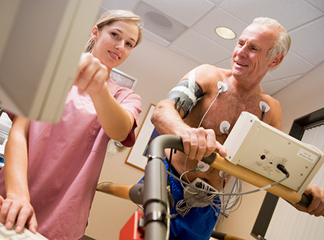
Treadmill exercise stress test
Endpoint: heart rate, blood pressure, exercise capacity, symptoms,
EKG changes
Target he art rate: 220-Hr X .85
Protocols: Bruce, modified bruce, Naughton
Achieve 85% MPHR for an optimal test
Hold beta blocker therapy for 24 to 48 hours

Slide 10
Treadmill exercise stress test- prognostic finding
Duke treadmill score:
Exercise minutes – (ST deviation in mm X 5)- (angina index X 4)
0 – None
1- non-limiting chest pain
2- limiting chest pain
Score <11 high risk 5 year survival rate 75%
Score -10 to 4 moderate risk 5 year survival rate 75-95%
Score ≥+5 low risk 5 year survival rate 97%

Slide 11
Absolute and relative Contraindications
Unstable angina
Recent myocardial infarction (within 2-4 days)
Uncontrolled and hemodynamically compromising arrhythmia
Active endocarditis
Severe and symptomatic aortic stenosis
Decompensated heart failure
Acute pulmonary embolism/deep vein thrombosis
Acute myocarditis and/or pericarditis
Active Aortic dissection
Physical disability that compromises patients
HCOM with severe resting gradient
Recent CVA
Significant hypertension >220/110 mmHg

Slide 12
Stress echocardiography
The basic concept is the detection of ischemia through the development of new regional wall motion abnormalities or worsening of preexisting regional wall motion abnormalities.
Dobutamine is the preferred pharmacologic agent for stress echocardiography. This is a synthetic catecholamine that stimulates beta 1 adrenergic receptors with the effect of increasing the heart rate (chronotropic effect) and myocardial contractility (inotropic effect).

Slide 13
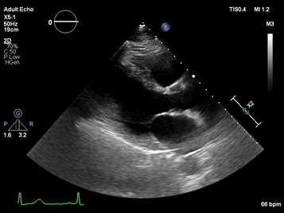
Stress echocardiography
Endpoint: heart rate, blood pressure, exercise capacity,
symptoms or EKG changes
Target heart rate: 220 – HR X 0.85
Protocols: Bruce or dobutamine
Baseline echo images
Exercise or dobutamine (titration from 10 mcg/kg/min to 40 mcg/kg/min) + atropine (0.25 X 4 doses as needed to achieve target HR)
With dobutamine low dose images
Peak images.

Slide 14
Dobutamine stress test
Contraindications
Sustained or frequent ventricular arrhythmia and atrial fibrillation with RVR
Recent MI or unstable angina
Hemodynamically significant LVOT
Aortic dissection
Moderate to severe hypertension (resting SBP>180)

Slide 15
Nuclear stress test
The basic concept of stress radionuclide MPI is the visual assessment of relative myocardial blood flow or perfusion (via the radioactive tracer) between the resting and stressed states.
Myocardial segments that demonstrates preserved myocardial perfusion at rest but decreased during stress considered to be indicative of ischemia where as matched reduction in perfusion between the rest and stress is suggestive of a myocardial infarction.

Slide 16
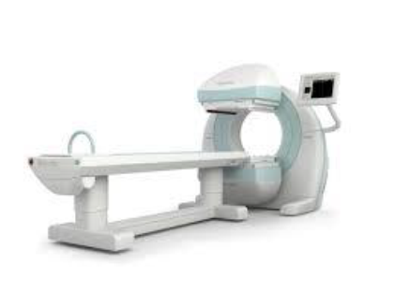

Nuclear stress test
Endpoint: HR, BP, exercise capacity, EKG and symptoms
Target HR: 220-age X 0.85
Protocols: Bruce or vasodilator
Patient will undergo scanning first
When patient achieves THR isotopes are injected
If patient’s cannot exercise/abnormal EKG then vasodilators (adenosine/regadenosene) are injected followed by isotope
After the stress portion, patient will undergo scanning again.

Slide 17
Contraindications for MPI
Bronchospastic airway disease
Sinus node dysfunction
Significant hypotension
Unstable angina or ACS (increased risk of ischemic events is present with all stress modalities)
Theophylline and caffeine should be withheld 48 and 12 hours prior to the procedures as these agents can decrease the effectiveness of vasodilators.

Slide 18
Exceptions
Baseline LBBB may undergo exercise stress test along with imaging, but preferably MPI if patients has baseline asynchronous left ventricular contraction.
For markedly obese patients, may limit interpretation of both stress echo and MPI.

Slide 19
Comparison of each stress testing
Types of stress test sensitivity specificity
Treadmill 61-68% 70-77%
Treadmill + stress echo 70-85% 77-89%
Treadmill + spect nuc MPI 82-88% 70-88%
Pharm Nuc MPI 88-91% 75-90%
Dobutamine stress echo 85-90% 79-90%

Slide 20
Case scenario
A 68 year old female with a history of DM, HTN, HLD, arthritis who was recently evaluated by family medicine for worsening shortness of breath for the past 2 weeks. Which cardiac stress test would be most appropriate?
A treadmill exercise
Treadmill + stress echo
Treadmill + Nuclear perfusion scan
Pharmacological nuclear perfusion scan
Dobutamine stress echo
Coronary angiography

Slide 21
Thank you

