Slide 1
Teri Metcalf McCambridge, MD
Assistant Professor of Pediatrics and Orthopedics
Case Based Approach to School yard MSK injuries: Identification and Treatment

Slide 2
Objectives:
Identify the physical findings consistent with an anterior shoulder dislocation
Differentiate between intra-articular and extra-articular swelling of the knee and review their differential diagnosis
Identify three developmental conditions that may cause limping in the school aged child
2

Slide 3

Case I: Shoulder Injury
12 year old boy playing on the playground abducts and externally rotates his arm to stop a run in red rover
He feels a pop
Unable to elevate or rotate his arm
You get called to the playground
He has a deformed right shoulder

Slide 4
Focused History Questions
Mechanism of Injury
  Helps predict injured structure
    Fall directly onto anterior/superior shoulder→AC joint injury (shoulder separation)
    Hit over anterior chest or fall onto lateral shoulder → Clavicle Fracture
    Arm forcefully abducted and externally rotated → subluxation or anterior dislocation
    Fall onto the posterior shoulder → Scapula Fracture
    If chronic pain, note activity that triggers pain, such as the cocking phase of throwing or the pull-through phase of swimming

Slide 5
Shoulder Anatomy:
Bony Anatomy
Humerus
Scapula
  Glenoid
  Acromion
  Coracoid
  Scapular body
Clavicle
Sternum

Slide 6
Anatomy: Important Muscle Groups
Scapulothoracic
Chest/Back
Biceps tendon
Deltoid
Rotator Cuff
  Supraspinatus
  Infraspinatus
  Subscapularis
  Teres Minor
Notes:
Rotator cuff—depress humeral head against glenoid
Subscapularis-IR
Infraspinatus-ER
Teres minor-ER
Teres Minor-ER
Subscapularis-IR
Scapular (rhomboids, trapezius, Levator scapulae, serratus anterior)—stabilize scapula
Chest/Back: Pectoralis major, deltoid, latissimus Dorsi, Biceps—primary movers of shoulder. Stabilize

Slide 7
Shoulder: Physical Examination
Inspection (Contour, position, skin)
Palpation
ROM
Strength
Neurological exam (including C-Spine evaluation)
Notes:
Contour-atrophy, elevation, shoulder angle
General position slight ER and abduction (Anterior)
Posterior dislocation arm is held in IR/ADDuction
Special tests: Sulcus sign (inferior instability), apprehension and relocation test (supine), Axial load test

Slide 8
Inspection
Swelling, asymmetry, muscle atrophy, scars, ecchymosis
Note posture/positioning
Deformities
  Squaring of shoulder - anterior dislocation
  Scapular "winging" - shoulder instability and serratus anterior or trapezius dysfunction
  Atrophy - supraspinatus or infraspinatus - suprascapular nerve entrapment or neuropathy
Notes:
Begins when athlete removes their shirt
Sprengel Deformity—congenital deformity with a small undescended scapula--associated with Klippel Feil, upper extremity deformity, and kidney disease
Poland Syndrome—Absences of Pectoralis muscle and often abnormality of the ribs, hand, and syndactly

Slide 9
Palpation
Sternoclavicular joint
Clavicle
Acromioclavicular joint
Acromion
Coracoid process
Bicipital groove
Proximal Humerus
Scapula
Cervical Spine
Include soft tissue
TIP: Start medially at
the SC joint, proceed
laterally, end posteriorly
Notes:
Soft tissue: Biceps, bursae region, shoulder musculature, anterior and posterior capsule

Slide 10
Quick Range of Motion (ROM) Assessment
Evaluate active ROM
  If movement limited by pain, weakness, or tightness, assist passively
Evaluate bilaterally
Don’t forget to check neck ROM
Notes:
If Apley’s Scratch test demonstrates full ROM individual ROM tests not required
Dominant shoulder may have 5 or 10 degrees more ER and 5-10 less of IR

Slide 11
Sensory Exam
Axillary
Musculocutaneous
Radial
Median
Ulnar
Notes:
http://www.aafp.org/afp/2010/0115/p147.html

Slide 12
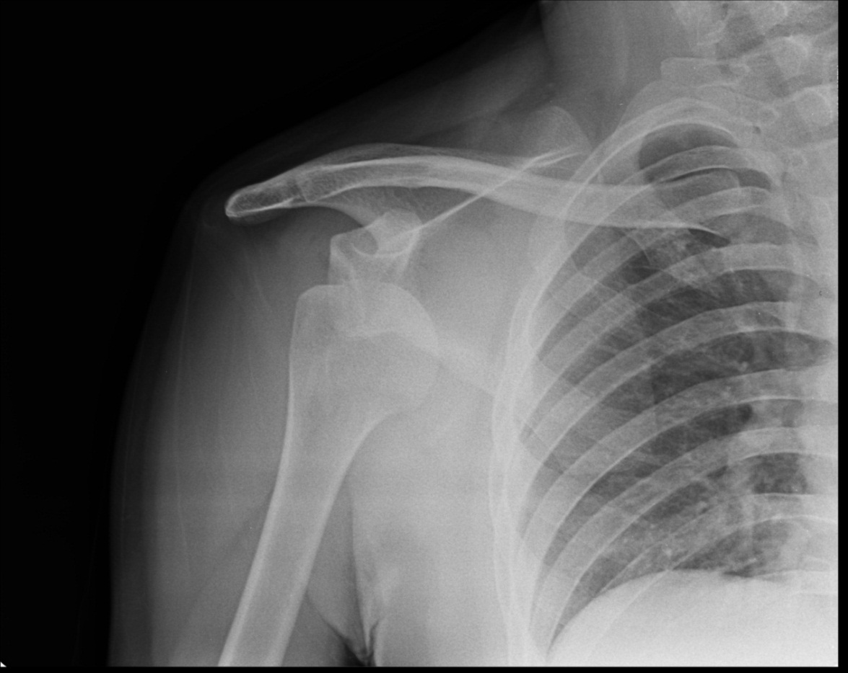
Shoulder Dislocations
Directions
  Anterior
  Posterior
  Inferior
  MDI
Shoulder stabilizers
  Negative pressure
  Static stabilizers
  Dynamic stabilizers
Notes:
Over 90 percent are anterior
Posterior more common with multidirectional instability
Shoulder is the most common diathrodial joint that is dislocated
Vacuum effect of the negative pressure inside the capsule
Rate of 17/100,000

Slide 13
Classic Presentation
Arm will be held externally rotated and abducted (away from the body)
Loss of normal prominence of the deltoid muscle (“squaring of the shoulder”)
Acromion will be more prominent laterally and posteriorly
Humerus may be palpated anteriorly
Notes:
Classic presentation of posterior shoulder dislocation: Limited external rotation of the shoulder (often to less than zero degrees).
Limited elevation of the arm (often to less than 90 degrees).
Posterior prominence and rounding of the shoulder compared with the normal side.
Flattening of the anterior aspect of the shoulder.
Prominence of the coracoid process on the dislocated side.

Slide 14
Shoulder dislocation
Management
Call mom
Call 911?
Comfort measures?
  Tylenol or Nsaids?
  Ice?
  Sling?
  Re-position/reduce?

Slide 15
What else to consider?
Differential Diagnosis
Posterior shoulder dislocation
Shoulder contusion
AC Sprain
Distal Clavicle Fracture
Proximal Humeral Fracture
Brachial Plexus neuropathy (won’t present acutely)
Notes:
Fixed internal rotation/abduction and prominent coracoid are signs of a posterior shoulder dislocation.

Slide 16
Acromialclavicular (AC) Sprain
Common
“Shoulder separation”
Mechanism:
  Fall landing on “point” or lateral aspect of shoulder
  Occasionally from fall on outstretched hand

Slide 17
AC Joint Sprain
Physical Exam:
  Well-localized swelling & tenderness over AC joint
  Painful active & passive range of motion
  Crossover testing increases pain
  Type II, III, V may have high riding clavicle
  May have tenderness to palpation over clavicle shaft, SC joint & clavicular attachments of trapezius & deltoids

Slide 18
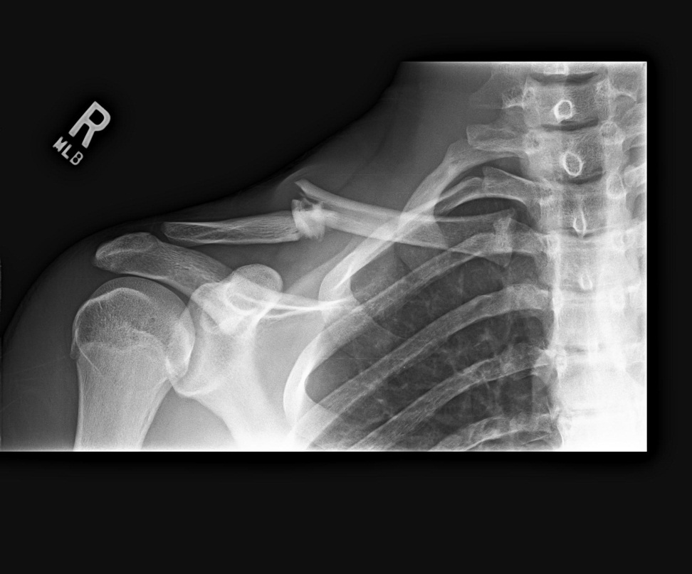
Clavicle Fractures:
2.6-5% of all fractures
88% occur <10 yoa
Mechanism
Fracture position
  Middle third 82%
  Lateral 15%
  Medial Rare
Notes:
Development: first bone in the body to ossify 5th month of fetal development. Ossification occurs via intramembranous ossification
Radiographs AP and AP with 45 degree cephalic tilt(minimizes overlap of ribs and scapula)
Immobilzation discontinued post 2 weeks
Medial epiphysis forms at the 16th year and closes between 22-25
Clavicle is S-Shaped with a medial convexity and a lateral concavity
Middle third is the thinnest, directly under the skin, with no soft tissue or muscle attachment
Mechanism: Direct fall onto shoulder (85%), fall on a straightened arm (2%), direct blunt trauma (13%)
Fracture classification Group I midshaft, group 2 lateral, group 3 medial
Function of clavicle: motion and stability of upper extremity, protection of neurovascular bundle.

Slide 19
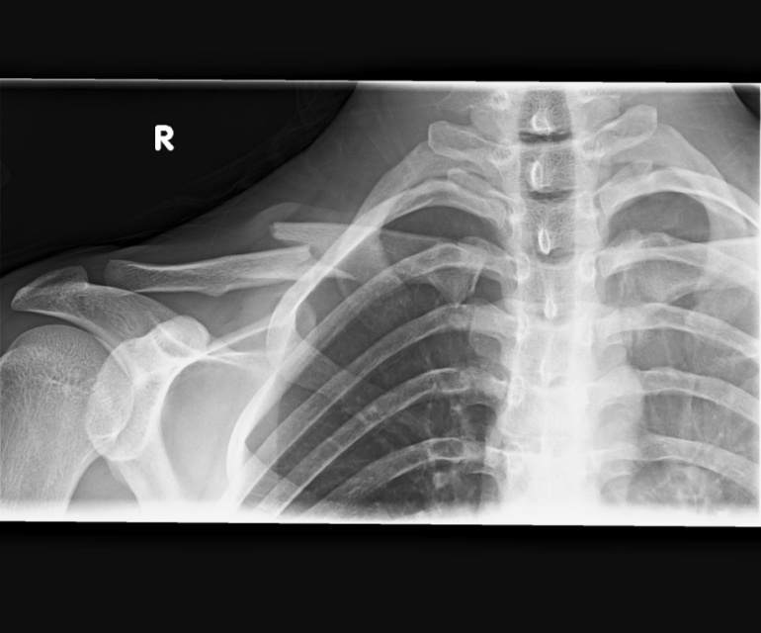
Clavicle Fractures:
When is surgery indicated?
Absolute:
  Open fracture
  Skin compromise or neurovascular injury
Relative:
  Greater then 15-20 mm shortening
  High risk of non-union
  Comminution
  Distal clavicle fx
Notes:
Risk factors for non-union/mal union: female gender, age, displacement more than on shaft width, and multiple fragments
Shortening of the shoulder girdle: chronic pain, muscular tension, weakness, and premature fatigue, scapularthoracic dyskinesis
Type II distal fractures where the coracoclavicular ligaments are torn from the medial fragment and only the trapezoid ligament remains

Slide 20
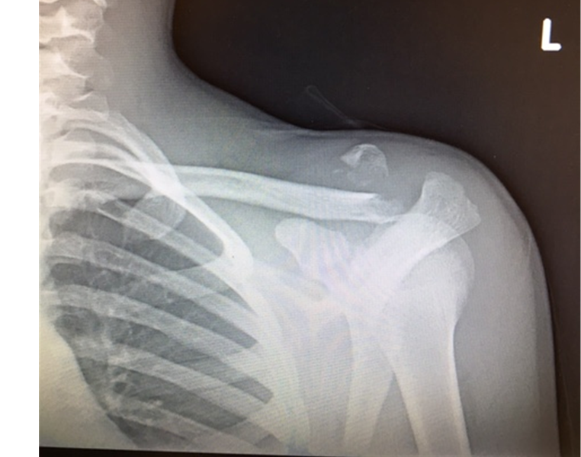
Clavicle Fractures:
What not to miss?
Medial Clavicle fracture
SC dislocation
Associated fractures
  First rib fracture
  Scapular fracture
Notes:
Remember pediatric clavicle medially is cartilagenous until 22 medially. Could have a physeal fracture not visible on xray.

Slide 21
Case 2: The Injured Elbow
6 year old little girl is playing on the monkey bars at school. She falls on an outstretched hand (Foosh). She immediately screams and has swelling in her elbow. You are called to the playground.

Slide 22
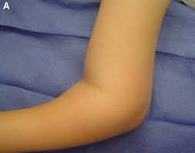
The Elbow Examination: Inspection
Observe joint above and below
Amount of swelling
Ecchymosis
Scars
Abrasions/Cuts

Slide 23
Palpation
Crepitus
Landmarks
  Olecranon
  Condyle
  Radial Head
  DRUJ
Neurovascular exam
  Brachial pulse
  Radial Pulse

Slide 24
Range of Motion
Elbow
  Flexion
  Extension
  Supination
  Pronation
Wrist
  Extension
  Flexion
Notes:
80 degrees pronation
85 degrees supination
Flexion to 0 -140

Slide 25
Nerve Injuries
Anterior interosseous nerve
Median
Radial
Ulnar
Notes:
Extension type injuries order of nerve injury: Anterior Interosseus Nerve, Median Radial and Ulnar
Flexion type injuries: Ulnar nerve
Most injuries resolve after 6 to 12 weeks (more worrisome if nerve deficit is noted post-op. Entrapment in the fracture/Pin through the nerve.
OK Sign for AIN

Slide 26
Case 2: The Elbow Injury
Physical examination
  Patient is in obvious discomfort
  Significant Swelling noted at elbow joint
  No pain at shoulder, clavicle or DRUJ
  Mild Deformity
  Pulses are strong and hand is pink
Differential Diagnosis
  Supracondylar Fracture
  Radial Head Fracture
  Monteggia Fracture
  Elbow Dislocation
  Nursemaid Elbow

Slide 27
Children: Supracondylar Fracture
3 percent of all pediatric fractures
Most commonly in children aged 5 to 7 years of age
Mechanism:
  98% are extension fractures with fall on an out-stretched hand with elbow in full extension.
Presentation
Associated Injuries: Ipsilateral distal radius*
Vascular and Nerve injuries are common
Notes:
Interesting facts: Most occur on the left side (non-dominant side)
Presentation: Pain and swelling around the elbow. Gross Deformity may be present with displaced fractures
*Higher risk of compartment syndrome

Slide 28
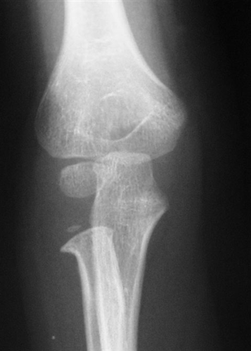
Radial Head Fracture
Median age is 9-10
Injury occurs around the metaphysis
Mechanism is full elbow extension with a valgus load.
Presentation minimal swelling, limited rotation, point tenderness, may complain of wrist pain

Slide 29
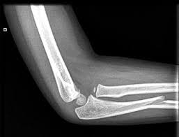
Monteggia Fracture
Fracture of proximal 1/3 of ulna and dislocation of proximal radial ulnar joint
Peak age is 4-10 years
FOOSH with maximal pronation
Urgent referral to orthopedics
Radial nerve and Posterior interosseous nerve most common complication

Slide 30
Elbow Dislocation
Occur in older children (10-15 years) and males 3:1 ratio to females
FOOSH
Elbow is swollen, held in flexion, pain with motion, shortened appearance of forearm.
Complications:
  Fx: medial epicondyle, coronoid
  Vascular: brachial artery injury
  Nerve: median or ulnar nerve injury
Notes:
Common in wrestling and gymnastics

Slide 31
Nursemaid’s elbow
Mechanism: Traction with rotation
Age: 1-4, rare after 5
Subluxation of annular ligament
X-ray should be normal. No posterior fat pad
Child will present with a extended, pronated hand
No Swelling
Recurrence is common

Slide 32
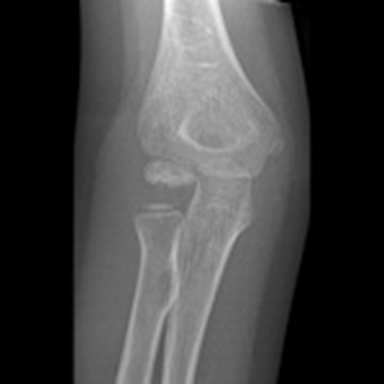
Panner’s Osteochondrosis
Occurs in males 5-12 years of age
Etiology: interference of blood supply to the capitellum
Not usually associated with throwing athletes
Usually have 20-30 loss of extension, pain laterally, and occasional swelling
Treatment: 3-4 weeks immobilization and then rest

Slide 33
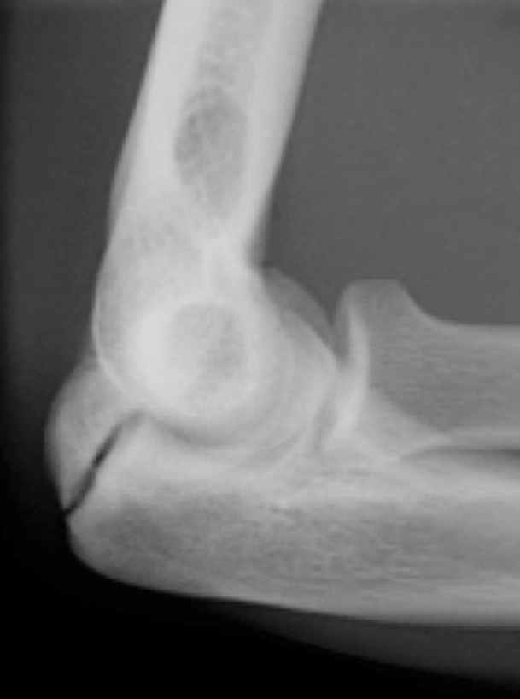
Olecranon Stress Fracture
Rare injury
Generally reported in throwers or weight bearing athletes
Mechanism impingement of the olecranon in its fossa or traction.
UCL insufficiency increases susceptibility
Brucker, J. Sports Health 2015; 7 (4):308-311
Notes:
Reported in baseball pitchers, javelin throwers, gymnasts, tower divers, and weight lifters

Slide 34
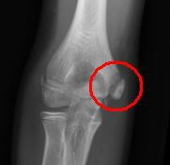
What is Little League Elbow?
Result of valgus overload to the medial elbow from repetitive throwing
Presents with medial elbow pain with throwing
Frequent in middle school age boys
X-ray AP, Lateral and Oblique should be obtained.
Benjamin, H Little League Elbow. Clin J Sport Med 2005; 15(1):37-40
Notes:
Incidence of elbow pain is 2—40% in 9-12 year old baseball players. Comparison view often helpful in skeletally immature athletes. Radiographs may initially be negative, so rest athlete regardless.

Slide 35
Little League Elbow:
(Conservative Treatment)
Recommended if separation of apophysis < 5 mm
Involves
  Rest from pitching for a minimum of 6 weeks
  ICE/NSAIDS
  Throwers Ten Exercise Program
  Technique evaluation/modification
  Gradual resumption of activity with throwing program
Notes:
No pitching remainder of season (may play first base or another modified position when pain and range of motion is normalized)

Slide 36
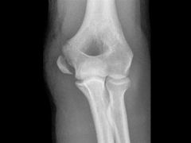
Medial Epicondyle Avulsion Fracture
Present with an acute pop and pain
Generally during pitching
Generally not following USA baseball throwing guidelines
Age range generally 11-15 (mean 13)
Present with medial pain, swelling, and limit in extension
Radiographs reveal avulsion off of the medial epicondyle
Treatment < 5mm conservative
Osbahr, D. et al. J Shoulder Elbow Surg 2010; 19:951-957
Notes:
Conservative treatment Long arm cast and then rest from throwing and rehab
Surgical Treatment ORIF
Generally able to return to activity in a range from 4-10 months after injury.

Slide 37
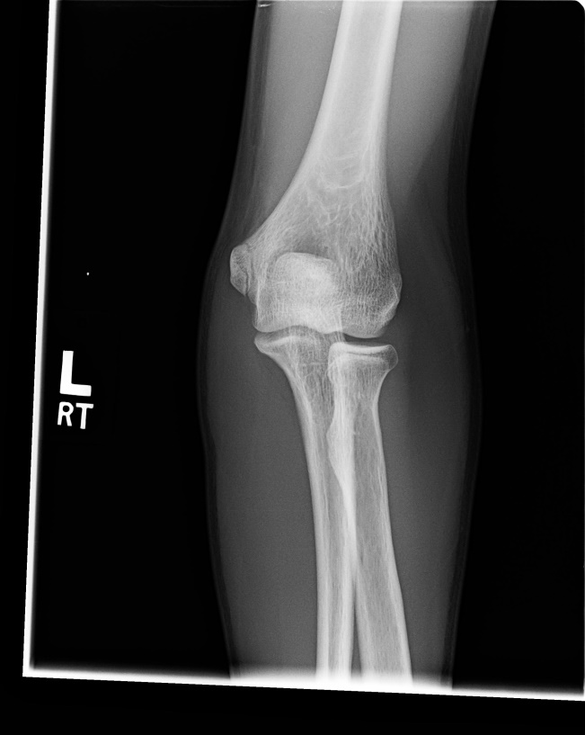
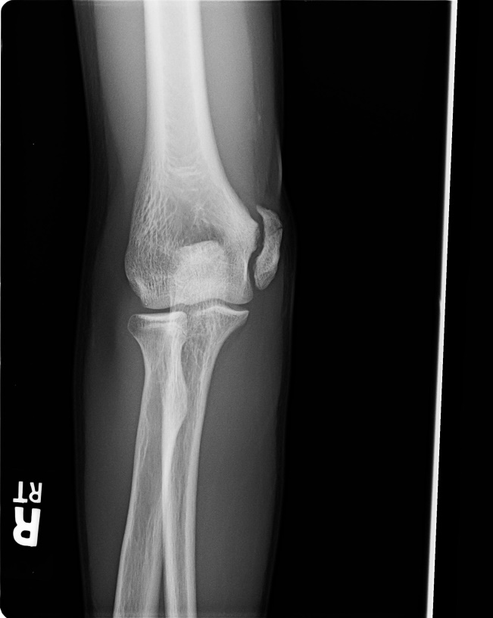
What Happens if you Miss the Diagnosis?
Normal side
Abnormal side

Slide 38
Case 3: The Swollen Knee
15 year old high school freshman is playing soccer on wrestling mats. He plants his foot, twists and feels a pop and has immediate pain, inability to bear weight, swelling, and deformity of his left knee. A student comes running into your office for help……..

Slide 39
Anatomy
Bones
Ligaments/Tendons
Cartilage

Slide 40
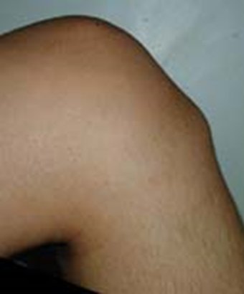
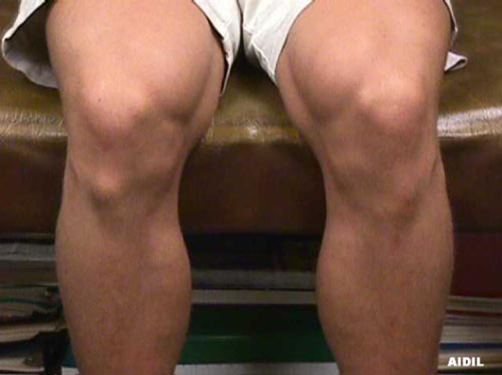
Inspection

Slide 41
Palpation:
Tibia tubercle
Patellar tendon
Adductor tubercle
Joint line

Slide 42
Special Tests:
Lachman Test
Anterior/posterior drawer
Pivot Shift
Tibial Sag
Varus/Valgus stress
McMurreys
Apley’s Grind

Slide 43
Differential:
Acute hemarthrosis
Cruciate ligament injury
Patellar dislocation
Intra-articular fractures
  Epiphysis, Tibia spine, or osteochondral
Peripheral meniscal injury
Popliteal tendon avulsion
Patellar Sleeve Fracture

Slide 44
Differential:
Extra-articular swelling
Collateral ligament injury
Baker’s cyst
Knee contusion
Bursitis or ruptured bursa
Meniscal cyst

Slide 45
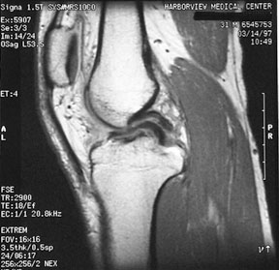
Differential: Locking/catching
Osteochondritis dissecans
Meniscal injury
  Bucket handle
Discoid meniscus
Loose body

Slide 46
Case 3:
In the nurses office or on the field
…… has marked deformity of the knee with obvious lateral patellar dislocation…..
What’s Next??

Slide 47
Options:
Apply Ice/Calm down
Call Certified ATC
Splint/crutches
Reduce
Call 911

Slide 48
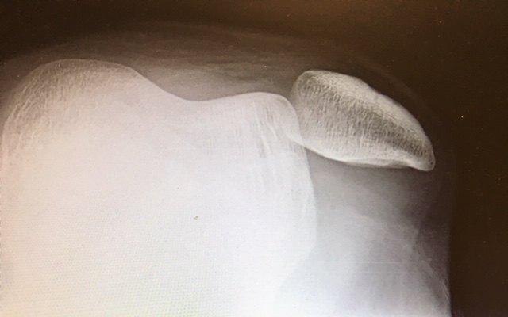
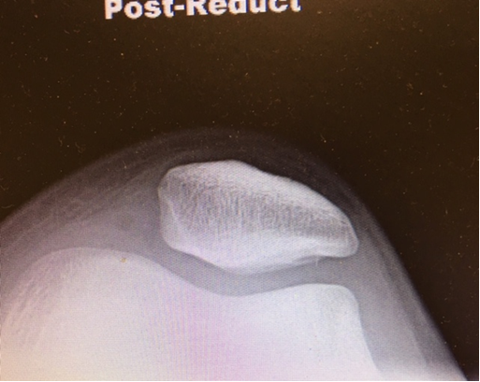
X-ray Findings of Patellar Dislocation

Slide 49
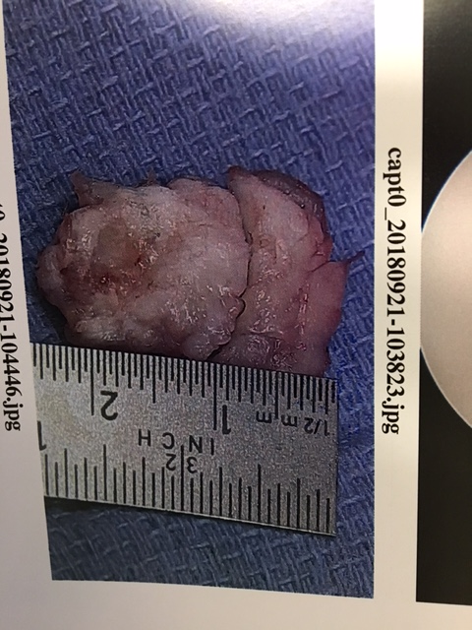
Complications:
Tear of MPFL Ligament
Bone Fragment
  Lateral femoral condyle
  Medial Facet
Chondral Fragment
Recurrent Dislocations

Slide 50
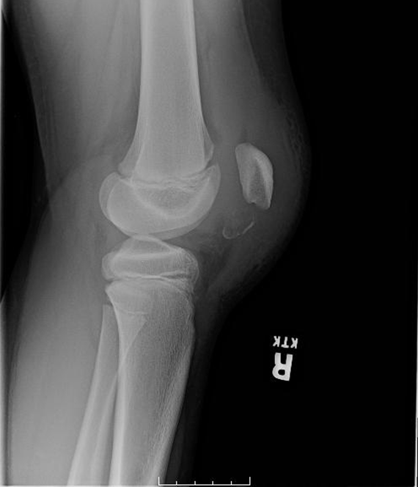
Patellar Sleeve Fracture!!
(Serious injury)
Acute traumatic pain
Associated with hemarthrosis and extension lag
Small bony avulsion is associated with a large cartilaginous injury
Urgent referral to ortho
Treatment dependent on displacement

Slide 51
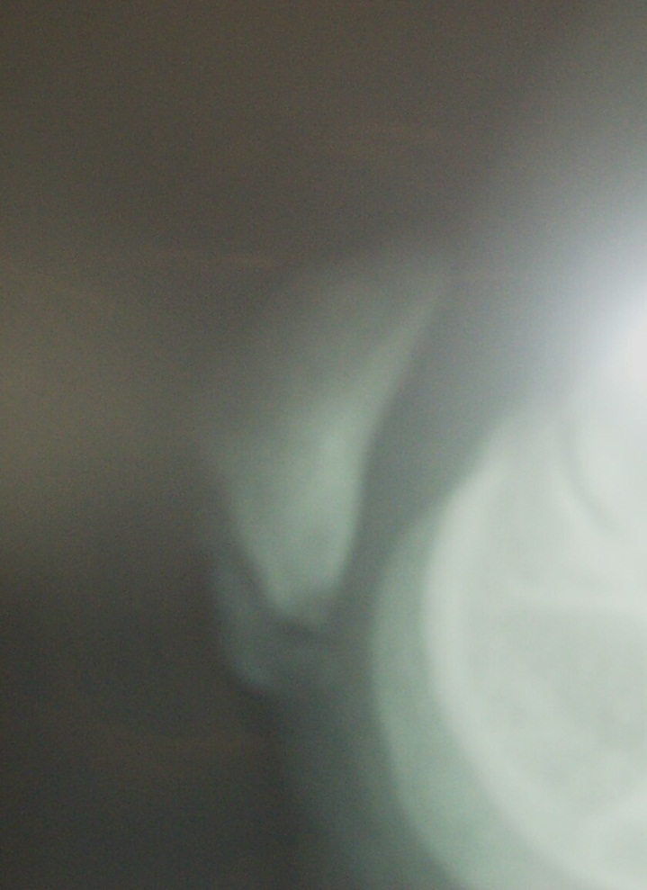
Sinding-Larsen-Johansson
(Growing Pain)
Irregularity inferior pole of patella
Acute or gradual onset
Presentation between 10-12
Pain with running, jumping and climbing
Point tenderness patella
Notes:
Persistent traction at the immature inferior pole of the patella leads to calcification and ossification at this junction.
Differential : Bipartite patella, stress fracture, insertional tendonitis, or sleeve fracture

Slide 52
Case 4: The Ankle Injury
14 year old boy is playing basketball in gym class. He goes up for a rebound and lands on his friend’s foot. He has an inversion injury to his ankle. He feels a pop. He is unable to bear weight and comes to the nurses office being assisted by the teacher…….

Slide 53
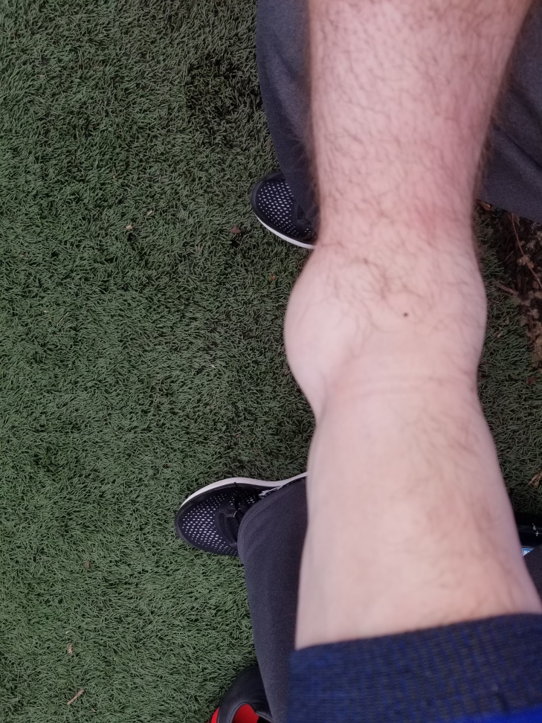
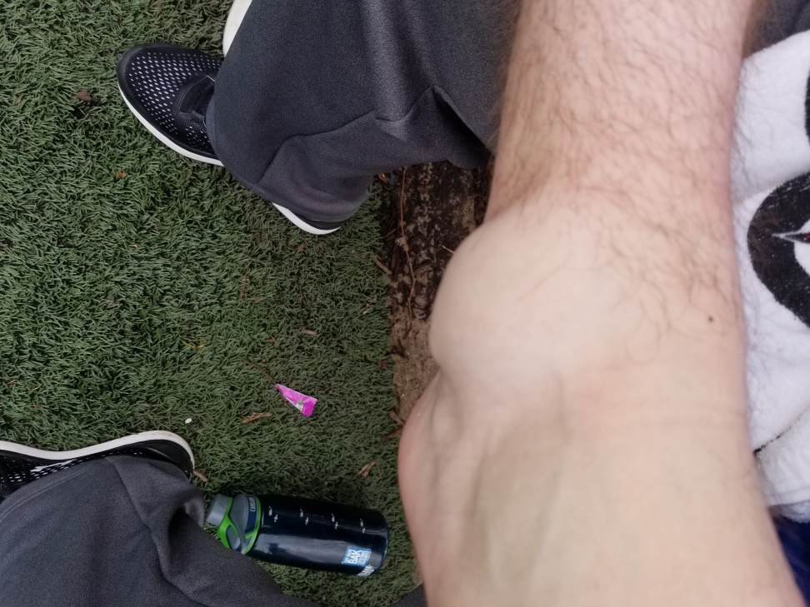
The Ankle

Slide 54
History
Mechanism
Position of foot
Previous injuries
Weight bearing status
Locking or catching
Pain location
Pain description
Swelling

Slide 55
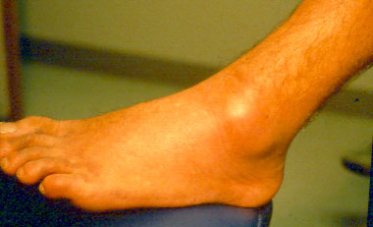
Physical Examination
Weight bearing/gait
Inspection
  footwear
  callous location
  ecchymosis
  deformity/swelling
Range of motion
  active/passive

Slide 56
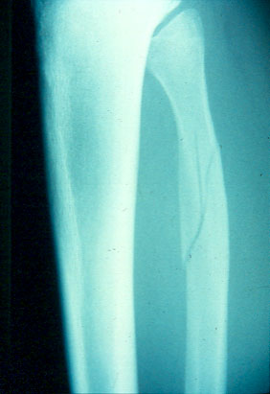
Physical Examination
Palpation
  Proximal tibia/fibula
  Ligaments
  Navicular
  Base of 5th metatarsal
  Malleoli
Assess Neurovascular status
  Pulses/color/temp.

Slide 57
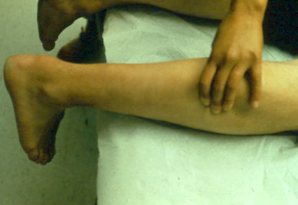
Physical Examination:
Special tests
  Anterior drawer
  Talar tilt
  Thompson test
  Syndesmosis squeeze test
  External rotation test

Slide 58
Differential Diagnosis by Location:
Anterior
Syndesmotic Sprain (high ankle sprain)
Navicular fracture
Talar dome Fracture
  osteochondral fracture
  osteochondritis dissecans
Posterior
Retrocalcaneal bursitis
Achilles injury
Severs “disease”
Os trigonum
Posterior impingement

Slide 59
Differential Diagnosis by Location:
Medial
Deltoid sprain
Maisonneauve fracture
Tendonitis
  Flexor Halluxis Longus
  Posterior tibialis
Accessory navicular
Stress fracture
Lateral
Lateral complex sprain
Fibular fracture
Peroneal injury
Jones fracture
Avulsion fracture
Stress Fracture
Notes:
Peroneal injury (tendonitis/subluxation)

Slide 60
Ottawa Ankle Rules:
Determining When to X-ray
Limitations:
No application for skeletally immature patients
May miss small avulsion
fracture
Criteria
  Age of 18 years of age
  Point tenderness Posterior and distal 6 cm of:
    Medial Malleolus
    Lateral Malleolus
  Inability to bear weight immediately and on exam in the ED
Buffalo Modification: Tenderness over only the middle 6 cm of Malleoli
Notes:
Weight bearing including being able to walk 4 steps in the emergency department
Less than 15% of ankle sprains are associated with fractures.
Ottawa ankle rules are 100% sensitive and 19% specific
Exclusions: Age less than 18, altered sensorium (including alcohol), pregnancy, multiple painful injuries

Slide 61
Ankle Sprain
Most common musculoskeletal injury in athletes
Accounts for 25% of missed time from sports
Generally an inversion injury
Notes:
85% of sprains involve the lateral ligament complex
Thought to occur at a frequency of 1 per 10,000 people a day

Slide 62
Physical Exam:
Swelling frequently over lateral malleolus
Limited range of motion
Dependent on severity: positive talar tilt/anterior drawer
Don’t forget to palpate syndesmosis, lateral foot, and proximal tibia/fibula

Slide 63
Treatment (immediate)
Limit Hematoma
Rest
  Crutches
Ice
  72 hours
  15-20 minutes
Compression
Elevation
Notes:
Compression U shaped compression dressing

Slide 64
Immediate Referral:
Open Fracture
Displaced fracture/significant deformity
Unstable fracture (bimalleolar/trimalleolar)
Joint Dislocation

Slide 65
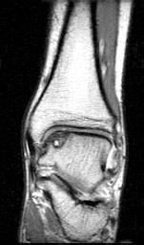
Beware of Improper Diagnosis:
Chronic Ankle Pain
Fractures
OCD
Syndesmosis injury
Peroneal injury
Tendon Injury
CRPS
Poor rehabilitation
Tarsal coalition

Slide 66
What you might see in a child with an OCD:
Recurrent Swelling (effusion)
Complaints of stiffness
Complaints of instability episodes
Locking or catching (painful)
Notes:
Presentation is generally delayed (average diagnosis is 2 years after presentation)

Slide 67
Key Points:
Always examine the joint above and below to avoid missing associated fractures.
If you are worried about a syndesmosis injury:
  Check for radiating pain with external rotation and a positive squeeze test
  Obtain standing mortise, stress views, or tibia-fibula films based on level of suspicion.

Slide 68
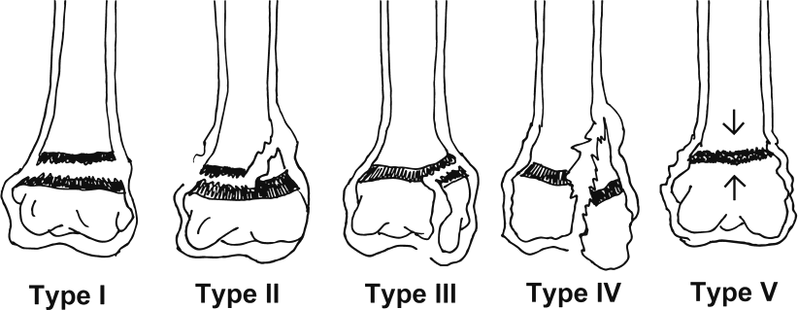
Acute traumatic epiphyseal plate injuries (Salter-Harris)
Account for 10-30% of all childhood fractures
Complications longitudinal or angular deformity
Radiographs may appear normal on type I and V, clinical suspicion is critical
15%
40%
25%
20-25%
rare
Notes:
Young children generally sustain Salter ½ injuries, while older children reaching skeletal maturity often sustain III or IV

Slide 69
Non-acute causes of joint pain or limp in kids
Foot
  Iselin’s
  Severs
Knee
  Osgood Schlatter
  OCD**
Hip
  Legg Calve Perthes
  Slipped capital Femoral Epiphysis
Notes:
Discussed earlier

Slide 70
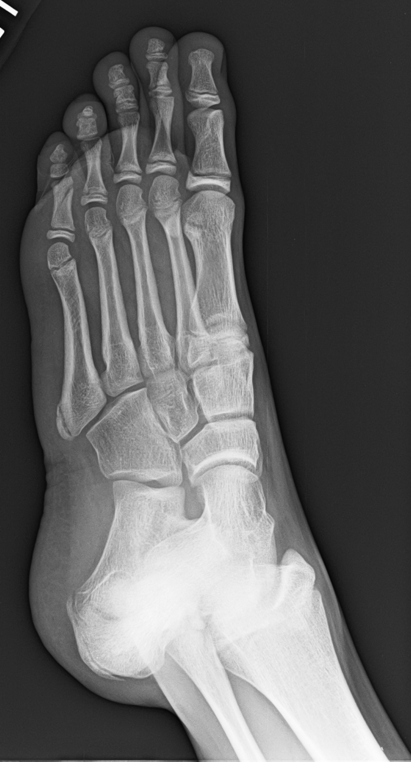
5th Metatarsal: Iselin’s
Inflammation or injury to apophysis at the base of the 5th metatarsal
Treatment based on pain and amount of swelling
Weight bearing as tolerated.
Does not need casting
3 weeks return to activity

Slide 71
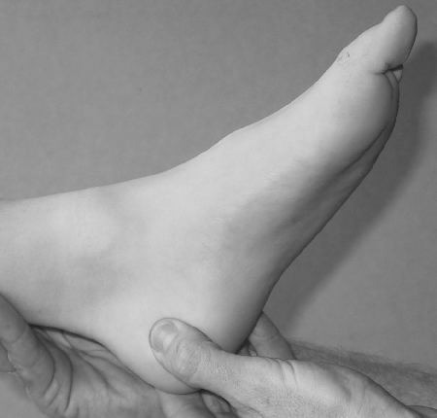
Sever’s
History
Physical Examination
Late elementary or early middle school
Often participate in multiple teams (cleated sports or barefoot)
Limp while playing sports
Report ankle or heel pain
Pain with squeeze test
Pain with heel walking
Tight Achilles tendon
Unable to perform single leg hop
Slight limp

Slide 72
Treatment
Rest
Ice
Heel cups (with activity)
Shoes with arch support and heel counter
Remove cleats
Avoid barefoot walking
Achilles Stretching
Casting, rarely
When Should You Seek Medical Advice??
Notes:
Cleats: force the heel into a negative heel position (dorsiflexion) increases the direct pressure on the epiphysis, as well as tightness of the Achilles.
Soccer cleats lack pressure absorption and motion control
X brace

Slide 73
Evaluate further if:
Swelling around the heel
Unable to walk normally on the heel after rest and PRICE.
Foot is colder then the opposite side and hypersensitive to touch.
Fevers, chills, weight loss, or other signs of illness.
Redness or warmth around the heel unrelated to activity.

Slide 74
What else causes heel pain?:
Osteoid Osteoma
Calcaneal stress fracture
Tarsal coalition
Achilles tendonitis
Plantar Fasciitis
Os Trigonum
Cancer (rarely)
Notes:
Osteoid osteoma, calcaneal stress fracture, tarsal coalition, achilles tendonitis, and plantar fasciitis

Slide 75
Osgood Schlatter’s
Traction apophysitis at the tibia tuberosity
Age range 12-16
Bilateral in 20-30%
  Usually dominant leg
Common in Basketball players
Notes:
Retrospective study of 412 athletes presenting to a sports clinic found an incidence of osd of 21% in active sports vs 4.5% in non-athletic students
Kujala Am j sports med 1985 13(4):236-41

Slide 76
Diagnosis
Often made based on physical and examination, age, and history alone
X-ray needed only if atypical age or history of a pop and significant swelling.
MRI is not needed for diagnosis or treatment.

Slide 77
When is mandatory rest recommend?
Inability to perform terminal knee extension
Inability to do a controlled box step up
Loss of knee flexion (secondary to pain)

Slide 78
Treatment options
R.E.S.T (If you trust them)
Knee immobilizer
  In severe cases
  Limited time (2 weeks)
Physical Therapy
  Eccentric Quad
  Flexibility
Braces
Tincture of time

Slide 79
Legg Calve Perthes
Avascular necrosis of the femoral head
Presents between 5-10
Presentation is groin, thigh or knee pain that worsens with activity
Exam limited IR and abduction
Diagnosis: x-ray
Treatment variable
Notes:
Boys 5x more common than girls
Thought to be genetic (not activity related)
Prognosis (age <6 at diagnosis better), greater than 50% of surface area affected chance of long term deformity, and stage at presentation
Treatment (2-6 limited activity and observation, PT, NSAIDS), casting with Petrie casts, surgery (tenotomy or osteotomy (> 8 at presentation)
Cast is to keep femoral head positioned correctly within the acetabulum

Slide 80
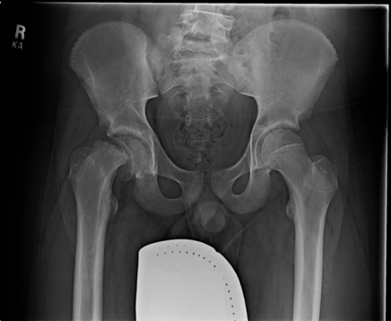
Slipped Capital Femoral Epiphysis
Osteochondrosis affecting femoral physis
Generally overweight preadolescent
Risk Factors: Diabetes or hypothyroidism
Insidious onset of pain in groin, thigh, or medial knee
Exam notable for Limited IR/ER/Flexion. Positive Trendelenberg.
Crutches and immediate referral if suspected

Slide 81
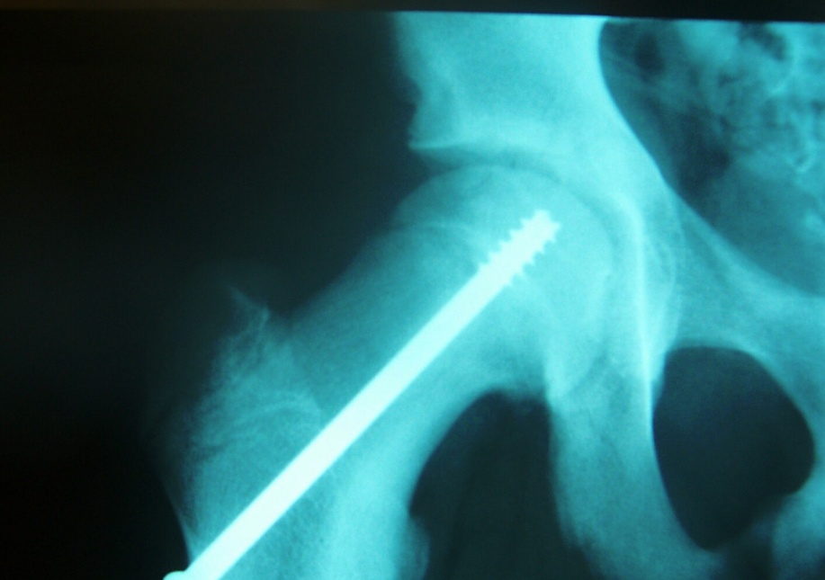
Treatment
Crutches
Activity limitation
Definitive treatment
  Percutaneous internal fixation of right hip

Slide 82
MSK Injuries are common at school
Have emergency action plans in place
Consider having simple immobilization devices/crutches available for when injuries occur
Familiarize yourself with good urgent care facilities or orthopedic groups that will take same day referrals

Slide 83

Thank you
tmccambridge@Towsonortho.com
410 961-6446 (cell)
410-337-7900 x 1231 (office)

