Slide 1
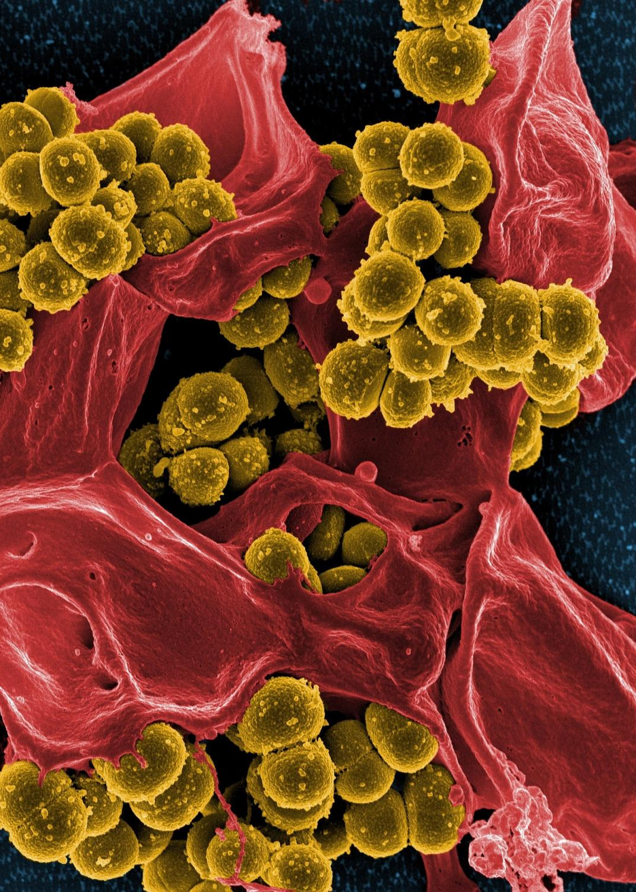



SAVE THE DATE
Surviving Sepsis: Every Second Counts
Presented by Nicole Kupchik
March 8, 2019 | 8:00 am – 4:30 pm
IU Health, Methodist Hospital
Indianapolis, IN
Hosted by CIC-AACN

