Slide 1
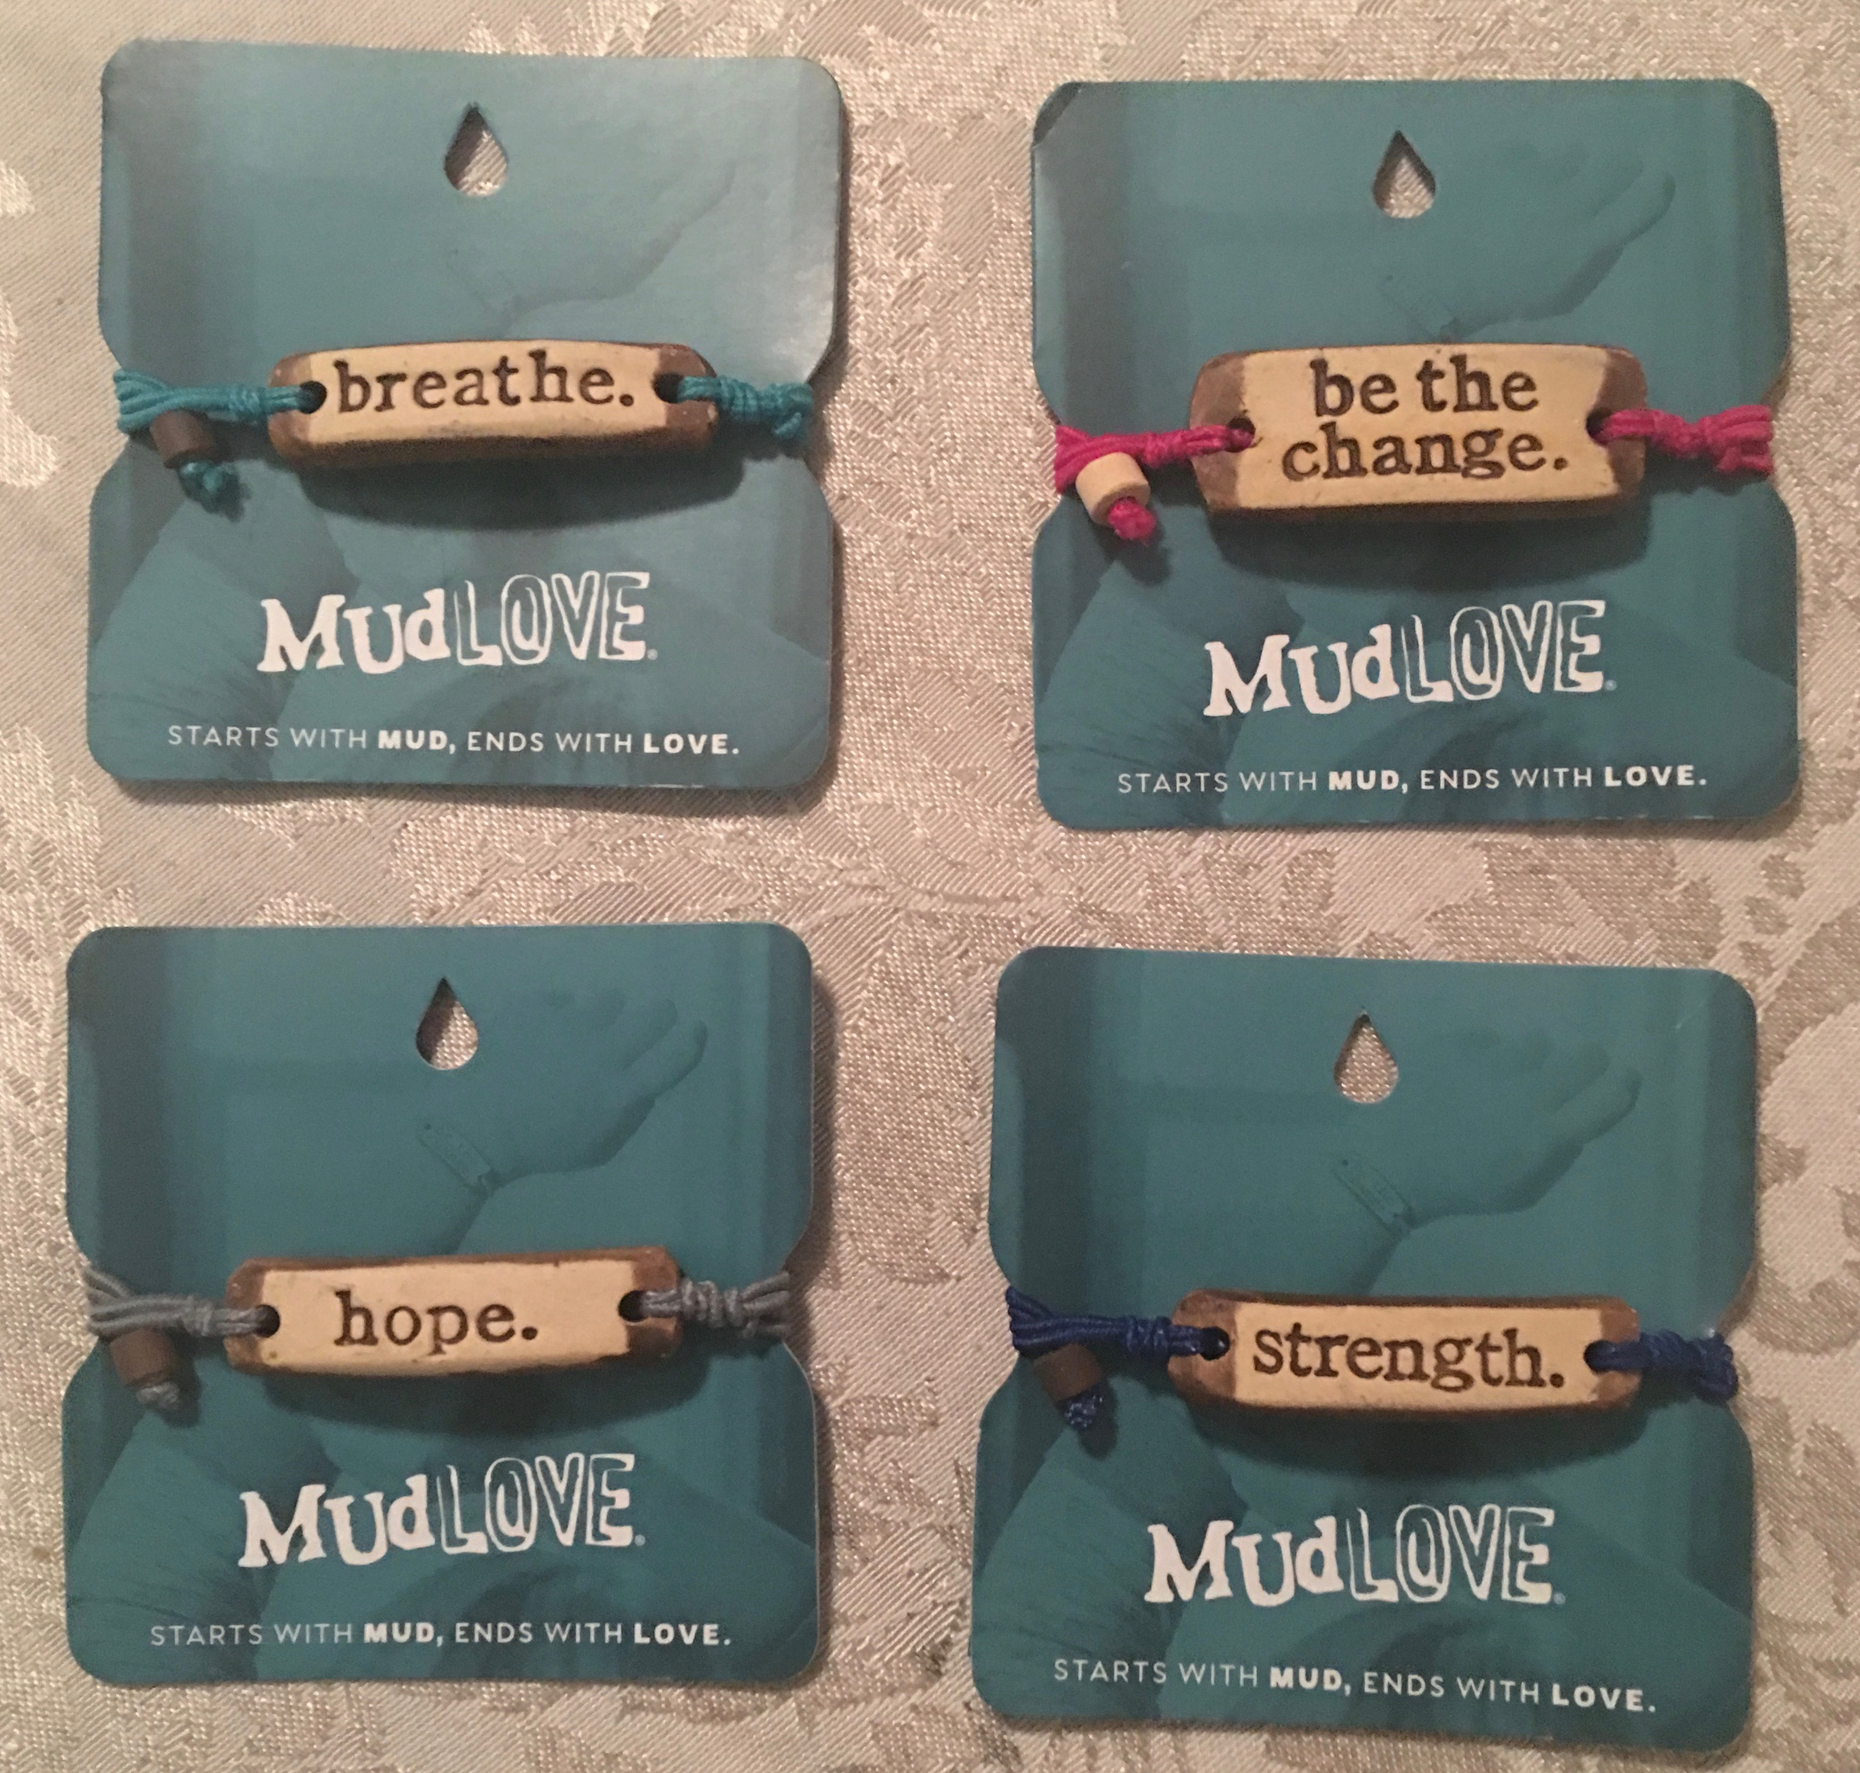
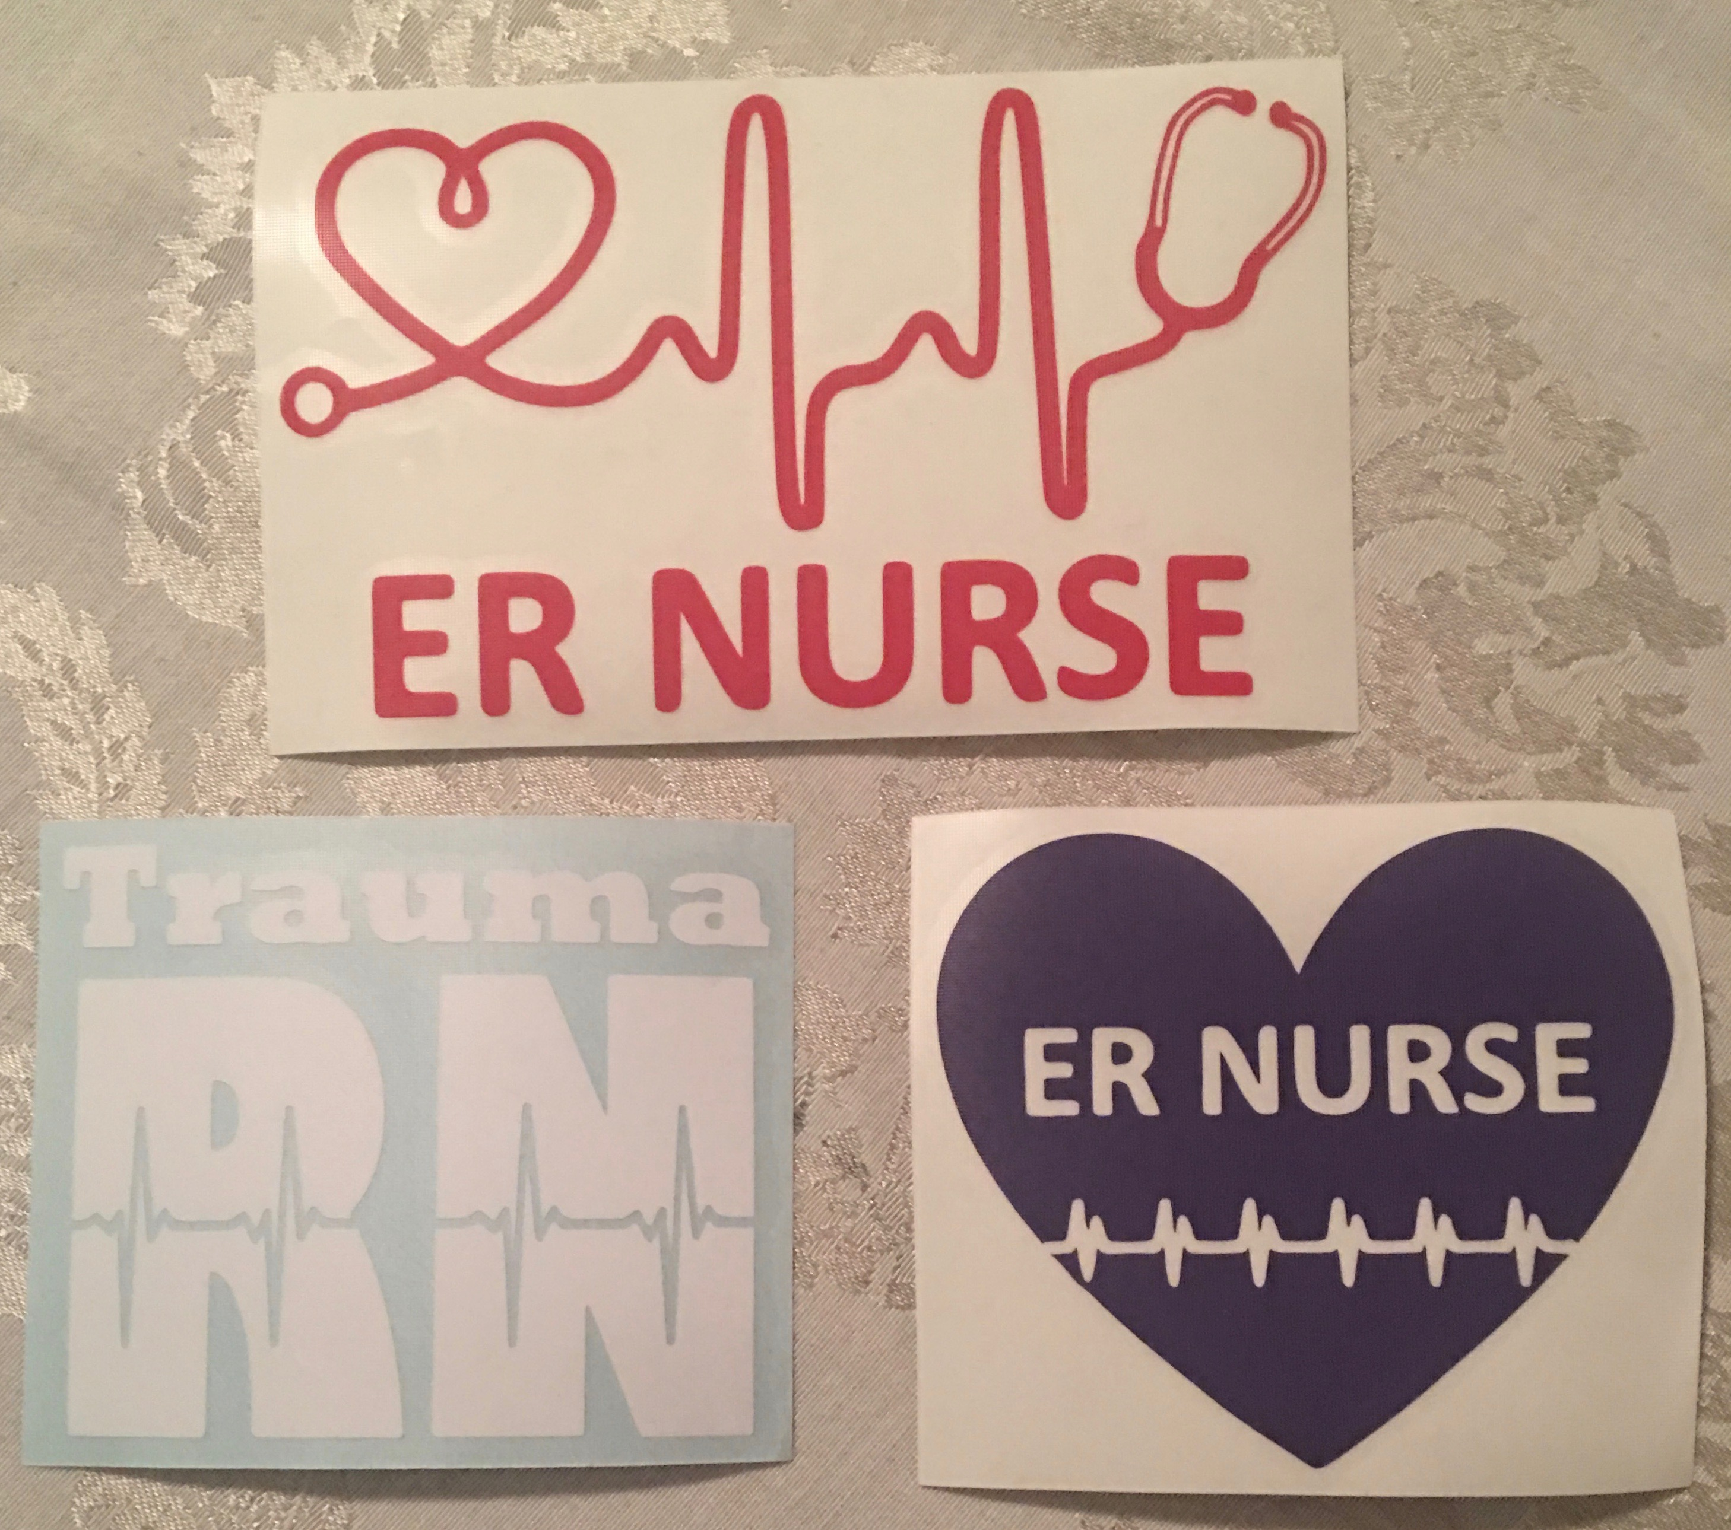
Support Virginia ENA
Purchase a MudLove Bracelet or DecaLS
Email Kathy.G.Ingersoll@gmail.com for more information

