Slide 1



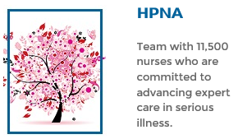
Join Us
Midwest Hospice and Palliative Nursing Association
Education Program
Date: Thursday, November 15, 2018
Location: Truman Medical Center – Board Room
TMC Hospital Hill, 2301 Holmes Road, KC MO 64108 (Map on next page)
6:00: Business Meeting, Light Dinner and Networking
6:30-7:30 Program: “Sometimes I Buy Myself Flowers: Preventing and Alleviating Compassion Fatigue and Burnout”.
Speaker: Dorothy Kurtz, RN, CHPN
Palliative Care Nurse
Midland Hospice and Palliative Care, Topeka, KS
Description
Purpose of this program is to provide valuable insight into strategies, and tools to anticipate, recognize and alleviate signs and symptoms of compassion fatigue and burnout. Target audience: RNs, APRNs, Chaplains, and SW in acute care and community settings.
Disclosures
There have been no conflicts of interest identified during the planning of this offering. To receive Contact Hours, participants must attend the entire program and complete the online evaluation.
1.0 contact hours for RNs and APRNs
Program Fee & Registration
-$5 for Midwest HPNA chapter members, $10 for non-members
-First time attendee? Fee waived if you join chapter at meeting.
-Support HPNA and join the chapter go to:
https://midwesthpna.nursingnetwork.com/
The University of Kansas Health System is accredited as a provider of continuing nursing education by the American Nurses Credentialing Center’s Commission on Accreditation.

Slide 2
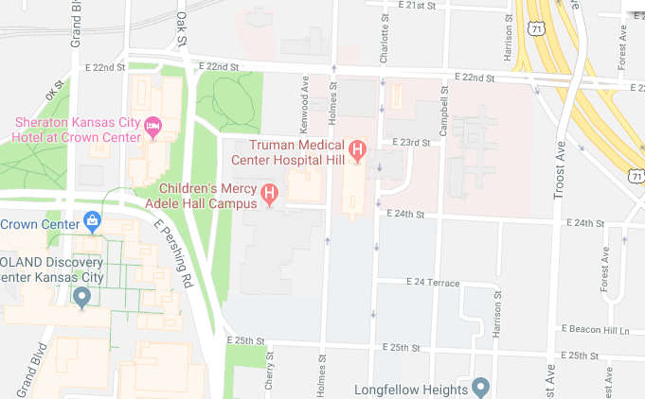
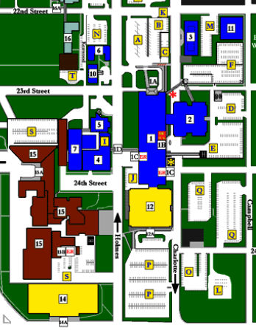
Truman Medical Center Hospital Hill
2301 Holmes Road
Kansas City, MO 64108
816-404-1000
Lot A or B
Main Entrance
Parking: Please park in lots A or B. Use the MAIN ENTRANCE to the hospital.
Directions to Board Room: located on the first floor (same level as the main entrance).
Contact: Maria Fox 913-488-5675 mobile

