Slide 1
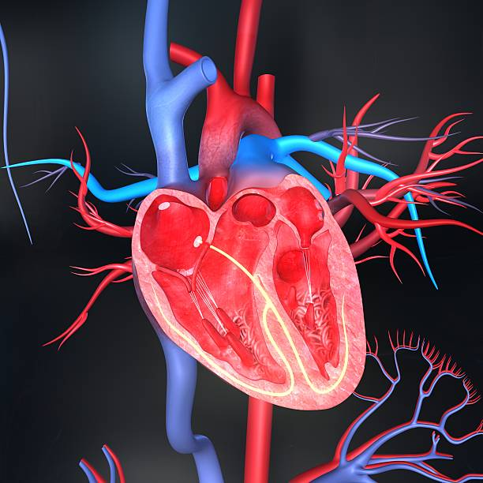

Caring for Patients with Left Ventricular Assist Devices (LVAD):
Clinical Tips & Implications in Palliative Care
Monica J. (Preolitti) Thomas BSN,RN,CCRN & Ellie Donalson MSN NCEL, RN
WVU Medicine-Heart and Vascular Institute
Thursday Sept 20, 2018 6:00-7:00 PM via on-line classroom. Attend from anywhere!
Free CE to all attendees (1.0).
Sponsored by the WV On-Line Chapter of HPNA.
Register at: https://wvohpna.nursingnetwork.com/nursing-events
Application for contact hours has been made to the West Virginia University School of Nursing, Charleston Division. WVUSON – Charleston Division is an approved provider of continuing education for Registered Professional Nurses by the West Virginia Board of Examiners for Registered Professional Nurses. WVBRN registration number: WV1997-0187-RN

