Slide 1

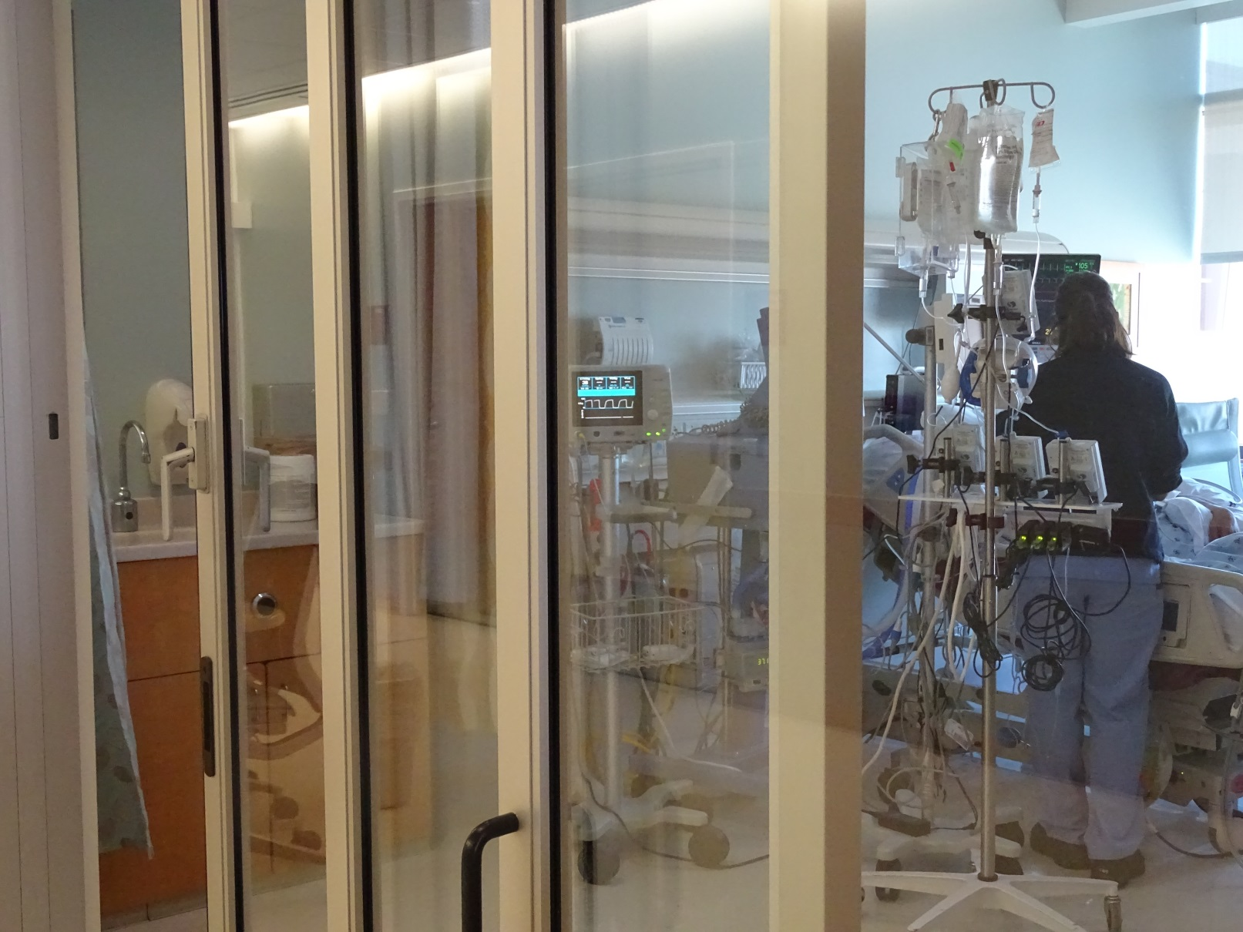
The Cost of Caring in Critical Care: Nursing Dilemmas and Distinctions
Debi Boyle MSN, RN, AOCNS, FAAN
Oncology Clinical Nurse Specialist
Advanced Oncology Nursing Resources
Huntington Beach, CA

Slide 2
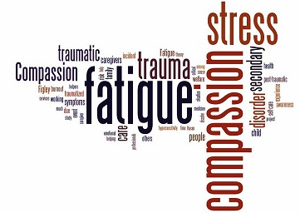

Slide 3
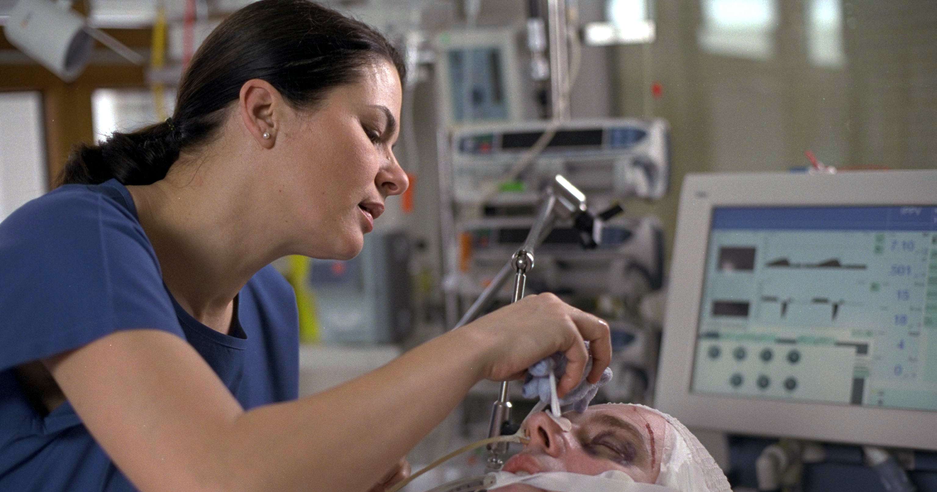
What is it?
When do we see it?
Why do we experience it?
What can we do about it?

Slide 4
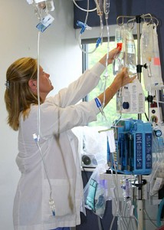
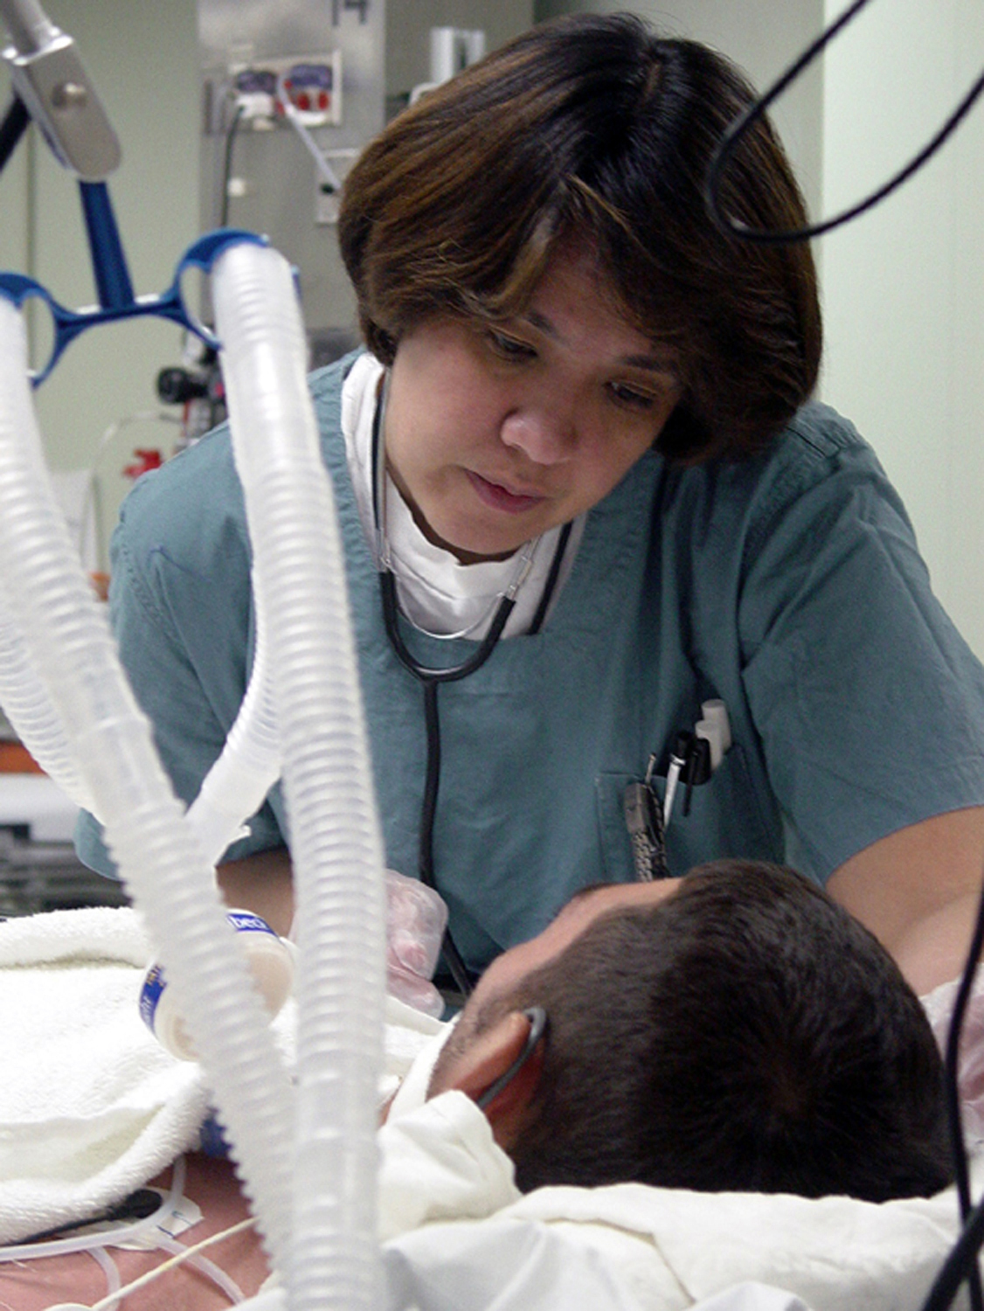
Differentiating Compassion Fatigue from Burnout
Organizational
RELATIONAL

Slide 5
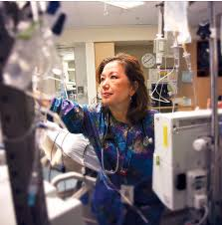
When Do You See It?
Children’s Hospital, Denver

Slide 6
Compassion Fatigue
https://vimeo.com/273790051

Slide 7

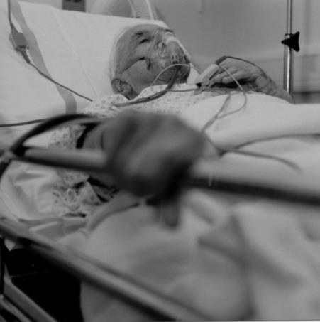
DYING IN ACUTE CARE: SCOPE OF THE PROBLEM
The majority of Americans die in the hospital vs. home, their preferred site of care
1 in 5 Americans die during or shortly after receiving care in the ICU
540,000 Americans die annually in ICUs representing 59% of all deaths
Sources: Angus DC et.al. (2004). Robert Wood Johnson ICU End-of-Life Peer Group. Use of intensive care at the end of life in the United States: An epidemiologic study. Critical Care Medicine, 32: 638-643; Nelson J et.al. (2010). In their own words: Patients and families define high quality palliative care in the ICU. Critical Care Medicine, 38(3): 808-818; Teno JM et.al. (2004). Family perspective on end of life care at the last place of care. JAMA, 291: 88-92.

Slide 8
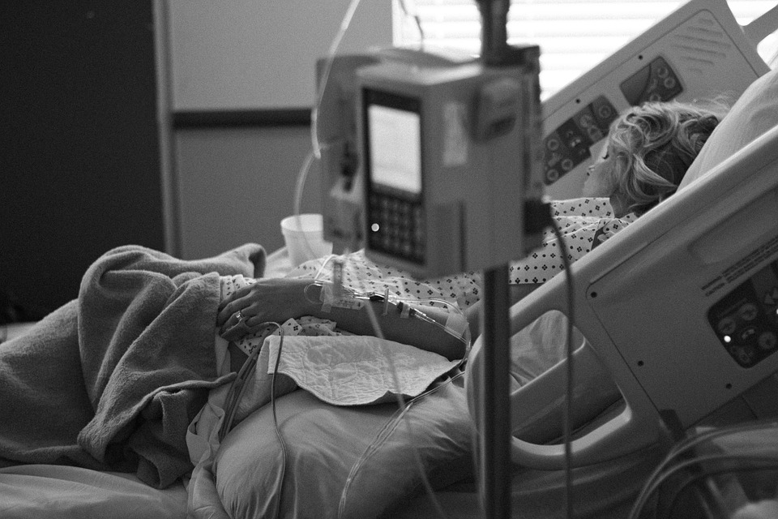
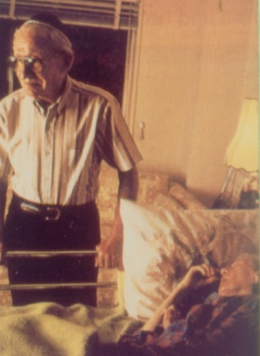
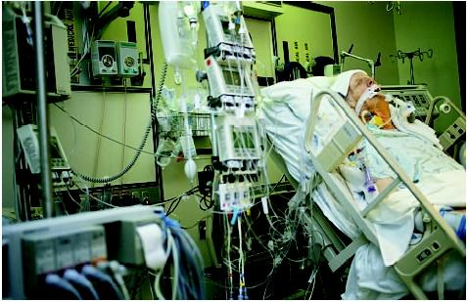
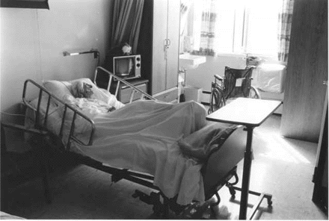
Where People Die
43%
25%
22%
10%
Other
Source: CDC (2016). Place of death, over time: US, 1989, 1997, 2007. Available at http://www.cdc.gov/nchs/data/hus/2010/fig33.pdf.

Slide 9

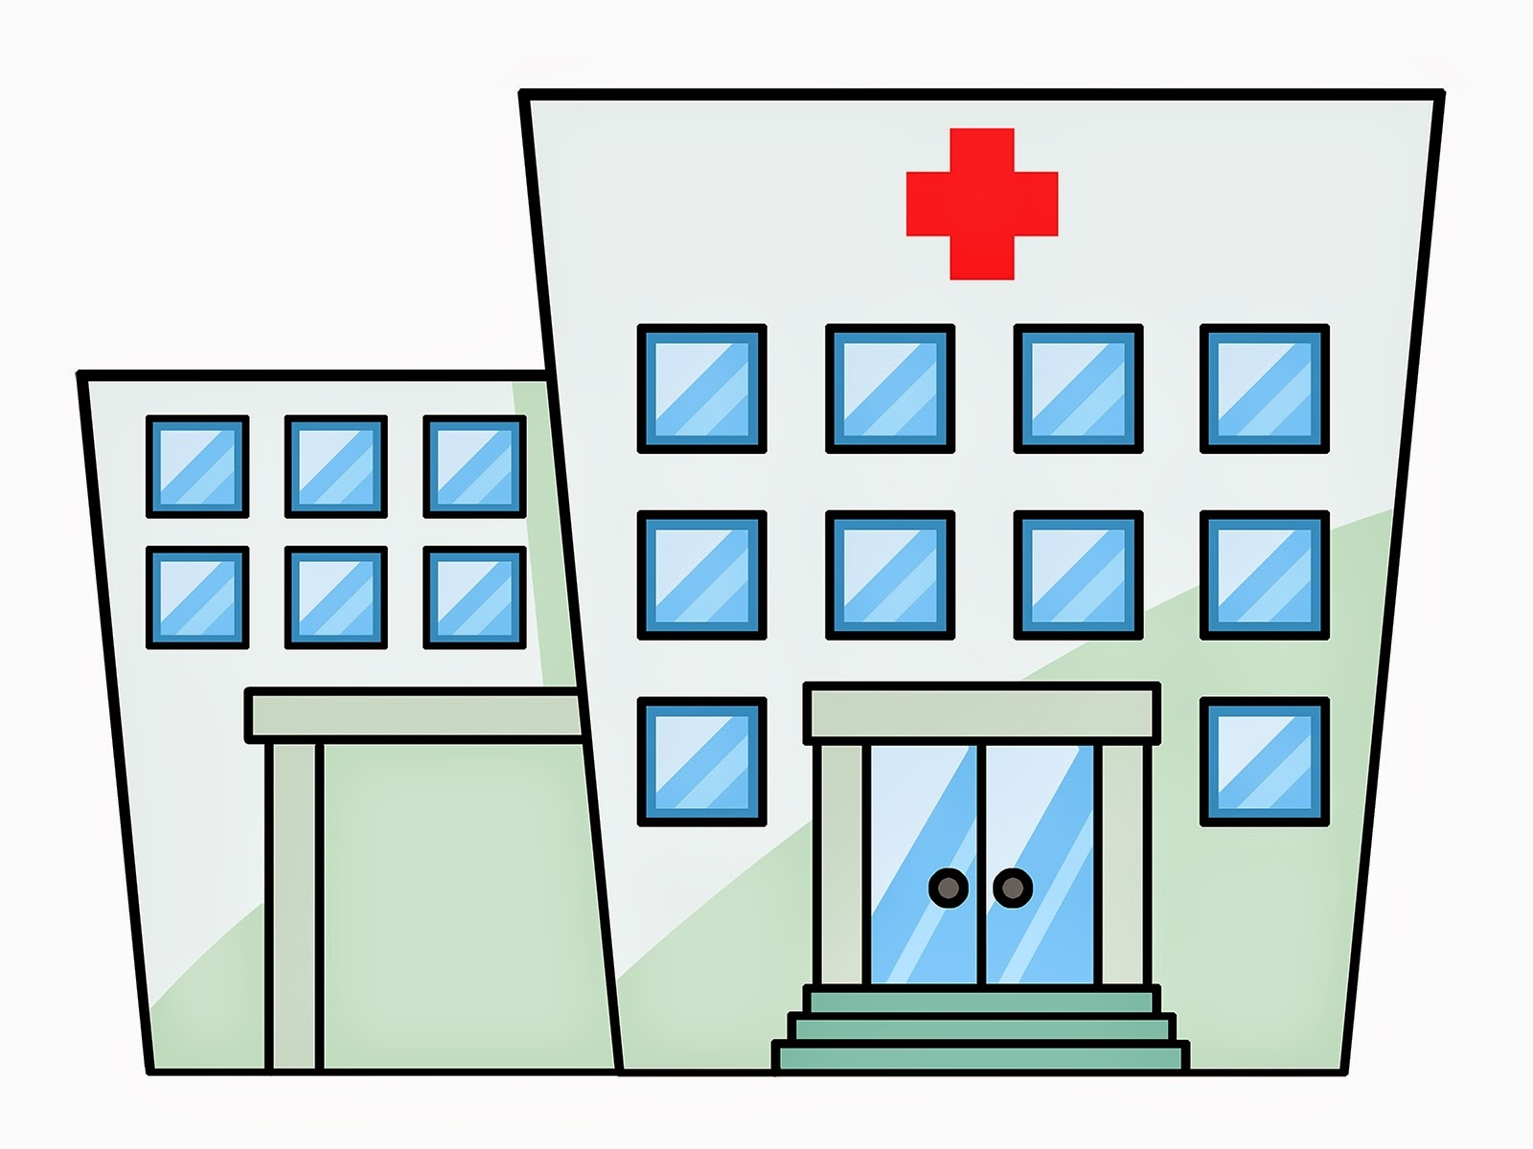
Setting the Stage in Southern Connecticut
- 2017 ICU Deaths -
125 in-patient deaths; 35 ICU
28% of all deaths

Slide 10


337 in-patient deaths; 175 ICU
52% of all deaths
QOD a patient died in the ICU
1,885 in-patient deaths; 1,305 ICU
69% of all deaths
3 patients per day died in the ICU

Slide 11

Why Do We Experience It?

Slide 12
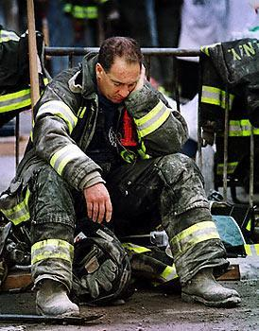
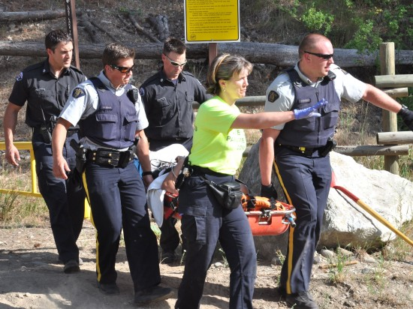
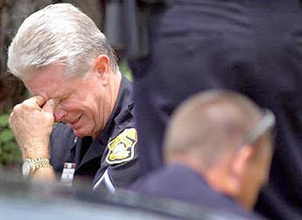
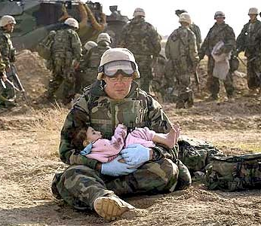
Recognition of our role as “1st responder
  Unsettling and tenuous nature of shock, disbelief, confusion, worry and despair
  Consequences of physical and emotional loss
  Disfigurement and depression
  Profound debility and incapacitation
  Significant disruption of family norms
  Deconstruction of the family’s future orientation
  Considerable energy targeting avoidance of ‘bad news’
  Death -
    Tragic
    Unanticipated
    Intolerable
    Premature

Slide 13

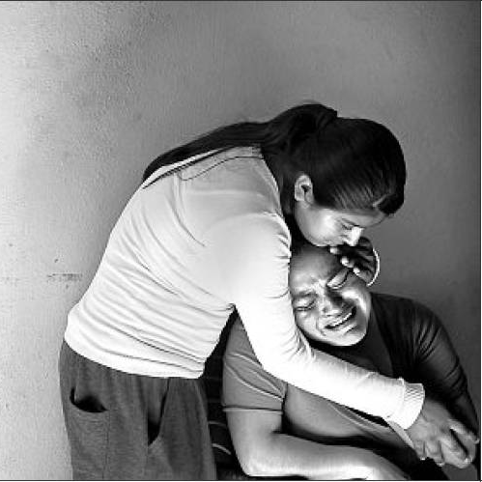
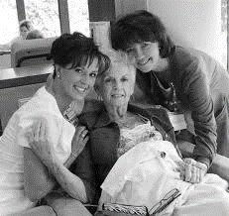
UNIQUE ELEMENTS NURSE 1ST RESPONDER DISTRESS
Cannot leave the tragic scene
Need to return to the disaster
Multiple catastrophes occurring concurrently in caseload
No preparatory guidance
No antidotes
Relationship established

Slide 14
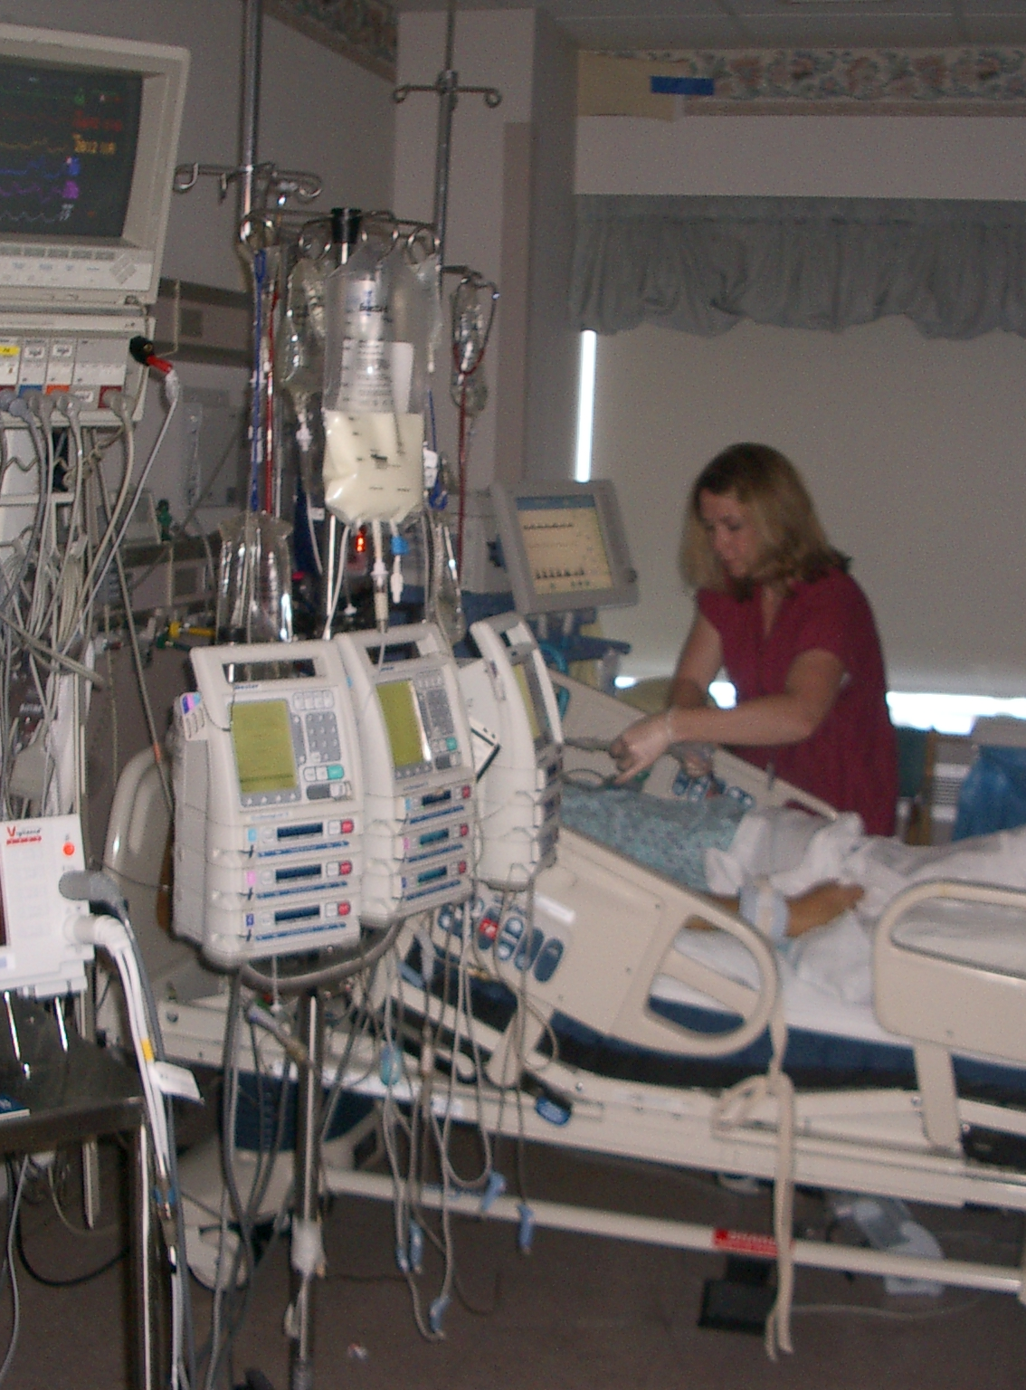
Critical Role of Nursing
Nurses are the constant in the acute care experience they have:
  Intense, protracted interactions with both the patient and family
  Develop close relationships
  Frequently have discussions about concerns, wishes and have clarified misperceptions
Know the dynamics of the patient’s symptom distress
Seen and heard multiple interactions with providers
Perceive their role as patient family advocate

Slide 15
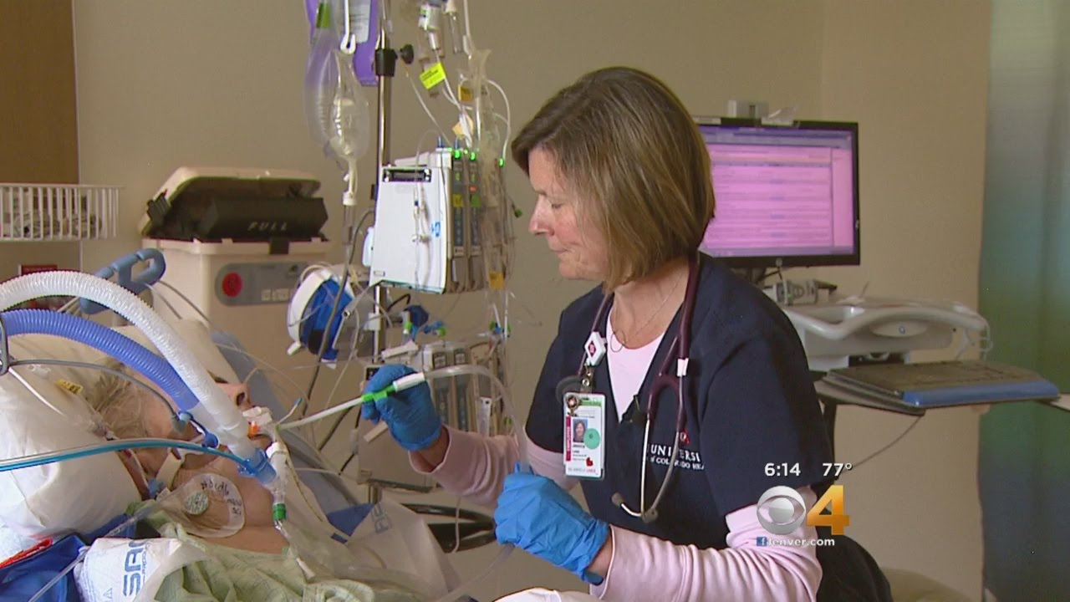
Competing Demands:
Save lives with technology, drugs, astute monitoring
Experience death frequently, perceived as ‘failure’; society denial pervasive
The ICU nurses Dilemma

Slide 16
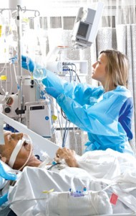
ICU Nursing/Patient Relationship Construct
Acute Episode/traumA
Chronic patient
‘Conflict predominant’

Slide 17
Quality Initiatives in Critical Care

Slide 18

The Cost of Caring:
Unique Corollaries of Nurse Compassion Fatigue
Education preparation gap
Moral anguish & questioning
Need for protracted compassion
  Sustained intimacy
  Affective weariness
Neglected grief; mourning aversion
  Experienced in isolation
  Disenfranchised grief
Occupational Hazard of Nursing!!
Unrecognized
Under-reported
Under-studied

Slide 19
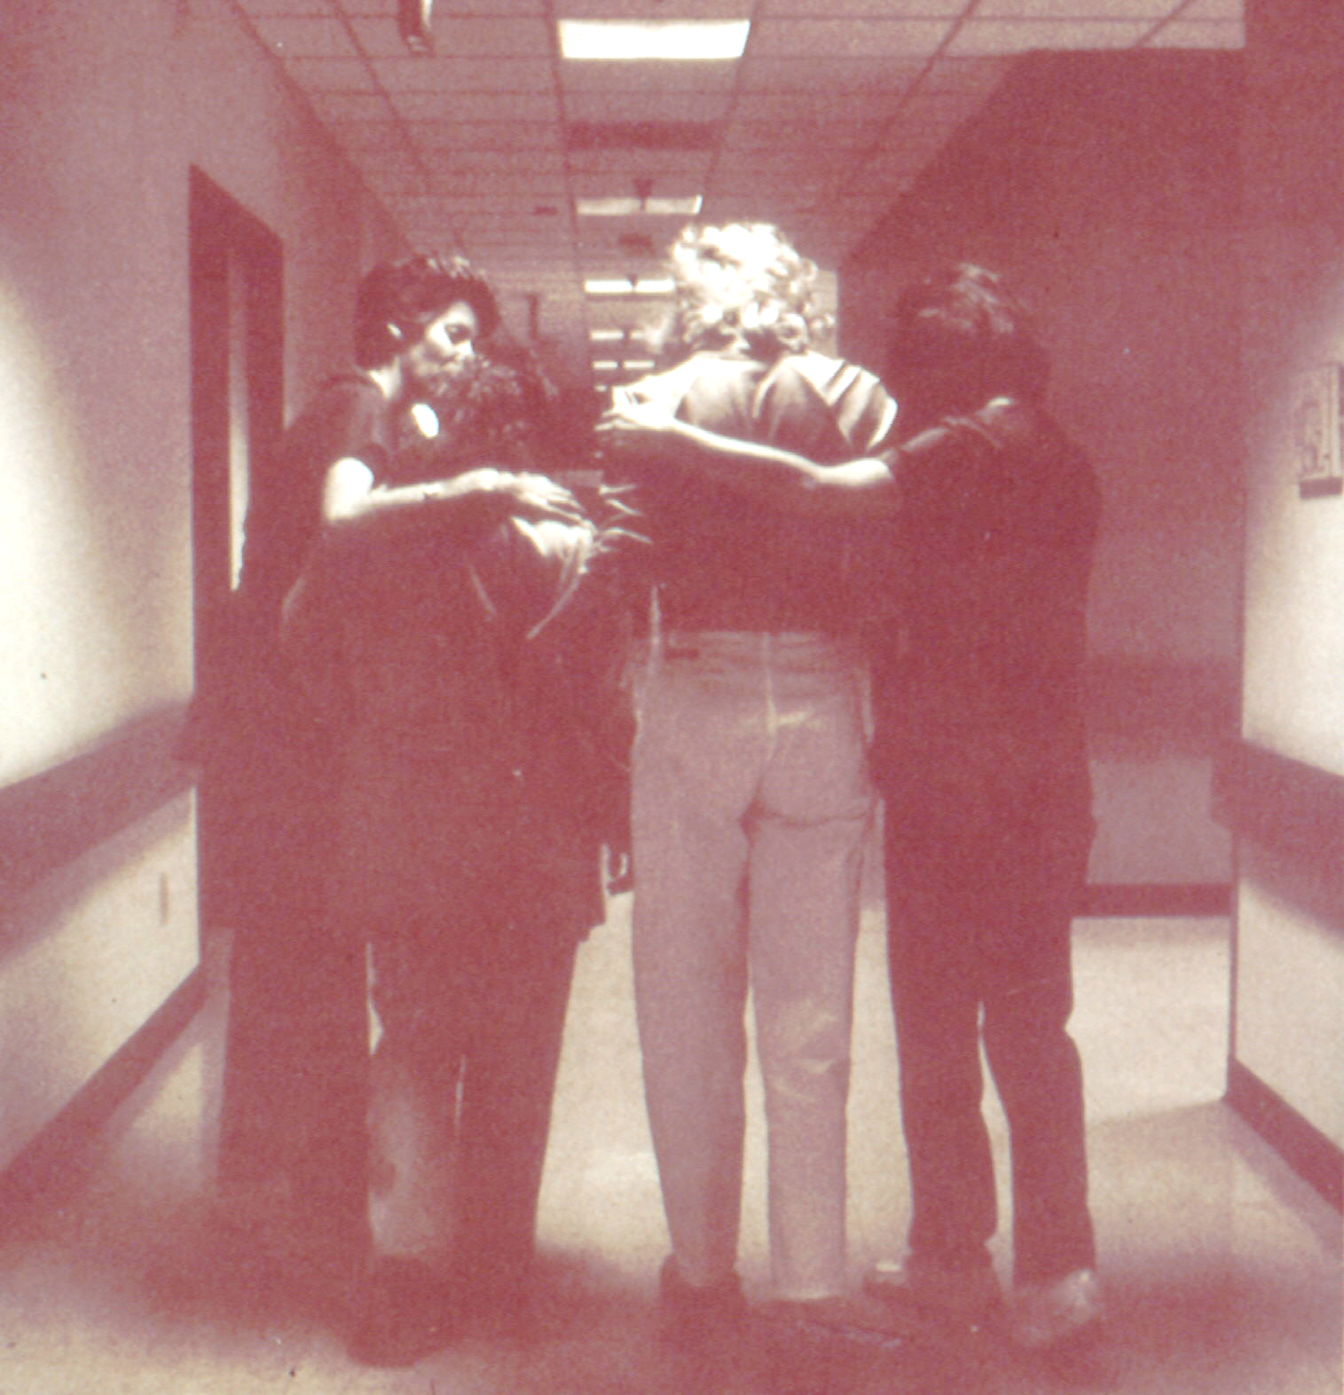
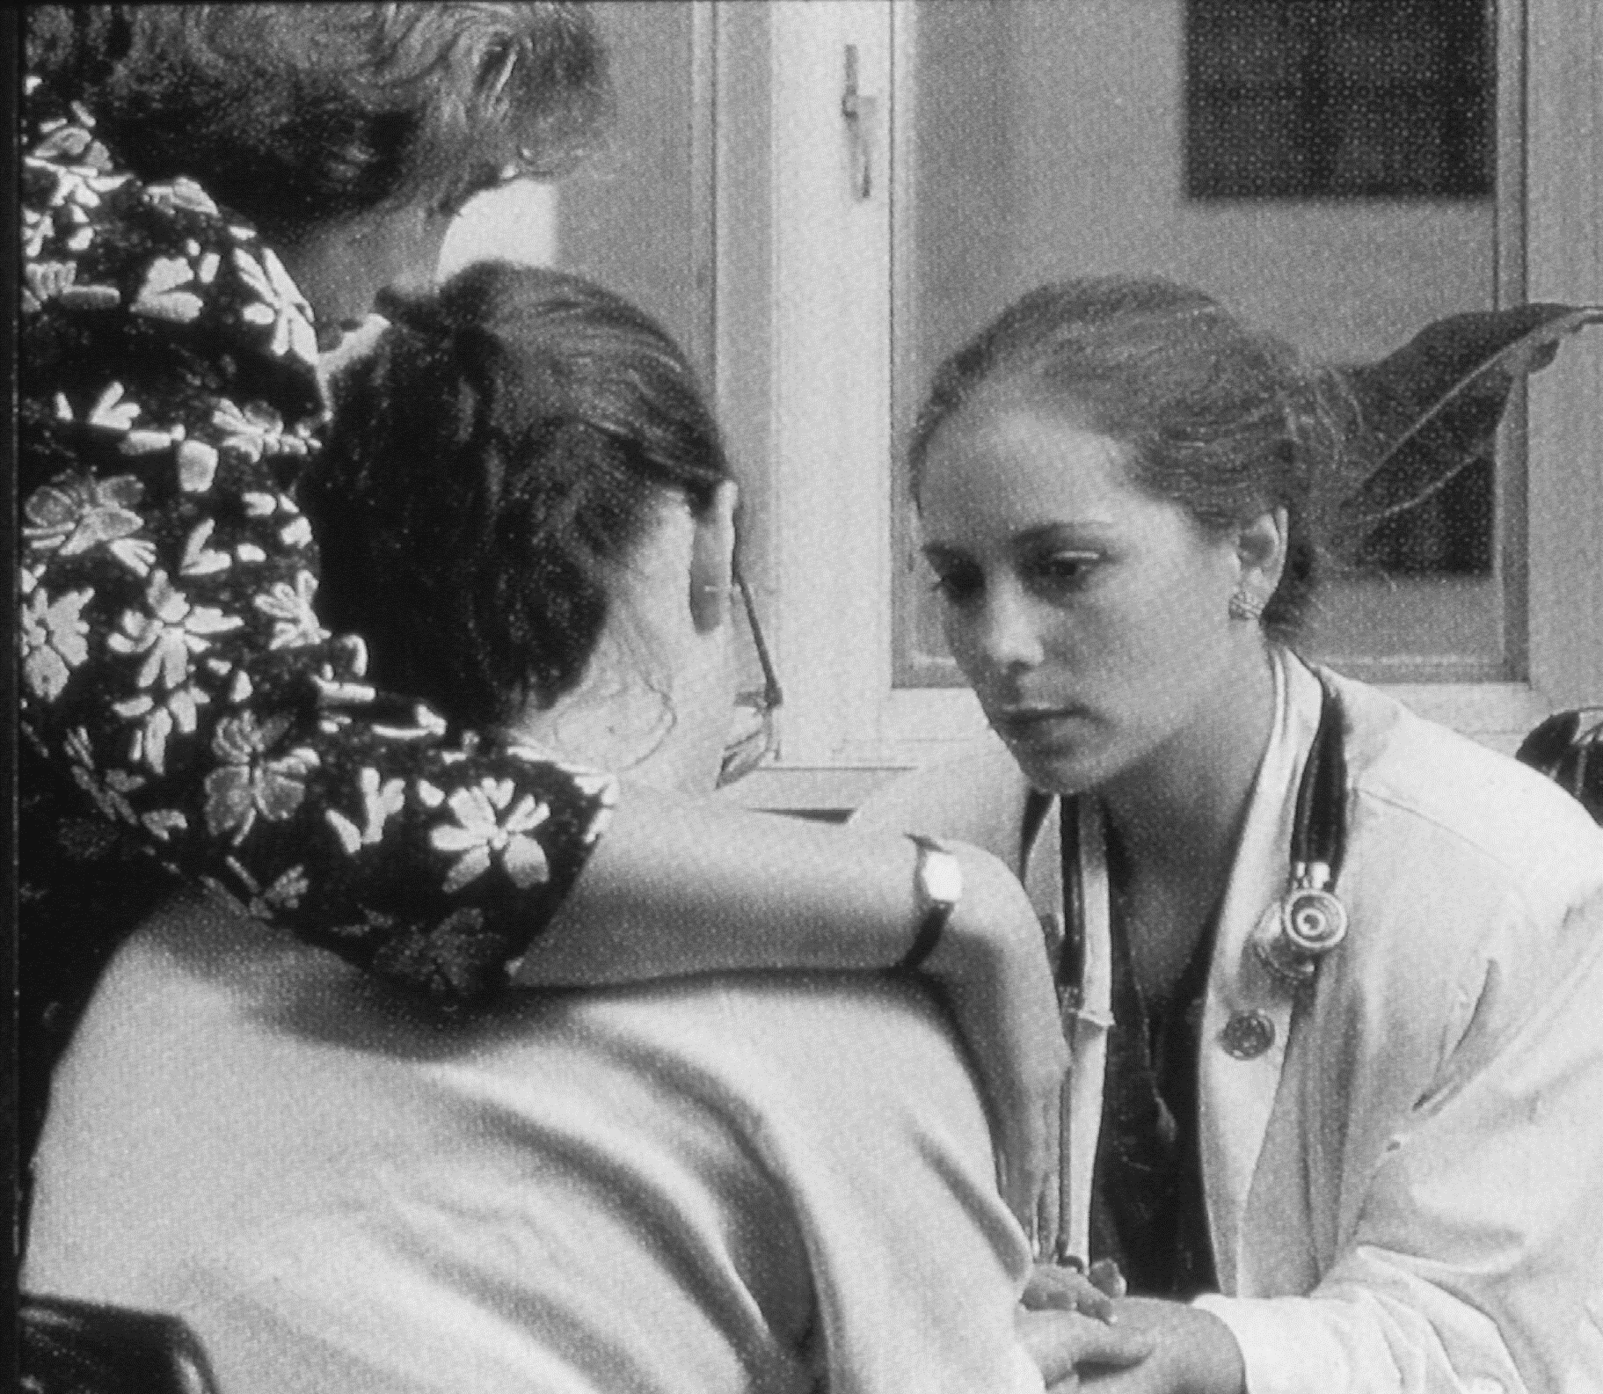
Risk Factors for Unattended Sorrow

Slide 20
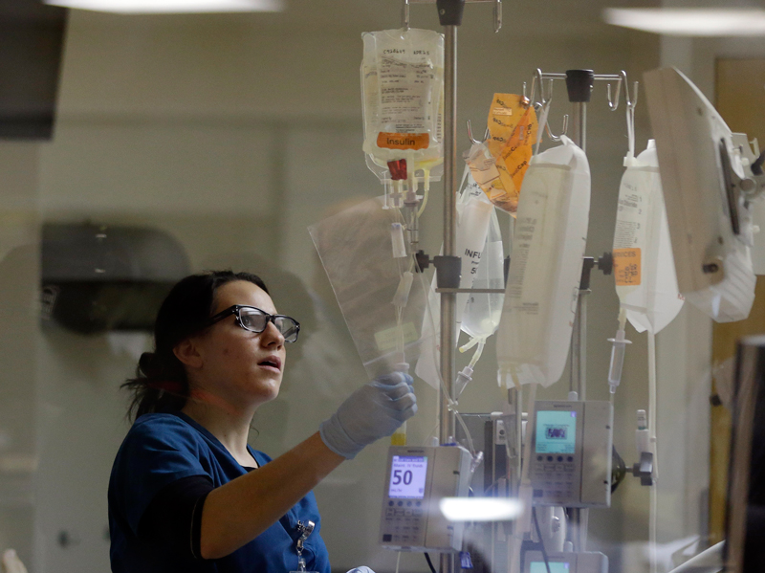

Slide 21
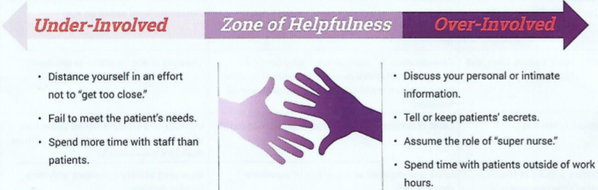
How Do I Know If I Have Compassion Fatigue?
Feelings of depression, responses of negativity
Lethargy, little energy
Sadness, emotional lability or response out of context to situation severity
Sustained effort to subdue mounting melancholy
Boundary issues/overextension*
*Source: National Council of State Boards of Nursing (2011). Professional Boundaries: A Nurse’s Guide to the Importance of Professional Boundaries.

Slide 22
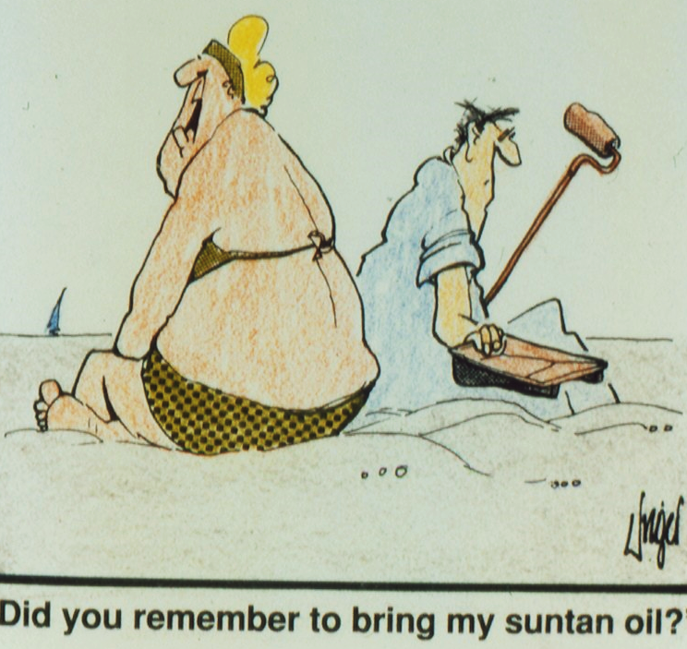
How Do I Know If I Have Compassion Fatigue?
Lack of attention to self (i.e., diet, exercise, personal enjoyment)
Reward substitution (i.e., food, ETOH)
Difficulty accepting feedback (+ or -)
Job transfer, turnover
Impatience with family or issues not deemed ‘life threatening’
Frustration with partner insensitivity to needs

Slide 23
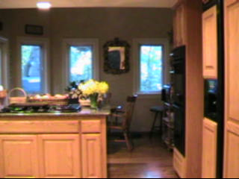

Slide 24

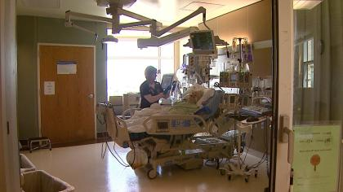
What’s Your Compassion Fatigue Quotient?

Slide 25
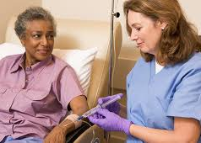
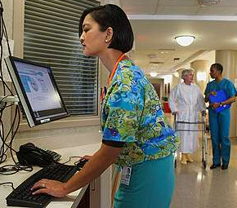
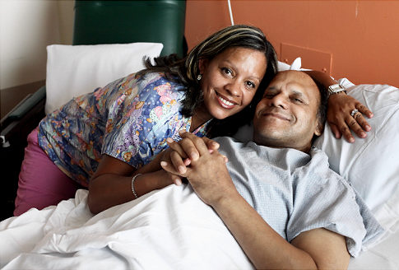
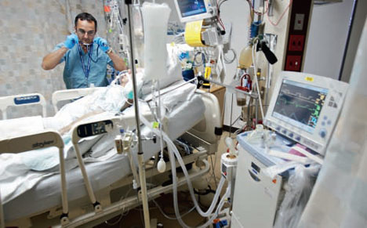

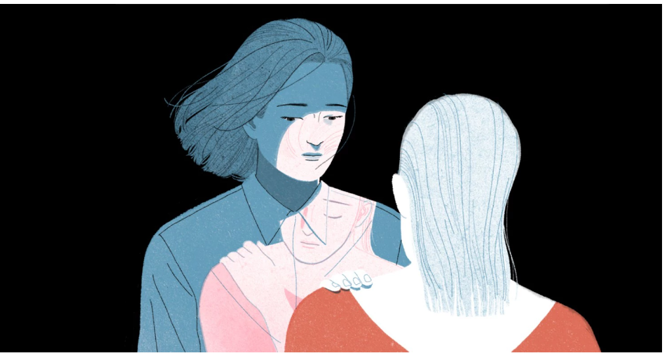

Source: Stamm, 1999.
The capacity for compassion and empathy seems to be at the core of our ability to do our work and at the core of our ability to be wounded by our work.

Slide 26

What can we do about it?

Slide 27

EDUCATION
Resilience training*
Mandatory ELNEC participation
Schwartz Rounds
Communication competency:
  Skill building
  Dealing with conflict
  Caring for ‘difficult’ practice scenarios
Recognition & management of compassion fatigue
  Can’t deal with it if you don’t know you have it!
*Source: Boyle DA, Bush NJ (2018). Reflections on the emotional hazards of pediatric oncology nursing: Four decades of perspectives and potential. Journal of Pediatric Nursing. 40, 63-73, 2018.

Slide 28
SUPPORT
Support Activities
  Formal groups
    Weekly patient care conferences
  Retreats
  ‘Code White’
  Attend family meetings
  Schwartz Rounds
Spiritual
  @ start of shift
  Blessing of Hands
  Tea for the Soul
  Honoring Ceremony
Complementary Approaches
  Massage
  Reiki
EOL/Enhance Closure
  Grief Cart
  Candle on unit
  Post-death de-briefings
  Remembrance ceremonies
  Acute Bereavement Protocol
    Delineate preferences for family support
      Offer to pray with me
      Ask about wanting to help with final care
      Sympathy card

Slide 29

PERSONAL STRATEGIES
Pre - & post-work car exercise
Consider skill requirements prior to entering patient room
‘Closing the drawer’ after work
Journaling:
  Work-related
  Personal
Learning forgiveness & gratitude

Slide 30
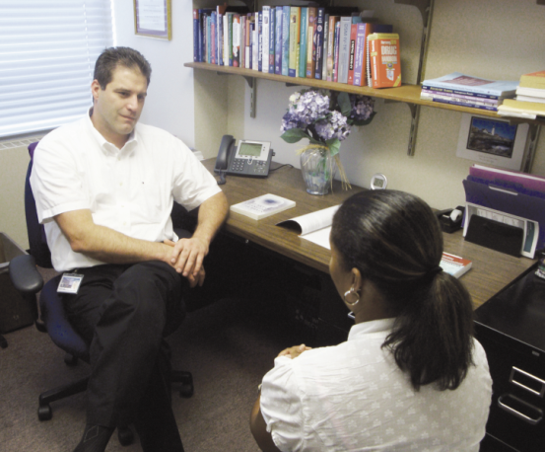

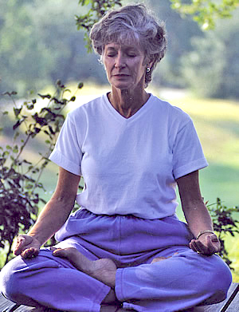
Self-care begins with healing. It requires a relentless pursuit of mind, body and spiritual balance.
Bush & Boyle, 2012

Slide 31

Some of the best caregiving advice we’ve ever heard comes from flight attendants …
“Put on your own oxygen mask first before assisting others.”

Slide 32

Kitchen Table Wisdom
Rachel Naomi Remen MD
The expectation that we can be immersed in suffering and loss daily and not be touched by it is as unrealistic as expecting to be able to walk through water without getting wet. This sort of denial is no small matter.

Slide 33

In traditional Native American teaching, it is said that each time you heal someone, you give away a piece of yourself until at some point, you will require healing.
Source: Mark Stebnicki (2008). Empathy Fatigue. Springer Publishing: New York.

