Slide 1
ASPAN
State of the Society Report
Katrina Bickerstaff BSN RN CPAN CAPA
ASPAN President 2016-2017

Slide 2
Membership as of 4/1/2017:
14,728
Category Breakdown:
Active – 14239 | Affiliate – 175
International - 65 | Past Presidents - 31
Honorary - 9 | Retired - 196
Student - 7 | Legacy for Life - 6

Slide 3
Marketing
Annual Communications Plan: Marketing and Communications Manager - Doug Hanisch
Seeks to convert high-level prospects into members
  1,033 potential members were identified from a variety of areas
    Non-members accessing the CPC network, Web site visits, ASPAN Seminars
    Individual communications sent
  12.4% or 129 people became members
Member Get a Member campaign (MGM)
  710 participants, 914 new/ren-+ewing members

Slide 4


Marketing and Communications
ASPAN is on Social Media
  The amount of interest on Facebook, Linkedin, Twitter has tripled in numbers
  ASPAN has quadrupled our message volume on each platform
ASPAN Conference App

Slide 5

President’s Activities
Updated 2016 Summer/Fall Webcasts & Seminars brochure & 2017 Winter/Spring Webcasts & Seminar brochure
Collaborated with Barbara Godden MHS RN CPAN CAPA (CO), Breathline Editor, to review Breathline articles/content/ revisions
Signed in support of several letters circulated to members of the Senate and House of Representatives
  Support addressed appropriations/funding for nursing related programs

Slide 6

President’s Activities
Reviewed/approved 2016 midyear and 2017 precon Board of Directors agendas
Reviewed/supported 2017 Representative Assembly Agenda items
Proofed all Specialty Practice Group (SPG) newsletters together with Pubs SWT, and national office staff
Planned the 16th Leadership Development Institute Program in Cincinnati, Ohio

Slide 7
President’s Activities: Appointments
Lori Silva RN CPAN (CA) as National Conference Strategic Work Team Coordinator for Anaheim 2018
Melanie Simpson PhD RN-BC OCN CHPN CPE (KS) as liaison to the American Society for Pain Management (ASPMN)
Katherine Simpson BSN RN CVRN CNRN (TX) as liaison to the American Association of Neuroscience (AANN)
Theresa Kennedy FNP-BC RN CPAN (MA) as liaison to the American Association of Nurse Practitioners (AANP)
Devin Carr DNP RN NEA-BC ACNS-BC CPPS (TN) as liaison to American Organization of Nurse Executives (AONE)

Slide 8
President’s Activities: Appointments
Armi Holcomb BSN RN CPAN (MO) as liaison to Anesthesia Patient Safety Foundation (APSF) and ASPAN International Liaison
Deborah Bickford BSN RN CPAN (CA) as ASPAN Military Liaison to represent our military, Retired, Active and Reserves
Jenny Allen MSQSM RN CPAN (MD) to be the editor of the 2017 Competency Based Orientation and Credentialing Program for the UNLICENSED Assistive Personnel in the Perianesthesia Setting
Kimberly Godfrey BSN RN CPAN (FL) as liaison to represent ASPAN to the Enhanced Recovery After Surgery - USA (ERAS)
Donna Goyer BS RN CPAN CAPA (VA) to Governmental Affairs SWT as Coordinator

Slide 9
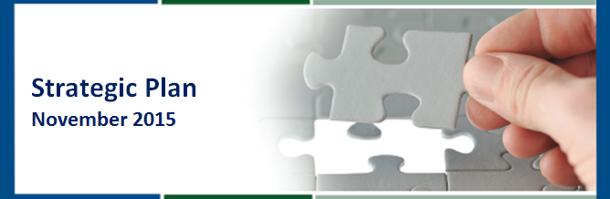
ASPAN’s Accomplishments
We continue our work with constant focus on our core values P.R.I.D.E.
    Passion
    Respect
    Integrity
    Diversity
    Excellence
3-5 years goals identified with indicators of achievement

Slide 10
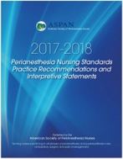
ASPAN’s Accomplishments
2017-2018 ASPAN Standards, Practice Recommendations and Interpretive Statements, available for purchase
Collaborated with ABPANC and their Regional Directors
2017 Candidate profiles uploaded to website
Veteran’s Day message sent to membership
Organizational membership to the International Collaboration of Perianesthesia Nurses – January 2017

Slide 11


ASPAN’s Accomplishments
Peri Anesthesia Nurse Awareness Week (PANAW) message sent to membership
  1st ASPAN Perianesthesia Nursing public service video introduced during the week of PANAW https://youtu.be/deIfDhWrPCA.
      As of 4/1 viewed over 5900 times
“WE ARE PERIANESTHESIA NURSES”

Slide 12
ASPAN’s Accomplishments
Publications
  2017-2018 Perianesthesia Nursing Standards Practice Recommendations and Interpretive Statements are available for purchase
  Manual: Competency Based Orientation and Credentialing Program for the Unlicensed Assistive Personnel in the Perianesthesia Setting, 2012 Edition in final phase of revision. Plan for summer release
  Book: Perianesthesia Certification Review Editors– Theresa Clifford MSN RN CPAN CAPA, and Denise O’Brien DNP RN ACNS-BC CPAN CAPA FAAN, available at National Conference

Slide 13
ASPAN Initiatives
The Joint Commission (TJC) invited ASPAN to identify a representative to serve on a technical advisory panel
  To advise TJC on contemporary pain management topics
  Terry Clifford applied for and was chosen to advise on the TAP (only 1 of 2 nurses on the panel)
TJC then asked to provide a nominee for be part of a panel to review the newly revised standards
  Antoinette (Toni) Zito (OH) was selected from a large pool of candidates
  Standards review panel is a new approach to assist TJC in developing standards that are valuable to their customers

Slide 14
Committee
Clinical Practice Committee: Diane Swintek MSN RN CPAN
1220 questions received from 4/2016-4/2017
    From members: 701
    From no history of being a member: 338
    Non- renewing members less than 1 year: 42
    Non- renewing members greater than 1 year : 130
    International: 9
  Diminishing numbers of questions related to vital signs
  Uptick in questions about blending units/populations
  There have been a number questions about postpartum care and skin-skin contact

Slide 15
Committee
Clinical Practice Committee: cont.
FAQ Columns in Breathline, 41 FAQs on the website
CPC member resources for answering questions include sample responses & website resources
Celebrate Successful Practices submissions selected for poster presentation at National Conference; selections for oral presentations completed: 92 submissions
Excellence in Clinical Practice Award nominees scored
  7 nominees

Slide 16
Strategic Work Team
Standards and Guidelines: Jacque Crosson MSN RN CPAN CAPA
  Guideline: Pain & Comfort Guideline in review: Moving forward with correlational study. Delphi Study: ASPAN Adult Patient Pain and Comfort Practices, IRB approval April 9, 2017, Delphi study underway
  Guideline: Hypothermia Guideline in review, literature review completed and evaluated Vallire Hooper PhD RN CPAN FAAN will provide a recommendation to the ASPAN Board of Director
  Position Statement: Perianesthesia Patient with a Do Not Resuscitate Advance Directive
    Received support from Association of periOperative Registered Nurses (AORN) & American Association of Nurse Anesthetist (AANA), American Society of Anesthesiologist (ASA) has declined support
    ASPAN Liaison and members of the Council on Surgical Patient Safety (CSPS) attended the American College of Surgeons Ethic Review Panel to present the position statement

Slide 17
Strategic Work Team
Standards and Guidelines-cont.
Position Statement: Air Quality and Occupational Hazard Exposure Prevention
  Received support from AANA
  Requested support from the Occupational Safety and Health Administration (OSHA); they responded with positive support and recommendations
  National Institute for Occupational Safety and Health (NIOSH) has given support and is commitment to conduct series of independent pilot studies
Standards & Guideline meeting: Articles reviewed and critiqued by the S&G teams, returned to the coordinator. The goal, to have the Obstructive Sleep Apnea (OSA) PR work completed prior to the face to face meeting in October 2017
Future: Director for Clinical Practice provided FAQs for review by S&G team for future relevant practice concerns for Standards. Slated after OSA Systematic Literature Review will be Safe Transfer of Care

Slide 18
Committees
  Research/ Evidence Based Practice (EBP) Elizabeth Card MSN APRN FNP-BC CPAN CCRP Director of Research & Christine Tomes MSN RN CPAN EBP coordinator
  Research study: Perianesthesia Burn-out Study Researcher- Elizabeth Card MSN APRN FNP-BC CPAN CCRP, completed manuscript in the process to be submitted to the Journal of Peri Anesthesia Nurses (JoPAN)
  Research study: Acuity/Complexity Rating Tool for Post Anesthesia Care Phase I. Researcher- Jacque Crosson MSN RN CPAN, IRB approval through Vanderbilt University Medical Center, experts surveyed & content of complexity index updated, then beta testing to be done at bedside
  Research study: Differences in Cognitive Functions, Decision Making, Self Efficacy, and Demographics in the Preop, PACU Phase I and a controlled PACU Phase I setting. Researcher-Dina A. Krenzischek, PhD, RN, CPAN, FAAN, Linda Wilson, PhD, RN, CPAN, CAPA, BC, CNE, CHSE, preparing for grant application.

Slide 19
Committees
  Research/ Evidence Based Practice (EBP) cont.
  Committee projects: Committee members updated Research Grant Guideline/policy (2x/year)
  Committee Projects: Creation of electronic auto calculating poster judging for awarding best poster ribbons at National Conference
  Evidence Based Practice (EBP) SWT: Christine Tomes EBP coordinator and Director of Research Elizabeth Card created an ASPAN Journal Club Forum; an interactive discussion board for members
  Research Meeting: Elizabeth Card participated in the American Association of Nurse Anesthetists Invitation to Perioperative Nursing Care
  Research Meeting: Elizabeth Card attended Southern Nursing Research Society Annual meeting, Dallas, TX

Slide 20
Committee
Education Provider Committee: Linda Beagley MS BSN RN CPAN
Seminars
  80 total seminars/webcasts scheduled between 4/16 & 4/17
    31 live in person scheduled; 8 cancelled
    49 live webcasts scheduled; 10 cancelled
  Certification Review Seminars both live & webcasts are most popular
  Pathophysiology & 2 Pediatric seminars critically reviewed
  3 seminars to be critically reviewed for 2017
  Summer/Fall/Winter Seminars/Webcasts 2016-2017
    Webcasts on Saturdays and Sundays
    Webcast at varied times to reach more time zones
    Teams working on developing more 2 hours webcasts
  New speakers

Slide 21
Committee
Education Provider Committee: con’t
On-Demand
  Since April 1, 2016: 592 total sessions have been purchased
  Certification Review Bundle has sold over 121 (4/2017)
ASPAN Select
  advertised on the website
Education Approver Committee: Renee Smith BSN RN-BC CPAN CAPA
Approved 16 component applications for seminars and new AANC forms updated and uploaded on ASPAN website

Slide 22
SWT/Committee Activities
Advocacy Committee: Susan Russell BSN RN JD CPAN
Articles submitted to Breathline from the Safety SWT, GA SWT
ASPAN signed on in support of numerous letters to legislators regarding Nursing Community and American Nursing Shortage Relief initiatives
Susan Russell attended Nurse In Washington Internship (NIWI) in March
Safety SWT: Donna Casey MSN RN CPAN
Articles in Breathline included information on:
  Texting Among Caregivers – How Much is Too Much?,
  Where Have These Drugs Been?
  Universal Protocol
  Medications at the Bedside

Slide 23
SWT/Committee Activities
Membership and Marketing SWT: Rose Durning MHS BSN RN CAPA
16 Gold Leaf Award applications received
  Expanded recognition by awarding certificates to 2nd & 3rd highest scoring components
PANAW products celebrated the uniqueness of our practice
2017 Award for Outstanding Achievement 4 nominations
22 nominations for Above & Beyond Award
  10 top winners will be recognized
Increased awards for MGM campaign

Slide 24
SWT/Committee Activities
Resource Development SWT: Karen Flanagan MSN RN VHA-CM
National Conference Activities include the Dream Walk; Silent Auction; Development Celebration; Legacy for Life recognition; Exhibit Hall Bingo
Scholarships awarded this year
National Conference Attendance 7
BSN 3
MSN 3
Doctoral 1
Humanitarian Mission 2
NIWI 2
TOTAL 18

Slide 25
SWT/Committee Activities
Leadership Development Committee: Armi Holcomb BSN RN CPAN
Emerging leaders program is uploaded on the ASPAN website with links for mentors and mentees both
Publications SWT: Stephanie Kassulke MSN RN CPAN & Susan Norris BSN RN CAPA
Continued review of publications
Credentials SWT: Linda Allyn BSN RN CPAN CAPA
Responsible for credentialing the Representative Assembly (RA), serve as floor tellers and runners and assist with any voting related assignments to facilitate the formal and informal sessions of the RA

Slide 26
SWT/Committee Activities
Policy & Procedure SWT: Valerie Watkins BSN RN CAPA
47 policy updates completed following mid year BOD meeting
Governmental Affairs SWT: Donna Goyer BS RN CPAN CAPA
Promoted SWT members to apply for ASPAN Scholarships, particularly Nurse In Washington Internship (NIWI)
Participate in monthly Nursing Community conference calls & disseminate information appropriately to ASPAN leaders and GA SWT for broader member distribution.
Focused attention on any Congressional activity during the fall which was minimal in terms of nursing and healthcare, in part due to elections and pending new administration
ASPAN pledged $250 for the one time Nursing Community Nurse in Washington Institute (NIWI) scholarship in honor of all the work for nurses Representative Capps and Senator Mikluski

Slide 27
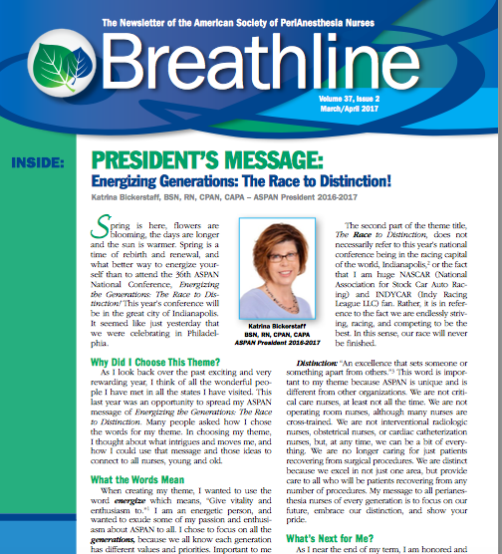
Editor Reports: Breathline
Breathline: Barbara Godden MHS RN CPAN CAPA
Continue to offer ASPAN members mission driven content and organizational news
Consistent dissemination of perianesthesia safety, clinical practice, education and research/EBP information
Shorter articles; additional information on ASPAN SWTs & Liaisons
Continue to explore methods to increase readership
Continue to seek feedback related to Breathline
Encourage original articles/work with JoPAN Editors

Slide 28
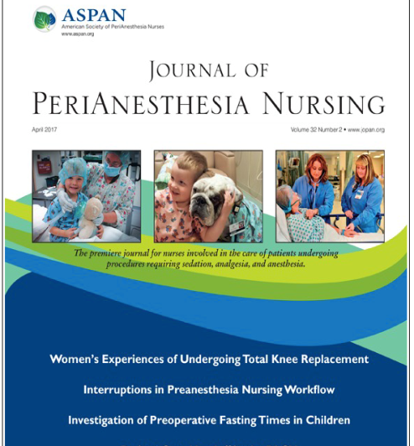
Editor Reports: JoPAN
Journal of PeriAnesthesia Nursing:
Vallire Hooper PhD RN CPAN FAAN &
Jan Odom-Forren PhD RN CPAN FAAN
Impact factor holding steady
JOPAN I-Phone and Android app launched mid-2016
  Full access now available via all mobile devices.
A wide variety of submissions covering all perianesthesia areas Manuscripts received from a wide range of nations.
3 CE articles published in 2016, 1 CE article has been published in 2017
New Research column runs 3 times per year
  Large majority of manuscripts are research & EBP projects

Slide 29
LIAISONS
American Academy of Ambulatory Care Nursing (AAACN) Chris Skinner, MSN, RN, CAPA
  Representing the interests of ambulatory nursing which includes office practices, surgery centers, clinics, tele-health, military clinics and centers.
American Association of Critical Care Nurses (AACN)
Maureen McLaughlin MS RN CPAN CAPA
  As the leader in critical care nursing, AACN continually develops and publishes evidenced-based practice alerts

Slide 30
Liaisons
American Association of Neuroscience Nurses (AANN)
Katherine Simpson BSN RN CVRN CNRN
  The mission is to provide professional support to neuroscience nurses via educational, advocacy and networking activities to achieve optimal patient outcomes
  To deliver a presentation concerning the recovering the neurological postoperative patient
American Association of Nurse Practitioners (AANP)
Theresa Kennedy FNP-BC RN CPAN
  Provides clinical resources, practice briefs and evidence based resources to support their practices
  There is not a specialty specifically for perianesthesia nursing in the NP role:
    Education: Topics range from pharmacology, pain management, diabetes mellitus, respiratory,
    Updated guidelines in ACS and stroke management.
    provides accreditation for high quality continuing education

Slide 31
Liaisons
American College of Surgeons-John A. Hartford Foundation (ACS-JAHF) Geriatric Program
Vallire Hooper PhD RN CPAN FAAN
      To establish standards and benchmark criteria for geriatric surgical procedures
      A multidisciplinary coalition representing the American College of Surgeons (ACS) and 58 diverse stakeholder organizations committed to improving the quality of geriatric surgical care with support from the John A. Hartford Foundation.
      The 1st comprehensive set of hospital-level surgical care standards for older adults has been released and published on the Annals of Surgery website The report, “Hospital Standards to Promote Optimal Surgical Care of the Older Adult,”

Slide 32
Liaisons
American Medical Informatics Association (AMIA)
Patricia Legg, MSN,RN, CPAN
The center of action for more than 5,000 health care professionals, informatics researchers, and thought-leaders in biomedicine, health care and science. AMIA is an unbiased, authoritative source within the informatics community and the health care industry.
  The future of medicine through technology
American Organization for Nurse Executives (AONE)
Devin Carr DNP RN NRA-BC ACNS-BC CPE
Member of AONE publication committee provided editorial input & content journal AONE Voice of Nursing Leadership.
  Co-authored article about Big Data to drive quality improvement, and authored article about leader competencies for using big data.

Slide 33
Liaisons
American Society for Pain Management Nurses (ASPMN)
Melanie H. Simpson, PhD, RN-BC OCN CHPN CPE
  New Position Statement in 2016: Prescribing and Administering Opioid Doses Based Solely on Pain Intensity
  Pain Management Scope and Standards of Practice 2nd Ed was released as a collaborative work by ASPMN and ANA in September 2016.
Anesthesia Patient Safety Foundation (APSF)
Armi Holcomb BSN RN CPAN
  The main mission for this sub group of the ASA is to assure that no patient will come to any harm while under anesthesia. APSF does not write standards or policies, the work is through education, education, education
  To attend the Stoelting Safety conference “PeriOperative Handoff Achieving Consensus and How to get it Right”

Slide 34
Liaisons
Association of Women’s Health Obstetric & Neonatal Nurses (AWHONN)
Nancy Martin BSN RN CPAN
  Our mission is to improve and promote the health of women and newborns and to strengthen the nursing profession through the delivery of superior advocacy, research, education and other professional and clinical resources to nurses and other health care professionals
  Focusing on “mindfulness has the added benefit of decreasing sensation of chronic and acute pain and possible subsequent physiological distress caused by pain”
  The Nursing for Women’s Health Journal has focused articles on Opioid Addiction : 1) Risk for Chronic Opioid Use After Surgery noting there is an increased risk in the first year after surgery by opioid naïve patients
  Partnering with Women for Postpartum Pain Management. A study of mom’s keeping/logging medication like ibuprofen at bedside
​

Slide 35
LIAISONS
Association for Radiologic and Imaging Nursing (ARIN)
Karen Munkley BSN MS RN
  The organization represents nurses who practice in the diagnostic, neuro/cardiovascular, interventional ultrasonography, computerized tomography, nuclear medicine, magnetic resonance, and radiation oncology
  ASPAN BOD Voted (11/16) to support the Association for Radiological and Imaging Nursing (ARIN) Position Statement on Capnography

Slide 36

Liaisons
Council on Surgical and Perioperative Safety (CSPS)
Dina Krenzischek PhD RN CPAN FAAN
Pamela Windle DNP RN NE-BC CPAN CAPA FAAN
Mission
The CSPS promotes excellence in patient safety in the surgical and perioperative environment
Vision
The CSPS envisions a world in which all patients receive the safest surgical care provided by an integrated team of dedicated professionals
“The Magnificent Seven”

Slide 37
Liaisons
Enhanced Recovery After Surgery (ERAS)
Kim Godfrey BSN RN CPAN
  Starting in the preoperative setting, advise patients to improve their overall health with nutrition, exercise, smoking cessation, and alcohol cessation.
  Patient education about the surgical process and recovery further brings the patient to the center of their care.
  The Society is in the process of accepting members & developing committees, ERAS has expressed interest of having ASPAN members on some of their committees.

Slide 38

Liaisons
International Liaison
Armi Holcomb BSN RN CPAN
The ASPAN representative to international meetings & conferences; represents ASPAN at the International Collaboration of Perianesthesia Nurses INC (ICPAN) as one of the members of the Global Advisory Council (GAC)
Attended:
  IARNA ( Ireland ) annual conference held in Mullingar, Ireland.
    Judge for their Research abstracts/poster
  NAPANc ( Canada ) conference in Toronto, Canada.
  ICPAN INC is working with the Australian perianesthesia nurses to hold the 4th International conference in Sydney Australia Nov 1-4, 2017

Slide 39
Liaisons
Malignant Hyperthermia Association of the US (MHAUS)
Terri Passig BSN RN CCRN CPAN CAPA
Continue to move forward with research and have a very active website.
As of 2/2017, 60 ASPAN members have partnered with MHAUS greatly reduced membership fee of $20 per year.
Military Liaison
Deb Bickford BSN RN CPAN
Identify the unique needs of our Military personal
National Conference Military/International Reception is scheduled for Tuesday May 2, 2017 from 6:00 to 7:00 PM.
  All active, reserve and now retired military attendees of the 2017 National Conference

Slide 40
Liaisons
The Nursing Community Forum
Donna Goyer BS RN CPAN CAPA
Provided information for supporting the Title VIII Nursing Workforce Reauthorization Act
Sent a Welcome Letter to the new Administration
Established a NIWI scholarship in recognition of the work of Representative Lois Capps (D-CA)
Awaiting the President’s budget before finalizing funding requests
In December the Department of Veterans Affairs (VA) released the final rule regarding practice for APRN’s serving in the VA
    Rule did exclude CRNAs
    The NC sent a modified advocacy request for the inclusion of the CRNAs

Slide 41
Liaisons
Pain Action Alliance to Implement a National Strategy (PAINS)
Melanie H. Simpson, PhD RN-BC OCN CHPN CPE
  A coalition of national leaders and organizations committed to advancing the 16 recommendations made in the Institutes of Medicine’s (IOM) report, Relieving Pain in America: A Blueprint for Transforming Prevention, Care, Education and Research
  Now working to pull the National Pain Strategy (NPS) up to the forefront of current pain care in the United States. https://iprcc.nih.gov/National_Pain_Strategy/NPS_Main.htm

Slide 42
Liaisons
Society of Anesthesia and Sleep Medicine (SASM)
Elizabeth Card MSN APRN FNP-BC RN CPAN CCRP
  To advance standards of care for clinical problems shared by Anesthesiology and Sleep Medicine, including peri-operative management of sleep disordered breathing, & to promote interdisciplinary communication, education & research in matters common to anesthesia and sleep.
  Manuscript on care of Obstructive Sleep Apnea patient in perianesthesia setting accepted for publication in JoPAN
  Educational brochures updated for interdisciplinary use on www.SASM.org. website

Slide 43
Liaisons
Society of Gastroenterology Nurses and Associates (SGNA)
Kathy Steindl BS RN CAPA
  Dedicated to the safe and effective practice of gastroenterology and endoscopy nursing by advancing the science and practice of gastroenterology and endoscopy nursing through education, research, advocacy, and collaboration, and by promoting the professional development of its members in an atmosphere of mutual support
  SGNA has recently released its Standard of Infection Prevention in Gastroenterology Settings

Slide 44
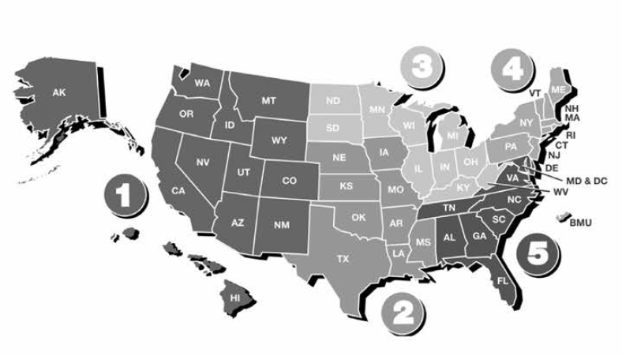
President’s Travels/Meetings
Component Meetings/Seminars
MSPAN
AzPANA
RMPANA
ISPAN
MASPAN
FLASPAN
MNDAKSPAN
MOKANPANA
ALAPAN
VT/NH APAN
MASPAN
CSPAN
RIAPAN

Slide 45
President’s Travels
  July 8-10: NCSWT meeting in Indianapolis, IN
  August 5: MSPAN Fall Conference in Pascagoula, MS
  August 10-12: Budget meeting ASPAN national office Cherry Hill, NJ
  August 13: ABPANC BOD meeting in Baltimore, MD
  September10-11: AANA Annual meeting in Washington, DC
  September 16-18: Leadership Development Institute in Cincinnati, OH
  September 25: AZPANA Fall Conference in Tucson, AZ

Slide 46
President’s Travels
  October 7-9: RMPANA Fall Conference and retreat in Winter Park, CO
  October 15: ISPAN Fall Conference in Sioux City, IA
  October 22: MASPAN Fall Conference in Randolph, MA
  October 28-30: FLASPAN Fall Conference in Orlando, FL
  November 12: ASPAN Midyear BOD meeting in Scottsdale, AZ
  November 17-19: Nursing Organizational Alliance in Omaha, NE
  December 9-12: NY Post Graduate Assembly in New York, NY

Slide 47
President’s Travels
  February 10-12: MNDAKSPAN Winter Conference in Plymouth, MN
  February 18: ALAPAN Winter Conference in Montgomery, AL
  March 4: MOKANPANA Spring Conference in Kansas City, MO
  March 18: VT/NH APAN Spring Conference in Manchester, NH
  March 25: MASPAN Spring Conference in Lowell, MA
  April 1: CSPAN Spring Conference in Cromwell, CT
  April 2-4: AORN Annual Conference in Boston, MA
  April 5: RIAPAN Monthly Conference in Providence, RI

Slide 48
National Office Activities
Without the support of our National Office team, none of these accomplishments are possible! Listed are only a few of the highlights!
All National Conference planning: brochure, syllabus, communication, opening & closing ceremony, speaker follow up, component night, President’s reception, development activities, stuffing bags, registration, space, room assignments
Prepared and uploaded 2017-18 election information online and candidate feedback form
Conducted 2017 Excellence in Clinical Practice Award nomination process
Prepared and uploaded approved policies from midyear 2016 Board meeting
Ongoing review and proofing of Breathline

Slide 49
National Office Activities
Prepared, sent and finalized information for the 2017 Representative Assembly including call for resolutions, official RA credentialing forms to all components and agenda material
Proofed, finalized and uploaded nine SPG newsletters for the 2017 winter-spring session
Proofed draft UAP CBO
Worked with ASPAN President to prepare and send all conference letters and invitations
Prepared and uploaded 2017 ASPAN scholarship program and ICPAN scholarship information
Coordinated delivery of Society information to Elsevier for publication in JoPAN
Coordinated call for photos from all ASPAN leaders and 40 component presidents to create opening ceremonies presentation

Slide 50
National Office Activities
December 2016 through April 2017
Prepared and uploaded 2017-18 election information online and candidate feedback form
Conducted 2017 Excellence in Clinical Practice Award nomination process
Prepared and uploaded approved policies from midyear 2016 Board meeting
Prepared, sent and finalized information for the 2017 Representative Assembly including call for resolutions, official RA credentialing forms to all components and agenda material

Slide 51
National Office Activities
Proofed, finalized and uploaded nine SPG newsletters for the 2017 winter-spring session
Proofed draft UAP CBO
Worked with ASPAN president to prepare and send all conference letters and invitations
Prepared and uploaded 2017 ASPAN scholarship program and ICPAN scholarship information
Coordinated delivery of Society information to Elsevier for publication in JoPAN
Ongoing review and proofing of Breathline
Coordinated call for photos from all ASPAN leaders and 40 component presidents to create opening ceremonies presentation

Slide 52
National Office Activities
Over 400 questions collated and prepared weekly for clinical practice question assignment roster
Pre-production work on 2017-18 ASPAN Directory
Met with Director for Education on an ongoing basis to determine needs and priorities
Met with all 3 Mission Directors on a regular basis for information on current projects and needed support
Reviewed, formatted and checked citations/references all slide sets for all seminars
Reviewed, formatted and checked citations/references for all slide sets for all 2 hour, 4 hour, and 8 hour webcasts

Slide 53
National Office Activities
Developed a knowledge outcome measurement post-test for every seminar and webcast
Reviewed and updated the accreditation information for all on demand modules
Reviewed/Revised seminar brochure
Reviewed/Revised seminar request brochure
Monitored all live webcasts for tech support by the newly oriented seminar speakers
Worked with the Director of Education and the National Office staff to design the “ASPAN Select Seminars”

Slide 54
National Office Activities
Ongoing updates and support for Approver Unit Chairperson
Reviewed and completed process for approximately 25 approver unit applications
Reviewed and revised approximately 17 component brochures/flyers/save the date notices for components
Revised the Approver Unit application forms based on updated regulations
Revised the sample application for the approver unit to be placed on the website
Working with Approver Chairperson to develop training module for approver team members and applicants
Answered clinical practice questions received as needed and those sent to me directly

Slide 55
National Office Activities
Answered research, grant and certification questions as needed
Pilot tested and developed accreditation information for 7 JOPAN continuing education articles
Assisted Jacque Crosson with electronic survey for Acuity Study and sent out 2 surveys and provided summary results
Participated in meeting for planning for the new development of orientation modules
Support all officers, committee chairs, SWT coordinators, liaisons, components, editors and anyone else requiring assistance to fulfill the strategic initiatives and missions of the American Society of PeriAnesthesia Nurses!!

Slide 56
“Success is no accident. It is hard work, perseverance, learning, studying, sacrifice and most of all, love of what you are doing or learning to do.”
Pelé (Brazilian athlete)
Thank you

