Slide 1
Christian Nationalism
Northminster Presbyterian Church
With Dr. Dick Hamm

Slide 2
Definition of Christian Nationalism
The belief that the United States was founded as a Christian nation and that its laws should therefore reflect Christian values.

Slide 3
Definition of Christian Nationalism
The belief that the United States was founded as a Christian nation and that its laws should therefore reflect Christian values.
First element: a strong moral traditionalism based on creating and sustaining social hierarchies.

Slide 4
Definition of Christian Nationalism
The belief that the United States was founded as a Christian nation and that its laws should therefore reflect Christian values.
First element: a strong moral traditionalism based on creating and sustaining social hierarchies.
Second element: comfort with authoritarian social control.

Slide 5
Definition of Christian Nationalism
The belief that the United States was founded as a Christian nation and that its laws should therefore reflect Christian values.
First element: a strong moral traditionalism based on creating and sustaining social hierarchies.
Second element: comfort with authoritarian social control.
Third element: white, native-born citizens are held up as the ideal.

Slide 6
Where did Christian Nationalism come from?
380 A.D. - Emperor Theodosius I made Christianity the official religion of the Roman Empire.

Slide 7
Where did Christian Nationalism come from?
380 A.D. - Emperor Theodosius I made Christianity the official religion of the Roman Empire.
1450’s – Papal Bulls issued

Slide 8
Where did Christian Nationalism come from?
380 A.D. - Emperor Theodosius I made Christianity the official religion of the Roman Empire.
1450’s – Papal Bulls issued
1494 – Papal Bull proclaiming the “Doctrine of Discovery”

Slide 9
Where did Christian Nationalism come from?
380 A.D. - Emperor Theodosius I made Christianity the official religion of the Roman Empire.
1450’s – Papal Bulls issued
1494 – Papal Bull proclaiming the “Doctrine of Discovery”
1823 – The Monroe Doctrine (opposes European colonialism in the Western hemisphere)

Slide 10
Where did Christian Nationalism come from?
380 A.D. - Emperor Theodosius I made Christianity the official religion of the Roman Empire.
1450’s – Papal Bulls issued
1494 – Papal Bull proclaiming the “Doctrine of Discovery”
1823 – The Monroe Doctrine (opposes European colonialism in the Western hemisphere)
1845 - Manifest Destiny: the belief that American settlers were obviously destined to expand westward across North America.

Slide 11
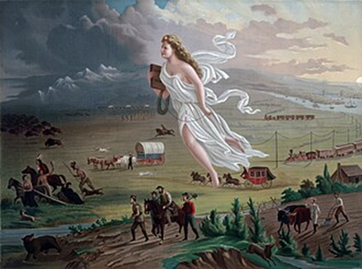
John Gast’s “American Progress” 1872

Slide 12
Definition of Christian Nationalism
The belief that the United States was founded as a Christian nation and that its laws should therefore reflect Christian values.
First element: a strong moral traditionalism based on creating and sustaining social hierarchies.
Second element: comfort with authoritarian social control.
Third element: white, native-born citizens are held up as the ideal.

Slide 13
Why has such a phenomenon, Christian nationalism, seen such growth in numbers and power in recent decades? And why is a similar trend toward religious nationalism and authoritarianism being seen in so many other countries around the world?

Slide 14
Why has such a phenomenon, Christian nationalism, seen such growth in numbers and power in recent decades? And why is a similar trend toward religious nationalism and authoritarianism being seen in so many other countries around the world?
FEAR

Slide 15
4 myths about how immigrants affect the U.S. economy | PBS NewsHour

Slide 16
I John 4 says, “Perfect love casts out fear.”
So, spiritually speaking, the opposite of love is not hate; the opposite of love is fear.

Slide 17
“Established religion” is the official, legal religion of a nation
This means, one religion is the official religion of a country, the legally established religion, and they enjoy certain political and economic privileges.

Slide 18
The young nation recognized the need to make all religions safe from government, and government safe from all religions, and all religions safe from all other religions.

Slide 19
Was the United States founded as a Christian nation?
NO

Slide 20
What is Deism?
Belief in the existence of a supreme being, specifically a creator, who does not intervene in the universe.

Slide 21
The young nation recognized the need to make all religions safe from government, and government safe from all religions, and all religions safe from all other religions.

Slide 22
Idolatry = substituting or confusing the human for the divine

Slide 23
Theocracy = Government by officials who are regarded as divinely inspired

