Slide 1
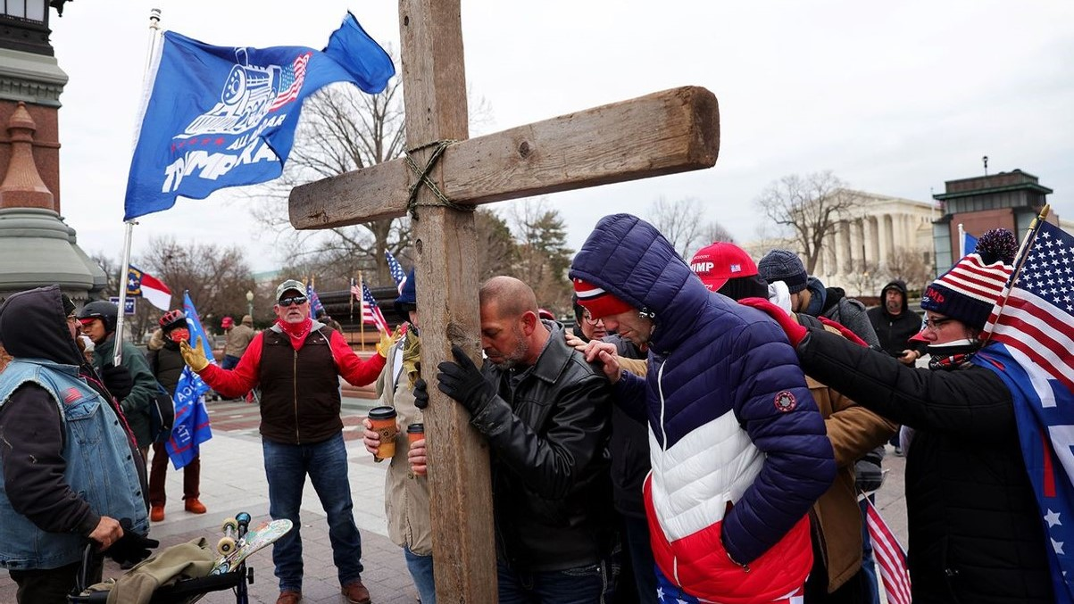
Christian Nationalism
Un-American and Un-Christian
© Donald E. Knebel
2024

Slide 2
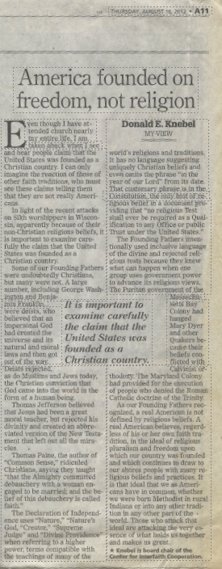
“As our Founding Fathers recognized, a real American is not defined by religious beliefs. A real American believes, regardless of his or her own faith tradition, in the ideal of religious pluralism and freedom upon which our country was founded and which continues to draw to our shores people with many religious beliefs and practices. It is that ideal that we as American have in common, whether we were born Methodist in rural Indiana or into any other religious tradition in any other part of the world. Those who attack that ideal are attacking the very essence of what holds us together and makes us great.”

Slide 3
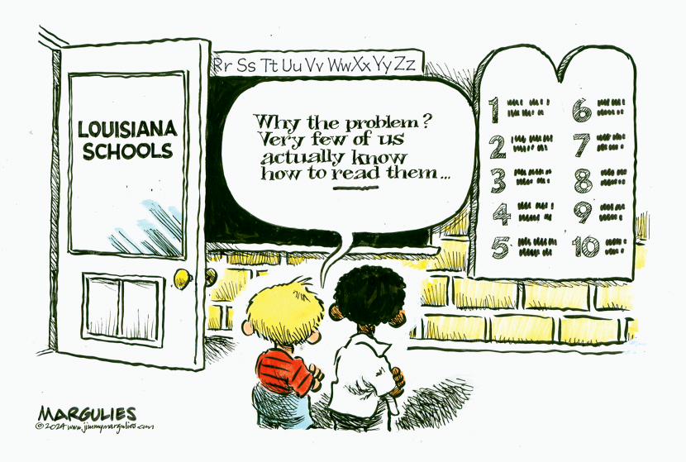

Slide 4

“The Bible is one of the most historically significant books and a cornerstone of Western civilization, along with the Ten Commandments.” Oklahoma Superintendent of Schools.

Slide 5
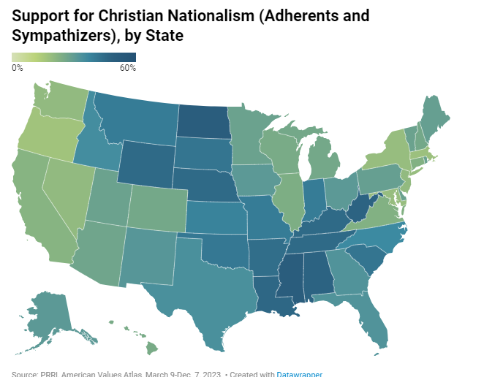

Slide 6
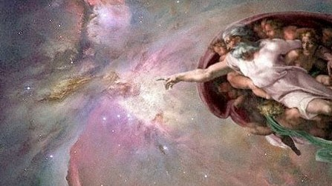

Slide 7
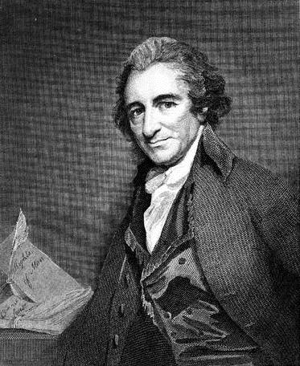
“People in general do not know what wickedness there is in this pretended word of God. *** Good heavens! it is quite another thing; it is a book of lies, wickedness, and blasphemy; for what can be greater blasphemy than to ascribe the wickedness of man to the orders of the Almighty?” Thomas Paine

Slide 8
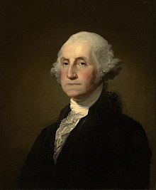
“By [the] standards . . . of twenty-first century conservative evangelical Christians, Washington was not Christian.” Waldman, Founding Faith at 60.

Slide 9
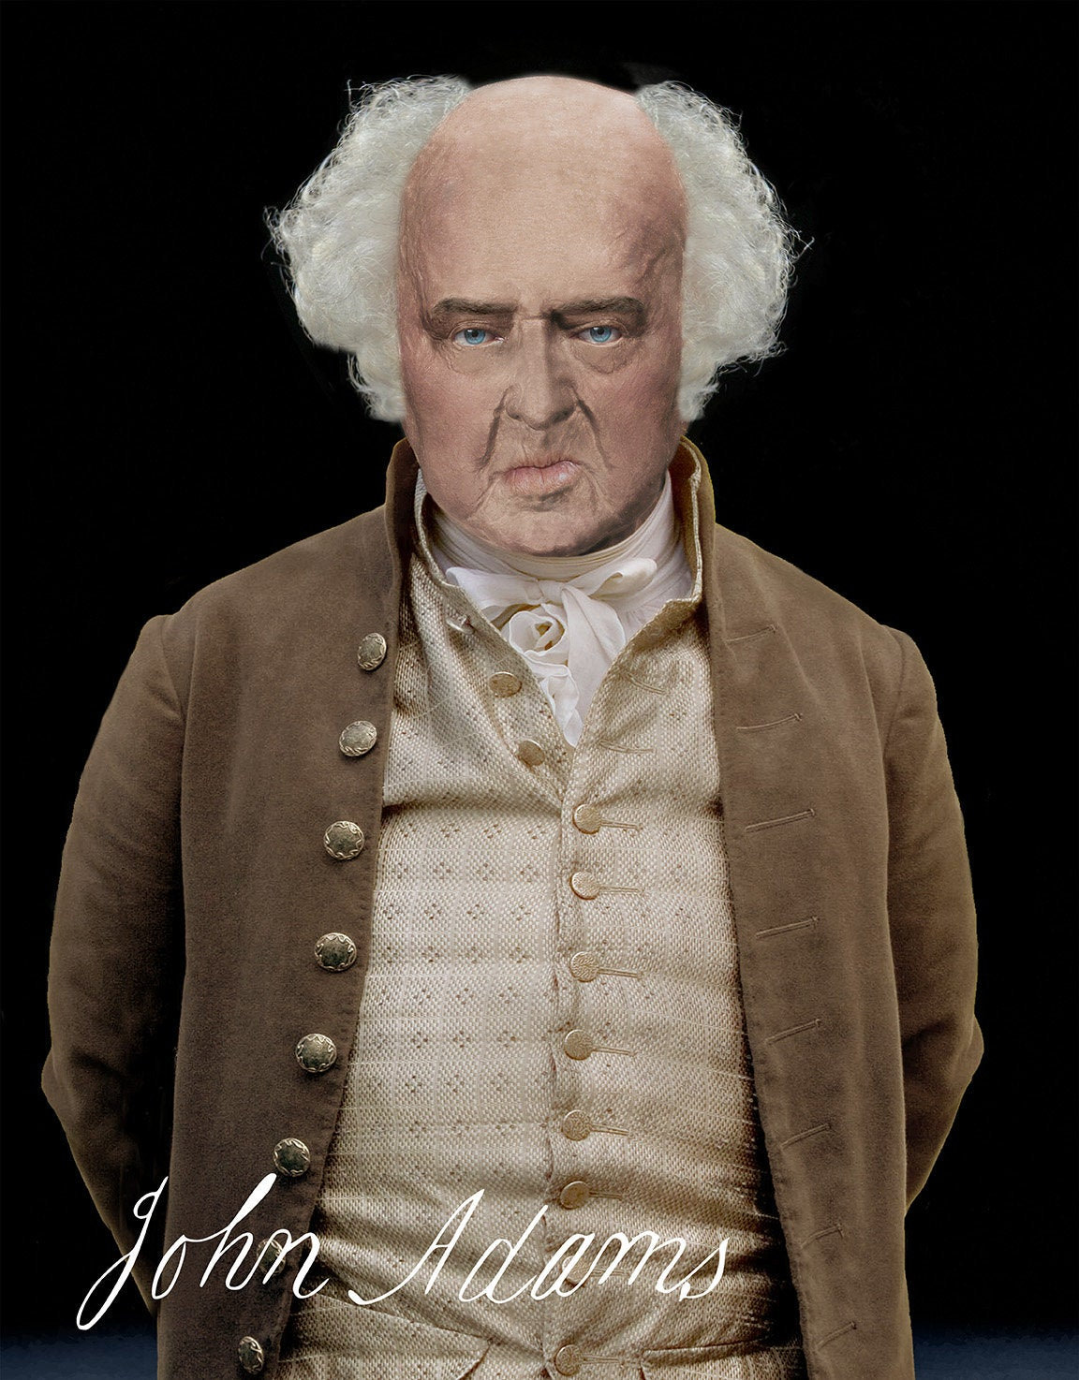
Like the Deists, Adams believed in a God who had created the universe and its laws, but concluded that Christianity has been infected with “millions of fables, tales, legends” and had become “the most bloody religion that ever existed.” Waldman, Founding Faith at 35.

Slide 10
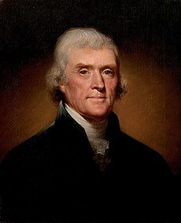
“Of this band of dupes and imposters, Paul was the great Coryphaeus, and first corrupter of the doctrines of Jesus.” Thomas Jefferson

Slide 11
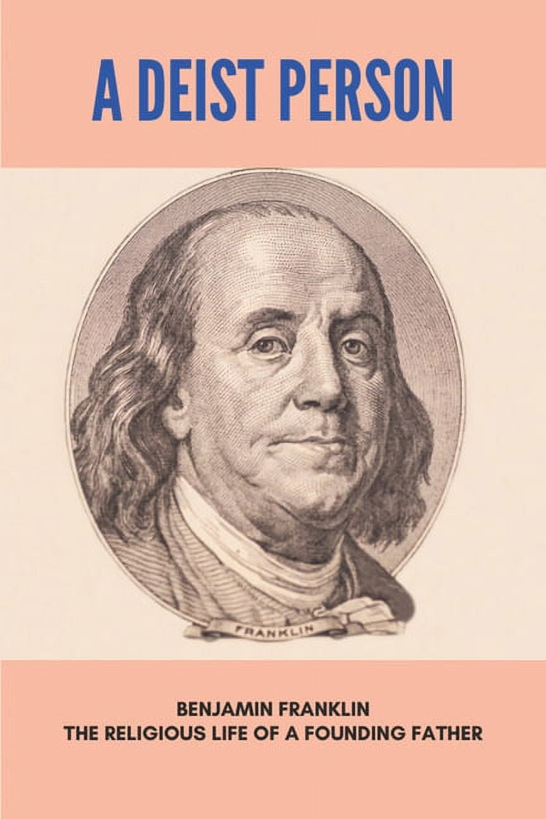
“It was the perfect theology for some one like him, because it imagined a Holy Inventor who wrote the natural laws and then gave humans the brains to master nature.” Waldman, Founding Faith at 19.

Slide 12
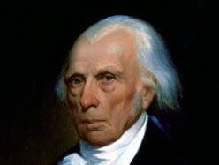
From the time he was 22, Madison “came down firmly on the side of religious freedom, arguing that only liberty of conscience could guarantee civil and political liberty.” Holmes, The Faiths of the Founding Fathers at 98.
From the time he was 22, Madison “came down firmly on the side of religious freedom, arguing that only liberty of conscience could guarantee civil and political liberty.” Holmes, The Faiths of the Founding Fathers at 98.

Slide 13
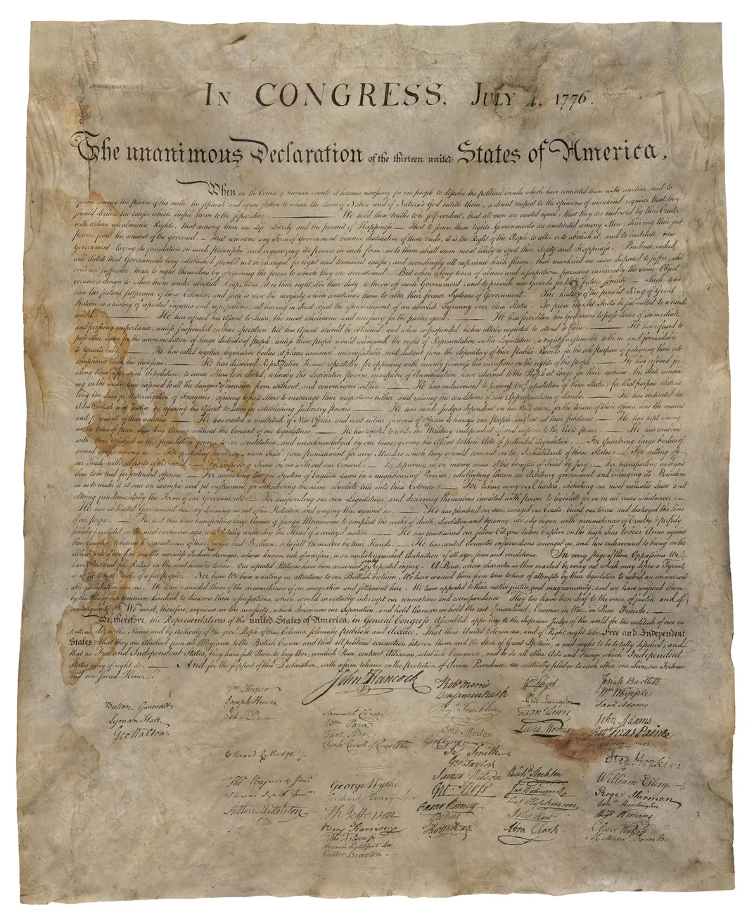
=

Slide 14
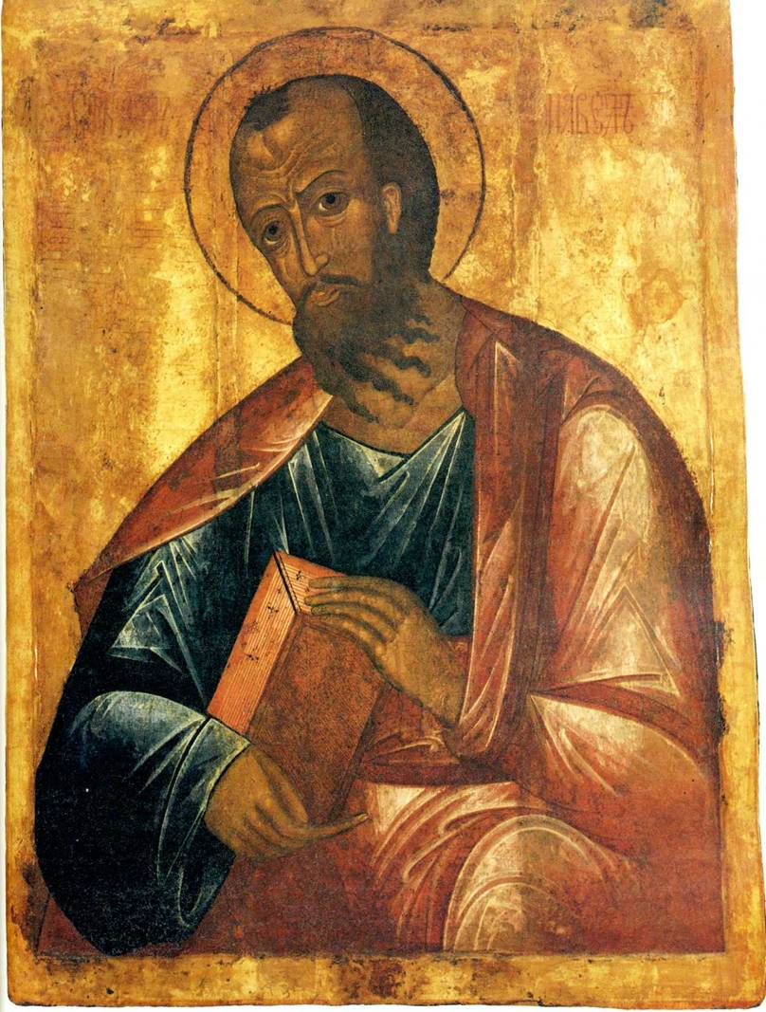
“Let everyone be subject to the governing authorities, for there is no authority except that which God has established. The authorities that exist have been established by God. Consequently, whoever rebels against the authority is rebelling against what God has instituted, and those who do so will bring judgment on themselves.” Romans 13:1 – 2.

Slide 15
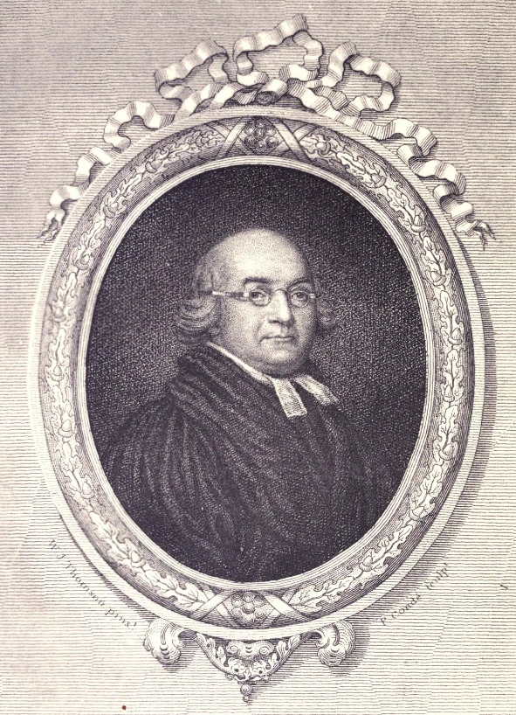
“Obedience to Government is every man’s duty because it is every man’s interest; but it is particularly incumbent on Christians, because it is enjoined by the positive commands of God.” Jonathan Boucher

Slide 16
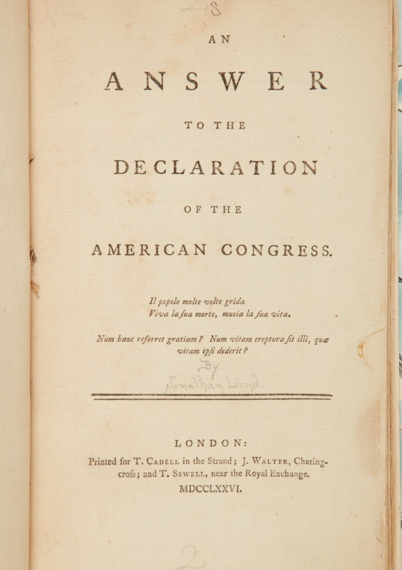
“If to what they now demand they were entitled to by any law of God, they had only to produce that law, and all controversy was at an end. Instead of this, what do they produce? What they call self-evident truths, ‘All men,’ they tell us, ‘are created equal.’” John Lind.

Slide 17
We hold these truths to be self-evident, that all men are created equal, that they are endowed by their Creator with certain unalienable Rights, that among these are Life, Liberty and the pursuit of Happiness.--That to secure these rights, Governments are instituted among Men, deriving their just powers from the consent of the governed, --That whenever any Form of Government becomes destructive of these ends, it is the Right of the People to alter or to abolish it, and to institute new Government, laying its foundation on such principles and organizing its powers in such form, as to them shall seem most likely to effect their Safety and Happiness.

Slide 18
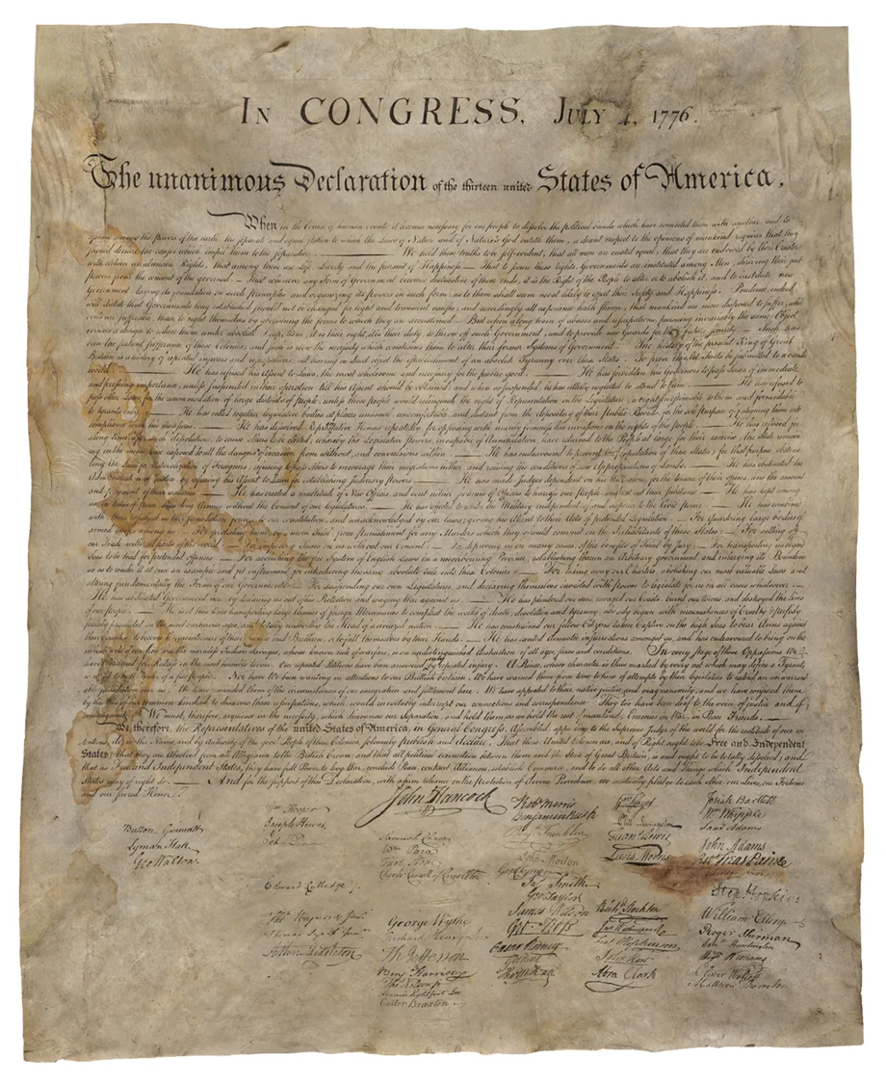
“Jefferson, Adams, and Franklin and the Continental Congress could have chosen to root the entitlements, endowments, appeals, and protections in Jesus Christ or any other specific god, but they did not. Instead, they carefully selected references that do not specify any religious denomination or sectarian belief.” Seidel, The Founding Myth at 70.

Slide 19
“When in the Course of human events, it becomes necessary for one people to dissolve the political bands which have connected them with another, and to assume among the powers of the earth, the separate and equal station to which the Laws of Nature and of Nature's God entitle them, a decent respect to the opinions of mankind requires that they should declare the causes which impel them to the separation.”

Slide 20
“We hold these truths to be sacred & undeniable, that all men are created equal and independent, and from that equal creation they derive rights inherent and inalienable, among which are the preservation of life, and liberty and the pursuit of happiness.” Original Draft
“We hold these truths to be self-evident, that all men are created equal, that they are endowed by their Creator with certain inalienable rights, that among these are Life, Liberty and the Pursuit of Happiness.” As Adopted

Slide 21
“We, therefore, the Representatives of the united States of America, in General Congress, Assembled, appealing to the Supreme Judge of the world for the rectitude of our intentions . . . .”

Slide 22
“And for the support of this Declaration, with a firm reliance on the protection of divine Providence, we mutually pledge to each other our Lives, our Fortunes and our sacred Honor.”

Slide 23
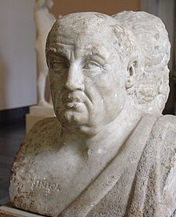
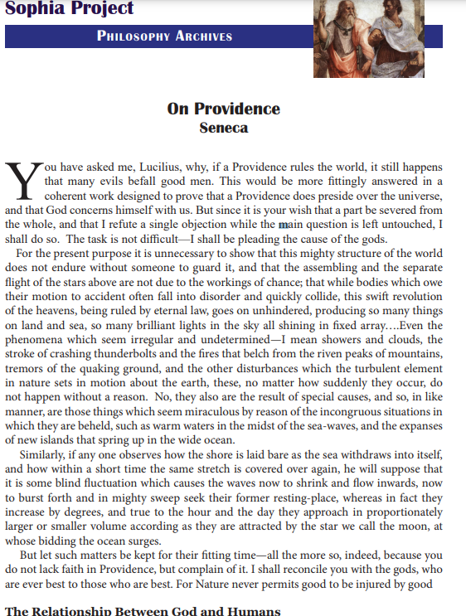

Slide 24
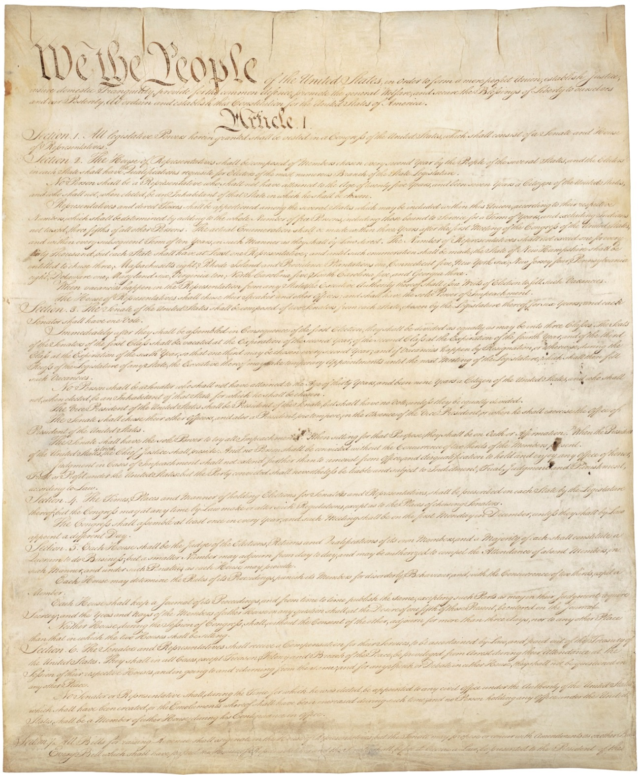
“We the People of the United States, in Order to form a more perfect Union, establish Justice, insure domestic Tranquility, provide for the common defence, promote the general Welfare, and secure the Blessings of Liberty to ourselves and our Posterity, do ordain and establish this Constitution for the United States of America.”

Slide 25
“No religious test shall ever be required as a qualification to any office or public trust under the United States.” United States Constitution, Art. VI.

Slide 26
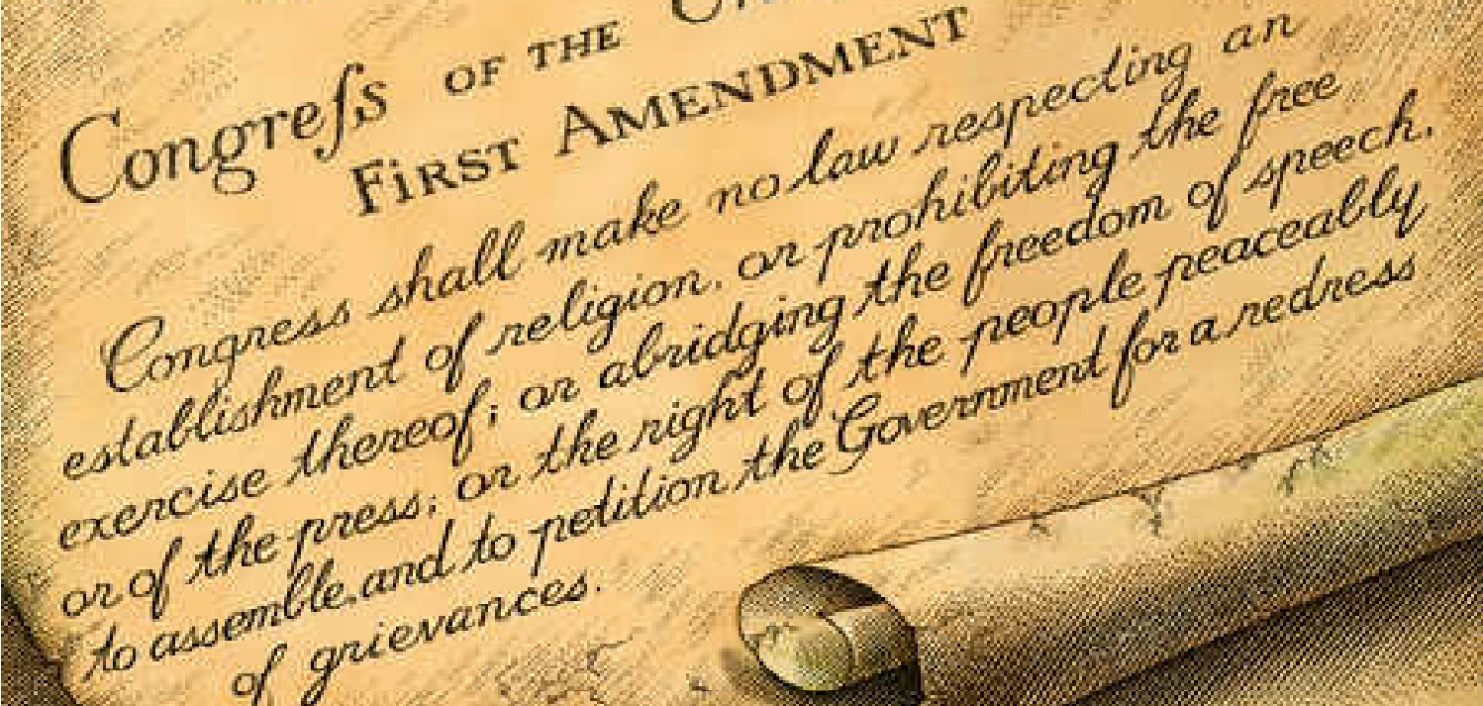
“Congress shall make no law respecting an establishment of religion or prohibiting the free exercise thereof, or abridging the freedom of speech, or of the press, or the right of the people peaceably to assemble and to petition the Government for a redress of grievances.” First Amendment to the Constitution.

Slide 27
“The bosom of America is open to receive, the oppressed and persecuted of all Nations and Religions, whom we shall welcome to a participation of all our rights and privileges.” George Washington

Slide 28
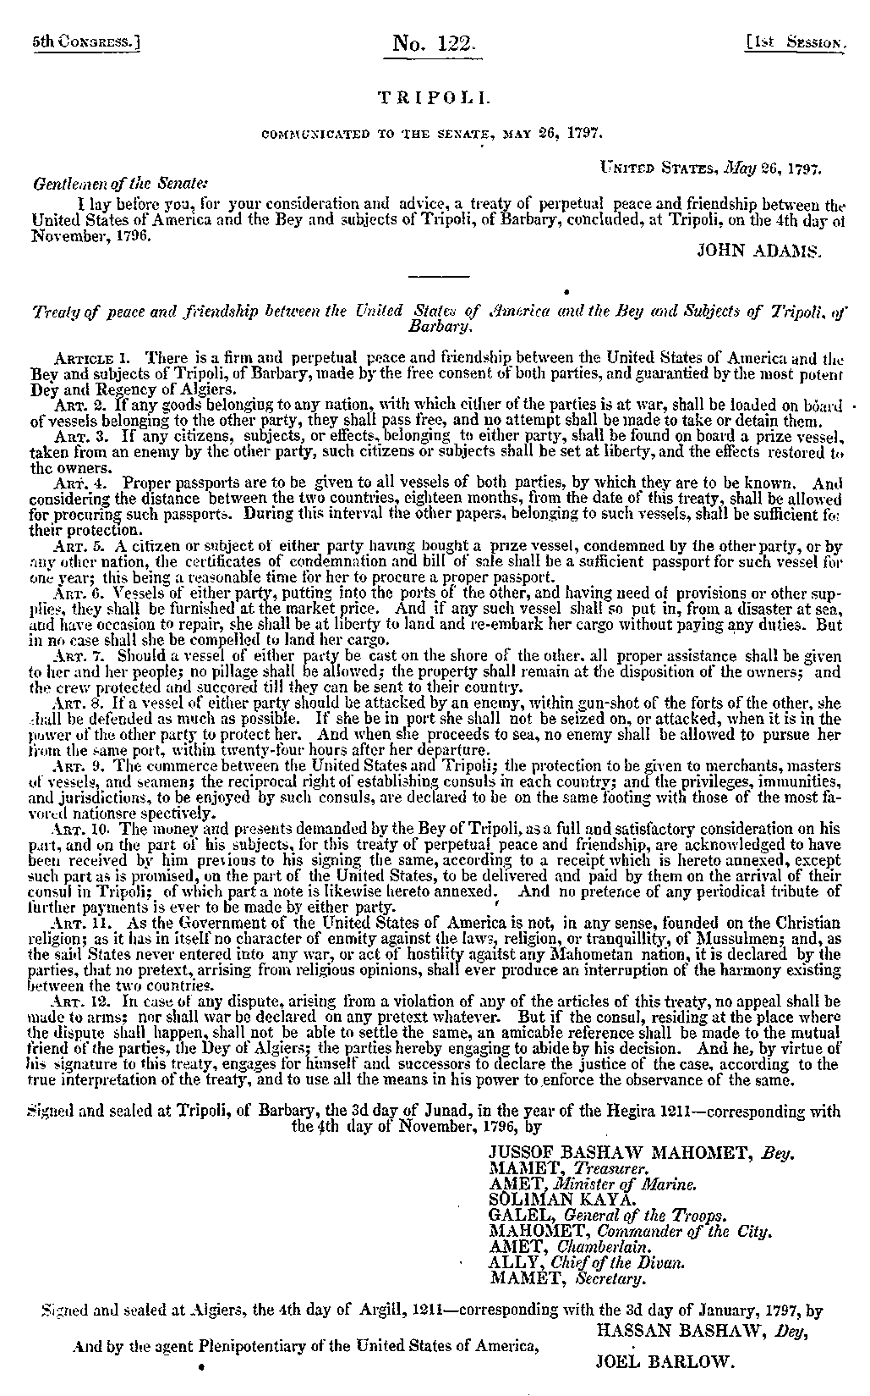
Art. 11. As the Government of the United States of America is not, in any sense, founded on the Christian religion; as it has in itself no character of enmity against the laws, religion, or tranquility, of Mussulmen [Muslims]; and as the said States never entered into any war or act of hostility against any Mahometan [Islamic] nation, it is declared by the parties that no pretext arising from religious opinions shall ever produce an interruption of the harmony existing between the two countries.

Slide 29
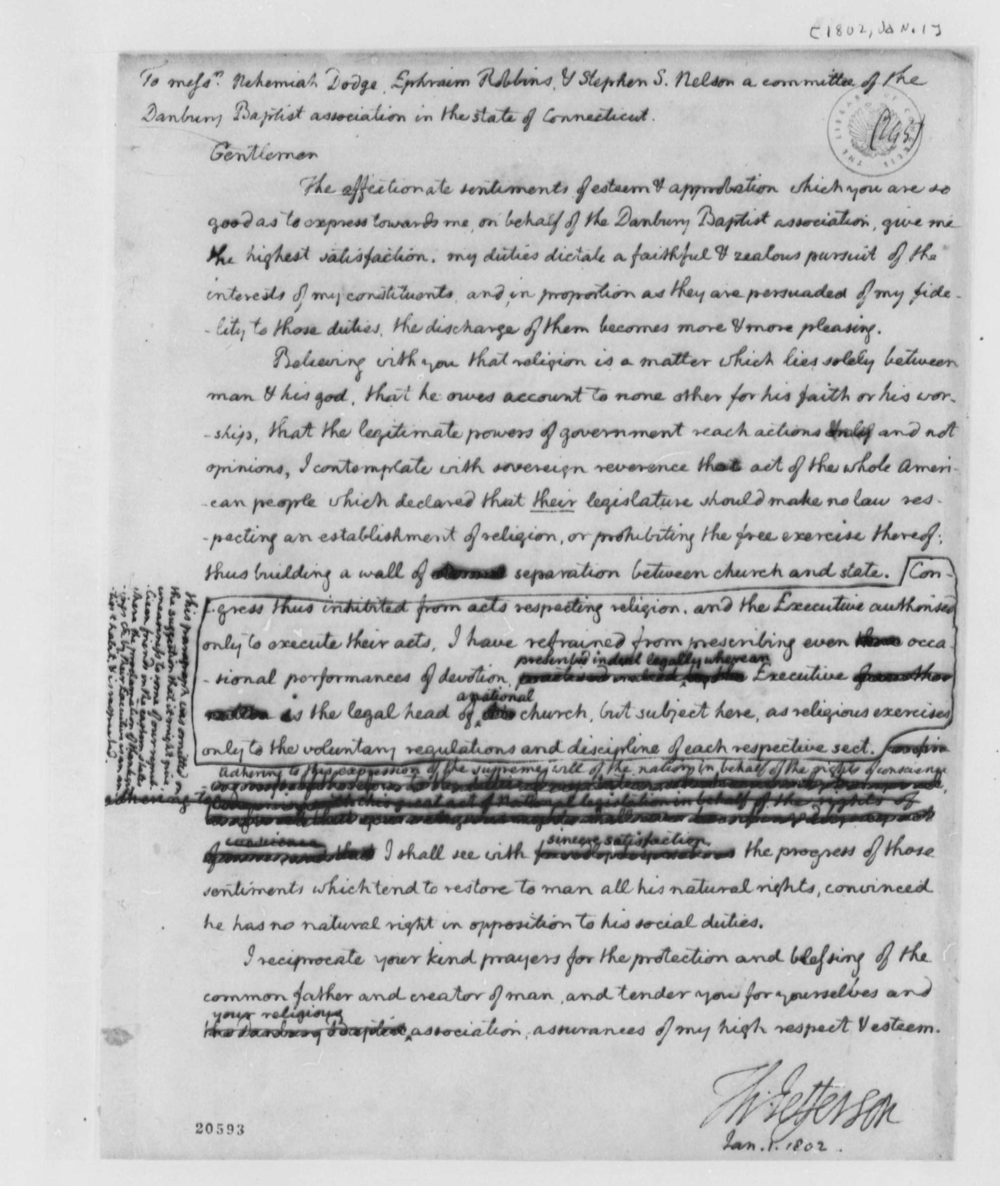
“I contemplate with sovereign reverence that act of the whole American people which declared that the legislature should ‘make no law respecting an establishment of religion or prohibiting the free exercise thereof,’ thus building a wall of separation between church and State.” Thomas Jefferson.

Slide 30
“In almost every action, [Madison] conveyed support for strict separation of church and state.” Waldman, Founding Faith at 172.

Slide 31
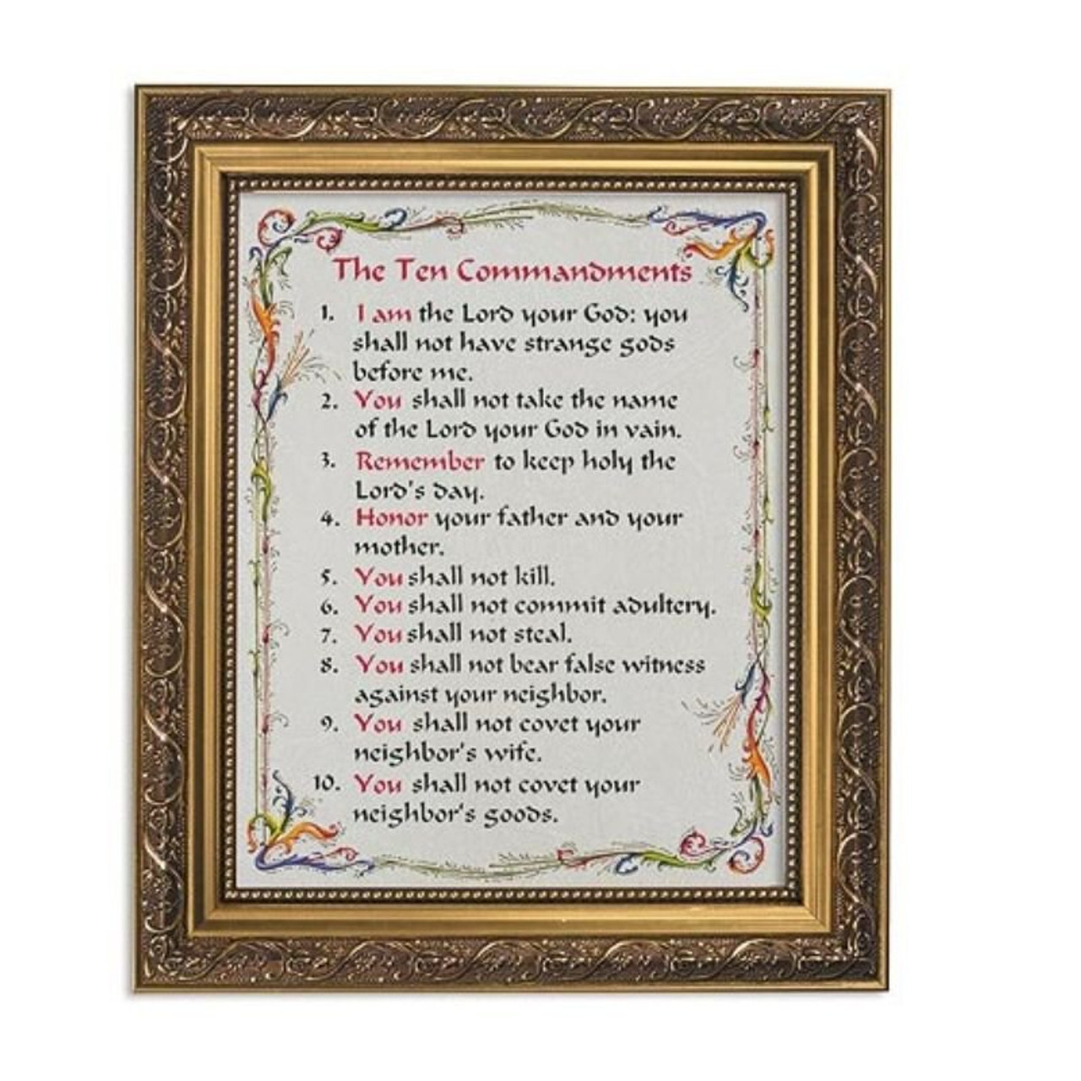
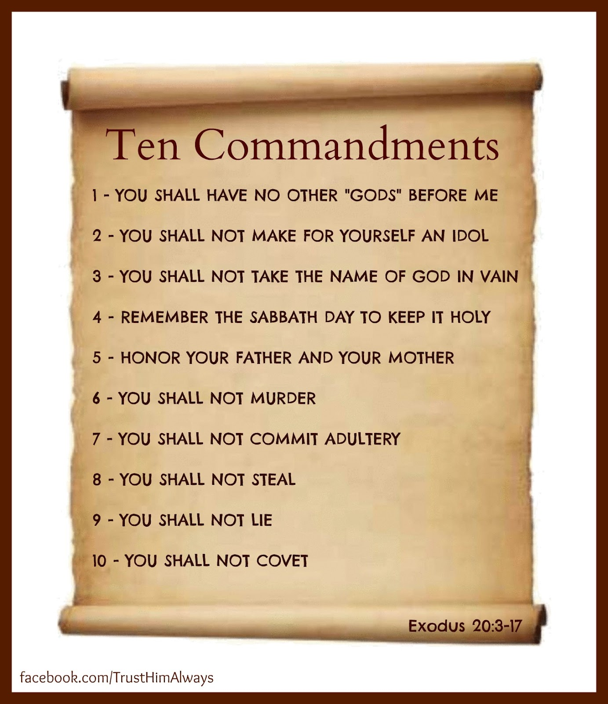

Slide 32
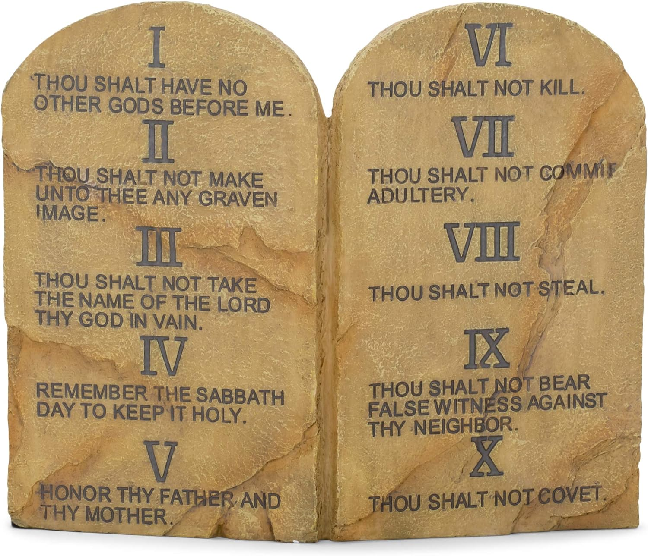

Slide 33
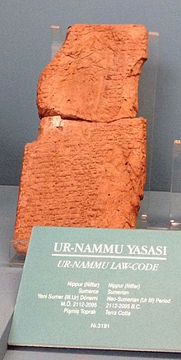

Slide 34

“By the time Trump arrived on the scene proclaiming himself their savior, [Christian nationalists] had already traded a faith that privileges humility and elevates ‘the least of these’ for one that derides gentleness as the province of wusses . . . . Rather than turning the other cheek, they’d resolved to defend their faith and their nation, secure in the knowledge that the ends justify the means.” Onishi, Preparing for War at 219.

Slide 35
“The foreigner residing among you must be treated as your native-born. Love them as yourself, for you were foreigners in Egypt. I am the LORD your God.” Leviticus 19:34.
“[God] defends the cause of the fatherless and the widow, and loves the foreigner residing among you, giving them food and clothing. And you are to love those who are foreigners, for you yourselves were foreigners in Egypt.” Deuteronomy 10:18 – 19.
“So, I will come near to you for judgment. I will be quick to testify against sorcerers, adulterers and perjurers, against those who defraud laborers of their wages, who oppress the widows and the fatherless, and deprive aliens of justice, but do not fear me, says the LORD Almighty.” Malachi 3.5.

Slide 36
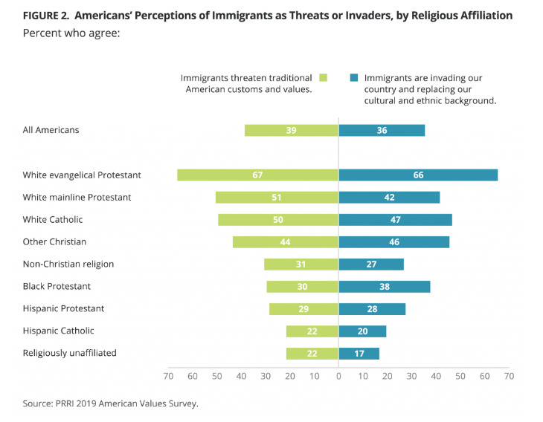

Slide 37
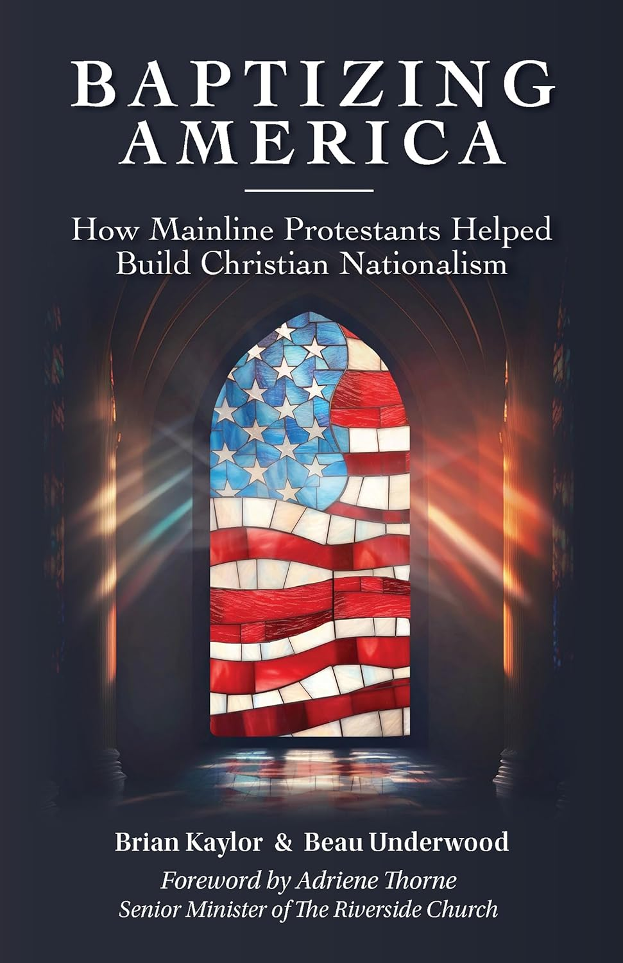
“The White Christian Nationalist version of patriotism is racist, xenophobic, patriarchal and exclusionary. *** For Christians who seek to be anti-racist—as some mainline Protestants profess as a goal—the danger of Christian Nationalistic ideas runs deeper than just issues of church and state. It can also undermine work in areas to confront racism, misogyny and other heresies.” Kaylor and Underwood, Baptizing America at 28.

Slide 38
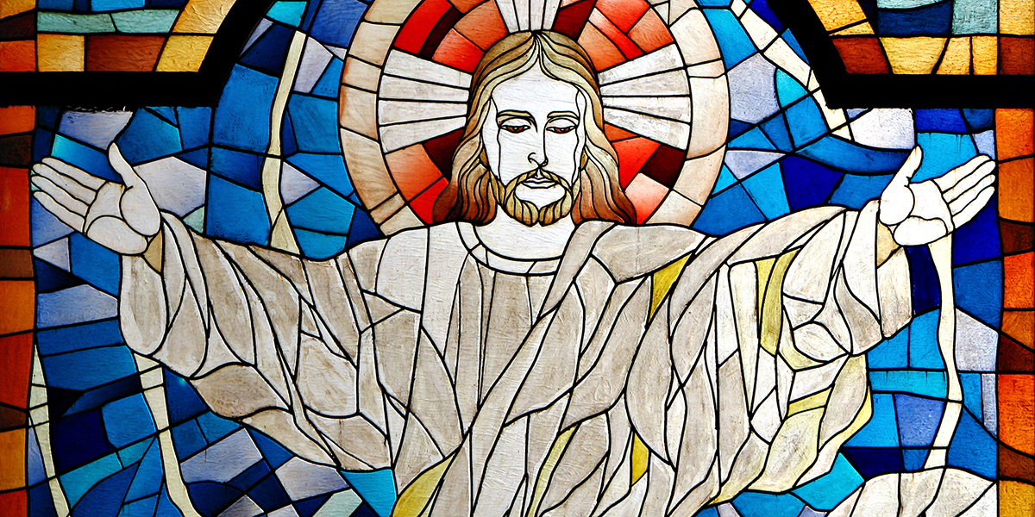

Slide 39
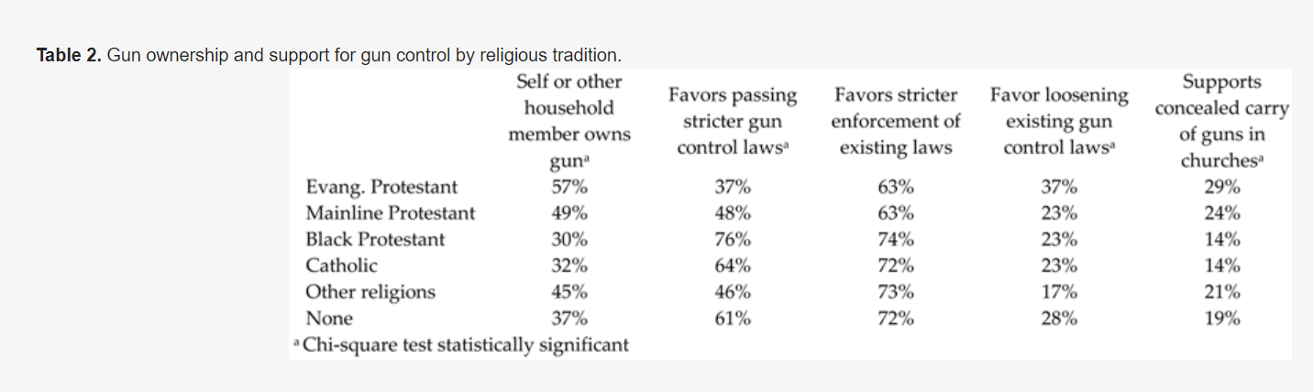

Slide 40
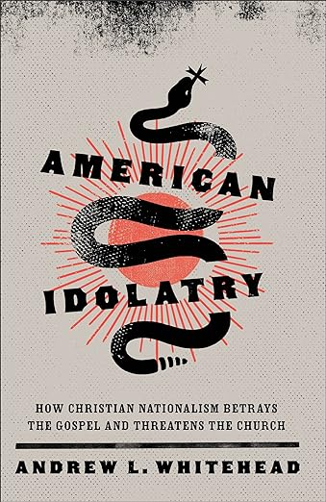
“Gaining and selfishly employing political power has not served to bring more Americans into the Christian fold. Study after study demonstrates that one effect of the culture-warring of the Christian Right was to actively push people out of the Christian tradition. *** In our effort to retain what we thought was a Christian nation, we have succeeded in pushing more Americans away from the faith.” Whitehead, American Idolatry at 20.

Slide 41

“While most Americans do not espouse authoritarian views, our study demonstrates that such views are disproportionately held by Christian nationalists, who we know in our past research have been more prone to accept political violence and more likely to hold antidemocratic attitudes than other Americans.” Dr. Melissa Deckman.

Slide 42
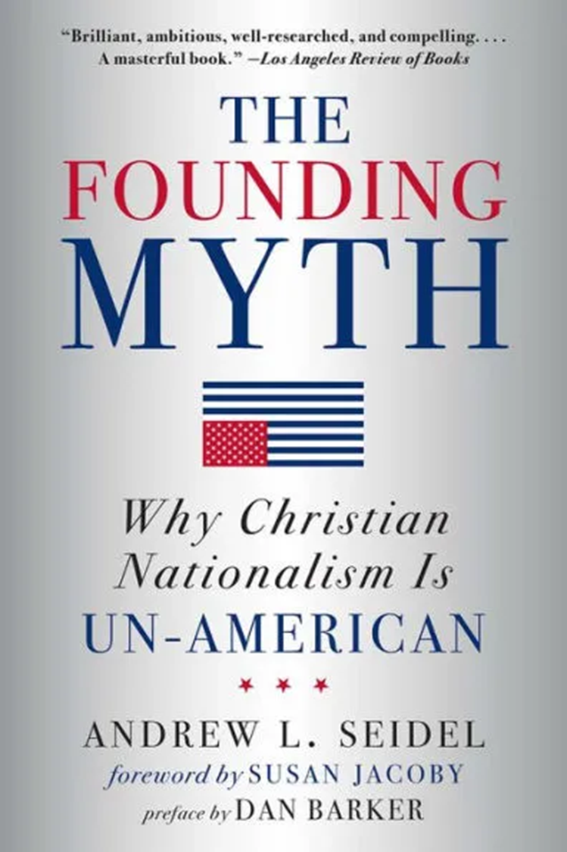
“America’s latest wave of Christian nationalism – Trump’s wave – culminated in this attack. But Christian nationalism did not die on January 6: it may even be more dangerous now, with adherents convinced that ‘God’s plan’ for White Christian America was stolen.” Seidel, The Founding Myth at 309.

Slide 43
“The [January 6] insurrection will [not] be the last example of violence suffused with Christian symbolism unless and until American Christians consistently confront Christian nationalism. *** To oppose white Christian nationalism is not to give up on Christianity. Christianity can be marked by sacrifice, hope, grace, service, faith, and, of course, love. Christians can disentangle our faith from Christian nationalism and thus more closely embody the life and teachings of Jesus, the gospel, in our congregations and communities.” Whitehead, American Idolatry at 49, 190.

Slide 44

“As the myths [of Christian nationalists] are proclaimed with more desperation, we must be prepared to refute them factually and vocally. This book provides the first half of that recipe. You are responsible for the rest. Outspoken resistance is, as Madison might say, the ‘first duty of citizens.’” Seidel, The Founding Myth at 297.

Slide 45
Questions?

