Slide 1
Healthcare Training

Slide 2
Agenda
Healthcare Overview and Trends
Patient Satisfaction
Healthcare Regulations
Recommended Products

Slide 3
Healthcare Overview and Trends

Slide 4
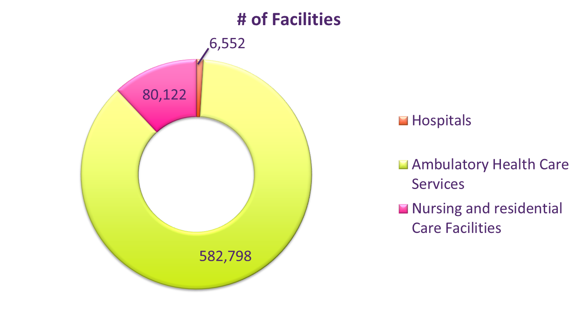
Healthcare Overview
6,552 Registered Hospitals in the US
800,566 Hospital Beds in the US
  Updated January 2, 2014 by American Hospital Association
15,653 Long Term (Elderly Care)Care Facilities in the US
  80,122 of All Nursing and Residential Care Facilities
  1.4 Million Long Term Care Residents
  That is 1 in ever 34 people in the US over the age of 65
  US News http://health.usnews.com
582,798 Ambulatory Care Facilities
  Outpatient Care Spending accelerates with 6.5% Growth
  Cost of an Emergency Room visit averages $2,457 compared to $192 with an outpatient facility
    Healthcare Finance News September 2013

Slide 5
Healthcare
Ambulatory Health Care Services
Hospital Care
Nursing & Residential Care
Physicians’ Offices
Outpatient Care Centers
Other Ambulatory Care Services
Acute Hospital,
Inpatient Care
Long Term Residential Facilities
Family or General Practice
Family Planning
Mental Health Practitioners
General Medical & Surgical Hospitals
Nursing Homes
Specialized Medicine
Outpatient Mental Health and Substance Abuse Centers
Dentistry
Psychiatric & Substance Abuse hospitals
Assisted Living facilities
Freestanding ambulatory, surgical and emergency centers
Chiropractors
Specialty Hospitals
Continuing Care Retirement Communities
Kidney Dialysis Centers
Optometrists
Mental Health & Substance Abuse Residential Facilities
Other
Physical, Occupational and Speech Therapists & Audiologists
Intellectual & Developmental disability residential facilities
Medical & Diagnostic Labs
Other Residential Care
Home Healthcare Services
Other
Chart 1
Notes:
North American Industry Classification System
Industry Statistics Portal

Slide 6

Trends
Consolidation of Healthcare Providers
  Health Systems will continue to merge and acquire locations
Accountable Care Organizations
  Group of Healthcare Providers who come together voluntarily to give coordinated high quality care to the patients they serve
Purchasing Decisions leaving the Building
  Janitorial products are being consolidated and purchasing decisions are being made at the IDN and GPO level.
Patient Satisfaction
  Due to the Affordable Care Act purchasing decisions, renovations, and employee training are made with the Patient’s experience in mind.
Focus on HAI Reductions
  Hospitals are being reimbursed by insurance companies based on their performance and outcomes.
Notes:
According to a baseline study of early ACO’s, ACO patients had 5.8% lower total cost of care than non- ACO patients. Source- “The Commonwealth Fund” Jan 2014

Slide 7
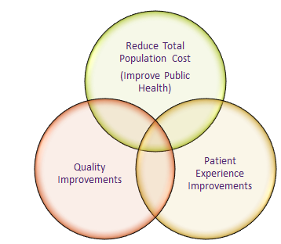
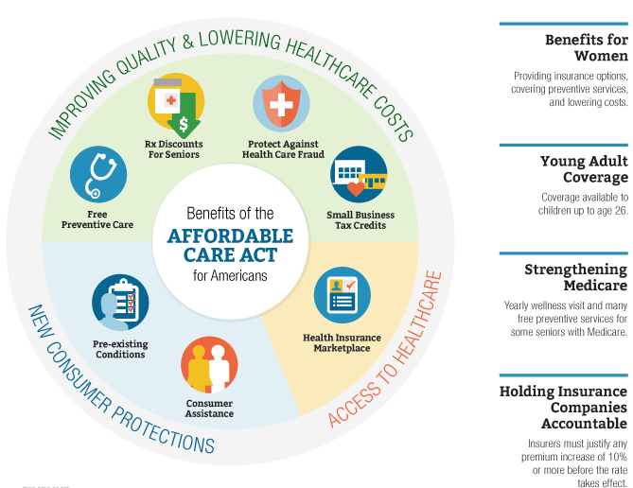
What is the Affordable Care Act?
PPACA – Patient Protection and Affordable Care Act of 2010
Source: http://www.hhs.gov/healthcare/facts/timeline/

Slide 8
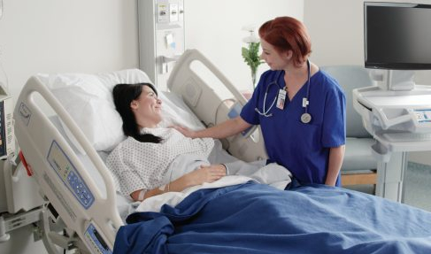

Driving Revenue
Maximize Reimbursements
PAY FOR PREFORMANCE
Quality
(70%)
Patient Satisfaction
(30%)
TPS
16 Measures Covering:
Patient Outcomes
Clinical Process
Healthcare-Associated Infections (HAI)
Measured by HCAHPS Survey Covering:
Communication
Hospital Environment
Pain Management
Noise Levels
Source: http://www.cms.gov/Medicare/Quality-Initiatives-Patient-Assessment-Instruments/hospital-value-based-purchasing/index.html, http://www.hcahpsonline.org/home.aspx

Slide 9
Patient Satisfaction

Slide 10
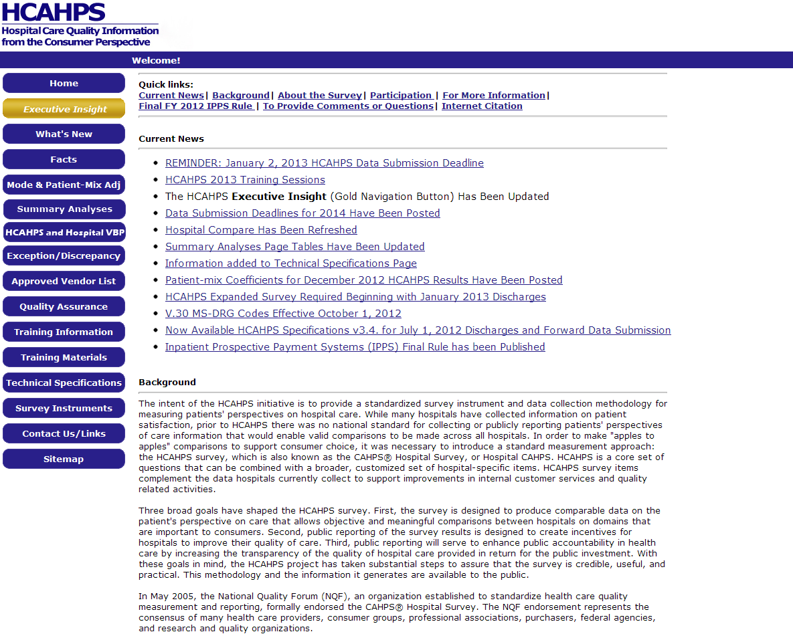
HCAHPS & Patient Satisfaction
HCAHPS stands for Hospital Consumer Assessment of Healthcare Providers and Systems and is a standardized survey of hospital patients that captures patients' unique perspectives on hospital care for the purpose of providing the public with comparable information on hospital quality.
  HCAHPS survey contains 21 questions on 9 topics:
    communication with doctors
    communication with nurses
    responsiveness of hospital staff
    pain management
    communication about medicines
    discharge information
    cleanliness of the hospital environment,
    quietness of the hospital environment,
    transition of care
  Hospital’s results can be found online
  https://www.medicare.gov/hospitalcompare/search.html
Nursing Home Compare- Available for all Medicare and Medicaid certified nursing homes in US. You can see how nursing homes compare in categories such as:
  potential harm for infection
  fire safety
  health inspection summary.
https://www.medicare.gov/nursinghomecompare/search.html
Notes:
EVS Directors and Managers often have bonuses tied to HCAHP scores

Slide 11
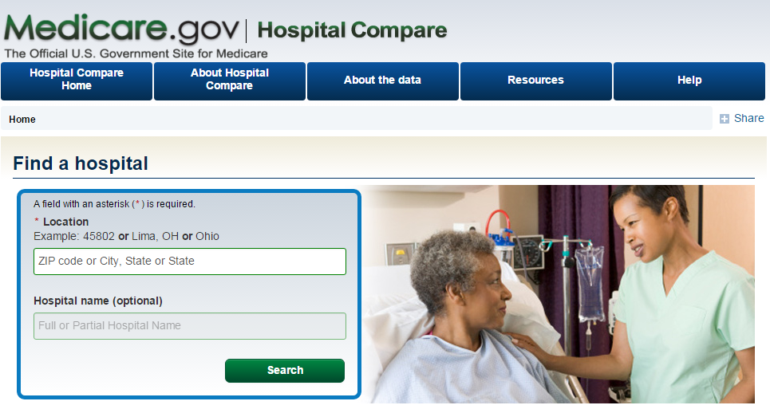
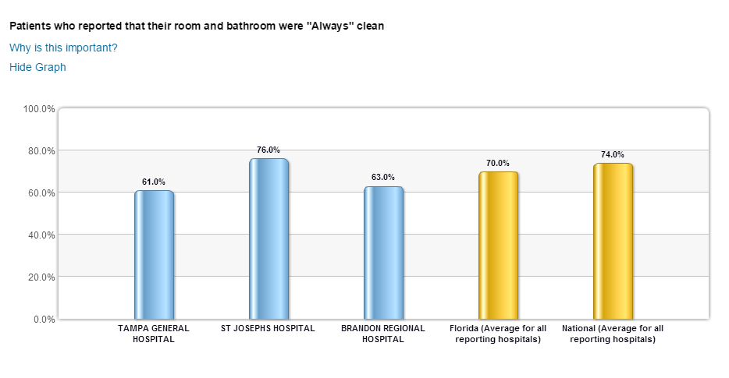
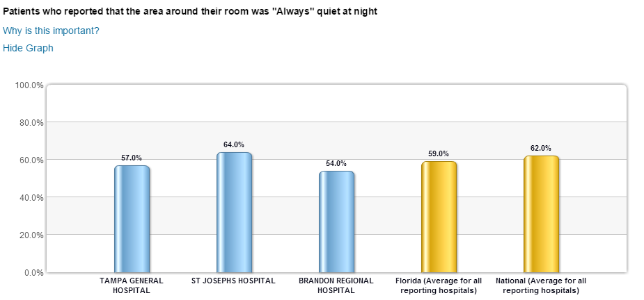
Hospital HCAHPS
www.medicare.gov/hospitalcompare
Room and Bathroom Cleanliness
Quiet Environment

Slide 12
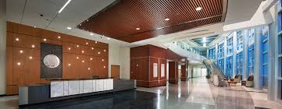
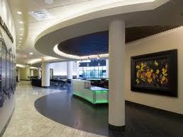

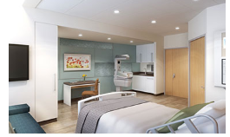
Importance of Image – Increasing the Patient Experience
Women’s Hospital Baton Rouge
Winnie Palmer Women and Babies Hospital Orlando
Stanford’s Children’s Health Specialty Services
UT South western's Clements University Hospital
Notes:
Hospitals are updating their image, providing concierge services, and serving gourmet meals all in efforts to increase the patient experience. New facilities are being designed to create a healing environment to speed up recovery time.

Slide 13
Healthcare Regulations

Slide 14
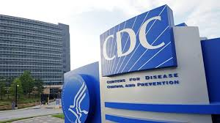

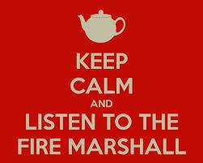

Regulations

Slide 15


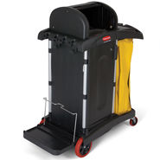
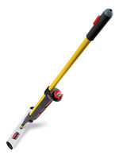
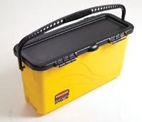
Responsible for accreditation of Hospitals
Hospitals must be accredited by Joint Commission to receive CMS Reimbursements
Inspections are 1 week long and occur every 3 years
Inspections are Unannounced
Joint Commission Standards Include:
Chemicals left unattended must be kept locked
Only 1 mop per room can be used in isolation rooms
Must change mop and mop water every 3 patient rooms
  (For normal, non isolation patient rooms.)
Notes:
Joint commission standards are old and based off using string mops. They have not come out with new standards. Joint Commission normally has a “Hot Button” they are looking at when visiting a facility. That hot button may be “air filters” or “MSDS sheets”. If you find out what Hot button Joint Commission is after do your hospitals a favor and let them know so they will be prepared. Joint commission tends to visit hospitals by region.

Slide 16
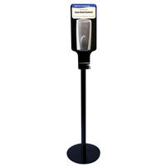
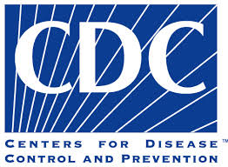
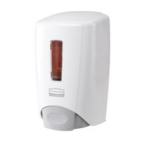

Centers for Disease Control and Prevention- CDC is the nation's health protection agency, working 24/7 to protect America from health and safety threats, both foreign and domestic. CDC increases the health security of our nation
The CDC is reactionary and they become involved after an outbreak occurs.
The CDC does not mandate that a disinfectant be used on the floors. Neutral Cleaner can be used on the floors and disinfectant on high tough areas.
The CDC sets hand hygiene guidelines that infection preventions use to standardize hand hygiene practices in their facilities.
The CDC recommends certain chemical usage for disinfection of diseases (example Ebola)
The CDC sets recommendations for Person Protective Equipment

Slide 17

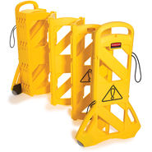
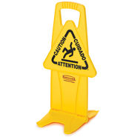
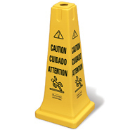
OSHA With the Occupational Safety and Health Act of 1970, Congress created the Occupational Safety and Health Administration (OSHA)* to assure safe and healthful working conditions for working men and women by setting and enforcing standards and by providing training, outreach, education and assistance
OSHA requires wet floor signs to be yellow with black wording.
OSHA Standards only apply to the worker’s safety , not the Patient or Visitor's Safety

Slide 18
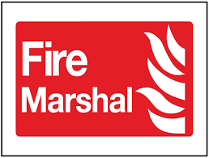
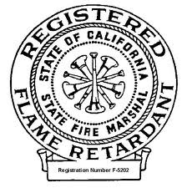

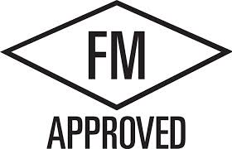
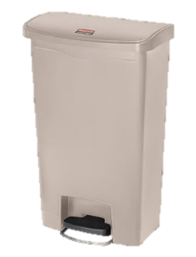
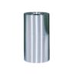
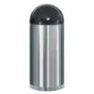
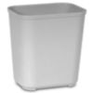
Underwriters Laboratory Classified or Listed waste receptacle is an open top waste receptacle has been tested and approved to the containment and resistance to temperature rise of surrounding surfaces.
California State Fire Marshalapproved receptacle that has either FM or UL approval (or both UL&FM) and then has also been approved by the State of California Fire Marshall. The state of California is regarded to have the most stringent fire codes.
Factory Mutual is an independent testing agency. A FM approved receptacle is a receptacle that has a lid and can withstand internal fires.
Most Patient Room receptacles need to have a Fire Rating. Each Hospital should defer to their local fire marshal for details on fire rating needs for their area.

Slide 19
Recommended Products

Slide 20
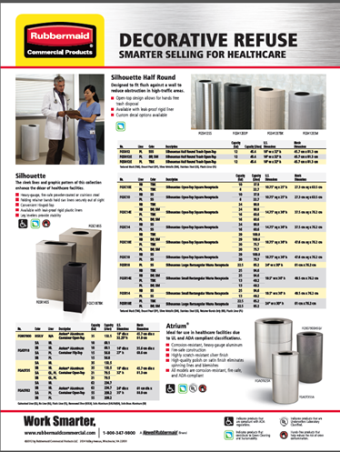
Upgraded Image
New Decorative Refuse Brochure
Patient Satisfaction
  The Importance of HCHAPS scores (Hospital Assessment of Healthcare Providers and Systems) is more than ever before.
  Did you know that HCHAPS scores must be submitted for the hospital to receive full Medicare reimbursements.
  The overall aesthetics of a facility plays an important role of the patient experience
Renovations and New Construction Continue
  According to Health Facilities Management, while new facility construction might have slowed health care facilities are investing in upgrades and additions to help them thrive under the Affordable Care act.
Check out the Healthcare Landing Page for a Full Listing of Fire Rated Cans
Notes:
We have seen an increase in decorative refuse cans. This is stemming from facility remodels and upgrades to enhance the patient experience.

Slide 21
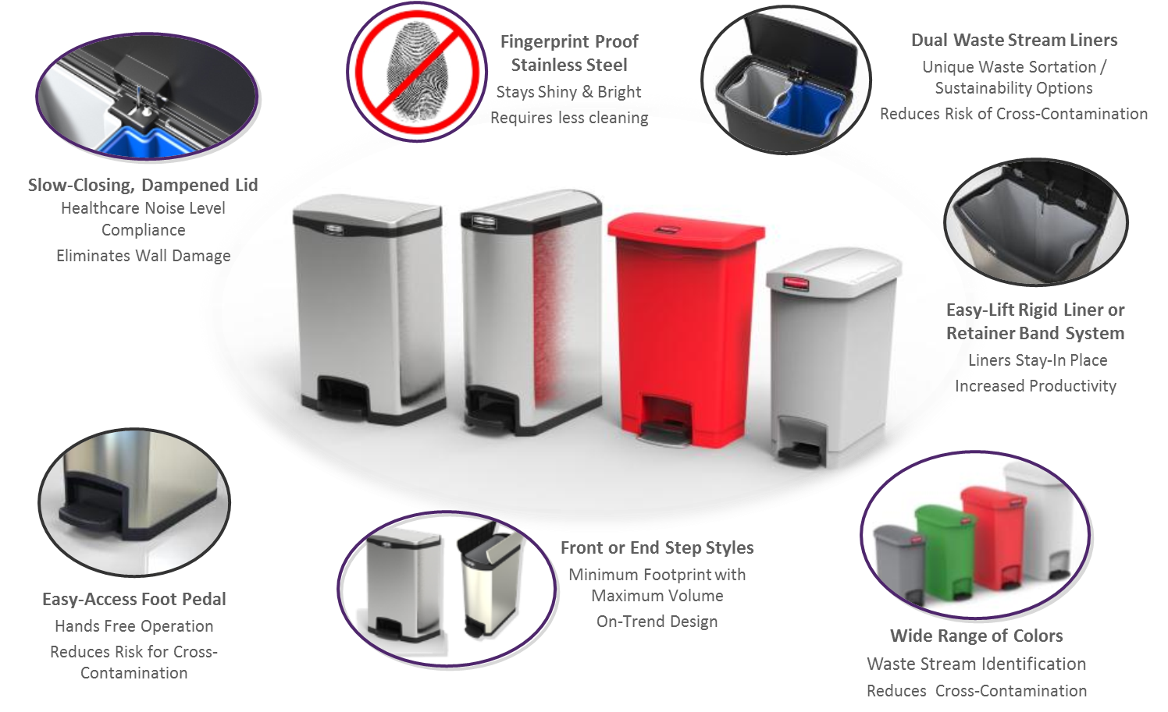
Quiet Solutions
Step-On Slim Jim™
What is considered “medical waste”?
According to the Centers for Disease Control and Prevention, medical waste is “waste sufficiently capable of causing infection during handling and disposal.” This may include blood-soaked bandages, discarded surgical gloves, discarded sharps, and so on, all of which merit special handling and disposal.
Easy-Access Footedal
Hands Free Operation
Reduces Risk for Cross-Contamination
Wide Range of Colors
Waste Stream Identification
Reduces Cross-Contamination
Notes:
In response to the need for increased aesthetics RCP will be introducing a new line of step on containers that will launch in Q1 of next year (Feb 15th expected launch date)

Slide 22
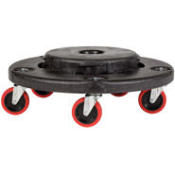
Quiet Solutions
Quiet Dolly
* Healthcare Patient Satisfaction Survey asks Patients “ Was the Hospital Environment Quiet?”
Eliminates 88% of traditional dolly noise across smooth and uneven surfaces
Fits 20,32, and 44 gallon size BRUTE containers
Non-Marking quiet casters allows users to go unnoticed while collecting waste
Up to 350 lb. continuous static load rating. All plastic construction resists rust, chipping and denting
Notes:
To help reduce noise levels the Quiet dolly is a easy change a hospital can make.

Slide 23

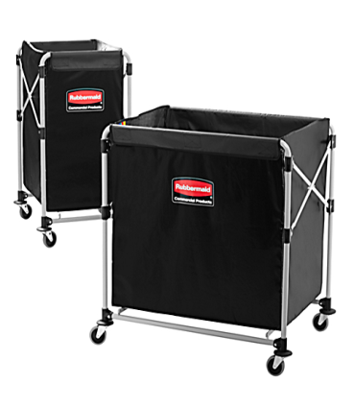
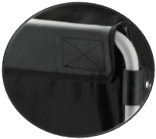
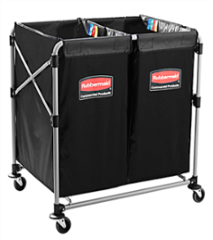
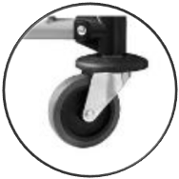
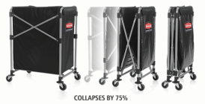
Collapsible X-Cart
Key Features
Compact, lightweight design for ease-of-use
Multi-Stream option provides the ability to easily divide and sort materials
Durable, flame retardant vinyl bag.
Color-coded ribbons classify transport materials to enhance organization and prevent cross-contamination
Detachable bag for easy cleaning. Discreet color disguises stains & dirt
Robust, powder-coated metal frame supports up to 220 lbs. of load
Minimize Storage Footprint
Compact, collapsible frame enables efficient storage. Cart’s width reduced by 75% to just 4.5” when collapsed. Unit stays upright in collapsed position.
Premium, quiet casters swivel for superior maneuverability, while bumper guards add extra protection during transport.

Slide 24
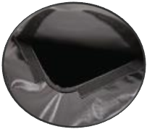
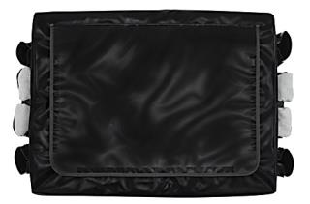
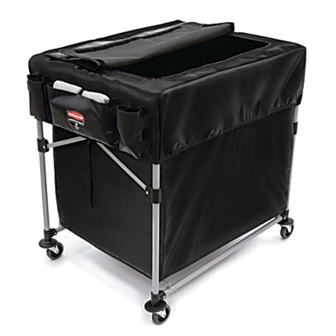
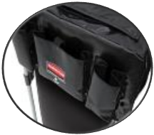
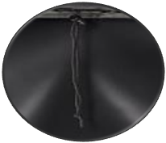
Quiet Solutions
Collapsible X-Cart Cover
Key Features
Lid stays secured with strong velcro trim.
Convenient lid provides easy access to contents inside of cart without having to remove cover.
SIX
Storage pockets hold cleaning tools, gloves, clothes, spray bottles, cleaning chemicals & more!
Two Sizes Options:
SMALL: Easily retrofits over the Collapsible X-Cart 4-Bushel/150L Model (1881749)
LARGE: Easily retrofits over the Collapsible X-Cart 8-Bushel/300L (1881750) and Multi-Stream Models (1881781)
Multiple storage pockets keep frequently used items within arms reach.
Frame remains collapsible with or without cover.
Drawstring tightly secures cover onto Collapsible X-Cart frame.
Notes:
The now available lid for the x cart is great for healthcare where waste and linen need to be kept covered.

Slide 25
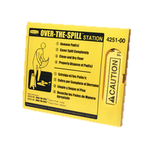
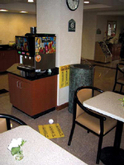
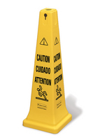
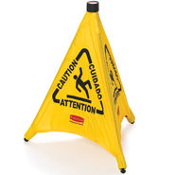
Safety- Preventing Slips, Tips and Falls
Don’t overlook this important category for Healthcare.

Slide 26
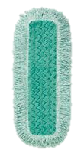
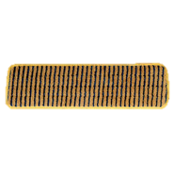
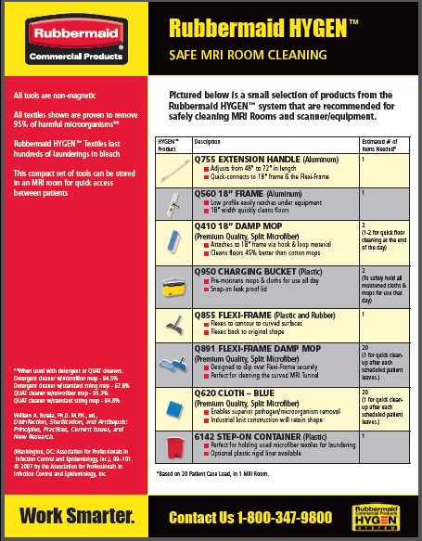
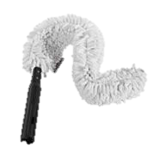


Infection Prevention/ Patient Safety
Microfiber Tips
The FG81000YL00 Microfiber Scrubber Mop works well on faux wood flooring and textured flooring
The Fringed Dust mops cover up to 50% more surface area versus non fringed dusters
*Using Microfiber does not eliminate the need for dust mopping.
Always recommend dust mopping before damp mopping!
The FGQ85200WH00 can be used dry or damp allowing more dust pick up.
The Flexi frame was designed to clean in the MRI machine. Did you know the inside of the MRI machine is one of the dirtiest places in a Hospital?
*For a MRI safe brochure check out the
Healthcare Landing Page

Slide 27



Infection Prevention/ Patient Safety
Disposable Microfiber
99.9% Microbes Removal
Streak-Free Cleaning
50% More Coverage
Effective Dirt Removal
Sanitizer Safe (Cloth)
Bleach Safe
Wet or Dry Cleaning
← Branding and Backer Print for Mops
(Insights Driven)
Compatible with Rubbermaid Hygen™ Charging Bucket, Quick-Connect Frames & Rubbermaid Pulse™
Notes:
Disposable microfiber gives you a 99.9% microbe removal (even with C.diff)with water alone. This product is great to use in an isolation room. Another great thing is that the end chooser can pair this product with any chemical which gives them flexibility on what chemical they use. This product can be used with quat, bleach, and hydrogen peroxide based cleaners.

Slide 28
Thank You!

