Slide 1


SBC Workspace
Annual Church Profile (ACP) and Leadership Profile
Data Collection

Slide 2
WHEN DO I DO THIS?
The information you provide is used to create the BMBA Yearbook for our Annual Meeting on October 22, 2015. Reports should be based on your church fiscal year. If your church year is calendar year, make sure you record statistics for the last 12 months.
Please complete reports by September 30.
If your church Fiscal Year ends in September,
please have reports completed by
October 9.

Slide 3
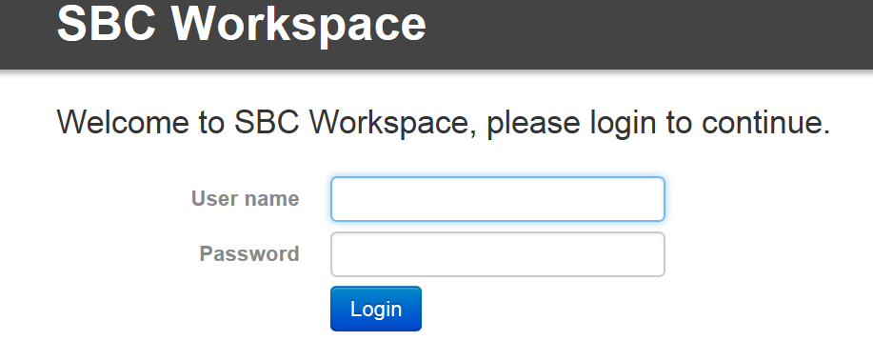
Log in at www.sbcworkspace.com

Slide 4
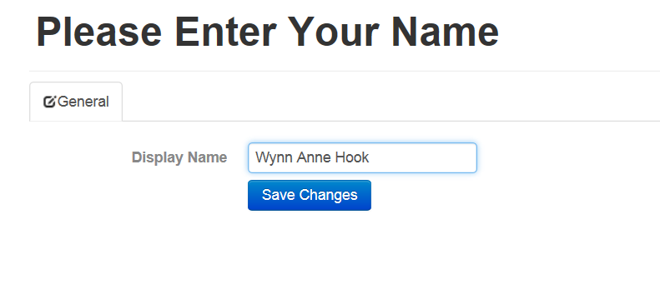
Type in the name of the person filling out the form and click on Save Changes

Slide 5
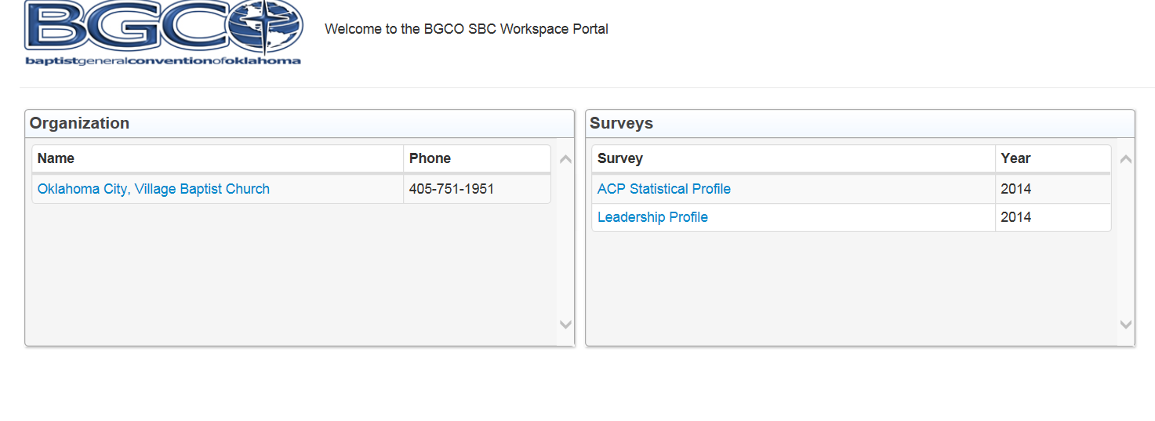
Both Surveys will show You will fill out 2 separate surveys
Click on Leadership Profile

Slide 6
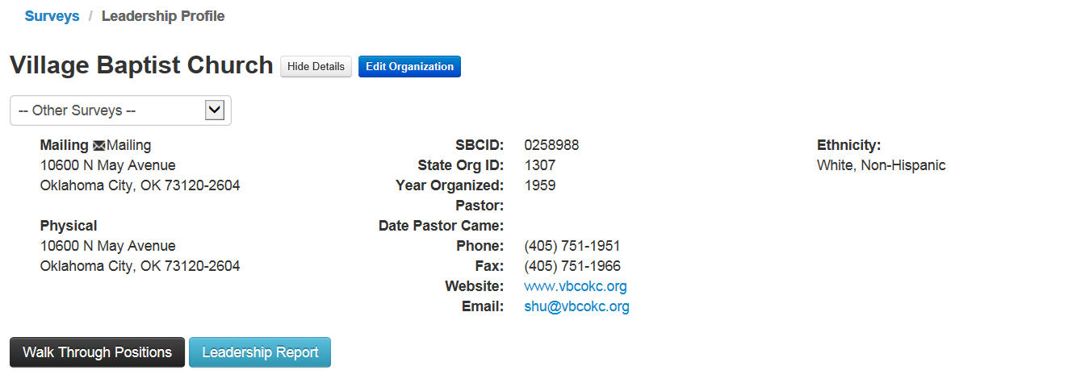
Scroll down from this screen to see current leadership

Slide 7
List of Leadership Positions (All positions do not have to be completed)
Senior Pastor
Minister of Missions
Mission Pastor
Associate Pastor
Minister of Education
Church Administrator
Minister of Music
Minister of Youth
Senior Adult Pastor
Minister of Young Adults
Pastoral Ministries
Minister of Children
Minister of Preschool
Graphic Designer
Media Director
Recreation/Sports Minister
Executive Pastor
Church Secretary/Ministry Assistants
Chairman of Deacons
Deacon
Church Treasurer
Sunday School Director
VBS Director
Church Clerk
Discipleship Training Director
WMU Director
Women’s Ministry Coordinator
CONTINUED ON NEXT PAGE

Slide 8
List of Leadership Positions (All positions do not have to be completed)
Men/Boys Msn Edu Dir (Bro Dir)
Men’s Ministry Coordinator/Contact
Adult Sunday School Contact
Senior Adult Contact
Family Ministry Contact
Single Adult Contact
Youth Sunday School Contact
Children’s Sunday School Contact
Preschool Sunday School Contact
Collegiate Ministry Contact
Stewardship Chairman
Evangelism Council Chairman
Prayer Ministry Coordinator
On Msn Team Ldr (Msn Dir/Chm)
Moral/Social Concerns Contact (e.g. Christian Life Comm.)
Church Library Team Leader
ACP Contact Person
Church Organist
Church Pianist
Ordained Ministers
Representatives on Assn Board
Messengers to Association
Pastor(s) Left During Year
Ministers Licensed During Year
Ministers Ordained During Year

Slide 9
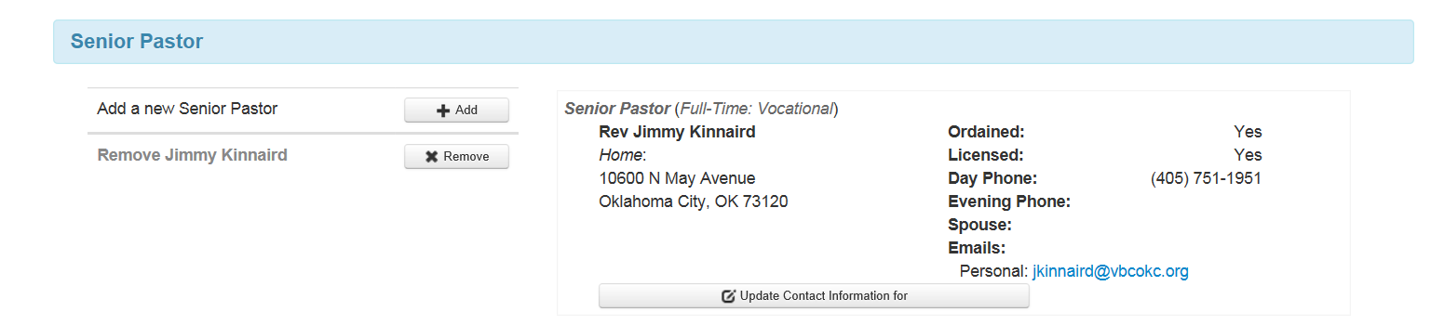
Each position has options to Add, Remove or Update information

Slide 10
Please do not attempt to go into the record for the person who is leaving and type the name of the new person over the leaving person. Remove the former staff person, then add the new staff person.

Slide 11
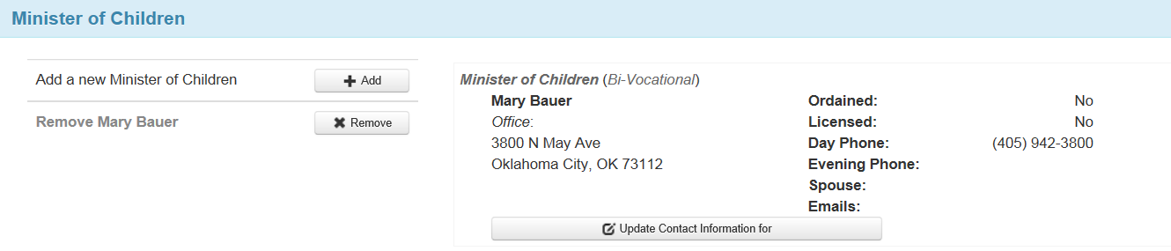
Click on the Remove button to take out a name from a position

Slide 12
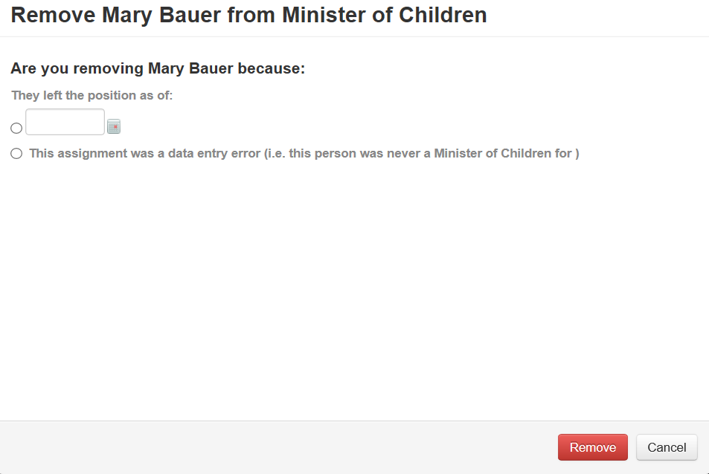
Choose one of the 2 options and click on Remove and the person will no longer be listed in that position

Slide 13
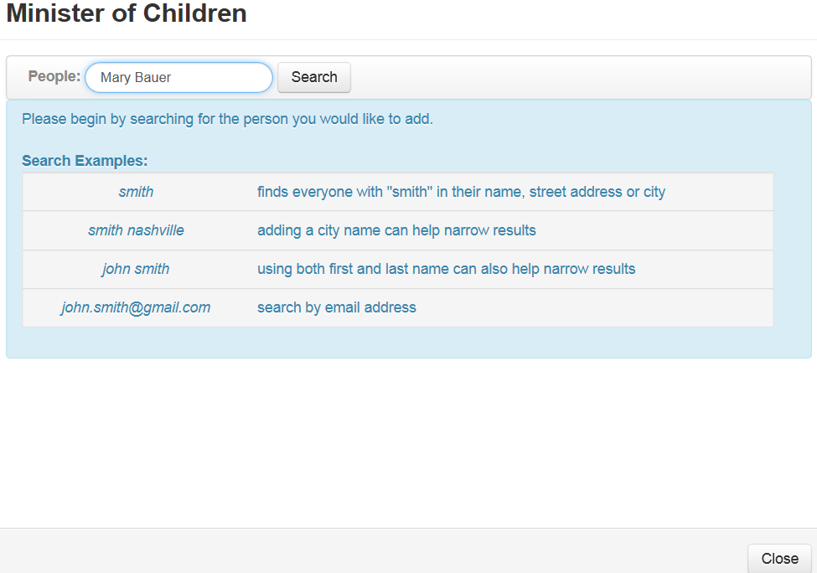
Clicking the Add button will show this screen for you to type in the name of the new person and click on Search

Slide 14
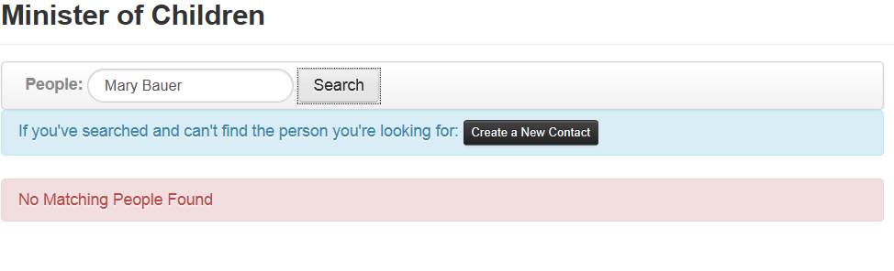
If that person is not in the system you will see this screen and can click on Create a New Contact

Slide 15
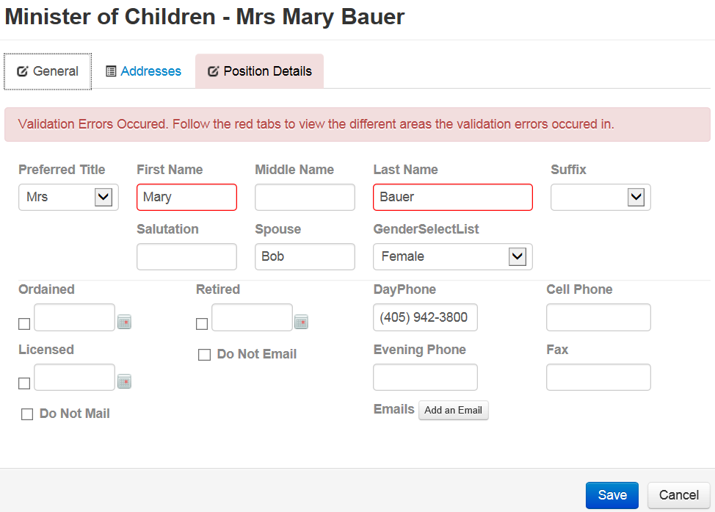
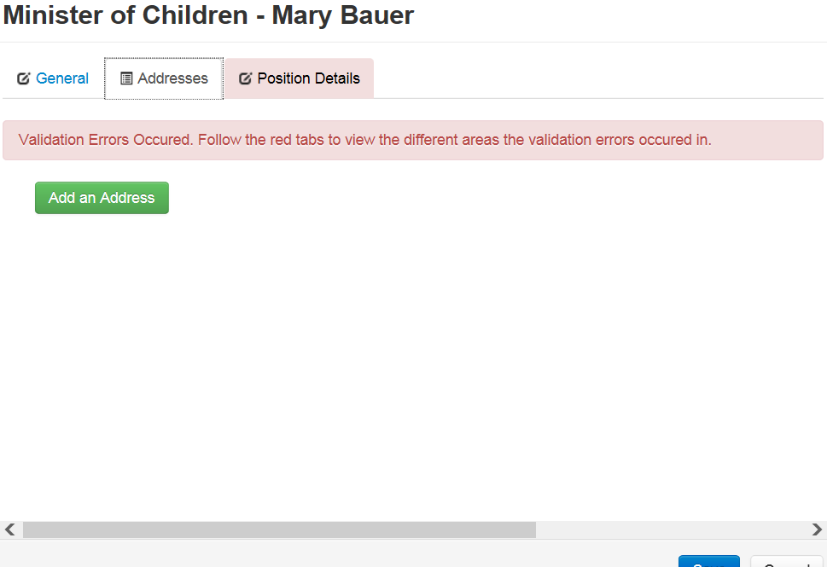
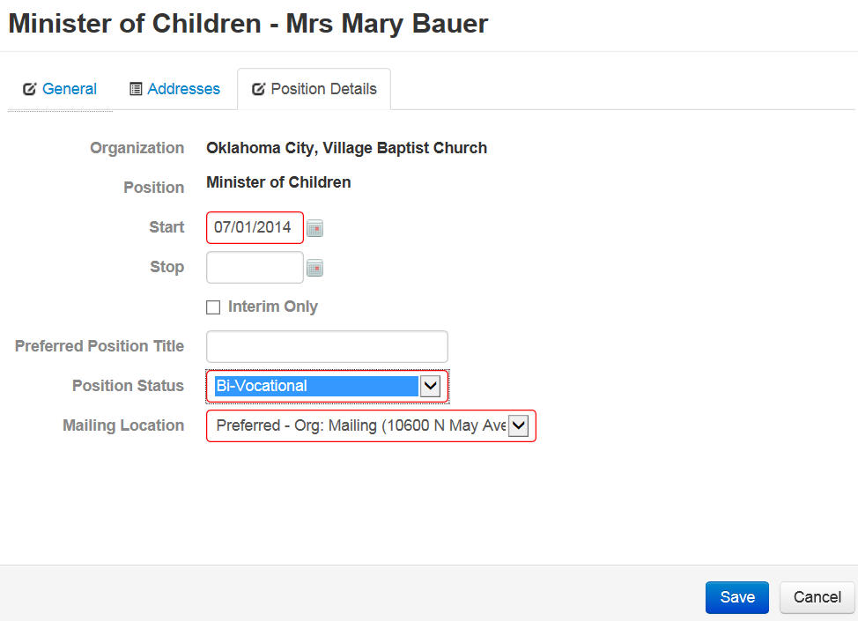
All red tab boxes are required fields and must have information to be able to save the entry.

Slide 16
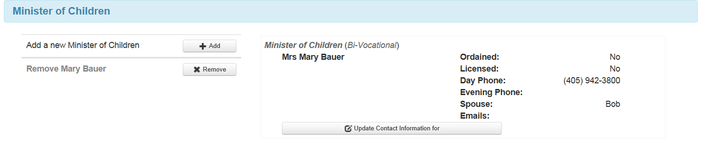
Clicking the Save button will add the new person to the position.

Slide 17
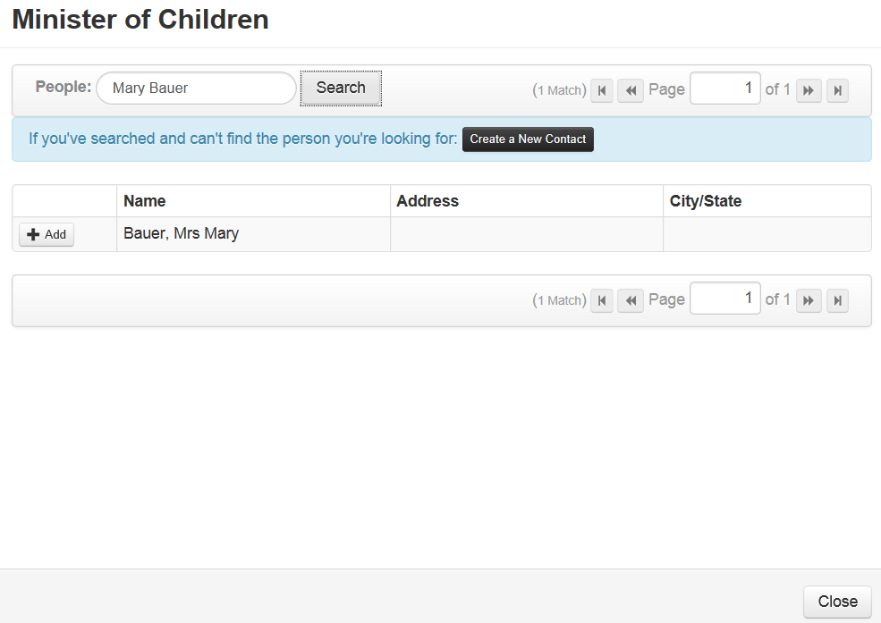
If the person is in the system you will see this screen and click the +Add button.

Slide 18
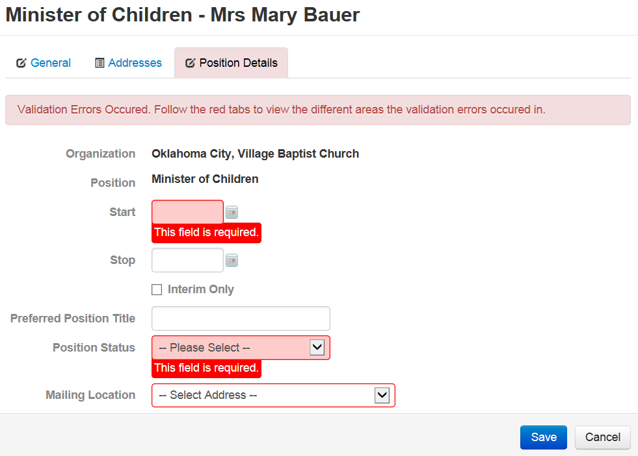
Select a start date and position status and click on Save

Slide 19
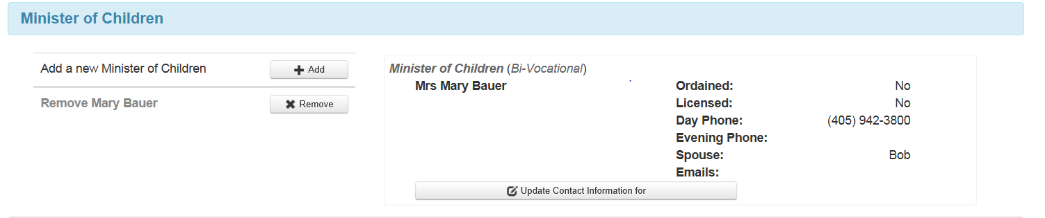
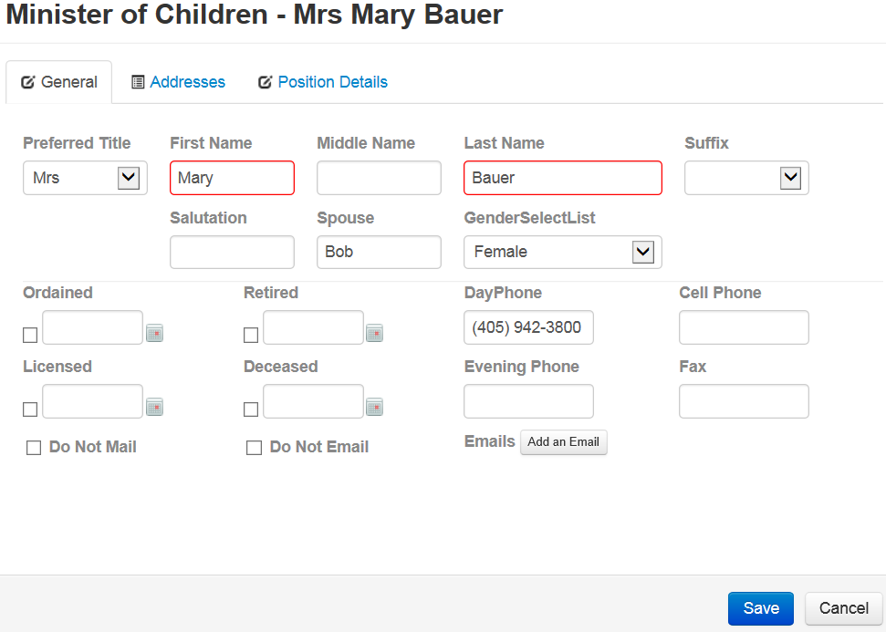
Clicking on the Update Contact Information for button will take you to the info sheet where corrections and changes can be made and saved

Slide 20
To complete the Leadership Survey:
Complete or Edit the entire survey
Or Complete or Edit only one or a few
Consider editing the survey throughout the year as personnel change
Be sure to click on “Save”button
Return any time to continue editing

Slide 21
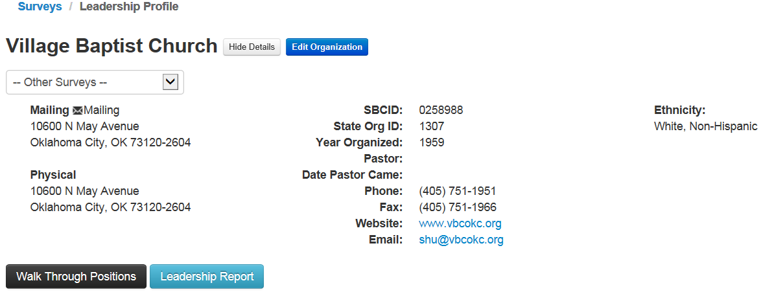
To get to the ACP survey click on Other Surveys at the top of the Leadership page and select 2015-ACP Statistical Profile
It will automatically take you to the ACP survey

Slide 22
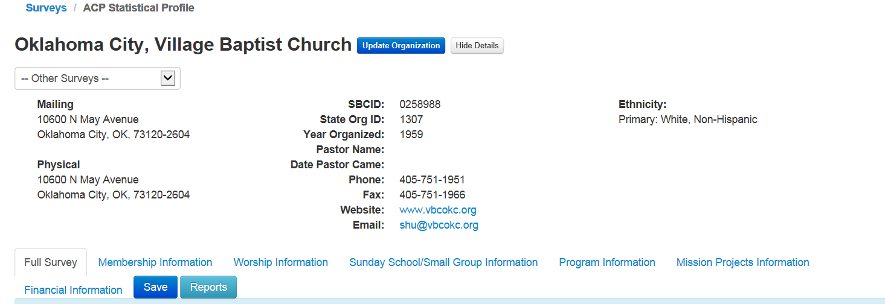
Scrolling down from this screen will show the ACP questions to be answered. They are in sections.

Slide 23
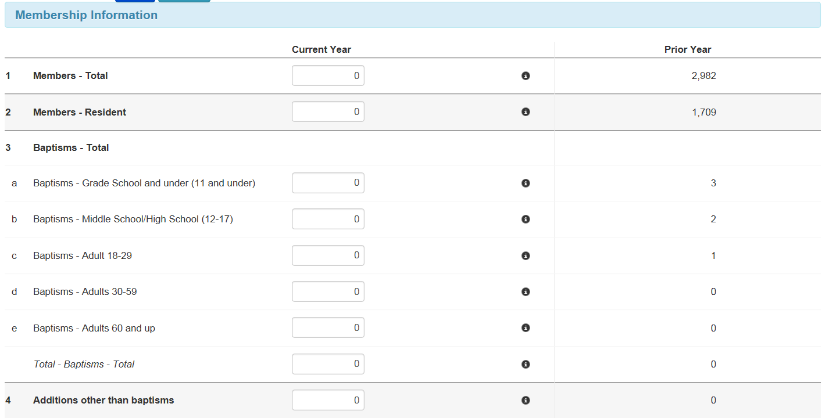
Fill in the boxes under current year. Previous survey numbers will appear in the right hand column. Clicking on the black dot in the center will show the definition.

Slide 24
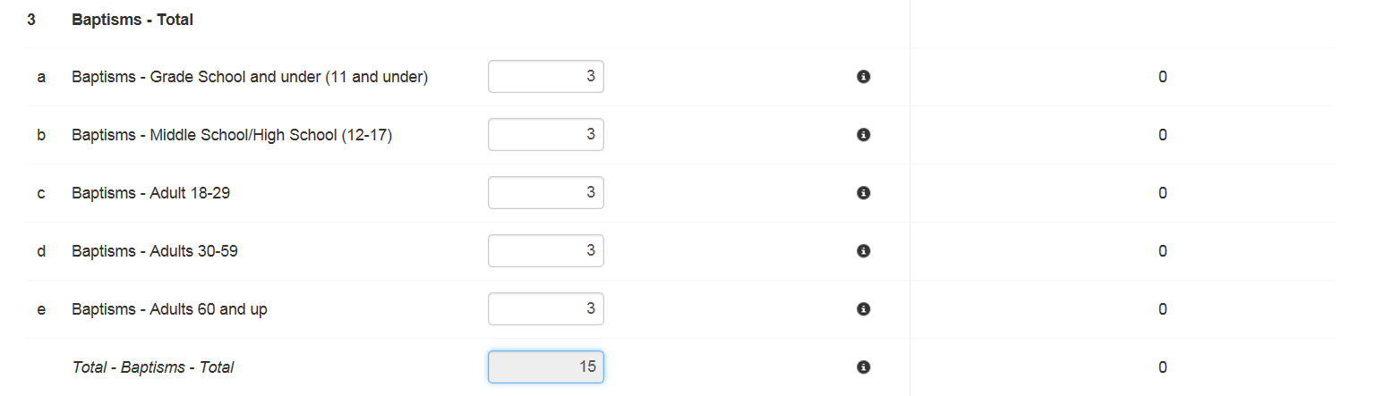
When entering data that requires a total – It will automatically total the subdivisions.

Slide 25
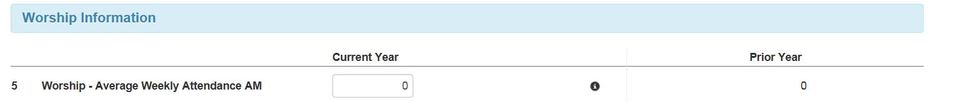
Worship Section

Slide 26
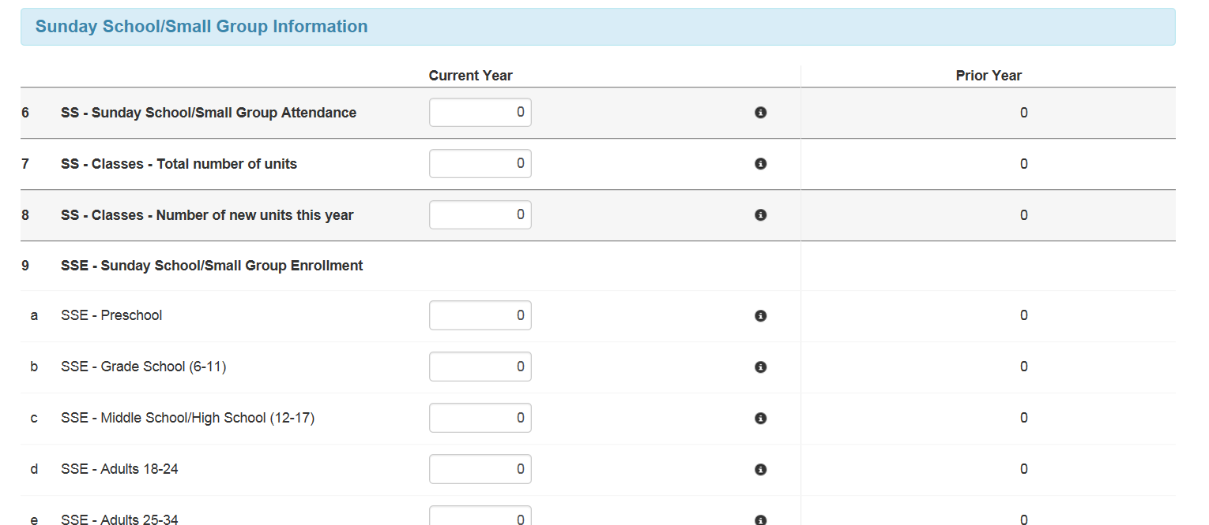
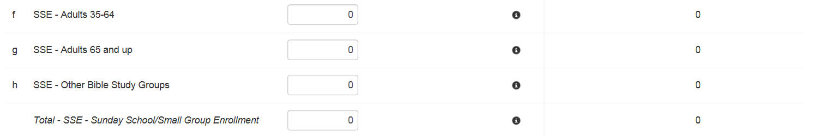
Sunday School/Small Group Information

Slide 27
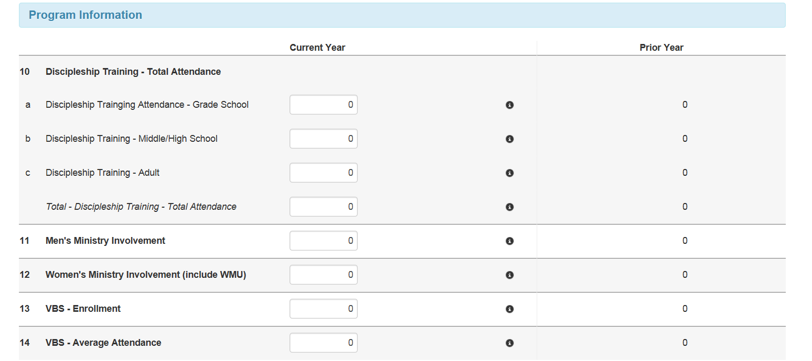
Program Information

Slide 28
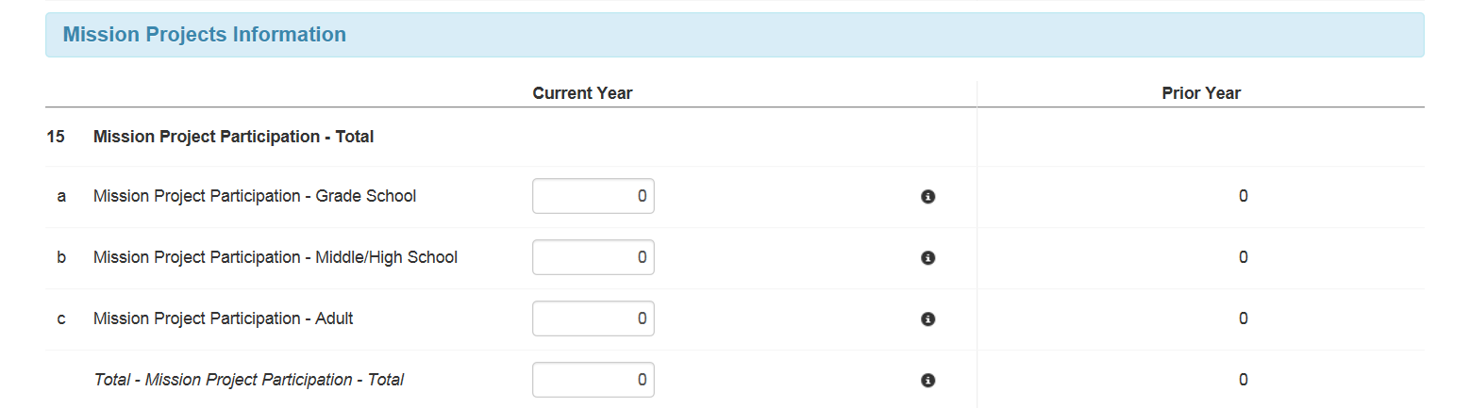
Mission Projects Information

Slide 29
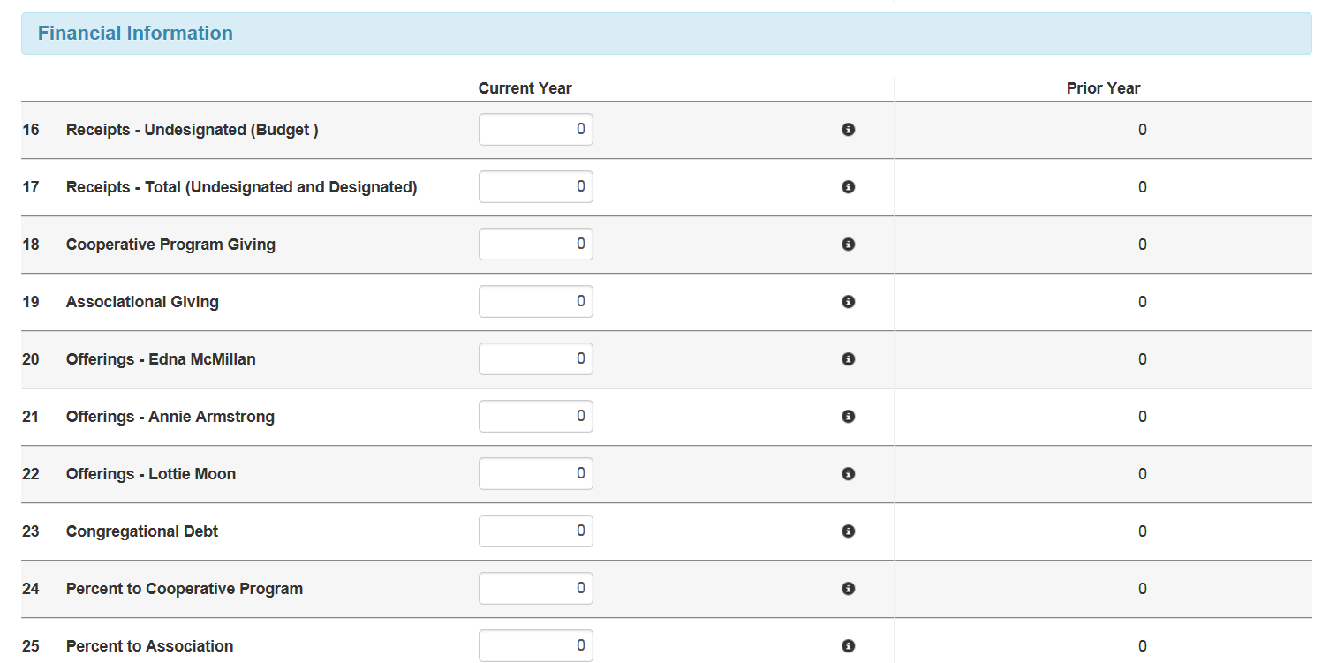
Financial Information

Slide 30
Once you have answered the 25 questions click on Save

Slide 31
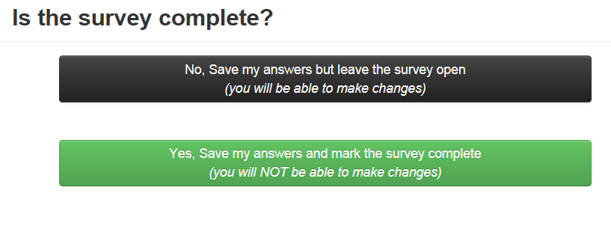
You have 2 options

Slide 32
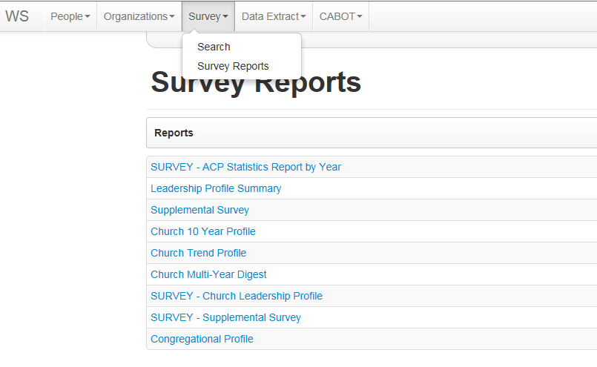
Reports available to you:

Slide 33
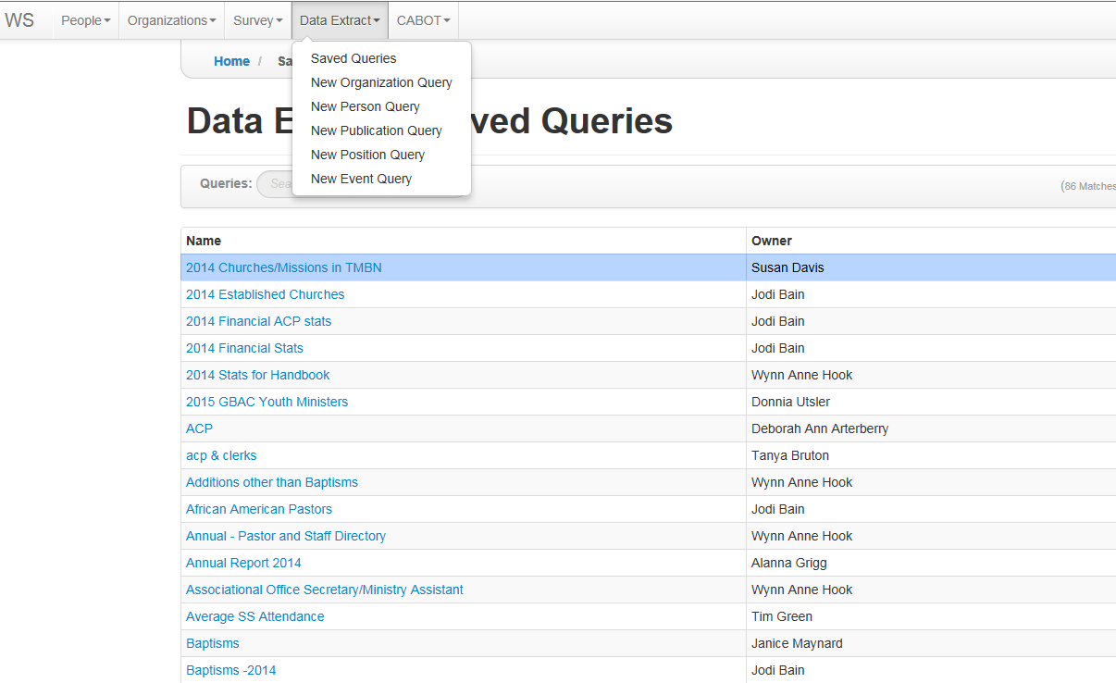
Personalize your report:
These are reports created by others using the system. Choosing their saved report will use your church’s data into the format they have set up. You can create a report that gets exactly what you need and save it for your future use as well as others. Your data will be not be available to anyone else—just your format.

Slide 34

ADDITIONAL INFORMATION NEEDED:
The Supplement Report this year includes only two items--Historical Events and Deceased Church Members
This report can be mailed or e-mailed to bmbaok@att.net or can be completed on our website www.bmbaok.org found in the Info Center under Annual Church Profile.
HISTORICAL EVENTS—We want to record in the Association Yearbook any major changes in your church this year. Examples are Pastoral changes, remodel projects or new building projects, mission trips, beginning new ministries. Give a brief explanation of each and the dates.
DECEASED MEMBERS—These are also listed in the yearbook and their lives are celebrated at the Annual Meeting in October. Please list their full name (including Mr., Mrs., Rev.) and tell us if they were an ordained pastor or deacon.
NEW THIS YEAR—Danny would like to show pictures of each member that has gone to be with the Lord as their name is called during the Annual Meeting. Please start looking for pictures and send them to us. We plan to continue this each year, so you might create a file to keep track of names and pictures throughout the year.

Slide 35

Don’t want to mess with online entry?
No Problem
Complete the Worksheet and send it to:
BMBA
PO Box 425
Sayre, OK 73662
I’ll be glad to complete the data entry

Slide 36
BMBA Contact Names & Numbers:
Danny Ringer, Director of Missions
Office 580-928-2585
Cell 580-253-9023
Arlene Epp, Ministry Assistant
Office 580-928-2585 FAX 580-928-8215
Cell 580-729-5266
(Feel free to call evenings or weekends if that’s when you are working on the ACP Report!)
Email– bmbaok@att.net Website– www.bmbaok.org

Slide 37
Thank you so much for your church’s participation in the Annual Church Profile for 2015. The information helps in the development of programs and materials to reach the world for Christ. If you have any questions, please contact your associational office or the ACP office of the BGCO at 405-942-3000 ext. 4641 or email wahook@bgco.org

