Slide 1
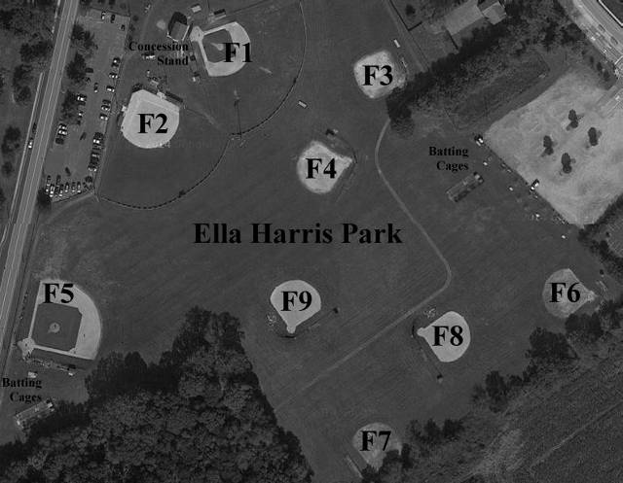
Clubhouse
Parking
Parking

