Slide 1

OUR APPROACH TO NAVIGATING COVID-19
BUILDING TOWARD A SAFE & TIMELY RETURN TO ON-FIELD ACTIVITY

Slide 2
Contents
Introduction
Provincial, Regional and National Updates
Baseball NL
Baseball Atlantic
Baseball Canada
Current Activity – Other Provinces
Provincial Season Scenarios
June Events Status
What Happens if July 1st Start?
What Happens if August 1st Start?
Recommendations for Associations
Pre-Season Planning
Heath & Safety Guidelines/Considerations
Practice, Gameplay and Rule Considerations
Frequently Asked Questions

Slide 3
Introduction
During this unprecedented time, our baseball season has entered a state of flux.
With the Provincial Government recently releasing their phased plan for a reopening of the province, as well as the information collected from other provinces, we feel now is appropriate for creating timelines and guidelines for our potential return-to-play.
This presentation will look to accomplish four objectives:
To update everyone with respect to provincial, regional and national baseball decisions that have been made to date;
To update everyone on the activity and status of remaining provinces nation-wide
Lay out some timelines with regard to what a potential season in the province could look like, and
Offer guidelines and suggestions for associations as they continue to navigate the COVID-19 situation in their own areas.
DISCLAIMER: Any or all of this information is subject to change based on the advice and guidance of public health officials and decisions of municipalities within the province. If, however, any decisions are made with the respect to cancelling Baseball NL activity, those decisions will be final at the time the decision is communicated.

Slide 4
Provincial, Regional and National Updates
Baseball NL, Baseball Atlantic and Baseball Canada

Slide 5
Updates To Date Baseball NL
Currently all in-person Baseball NL-sanctioned activity suspended until May 31st.
“Indefinite” suspension of activity effective March 13th
“Indefinite” updated on March 20th with an April 30th timeline
April 30th updated on April 24th with a May 31st timeline
In-person activity includes Provincial Team & High Performance Training, Canada Games Program Training, Coaching Clinics, Umpire Clinics and Meetings.
Online Coaching Clinics have started as of April 30th; online Umpire Clinic resources are nearing completion.

Slide 6
Updates To Date Baseball Atlantic
Currently, no decisions made on Baseball Atlantic Championships.
Decision to come at some point in June.
Baseball Atlantic also working on a High Performance replacement for the 15U, 16U Girls and 17U Provincial Teams.
Considerations/Concerns with both scenarios:
Out-of-province travel (especially NL teams).
Ability of provinces to get back to on-field activity no later than July 1st.
Ability of provinces to play as much baseball in their respective province as possible (given likely shortening of season in some areas).

Slide 7
Updates To Date Baseball Canada
In-person activity suspended until further notice, including to date:
Comp-Dev Coaching Clinic (April)
Junior National Team Training (April)
National Umpire Committee Meetings (April)
Safe Sport Workshop (April)
Executive Director Meetings (May)
2020 National Championships – Cancelled

Slide 8
Current Activity – Other Provinces
Updates from our Provincial Baseball Partners

Slide 9
Other Provinces
Baseball Nova Scotia
Baseball PEI
Currently all in-person activity suspended until June 1st
Currently working on a contingency plan release for membership.
Awaiting direction from government and health officials with respect to guidelines and protocols needed.
Currently all in-person activity suspended indefinitely.
Have been grouped into Phase 3 of PEI’s Provincial four-phase plan
Earliest return – June 12th
Awaiting direction from government and health officials with respect to guidelines and protocols needed.

Slide 10
Other Provinces
Baseball New Brunswick
Baseball Quebec
Currently all in-person activity suspended indefinitely.
Offering online coaching and umpire training.
Awaiting direction from government and health officials with respect to guidelines and protocols needed.
Currently all in-person activity is suspended indefinitely.
Have communicated to membership multiple scenarios for a shortened season (July 1st and August 1st starts)
Awaiting direction from government and health officials with respect to guidelines and protocols needed.

Slide 11
Other Provinces
Baseball Ontario
Baseball Manitoba
Currently all in-person activity suspended until May 31st
Continuing to plan and prepare for the coming season – no cancellations to this point.
Awaiting direction from government and health officials with respect to guidelines and protocols needed.
Currently all in-person activity suspended until May 30th
Provincial Summer Games & Baseball West Championships have been cancelled.
Provincial Championships currently have not been cancelled.

Slide 12
Other Provinces
Baseball Saskatchewan
Baseball Alberta
Currently all in-person activity suspended indefinitely.
Baseball West Championships have been cancelled.
No current plans to cancel season or Provincial Championships.
May reschedule for late August depending on when season starts
Currently all in-person activity suspended until June 1st
Baseball West Championships have been cancelled.
No current plans to cancel season or Provincial Championships.
Awaiting direction from government and health officials with respect to guidelines and protocols needed.

Slide 13
Other Provinces
Baseball BC
Currently all in-person activity suspended indefinitely.
Baseball West Championships have been cancelled.
Provincial Championships have been cancelled (held much earlier than other provinces).
No outright cancellation of the season to this point.

Slide 14
Provincial Season Scenarios
What could our potential season look like?

Slide 15
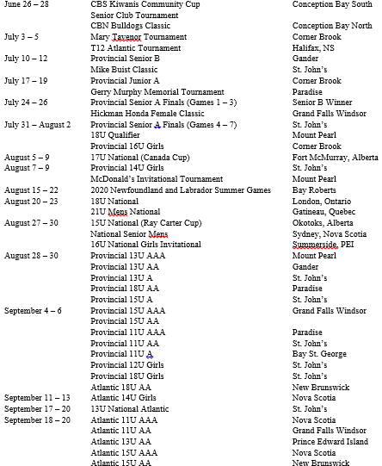
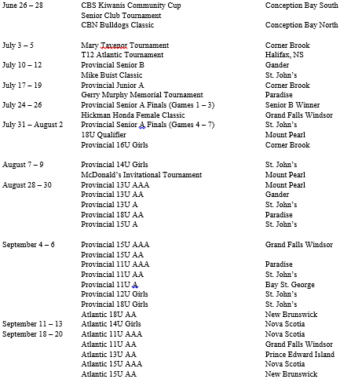
2020 Calendar of Events
As Approved at the AGM
Current
PLEASE SEE SLIDE 18 FOR MORE INFORMATION ON THESE THREE TOURNAMENTS
STILL SEEKING HOST FOR 15U AA
LABOUR DAY WEEKEND

Slide 16
2020 Calendar of Events
“Current” Calendar reflects the cancellation of the Baseball Canada National Championships
Currently, there are no considerations being given to rescheduling Provincial Championships due to the cancellation of Nationals (exception being 15U AA if host requests a change for hosting purposes)
Should not expect parents to reschedule their summer given current circumstances
Planning and preparation for parents (vacation time, holidays, etc.) was built around these dates before COVID-19 situation happened.
Other sports – basketball, volleyball, hockey, etc. – will be looking to get back to programming ASAP given the early shutdown of their seasons
Leaving Provincials as scheduled will allow local associations, if possible, the chance to play a “Fall Ball” season should they wish (as a way to offer more programming due to the excepted later start).
It is our hope to play as close to a full baseball season as we can this summer. With this in mind, however, we also recognize that safety is paramount. We will be acting on advice from health and government officials when making any decisions around our return-to-play.
It is also our hope to allow associations to play as much baseball at the local level as possible. Any cancellations to the Provincial calendar – Provincials and Invitational Tournaments – will be made for their own reasons and will not impact the ability of local associations to offer their own programming should it be deemed safe to do so.
Please see slide 18 for more information on the status of June events – CBS Kiwanis Community Cup, Senior Club Tournament and CBN Bulldog Classic

Slide 17
Provincial Phase Back Plans Assuming the provincial models continue current trends
EFFECTIVE MAY 11
EFFECTIVE JUNE 8
Low-risk outdoor recreational activities
https://www.gov.nl.ca/covid-19/alert-system/alert-level-4/
Medium-risk outdoor recreational activities (team field sports)
https://www.gov.nl.ca/covid-19/alert-system/alert-level-3/

Slide 18
June Events Status
After consultation with the event hosts, the following JUNE events are officially cancelled:
CBS Kiwanis Community Cup
Senior Club Tournament
CBN Bulldog Classic
Based on the current health guidelines and phase back plan as outlined by the Provincial Government, we are forecast to be able to resume activity on June 8th.
Though this is ahead of the July 1st date (mentioned on the following slide), the joint opinion of hosts and Baseball NL is that June 8th does not allow associations time to adequately start their season on top of planning and preparation for these events (especially for the hosts).
Additionally, this does not build into consideration that June 8th is a “perfect scenario” date and may be delayed depending on direction from public health officials and how trends continue as we move closer to the key dates of the phase back plan.
Lastly, there is still a possibility that the June 8th could still see some travel restrictions in place, making it challenging for traveling teams to participate in these tournaments.
BASEBALL NL WEBSITE WILL BE UPDATED TO REFLECT THESE CHANGES

Slide 19
July 1st Start What Does a Season Look Like?
Considerations for Return To Play (NOT LIMITED TO THE FOLLOWING):
Travel – will government allow travel out of region/community?
Timing – does it make sense to hold the tournaments mentioned below if the season is just beginning on July 1st?
Facilities & Hosts – will municipalities open up facilities with enough time to prepare them for games?
Safety guidelines
What will be the potential guidelines public health officials put in place for a return-to-play?
Will they affect baseball? If so – how?
Assuming the above considerations can be met to allow on-field activity to resume on July 1st:
Minor Provincial Championships (August) – WILL go ahead as scheduled
18U AA Qualifier (July 31st – August 2nd) – discussion among Minor associations that would enter tournament
Junior/Senior Provincial Championships (July) – discussion among Junior and Senior Centres that would enter respective tournaments
Invitational Tournaments (July/August) – discussion among the hosting association and Baseball NL

Slide 20
August 1st Start What Does a Season Look Like?
Considerations for Return To Play (NOT LIMITED TO THE FOLLOWING):
Travel – will government allow travel out of region/community?
Timing – does it make sense to hold the tournaments mentioned below if the season is just beginning on August 1st?
Facilities & Hosts – will municipalities open up facilities with enough time to prepare them for games?
Safety guidelines
What will be the potential guidelines public health officials put in place for a return-to-play?
Will they affect baseball? If so – how?
Assuming the above considerations can be met to allow on-field activity to resume on August 1st:
Minor Provincial Championships (August) – WILL BE CANCELLED
There will simply not be enough time for associations to plan and prepare for a Provincial Championship season with an August 1st start date
18U AA Qualifier (July 31st – August 2nd) – WILL BE CANCELLED
Junior/Senior Provincial Championships (July) – WILL BE CANCELLED
Invitational Tournaments (July/August) – WILL BE CANCELLED
In the event of the cancellation of Provincial Championships, Baseball NL will work with local associations in whatever capacity needed to ensure they are able to offer programming at the local/grassroots level for as much of the 2020 season as possible

Slide 21
Recommendations for Associations
Pre-Season Planning
Health & Safety Guidelines/Considerations
Practice, Gameplay and Rule Considerations

Slide 22
Recommendations for Associations Pre-Season Planning
Continue to plan and prepare as much as possible!
No one knows what the season will look like or when it will begin. Doing as much as possible now will limit the work needed once things resume.
Look at alternate ways to conduct registration instead of the traditional “in-person” methods
Online registration (Google Docs, via association website, etc.)
Online payment options (etransfer, payment via association website, etc.) to minimize contact with money
Hold registration now to collect player information; collect fees and payments at a later date (using safe practices)

Slide 23
Recommendations for Associations Health & Safety Guidelines/Considerations
Anyone displaying any symptoms of any illness WILL NOT be permitted to participate
No sharing of water bottles or food of any kind
No spitting
No chewing gum
No sunflower seeds
No sharing of equipment of any kind
Ride sharing/carpooling only if deemed appropriate by health officials
Uniforms be washed as soon as possible upon the completion of a days events
All participants recommended to shower as soon as possible upon completion of a days events

Slide 24
Recommendations for Associations Practices, Gameplay and Rules Considerations
Depending on the potential guidelines public health officials request us to maintain in a return-to-play, there could be a need for an alteration to the “normal” way we play baseball. We are working with Sport NL to get a clearer understanding of what these potential guidelines could be. At this time, we are not stipulating or mandating the following. They are, however, things that may need to be considered depending on the guidance we receive from public health officials:
Practices
No team huddles, one team practicing at a time, no dugout use
Gameplay
No plate meetings, mound visits, arguments with umpires, no dugout use
Rules
Umpire behind home plate, force play at all bases, no stealing, no rundowns
Again – at this time these are nothing more than suggestions/considerations of things that MAY have to be looked at closer once we get a clearer understanding of the specific public health measures expected of us by public health officials

Slide 25
Frequently Asked Questions

Slide 26
Frequently Asked Questions
Has Baseball NL cancelled the 2020 baseball season?
No. The 2020 season has not been cancelled in any way. It is our goal to play as much baseball this summer once it is deemed safe by public health and government officials to resume activity.
What will a potential baseball season in our province look like?
This will depend on when we are permitted to get back on fields, and how much time we have to run programming. Please refer to slides 14 – 20 for more information.
What is my local association doing for registration, all-star tryouts, etc.?
As all local associations operate under different timelines, please check with your local association for more information.
What can coaches do with no in-person activity? Umpires?
Online Coach Training has begun via Adobe Connect. Please head to www.baseballnl.com for a complete schedule of remaining courses.
Online Umpire Training is in the final stages of completion and will be communicated to local associations ASAP.
Does Baseball NL have a firm “drop dead” date with respect to the complete cancellation of the 2020 season?
No. With the most recent guidance as outlined in the Provincial Phase Back plan, we are confident we will be able to play some form of baseball in 2020. Certain considerations – as outlined in the previous slides – will have to be made, but it is our goal to play as much baseball as possible in 2020. With that in mind, we will be delaying a decision on complete cancellation of the 2020 season as long as possible.

