Slide 1
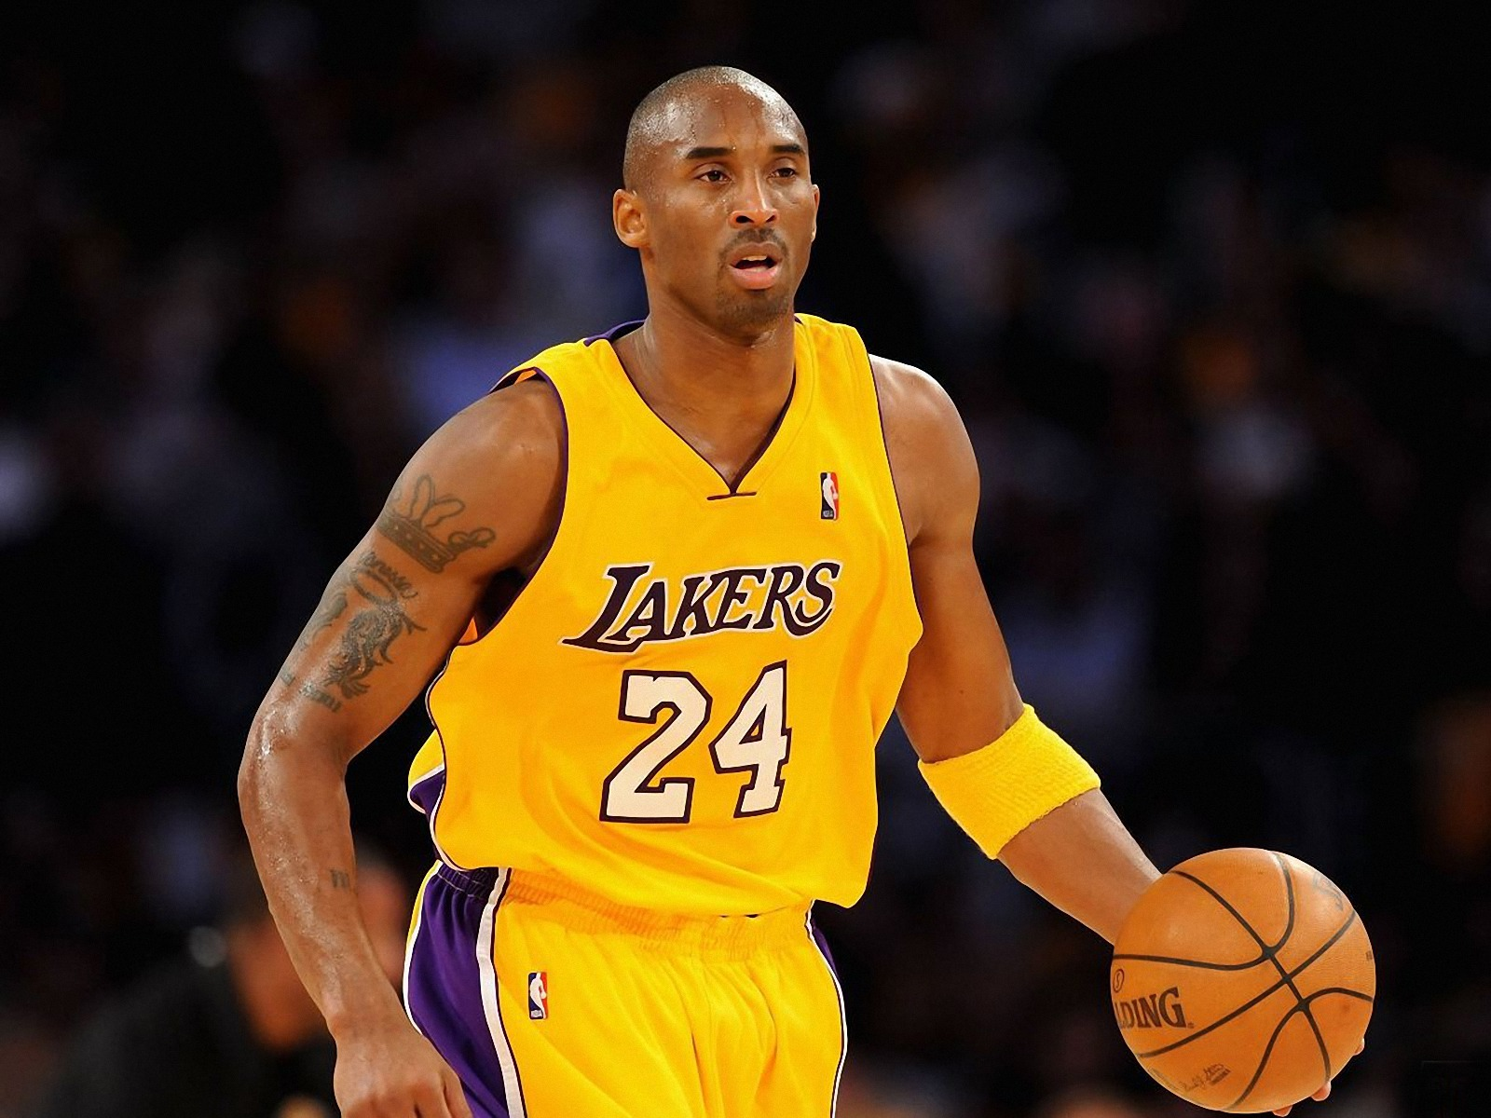
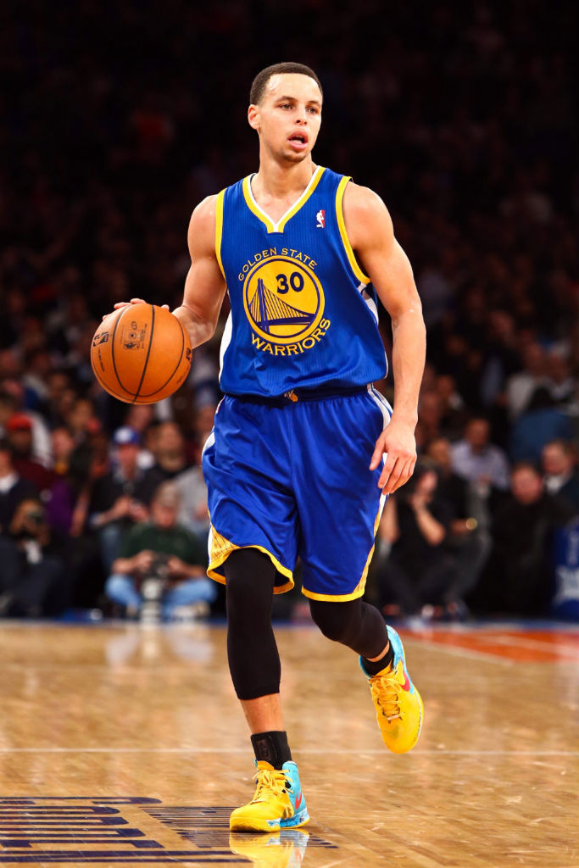
Are You Serious About Taking Your Game To The Next Level?
If so, be sure to join us for:
SKILLS TRAINING
SHOOTING TRAINING
VERTIMAX TRAINING
Are You Serious About Taking Your Game To The Next Level?
If so, be sure to join us for:
SKILLS TRAINING
SHOOTING TRAINING
VERTIMAX TRAINING
 | PREMIER PLAYER |  |  | NON-PREMIER PLAYER
Package | One-Session Purchase | 4-Session Purchase |  | One-Session Purchase | 4-Session Purchase
Skills Training | $25 | $95 |  | $30 | $115
Shooting Ball Training | $25 | $95 |  | $30 | $135
Combined Training (Skills or Vertimax training & Shooting Ball) | $45 | $175 |  | $55 | $215
Vertimax Training (30 Minutes per Session) | $25 | $95 |  | $30 | $115
 | PREMIER PLAYER |  |  | NON-PREMIER PLAYER
Package | One-Session Purchase | 4-Session Purchase |  | One-Session Purchase | 4-Session Purchase
Skills Training | $25 | $95 |  | $30 | $115
Shooting Ball Training | $25 | $95 |  | $30 | $135
Combined Training (Skills or Vertimax training & Shooting Ball) | $45 | $175 |  | $55 | $215
Vertimax Training (30 Minutes per Session) | $25 | $95 |  | $30 | $115
Register at www.agsportsandtraining.com or call
Coach Gee @ (317) 498-4400
Training conducted by the staff of AG Sports & Training
Register at www.agsportsandtraining.com or call
Coach Gee @ (317) 498-4400
Training conducted by the staff of AG Sports & Training

