Slide 1
Uni HS Girls Soccer:
Parent Night
Nov 13, 2017
WELCOME!!

Slide 2
Agenda
Introduction
Program Description
Misc. Items/Logistics
Q/A
Coach Introduction
Spirit Wear

Slide 3
Introduction
The University High School Girls Soccer program fields 3 teams: V, JV, FS
We will have ~70 players in the program this year
The program is largely parent supported through donations which make up ~90% of the funding
There would be no Uni HS Girls Soccer without parent donations and the work of the Girls Soccer Boosters Club!!!

Slide 4
Introduction (cont’d)
Uni HS Girls Soccer Boosters Club
The University High School Girls Soccer Booster Club is an all-volunteer non-profit organization which helps support the teams by coordinating the support provided by parents to guarantee a high-quality soccer program.
The University High School Girls Soccer Booster Club is incorporated and structured as a non-profit 501(c)3 organization. This means that the Booster Club contributions are, most likely, tax deductible (consult a tax professional for your particular circumstance). Your copy of the registration form serves as your receipt.
Collection of donations and distribution of funds is organized by the Uni HS Girls Soccer Boosters Club
We need the help of parent volunteers, as well as financial donations to help support the needs of the teams.

Slide 5
Introduction (cont’d)
The Girls Soccer Booster Club 2017/2018

Slide 6
Introduction (cont’d)
This year, the Boosters are requesting donations of $350 from each player. (Examples from other schools CDM=$750; JSerra=$3000)
The best soccer deal in town: $350 for a 20-game season!
Please fill out the Registration Form (File: "UHS Girls Soccer Player registration 2017.docx") completely and please use one of the two options below:
    Use a check for your donation payable to “University High School Girls Soccer Boosters”
OR
    Use a credit card and we will accept onsite credit card payments

Slide 7
Introduction (cont’d)
Your donation helps to fund expenses for the soccer season in several areas:
    trainers
    assistant coaches
    uniforms
    practice apparel
    team supplies
    end of season banquet underwriting
    new equipment: balls, nets, cones, pinnies and tents
    ..and other items

Slide 8
Program Description
The UNI High School Girls Soccer Program has qualified for CIF the last 2 seasons
In the 2016/2017 season Uni HS Girls Varsity made it to the 3rd round of CIF. This was the best result of the Varsity program in 20+ years!
The coaching staff/Booster club goal is to build on the successes of the last two seasons
The season runs from Nov 15, 2017 to Feb 8, 2018. Qualification for CIF may extend the season
Schedules are posted on Uni HS Soccer website: http://www.leaguelineup.com/welcome.asp?url=unihighsoccer&sid=784804798
NO PRE-SEASON TOURNAMENTS!!!
League games follow a Tue/Thu schedule usually
At the end of the season there is Girls Soccer Banquet jointly for all 3 teams (Usually at a location at Mariners Church)
The Banquet includes a video montage of photos for each team so please take pictures during the season…good ones!

Slide 9
Sprit Wear
Spirit Wear can be ordered online.
We have some samples on display
We sell the spirit wear at cost. Spirit wear is not a current source of funding for the program
Placing your orders by Sunday November 19th will allow for the fastest turnaround time plus FREE DELIVERY to Uni High

Slide 10
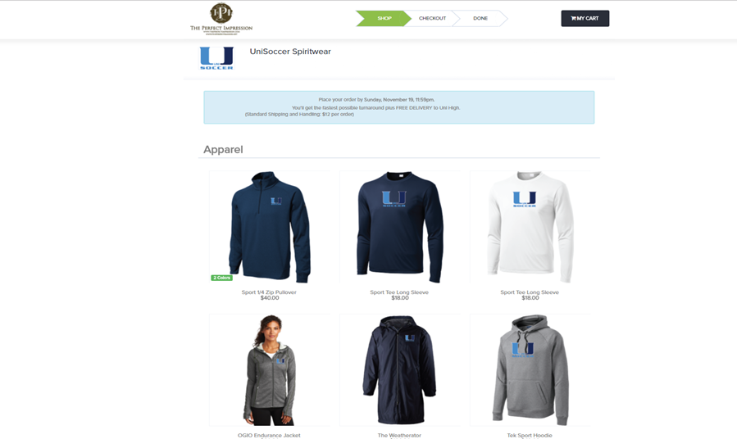
Sprit Wear
Web site: https://unisoccer.itemorder.co m/sale

Slide 11
Misc. Items & Logistics
Each of the teams are managed by a volunteer team parent team manager
URGENT: We need team managers to volunteer for the JV and FS teams
Most communication to parents will be coming from the team manager
Please volunteer to support the work of the designated team manager and any open positions within the Booster club
Fundraising outside of parent donations: on an as needed basis

Slide 12
Misc. Items & Logistics
TEAM DINNERS!!!! - ~10 on Wed 6:30PM-8:30PM at a hosting family or families house. Team dinners are one of the highlights of the program for the girls
Secret Sisters – Gift exchange throughout the season
Night games (parent participation) – Please make every effort to attend night games and afternoon games. The season and their time in high school and the soccer program flies by.
Bus waiver – Can be signed a the beginning of the season if a parent needs to pick up their player instead of team bus ride
Trainer fees - Covered

Slide 13
Coach Introduction
      Varsity:
          Ignacio (Nacho) Cid
          Terryn Soelberg
          Emily Elkendier
      Junior Varsity:
          Jade Gabriel
      Freshman/Sophomore:
      Alexa Winder

Slide 14
Coach Introduction: Ignacio (Nacho) Cid

Slide 15
Coach Introduction: Emily Elkendier
        Emily Elkendier (Coach E) grew up in Appleton, Wisconsin where her family still resides. Even early in life, Coach E was passionate about soccer she played 8 years of Club soccer, competing from U10-u17. Her love of soccer continued in high school where she played 3 years on her high school team. In her Junior year, Emily was selected for her varsity team and earned her letter. Unfortunately, her soccer career was cut short, when she was sidelined her during her senior year due to health issues. Her love of soccer never faded, however, and that has led to her coaching career.
        At the age of 21, Emily moved to Southern California to pursue a career as an interpreter for the Deaf. This led her to University High School in 2002, and her work as a paraprofessional interpreter in the regional Deaf and Hard of Hearing Program. While working at Uni, Emily's passion for soccer was rekindled and she joined the coaching staff.
        Emily has been a part of the coaching staff at UNI High since 2007. She started out coaching the JV team, and quickly became an integral part of the varsity coaching staff. Coach E is currently the assistant coach for the girls’ varsity team, but her responsibilities do not end there. She works hard to support all the soccer teams at UNI as well as the coaches. She loves watching the girls she works with grow as athletes, and looks forward to a great season!

Slide 16
Coach Introduction: Terryn Soelberg
        Playing History
        Terryn Soelberg grew up playing soccer in Bakersfield, CA. She played four years of varsity soccer for Highland High and won two CIF titles there. Terryn went on to play 2 years at Bakersfield College where she was captain both her freshman and sophomore year. She led not only her team but the conference in goals and was ranked in the top twenty for points in the state of California. She helped lead her team to State playoffs both years and scored the winning goal in the Junior College Showcase Tournament Terryn was named all conference first team for two years, and was voted best attacker her freshman year and MVP her sophomore year. Terryn went on to finish her college career at BYU-Hawaii where she again was the team’s top scorer. She was PAC west player of the week, named all conference second team and helped her team make it to regionals.
        Coaching History
        Terryn Soelberg began her coaching career in Hawaii were she coached the Kahuku High girls varsity team. She then moved back to Bakersfield and was the assistant coach at her alma mater, Bakersfield College. She coached club for South Valley Thunder and South’s High girls varsity team. She has also spent the last four summers coaching soccer camps at Berkshire Soccer Academy. Terryn just completed her third season at Santa Ana College as assistant women’s soccer coach. She currently coaches club soccer for the Pateadores Soccer club and is looking forward to this season with University High.
        Personal
        Terryn Soelberg grew up in Bakersfield California were her family still resides. She has an older sister and an identical twin sister. She is a proud aunt to Olivia, Cole and Carter. Terryn moved to Huntington Beach to attend grad school and graduated with her master’s in Kinesiology from California State Long Beach. She is currently a professor at Santa Ana College where she teaches the activity classes. Terryn still loves to play soccer and plays indoor whenever her schedule allows it. She also enjoys surfing when the waves aren’t too big.

Slide 17
Coach Introduction: Jade Grabiel
        Playing History
        Jade Grabiel grew up playing in Mission Viejo. Jade played club soccer from the ages 7-18 years old at United FC and at Irvine Strikers. Jade played at the highest level, gold, during her club years. She went to many different tournaments and won most of them. During her club years she attended state cup and nationals. She won one state cup title and got to the finals of nationals three times in a row. From the years 2012-2016, Jade attended Tesoro High School and was the on girl’s JV soccer team. Her successful years in club soccer got her a scholarship to Vanguard University in Costa Mesa. As a player at Vanguard we won GSAC conference in 2017 and GSAC tournament in 2016 and 2017. She didn’t play her first two years at Vanguard due to knee injuries. This past year she tore her Acl, Mcl and medial meniscus while playing in a game.
        Coaching Career
        Jade has been a coach for two years. She started off at Marina High School girl’s JV coach and is now at University High School. As she was at Marina High School her team went 9-3 as a record for season. She also does private trainings with some of the girls from her old team. She wants to continue to coach at University High School, as well as join a club team to start coaching youth girls’ soccer teams.
        Personal
        Jade Grabiel is the daughter of Keith and Noemi Grabiel. She was born on March 16th 1998, in Laguna Hills. She has one sibling named Kyle. Her parents would come out to all of her soccer games to support. She is planning on getting her Bachelor’s degree in Kinesiology from Vanguard University. Then she plans on getting her Masters in Athletic Training at Cal State Fullerton. During the summer Jade spends most of her time volunteering at the Pageant of the Masters in Laguna Beach. She has been in the show for 14 years now. It is a family thing to do in the summer, as both her mother and father are in the show as well. She likes to go on hikes, go to the beach, spend time with her dog Zeus and play soccer on her free time with teammates. Jade plans on staying at University High School for many seasons.

Slide 18
Coach Introduction: Alexa Winder
        Alexa Winder was born on April 21, 1994 in San Francisco California. She has two younger siblings Sierra and Sam. When Alexa was six, her and her family moved to Irvine.
        Alexa attended University High School from 2009-2013. She played club soccer from the age of 7-18 for two clubs Pateadores and Newport Beach Slammers ECNL. Alexa played her freshman year of college at Saddleback Community College. Where she earned First Team All-Conference selections and Female Athlete of the Year. After completing her first college season she had a career ending knee surgery.
        Alexa got her Bachelor's Degree in nursing from Cal State Long Beach. This will be her 5th season coaching for the girls soccer program at University High School.

Slide 19



