Slide 1
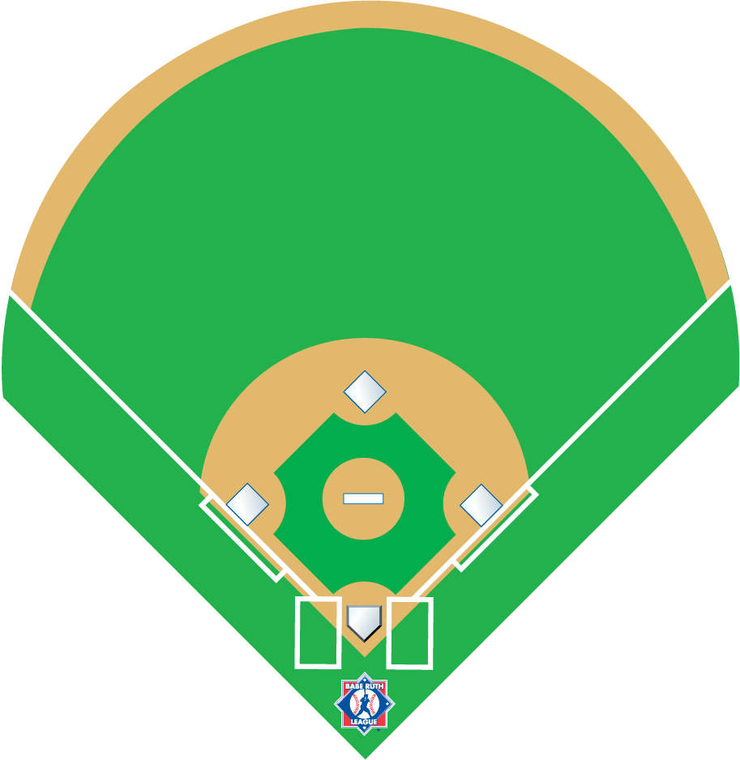
^{3 Man Mechanics}
^{Mechanics Manual}
^{3 umpires}
Notes:
3 Man Mechanics
Based on the AHSAA
Mechanics Manual
3 umpires

Slide 2
Equipment Inspection
Only in a 3 man crew, the plate umpire and the base umpire nearest to the dugout will inspect the equipment in that dugout. The remaining umpire will take a position 45 feet from home plate on the foul line opposite that dugout while observing all dugout activity. Then the same procedure will be applied to the other dugout activity. Then the same procedure will be applied to the other dugout utilizing the other base umpire.
U3
U1
U2

Slide 3
5 minutes prior to the start of the start of the game
U1 conducts pre-game conference
Both teams shall remain in their dugouts/bench or bullpen area until pre-game conference has concluded
Discussion:
Verify Line-Up Cards (Home team 1st)
Check if using designated hitter
Ask if using speed-up rules
Verify players are legally equipped
Discuss ground rules-home team coach should inform unless playing on a neutral site, then U1 will explain the ground rules.
Make sure coach’s ground rules do not violate any book rules.
U3
U2
Pre Game Conference
C
C
U1
Notes:
5 minutes prior to the start of the start of the game
U1 conducts pre-game conference
Both teams shall remain in their dugouts/bench or bullpen area until pre-game conference has concluded
Discussion:
Verify Line-Up Cards (Home team 1st)
Check if using designated hitter
Ask if using speed-up rules
Verify players are legally equipped
Discuss ground rules-home team coach should inform unless playing on a neutral site, then U1 will explain the ground rules.
Make sure coach’s ground rules do not violate any book rules.

Slide 4

8
U2 and U3
Position yourself between the bases about 10-15 feet in the outfield grass. Relax.
9
7
6
4
5
U2
3
1
Offensive Team
U3
U1
Walk down the foul line towards the defensive team and encourage to hustle on if needed. Move back closer to the coaches area and be able to supply another ball if needed
Defensive Team
2
Between Innings
U1
Notes:
3 Man Mechanics
Based on the AHSAA
Mechanics Manual
3 umpires

Slide 5
U2 and U3
Position yourself about 10-15 feet in the outfield grass on the side that you will return to.
8
7
9
6
2
4
5
U3
3
1
3
1
U2
C
U1
Should go to the 45 foot line of the offensive team.
Defensive Conference or Pitching Change
B
2
U1
Notes:
3 umpires

Slide 6
No Runners on base
Ground balls
Fly balls to the outfield

Slide 7
Signals:
U1: Number of Outs
U2&U3 ready
8
7
9
6
4
5
3
U2
U3
1
Whomever the fielder is facing at the time of the play will be responsible for the catch/no catch decision. If the fielder is not facing either umpire at the time of the play, the responsibility of the call will be with the nearest umpire.
OUT!
B
No runners on base.
Foul ball left side
2
U1
Notes:
Signals

Slide 8
Signals:
U1 number of outs
U2 and U3 ready
8
7
9
5
4
6
3
U2
U3
1
No runners on base.
Ground ball to the infield.
Left side
B
2
U1
Notes:
Signals

Slide 9
Signals:
U1 number of outs
U2 and U3 ready
8
7
9
5
4
6
3
U2
U3
1
B
2
Bunt to the catcher
U1
Notes:
Signals

Slide 10
Signals:
U1 number of outs
U2 and U3 ready
8
7
9
6
4
U3
5
3
U2
1
No runners on base.
Ground ball to the infield.
Right side
B
2
U1
Notes:
Signals

Slide 11
Signals:
U1 number of outs
U2 and U3 ready
8
7
9
4
6
U3
5
3
U2
1
No Runners On
Ground Ball Double
B
2
U1
Notes:
Signals

Slide 12
8
U2 Fly ball area.
Center field straight in,
back and all the way to the 1st base foul line.
U3 fly ball area. If the center fielder moves left all the way to the 3rd base foul line.
7
9
6
4
5
3
1
U2
U3
B
Fly ball coverage
2
U1
Notes:
3 Man Mechanics
Based on the AHSAA
Mechanics Manual
3 umpires

Slide 13
Signals:
U1 number of outs
U2 and U3 ready
8
7
9
U3’s fly ball area
6
4
5
3
U3
1
U2
B
No runners on
Fly Ball Triple
Left Side
2
U1

Slide 14
Signals:
U1 number of outs
U2 and U3 ready
8
9
7
U2’s fly ball area
6
4
5
3
1
U2
U3
No runners on
fly ball triple
Right side
B
2
U1

Slide 15
Runner on first base
Groundballs and fly balls to the outfield

Slide 16
8
Runner on 1st base
U3 is inside in a direct line between home and the edge of the mound
7
9
6
4
U3
5
1
1
3
U2
2
U1
Notes:
Signals

Slide 17
Signals
8
U1: Number of Outs
Everyone: Rotates
7
9
6
4
U3
5
1
U2
3
1
Ground ball to infield left side, double play
B
2
U1

Slide 18
8
U3 has LF to his left
CF to his right
U2 Has Center Field In, back & all the way to the 1st base foul line
7
U1 has LF
To 3B Line
9
6
4
U3
5
3
1
U2
1
B
2
Fly ball coverage with runner on 1st
U1

Slide 19
Signals
U1: number of outs
Everyone: rotates
8
7
9
U1’s Catch
6
4
5
U3
1
U2’s tag
U2
1
3
Fly ball left field caught
B
2
U1

Slide 20
Signals
U1: number of outs
Everyone: rotates
8
7
9
U1’s Catch
6
4
5
U3
1
U2’s tag
U2
1
3
Fly ball left field
not caught
B
2
U1

Slide 21
Signals
U1: number of outs
Everyone: rotates
8
U2’s Catch Area
9
7
6
4
U3
5
1
U2
1
U3’s tag
3
Fly ball right field not caught
B
2
U1

Slide 22
Signals
U1: number of outs
Everyone: rotates
8
New from 2007
When the ball is hit on the border line of the coverage area, the field umpire may use either a verbal or visual signal to communicate to the plate umpire that the base umpire has the responsibility of the catch. If the plate umpire is certain that the ball is in his coverage area he should use a verbal signal to communicate to the base umpire that he will take the responsibility for the catch / no catch.
This is used anytime the base umpire is in C or F or the other base umpire is in B or E and the ball his hit on the border line of his coverage area and the plate umpires coverage area.
7
9
6
4
U3
5
1
1
U2
3
Fly ball left center field caught
B
2
U1

Slide 23
Signals
U1: number of outs
Everyone: rotates
8
7
U3’s Catch Area
9
6
4
U3
5
U2’s
Tag
1
3
1
U2
B
Fly ball left center field
caught
U1
2

Slide 24
Signals
U1: number of outs
Everyone: rotates
8
7
U3’s Catch Area
9
6
4
U3
5
3
U2’s
Tag
U2
1
1
Fly ball left center field
Not caught
B
2
U1

Slide 25
Signals
U1: number of outs
Everyone: rotates
8
7
9
6
4
5
U3
1
U2
1
3
B
2
Ground ball to the outfield
U1

Slide 26
Runner on second base
Ground balls and fly balls to the outfield

Slide 27
8
Runner on 2nd base
U2 is inside a direct line between home and the edge of the mound
9
7
6
4
1
U2
5
3
1
U3
B
2
U1

Slide 28
Signals
U1: number of outs, staying home
U2 & U3 Stay
8
7
9
6
1
4
5
U2
3
1
U3
B
2
Ground ball left side
U1

Slide 29
Signals
U1: number of outs, staying home
U2 & U3 Stay
8
7
9
U3’s catch area
U2’s Tag
6
4
1
5
U2
3
1
U3
B
2
Fly ball left-center
U1

Slide 30
Runner on third base
Ground balls and fly balls to the outfield

Slide 31
Signals
U1: number of outs and staying home
U2: staying home and going out reminder
U3: slide and going out reminder
8
7
9
6
4
5
3
U3
1
U2
1
B
2
Ground ball to the infield
U1

Slide 32
Signals
U1: number of outs and staying home
U2: staying home and going out reminder
U3: slide and going out reminder
8
U2’s catch area
7
9
6
4
5
3
1
U2
U3
U1’s tag
1
B
2
Fly ball right side
U1

Slide 33
Signals
U1: number of outs and staying home
U2: staying home and going out reminder
U3: slide and going out reminder
8
7
9
U3’s fly ball area
6
4
5
3
U1’s tag
1
1
U2
U3
B
2
Fly ball left side
U1

Slide 34
Runners at 1st and 2nd
Ground balls and fly balls

Slide 35
Signals
U1 number of outs and staying home
Less than 2 outs, double tag, infield fly,
2 outs timing play
U2 & U3 Slide
8
7
9
6
4
1
5
U3
3
1
2
U2
B
2
Ground ball to the infield
U1

Slide 36
Signals
U1 number of outs and staying home
Less than 2 outs, double tag, infield fly,
2 outs timing play
U2 & U3 Slide
8
7
9
6
4
1
5
U3
3
1
2
U2
B
2
Ground ball to the outfield
U1

Slide 37
Signals
U1 number of outs and staying home
Less than 2 outs, double tag, infield fly,
2 outs timing play
U2 & U3 Slide
8
7
9
U2’s catch area
6
U3’s tag
4
1
5
U3
3
1
U3’s Tag
U2
2
B
Fly Ball to the Outfield
Right Side
Not Caught
2
U1

Slide 38
Signals
U1 number of outs and staying home
Less than 2 outs, double tag, infield fly,
2 outs timing play
U2 & U3 Slide
8
7
9
U1’s Catch
6
U3’s Tag
4
1
5
3
U3
1
U2’s Tag
U2
2
B
Fly Ball to the Outfield
LF Line, Caught
2
U1

Slide 39
Signals
U1 number of outs and staying home
Less than 2 outs, double tag, infield fly,
2 outs timing play
U2 & U3 Slide
8
7
9
U2’s Catch Area
6
U3’s Tag
4
1
5
3
U3
1
U3’s Tag
U2
2
B
Fly Ball to the Outfield RF Line
Not Caught
2
U1

Slide 40
Runners at 2nd and 3rd
Ground Balls and Fly Balls

Slide 41
Signals
U1 number of outs and staying home
2 outs timing play
U2 & U3 Stay
8
7
9
6
2
4
U2
3
5
1
U3
1
B
2
Ground ball to the outfield
U1

Slide 42
Signals
U1 number of outs and staying home
2 outs timing play
U2 & U3 Stay
8
7
9
U1’s Catch
6
U2’s Tag
4
2
U2
3
5
1
U3
U3’s Tag
1
B
Fly Ball to the Outfield
RF Line
Caught
2
U1

Slide 43
Signals
U1 number of outs and staying home
2 outs timing play
U2 & U3 Stay
8
7
9
U3’s Catch Area
6
U2’s Tag
4
2
U2
3
5
1
U3
U1’s Tag
1
B
Fly Ball LF Line
Caught
2
U1

Slide 44
Runners at 1st and 3rd
Ground Balls and Fly Balls

Slide 45
Signals
U1: Number of Outs
8
All Rotate
7
9
U1’s Catch
6
4
5
U3
3
1
U2
U1’s Tag
1
U2’s Tag
2
B
Fly Ball LF Line
Caught
2
U1

Slide 46
Signals
U1: Number of Outs
All Rotate
8
7
9
U3’s Catch
Area
6
4
U3
3
5
1
U2
U1’s Tag
1
U2’s Tag
2
B
Fly Ball Left-Center Field
Caught
2
U1

Slide 47
Signals
U1: Number of Outs
All Rotate
8
7
9
6
4
U3
3
5
1
U2
1
2
B
U1 Pauses and makes sure R1 touches home plate
Ground Ball to Left-Center Field
2
U1

Slide 48
Signals
U1: Number of Outs
All Rotate
8
7
9
U2’s Catch Area
6
4
U3
3
5
1
U2
U1’s Tag
1
U3’s Tag
2
B
U1 pauses and makes sure R1 touches home plate
Fly ball to Center Field
Not Caught
2
U1

Slide 49
Bases Loaded
Ground Balls and Fly Balls

Slide 50
Signals
U1: Number of Outs, Staying Home
With 2 outs, timing play
Less than 2 outs infield fly
U2 & U3 Slide & Infield fly
8
7
9
U2’s Catch Area
6
U3’s Tag
4
2
U3
3
5
U1’s Tag
1
U3’s Tag
U2
1
3
B
Fly Ball to Center Field
Not Caught
2
U1

Slide 51
Signals
U1: Number of Outs, Staying Home
With 2 outs, timing play
Less than 2 outs infield fly
U2 & U3 Slide & Infield fly
8
7
9
6
4
2
U3
3
5
U2
1
1
3
B
Ground Ball to Right Field
2
U1

Slide 52




If you have any further questions about situational umpiring, or would like to inquire on how to get certified as an NUA official, contact Babe Ruth Headquarters at 1-800-880-3142

