Slide 1
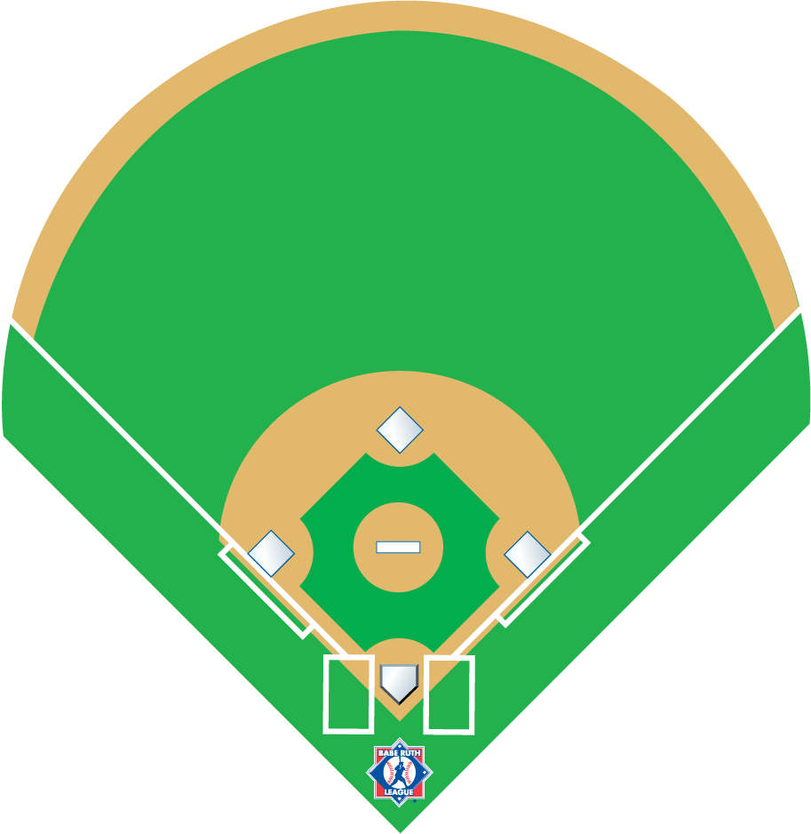
ASHAA 2 Official
Baseball Umpire Mechanics

Slide 2
5 minutes prior to the start game
U1 conducts pre-game conference
Both teams shall remain in their dugout/bench or bullpen area until pre-game conference has concluded
Discussion:
Verify Line-up Cards (Home team 1st)
Ask if using designated hitter
Verify players are legally equipped
Discuss ground rules- home team coach should inform unless playing on a neutral site, then U1 will explain the ground rules.
Make sure coach’s ground rules do not violate any book rules.
U2
HC
HC
U1
Pre-game Conference

Slide 3

8
U2
Position yourself between 1st and 2nd base
About 10-15 feet in the outfield grass.
Relax
7
9
U2
6
4
5
3
Defensive Team
1
Offensive Team
U1
Walk down the foul line towards the defensive team and encourage to hustle on if needed.
Move back closer to the catchers area and be able to supply another ball if needed
U1
2
Between Innings

Slide 4
8
7
9
6
4
2
U2
5
3
3
1
1
Defensive Conference or Pitching Change
2
U1

Slide 5
U2
Position yourself about 10-15 feet in the outfield grass on the side that you will return to
8
7
9
6
4
2
U2
5
3
3
1
1
C
U1
Should go to the 45 foot line of the offensive team
Defensive Conference or Pitching Change
B
2
U1

Slide 6
8
8
7
9
7
9
9
6
4
5
3
U2
1
B
No runners on base
Routine fly ball coverage
All ROUTINE fly balls belong to U1
2
U1

Slide 7
8
7
9
9
6
4
5
3
U2
1
U1 has center to the left field foul line.
B
No runners on base
Routine fly ball coverage
2
U1

Slide 8
8
7
9
6
4
5
3
U2
1
U1 has center to the left field foul line.
B
No runners on base
Routine fly ball coverage
2
U2 has CF in and back all the way to the right field foul line.
U1

Slide 9
8
9
7
6
4
U2
5
3
1
U2 has LF to center and RF to center. NEVER GO OUT!
B
Any runner on base trouble fly ball coverage
2
U1 has LF and RF right to the lines.
U1

Slide 10
Signals:
U1: number of outs and staying home
8
7
9
6
4
5
3
1
U2
B
2
No runners
Ground ball left side
U1

Slide 11
Signals:
U1: number of outs and staying home
8
7
9
6
4
5
3
1
U2
B
2
No runners
Ground ball left side
U1

Slide 12
Signals:
U1: number of outs and staying home
8
7
9
6
4
5
3
1
U2
B
2
No runners
Ground ball right side
U1

Slide 13
Signals:
U1: number of outs and staying home
8
All routine catches belong to U1
7
9
6
4
5
3
1
U2
U2 will pivot with the runner and lead him to second base
B
2
No runners
Routine fly ball left side
U1

Slide 14
Signals:
U1: number of outs and staying home
8
U2’s catch responsibility
7
9
6
4
5
3
1
U2
B
2
No runners
Trouble fly ball right side
U1

Slide 15
Signals:
U1: number of outs and rotate
8
7
9
6
4
U2
5
3
1
1
B
2
Runner at first
Ground ball right side
U1

Slide 16
Signals:
U1: number of outs and rotate
8
7
9
6
4
Runners try to advance two bases!
U2
5
3
1
1
B
2
Runner at first
Ground ball through left side
U1

Slide 17
Signals:
U1: number of outs and rotate
8
7
9
6
4
Runners try to advance two bases!
1
U2
5
3
B
1
U1
2
Runner at first
Ground ball through left side

Slide 18
Signals:
U1: number of outs and rotate
8
9
U2’s fly ball coverage area
7
6
4
U2
5
3
1
1
U2’s tag-up
B
2
Runner at first
Fly ball left side
U1

Slide 19
Signals:
U1: number of outs and rotate
8
U1’s fly ball area.
7
9
6
4
U2
5
3
1
U2’s tag-up
1
B
2
Runner at first
Fly ball right side
U1

Slide 20
Signals:
U1: number of outs
and staying home
if 2 outs, timing play
8
7
9
6
4
1
5
U2
3
1
B
2
Runner at second
Ground ball left side
U1

Slide 21
Signals:
U1: number of outs and staying home
if 2 outs, timing play
8
7
9
6
4
1
5
U2
3
1
B
2
Runner at second
Ground ball right side
U1

Slide 22
Signals:
U1: number of outs and rotate
8
7
9
U1’s fly ball area
6
U2’s tag-up
4
1
5
U2
3
1
B
Runner at second
Fly ball left side
2
U1

Slide 23
Signals:
U1: number of outs and staying home
if 2 outs, timing play
8
U2’s fly ball coverage area
7
9
6
4
U2’s tag-up
1
5
U2
3
1
B
2
Runner at second
Fly ball center
U1

Slide 24
Signals:
U1: number of outs and staying home
8
7
9
6
4
5
U2
3
1
1
B
2
Runner at third
Ground ball left side
U1

Slide 25
Signals:
U1: number of outs and staying home
8
7
9
U1’s fly ball area
6
4
5
U2
3
U1’s tag
1
1
B
2
Runner at third
Fly ball right side
U1

Slide 26
Signals:
U1: number of outs and staying home
8
U2’s fly ball coverage area
7
9
6
4
5
U2
3
U1’s tag
1
1
B
2
Runner at third
Fly ball center field
U1

Slide 27
Signals:
U1: number of outs and staying home if less than 2 outs, infield fly and double tag if 2 outs, timing play
8
7
9
U1’s
interference
6
4
1
5
U2
3
1
2
B
2
Runner at 1st and 2nd
Ground ball left side
U1

Slide 28
Signals:
U1: number of outs and staying home if less than 2 outs, infield fly and double tag if 2 outs, timing play
8
7
9
6
4
1
5
U2
3
1
2
B
2
Runner at 1st and 2nd
Ground ball right side
U1

Slide 29
Signals:
U1: number of outs and staying home if less than 2 outs, infield fly and double tag if 2 outs, timing play
8
7
9
U1’s Catch
6
4
U2’s tag
1
5
U2
3
1
U2’s tag
2
B
2
Runner at 1st and 2nd
Fly ball left side
U1

Slide 30
Signals:
U1: number of outs and staying home if less than 2 outs, infield fly and double tag if 2 outs, timing play
8
U2’s fly ball coverage area
7
9
6
4
U2’s tag
1
5
U2
3
1
U2’s tag
2
B
2
Runner at 1st and 2nd
Fly ball left side
U1

Slide 31
Signals:
U1: number of outs and staying home if less than 2 outs, infield fly and double tag if 2 outs, timing play
8
U2’s fly ball coverage area
7
9
6
4
U2’s tag
1
5
U2
3
1
U2’s tag
2
B
2
Runner at 1st and 2nd
Fly ball center
U1

Slide 32
Signals:
U1: number of outs and rotate
8
7
9
6
4
5
U2
3
1
1
2
U1 is Responsible for R1 touching the plate
B
2
Runner at 1st and 3rd
Ground ball left side
U1

Slide 33
Signals:
U1: number of outs and rotate
8
7
9
U1’s fly ball area
6
4
5
U2
3
U1’s tag
1
1
2
B
2
Runner at 1st and 3rd
Fly ball right side
U1

Slide 34
Signals:
U1: number of outs and rotate
8
U2’s fly ball coverage area
7
9
6
4
5
U2
3
U1’s tag
1
1
U2’s tag
2
B
2
Runner at 1st and 3rd
Fly ball center
U1

Slide 35
Signals:
U1: number of outs and staying home if 2 outs timing play
8
7
9
6
4
2
5
U2
3
1
1
B
2
Runner at 2nd and 3rd
Ground ball left side
U1

Slide 36
Signals:
U1: number of outs and staying home if 2 outs timing play
8
7
9
6
U2’s tag
4
2
5
U2
3
U1’s tag
1
1
B
2
Runner at 2nd and 3rd
Fly ball right side
U1

Slide 37
Signals:
U1: number of outs and staying home if 2 outs timing play
8
7
9
6
4
2
5
U2
3
1
1
3
B
Bases loaded
Ground ball left side
2
U1

Slide 38
Signals:
U1: number of outs and staying home if 2 outs timing play
8
7
9
U1’s Catch
6
4
U2’s tag
2
5
U2
3
U1’s tag
1
U2’s tag
1
3
B
Bases loaded
Fly ball left side
2
U1

Slide 39
Signals:
U1: number of outs and staying home if 2 outs timing play
8
U2’s fly ball coverage area
7
9
6
4
2
5
U2
3
1
1
3
B
Bases loaded
Fly ball center
2
U1

Slide 40
8
7
9
6
4
5
U2
3
1
1
B
U1 will move into position when the runner is moving away from 1st base or 3rd base and tell U2 “I’ve got this end” only when he is in position.
Rundowns
2
U1

Slide 41
8
7
9
6
4
5
U2
3
1
1
2
B
U1 cannot move to help with the Rundown with a runner at 3rd.
The rundown is usually started to score the runner from 3rd.
Rundowns
2
U1

Slide 42



If you have any further questions about situational umpiring, or would like to inquire on how to get certified as an NUA official, please visit our website www.baberuthleague.org or contact Babe Ruth Headquarters at 1-800-880-3142.

