Slide 1


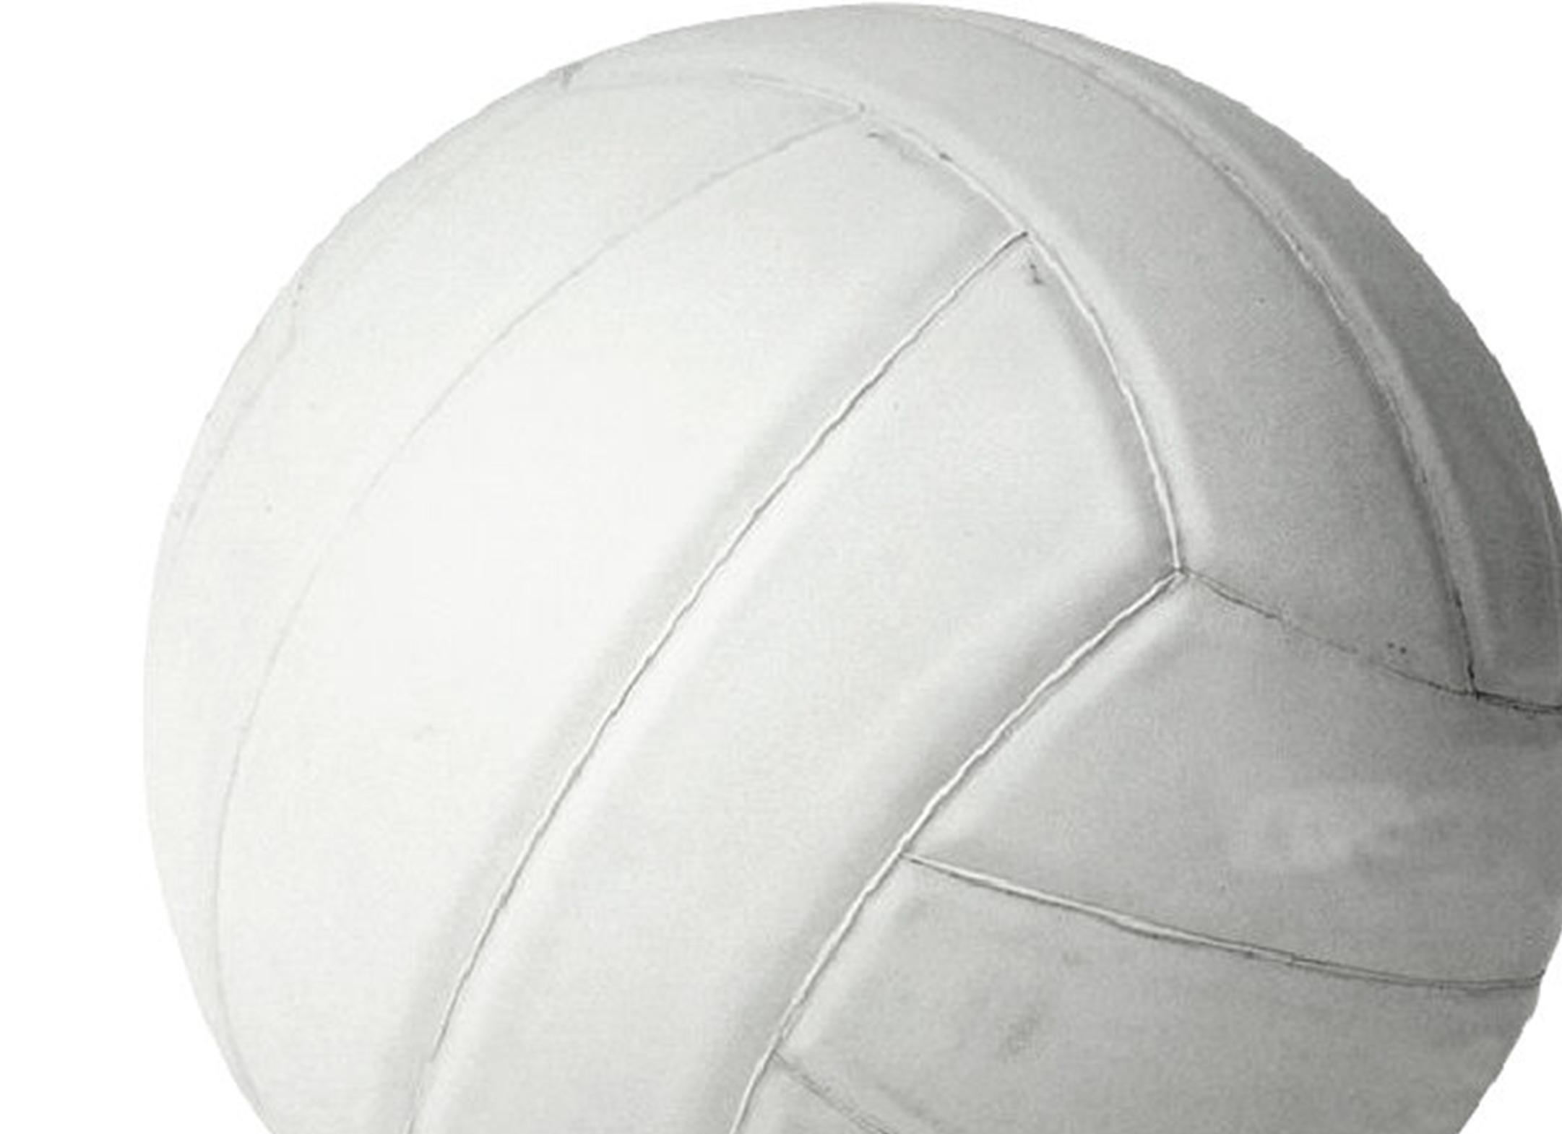
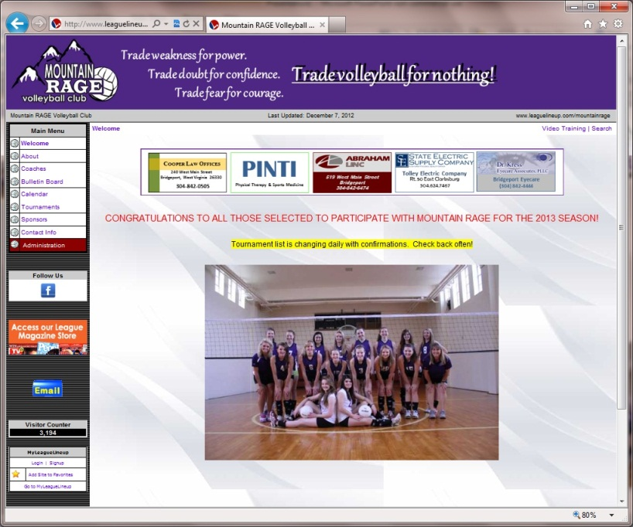
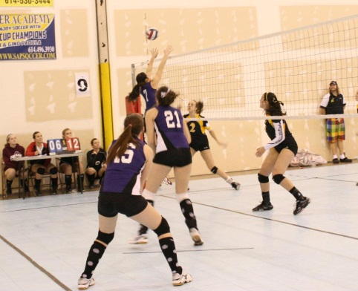
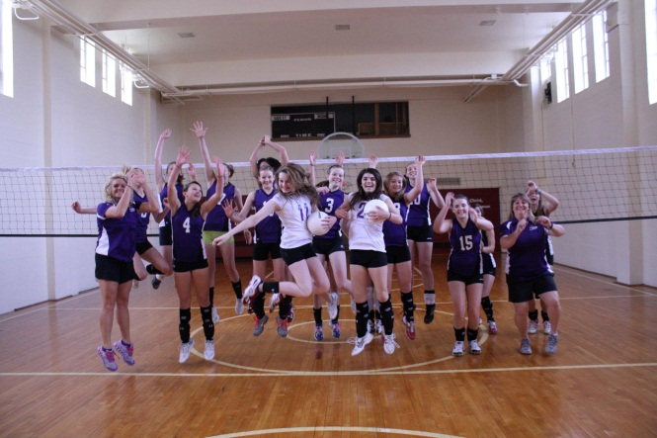
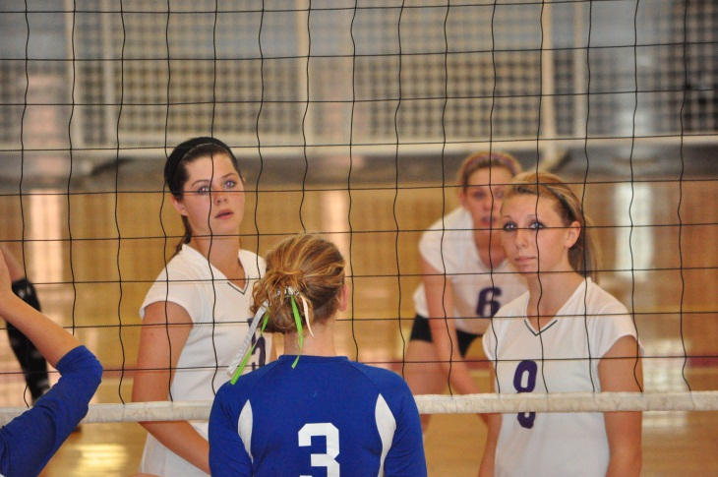
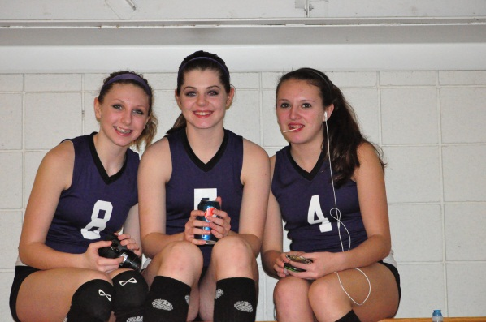
Mountain RAGE is a non-profit organization. (But not a charity.) All funds go towards enhancing the experience for our players.
We are a Junior Olympics club program organized under USA Volleyball.
Last season, Mountain Rage had 17 players, and this season over 50!
Players come from 6 areas High Schools and 4 Middle Schools!
We can’t do it without our SPONSORS!
Last season, our website generated over 3,000 views! Sponsors are featured in ad spaces.
www.mountainrage.com
Sponsors make it possible for more girls to participate than could otherwise afford to do so.

