Slide 1
Scrimmage Kicks and Pass Interference
Assigner’s Corner Video Play Review.
Scrimmage Kicks.
Pass Interference

Slide 2
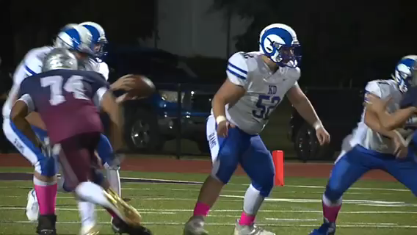

Slide 3
Targeting
Rule 2-20-2 Targeting is an act by any player who takes aim and initiates contact against an opponent above the shoulders with the helmet, forearm, hand, fist, elbow or shoulders.
Rule 9-4-3 No player or non-player shall:
  m. Target an opponent.
  PENALTY: Art. 3m. Targeting an opponent-15 yards.
  DISQUALIFICATION also if any fouls under these articles are judged by the game official to be flagrant.

Slide 7
Equipment Rule Review
Rule 1-5 Player Equipment
  Art 1: Mandatory equipment. Each player shall participate while wearing the following pieces of properly fitted equipment:
    a. A helmet and face mask
    d. Pads and protective equipment-The following pads and protective equipment are required of all players:
      1. Hip pads and tailbone protector which are unaltered from the manufacturer’s design.
      2. Knee pads which are unaltered from the manufacturer’s original design which are worn over the knee and under he pants.
      3. Shoulder pads and hard surface attachments, which shall be fully covered by the jersey.
      4. Thigh guards which are unaltered from the manufacturer’s original design.
      5. A tooth and mouth protector.
    e. Pants which completely cover the knees, thigh guards and knee pads and any portion of any knee brace.

Slide 8
Equipment Rule Review

Slide 9
Scrimmage Kicks
6-3-1 It is a touchback if any free kick or scrimmage kick:
  a. Which is not a scoring attempt or which is a grounded three-point field-goal attempt, breaks the plane of R’s goal line, unless R chooses a spot of first touching by K.
  b. Which is a three point field goal attempt, in flight touches a K player in R’s end zone, or after breaking the plane of R’s goal line is unsuccessful.
2-13-1 Force is the result of energy exerted by a player which provides movement of the ball. The term force is used only in connection with the goal line and in only one direction, i.e. from the field of play into the end zone. Initial force results from a carry, fumble, kick, pass or snap. After a fumble, kick or backward pass has been grounded, a new force may result from a bat, illegal kick or a muff.

Slide 10
Scrimmage Kicks
6-3-1 It is a touchback if any free kick or scrimmage kick:
  a. Which is not a scoring attempt or which is a grounded three-point field-goal attempt, breaks the plane of R’s goal line, unless R chooses a spot of first touching by K.
  b. Which is a three point field goal attempt, in flight touches a K player in R’s end zone, or after breaking the plane of R’s goal line is unsuccessful.
2-13-1 Force is the result of energy exerted by a player which provides movement of the ball. The term force is used only in connection with the goal line and in only one direction, i.e. from the field of play into the end zone. Initial force results from a carry, fumble, kick, pass or snap. After a fumble, kick or backward pass has been grounded, a new force may result from a bat, illegal kick or a muff.
2-13-4 Force is not a factor:
  a. On kicks going into R’s end zone, since these kicks are always a touchback regardless of who supplies the force.

Slide 11
Scrimmage Kicks
Fair Catch:
It is a fair catch and the ball is dead if any receiver gives a valid fair catch signal and catches a scrimmage kick in flight beyond the neutral zone to R’s goal line.

Slide 12
Scrimmage Kicks
Fair Catch:
It is a fair catch and the ball is dead if any receiver gives a valid fair catch signal and catches a scrimmage kick in flight beyond the neutral zone to R’s goal line.
If any other R player catches the ball after a valid or invalid signal is given, the ball is dead.

Slide 13
Scrimmage Kicks
Fair Catch:
It is a fair catch and the ball is dead if any receiver gives a valid fair catch signal and catches a scrimmage kick in flight beyond the neutral zone to R’s goal line.
If any other R player catches the ball after a valid or invalid signal is given, the ball is dead.
Only the player giving a fair catch signal is given protection.

Slide 14
Scrimmage Kicks
Fair Catch:
It is a fair catch and the ball is dead if any receiver gives a valid fair catch signal and catches a scrimmage kick in flight beyond the neutral zone to R’s goal line.
If any other R player catches the ball after a valid or invalid signal is given, the ball is dead.
Only the player giving a fair catch signal is given protection.
Following a fair catch the offensive team may choose to free kick or snap anywhere between the hash marks on the yard line where the fair catch was made.

Slide 15
Scrimmage Kicks
Kick Catching Interference:
While any scrimmage kick is flight beyond the neutral zone to R’s goal line K shall not;
  Touch the ball or R, unless blocked into the ball or R.
  Obstruct R’s path to the ball.

Slide 16
Scrimmage Kicks
Kick Catching Interference:
While any scrimmage kick is flight beyond the neutral zone to R’s goal line K shall not;
  Touch the ball or R, unless blocked into the ball or R.
  Obstruct R’s path to the ball.
  This is true even though no fair catch signal is given.

Slide 17
Scrimmage Kicks
Kick Catching Interference:
While any scrimmage kick is flight beyond the neutral zone to R’s goal line K shall not;
  Touch the ball or R, unless blocked into the ball or R.
  Obstruct R’s path to the ball.
  This is true even though no fair catch signal is given.
  The restriction ends when R touches the ball beyond the neutral zone and when the ball touches the ground.

Slide 18
Scrimmage Kicks
Kick Catching Interference:
While any scrimmage kick is flight beyond the neutral zone to R’s goal line K shall not;
  Touch the ball or R, unless blocked into the ball or R.
  Obstruct R’s path to the ball.
  This is true even though no fair catch signal is given.
  The restriction ends when R touches the ball beyond the neutral zone and when the ball touches the ground.
  EXCEPTION: K may touch, catch, muff or bat a scrimmage kick in flight if no R player is in position to catch the ball.

Slide 19
Scrimmage Kick Mechanics Seven Man Crew
Positioning and Zones
Referee: Take a position slightly behind and to the side of the kicker, outside the tight end position and on the kicking leg side of the kicker. See the ball from snap to kick and observe blockers and kickers at same time. If kicker is near end line, straddle end line and warn kicker before snap.
Umpire: Position is approximately 10 yards off the LOS. Find a spot that allows you to observe action on and around the snapper.
Head Linesman and Line Judge: Take your basic position and officiate as on a scrimmage play. Hold your position until kick crosses NZ.
Field Judge and Side Judge: Take a position on your sideline not less than 5 yards behind the deepest receiver on the same yard line as Back Judge. If ball snapped from on or inside the B40 yard line initial position is on the goal line.
Back Judge: Position not less than 5 yards behind deepest receiver on same yard line as SJ and FJ, to the side of receiver favoring wide side of field. Work to maintain 45° angle with receiver while kick is in flight.

Slide 21
Scrimmage Kick Mechanics Seven Man Crew
Coverage
Referee: Responsible for observing action on the kicker and shield in front of kicker. If kick is towards side line be prepared to assist in marking OOB spot. Never let players behind you. During return observe action against kicker, especially if he is clearly out of play. Be prepared to cover goal line on long return.
Umpire: Observe blocks of team A and action by team B players, especially those over the snapper. Once kick has gone downfield turn toward return area and observe blocks in your area.
Head Linesman: Hold position on LOS until kick crosses line, then move downfield slowly. Observe action of players in middle of field. If SJ has coverage of runner, observe action ahead of runner. Maintain adequate cushion, be prepared to cover goal line on long return.
Line Judge: Assist referee in observing shield in front of kicker. When kick crosses LOS, move slowly downfield observing actions of players in middle of field. If FJ has coverage of runner observe action ahead of runner. Maintain adequate cushion, be prepared to cover goal line on long return.
Side Judge and Field Judge: Primary coverage of gunner on your side. After kick, when kick is to other zones, observe action in front of receiver. After kick, if kick is to your zone take over coverage of receiver as soon as he starts to advance. Be prepared to rule on kick catching interference by your gunner and legality of handoffs. Follow kick if receiver fails to field ball. Be alert for fair catch signals and actions of signalers.
Back Judge: Have bean bag in hand, mark end of kick. Work to maintain 45 degree angle to receiver and adjust as necessary. Be prepared to rule on balls going into end zone and validity of fair catch signals. Primary responsibility for KCI and validity of handoffs. Follow ball if receiver fails to catch it. When runner starts to return, observe action in middle of field in front of runner

Slide 22
Scrimmage Kick Mechanics Five Man Crew
Positioning and Zones
Referee: Take a position slightly behind and to the side of the kicker, outside the tight end position and on the kicking leg side of the kicker. See the ball from snap to kick and observe blockers and kickers at same time. If kicker is near end line, straddle end line and warn kicker before snap. Count A players.
Umpire: Position is approximately 10 yards off the LOS. Find a spot that allows you to observe action on and around the snapper. Count A players. Check numbering exceptions.
Head Linesman: Take your basic position and officiate as on a scrimmage play. Hold your position until kick crosses NZ. Responsible for action on line at snap. Count B players.
Line Judge Take your basic position and officiate as on a scrimmage play. Count B players. Release on snap moving slowly downfield.
Back Judge: Position 5-7 yards deeper than deepest receiver and 10-12 yards wider on Linesman’s side. Count R players.

Slide 23
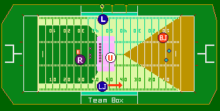

Slide 24
Scrimmage Kick Mechanics Five Man Crew
Coverage
Referee: Responsible for observing action on the kicker and shield in front of kicker. If kick is towards side line be prepared to assist in marking OOB spot. Never let players behind you. During return observe action against kicker, especially if he is clearly out of play. Be prepared to cover goal line on long return.
Umpire: Observe blocks of team A and action by team B players, especially those over the snapper. Once kick has gone downfield turn toward Line Judge’s side of return area and observe blocks in your area.
Head Linesman: Primary key is gunner on your side. Observe action against gunner at snap. Assist Referee on snaps over kicker’s head. Hold position on LOS until kick crosses line, then move downfield slowly. Observe action of players in middle of field ahead of runner. If runner comes into your side zone pick up coverage, observe action ahead of runner. Maintain adequate cushion, be prepared to cover goal line on long return.
Line Judge: Primary key is gunner on your side. Observe action against gunner at snap. Release downfield on snap. Cover all kicks in your zone. Mark spot when ball becomes dead.
Back Judge: Have bean bag in hand, mark end of kick. Work to maintain 45 degree angle to receiver and adjust as necessary. Be prepared to rule on balls going into end zone and validity of fair catch signals. Primary responsibility for KCI and validity of handoffs. Follow ball if receiver fails to catch it. When runner starts to return, observe action in middle of field in front of runner.

Slide 26
Field Goals And Trys
Seven Man Crew
Referee Position facing the holder, approximately 10-12 yards wide on about the same yard line as the holder. Referee is responsible for action on the kicker and holder.
Umpire, Side Judge Line up in a twin umpire position seven yards deep and cover all line of scrimmage action. U will have primary responsibility to protect snapper. Be aware of numbering exceptions if applicable.
Head Linesman, Line Judge Take regular position. Be ready to cover sideline from line of scrimmage to end line. After kick is dead, move in toward players watching for dead ball fouls.
Back Judge, Field Judge Take position inside the limit line; each man will cover one of the two goal posts. Rule on success or failure of field goal attempts, BJ will sound whistle. Official nearest ball rules on play with other official reflecting ruling. Be alert for ball striking an upright or crossbar. If ball strikes the crossbar, the BJ is responsible for the ruling. FJ and BJ count defensive players.
Back Judge AFTER TRY - Moves up sideline with ball to place ball for kickoff.
REMINDER: During a TRY, if B secures possession or as soon as it is apparent a kick has failed to score, the ball is dead and the play is over. Officials should sound their whistle immediately.

Slide 27
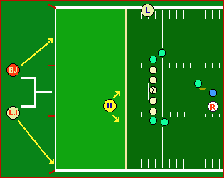
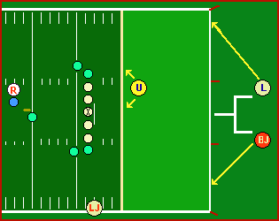

Slide 28
Field Goals And Trys
Seven Man Crew
Referee Position facing the holder, approximately 10-12 yards wide on about the same yard line as the holder. Referee is responsible for action on the kicker and holder.
Umpire Line up seven yards deep and cover all line of scrimmage action. U will have primary responsibility to protect snapper. Be aware of numbering exceptions if applicable. After snap move toward LOS. Know if ball crosses neutral zone.
Head Linesman or Line Judge Whichever official is facing R, take regular position. Be ready to cover sideline from line of scrimmage to end line. After kick is dead, move in toward players watching for dead ball fouls. Official not facing R take position under goal post with B
Back Judge take position inside the limit line with either H or LJ; each man will cover one of the two goal posts. Rule on success or failure of field goal attempts, BJ will sound whistle. Official nearest ball rules on play with other official reflecting ruling. Be alert for ball striking an upright or crossbar. If ball strikes the crossbar, the BJ is responsible for the ruling. BJ and H or LJ count defensive players.
Back Judge AFTER TRY - Moves up sideline with ball to place ball for kickoff.
REMINDER: During a TRY, if B secures possession or as soon as it is apparent a kick has failed to score, the ball is dead and the play is over. Officials should sound their whistle immediately.

Slide 29
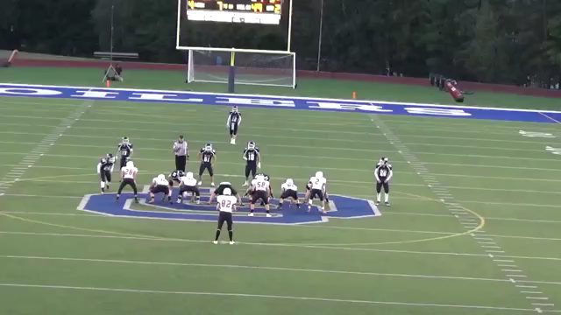

Slide 30
Agenda for May 2, 2019
Pass Interference:
7-5-7 Pass interference restrictions only apply beyond the neutral zone and only if the legal forward pass, untouched by B in or behind the neutral zone, crosses the neutral zone. Pass interference restrictions are in effect for all A and B players until the ball is touched or the pass is incomplete.

Slide 31
Agenda for May 2, 2019
Pass Interference:
7-5-7 Pass interference restrictions only apply beyond the neutral zone and only if the legal forward pass, untouched by B in or behind the neutral zone, crosses the neutral zone. Pass interference restrictions are in effect for all A and B players until the ball is touched or the pass is incomplete.
7-5-8 Pass interference restrictions on a legal forward pass begin for
  a. A with the snap.
  b. B when the ball leaves the passers hand.

Slide 32
Agenda for May 2, 2019
Pass Interference:
7-5-7 Pass interference restrictions only apply beyond the neutral zone and only if the legal forward pass, untouched by B in or behind the neutral zone, crosses the neutral zone. Pass interference restrictions are in effect for all A and B players until the ball is touched or the pass is incomplete.
7-5-8 Pass interference restrictions on a legal forward pass begin for
  a. A with the snap.
  b. B when the ball leaves the passers hand.
  7-5-9 Pass interference restrictions on a legal forward pass end for:
    a. All eligible A players when the pass when the pass has been touched by any player.
    b. All ineligible A players when B touches the pass.
    c. All B players when the pass has been touched by any player.
    d. All players when the pass is incomplete.

Slide 33
Agenda for May 2, 2019
Pass Interference:
7-5-10 It is forward pass interference if any player of A or B who is beyond the neutral zone interferes with an eligible opponent’s opportunity to move toward, catch or bat the pass.

Slide 34
Agenda for May 2, 2019
Pass Interference:
7-5-10 It is forward pass interference if any player of A or B who is beyond the neutral zone interferes with an eligible opponent’s opportunity to move toward, catch or bat the pass.
7-5-11 It is not forward pass interference if:
  a. Unavoidable contact occurs when two or more eligible receivers are making a simultaneous, bona fide attempt to move toward, catch or bat the pass.
  b. Contact by A is immediately made on a B lineman and the contact does not continue beyond the expanded neutral zone.
  c. Contact by B is obviously away from the direction of the pass.
  REMEMBER: There must be contact. There must be an obvious intent to impede the receiver.

Slide 35
Agenda for May 2, 2019
Categories of Defensive Pass Interference:
1. Early contact-Contact which occurs before the pass arrives.
2. Playing through the receiver-Often occurs when defender plays over the back of the receiver.
3. Not playing the ball-Occurs when defender is playing the receiver and not the ball.
4. Arm Bar-Defender places arm across the receiver’s chest or arm while running side-by-side and uses this as leverage to restrict the receiver.
5. Grabbing the arm-the defender grabs or pins the receiver’s arm as he tries to reach to catch the pass.
6. Cutoff-Defender who is not playing the ball, moves to prevent the receiver from moving toward and catching the ball.
7. Hook and turn-Defender places arm around waist or chest of receiver and turns or spins receiver to prevent him from catching the pass.

Slide 36
Agenda for May 2, 2019
Categories of Offensive Pass Interference:
1. Blocking downfield prior to the touching of the pass.
2. Push off creating separation-If the push is not significant and does not create separation it is a good no call.
3. Any of the categories that apply to defensive interference may also apply to offensive interference.

