Slide 1
October 1, 2020
Review of video clips from Assigner’s Corner.
Forward Progress.
Goal Line Plays.

Slide 2
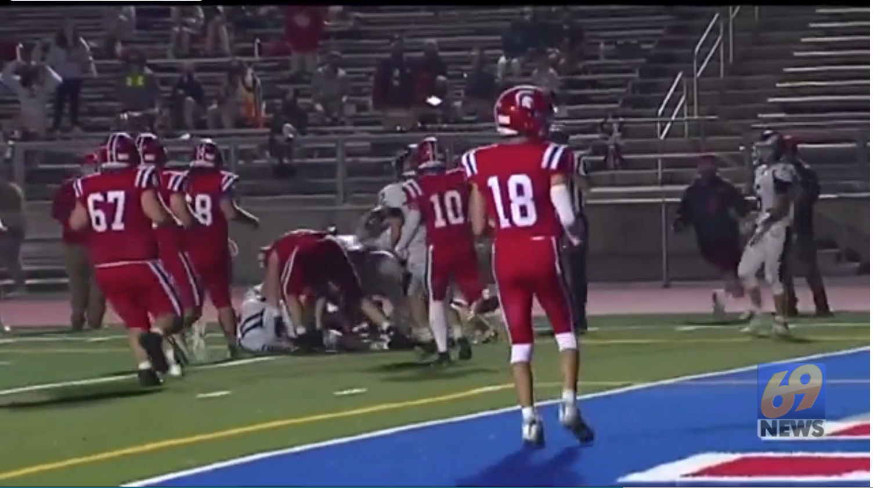

Slide 3
Video Clips from Assigner’s Corner
Rule 4-2 Dead Ball and End of Down:
  Art. 2- The ball becomes dead and the down is ended:
      a. When a runner goes out of bounds, is held so his forward progress is stopped or allows any part of his person other than a hand or foot to touch the ground.
  EXCEPTIONS:
  1. The ball remains live if at the snap, a place-kick holder with his knee(s) on the ground and with a teammate in kicking position catches or recovers the snap while his knee(s) is on the ground and places the ball for a kick, or if he rises to advance, hand, kick or pass; or
  2. The ball remains live if, at the snap a place kick holder with his knee(s) on the ground and with a teammate in kicking position rises and catches or recovers an errant snap and immediately returns his knee(s) to the ground and places the ball for a kick or again rises to advance, hand, kick or pass.
  Note: The ball becomes dead if a place kick holder muffs the snap or fumbles and recovers after his knee(s) have been off the ground, and he then touches the ground with other than a hand or foot while in possession of the ball.

Slide 4
Video Clips from Assigner’s Corner
Case Play 4.2.2
  Situation A: K1 has one knee on the ground to hold for an apparent field-goal attempt. K2 is in position to kick. K1 catches the snap and: (a) places the ball which is kicked by K2; or (b) rises and either runs or passes; or (c) without rising flips the ball to K2 who attempts to run.
  RULING: Legal in (a) and (b). In (c) the ball becomes dead immediately when K1 tosses the ball to K2 while K1 has his knee on the ground.

Slide 6
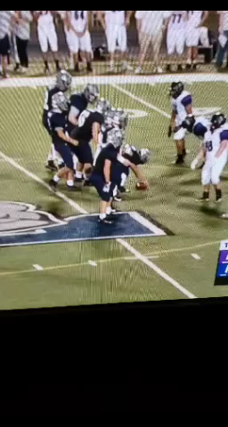

Slide 7
You Make the Call
1. Legal Play
2. Illegal Formation
3. Illegal Motion

Slide 9
Video Clips from Assigner’s Corner
Rule 7-2 Formation/Position, Numbering and Action at the Snap:
  Art. 3. Of the players of A who are not on their line at the snap only one may penetrate the vertical plane through the waistline of his nearest teammate who is on his line. He must have his hands in position to receive the ball if it is snapped between the snapper’s legs but he is not required to receive the snap. Any other player(s) must be in legal position as a back.
  Art. 5. Player formation and numbering requirements include:
    a. No more than four A players may be backs and only one A player may penetrate the vertical plane through the waist line of his nearest teammate who is on his line as in 7-2-3;
  Art. 7. Only one A player may be in motion at the snap and then only if such motion is not towards the opponents goal line. Except for the player “under the snapper,” as outlined in Article 3, the player in motion must be at least 5 yards behind his line of scrimmage at the snap if he started from any position not clearly behind the line and did not establish himself as a back by stopping for at least one full second while no part of his body is breaking the vertical plane through the waistline of his nearest teammate who is on the line of scrimmage.

Slide 11
Forward Progress and Goal Line Plays
Forward Progress
Rule 2-15: Forward Progress:
Art.1. Forward progress is the end of advancement of the ball, toward the opponent’s goal line, in a runner’s possession or the forward-most point of the ball when it is fumbled out of bounds and it determines the out of bounds spot
Rule 4-2 Dead ball and End of Down:
  Art. 2. The ball becomes dead and the down is ended:
  a. When a runner goes out of bounds, is held so his forward progress is stopped or
  allows any part of his person other than a hand or foot to touch the ground.

Slide 12
Forward Progress and Goal Line Plays
Goal Line Plays.

Slide 13
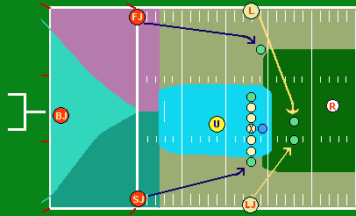
Goal Line Plays
Seven Man Crew B20 to B7 Yard Line

Slide 14
Goal Line Plays
Seven Man Crew B20 to B7 Yard Line
Ball Snapped From Team B's 20 to 7-Yard Line:
The Referee, Umpire, Head Linesman, and Line Judge will assume their normal positions. The Field Judge and Side Judge will position themselves on the goal line outside the pylon and will maintain this position as Team A moves toward the goal line. The Back Judge will position himself on the end line once the snap is on or inside Team B's 20-yard line. The Head Linesman/Line Judge will have forward progress to the Team B two-yard line. The Field Judge/Side Judge will have forward progress between the Team B two-yard line to the goal line

Slide 15
Goal Line Plays
Seven Man Crew B7 to Goal Line

Slide 16
Goal Line Plays
Seven Man Crew B7 to Goal Line
Ball Snapped On and Inside Team B's 7-Yard Line:
The Referee, Umpire, Head Linesman, and Line Judge will assume their normal positions. The Field Judge and Side Judge will position themselves on the end line outside the pylon and will maintain this position as Team A moves toward the goal line. The Back Judge will be on the end line. At the snap, the Head Linesman and Line Judge should move to the goal line outside the pylon and officiate from that spot. Be on the goal line before the runner crosses it. The Referee will take responsibility on ruling passes behind the line of scrimmage. The Umpire will take responsibility for determining whether the pass or passer crossed the line of scrimmage.
Head Linesman and Line Judge: On dive plays to the middle of the field, crash hard to the action. If you don’t see the ball in the end zone, keep coming until you find it. Only the official seeing the touchdown should signal. Do not mirror signals.

Slide 17
Five Man Crew B10 to B5

Slide 18
Goal Line Plays
Four Man Crew B10 to B5 Yard Line
Ball Snapped From Team B's 10 to 5-Yard Line:
The Referee, Umpire, Head Linesman, and Line Judge will assume their normal positions. Back Judge should position on end line when ball is snapped on or inside the 10 yard line. The Head Linesman/Line Judge will have forward progress.
H and LJ release slowly downfield and stay ahead of runner to goal line.
U responsible to know if forward pass crosses neutral zone.

Slide 19
Five Man Crew B5 to Goal Line

Slide 20
Goal Line Plays
Five Man Crew B5 to Goal Line
Ball Snapped From Inside Team B's 5 Yard Line:
The Referee, Umpire, Head Linesman, and Line Judge will assume their normal positions. The Head Linesman/Line Judge will have forward progress. At the snap the H and the LJ will move to the goal line and officiate back to the play. On dive plays to the middle of the field, crash hard to the action. If you don’t see the ball in the end zone, keep coming until you find it. Only the official seeing the touchdown should signal. Do not mirror signals.

Slide 21
Seven Man Crew Goal Line Coming Out

Slide 22
Goal Line Plays
Seven Man Crew Goal Line Coming Out
Ball Snapped From Inside Team A's 5 Yard Line:
When Team A snaps the ball on or inside its own five yard line, the Head Linesman and Line Judge should immediately move to the goal line outside the pylon. All other officials should officiate the play as normal.
H, LJ, SJ, FJ, BJ All keys remain unchanged. All be alert for pick plays.
R position on end line. Be alert for plays ending in end zone. Be alert for fouls occurring in end zone.

Slide 23
Five Man Crew Goal Line Coming Out

Slide 24
Goal Line Plays
Five Man Crew Goal Line Coming Out
Ball Snapped From Inside Team A's 5 Yard Line:
When Team A snaps the ball on or inside its own five yard line, the Head Linesman and Line Judge should immediately move to the goal line outside the pylon. All other officials should officiate the play as normal.
U, BJ Keys and responsibilities same as normal scrimmage play.
H, LJ Keys remain unchanged. Be alert for pick plays.
R Position on end line. Be alert for plays ending in end zone. Be alert for fouls occurring in end zone.

