Slide 1

Naaman Forest Baseball
Program
Covers
We would like to keep adding all Program Covers to our Website
Please email to naamanbaseball@gmail.com

Slide 2


Slide 3


Slide 4


Slide 5


Slide 6


Slide 7


Slide 8


Slide 9



2010

Slide 10


Slide 11


Slide 12


Slide 13


Slide 14


Slide 15


Slide 16


Slide 17
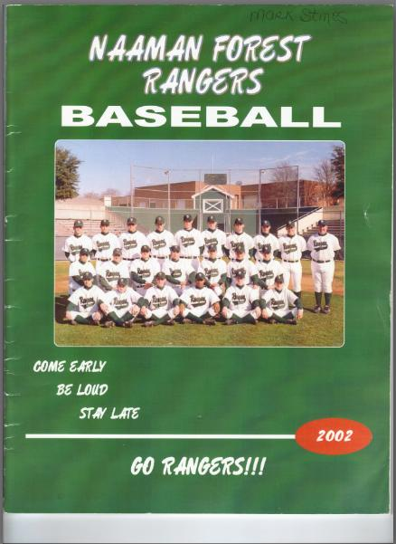

Slide 18


Slide 19


