Slide 1
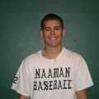

2010 Varsity Squad
Senior - # 22
Scott Castleman
Senior - # 20
Chris Fastle
Not Pictured: Chase Potts – Senior # 10

Slide 2
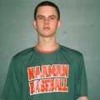
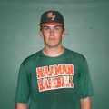
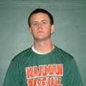
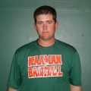
Junior - # 5
Matt Averitt
Junior - # 34
Kyle Clowe
Junior - # 12
Taylor Elms
Junior - # 9
Nick Rodgers

Slide 3
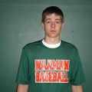
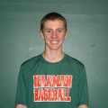
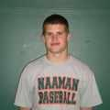
Junior - # 16
Jordan Walker
Junior - # 3
Justin Merkle
Junior - # 4
Josh Trout

Slide 4

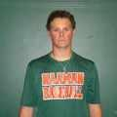
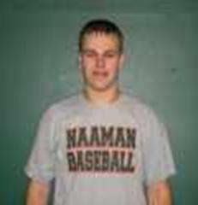
Sophomore - # 8
Kyle Clausing
Sophomore - # 2
Hunter Courson
Sophomore - # 17
Collin Sherrod

Slide 5
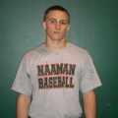
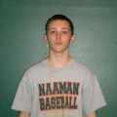
Sophomore - # 1
Josh Smith
Sophomore - # 13
Taylor Swallow

