Slide 1

Welcome to the 2012
Winslow Travel Soccer Club
Annual Meeting
April 9, 2012

Slide 2
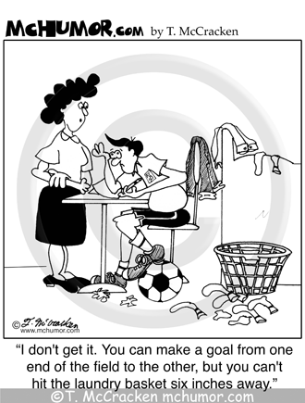

Slide 3
Agenda
Introductions
“Thank yous”
2011/12 Year in review
2012/13 Year ahead
Election of 2012/13 Board and Officers
Monthly Board Meeting

Slide 4
Introductions
Name
Children in program
Role (s) with Club

Slide 5
Thank yous
Players & families moving on to high school
“Retiring” board members and coaches
Other participating players and families
Other board members, coaches and team administrators
Coaches Larrabee, Carey and Smith and Winslow High School Boys & Girls teams
Those that supported the Club by way of various fundraisers and events

Slide 6
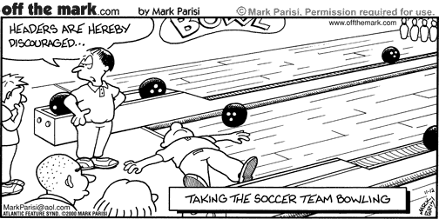

Slide 7
2011/12 Year in review
10 teams and 124 players- see next slide
Successful performance on the field
Player clinics and goalie clinic
Kept player fee reasonable
Financially positive year- see 4 year summary
Introduced new Club uniform
Successful fundraising efforts
Soccer gear swap
Established Club Facebook Page
11 Board Meetings

Slide 8
WTSC- Historical look at teams, players and fee
 | 2011 | 2010 | 2009 | 2008 | 2007
Girls
U9 | 8 | 9 | 10 | -- | --
U10 | 10 | 10 | -- | 11 | 17 |  | 2 teams in 2007
U11 | 13 | -- | 15 | 14 | --
U12 | 14 | 12 | 14 | -- | --
U13 | -- | 15 | -- | -- | 14
U14 | 19 | -- | -- | 15 | --
Total Girls | 64 | 46 | 39 | 40 | 31
Boys
U9 | -- | -- | 9 | 9 | --
U10 | 8 | 12 | 12 | 10 | 16 |  | 2 teams in 2007
U11 | 10 | 14 | 12 | 14 | 13
U12 | 14 | 11 | 13 | 11 | --
U13 | 14 | -- | -- | -- | 13
U14 | 14 | 17 | 15 | 14 | --
Total Boys | 60 | 54 | 61 | 58 | 42
Teams | 10 | 8 | 8 | 8 | 7
Players | 124 | 100 | 100 | 98 | 73 |  |  | 2006- $70
 |  |  |  |  |  |  |  | 2003- $95
Player Fee | $100 | $100 | $90 | $90 | $80 |  |  | 2002- $75

Slide 10
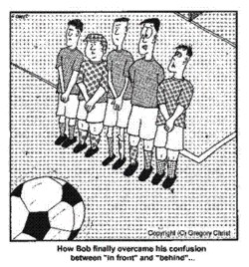

Slide 11
2012/13 Year ahead
Change in Club President
Concern about volunteer turnover
On going player registration
Concern about player numbers
Planned financial stability
Identification of fundraising events
Coach and player clinics, training, etc.

Slide 12
Election of 2012/13 Board and Officers
President: Wayne Doughty Imm. Past President: Scott Smith
Vice President: Bruce Lambrecht Secretary: Open
Treasurer: Charlie Spaulding Registrar: Hilary Lambrecht
Director of Coaching*: Carrie Larrabee Referee Adm.*: Garrett Shepherd
At Large Members: Larry Goodwin, Beth Hillier, Andrew Morneault, Chris Phair, Chad Pooler, Joel Selwood, Chad Sisson, Steve Soucy, Maureen Vashon, Eric Warn
*Non-voting, non-Board
By-laws allow for 15 Board Members

Slide 13
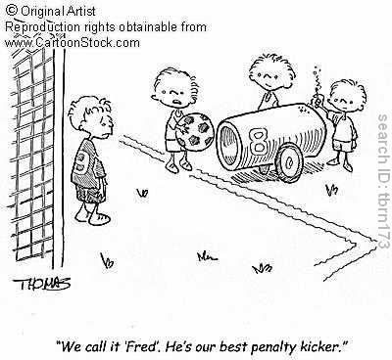

Slide 14
Thank you for attending !

