Slide 1
Sexual Health Education
Volusia County Schools
Grades 9-12 Abstinence Plus

Slide 2
In this lesson, we will:
Review what we’ve learned in Grade 4 to now
Look at local high schoolers’ behavior and knowledge
Look at Volusia and Florida data
Learn how pregnancy occurs
Learn how to avoid pregnancy
Learn how HIV/AIDS is transmitted
Learn about consent
Recognize a healthy vs. unhealthy relationship

Slide 3
What we’ve learned, so far…
4th and 5th grade
Biology
Plant reproduction: spore, egg, pistol, stamen
Animal reproduction: egg, sperm, zygote
Changes program: Puberty education…testes descending, menstrual cycle starting, acne, body odor, voice cracking and deepening
Reproductive system:
Female: ovaries, fallopian tubes, uterus
Male: testes, sperm
Notes:
Pituitary gland->estrogen/testosterone. Mood swings, rebellion from parents, risky behaviors...pressure from peers, both positive and negative

Slide 4
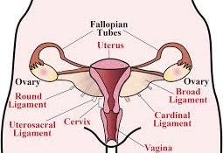
Female reproductive system
Notes:
Eggs stored in ovaries, released into fallopian tubes, unfertilized egg does not implant and uterine lining is shed approximately every 28 days, a menstrual cycle.

Slide 5
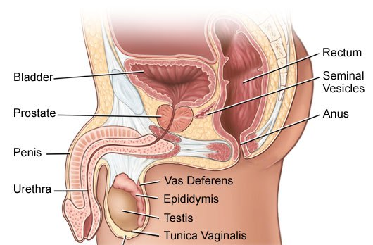
Male reproductive system
Notes:
Sperm is created in the testis, where testosterone is also produced, stored in the vas deferens, carried out of the testicle through the epididymis. In order to survive, sperm require slightly lower than body temperature, which is why the testes descend out of the body into the scrotal sac.

Slide 6
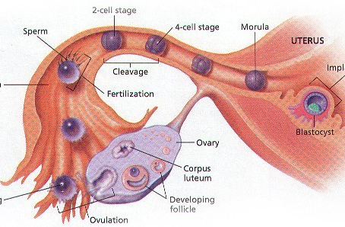
Conception: fertilization, implantation, pregnancy
Notes:
Egg and sperm are gametes, each possessing a half set of DNA. A sperm lives for up to 5 days and an egg lives for 12-24 hours. A fertilized egg is called a zygote (2 gametes=>a full set of DNA. The zygote implants in the wall of the uterus. At 2 months it is called a fetus. Gestation is typically 9 months and a baby is born. USDA reports that on average, it costs $233,610 to raise a child in the USA, not including college. (Jan 2017, looking at March 2015 data)

Slide 7
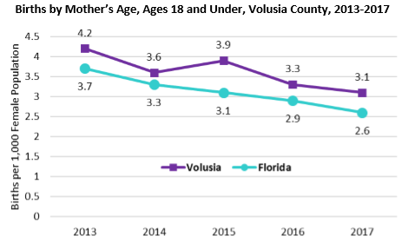
Births to under 18’s 2013-2017
Source: FL Department of Health
Notes:
Abstinence is the only 100% way to not get pregnant.

Slide 8
Volusia County student data
Florida Youth Behavior Survey Data
According to a high school survey, last year, more students think that condom use is more effective than abstinence. To be clear, abstinence is the only 100% effective way to prevent pregnancy and sexually-transmitted infections
Notes:
Only 42% of high schoolers have had sex at least once. Your peers are not all having sex. You have a choice.

Slide 9
Contraception
Abstinence is 100% effective
Condom: external condom, internal condom
IUD
Spermicidal foam
Sponge
Birth control pill
Hormonal IUD
Birth control patch
Diaphragm
Ring
Vasectomy
Tubal ligation
Source: Centers for disease control
Notes:
% = number of women / 100 who had unintended pregnancy with 1st year of use (CDC data)

Slide 10
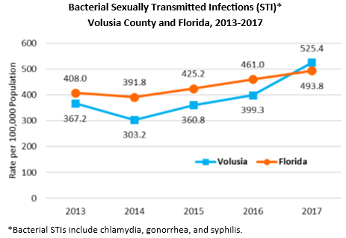
Bacterial STI’s
Source: FL Department of Health
Notes:
Sexual activity is risky behavior; it carries the risk of diseases, as well as pregnancy. On the rise…

Slide 11
Sexually-transmitted infections
Bacterial STI’s:
Chlamydia
Syphilis
Gonorrhea
Viral STI’s:
Genital warts/Human Papilloma Virus (HPV)
Herpes
HIV/AIDS
Bacterial STI’s can be cured with antibiotics.
Viral STI’s cannot be cured. They can only be controlled. Once you contact a viral STI, you will have it for the rest of your life.
Notes:
HPV is linked to cervical cancer in females and throat cancer in males. It can be immunized.
There is no cure for viral infections.

Slide 12
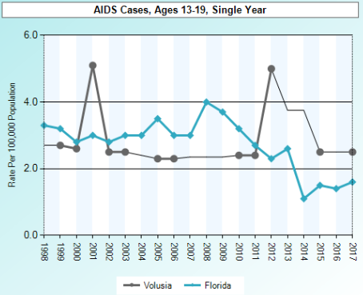
AIDS infections
Source: FL Department of Health
Notes:
On the rise…and this is only those who have been tested. Many have not been tested and do not yet know they carry the infection.

Slide 13
Transmission of HIV/AIDS
Blood
Breast milk
Genital fluids
Three ways HIV/AIDS can be transmitted.
Notes:
Genitals are the external reproductive organs of males and females.

Slide 14
How do we prevent the spread of HIV/AIDS?
Universal precautions when dealing with blood (Latex gloves)
Abstinence from sexual behavior
Consistent and correct condom use
Medication for infected mother to prevent infection to child
Notes:
ABSTINENCE!

Slide 15
True or False?
The egg and sperm are gametes
Fertilization occurs in the uterus
Viral STIs can be cured
HIV is transmitted by kissing

Slide 16
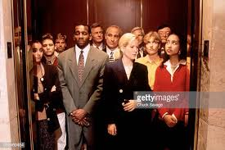
The Crowded Bed
http://pe.dadeschools.net/healthliteracy/HS%20Activity%20The%20Crowded%20Bed.pdf
Notes:
http://pe.dadeschools.net/healthliteracy/HS%20Activity%20The%20Crowded%20Bed.pdf

Slide 17
Percentage of High School Students Who Experienced Sexual Dating Violence,* by Sex,† Grade, and Race/Ethnicity, 2017
*Being forced by someone they were dating or going out with to do sexual things (counting such things as kissing, touching, or being physically forced to have sexual intercourse) that they did not want to, one or more times during the 12 months before the survey, among students who dated or went out with someone during the 12 months before the survey
†F > M (Based on t-test analysis, p < 0.05.)
All Hispanic students are included in the Hispanic category. All other races are non-Hispanic.
Missing bar indicates fewer than 100 students in this subgroup.
Note: This graph contains weighted results.
Florida - YRBS, 2017 - QN21
Notes:
Data for this slide are from the 2017 Florida Youth Risk Behavior Survey. This slide shows the percentage of high school students who experienced sexual dating violence (being forced by someone they were dating or going out with to do sexual things [counting such things as kissing, touching, or being physically forced to have sexual intercourse] that they did not want to, one or more times during the 12 months before the survey, among students who dated or went out with someone during the 12 months before the survey). Without consent, this is sexual assault.
The percentage for all students is 6.2. The percentage for Male students is 4.9. The percentage for Female students is 7.6. The percentage for 9th grade students is 6.8. The percentage for 10th grade students is 5.5. The percentage for 11th grade students is 7.3. The percentage for 12th grade students is 4.8. The percentage for Black students is 4.9. The percentage for Hispanic students is 6.6. The percentage for White students is 6.7. All Hispanic students are included in the Hispanic category. All other races are non-Hispanic. Note: This graph contains weighted results. Missing bar indicates fewer than 100 students in this subgroup.
For this behavior, the prevalence for female students is higher than for male students. (Based on t-test analysis, p < 0.05.)

Slide 18
Percentage of High School Students Who Experienced Sexual Violence,* by Sex,† Grade, and Race/Ethnicity, 2017
*Being forced by anyone to do sexual things [counting such things as kissing, touching, or being physically forced to have sexual intercourse] that they did not want to, one or more times during the 12 months before the survey
†F > M (Based on t-test analysis, p < 0.05.)
All Hispanic students are included in the Hispanic category. All other races are non-Hispanic.
Note: This graph contains weighted results.
Florida - YRBS, 2017 - QN20
Notes:
Data for this slide are from the 2017 Florida Youth Risk Behavior Survey. This slide shows the percentage of high school students who experienced sexual violence (being forced by anyone to do sexual things [counting such things as kissing, touching, or being physically forced to have sexual intercourse] that they did not want to, one or more times during the 12 months before the survey). Without consent, this is sexual assault.
The percentage for all students is 9.9. The percentage for Male students is 7.0. The percentage for Female students is 12.8. The percentage for 9th grade students is 10.2. The percentage for 10th grade students is 9.5. The percentage for 11th grade students is 9.7. The percentage for 12th grade students is 9.9. The percentage for Asian students is 7.4. The percentage for Black students is 9.3. The percentage for Hispanic students is 10.2. The percentage for White students is 9.8. All Hispanic students are included in the Hispanic category. All other races are non-Hispanic. Note: This graph contains weighted results.
For this behavior, the prevalence for female students is higher than for male students. (Based on t-test analysis, p < 0.05.)

Slide 19

What is consent?
https://youtu.be/QDhKM8qWWBM

Slide 20
10 Signs of an Unhealthy relationship?
INTENSITY
Having really extreme feelings or over-the-top behavior that feels like too much. Examples are rushing the pace of a relationship, always wanting to see you and talk to you, and feeling like someone is obsessed with you.
JEALOUSY
An emotion that everyone experiences, jealousy becomes unhealthy when someone lashes out or tries to control you because of it. Examples can be getting upset when you text or hang out with people your partner feels threatened by, accusing you of flirting or cheating, being possessive over you or even going so far as to stalk you.
MANIPULATION
When a partner tries to influence your decisions, actions or emotions. Manipulation is not always easy to spot, but some examples are convincing you to do things you wouldn’t normally feel comfortable with, ignoring you until they get their way, and using gifts and apologies to influence your decisions or get back in your good graces.
ISOLATION
Keeping you away from friends, family, or other people. Examples can be when your partner makes you choose between them and your friends, insisting you spend all your time with them, making you question your own judgement of friends and family, and making you feel dependent on them for money, love or acceptance.
SABOTAGE
Purposely ruining your reputation, achievements or success. Examples can be making you miss work, school or practice, keeping you from getting school work done, talking about you behind your back or starting rumors, and threatening to share private information about you.
Notes:
At the completion of this activity, students volunteer to share their group’s “not sure” cards. Discussion of those leads to: healthy/unhealthy behaviors depends upon the INTENT of one person towards the other. An attempt to CONTROL is always unhealthy.
Cards: https://bit.ly/2BFxFLD

Slide 21
10 Signs of an Unhealthy Relationship Cont….
BELITTLING
Making you feel bad about yourself. Examples can be calling you names, making rude remarks about who you hang out with, your family or what you look like, and making fun of you – even if it’s played off as just a joke.
GUILTING
Making you feel guilty or responsible for your partner’s actions. Examples can be making you feel responsible for their happiness, making you feel like everything is your fault, threatening to hurt themselves or others if you don’t do as they say or stay with them, pressuring you to do anything sexual you’re not comfortable with.
VOLATILITY
Unpredictable overreactions that make you feel like you need to walk on eggshells around them or do things to keep them from lashing out. Examples can be mood swings, losing control of themselves by getting violent or yelling, threatening to hurt you or destroy things, and making you feel afraid of them. This can also be lots of drama or ups and downs in a relationship.
DEFLECTING RESPONSIBILITY
Making excuses for their behavior. Examples can be blaming you, other people or past experiences for their actions, using alcohol or drugs as an excuse, using mental health issues or past experiences (like a cheating ex or divorced parents) as a reason for unhealthy behavior.
BETRAYAL
When your partner acts differently with you versus how they act when you’re not around. Examples can be lying to you, purposely leaving you out or not telling you things, being two-faced, acting differently around friends, or cheating while in a relationship with you.

Slide 22
Sources
Florida Department of Health
Florida Department of Education
Healthy Schools
Teen Pregnancy/HIV Prevention Specialist
Advocates for Youth-Florida Folder
Centers for Disease Control
Florida Youth Behavior Survey Data

