Slide 1
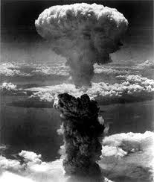
Holy War, Holy Peace
A biblical, historical and political perspective

Slide 2
Welcome!
Notes:
Do introductory questions

Slide 3

Question / Comments
GodandCaesar@gmail.com
Notes:
I created a special email account for this class for you to contact me – questions, comments, clarifications

Slide 4
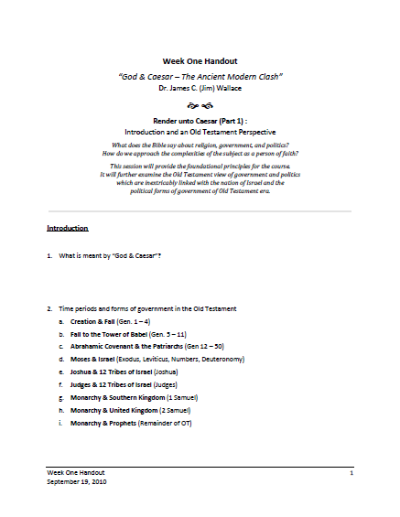
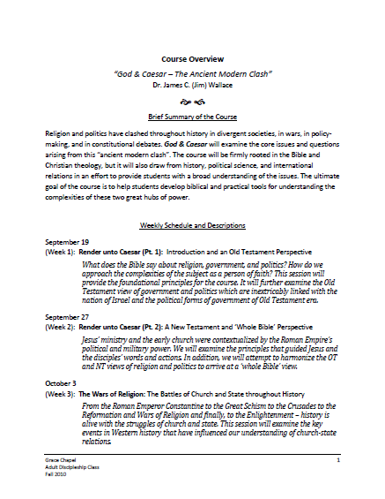
Introduction
Handouts
Notes:
Will have handouts each week
Completed handouts will be posted online at Grace Chapel website

Slide 5
Holy War, Holy Peace
Meaning of “War”
Oxford English Dictionary
Hostile contention by means of armed forces, carried on between nations, states, or rulers, or between parties in the same nation or state; the employment of armed forces against a foreign power, or against an opposing party in the state.

Slide 6
Holy War, Holy Peace
Meaning of “War”
Merriam - Webster
A state of usually open and declared armed hostile conflict between political units (as states or nations).
A state of hostility, conflict, opposition, or antagonism between mental, physical, social, or other forces (i.e., war on drugs [1971], war on terror [2001], war on poverty [1964], war on cancer [1971])

Slide 7
Holy War, Holy Peace
Three Kinds of War
Wars of gain = wars of opportunity, wars of conquest, wars of territorial expansion, wars of imperialism and colonialism
Wars of fear = wars of necessity, defensive wars, pre-emptive wars (looming threat and
impending disaster)
Wars of doctrine = wars to assert a principle, wars to advance a cause, a crusading war, a missionary war

Slide 8
Holy War, Holy Peace
Three Additional, New Kinds of War
Wars to uphold international peace and security
Wars of national liberation
Wars to protect human rights

Slide 9
An Old Testament View
‘War’ in the Hebrew language and culture
Several different words translated ‘war’
To strive , to contend, to stir up strife, to engage in conflict
To conquer, to fight, to overcome
To arm, army, battle, warrior, war cry or shout

Slide 10
An Old Testament View
A god of war
In early Israel, God is sometimes described as a warrior God.
Exodus 15:3 – “The LORD is warrior”
Numbers 21:14 – “Book of Wars of the Lord”
Joshua 10:11 – “The LORD hurled large hailstones”
Judges 5:1-31 – The Song of Deborah
Psalms 46:7 – “The LORD of hosts”

Slide 11
An Old Testament View
A nation of war
“Israel” is the name that God gave Jacob after he wrestled with God all night at the crossing of the Jabbock. (Genesis 32:22-32)
Genesis 32:28 – “Then the man said, ‘Your name will no longer be Jacob, but Israel, because you have struggled with God and with men and have overcome.’”
Israel = “God strives”. Could also be translated, “God wars against . . .”

Slide 12
An Old Testament View
The Canaanite period
Israel was borne in battle – the battle with the army of Pharaoh at the crossing of the Red Sea. (Exodus 14-15)
Exodus 14:13-14 – Moses answered the people, “Do not be afraid. Stand firm and you will see the deliverance the LORD will bring you today. The Egyptians you see today you will never see again. The LORD will fight for you; you need only to be still.”
Deuteronomy 20 – Instructions for how to go to war and fight battles.

Slide 13
An Old Testament View
The period of conquest and settlement
The story of the conquest and settlement of the Promised Land is the story of successive battles fought by Joshua and the Judges of Israel.
Joshua 5:13 – 6:27 - The Battle of Jericho
Judges 4-5 – Deborah
Judges 7 – Gideon

Slide 14
An Old Testament View
The period of the monarchies
1 Samuel 8:19-20 – “We want a king over us. Then we will be like all the other nations, with a king to lead us and go out before us and fight our battles.”
1 Samuel 13 – Saul was rejected by God as king, because he was impatient in the preparations for going into battle.
(cf. Deuteronomy 20:1-4).
2 Samuel 11:1 –“In the spring, at the time when kings go off to war . . .”

Slide 15
An Old Testament View
The period of the second Temple
The period of the second Temple (516 BC to 70 AD) was the era of the Persian and Greek wars of which we know a great deal from extra-biblical sources:
  Thucydides – The Peloponnesian War
  Herodotus – The Histories

Slide 16
An Old Testament View
The period of the second Temple
It was the Persian king, Cyrus the Great, that allowed the Jewish exiles to return from captivity to Jerusalem to start rebuilding the temple in 538 BC (2 Chronicles 36:22-23; Ezra 1:1-4). The work was completed under King Darius (Ezra 5-6).

Slide 17
An Old Testament View
A view of peace
OT view is largely individualistic
False prophets often prophesied “peace”
(Jeremiah 14:13, 28:9)
A coming new era 0f peace
  A Prince of Peace (Isaiah 9:2-7)
  A kingdom of peace (Zechariah 9:9-12; Micah 4:1-3)
Gideon saw the true nature of God
(Judges 6:22-24)

Slide 18
Holy War, Holy Peace
Questions?
Discussion?
What have we learned today?

