Slide 1
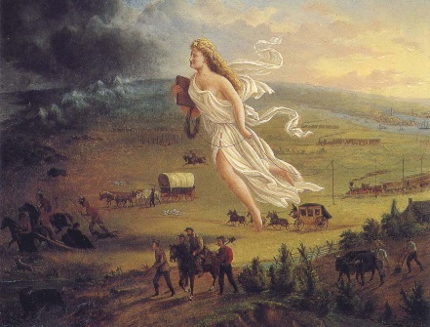
Religion & American Foreign Policy Through Christian Eyes
Week #5 – Manifest Destiny: Is it God’s Will that
we spread American Values
Grace Chapel Discipleship Series – Fall 2014
Dr. James C. (Jim) Wallace

Slide 2

Good Morning!
All class materials are available online at www.grace.org/discipleshipcourses
Next Sunday – October 25
  I’ll be away
  I have a video for you
  I will add an extra class at the end –
  December 14 – as a make-up

Slide 3
Now to finish
last week

Slide 4
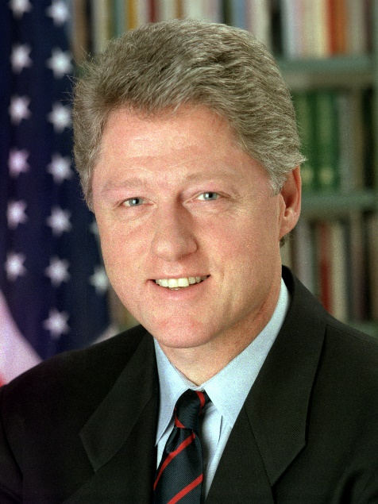
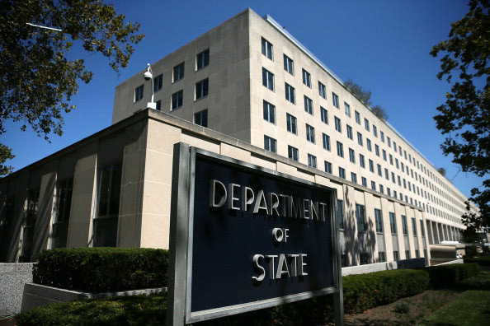
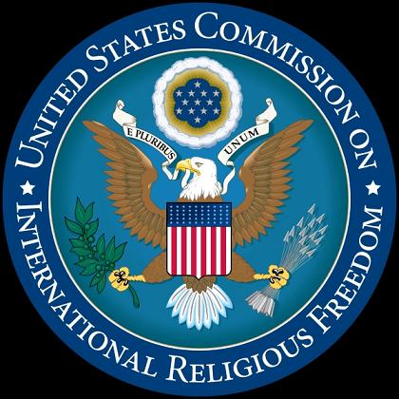
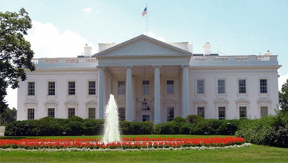
Implications for
U.S. Foreign Policy
International Religious Freedom Act of 1998

Slide 5
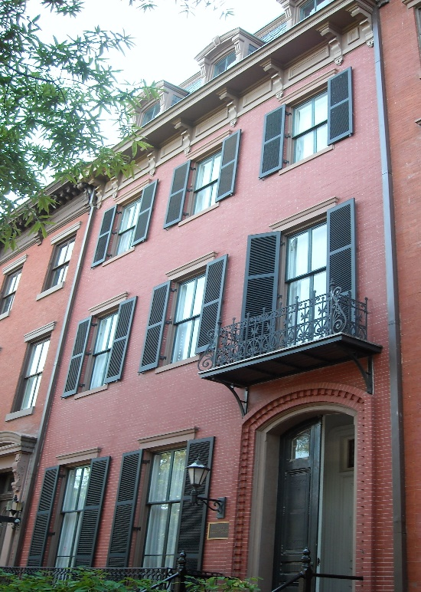
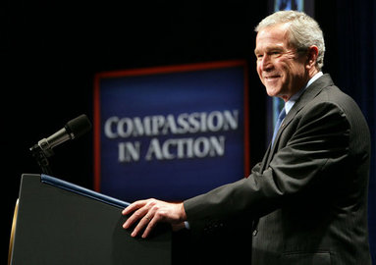
Implications for
U.S. Foreign Policy
White House Office of Faith-based and Neighborhood Partnerships, 2001

Slide 6
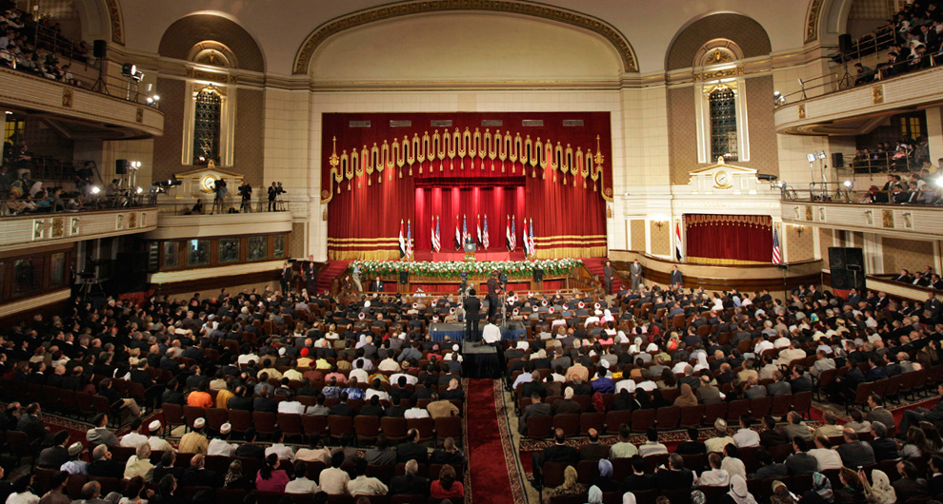
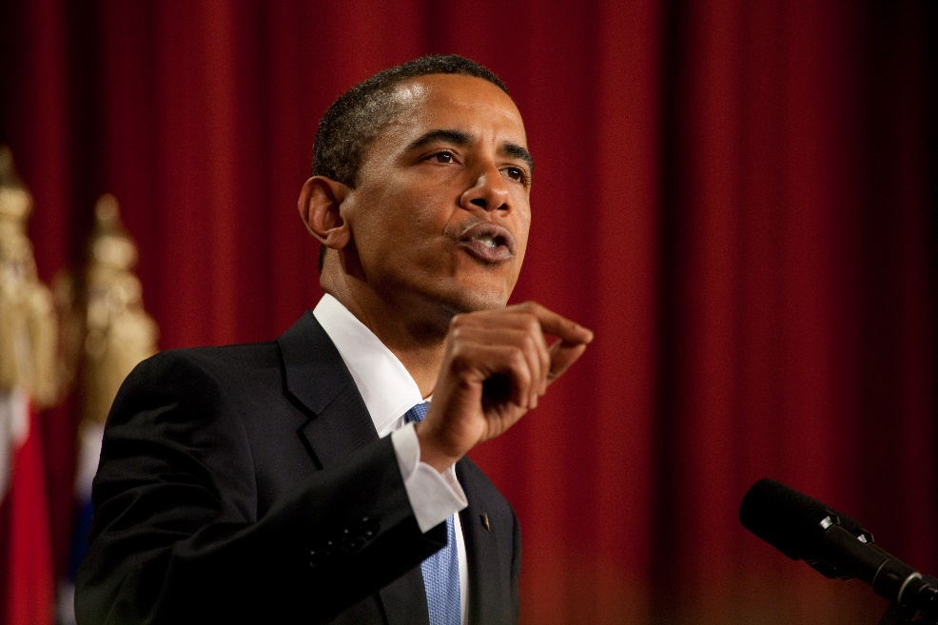
Implications for
U.S. Foreign Policy
President Obama speech to Muslim leaders – “A New Beginning” – Al-Azhar University, Cairo, Egypt, June 4, 2009

Slide 7
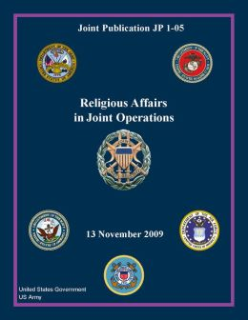
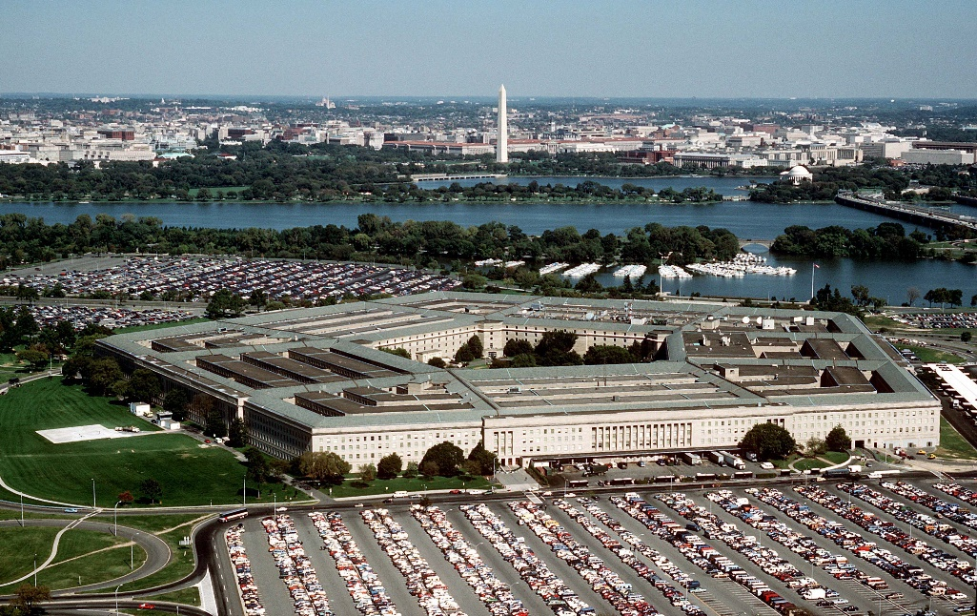
Implications for
U.S. Foreign Policy
Department of Defense
JP 1-05
Religious Affairs in Joint Operations
November 13, 2009

Slide 8
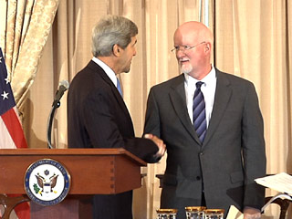
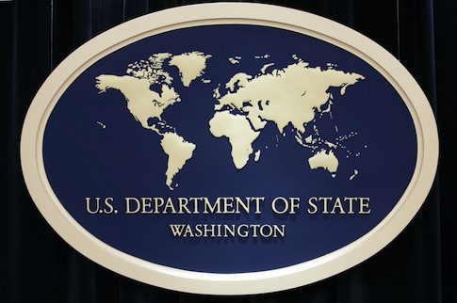
Implications for
U.S. Foreign Policy
State Department
Office of Faith-based
Community Initiatives
August 9, 2013

Slide 9
Now on to
this week

Slide 10
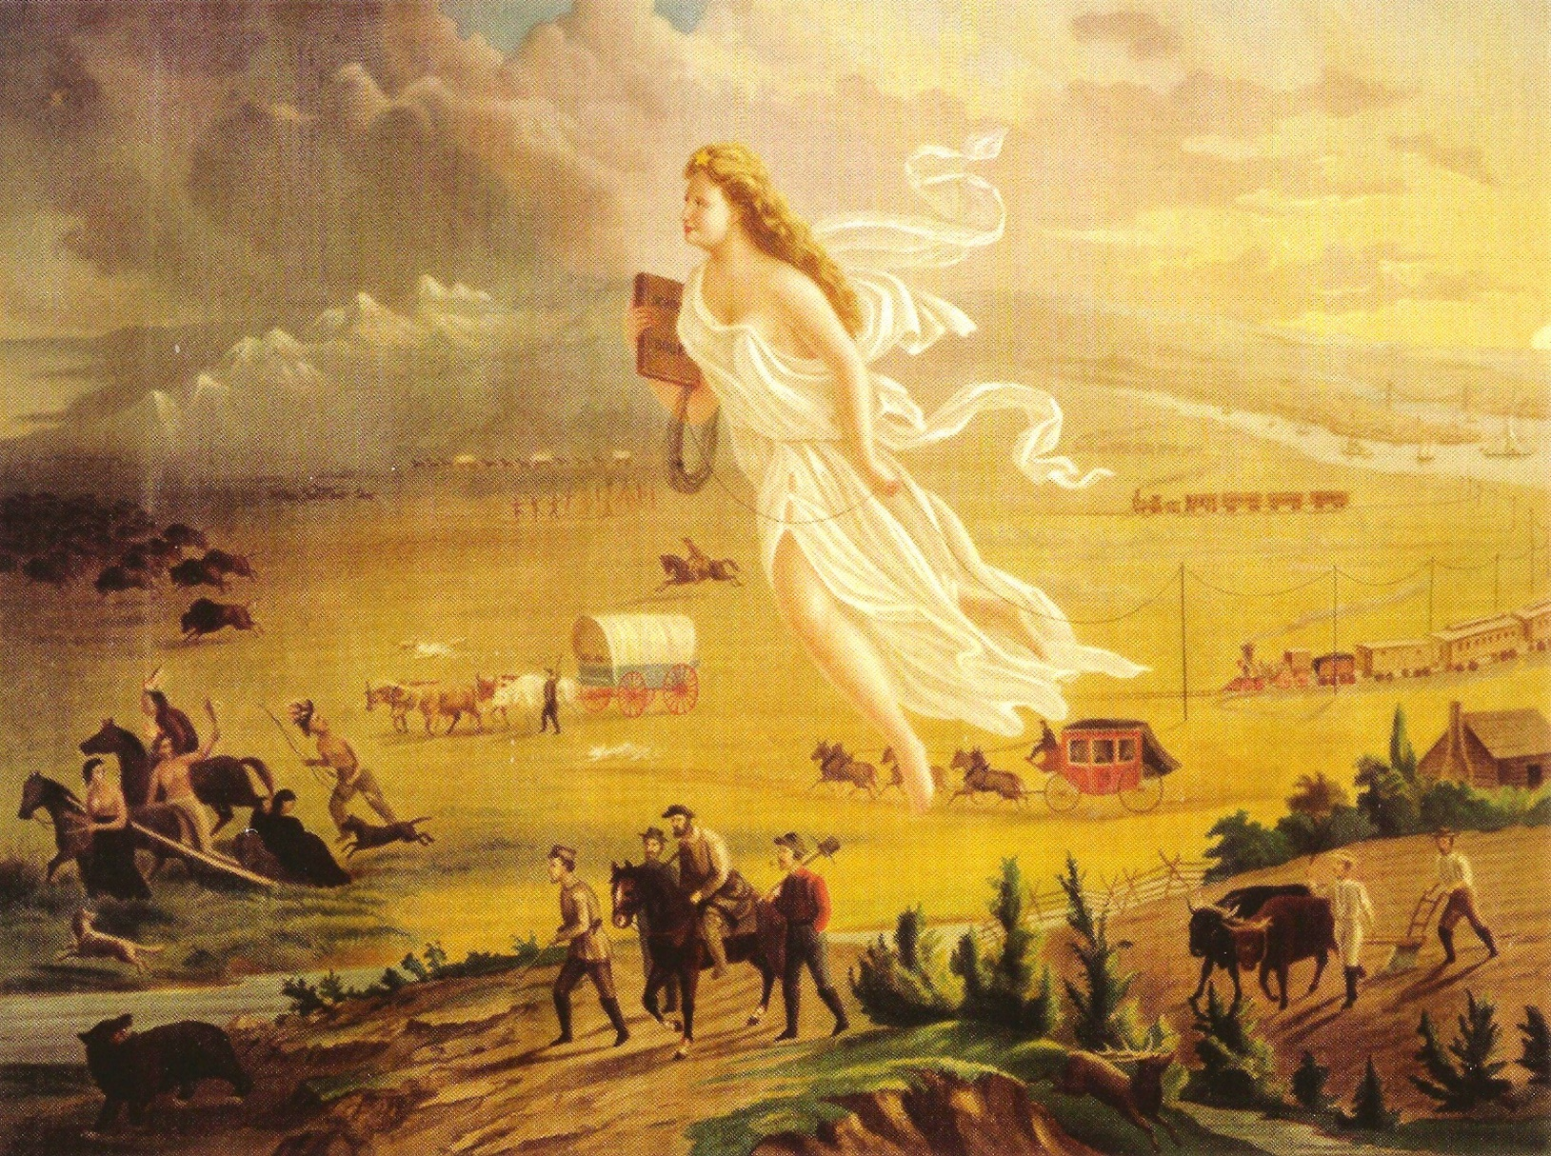
“Columbia”
The personification of American Progress
Painting – “American Progress”
John Gast (circa 1872)
Notes:
This painting (circa 1872) by John Gast called American Progress, is an allegorical representation of the modernization of the new west. Here Columbia, a personification of the United States, leads civilization westward with American settlers, stringing telegraph wire as she sweeps west; she holds a school book as well. The different stages of economic activity of the pioneers are highlighted and, especially, the changing forms of transportation.
Columbia (/kəˈlʌmbiə; kə-LUM-bee-ə) is a historical and poetic name used for the United States of America and is also one of the names of its female personification. It has inspired the names of many persons, places, objects, institutions, and companies; e.g., Columbia University, the District of Columbia (the national capital), and the ship Columbia Rediviva, which the Columbia River would be named after. Columbia was largely displaced as the female symbol of the U.S. by the Statue of Liberty around 1920.[

Slide 11
Expansionism & Reform
Following the War of 1812 . . .
  The U.S. entered a period of optimism and
  explosive growth
  Immigration and infrastructure growth
  Social reform driven by the Second Great Awakening
    1790-1840
    Charles Finney, camp meeting revivals, church membership soars
    Mormonism, Adventism, Christian Restorationism
    Social reform movements (temperance, women’s rights, abolitionist movement)
  Expansionism . . .
    Louisiana Purchase from France (1803) – T. Jefferson

Slide 12
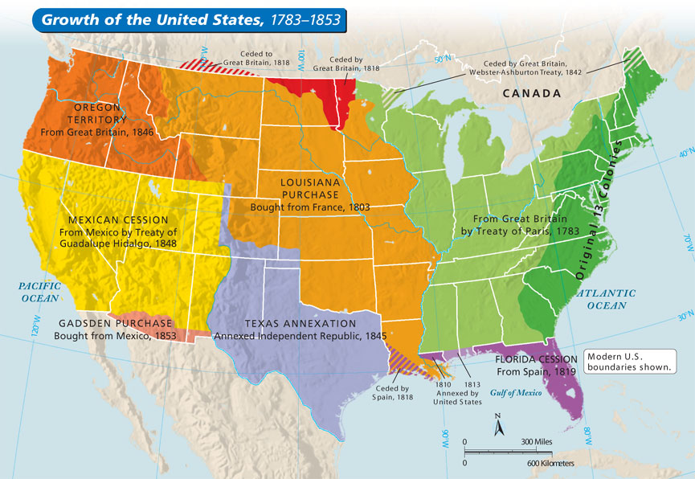

Slide 13
Expansionism & Reform
  Expansionism . . . and the question of slavery
    Will new Western states be slave or free?
    Missouri Compromise (1820) – J. Monroe
    Prohibited slavery in the former Louisiana Territory, except Missouri
    Kansas-Nebraska Act (1854) – Stephen A. Douglas
    Created Kansas and Nebraska
    Repealed the Missouri Compromise
    Allowed states to determine for themselves whether they would allow slaves . . .
    The only voters were white men!

Slide 14
Manifest Destiny
The belief that America had a God-given
right and duty to conquer and civilize
the entire North American continent
  Virtue of the American system and institutions
  Mission to spread American ideas and institutions
  A destiny determined by God (Calvinist predestination)

Slide 15
Manifest Destiny
John O’Sullivan (newspaperman) coined
the term
  1839 – spoke of “divine destiny” - "to establish on earth the moral dignity and salvation of man“
  1845 – spoke of “manifest destiny” – in essay entitled Annexation urging the U.S. to annex the Republic of Texas
  Used to justify westward expansion – “Continentalism”
  Used to justify war with Mexico – over Texas & the Southwest
Manifest Destiny also involved . . .

Slide 16
Manifest Destiny
Native Americans – missionizing, moving and then removal
Westward settlement – Texas, Oregon, California
Key element of the Mormon story

Slide 17
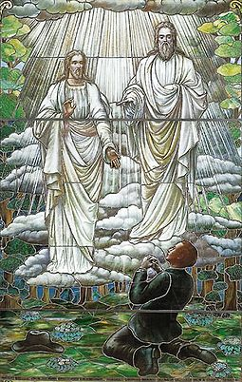
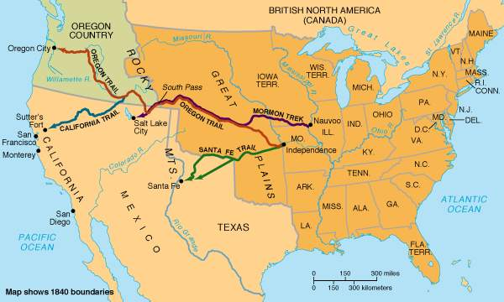
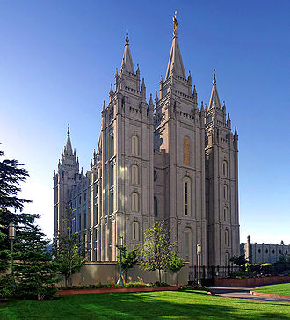

Slide 18
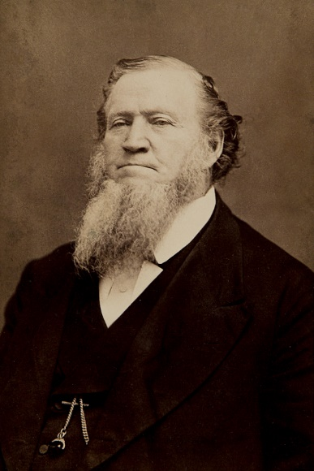
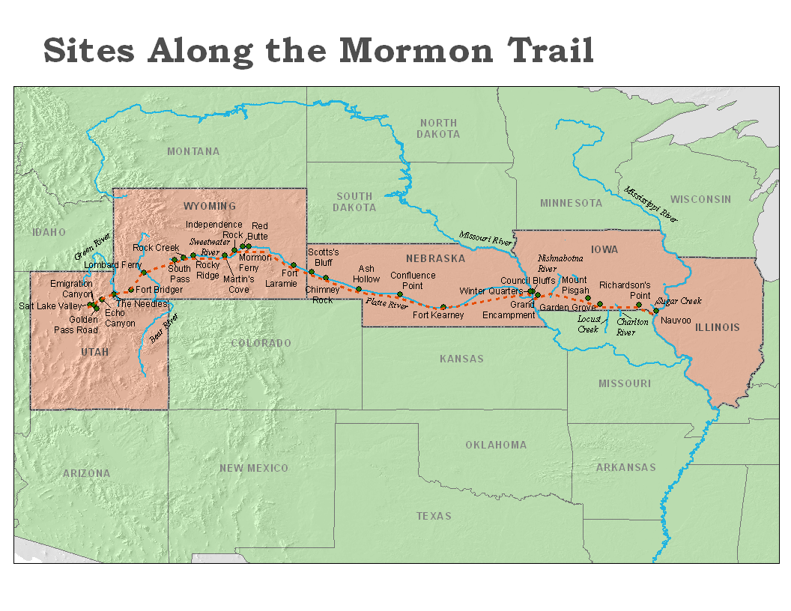
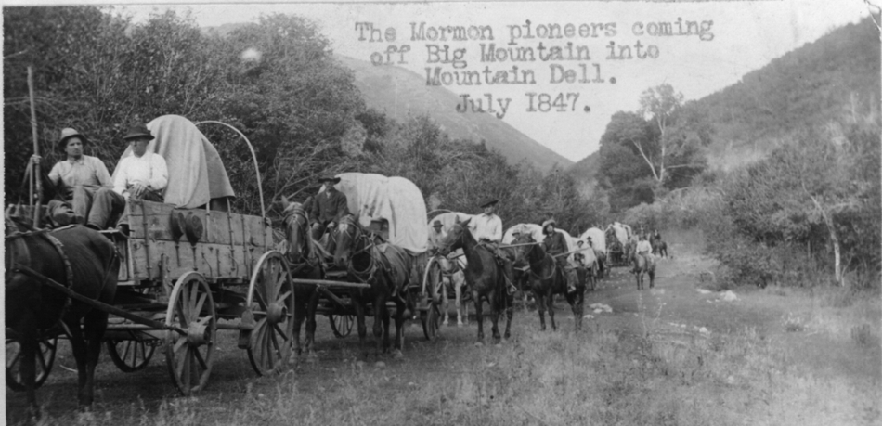

Slide 19
Manifest Destiny
Native Americans – missionizing, moving and then removal
Westward settlement – Texas, Oregon, California
Key element of the Mormon story
Divided religious views on slavery
  Pro-slavery manifest destiny
  Anti-slavery manifest destiny
  “Providence cuts both ways”

Slide 20
Manifest Destiny & Foreign Affairs
Missionaries
  Vanguards of manifest destiny – first at home,
  then abroad
    1800 – New York Missionary Society
    1810 – American Board of Commissioners for Foreign Missions
    1813 – Wesleyan Missionary Society
    1816 – American Bible Society
  Advance agents of civilization
  Spreading American ideas, values, institutions, economics and religion
  “Missionaries thus combined internationalism, nationalism, cosmopolitanism and parochialism in highly combustible and unpredictable ways.”

Slide 21
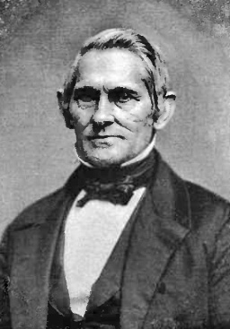
Manifest Destiny & Foreign Affairs
  Four regions where American missionaries were active:
    China
    Ottoman Empire (Middle East)
    Africa
    Hawaii
  Missionaries became facilitators and agents of American foreign expansion and imperialism
Hiram Bingham
Lead American Missionary Group
which introduced Christianity to Hawaii

Slide 22
Manifest Destiny & the Middle East
Middle East
  Place of trade and American commerce
  Place of deep religious interest to Americans
  Logical place of missions focus:
    Under Muslim domination since Crusades
    Return to Christian and Jewish control
    Restoration and return of Jews to Israel
  1885-1895 missions in the Middle East
    Missions budgets expanded sevenfold to support . . .
    400 schools
    9 colleges
    9 hospitals
    Newspapers, journals, presses

Slide 23
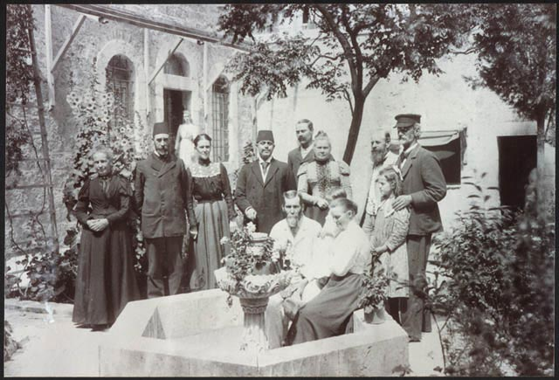
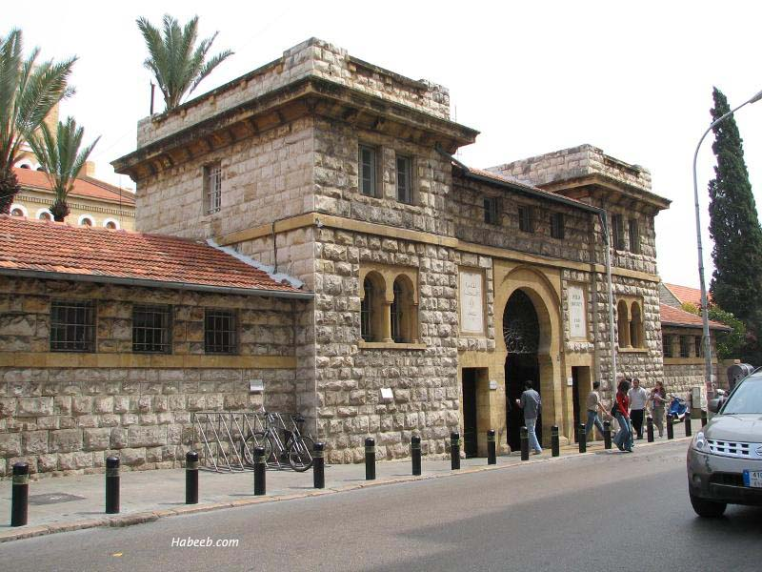
American Colony, Jerusalem (1881)
Anna & Horatio Spafford
Syrian Protestant College (1866)
American University of Beirut (1920)
Rev. Daniel Bliss

Slide 24
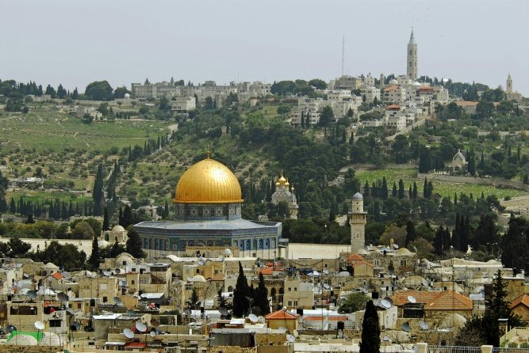
Manifest Destiny & the Middle East
  Missionaries and their supporting organizations became one of the primary influences in shaping American foreign policy in the
  Middle East – both abroad and
  at home – for generations.

Slide 25
Discussion Questions
Do you think it is possible for missionaries to do their work – preaching, teaching, healing – without also becoming “ambassadors” for the country they call home? Is this a good thing or a bad thing?
How much influence do you think missionaries and their host organizations should exert on the political foreign policy of their home country? Do you feel the same way about missionaries that come from other countries to the United States?

