Slide 1
Religion & American Foreign Policy Through Christian Eyes
Week #4 – The Constitution: The First Amendment and the
Roots of a Secular Foreign Policy
Grace Chapel Discipleship Series – Fall 2014
Dr. James C. (Jim) Wallace

Slide 2
Good morning!
Video, PowerPoint and materials online
http://www.grace.org/article397645.htm?body=1
A reminder about discussion etiquette

Slide 3
Religion
Congress vs. U.S. Population
Congressional Religious Belief | # | %
Christian | 480 | 90.5
Agnostic (Unitarian) | 1 | 0.2
Jewish | 32 | 6
Muslim | 2 | 0.4
Buddhist | 3 | 0.6
--- | -- | --
Hindu | 1 | 0.2
Unaffiliated | None | 1 | 0.2
--- | -- | --
--- | -- | --
Don’t Know | Refused | 10 | 2
Source: CQ Roll Call & Pew Forum | January 3, 2013
U.S. Religious Belief | # | %
Christian | 248M | 79.7
Agnostic | 43M | 13.9
Jewish | 5.2M | 1.7
Muslim | 4.1M | 1.3
Buddhist | 3.9M | 1
New religionist | 1.6M | 0.5
Hindu | 1.4M | 0.4
Atheist | 1.3M | 0.4
Ethnoreligionist | 1M | 0.3
Baha'i | 515K | 0.17
Other | 798K | .63
Source: World Religions Database | Boston University | February 9. 2013

Slide 4
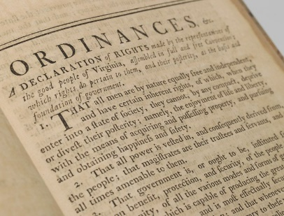
Religion in
The Documents
Virginia Declaration of Rights (June 12, 1776)
Model for Declaration of Independence (1776), U.S. Bill of Rights (1789/1791), French Declaration of the Rights of Man (1789)
Authors: George Mason and Thomas Ludwell Lee
  Section 1. That all men are by nature equally free and independent and have certain inherent rights, of which, when they enter into a state of society, they cannot, by any compact, deprive or divest their posterity; namely, the enjoyment of life and liberty, with the means of acquiring and possessing property, and pursuing and obtaining happiness and safety.

Slide 5
Religion in
The Documents
Virginia Declaration of Rights (cont.)
  Section 16. That religion, or the duty which we owe to our Creator, and the manner of discharging it, can be directed only by reason and conviction, not by force or violence; and therefore all men are equally entitled to the free exercise of religion, according to the dictates of conscience; and that it is the mutual duty of all to practise Christian forbearance, love, and charity toward each other.

Slide 6
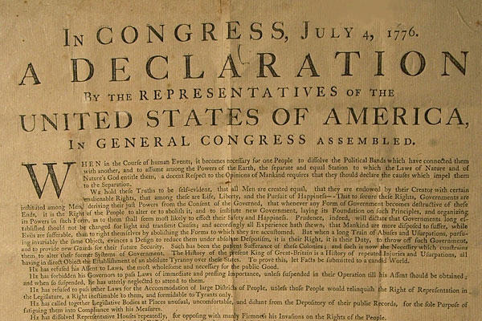
Religion in
The Documents
The Declaration of Independence (July 4, 1776)
Authors: T. Jefferson (VA), J. Adams (MA), B. Franklin (PA), Roger Sherman (CT), and Robert Livingston (NY)
  When in the Course of human events, it becomes necessary for one people to dissolve the political bands which have connected them with another, and to assume among the powers of the earth, the separate and equal station to which the Laws of Nature and of Nature's God entitle them . . .
  We hold these truths to be self-evident, that all men are created equal, that they are endowed by their Creator with certain unalienable Rights, that among these are Life, Liberty and the pursuit of Happiness.

Slide 7
Religion in
The Documents
The Declaration of Independence (cont.)
  We, therefore, the Representatives of the united States of America, in General Congress, Assembled, appealing to the Supreme Judge of the world for the rectitude of our intentions . . .
  And for the support of this Declaration, with a firm reliance on the protection of divine Providence, we mutually pledge to each other our Lives, our Fortunes and our sacred Honor.

Slide 8
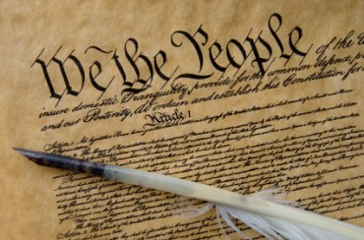
Religion in
The Documents
The U.S. Constitution (June 21, 1788)
Primary author: James Madison “Father of the Constitution”
  Preamble: We the People of the United States, in Order to form a more perfect Union, establish Justice, insure domestic Tranquility, provide for the common defence, promote the general Welfare, and secure the Blessings of Liberty to ourselves and our Posterity, do ordain and establish this Constitution for the United States of America.

Slide 9
Religion in
The Documents
The U.S. Constitution (cont.)
  Article Two, Section 1.8 – Oath of the President
  Before he enters the Execution of his Office, he shall take the following Oath or Affirmation:—"I do solemnly swear (or affirm) that I will faithfully execute the Office of President of the United States, and will to the best of my Ability, preserve, protect and defend the Constitution of the United States.“

Slide 10
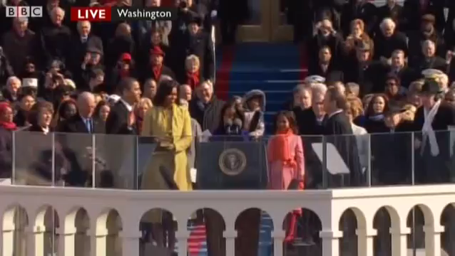
Obama Oath of Office
January 2009

Slide 11
Religion in
The Documents
The U.S. Constitution (cont.)
  Oath of VP, Senators, and Representatives – wording not specified in Constitution – established in law in 1884.
  Also used for other high government officials.
  I, A— B—, do solemnly swear (or affirm) that I will support and defend the Constitution of the United States against all enemies, foreign and domestic; that I will bear true faith and allegiance to the same; that I take this obligation freely, without any mental reservation or purpose of evasion; and that I will well and faithfully discharge the duties of the office on which I am about to enter. So help me God.

Slide 12
Religion in
The Documents
The U.S. Constitution (cont.)
  Article Six – Laws and Treaties
  The Senators and Representatives before mentioned, and the Members of the several State Legislatures, and all executive and judicial Officers, both of the United States and of the several States, shall be bound by Oath or Affirmation, to support this Constitution; but no religious Test shall ever be required as a Qualification to any Office or public Trust under the United States.
  In 1961, in Trocaso v. Watkins the USSC ruled the religious tests for public office written into State constitutions were unconstitutional (Arkansas, Maryland, Mississippi, North Carolina, Pennsylvania, South Carolina, Tennessee, Texas)

Slide 13
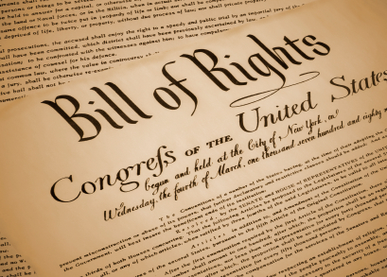
Religion in
The Documents
The U.S. Bill of Rights (December 15, 1791)
  There were no “rights” outlined in the original Consitution
  Became an issue during the ratification process between the Federalists and Anti-federalists
  James Madison proposed a Bill of Rights to the first session of the new U.S. Congress.
  A joint committee of the Senate and House proposed 12 amendments to the Constitution; sent them to the States for ratification (Sept. 25, 1789).
  Articles 3-12 we ratified by three-fourths of the States, so Article 3 became the First Amendment of the Constitution.

Slide 14
First Amendment
To The U.S. Constitution
Congress shall make no law respecting an establishment of religion, or prohibiting the free exercise thereof; or abridging the freedom of speech, or of the press; or the right of the people peaceably to assemble, and to petition the Government for a redress of grievances.

Slide 15
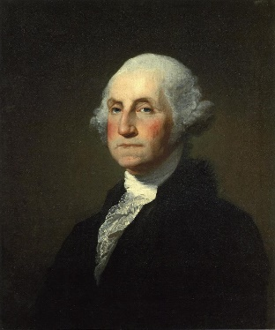
George Washington and the bill of rights
George Washington sworn into
office April 30, 1789
First Inaugural Address:
  For I assure myself that whilst you carefully avoid every alteration which might endanger the benefits of an United and effective Government, or which ought to await the future lessons of experience; a reverence for the characteristic rights of freemen, and a regard for the public harmony, will sufficiently influence your deliberations on the question how far the former can be more impregnably fortified, or the latter be safely and advantageously promoted.

Slide 16
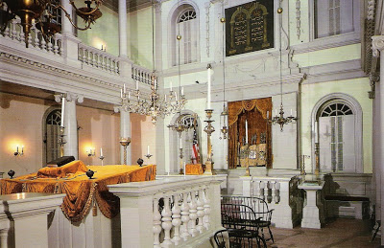
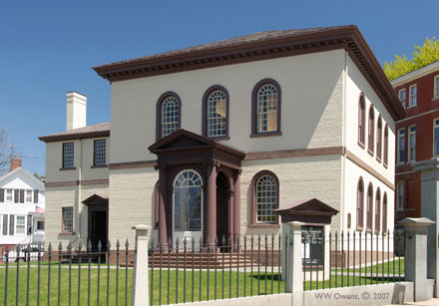
George Washington and the bill of rights
George Washington visited Newport, RI
August 17, 1790 to rally support for the new Bill of Rights, along with Thomas Jefferson.
Visited the Touro Synagogue, the oldest synagogue in America.

Slide 17
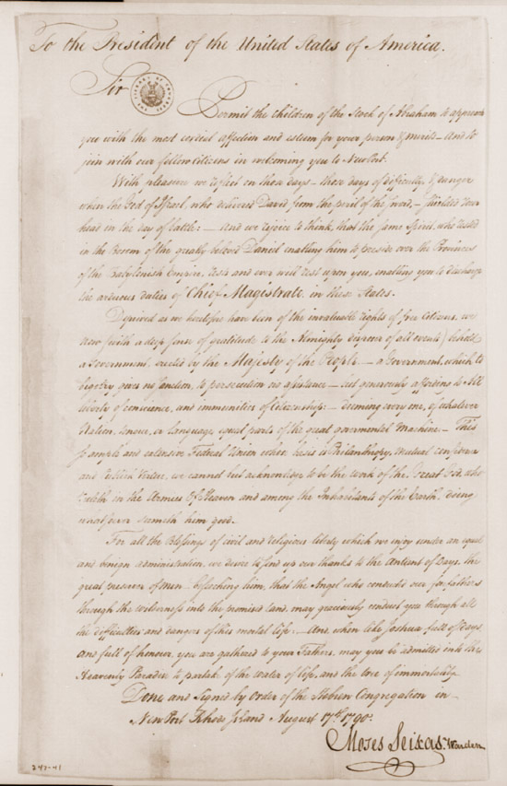
George Washington
and the bill of rights
Greetings from Moses Seixas, an official of the Jewish congregation
Deprived as we heretofore have been of the invaluable rights of free Citizens, we now (with a deep sense of gratitude to the Almighty disposer of all events) behold a Government, erected by the Majesty of the People—a Government, which to bigotry gives no sanction, to persecution no assistance—but generously affording to All liberty of conscience, and immunities of Citizenship: deeming every one, of whatever Nation, tongue, or language, equal parts of the great governmental Machine . . .

Slide 18
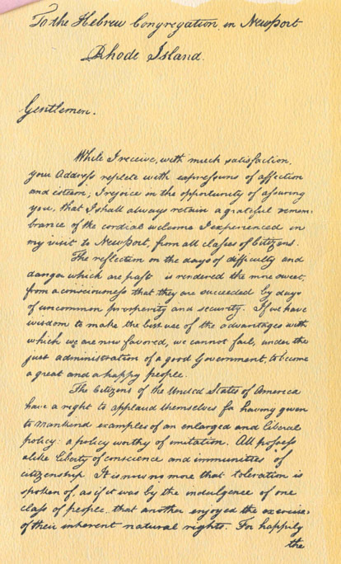
George Washington
and the bill of rights
Reply from George Washington to the “Hebrew Congregations of Newport, Rhode Island”
It is now no more that toleration is spoken of as if it were the indulgence of one class of people that another enjoyed the exercise of their inherent natural rights, for, happily, the Government of the United States, which gives to bigotry no sanction, to persecution no assistance, requires only that they who live under its protection should demean themselves as good citizens in giving it on all occasions their effectual support.

Slide 19
George Washington
and the bill of rights
May the children of the stock of Abraham who dwell in this land continue to merit and enjoy the good will of the other inhabitants—while every one shall sit in safety under his own vine and fig tree and there shall be none to make him afraid.
[Micah 4:4]
May the father of all mercies scatter light, and not darkness, upon our paths, and make us all in our several vocations useful here, and in His own due time and way everlastingly happy.

Slide 20
First Amendment
To The U.S. Constitution
Congress shall make no law respecting an establishment of religion, or prohibiting the free exercise thereof; or abridging the freedom of speech, or of the press; or the right of the people peaceably to assemble, and to petition the Government for a redress of grievances.

Slide 21
Four Streams of Thought
The Puritan View (Theological)
  Institutions are instruments of God’s authority
  Pluralism and liberty of conscience
The Evangelical View (Theological)
  Religious liberty and the wall of separation
  Liberty of conscience

Slide 22
Four Streams of Thought
The Enlightenment View (Political)
  State and church absolutely distinct
  Laws should not be based on religious premises or serve exclusively religious purposes
  Virginia Statute for the Establishment of Religious Freedom (drafted 1779, enacted 1786)
The Republican View (Political)
  The utility of religion in providing common ethic and common good
  A plurality of religions provides safeguards

Slide 23
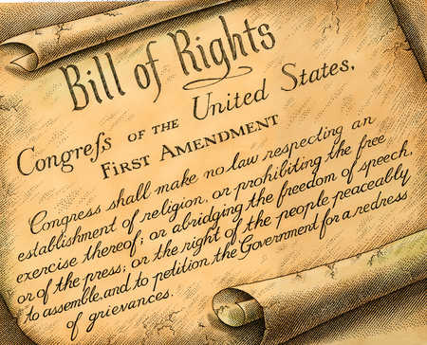
The Rights and Liberties of the Establishment Clause
Liberty of conscience
Free exercise of religion
Religious pluralism
Religious equality
Separation of church and state
Disestablisment of religion
No single principle could by itself guarantee religious liberty.

Slide 24
Reading and Interpreting The Establishment Clause
A thinner reading
  Congress may not prescribe [mandate] religion.
  Congress may not proscribe [prohibit] religion.
A thicker reading
  “Congress” – not binding on the states
  “Shall make” – an order
  “Respecting an establishment” – hotly contested meaning
  “Prohibiting free exercise”
  “Religion”

Slide 25
“The American experiment in religious liberty cannot be reduced to the First Amendment clauses alone, nor can the understanding of the framers be determined simply by studying the debates on these clauses in the First Session of Congress in 1789. . . .
The religion clauses on their face define only the outer boundaries of appropriate governmental action respecting religion.”
~ John Witte, Jr.

Slide 26
Separation of Church and State
Idea found in the Bible – Old and New Testaments
Idea a part of the Protestant Reformation
  “A wall of separation between the garden of the Church and the wilderness of the world”
  – Roger Williams, 1643
Thomas Jefferson letter to the Danbury Baptist Association, 1802, referencing the 1st Amendment:
  Believing with you that religion is a matter which lies solely between Man & his God, that he owes account to none other for his faith or his worship, that the legitimate powers of government reach actions only, & not opinions, I contemplate with sovereign reverence that act of the whole American people which declared that their legislature should 'make no law respecting an establishment of religion, or prohibiting the free exercise thereof,' thus building a wall of separation between Church and State.

Slide 27
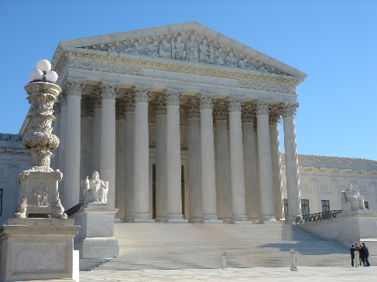
Supreme Court Decisions
1925 – Gitlow v. New York – In this free speech case in which the Supreme Court began to selectively incorporate rights from the Bill of Rights into the Fourteenth Amendment and declare that they were binding on the states. While the case only spoke of the freedom of speech and the press from the First Amendment it was later expanded to include religion.
1940 – Cantwell v. Connecticut – Continued the incorporation process begun by Gitlow and declared that the Fourteenth Amendment required states to abide by the Free Exercise clause of the First Amendment.

Slide 28
Supreme Court Decisions
1947 – Everson v. Board of Education - While allowing public schools to spend money transporting students to parochial schools this decision helped to clarify the court’s interpretation of the Establishment clause and incorporated it into the 14th amendment.
  The 'establishment of religion' clause of the First Amendment means at least this: Neither a state nor the Federal Government can set up a church. Neither can pass laws which aid one religion, aid all religions, or prefer one religion over another. Neither can force nor influence a person to go to or to remain away from church against his will or force him to profess a belief or disbelief in any religion.”

Slide 29
Supreme Court Decisions
  No person can be punished for entertaining or professing religious beliefs or disbeliefs, for church attendance or non-attendance. No tax in any amount, large or small, can be levied to support any religious activities or institutions, whatever they may be called, or whatever from they may adopt to teach or practice religion. Neither a state nor the Federal Government can, openly or secretly, participate in the affairs of any religious organizations or groups and vice versa. In the words of Jefferson, the clause against establishment of religion by law was intended to erect 'a wall of separation between Church and State.

Slide 30
Supreme Court Decisions
1971 – Lemon v. Kurtzman – Struck down Rhode Island and Pennsylvania laws that allowed the state government to partially reimburse parochial schools for the cost of teachers salaries, text books, and other instructional materials. It created the three pronged lemon test for determining whether specific laws violated the constitution.
  First, the statute must have a secular legislative purpose; second, its principal or primary effect must be one that neither advances nor inhibits religion, finally, the statute must not foster ‘an excessive government entanglement with religion.’
  The Lemon Test

Slide 31
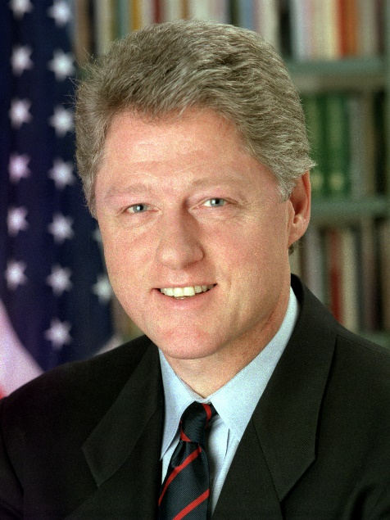
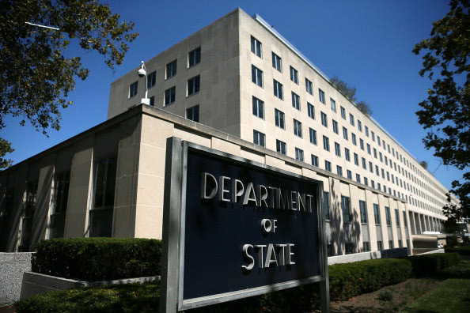

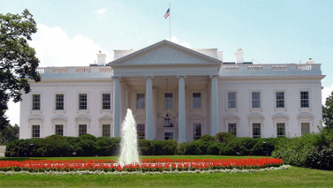
Implications for
U.S. Foreign Policy
International Religious Freedom Act of 1998

Slide 32
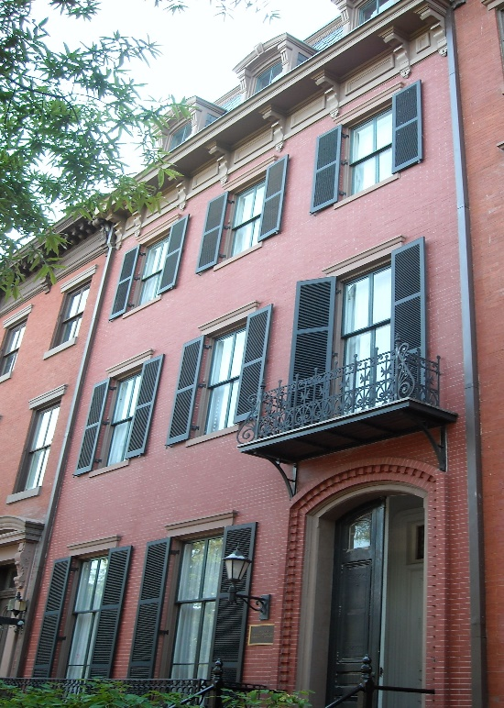
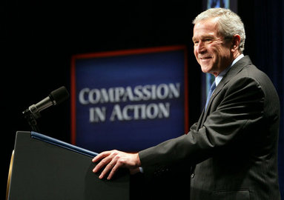
Implications for
U.S. Foreign Policy
White House Office of Faith-based and Neighborhood Partnerships, 2001

Slide 33
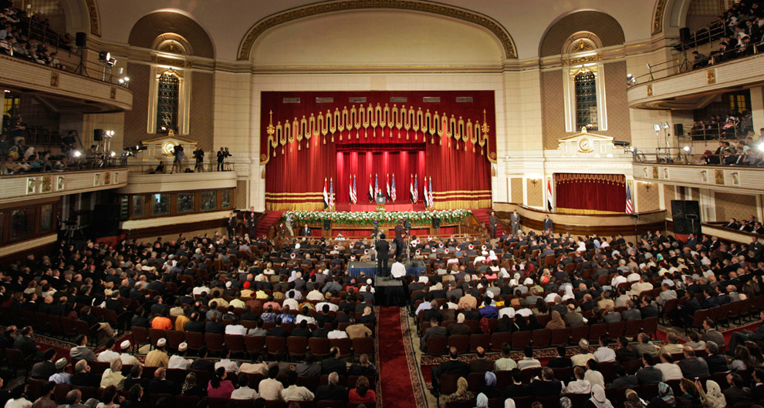
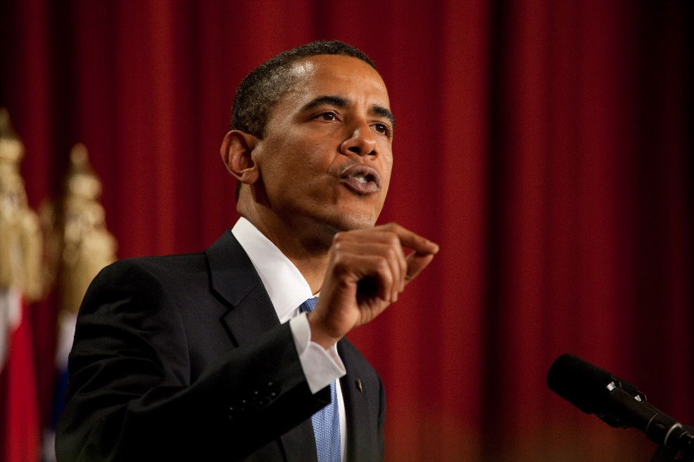
Implications for
U.S. Foreign Policy
President Obama speech to Muslim leaders – “A New Beginning” – Al-Azhar University, Cairo, Egypt, June 4, 2009

Slide 34
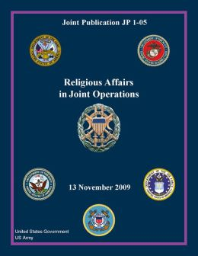
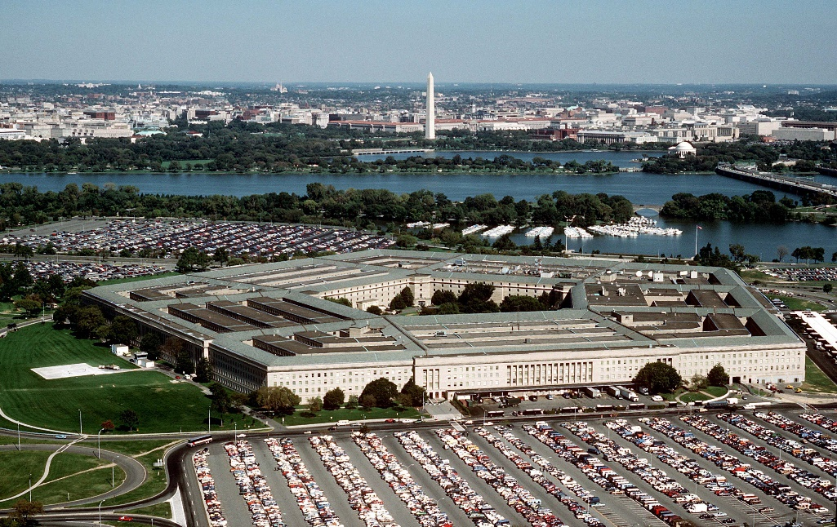
Implications for
U.S. Foreign Policy
Department of Defense
JP 1-05
Religious Affairs in Joint Operations
November 13, 2009

Slide 35
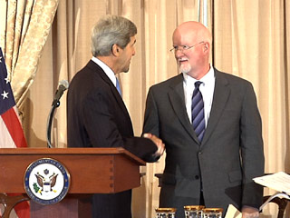
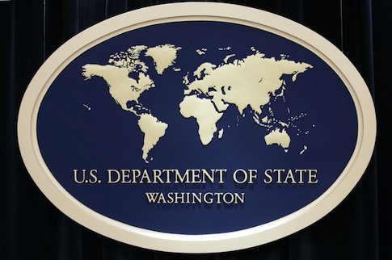
Implications for
U.S. Foreign Policy
State Department
Office of Faith-based
Community Initiatives
August 9, 2013

Slide 36
See you Next Sunday!

