Slide 1
Religion & American Foreign Policy Through Christian eyes
Week #3 – Wars and Peace Treaties: Our First Encounters with
Islam and Allah
Grace Chapel Discipleship – Fall 2014
Dr. James C. (Jim) Wallace

Slide 2
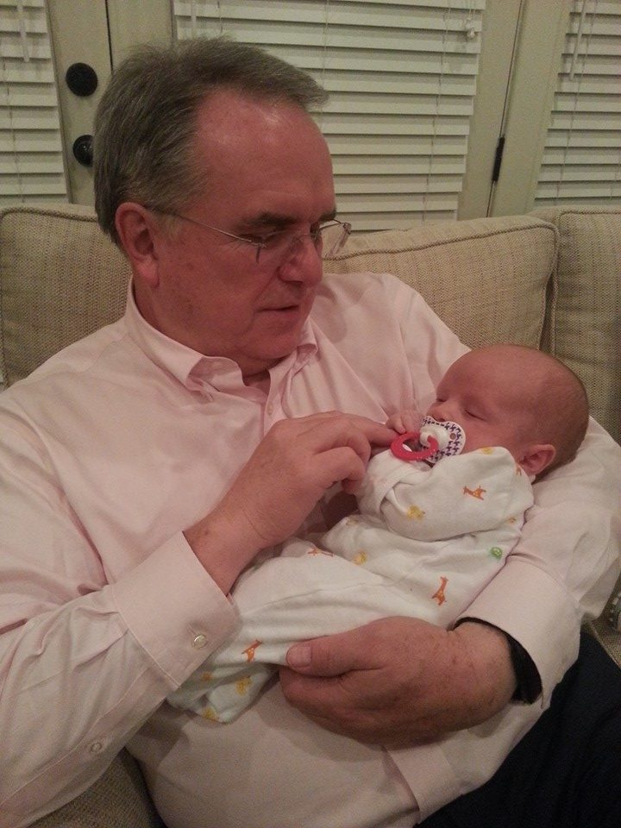
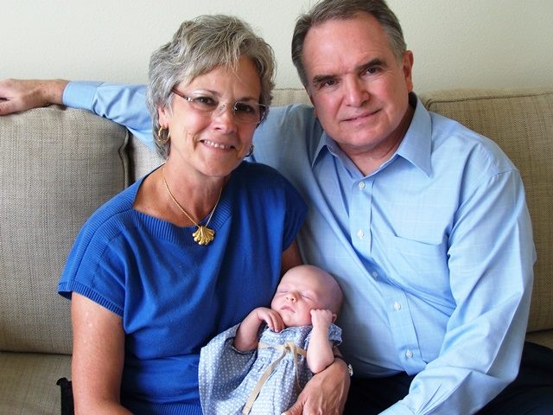
Good morning!
My Trip to Houston

Slide 3
Good morning!
My Trip to Houston
Last Week’s Video – Hugh Heclo
  Impressions
  “Yes – no – no – no – sort of – sort of – and no way”
  Points of agreement
  Points of disagreement

Slide 4
Religion in America – The Data
Religion | 1900 | % | 2005 | % | 2050 | %
Christians | 73.2 M | 96.4 % | 240.4 M | 80.6 % | 298.7 M | 74.5%
Jews | 2.5 M | 1.97 % | 5.4 M | 1.82 % | 5.0 M | 1.25 %
Muslims | 10 K | 0.01 % | 3.7 M | 1.27 % | 9.0 M | 2.25 %
Buddhists | 30 K | 0.04 % | 3.7 M | 1.26 % | 7.0 M | 1.75 %
Hindus | 1 K | 0.00 % | 1.3 M | 0.45 % | 2.5 M | 0.62%
Agnostics | 1 M | 1.32 % | 38.2 M | 12.8 % | 71.1 M | 17.7 %
Atheists | 1 K | 0.00 % | 1.2 M | 0.41 % | 2.0 M | 0.50 %
New Religionists | 10 K | 0.01% | 1.5 M | 0.52 % | 2.1 M | 0.54 %
Ethnoreligionists | 100 K | 0.13 % | 1.0 M | 0.36 % | 1.2 M | 0.30 %
Chinese Folk Religion | 70 K | 0.09 % | 105 K | 0.04 % | 150 K | 0.04 %
SOURCE: Todd M. Johnson and Brian J. Grim, eds.
World Religion Database
Leiden/Boston: Brill, www.worldreligiondatabase.org, accessed June 2014

Slide 5
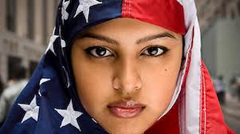
Islam in America
As of 2014, estimates
6-7 million Muslims in
the USA
2,000 mosques, Muslim
schools and Islamic centers in America
Since 1994, CAIR has detailed 64 acts of destruction and desecration of Islamic places of worship in America
SOURCE: CAIR – Council on American-Islamic Relations
www.cair.com, accessed June 2014

Slide 6
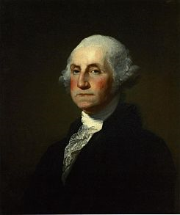
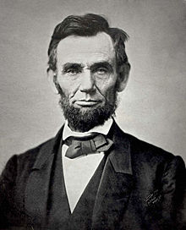
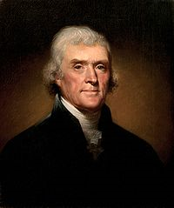
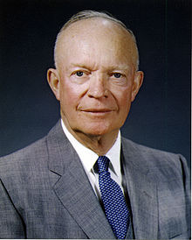
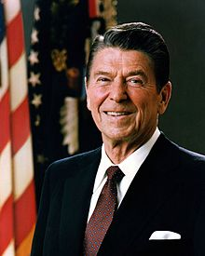
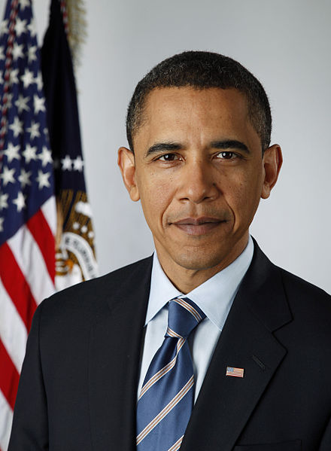
God in the white house
Presidential Faith by Religion | #
Episcopal / Anglican | 11
Presbyterian | 8
Baptist | 4
Methodist | 4
Unitarian | 4
No formal affiliation | 3
Disciples of Christ | 2
Dutch Reformed | 2
Quaker | 2
Catholic | 1
Congregationalist | 1
United Church of Christ | 1
Source: Pew Forum | January 15, 2009

Slide 7
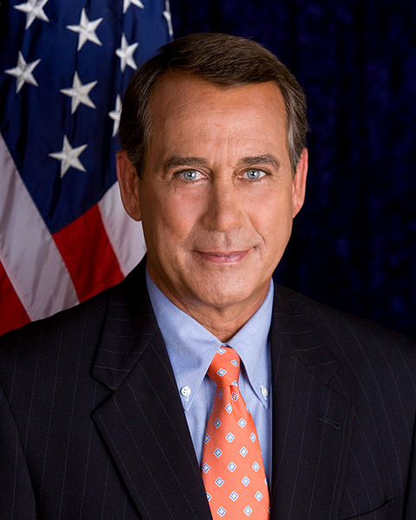
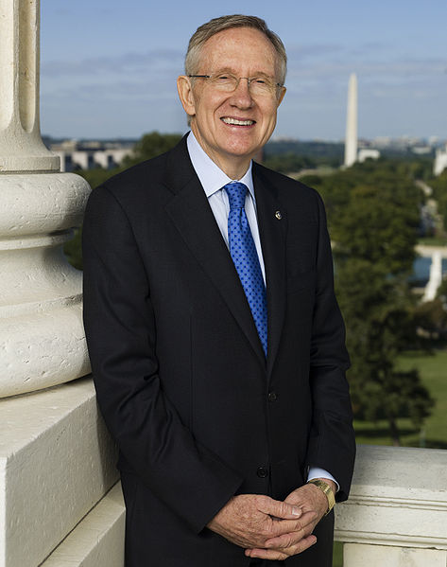
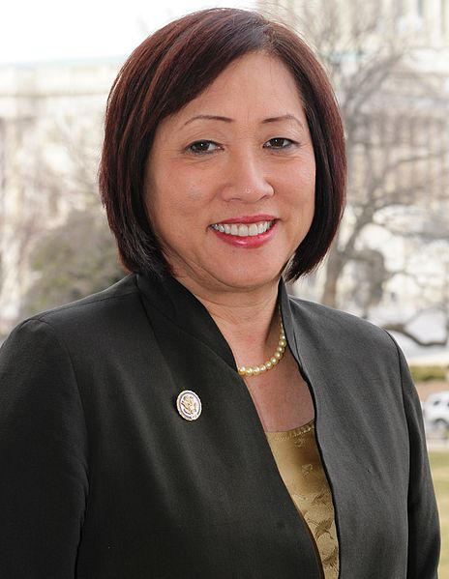
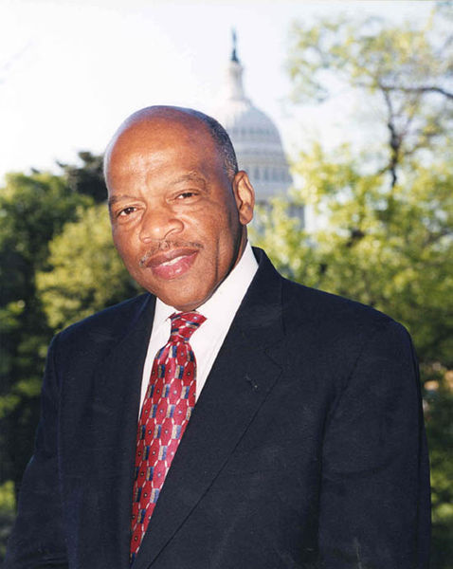
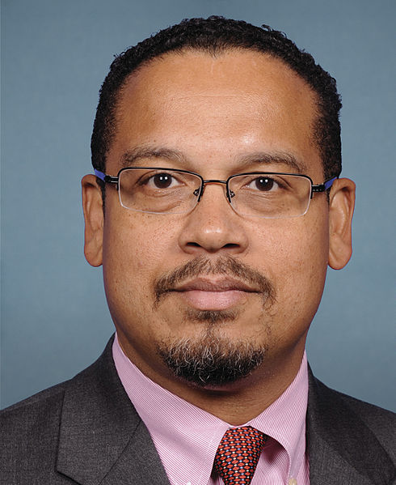
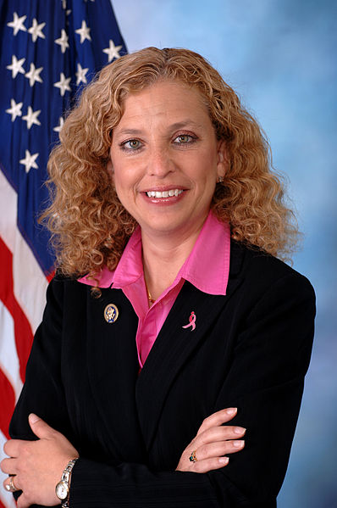
God in Congress
Congressional Faith by Religion | #
Christian – Protestant | 299
Christian – Catholics | 161
Jewish | 32
Mormon | 15
Orthodox Christian | 5
Buddhist | 3
Muslim | 2
Hindu | 1
Unitarian | 1
Unaffiliated | None | 1
Don’t Know | Refused | 10
Source: CQ Roll Call & Pew Forum | January 3, 2013

Slide 8
Video Clip
Click to view or copy URL to browser
https://www.youtube.com/watch?v=Sp6jpeDeQmE

Slide 9
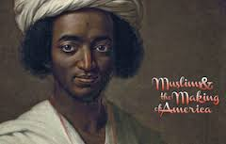
Colonial America
Muslim presence in America dates
to its earliest days; some say,
it pre-dates Columbus in 1492
It is likely that Muslims (Moors & Turks)
were brought to the Carolinas in
pre-colonial days as slaves
In 1776, John Adams published his “Thoughts on Government” in which he praised Mohammed as a
“sober inquirer after truth”
In 1785, George Washington stated a willingness to hire “Mahometans” to work at Mount Vernon

Slide 10
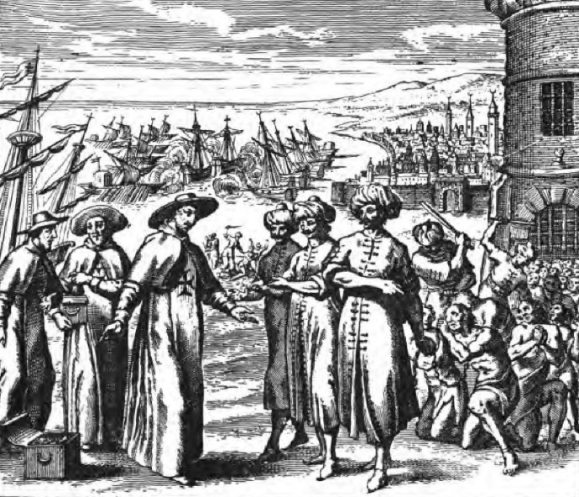
Colonial America
In 1790, the South Carolina
legislature passed a law granting
special legal status to a group
of Morroccans –
“Moors Sundry Act of 1790”
  Moors recognized as “white” people
  Not subject to the laws governing blacks and slaves
  As “white” people, they were allowed to serve on jury duty

Slide 11
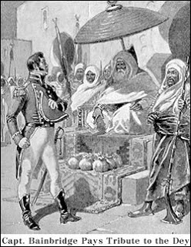
Barbary states
In Colonial times, trade between
America and the Middle East
was protected by the British Navy
During the Revolutionary War,
trade was protected by the French Navy
After the Revolutionary War, American trading ships were subject to pirates and demands of tribute

Slide 12
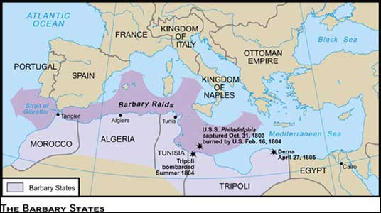
Barbary states

Slide 13
Barbary states
Threat to the new USA:
  Pirates
  Kidnapping of sailors & missionaries
  Demands for bribes & tribute
  Forced conversion to Islam
  Raised questions about the viability of the new country

Slide 14
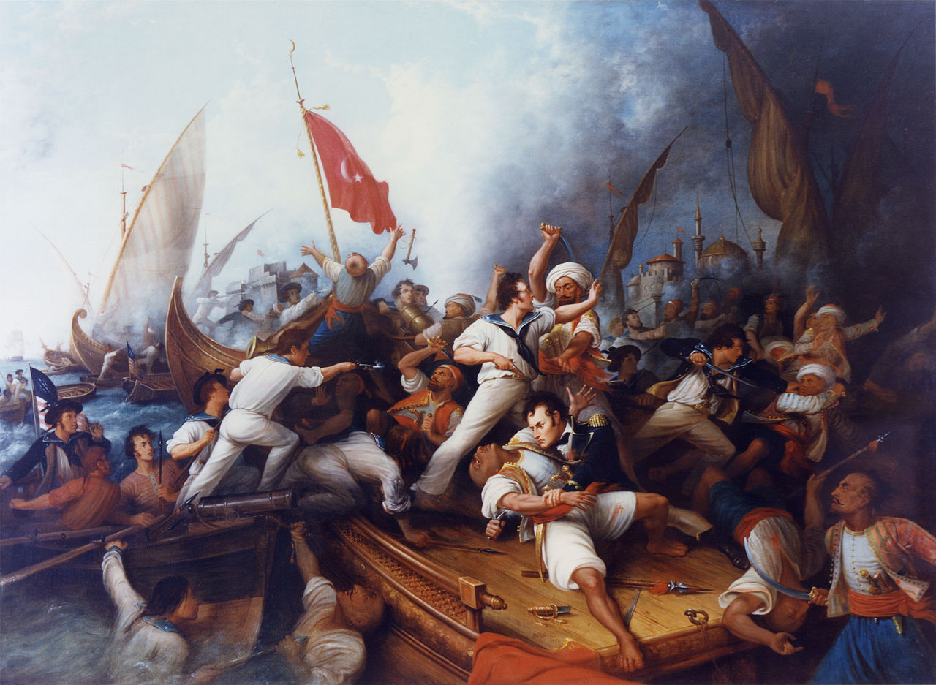
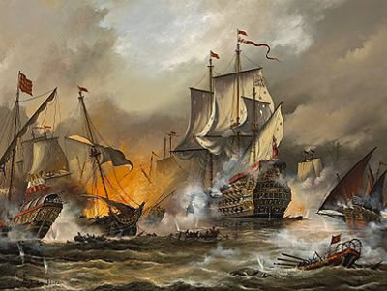
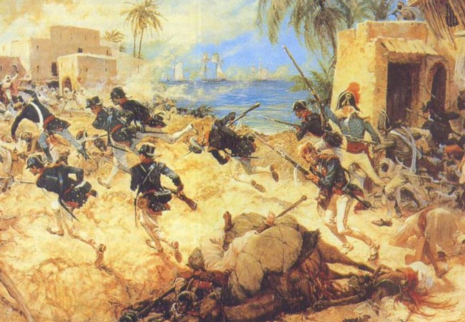

Slide 15
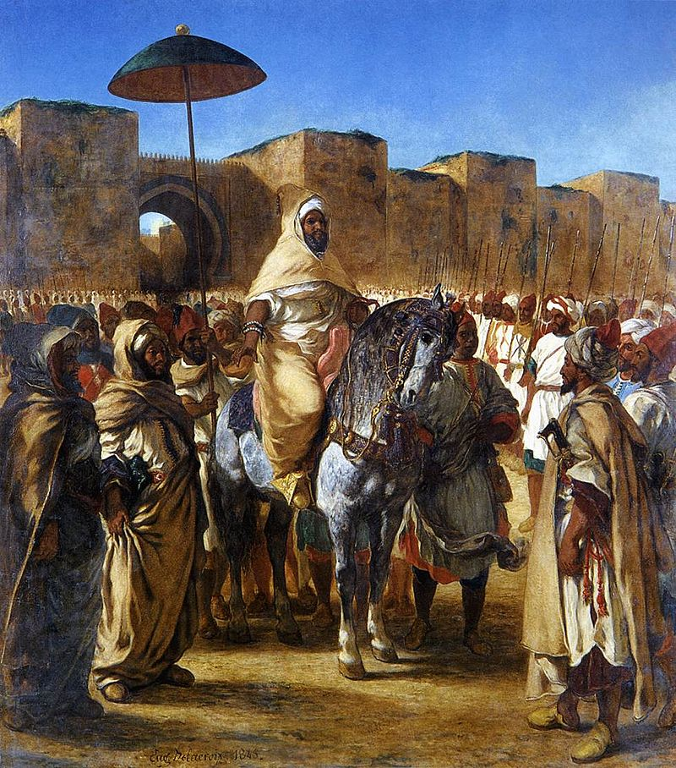
Treaty of Morocco (1786)
Morocco was the first nation to recognize the United States as a new nation in 1777
On December 20, 1777, the Sultan of Morocco declared that the U.S. ships would be under protection of the sultanate and would enjoy protection
The United States paid “tribute” for
this protection
A treaty of friendship was signed
between the U.S. and Morocco in 1786
to seal the friendship

Slide 16
Treaty of Morocco (1786)
Treaty of Peace, Friendship and Ship-signals (1786)
Showed need for U.S. Constitution – Article One, Section Eight [Enumerated Powers of Congress] (1789)
  To define and punish Piracies and Felonies committed on the high Seas, and Offenses against the Law of Nations;
  To declare War, grant Letters of Marque and Reprisal, and make Rules concerning Captures on Land and Water;
  To raise and support Armies, but no Appropriation of Money to that Use shall be for a longer Term than two Years;
  To provide and maintain a Navy;
Led to the creation of the U.S. Navy (1794)

Slide 17
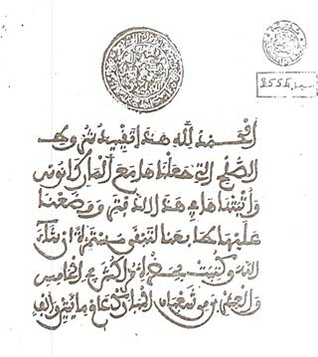
Treaty of Morocco (1786)
The official seal on the treaty
Signed by Thomas Jefferson &
John Adams

Slide 18
Treaty of Morocco (1786)
In the name of God, the Compassionate, the Merciful, and there is no might nor power but in God, the Great, the High.
From the servant of God, Muhammed, son of Abdallah, may God bestow His favor upon him. Amen!
[Seal]
To the Great One of the American States, the President. Peace be on those who follow the right guidance! To come to the point: Your letter has reached us and also have reached us the articles of the Treaty of Peace which you have sent us, and we are with you on terms of complete truce and peace. We have now written what you wanted us to write to Tunis and Tripoli, and all that you have asked from us shall be fulfilled if God please. Greetings! Written in the middle in [the month Dhu] al-Qa'dah [Zu'lkadah] of the year two and two hundred and thousand 1202.

Slide 19
Treaty of Morocco (1786)
Placing the seal at the head of the letter denotes great superiority in rank of the writer in comparison with that of the person to whom the letter is addressed.
"The Great One of . . ." is the title by which infidel rulers are addressed in letters from the Prophet. The greeting formula, " Peace be on those who follow the right guidance," is the classical one to be addressed to unbelievers, implying that they are not worth greeting.

Slide 20
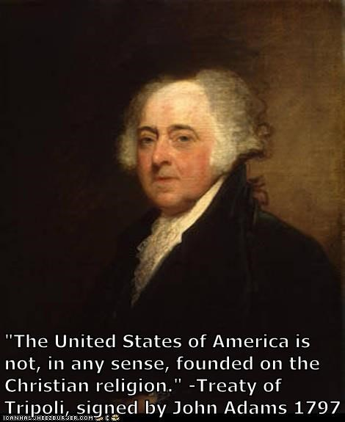
Treaty of Tripoli (1797)
Treaty of Peace and Friendship between the United States of America and the Bey and Subjects of Tripoli of Barbary (1797)
Passed unanimously by the
U.S. Congress
Written originally in Arabic and English
Uses the name of “Allah”

Slide 21
Treaty of Tripoli (1797)
Article 11:
  “As the Government of the United States of America is not, in any sense, founded on the Christian religion,—as it has in itself no character of enmity against the laws, religion, or tranquility, of Mussulmen [Muslims],—and as the said States never entered into any war or act of hostility against any Mahometan [Muslim] nation, it is declared by the parties that no pretext arising from religious opinions shall ever produce an interruption of the harmony existing between the two countries.”

Slide 22
Treaty of Tripoli (1797)
Article 11:
  “As the Government of the United States of America is not, in any sense, founded on the Christian religion,—as it has in itself no character of enmity against the laws, religion, or tranquility, of Mussulmen [Muslims],—and as the said States never entered into any war or act of hostility against any Mahometan [Muslim] nation, it is declared by the parties that no pretext arising from religious opinions shall ever produce an interruption of the harmony existing between the two countries.”

Slide 23
Treaty of Tripoli (1797)
Frank Lambert, Professor of History at Purdue University:
  Article 11 was "intended to allay the fears of the Muslim state by insisting that religion would not govern how the treaty was interpreted and enforced. John Adams and the Senate made clear that the pact was between two sovereign states, not between two religious powers."

Slide 24
Treaty of Tripoli (1797)
Frank Lambert (continued):
  "By their actions, the Founding Fathers made clear that their primary concern was religious freedom, not the advancement of a state religion. Individuals, not the government, would define religious faith and practice in the United States. Thus the Founders ensured that in no official sense would America be a Christian Republic. Ten years after the Constitutional Convention ended its work, the country assured the world that the United States was a secular state, and that its negotiations would adhere
  to the rule of law, not the dictates
  of the Christian faith.”

Slide 25
Official Barbary Wars
First Barbary War (1801-05)
U.S. had been paying “tribute”
to Barbary States to assure peace
In 1801, President Thomas
Jefferson refused to increased the tribute to the
Pasha of Tripoli
Tripoli declared war against the U.S.
U.S. sent its new Navy to the Mediterranean; war lasted five years
In 1805, a Peace Treaty was signed and a $60,000 ransom was paid for all U.S. prisoners

Slide 26
Official Barbary Wars
Second Barbary War (1815)
Algeria broke the first peace treaty
U.S. diverted by the War of 1812
with Great Britain
In 1815, President James Madison sent the U.S. Navy to fight against the Barbary States
The U.S. Navy was much superior this time and quickly defeated the Barbary ships
A peace treaty was signed 24 September 1816; all Christian prisoners were returned; all tribute was repaid

Slide 27
Questions for discussion
What do you think of the United States signing treaties that are written in the name of Allah?
Is Allah a generic name for “God” or is it the specific name of a non-Christian God? Should missionaries use the name of Allah in translations and preaching in Muslim-majority countries?

Slide 28
See you Next Week!

