Slide 1
Religion and American Foreign Policy through
Christian Eyes
Dr. James C. (Jim) Wallace
Grace Chapel - Week #1

Slide 2
Welcome!
Class hosts
Syllabus & class schedule
The challenge of a class on religion and politics
What have I been up to?

Slide 3


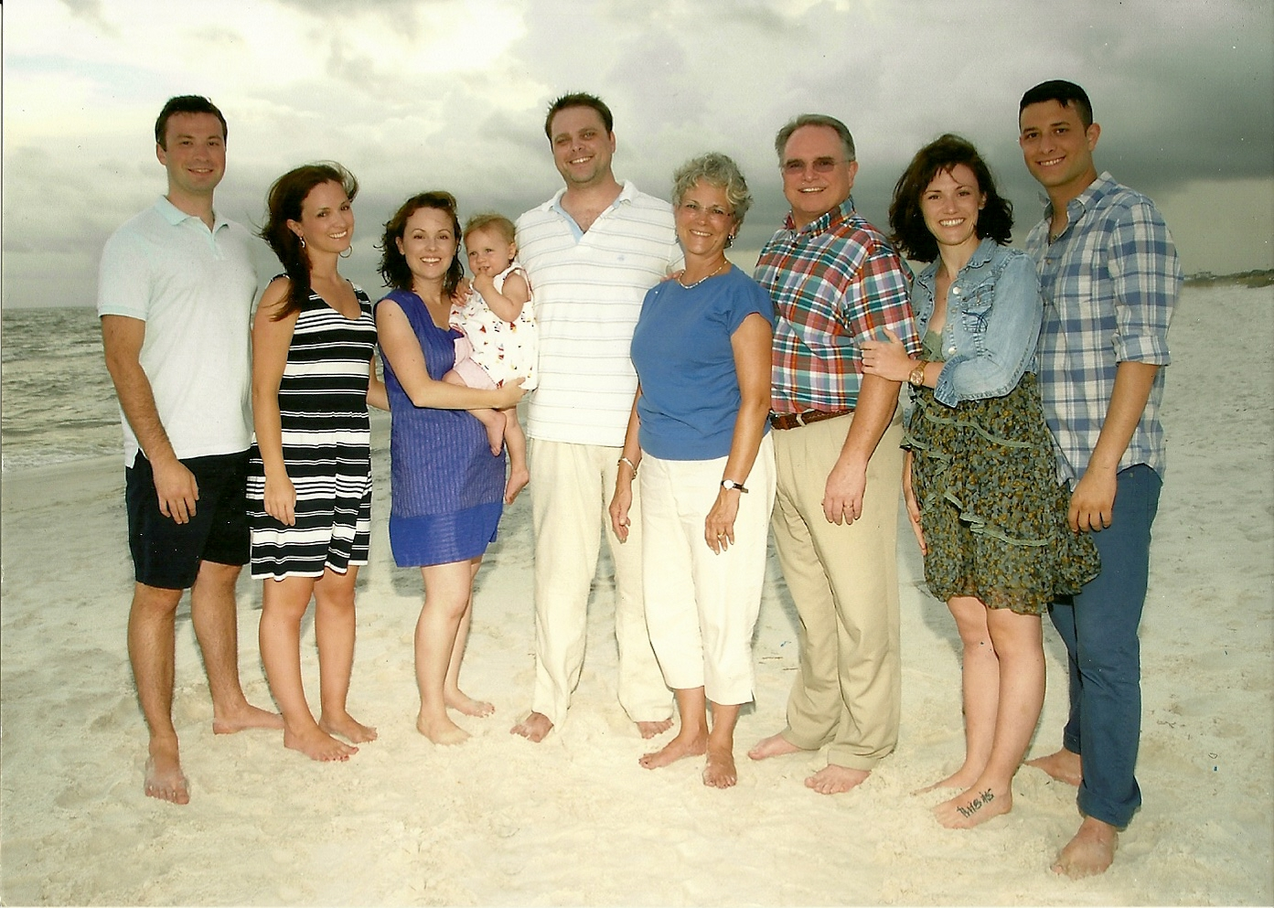
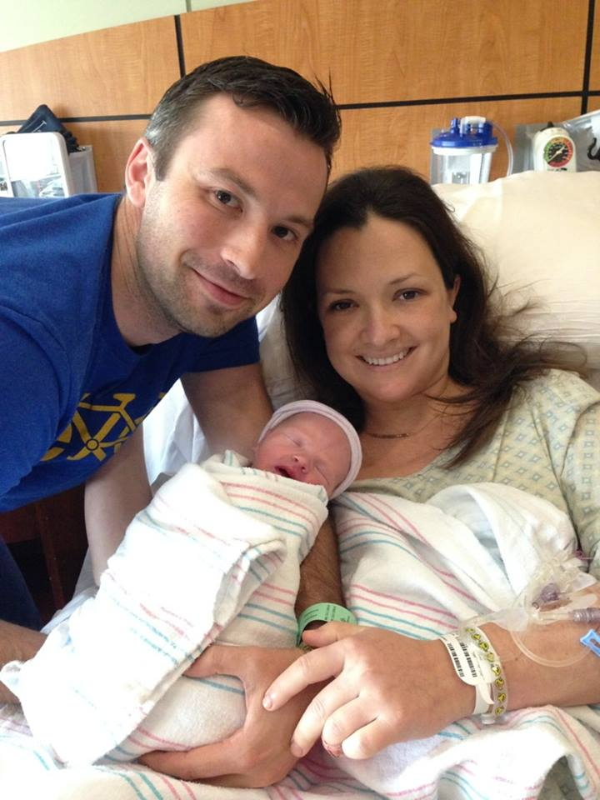


Slide 4


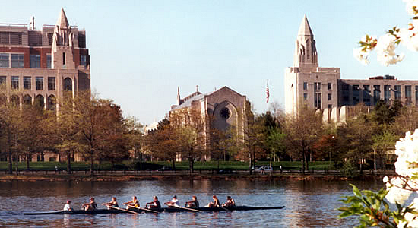
Boston University

Slide 5
Religion and American Foreign Policy . . .
“. . . through Christian eyes”
“. . . through Secular eyes”
“. . . through Religious eyes”
“. . . through American eyes”

Slide 6
John 8:32
Context
  Jesus in Jerusalem
  Jesus in the Temple Courts
  Jesus and the woman caught in adultery
  Pharisees challenged the validity of his testimony
“Then you will know the truth, and the truth will set you free.” (NIV)
“Then you will experience for yourselves the truth, and the truth will free you.” (Message)

Slide 7
Truth!?
What is “the truth”?
How do we learn/know “the truth”?
What impacts our understanding/interpretation of “the truth”?

Slide 8
Foreign Policy
Definition
  A country's foreign policy consists of strategies chosen by the state to protect and project its national interests and to achieve its goals internationally.
Requirements
  Nations
  Rulers and government
  Relations between two or more governments
Purpose of policy
  Trade
  Defense and projection of power
  War

Slide 9
Foreign Policy
Nature of the Policy
  Friendly
  Hostile
  Neutral or ambivalent

Slide 10
Foreign Policy
Bias
  We all have them
  Our biases may be different even though we are the same . . .
    Family
    Ethnicity
    Religion
Perceptions of Foreign Policy
  Depends on which nation an individual identifies with
  Depends on one’s opinion of the ruler and/or the government
  Depends on how the policy impacts an individual

Slide 11
Foreign Relations in the Bible
Political Entities
  Family, clan, tribe
  City states – Tyre & Sidon
  Nations – Israel, Egypt
  Empires – Babylonian, Greek, Roman

Slide 12
Foreign Relations in the Bible
Psalm 2:1-3, 10-11
Psalm 46
Genesis 41:41-57
1 Kings 10:1-13
2 Chronicles 26:1-15
Matthew 2:1-12, 13-15
Acts 22:22-29, 23:11
Revelation

Slide 13
Dr. James C (Jim) Wallace godandcaesar@gmail.com

