Slide 1
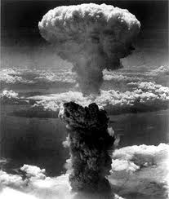
Holy War, Holy Peace
A biblical, historical and political perspective

Slide 2

Question / Comments
http://www.grace.org/adultdiscipleship
GodandCaesar@gmail.com

Slide 3
Types of War
Family/clan/tribal war – conflicts of identity and territory
Border war – conflicts over territory
Imperial war – conflicts of territory and resources
Religious war – conflicts of ideology and belief

Slide 4
Types of War
Civil war – national conflicts of identity and political control
World war – global conflicts of identity, ideology, territory, political control and power
Asymmetric warfare – conflicts between two groups of vastly different military size and capability involving state and non-state actors; often involving guerilla war or terrorism

Slide 5
Types of War
Humanitarian warfare – conflicts of intervention to stop genocide or mass violations of human rights; usually authorized by the UN or other international body; conducted in keeping with the humanitarian principles detailed in the International Bill of Human Rights (UDHR with the ICCPR and ICESR)

Slide 6
History and Destructiveness of War
See handout for specific statistics
Top ten most destructive wars
(military and civilian deaths)
Other wars for comparison

Slide 7
Religious Warfare
Major Religious Conflicts:
Thirty Years War
French Wars of Religion
Second Sudanese War
Crusades
Lebanese Civil War

Slide 8
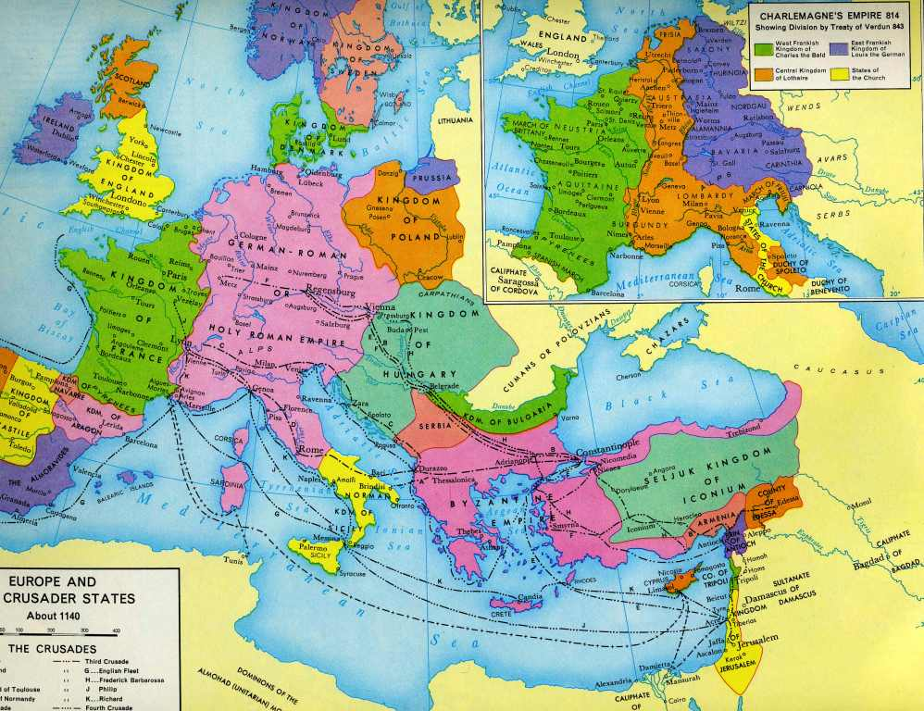
Religious Warfare

Slide 9
Holy War, Holy Peace
Questions?
Discussion?
What have we learned today?

