Slide 1
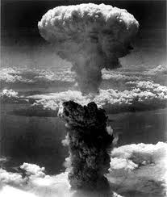
Holy War, Holy Peace
A biblical, historical and political perspective

Slide 2

Question / Comments
GodandCaesar@gmail.com
Notes:
I created a special email account for this class for you to contact me – questions, comments, clarifications

Slide 3
Tuesday Night Taping
Special thanks to . . .
Doug Whallon and Maria Kakolowski
Mark and Nancy Cannister
Santo Wiryaman

Slide 4
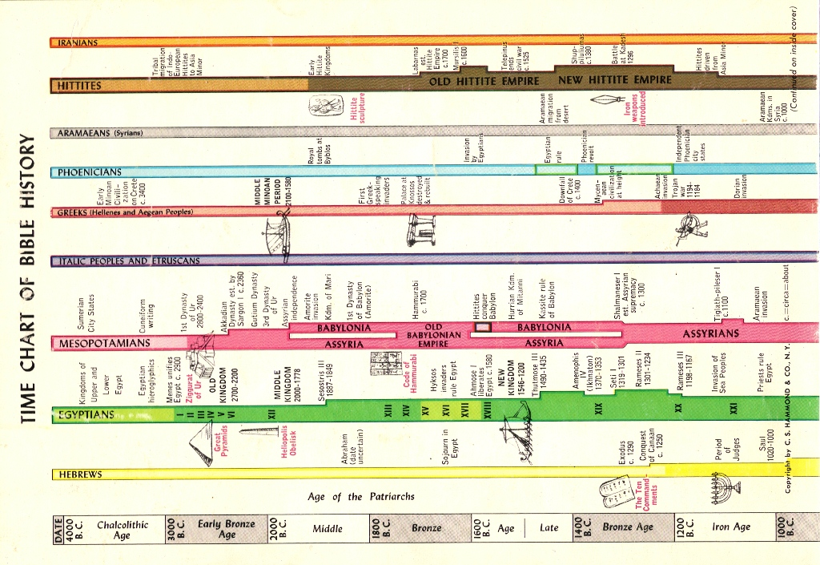
Setting the Context
Notes:
Time Chart of Bible History (from Hammond Atlas of the Bible Lands)

Slide 5
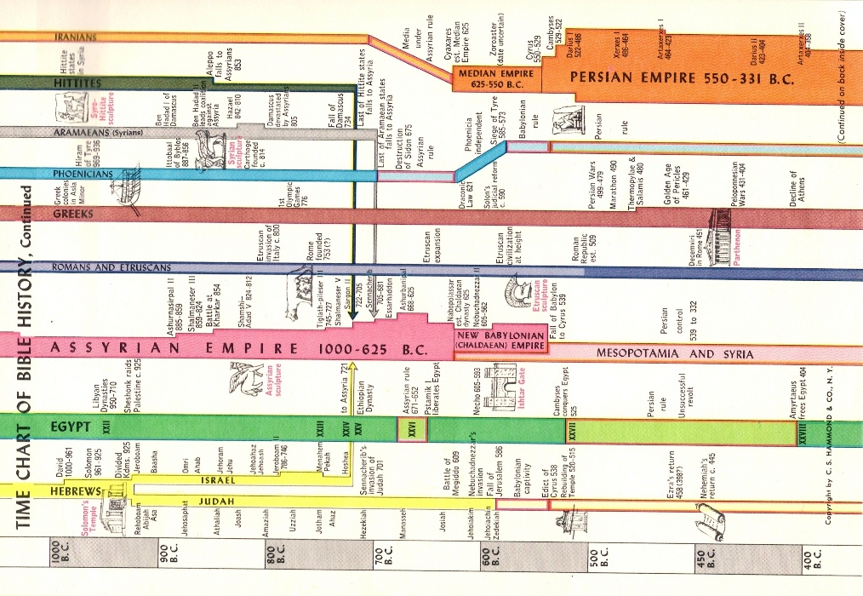
Setting the Context
Notes:
Time Chart of Bible History (from Hammond Atlas of the Bible Lands)

Slide 6
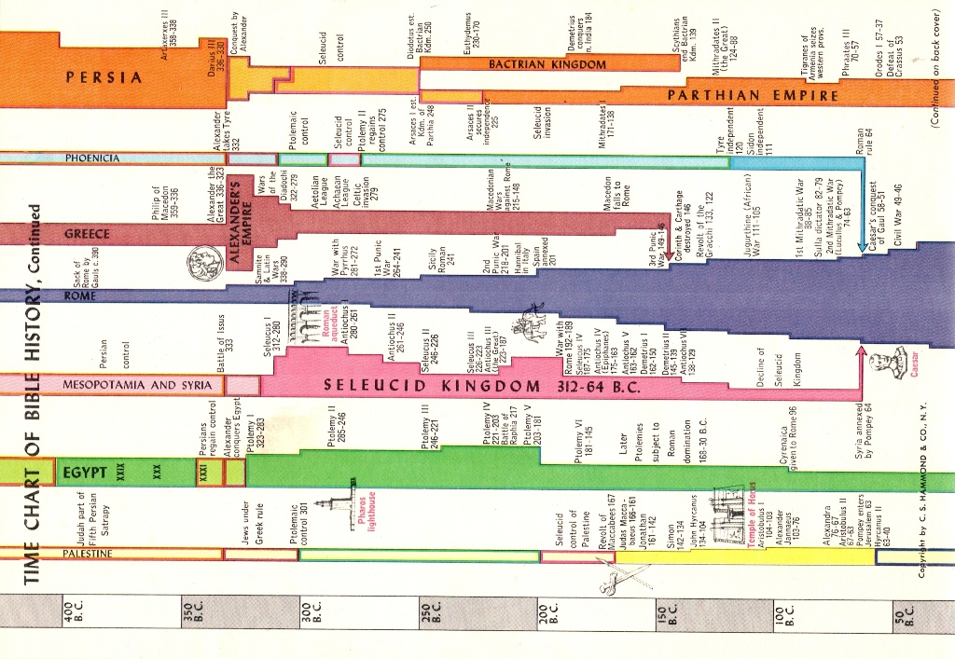
Setting the Context
Notes:
Time Chart of Bible History (from Hammond Atlas of the Bible Lands)

Slide 7
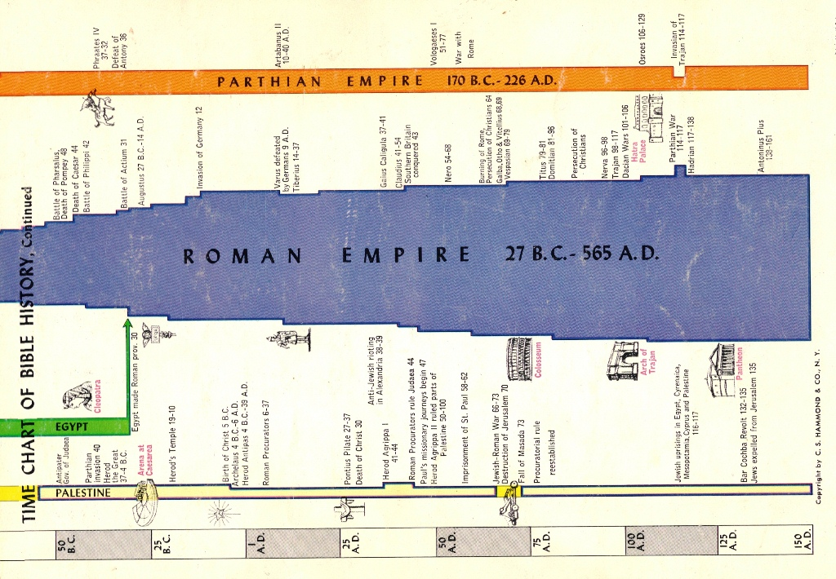
Setting the Context
Notes:
Time Chart of Bible History (from Hammond Atlas of the Bible Lands)

Slide 8
New Testament View of War
War and military and accepted reality
  Matthew 24:6 – You will hear of wars and rumors of wars, but see to it that you are not alarmed. Such things must happen, but the end is still to come
  Luke 14:31-32 – Or suppose a king is about to go to war against another king. Will he not first sit down and consider whether he is able with ten thousand men to oppose the one coming against him with twenty thousand? If he is not able, he will send a delegation while the other is still a long way off and will ask for terms of peace. In the same way, any of you who does not give up everything he has cannot be my disciple.

Slide 9
New Testament View of War
War and military and accepted reality
  Matthew 8:5-13, Acts 10 – Soldiers who were among Jesus followers
  Hebrews 11:32 – Soldiers are listed as among the “heroes of the faith”

Slide 10
New Testament View of War
War imagery used to describe the work of Christ
  2 Corinthians 2:14 – But thanks be to God, who always leads us in triumphal procession in Christ . . .
  Colossians 2:15 – And having disarmed the powers and authorities, he made a public spectacle of them, triumphing over them by the cross.

Slide 11
New Testament View of War
War and the individual – Spiritual Warfare
  Romans 7:23 – But I see another law at work in the members of my body, waging war against the law of my mind and making me a prisoner of the law of sin at work within my members.
  1 Peter 2:11 – Dear friends, I urge you, as aliens and strangers in the world, to abstain from sinful desires, which war against your soul.

Slide 12
New Testament View of War
War and the individual – Spiritual Warfare
  2 Corinthians 10:3-6 – For though we live in the world, we do not wage war as the world does. The weapons we fight with are not the weapons of the world. On the contrary, they have divine power to demolish strongholds. We demolish arguments and every pretension that sets itself up against the knowledge of God, and we take captive every thought to make it obedient to Christ. And we will be ready to punish every act of disobedience, once your obedience is complete.

Slide 13
New Testament View of War
War and end times - Armageddon
  Revelation 16:14, 16 – They are spirits of demons performing miraculous signs, and they go out to the kings of the whole world, to gather them for the battle on the great day of God Almighty. . . . Then they gathered the kings together to the place that in Hebrew is called Armageddon.
  Revelation 17:14 – They will make war against the Lamb, but the Lamb will overcome them because he is Lord of lords and King of kings—and with him will be his called, chosen and faithful followers.

Slide 14
New Testament View of War
War and end times - Armageddon
  Revelation 19:11-16 – I saw heaven standing open and there before me was a white horse, whose rider is called Faithful and True. With justice he judges and makes war. His eyes are like blazing fire, and on his head are many crowns. He has a name written on him that no one knows but he himself. He is dressed in a robe dipped in blood, and his name is the Word of God. The armies of heaven were following him, riding on white horses and dressed in fine linen, white and clean. Out of his mouth comes a sharp sword with which to strike down the nations. “He will rule them with an iron scepter.” He treads the winepress of the fury of the wrath of God Almighty. On his robe and on his thigh he has this name written: KING OF KINGS AND LORD OF LORDS.

Slide 15
New Testament View of Peace
A God of Peace
1 Thessalonians 5:23 – May God himself, the God of peace, sanctify you through and through.
Hebrews 13:20-21 – May the God of peace, who through the blood of the eternal covenant brought back from the dead our Lord Jesus, that great Shepherd of the sheep, equip you with everything good for doing his will, and may he work in us what is pleasing to him, through Jesus Christ, to whom be glory for ever and ever. Amen.
Romans 15:33; Philippians 4:9

Slide 16
New Testament View of Peace
God gives peace
Philippians 4:7 – And the peace of God which transcends all understanding will guard your hearts and minds in Christ Jesus

Slide 17
New Testament View of Peace
The birth of the Prince of Peace
Isaiah 9:6-7
Luke 1:76-79 – Zechariah declares John the Baptist to be the “path to peace”
Luke 2:14 – The angels sing, “Peace on earth to men on whom his favor rests”

Slide 18
New Testament View of Peace
Peace is central to Jesus’ teaching
The Sermon on the Mount:
  Matthew 5:9 – Blessed are the peacemakers, for they will be called sons of God.
  Matthew 5:39-40 – Turn the other cheek
  Matthew 5:43-44 – Love your enemies

Slide 19
New Testament View of Peace
Peace is central to Jesus’ teaching
Mark 5:34, Luke 7:50, 8:48 – Jesus tells those he healed to “go in peace”
Luke 10:5-6 – The disciples were to pronounce “peace on this house” when they went out two-by-two
Luke 19:38, 42 – At the triumphal entry into Jerusalem, he came to bring “peace”

Slide 20
New Testament View of Peace
Peace is central to Jesus’ teaching
The Last Supper:
  John 14: 27 – Peace I leave with you; my peace I give to you. I do not give as the world gives. Do not let your hearts be troubled and do not be afraid.
  John 16:33 – I have told you these things, so that in me you may have peace. In the world you will have trouble. But take heart! I have overcome the world.

Slide 21
New Testament View of Peace
Jesus is the source of peace
Ephesians 2:14-17
Peace is the essence of the Gospel and salvation
Acts 10:36; Ephesians 2:17, 6:15.
Romans 5:1
Galatians 5:22
Romans 8:6

Slide 22
OT & NT Contrast
The OT era was largely a time of war for Israel,
while the NT era was a time of peace.
The OT says much more about “war” because that was its context and reality. Peace is seen as something rare, something longed for, something that will come when the Messiah comes.
The NT accepts “war” but commends “peace.”

Slide 23
OT & NT Contrast
In the OT, God is a warrior; in the NT, God is a God of Peace.
In the NT, peace is not only the nature of God, but also the nature of Jesus, his teachings and the promise of salvation.

Slide 24
OT & NT Contrast
Those who support a theology of war, tend to lean on OT scriptures.
Those who support a theology of peace and pacifism, tend to lean on NT scriptures.
The challenge is to have a theology of war and peace that uses the whole Bible and reconciles seemingly contradictory scriptures. Our theology of war and peace cannot be justified by selective proof-texting.

Slide 25
Church Views of War & Peace
Realism & Christian Realism
Adopted by numerous churches during the Cold War.
Pacifism & Christian Pacifism
Adopted by . . .
  Religious Society of Friends (Quakers), Church of the Brethren, Anabaptists, Mennonites, Amish, Seventh Day Adventists
  Elements of the Church of Christ, Russian Orthodox, Catholics, Methodists, and Baptists
  Martin Luther King, Jr.

Slide 26
Church Views of War & Peace
Just War Theory
Adopted by . . .
  Roman Catholic Church
  Orthodox Churches
  Most Mainline, Evangelical, and Pentecostal Churches
Just Peace Theory
Adopted by . . .
  United Church of Christ
  Congregational Churches

Slide 27
Holy War, Holy Peace
Questions?
Discussion?
What have we learned today?

