Slide 1

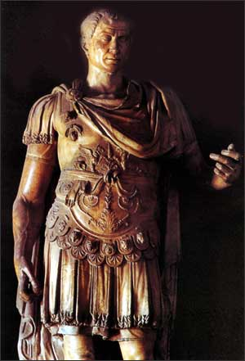
God & Caesar:
The ancient modern clash

Slide 2

Welcome!
GodandCaesar@gmail.com
Notes:
Welcome
Thanks for those that fixed food
Email address
All materials available online – use link from e-blast
If don’t have it, then email me and I will send it to you

Slide 3
Introduction
Genesis 15:18-21 On that day the LORD made a covenant with Abram and said, “To your descendants I give this land, from the river of Egypt to the great river, the Euphrates— the land of the Kenites, Kenizzites, Kadmonites, Hittites, Perizzites, Rephaites, Amorites, Canaanites, Girgashites and Jebusites.”
Joshua 1:1-4 After the death of Moses the servant of the LORD, the LORD said to Joshua son of Nun, Moses’ aide: “Moses my servant is dead. Now then, you and all these people, get ready to cross the Jordan River into the land I am about to give to them—to the Israelites. I will give you every place where you set your foot, as I promised Moses. Your territory will extend from the desert to Lebanon, and from the great river, the Euphrates—all the Hittite country—to the Great Sea on the west.

Slide 4
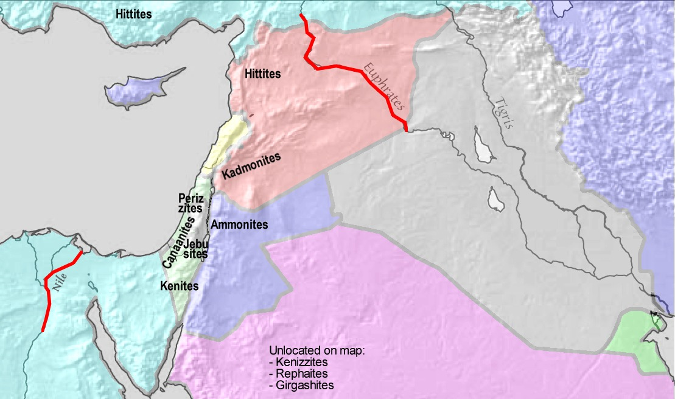
Introduction

Slide 5
Zionism
Much of the debate today over the modern nation-state of Israel is wrapped up in the modern concept of Zionism:
Theodor Herzl
  Judenstaat (1896) – solution to the pogroms and anti-Semitism of Europe
  Political Zionism – secular approach
Abraham Isaac Kook
  Moved to Israel (1904)
  Talmudic approach – Chief Rabbi of the British Mandate
Zvee Yhuda Kook (son)
  Religious Zionist
  Father of the modern settlement movement

Slide 6
Zionism
Balfour Declaration – November 2, 1917
Letter from Foreign Secretary Arthur James Balfour to Baron Rothschild – policy of British government
"His Majesty's government view with favour the establishment in Palestine of a national home for the Jewish people, and will use their best endeavours to facilitate the achievement of this object, it being clearly understood that nothing shall be done which may prejudice the civil and religious rights of existing non-Jewish communities in Palestine, or the rights and political status enjoyed by Jews in any other country.”

Slide 7
Key Dates
1916 – Sykes-Picot agreement

Slide 8
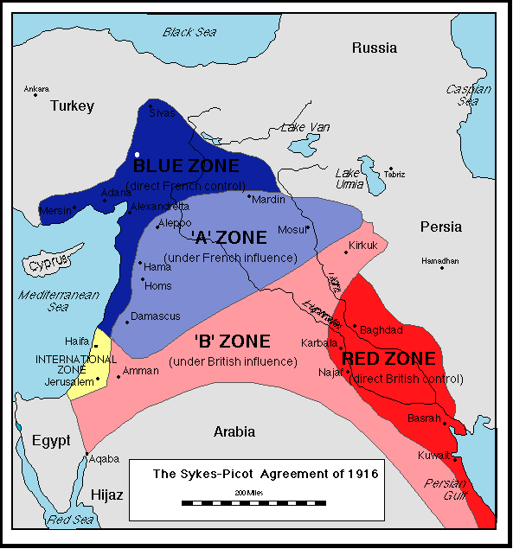

Slide 9
Key Dates
1916 – Sykes-Picot agreement
1917 – Balfour Declaration
1919 – End of WWI
1945 – End of WWII
1947 – UN plan for Middle East
May 15, 1948 – Partition of Palestine into Jewish State and Arab State
May 15, 1948-January 7, 1949 – War of Independence

Slide 10
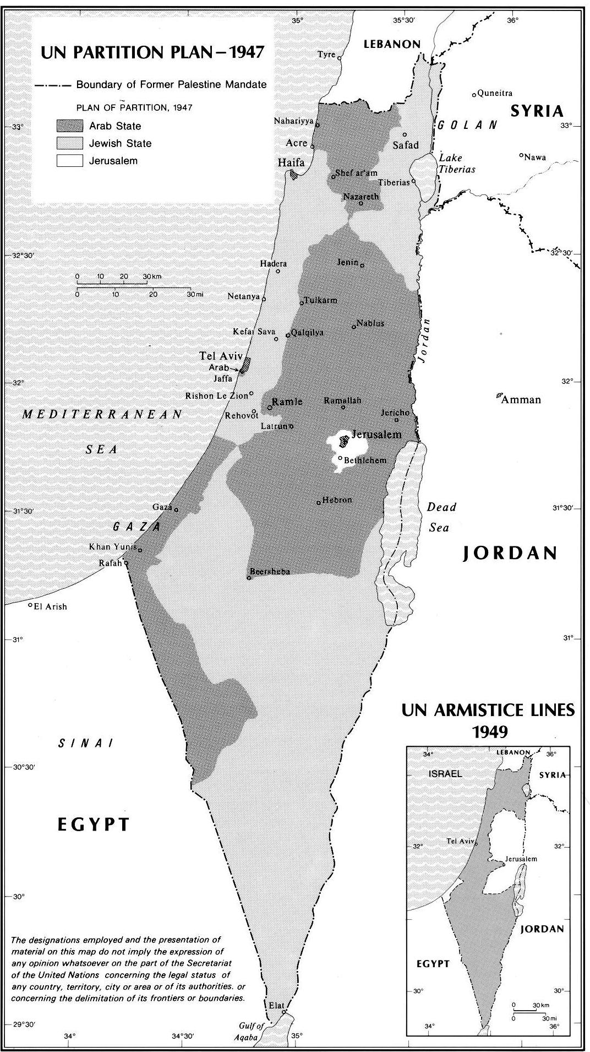

Slide 11
Key Dates
1916 – Sykes-Picot agreement
1917 – Balfour Declaration
1919 – End of WWI
1945 – End of WWII
1947 – UN plan for Middle East
May 15, 1948 – Partition of Palestine into Jewish State and Arab State
May 15, 1948-January 7, 1949 – War of Independence
June 5-10, 1967 – Six Day War (pre-emptive by Israel)
October 6-23, 1973 – Yom Kippur War (pre-emptive by Egypt)
September 17, 1978 – Camp David Accords
(Peace with Egypt / 1979)
1987-1993 – First Intifada (Killing, car wreck, rumors)
1991 – Madrid Peace Conference
1993 – Oslo Peace Conference

Slide 12
Key Dates
October 26, 1994 – Peace Treaty between Israel and Jordan
2000 – Camp David Talks & Clinton “parameters”
2002 – “Quartet” roadmap for peace; Arab League proposal
2000-2005 – Second Intifada (Oslo, Al-Aqsa Incident)
2005 – Israel withdraws from Gaza
2006-07 – Palestinian intra-political conflict / Hamas control of Gaza
December 27, 2008 – “Operation Cast Lead” in Gaza
2010 – Direct talks brokered by U.S.
September 2011 – Palestine to see recognition as a country at the U.N., including East Jerusalem, West Bank and Gaza. Two fellow U.N. states occupying the same land

Slide 13
Key Issues
80% of issues agreed upon based on Oslo two-state framework
Final Status Issues
  Palestinian Refugees - “Right of return”
  Compensation
  Settlements and Borders
  Mutual Security
  Jerusalem

Slide 14
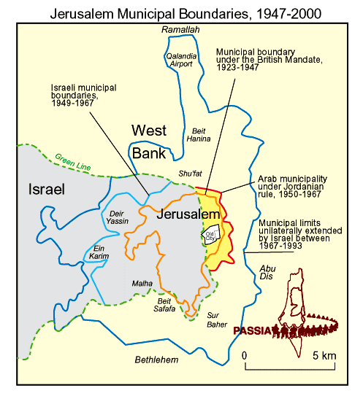

Slide 15
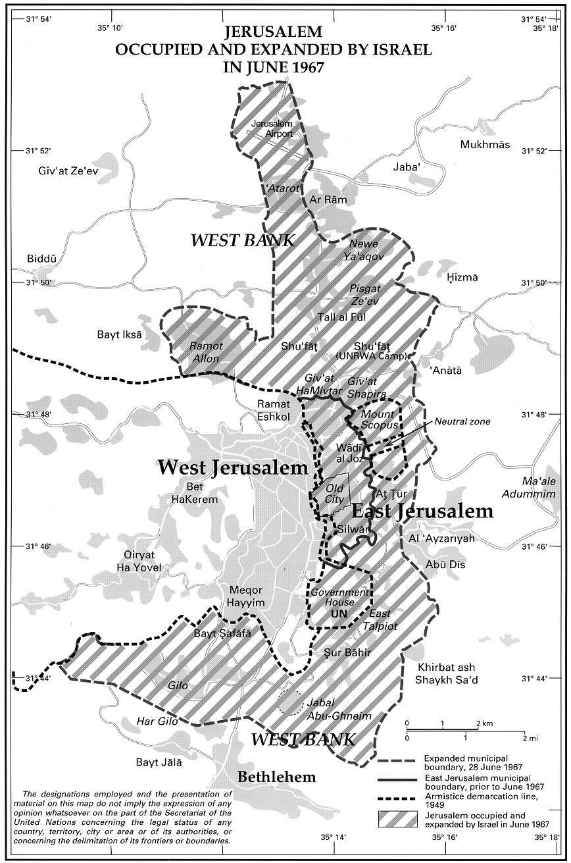

Slide 16
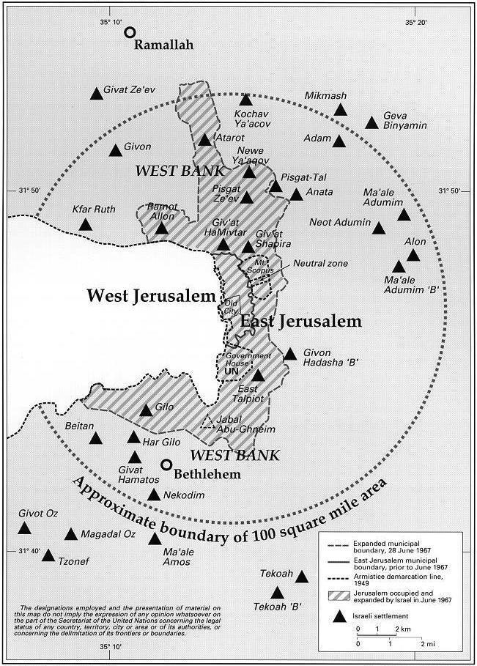

Slide 17
Key Issues
Question – Do we decide easy questions first or hard questions first?
Question – Two states or one state?

Slide 18
Current Peace Efforts
Quartet on the Middle East – UN, US, EU, Russia
Special U.S. envoy – George Mitchell
USAID – West Bank and Gaza
Arab League and OIC – Peace proposal endorsed in 2002 and 2007

Slide 19

God & Caesar
Questions? Comments?

