Slide 1

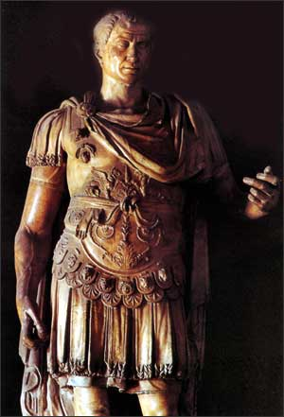
God & Caesar:
The ancient modern clash

Slide 2

Welcome!
GodandCaesar@gmail.com
Notes:
Email address
All materials available online – use link from e-blast
If don’t have it, then email me and I will send it to you

Slide 3
Last Week
We looked at three views of war from a Christian perspective:
Pacifist view
“Just war” view
“Holy war” view

Slide 4
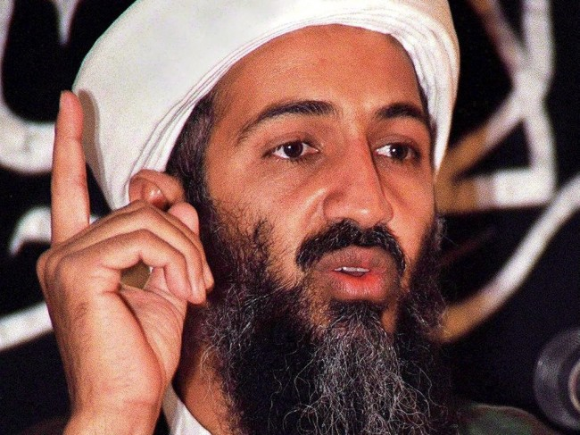
The Past Week
Do you have any thoughts or
reflections on last week’s discussion on
war & violence in light of the events
of last Sunday?

Slide 5
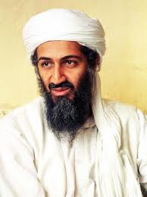
Death of Osama bin Laden
Biblically, how are Christians to respond to
the news of the death of Osama bin Laden?
“As surely as I live, declares the Sovereign LORD, I take no pleasure in the death of the wicked, but rather that they turn from their ways and live.” – Ezekiel 33:11
“Do not gloat when your enemy falls; when he stumbles, do not let your heart rejoice.” – Proverbs 24:17
“But I tell you, love your enemies and pray for those who persecute you.” – Matthew 5:44

Slide 6
Since 9/11
Governments –
  UN – Millennium Peace Initiative (2000); World Council of Religious Leaders
  UN - United Nations Alliance of Civilizations
  EU – European Union Agency for Fundamental Rights
  Saudi Arabia – Interfaith Dialogue in Madrid and with the UN
  Jordan – Common Word Initiative
  Qatar, UAE – U.S.-Islamic World Forum (Doha Initiative)
  Morocco – Evangelical and Interfaith dialogues
  Norway – Oslo Coalition on Freedom of Religion or Belief
  Canada – new Office of Religious Freedom in the Ministry of Foreign Affairs

Slide 7
Since 9/11
Think Tanks – Council on Foreign Relations, The World Bank, World Economic Forum, Brookings Institution, Club of Madrid, Royal Aal al-Bayt Institute for Islamic Thought, Carnegie Council, Center for Strategic and International Studies, Social Science Research Council, Pew Forum on Religion and Public Life, Ethics & Public Policy Institute, Hudson Institute, Institute for Global Engagement, International Center for Religion & Diplomacy, Public Research Religion Institute
Academic Institutions – Yale, Georgetown, Harvard, Boston University, Notre Dame, University of Virginia, Penn, Cambridge (UK), Al-Azhar (Cairo), Seton Hall.

Slide 8
Since 9/11
Foundations – Henry Luce Foundation, Foundation for Dialogue among Civilizations, Clinton Global Initiative, Tony Blair Faith Foundation
Religious Institutions – The Vatican, World Anglican Communion, Orthodox Church, World Council of Churches, World Evangelical Alliance
Events – UN Millennium Goals and Dialogue of Civilizations, Council of 100 World Religious Leaders

Slide 9
U.S. Government Departments
1998 – International Religious Freedoms Act (IRFA), Office of International Religious Freedom at the State Department, U.S. Commission on International Religious Freedom (USCIRF), National Security Council (Human rights, Multilateral affairs)
2000 – Office of Faith-based and Neighborhood Partnerships (extension offices in different departments/ministries of government)
2003 – CIA – Political Islam Strategic Analysis Project (PISAP), Book: A Necessary Engagement, Emile Nakhleh; covert-ops (“The Search for a Moslem Billy Graham” [1951], “Occultism in High Places”)

Slide 10
U.S. Government Departments
Department of Defense – “Operation Minerva” (Research); COIN initiatives
Foreign Service Institute, USAID – Training in religion as a part of cultural dynamics

Slide 11
Next Steps
Need to become informed and learn the languages of religion and politics
Need to understand that religion is here-to-stay in international affairs
Need to make a “place at the table” for people of faith and faith-based organizations – a seat at the table does not mean that religion should control the agenda
Need to be “wise as a serpent and gentle as a dove” as we deal with leaders in positions of political power
Need to be prayerful, listening, and humble

Slide 12

God & Caesar
Questions? Comments?

