Slide 1
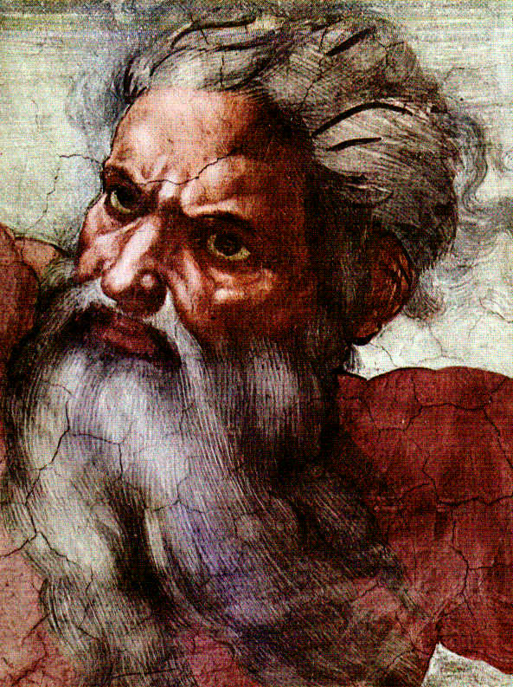
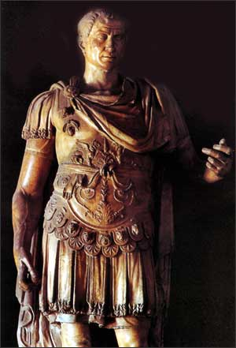
God & Caesar:
The ancient modern clash

Slide 2

Welcome!
GodandCaesar@gmail.com
Notes:
Email address
All materials available online – use link from e-blast
If don’t have it, then email me and I will send it to you

Slide 3
Answering Questions
What is Islamic finance or Shariah-compliant finance?
  A form of ethical investing in keeping with the Qur’an
  Creates “asset-based” financing arrangements as a shareholder versus a “debt-instrument” relationship as a borrower
  “Return” is linked to tangible results versus a speculation on return
    Murabaha – buy-sell-back arrangement between a customer and the bank with set return
    Musharaka – lease-to-purchase arrangement
    Takaful – a mutual insurance arrangement where policyholder is share holder
    Sukuk – Asset-based Islamic bonds
    Twarruq – A three way commodity monetization arrangement between a customer, the bank, and a commodities dealer

Slide 4
Answering Questions
What is Islamic finance or Shariah-compliant finance?
  Growing at a rate of 20% per year
  $2 trillion dollars in 2010
  international Western financial institutions like UBS, HSBC, Barclays, Deutsche Bank, Goldman Sachs, Citigroup, J.P. Morgan Chase, AIG, Lloyds TSB, Standard Chartered, and Swiss Re have developed Islamic finance departments or divisions
  In 1999, the Dow Jones Islamic Market Index (DJIMI) was launched and today it encompasses over 70 sub-indices tracking international equity products around the world that are fully Shariah–compliant
  Since the early 1990s, the U.S. Treasury Department, the World Bank and the International Monetary Fund have targeted serious programs towards SCF

Slide 5
Answering Questions
How was your week in Washington, DC?
  U.S.-Islamic World Forum
  U.S. State Department, Brookings Institution, and the government of Qatar
  Leaders from government, political, business, finance, NGO and religious sectors
  How to improve understanding and engagement between the U.S. and Islamic worlds
  Discussions focused on the MENA region and the ‘Arab Spring’

Slide 6
Discussion Question from Last Week
After viewing the various arrangements of religion-state relations in the different
nation-states, are you satisfied with the
current way religion is dealt with in the
United States or do you wish it was different?
If so, how would you change it?

Slide 7
Opening Question for This Week
From the perspective of religion-state relations,
do you think 9/11 changed the perception
of the importance of religion in
international affairs?
If so, is the ‘change’ a matter of perception only
or a matter of actual real-time activities?

Slide 8
Scriptures to Consider
In the light of 9/11, different scriptures were used to frame the discussion of our current global situation:
  Ephesians 6:10-13
  Matthew 24:4-8
  Isaiah 9:6-7

Slide 9
A Clash of Civilizations?
Samuel P. Huntington (deceased), Director of Harvard University’s Weatherhead Center for International Affairs
Early 90s debates over post-Cold War configuration of the world
Francis Fukuyama, The End of History and the Last Man (1992)
Article: “The Clash of Civilizations?, ” Foreign Affairs journal (Summer 1993)
Debate over what will control and “order” the world with the fall of Communism
Book: “The Clash of Civilizations and the Remaking of the World Order” (1996)
Hotly debated issue is the role of ideology (including religion) in shaping the world order

Slide 10
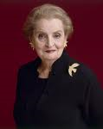
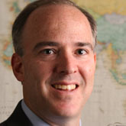
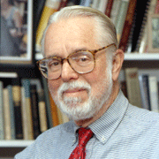
Impact of 9/11

Slide 11
Framing the debate
Global war on terrorism
versus
War with Islam
versus
War with religious extremism

Slide 12
Group Discussion Questions
Since 9/11 has the United States been “at war” against terror or against radical Islam? How do you view the current U.S. initiatives in this regard (Iraq, Afghanistan, and Homeland Security)?
Is the primary threat radical Islam or all forms of extremist, violent religious fundamentalism? Can you think of examples of radical, violent Christian fundamentalism?
Do you think extreme and violent reactions to world events and social changes are ever justified by the Bible? If so, what scripture verses do you use to support your point-of-view?

Slide 13

God & Caesar
Comments?

