Slide 1
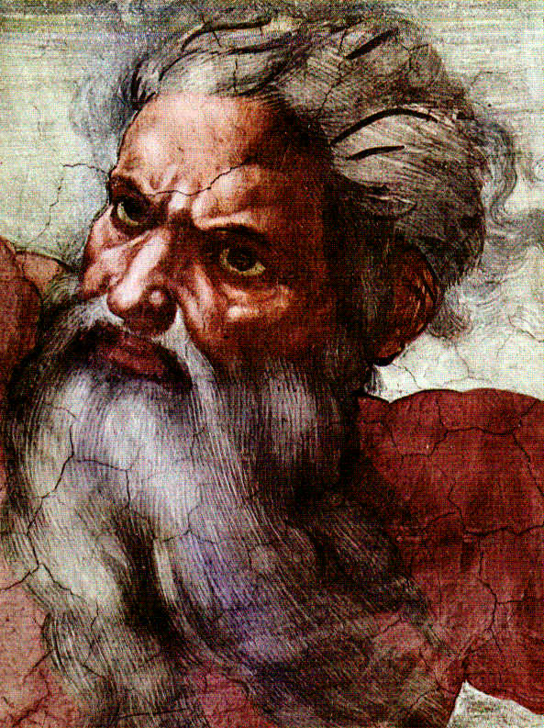
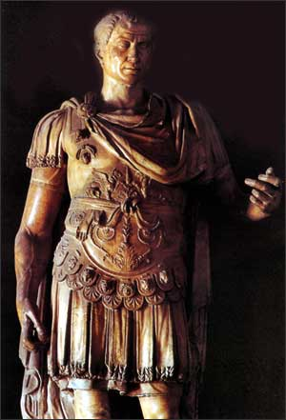
God & Caesar:
The ancient modern clash

Slide 2

Welcome!
GodandCaesar@gmail.com
Notes:
Email address
All materials available online – use link from e-blast
If don’t have it, then email me and I will send it to you

Slide 3
Follow-up on Last Week
If prayer was returned to public schools, what prayers should be said in large portions of Dearborn, Michigan which are Muslim-majority? What should Christian students do who attend these schools?
What about in Alabama, which is dominantly evangelical Christian, what should Jewish students do?
Should the dominant religion of a community determine what kind of prayers are said in public schools?

Slide 4
Follow-up on Last Week
If tax deductions are allowed for interest paid on funds borrowed (mortgages, business, etc.), should special tax allowances be made in order to avoid double taxation for “Islamic finance” which outlaws interest?
If not, how does one justify other laws that remove double-taxation? Is this religious discrimination?

Slide 5
Varieties of Church-State Accommodation
Separation of Church and State – The United States
  First Amendment of the U.S. Constitution
    Congress shall make no law respecting an establishment of religion, or prohibiting the free exercise thereof; or abridging the freedom of speech, or of the press; or the right of the people peaceably to assemble, and to petition the Government for a redress of grievances.
  Six core principles
    Liberty of conscience
    Free exercise of religion
    Religious pluralism
    Religious equality
    Separation of church and state
    Disestablishment of religion

Slide 6
Varieties of Church-State Accommodation
Separation of Church and State – The United States
  “Wall of separation”
    John Locke, Richard Hooker, Roger Williams, Thomas Jefferson
    Danbury Baptists (1802)
    Everson v. Board of Education (1947)
      Formally incorporated the First Amendment disestablishment clause into the Fourteenth Amendment due process clause and applied it to the states.
      Justice Hugo Black writing for the court: “Neither a state nor the Federal Government can, openly or secretly, participate in the affairs of any religious organization or groups, or vice versa. In the words of Jefferson, the clause against establishment of religion by law was intended to erect ‘a wall of separation between church and state.’ . . . That wall must be kept high and impregnable. We could not approve the slightest breach.”

Slide 7
Varieties of Church-State Accommodation
Official State Church – United Kingdom
  Henry VIII separated the Church of England from the Roman Catholic Church in 1534 by the Act of Supremacy; made the monarch the “Supreme Head” of the Church of England
  Henry’s Act of Supremacy was repealed by his Catholic daughter, Mary 1, in 1554
  A revised Act of Supremacy was reinstated by Elizabeth 1 in 1558 when she ascended to the throne
  Monarch is “Supreme Governor” of the church; cannot be or marry a Catholic
  Required an “Oath of Supremacy” of anyone taking public office or church office
  Official Church of England appointments are Crown appointments
  High church officials have seats in the House of Lords
  England has no written constitution; there is no constitutional principle of freedom of religion, although in practice, this is the case

Slide 8
Varieties of Church-State Accommodation
Official State Church – Germany
  Freedom of religion is guaranteed in the German constitution (German Basic Law): Article 4 – Freedom of Faith and Conscience
  According to the German constitution, religious instruction may be taught in state-run schools : Article 7, Section 3
  Article 140 of the German constitution affirms the rights of religious groups and denominations, including Sunday and holidays recognised by the state shall remain protected by law as days of rest from work and of spiritual improvement
  Under the constitution, religious societies have the right to levy an 8-9% tax on its members through the state income tax revenue collection process. 70% of church revenues in Germany come via the state collections process.

Slide 9
Varieties of Church-State Accommodation
Official State Church – Norway
  According to the Constitution of the Kingdom of Norway, the church has an official state church – the Evangelical-Lutheran Church – while still guaranteeing the free exercise of religion. The King is the head of state and the church. He must profess the state religion.
  Article 2 - All inhabitants of the Realm shall have the right to free exercise of their religion.The Evangelical-Lutheran religion shall remain the official religion of the State. The inhabitants professing it are bound to bring up their children in the same.
  Article 4 - The King shall at all times profess the Evangelical-Lutheran religion, and uphold and protect the same.
  Article 12 - The King himself chooses a Council from among Norwegian citizens who are entitled to vote. This Council shall consist of a Prime Minister and at least seven other Members. More than half the number of the Members of the Council of State shall profess the official religion of the State.

Slide 10
Varieties of Church-State Accommodation
Official State Church – Other Countries and varieties
  Denmark – Evangelical-Luther Church is the official state church; the King is required to be a member; church tax of 1.5%; government contributes an additional 13% to support the state church.
  Switzerland – There is no official state church; however each of the 26 cantons (states) supports at least one of the three official denominations (Catholic, Old Catholic, Evangelical Reformed) with funds collected through taxation.

Slide 11
Varieties of Church-State Accommodation
Laïcité – France
  Le France est une République indivisible, laïque, démocratique, et sociale
  “France is an indivisible, secular, democratic, and social Republic”
How did France get to this point and what does it mean?
Notes:
State Churches – Britain (Anglican), Germany, Denmark, Scandinavian countries (Lutheran), Russia, Baltic states (Orthodox), Islamic states (Islam)

Slide 12
Varieties of Church-State Accommodation
Freedom of religion (Declaration of the Rights of Man and the Citizen) and freedom of conscience (law of 1795)
Religion must limit its expression and activity in public spaces (laws of 1795 and 1905)
Religion must be limited and operate within boundaries established by the state (Concordats of 1801, 1802 and 1807)
The disassociation of the public calendar from religion (law of 1880)

Slide 13
Varieties of Church-State Accommodation
A secular education system (law of 1882) and the prohibition for members of religious orders teaching in the public school system (law of 1904)
Private citizens allowed to form voluntary associations (law of 1901) - associations culturelles
Churches were no longer considered public institutions, but allowed to reorganize as private associations
(law of 1905) - associations cultuelles
The French Republic is officially declared laïque – secular (Constitutions of 1946 and 1958)

Slide 14
Varieties of Church-State Accommodation
Laïcité involves a great deal of government entanglement and control:
  Maintenance of houses of worship by state and local governments.
  Payment of religious chaplains in the military, prisons and hospitals.
  A special social security system for the clergy.
  Tax exemptions granted for officially registered religious institutions.
  Government subsidies for non-profit religious associations that pursue educational and humanitarian tasks in the public interest.
  The provision for voluntary religious classes in elementary schools.
  Allocations for subsidized TV broadcasts of religious programs.
  Tax benefits for endowments for educational (including religious) purposes

Slide 15
Varieties of Church-State Accommodation
Laiklik – Turkey
  Ottoman Empire (1299-1923) and Islamic Caliphate (16th – 20th c.)
  Mustafa Kemal Ataturk – Father of modern Turkey (1923-1938)
  Kemal’s Six Arrows - nationalism, republicanism, populism, secularism, transformationism, statism
  Diyanet (Office of Religious Affairs) and the control of religion

Slide 16
Varieties of Church-State Accommodation
Laiklik – Turkey
  Ascendency of Prime Minister Tayyip Erdogan and admission to the EU
    EU Charter of Fundamental Rights – Article 10: Freedom of Thought Conscience and Religion
    Everyone has the right to freedom of thought, conscience and religion. This right includes freedom to change religion or belief and freedom, either alone or in community with others and in public or in private, to manifest religion or belief, in worship, teaching, practice and observance.
    International Bill of Human Rights – UDHR, ICESCR, ICCPR

Slide 17
Varieties of Church-State Accommodation
Jewish and Islamic States – Constitutional Descriptions
  Israel
  Pakistan
  Afghanistan
  Mauritania

Slide 18
Varieties of Church-State Accommodation
Religion with Indigenous Characteristics – China
  China’s history of religious conflict
  Mao and the cultural revolution
  1982 Constitution – “freedom of religious belief”
  Opening up and explosive religious growth
  Accommodation and “religion with Chinese characteristics”

Slide 19
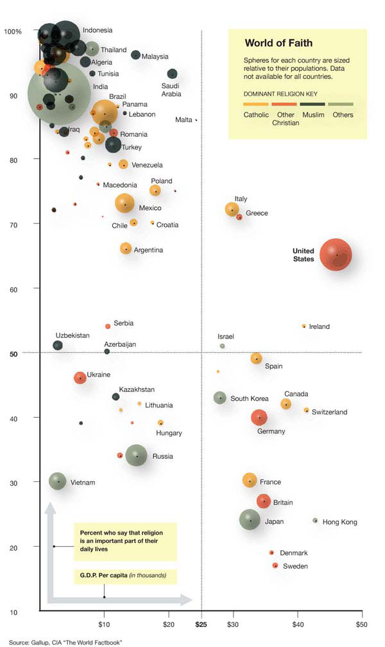

Slide 20
Conclusions about the
Varieties of Church-State Accommodation
Religion is a critically important issue in the formation of nation-states, so much so that many states outline foundational principles of dealing with religion as a part of their constitutional structure.
Nation-states have crafted a variety of arrangements to address religion-state issues. There is no one, dominant model.
Religion-state arrangements for individual nation-states are determined and shaped, to a large degree, by indigenous historical, cultural, religious, and political factors, rather than dominantly by political philosophy.
The “separation of church and state” model of the United States with its dual dis-establishment and free exercise clauses of the First Amendment was revolutionary when it was conceived and still stands uniquely apart from the religion-state models adopted by the majority of contemporary nation-states.

Slide 21
Closing Question
After viewing the various arrangements of religion-state relations in the different
nation-states, are you satisfied
with the current way religion is dealt with
in the United States or
do you wish it was different?
If so, how would you change it?

Slide 22

God & Caesar
Questions? Comments?

