Slide 1
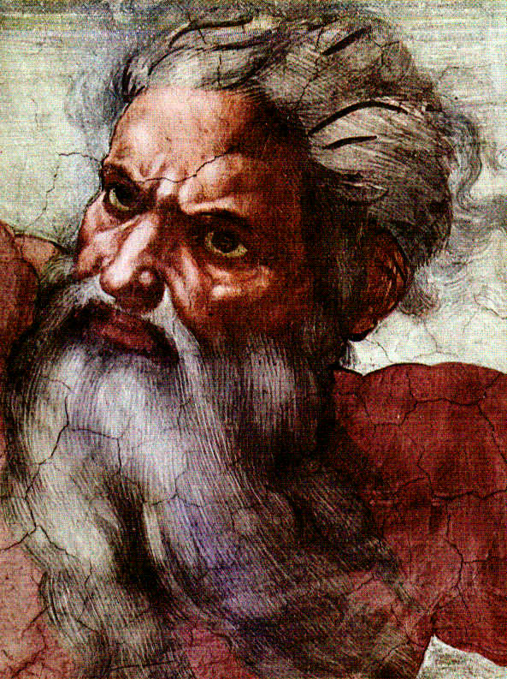
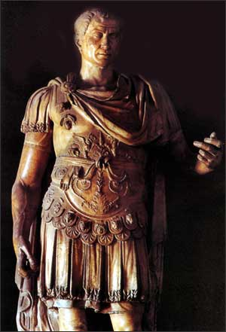
God & Caesar:
The ancient modern clash

Slide 2

Welcome!
GodandCaesar@gmail.com
Notes:
Welcome – thanks for coming – Week #5
Take a moment and fill out a name tag – if you haven’t filled out a registration card please do so
Handouts for previous weeks material online – link in email sent to you last week
Signup sheet for refreshments – Thank you this week to Dafne and Andrea
Email address
Problems with online link – use first link

Slide 3
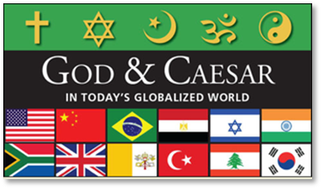
Response?
Notes:
Welcome – thanks for coming – Week #5
Take a moment and fill out a name tag – if you haven’t filled out a registration card please do so
Handouts for previous weeks material online – link in email sent to you last week
Signup sheet for refreshments – Thank you this week to Dafne and Andrea
Email address
Problems with online link – use first link

Slide 4
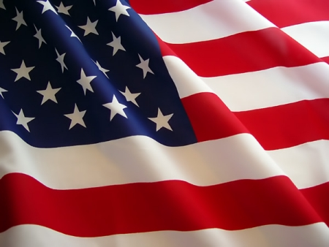
America, the Secular?
In the past 60 years, has America become more secular? If so, how?
What is the difference in a “secular” nation and a “religious” nation?
Notes:
1962 – Disallow prayer in public schools
1963 – Disallow Bible reading in public schools
1964 – Reading Bible & saying the Lord’s prayer in public schools is unconstitutional
1968 – Allow teaching of evolution in public schools
1973 – Roe v. Wade
1985 – Disallow a “moment of silence” in public schools

Slide 5
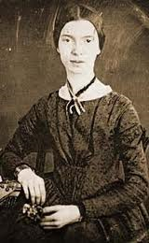
The Power of Words
A Word
Emily Dickinson
(#1212, c. 1872)
A word is dead,
When it is said,
Some say.
I say it just
Begins to live
That day.
Notes:
Dear Old Emily

Slide 6
The Power of Words
James 1:19
My dear brothers, take note of this: Everyone should be quick to listen, slow to speak and slow to become angry, for man's anger does not bring about the righteous life that God desires.
Ecclesiastes 10:12
Words from a wise man's mouth are gracious, but a fool is consumed by his own lips.
Matthew 12:36-37
But I tell you that men will have to give account on the day of judgment for every careless word they have spoken. For by your words you will be acquitted, and by your words you will be condemned.
Notes:
A reminder from scripture over the importance of words

Slide 7
“Secular” – A Place
The dual nature of the Medieval world –
  “Two worlds” (sacred & profane)
  “Two swords” (temporal & spiritual)
Saeculum – Medieval term denoting “of the world”
versus “of the church”
Rooted in Canon Law of the Roman Catholic Church – it was the legal action of a monk or priest leaving the cloister
One could be both “religious” and “secular” at the same time – “secular priest”
Concept rooted in scripture . . .
Notes:
Derived from Jose Casonova’s teaching

Slide 8
“Secular” – A Place
“In the world, but not of the world”
  John 17:14-18
  I have given them your word and the world has hated them, for they are not of the world any more than I am of the world. My prayer is not that you take them out of the world but that you protect them from the evil one. They are not of the world, even as I am not of it. Sanctify them by the truth; your word is truth. As you sent me into the world, I have sent them into the world.
  1 Corinthians 5:9-13
I have written you in my letter not to associate with sexually immoral people— not at all meaning the people of this world who are immoral, or the greedy and swindlers, or idolaters. In that case you would have to leave this world. But now I am writing you that you must not associate with anyone who calls himself a brother but is sexually immoral or greedy, an idolater or a slanderer, a drunkard or a swindler. With such a man do not even eat. What business is it of mine to judge those outside the church? Are you not to judge those inside? God will judge those outside. “Expel the wicked man from among you.”
Notes:
Derived from Jose Casonova’s teaching

Slide 9
“Secularization” – A Process
The process by which sectors of society and culture are removed from the domination of religious institutions
and relocated into the realm of the secular
(i.e., non-religious) world.
16th century roots in Protestant Reformation – mass expropriation of religious lands by the state
Idea operates on two levels –
  Descriptive – level of conscious - subjective
  Ideological – level of socio-structural - objective
Notes:
See printed hand notes

Slide 10
“Secularization” – A Process
Classic secularization narrative – three changes in the role of religion in society
  the decline of religious belief, affiliation and practice
  the individualization and privatization of religion with the attendant erosion of its public role
  the differentiation of the religious sphere from other public spheres, such as the political, legal, and economic spheres
Classic secularization thesis – religion will decline and disappear as world becomes more modern
Notes:
See printed hand notes

Slide 11
“Secularism” – An Ideological Position
An ideological derivative of secularization – a belief system, a worldview
George Jacob Holyoake (1817-1906) coined the term “secularism” in 1840s in England = “it is a policy of life for those who do not accept theology.” Religion should not be taken into account in human affairs.
In England, secularism arose in the working classes (Holyoake) and was designed to appeal to pragmatic workers.
In America, secularism started with educated elites who embraced rationalism and science rather than traditional religious beliefs.
Notes:
See printed hand notes

Slide 12
“Secularism” – An Ideological Position
The secularist movement was initially ideological and became political.
Secularism generally deems religion to be a threat to society and the state – to peace, order and good government. It must be removed from the public sphere or, at the least, greatly controlled.
Secularism has been adopted by philosophers, politicians and ordinary people as the reasonable, enlightened way to structure society.
According to Kuru, secularism can be “passive” or “aggressive” in how it is reflected in state policies
Secularism can be dogmatic and destructive – an accusation that radical secularists regularly hurl at religion.
Notes:
See printed hand notes

Slide 13
“Secularity” – A Social Condition
A second derivative of secularization – a social condition
Secularity is a social condition or situation that agrees that there should be no official state religion, no religious interference in governmental affairs, and no religious entanglement in the public sphere.
Secularity affirms that religion does provide some positive benefits to society and must be allowed to share the public’s “social space.”
Rather than rejecting religion outright, secularity places religion at arms-length, thus creating distance and separation from the affairs of state and public life.
Secularity is the social condition that is often characterized as the “separation of church and state.”
Notes:
See printed hand notes

Slide 14
Case Studies
If prayer was returned to public schools, what prayers should be said in large portions of Dearborn, Michigan which are Muslim-majority? What should Christian students do who attend these schools?
What about in Alabama, which is dominantly evangelical Christian, what should Jewish students do?
Should the dominant religion of a community determine what kind of prayers are said in public schools?

Slide 15
Case Studies
If tax deductions are allowed for interest paid on funds borrowed (mortgages, business, etc.), should special tax allowances be made in order to avoid double taxation for “Islamic finance” which outlaws interest? If not, how does one justify other laws that remove double-taxation? Is this religious discrimination?

Slide 16

God & Caesar
Next Week –
We will look at varieties of secularism
and/or secularity in
different countries.

